Slide 1

First-Year NPP VIIRS and Aqua MODIS Comparison for Reflective Solar Bands
Aisheng Wuª, Jack Xiong^{b} & Changyong Cao^{c}
ªThe Sigma Space Corporation, Lanham, MD 20706
^{b}Science and Exploration Directorate, NASA/GSFC, Greenbelt, MD 20771
^{c}NOAA/NESDIS/STAR, College Park, MD 20740
2013 GSICS Data & Research Working Group meeting
Williamsburg, VA, March 4-8, 2013

Slide 2
Outline
Introduction
Methodology
  SNO orbits and data sampling
  Data from fixed ground sites (Libya-4, Dome C)
Results
  MODTRAN simulated at-sensor radiance, Esun
  VIIRS/MODIS reflectance ratio trends
Summary

Slide 3
Introduction
Need to conduct immediate post-launch assessment for VIIRS RSB
Comparison with a stable and well-calibrated sensor provides a quick and proper assessment
Major challenges are to obtain high quality data due to differences in observation times, viewing and illumination angle and RSR
Using simultaneous nadir overpasses (SNO) between two POS significantly reduce these biases
This approach has been successfully applied to cross-sensor comparison among NOAA series AVHRR, AVHRR and MODIS etc.
Radiometrically stable sites (Libya-4 desert, Dome C snow) provide an excellent opportunity to track sensor calibration performance
The VIIRS performance evaluation is conducted with focus on calibration stability and consistency

Slide 4
Visible Infrared Imaging Radiometer Suite
VIIRS RSB/TEB (nm) |  |  | MODIS RSB/TEB (nm)
Band | CW | BW | Band | CW | BW
M1 | 412 | 20 | B8 | 412 | 15
M2 | 445 | 18 | B9 | 443 | 10
M3 | 488 | 20 | B10 | 488 | 10
M4 | 555 | 20 | B4 | 555 | 20
M5 | 672 | 20 | B1 | 645 | 50
M6 | 746 | 15 | B15 | 748 | 10
M7 | 865 | 39 | B2 | 858 | 35
M8 | 1240 | 20 | B5 | 1240 | 20
M9 | 1378 | 15 | B26 | 1375 | 30
M10 | 1610 | 60 | B6 | 1640 | 24
M11 | 2250 | 50 | B7 | 2130 | 50
I1 | 640 | 80 | B1 | 645 | 50
I2 | 865 | 39 | B2 | 858 | 35
I3 | 1610 | 60 | B6 | 1640 | 24
M12 | 3700 | 180 | B20 | 3750 | 180
M13 | 4050 | 155 | B23 | 4050 | 61
M14 | 8550 | 300 | B29 | 8550 | 300
M15 | 10763 | 1000 | B31 | 11030 | 500
M16 | 12013 | 950 | B32 | 12020 | 500
I4 | 37400 | 380 | B20 | 3750 | 180
I5 | 11450 | 1900 | B31 | 11030 | 500
Suomi NPP VIIRS
Scanning radiometer
22 bands between 0.4 and 12 µm
Afternoon polar orbit
Swath distance of 3000 km
Nadir resolutions: 0.37, 0.74 km
Launched Oct 28, 2011
Terra/Aqua MODIS
Scanning radiometer
36 bands between 0.4 and 14 µm
Morning/afternoon polar orbits
Swath distance of 2300 km
Nadir resolutions: 0.25, 0.5, 1.0 km
Launched Dec 1999 & May 2002

Slide 5

SNO (Simultaneous Nadir Overpasses)
Aqua
Terra
Suomi NPP
Aqua/NPP SNO orbits also regularly extend to low latitudes
Date Time NPP Lat/Lon Aqua Lat/Lon Nadir Distance (km)
07/21/2012 15:39:00 ( 79.0 281.8) ( 78.4,277.8) 105
07/21/2012 15:39:30 ( 80.1 273.8) ( 79.5,270.3) 94
07/21/2012 15:40:30 ( 81.6 252.7) ( 81.0,251.0) 71
07/21/2012 15:41:00 ( 81.8 240.0) ( 81.3,239.5) 60
07/21/2012 15:41:30 ( 81.7 227.2) ( 81.3,227.7) 50

Slide 6
SNO Data Sampling
Pixel by pixel match
1 by 1
10 by 10
20 by 20
Grid by grid match
1 degree by 1 degree (latitude and longitude)

Slide 7
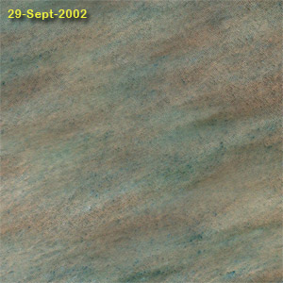
Radiometrically Stable Sites
Latitude Longitude Name of Site
[19.40, -9.30] Mauritania 1
[19.12, -4.85] Mali 1
[23.80, -0.40] Algeria 1
[30.32, 7.66] Algeria 3
[19.67, 9.81] Niger 1
[24.42, 13.35] Libya 1
[25.05, 20.48] Libya 2
[28.55, 23.39] Libya 4
[27.12, 26.10] Egypt 1
[22.00, 28.50] Sudan 1
[18.88, 46.76] Yemen Desert 1
[20.13, 50.96] Arabia 2
[-75.1, 123.4] Dome C
http://calval.cr.usgs.gov/sites_catalog_map.php
Mauritania 1
Notes:
7

Slide 8
Data Extraction for Libya-4 Desert Site
The region of interest (ROI) is 20 km along-track x 10 km cross-track for each site
Pixel-level SDR reflectances of ROI are extracted
Angular parameters (viewing and illumination) centered at each ROI are also collected
Spatial uniformity of ROI (standard error of reflectance) is examined to exclude those affected by cloud
For each cloud-free ROI, reflectances are averaged at each HAM side
Trends of reflectance at fixed scan angles (angle of incidence) are derived
Trends are normalized with a MODIS-based BRDF (i.e., refl ratio)

Slide 9
BRDF Correction
For each desert site, a semi-empirical bi-directional reflectance function* (BRDF) consisting of two kernel-driven components (f₁ and f₂)
BRDF (θ,ψ,φ) = K₀ + K₁ f₁(θ,ψ,φ) + K₂ f₂(θ,ψ,φ)
θ, ψ, φ - solar zenith, view zenith and relative azimuth angle
K₀, K₁ and K₂ – site-dependent coefficients, which are derived using MODIS two-year overpasses (2012-2013) for the spectrally matched bands
*Roujean J.L. et al. 1992, Journal of Geophysical Research, Wu et al., 1995, JGR, Schaaf, C.B., 2002, Remote Sensing of Environment)

Slide 10
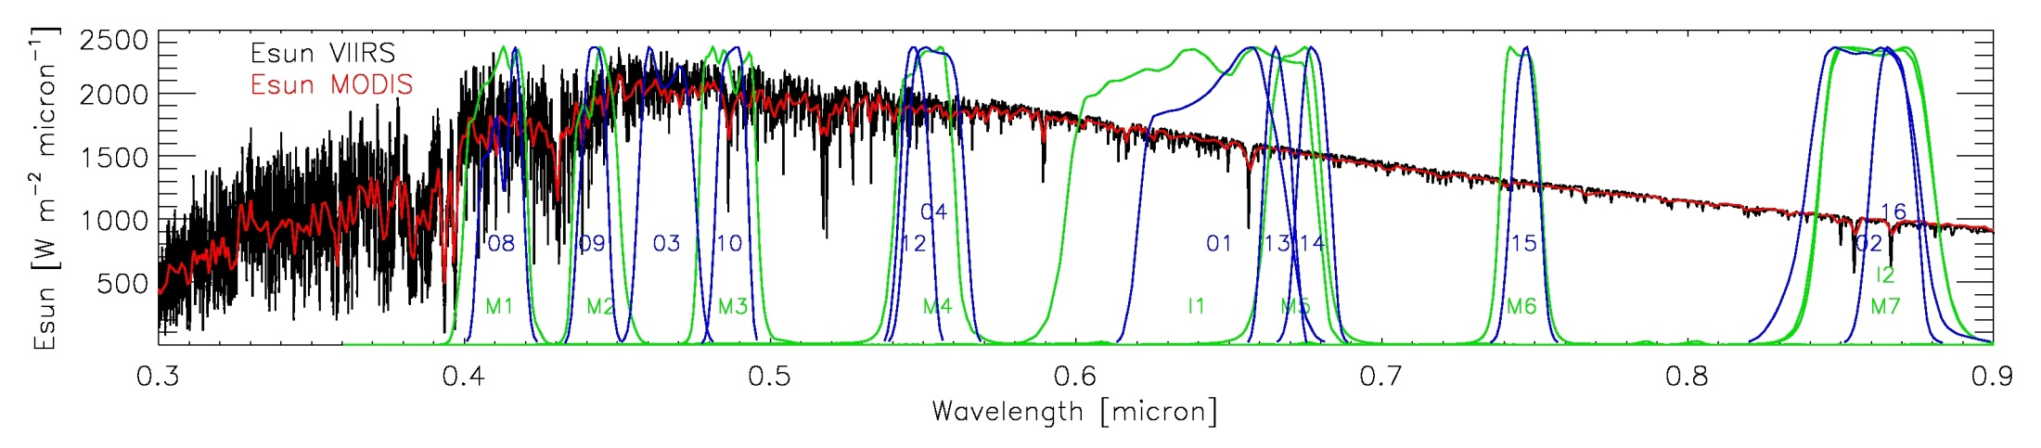
Solar Irradiance Models and RSR
MODIS RSR VIIRS RSR
VIIRS to MODIS radiance ratios determined using sensor-based Esun models (MODIS and VIIRS) and RSR for their spectrally matched bands

Slide 11
MODTRAN5 Simulations for Comparison
VIIRS/MODIS refl ratio
Input options include a standard atmospheric profile (U.S. 1976), a standard aerosol model, a fixed viewing angle, a wide range of solar angle & atmospheric water content, and surface-type dependent spectral reflectances.
± 2%
Ocean Desert Snow Cloud

Slide 12
MODIS C6 Reflectance Trends Since 2011
Libya-4 Desert
Trends from MODIS Collection-6 L1B show that they are stable to well within 1%, providing a good reference to track the calibration performance of the VIIRS RSB.
Linear regression

Slide 13
VIIRS/MODIS Reflectance Ratio Trends
SNO
16-day repeatable orbits
Libya-4 Desert
Linear regression to data after April 10, 2012

Slide 14
VIIRS/MODIS Reflectance Ratio Trends
SNO
Libya-4 Desert

Slide 15
VIIRS/MODIS Reflectance Ratio Trends
Tau update
SNO
Libya-4 Desert

Slide 16
VIIRS/MODIS Reflectance Ratio Trends
SNO
Libya-4 Desert

Slide 17
VIIRS/MODIS Reflectance Ratio Trends
SNO
Libya-4 Desert

Slide 18
VIIRS/MODIS Reflectance Ratio Trends
Before RSR correction After RSR correction*
SNO
SNO
Libya-4 Desert
Libya-4 Desert
*Correction is based on MODTRAN5 simulations with averaged atmospheric conditions (std. atmo. profile, 1.0 gcm-2 atmo. water content for SNO, 5.0 gcm-2 for desert)

Slide 19
VIIRS/MODIS Reflectance Ratio Trends
SNO
Libya-4 Desert

Slide 20
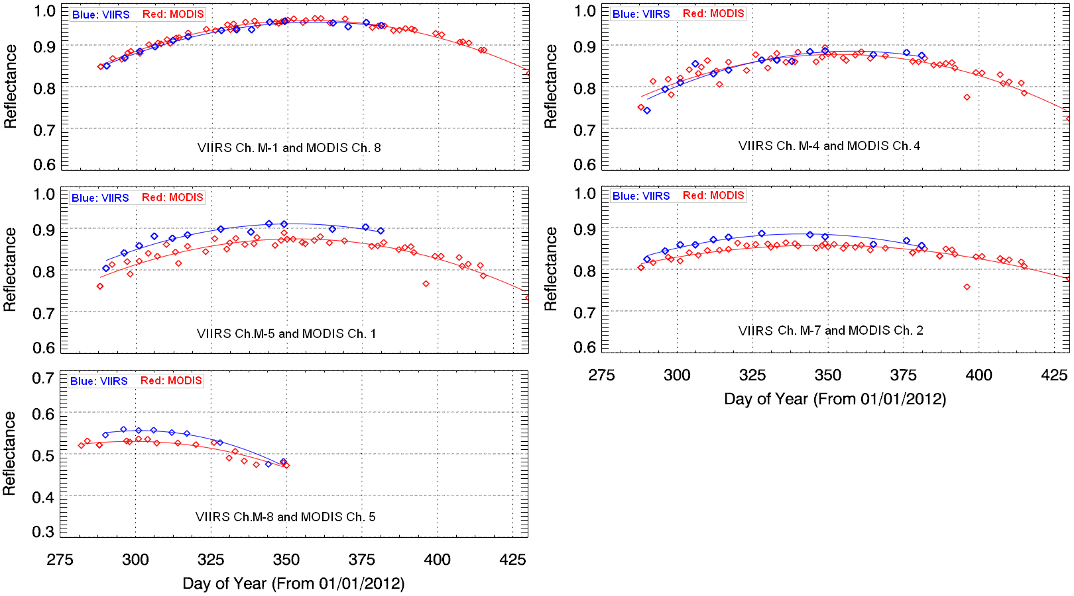
VIIRS and MODIS Reflectance Trends
Dome C, Antarctica*
*Plot from Sirish Uprety etc. working with NOAA/STAR

Slide 21
Relative Differences between VIIRS and MODIS
VIIRS/MODIS ratios from SNO observations and MODTRAN5
 | Reflectance
Band | M1 | M2 | M3 | M4 | M5 | M6 | M7 | I1 | I2 | MU
SNO | 0.989 | 0.986 | 0.995 | 1.018 | 1.069 | 1.003* | 1.019 | 0.998 | 1.020 | 1.6%
Libya4 | 1.025 | 1.007 | N/A | 1.000 | 1.096 | N/A | 1.034 | 0.990 | 1.035 | 1.5%
ModT | 0.996 | 1.006 | 0.994 | 1.000 | 1.046 | 0.991 | 1.006 | 1.009 | 0.987 | 1.0%
Calib Diff** | -0.7% | -2.0% | 0.1% | 1.8% | 2.2% | 1.2% | 1.3% | -1.1% | 3.3% | ±2.0%
Values are derived from the SNO trends after day 100 of 2012
Cali Diff = [Ratio (observed) / Ratio (modeled) – 1.0 ] x 100
MU – measurement or model uncertainty (%)
* MU values for M6 ratios are significantly higher than 2% due to early saturation for MODIS
** Calib. Diff – RSR corrected calibration difference between VIIRS SDR and MODIS C6 reflectances

Slide 22
Summary
A well-calibrated Aqua MODIS is used as reference to track and evaluate the newly launched Suomi NPP VIIRS RSB stability and performance
First-year trending results show that the calibration of the VIIRS RSB is generally stable to within 2% (based on data after April 2012 since calibration of the RSB has been stable). There is a concern on the stability of M1 showing an upwards trend (~2%)
Results from SNO orbits and desert & Dome C sites have a generally good agreement
With the help of MODTRAN simulated at-sensor radiances, the result of this study indicates that the relative differences between VIIRS and MODIS RSB are within 2% for most RSB (3% for I2)

