Slide 1
CLARREO RSS: Reference Inter-calibration on Orbit
C. Lukashin, C. Roithmayr, P. Speth, B. Wielicki, D. Young, C. Currey
NASA LaRC, Hampton, VA
K. Thome
NASA GSFC, Greenbelt, MD
W. Sun
SSAI, Hampton, VA
Annual GRWG+GDWG Meeting 2013, Williamsburg, VA

Slide 2
Presentation outline
CLARREO RSS Inter-calibration approach, mission requirements, and on-orbit matched-data sampling.
CLARREO RSS inter-calibration approach to sensor’s sensitivity to polarization, estimates for resulting radiometric uncertainty.
Multi-Instrument Inter-Calibration (MIIC) framework.

Slide 3
CLARREO Reflected Solar Spectrometer (RSS) Science Implementation Strategy
1) CLARREO will create benchmark climate data records using two complementary approaches:
(a) Direct benchmark observations by CLARREO RSS: spectral
fingerprinting techniques.
(b) Enabling Climate Benchmark using CLARREO for reference
inter-calibration of existing operational sensors.
2) CLARREO Reference Inter-calibration (RI) will be used to determine
and correct operational sensors for:
- Sensor offset and gain (effective).
- Spectral response function change on orbit.
- Sensitivity to Polarization.
- Non-linearity.
3) CLARREO RSS RI goal: uncertainty contribution ≤ 0.15% (k=1)
over autocorrelation time period ≤ 0.8 year (Wielicki et al., BAMS 2013)

Slide 4
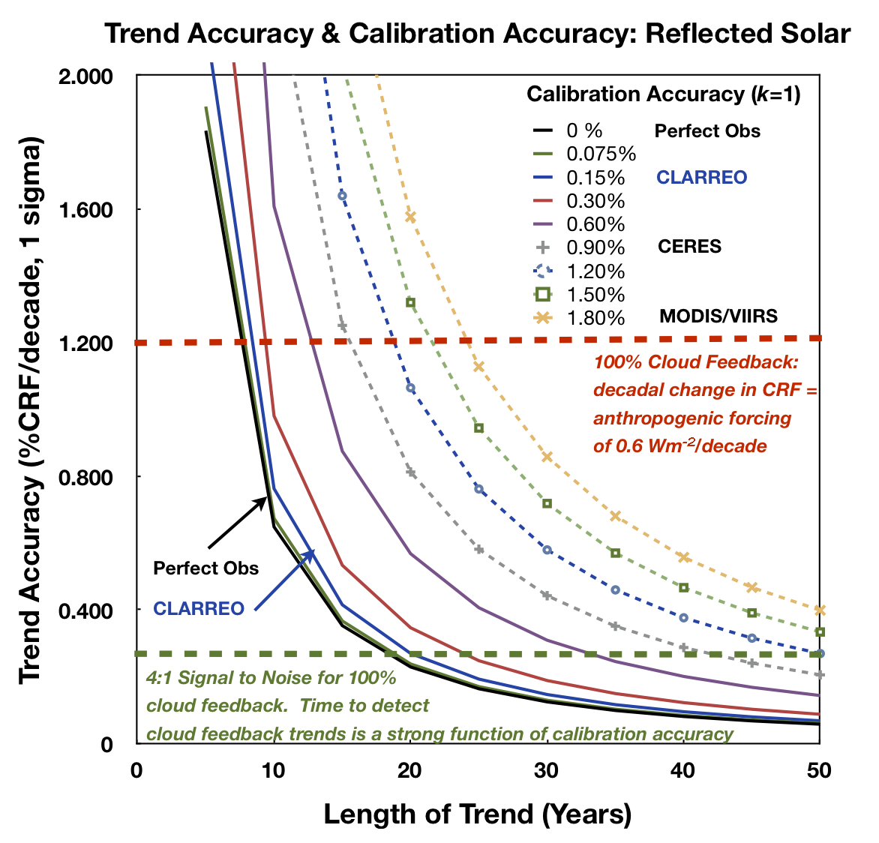
CLARREO RSS Mission Requirements
(1) CLARREO RS accuracy 0.15% (k=1) for measuring reflected radiation.
B. Wielicki et al. (BAMS, 2013)
(2) High Priority RI Targets:
Sensors: CERES & VIIRS/JPSS,
AVHRR/Metop, Landsats,
ESA Sentinels (optical),
GEO imagers, TEMPO.
Surface: Dome C, Desert sites.
Space: Lunar Irradiance.
(3) Uncertainty contribution from
RI method: ≤ 0.15% (k=1) over
climate autocorrelation time
period 0.8 year.
RI error is considered to be
random (data matching noise).

Slide 5
CLARREO RSS Reference Inter-calibration Objectives
RI Method: Sensor measurements compared to high accuracy reference on orbit (CLARREO RSS
observations). The method is statistical , approach is different from sensor to sensor
depending on its calibration model.
Requirement: On-orbit matched data sampling is required to reduce random noise from data
matching by averaging. Data matching in Time & Viewing geometry in orbit.
Note: Requirements are set for limiting data matching noise to 1% (k=1).
1) CLARREO RSS Inter-Calibration Objectives: Broadband Radiometers (CERES)
Parameter | Time scale | Variable | RI Error, k=1 (%) | N Samples
Effective Offset | monthly | Scan angle | ≤ 0.45 | 2.5 ✕ 10³
Effective Gain | monthly | Scan angle | ≤ 0.45 | 2.5 ✕ 10³
RSR Degradation | seasonally | Scene Type | ≤ 0.25 | 30 ✕ 10³
Non-Linearity | Validation Annually, RI Error 0.15% (k=1)
Sensitivity to Polarization | Not Sensitive, Validation Annually, RI Error 0.15% (k=1)
2) CLARREO RSS Inter-Calibration Objectives: Imaging Radiometers (VIIRS)
Parameter | Time scale | Variable | RI Error, k=1 (%)
Effective Offset | monthly | Scan angle, DOP, HAM | ≤ 0.45 | 7 ✕ 10³
Effective Gain | monthly | Scan angle, DOP, HAM | ≤ 0.45 | 7 ✕ 10³
Sensitivity to Polarization | seasonally | Scan Angle(7), DOP, χ (9), HAM | ≤ 0.25 | 1.2 ✕ 10⁶
RSR CW Shift | Validation Annually, RI Error 0.15% (k=1)
Non-Linearity | Validation Annually, RI Error 0.15% (k=1)

Slide 6
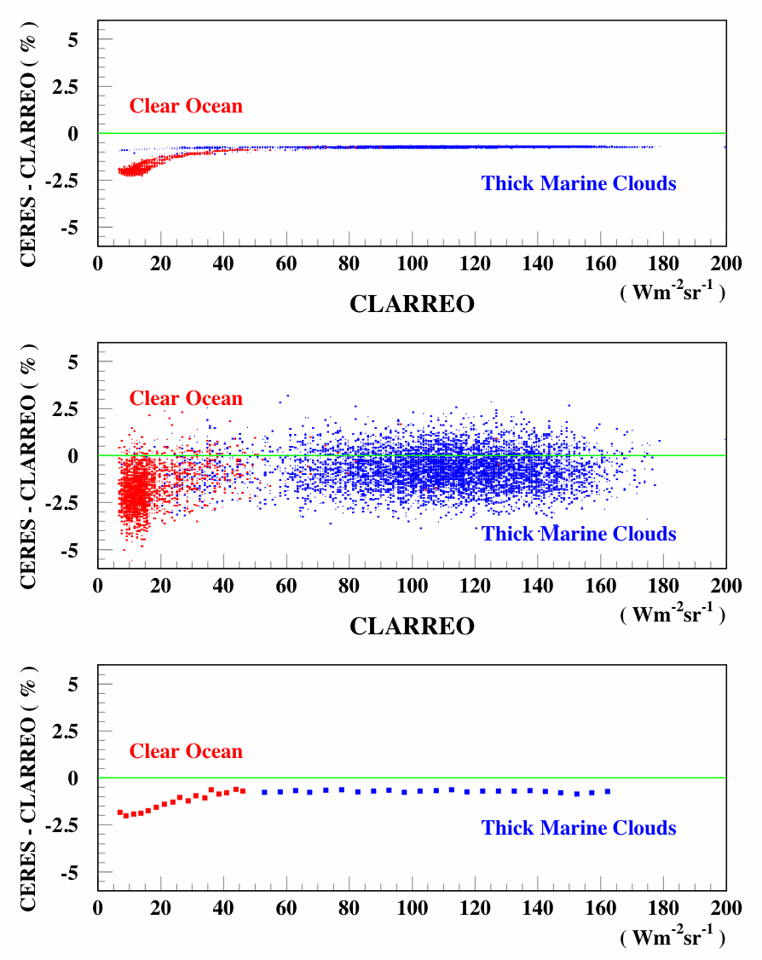
Simulation Study: CERES RSR Degradation SCIAMACHY data: Clear ocean (N = 1800) and marine clouds scenes (N = 7000)
CERES RSR Degradation:
α = 9.8155 (D=0.999 @ λ=0.7 μm)
Top: CERES – CLARREO difference versus CLARREO signals (%).
Middle: CERES – CLARREO difference versus CLARREO signals (%) with 1% matching noise.
Bottom: Relative difference between
CLARREO and CERES signals with noise reduced by averaging.
FIT RESULTS:
Scene | OFFSET (Wm⁻²sr⁻¹) | GAIN (%)
CLRO | -0.183 ± 0.028 | -0.31 ± 0.18
MCLD | 0.021 ± 0.108 | -0.73 ± 0.10
* CLRO: Offset error (k=1) = 0.10%
* MCLD: Offset error (k=1) = 0.05%

Slide 7
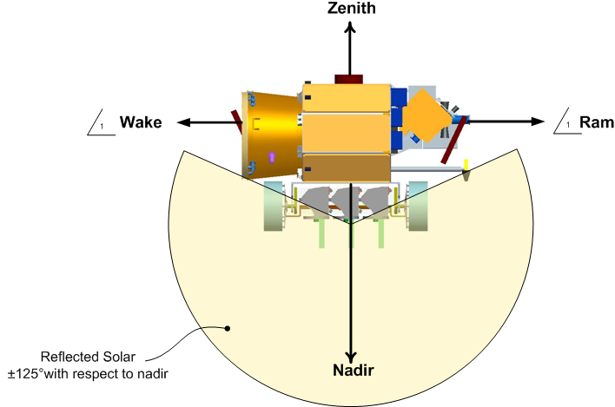
CLARREO RSS Requirement - 2D Pointing Ability
Studies by CLARREO Engineering Team, K. Thome, and C. Lukashin
Requirement:
Ability to provide RI coincident data, matched in both RAZ and VZA angles.
Requirement implies at least 2D pointing ability in orbit.
1) Yaw & Roll pointing: roll +/- 55º, and yaw +/- 84º range.
2) Pitch & Roll pointing: roll +/- 55º, and pitch +/- 55º range.
Comments:
- Yaw & Roll pointing option
is preferred from RI point of view:
RAZ is matched accurately,
matching with GEO imagers
is more effective.
Hyperspectral image has
directional definition of swath:
RAZ (or Yaw).
Pitch & Roll pointing option
may be preferred for Lunar &
Solar measurements.

Slide 8
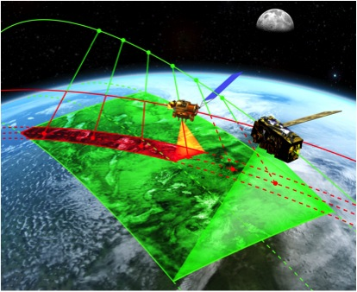
CLARREO RSS On-Orbit Pointing Operations
CLARREO RSS 2D pointing option:
1) Yaw (azimuth angle) match = constant (matching within 0.4º).
2) Continuous Gimbal Roll (scan angle) match → a function of time.
Note: yaw could also be varied continuously
CLARREO
⬇
⬅ JPSS

Slide 9
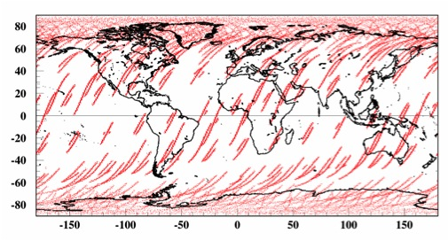
CLARREO RSS in Polar 90º Orbit – Orbital Modeling
Inter-calibration with sensors on the JPSS
Goal:
- Time/space/angle matching to obtain ensemble of
samples with data matching noise ≤ 1%
Wielicki et al., IGARSS 2008
Matching requirements:
Within +/- 5 min of the JPSS passing.
VZA match within 1.4° (CLARREO RSS 100 km swath).
SZA < 75º.
At least 10 km effective width of swath.
Figure: CLARREO RSS boresight
locations, which matched JPSS
cross-track data over one year time period.

Slide 10
Sampling Estimates and Restrictions
Sampling for VIIRS/AVHRR is nadir equivalent 10×10 km area in angular space,
1º CLARREO elevation angle. To estimate number of samples with independent
spatial noise 1 km shift (0.1º in elevation angle ) is required from one sample to
the next in both spatial directions (along and perpendicular to the ground
track). With CLARREO spatial resolution of 0.5×0.5 km the 1 km shift ensures
that only 2 boundary pixels are common.
- This approach to CLARREO/VIIRS RI sampling does not allow the inter-
calibration on detector-by-detector basis. Relative calibration of VIIRS
detectors to each other requires the use of VIIRS data alone, and would
be performed using common histogram equalization, or overlapping field-of-
view methods.
For CERES sampling is estimated taking into account CERES FOV size of 25 km
at nadir (from JPSS orbit, 2.5º in CLARREO elevation angle), and data acquisition
rate 330/180 = 1.8 footprints per degree of scan angle every 3.3 seconds.
General Restrictions:
- SZA < 75º;
- CLARREO RSS effective swath > 10 km (VIIRS), and > 25 km (CERES).
- VZA difference < 1.4º.

Slide 11
CLARREO RSS / Target Sensor - RI Sampling
Summary: Monthly (top) and seasonal (bottom) RI sampling (RAAN = 0º)
VIIRS
CERES
Red Lines: Required number
of samples for RI monthly error contribution 0.45% (k=1)
Red Lines: Required number
of samples for RI seasonal error contribution 0.25% (k=1)
NOTES: - The number of RI samples is derived under assumption of uniform
sampling distribution in relevant parameters to VIIRS sensitivity
to polarization: DOP and polarization angle.
- The sampling estimate for VIIRS derived for 670 nm wavelength.
- 1% noise : variability of noise due to time matching is averaged.

Slide 12
CLARREO RSS / GEO Imager – Inter-calibration Sampling
Summary: Daily (left) and monthly (right) RI sampling (CLARREO orbit RAAN = 0º)
GEO: GOES-East (longitude = 75º W)
Note on time matching: future GEO imagers will have shorter duty cycle (about 10 min).

Slide 13
CLARREO RSS on ISS / Target Sensor - RI Sampling
Summary: Monthly and seasonal RI sampling (CLARREO on ISS)
Estimated inter-calibration
sampling for VIIRS and CERES on the JPSS, AVHRR on the MetOP.
CLARREO RSS boresight
locations matching JPSS
cross-track data over one year time period.

Slide 14
Summary on CLARREO RSS Inter-Calibration Sampling
(1) CLARREO RSS instrument radiometric accuracy at 0.15% (k=1).
(2) CLARREO RSS 2-D data matching on-orbit (azimuth and elevation):
constant in azimuth and varying in elevation within matching tent.
(3) All reference inter-calibration goals are feasible from sampling point of view
CLARREO RSS instrument in polar 90º inclination orbit or the ISS orbit provides
adequate sampling monthly, seasonally and annually for inter-calibration of
sensors on the JPSS, MetOP, and in GEO satellites.
References:
C.M. Roithmayr, and P.W. Speth, Chap. 13, “Analysis of Opportunities for Intercalibration between
Two Spacecraft," Advances in Engineering Research, Vol. 1, edited by V. M. Petrova, Nova Science
Publishers, Hauppauge, NY, 2012, pp. 409 - 436.
C.M. Roithmayr, C. Lukashin, P.W. Speth, K. Thome, B.A. Wielicki, D.F. Young, “CLARREO Approach
for On-Orbit Reference Inter-Calibration of Reflected Solar Radiance Sensors,” submitted to IEEE
Tran. Geo. Rem. Sensing, February, 2013.
C.M. Roithmayr, C. Lukashin, P.W. Speth, K. Thome, D.F. Young, B.A. Wielicki, “Opportunities to
Intercalibrate Radiometric Sensors from International Space Station,” in preparation for submission
to JTECH, March, 2013.

Slide 15
CLARREO RSS Approach to Account for Imager Sensitivity to Polarization on Orbit
(a) Polarization factors for Aqua band 8.
(b) Detector-averaged polarization factors for Aqua.
Sun and Xiong: "MODIS Polarization-Sensitivity Analysis”,
IEEE Trans. on Geo. and Rem. Sensing, v. 45, n. 9, 2007.
Objective: Take into account MODIS/Terra/Aqua & VIIRS/JPSS sensitivity to polarization in orbit
by providing Polarization information on as function of viewing geometry and
scene type.
Impact: Accuracy of Level-1B data (intercal), Ocean Color and Level-2 Aerosol data products.
3

Slide 16
Imager Calibration Model (MODIS as an example)
MODIS calibration model, reflectance factor (Xiong et al., 2003, 2006)
θ_{EV} - solar zenith angle
m₁ - factor from solar calibration (SD and SD Monitor)
dn_{EV} - detector response to earth radiance
d_{ES} - sun-to-earth distance
k_{inst} - temperature correction coefficient
ΔT - temperature difference from reference value
RVS_{EV} - response versus scan angle
Simplified RI Imager calibration model with polarization factor in:
Consistent with
Sun and Xiong 2007.
m - sensitivity to polarization, it is function of θ and χ
ρ₀ = ρ_{EV} (not-polarized reflectance)

Slide 17
CLARREO RSS RI: Polarization Parameters
Degree of linear polarization (P or DOP):
Polarization angle, defined relative to viewing plane
(PARASOL definition, range from -45º to 135º):
Note: The χ should be 90º for scattering in principle plane

Slide 18
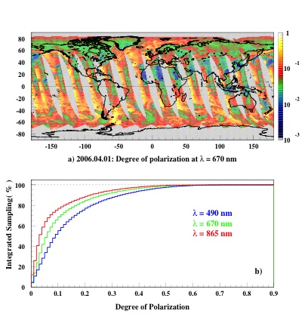
Polarization Data from PARASOL (2006.04.01)
PARASOL data:
Simulated cross-track sampling,
1º ✕ 1º lon/lat grid,
670 nm wavelength.
Cumulative sampling for
PARASOL Polarization bands

Slide 19
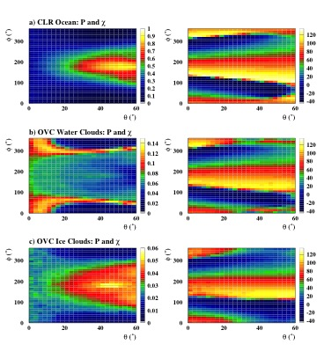
Examples of Empirical PDMs (12 days of PARASOL data)
40º < SZA < 50º, 670 nm wavelength.
DOP:
Polarization angle:
a) Clear-sky ocean:
WS < 2.5 m/s
b) Overcast water clouds over ocean:
5 < OD < 10
c) Overcast ice clouds over ocean:
5 < OD < 10
Note: DOP patterns are strongly
dependant on scene type, but the
Polarization angle is very similar.

Slide 20
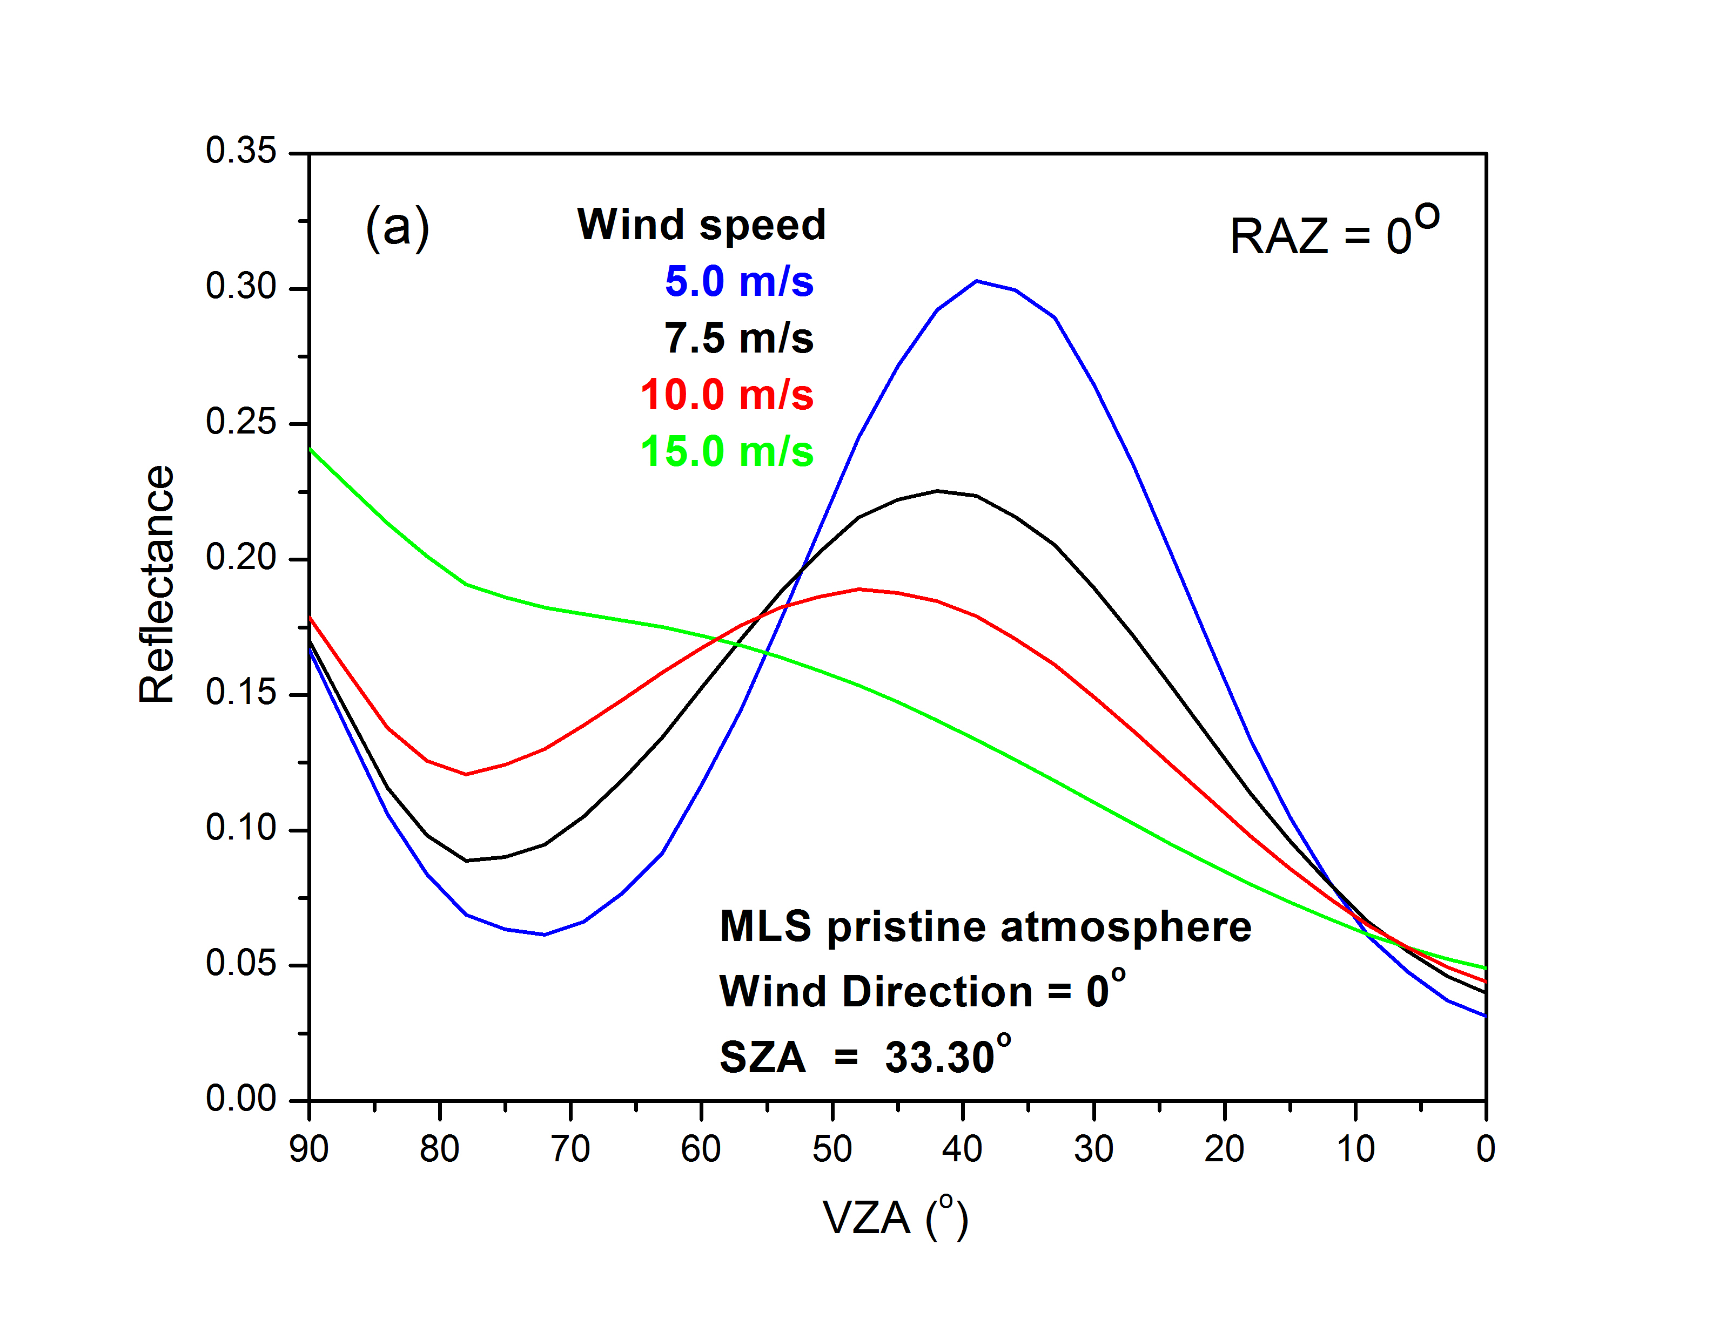
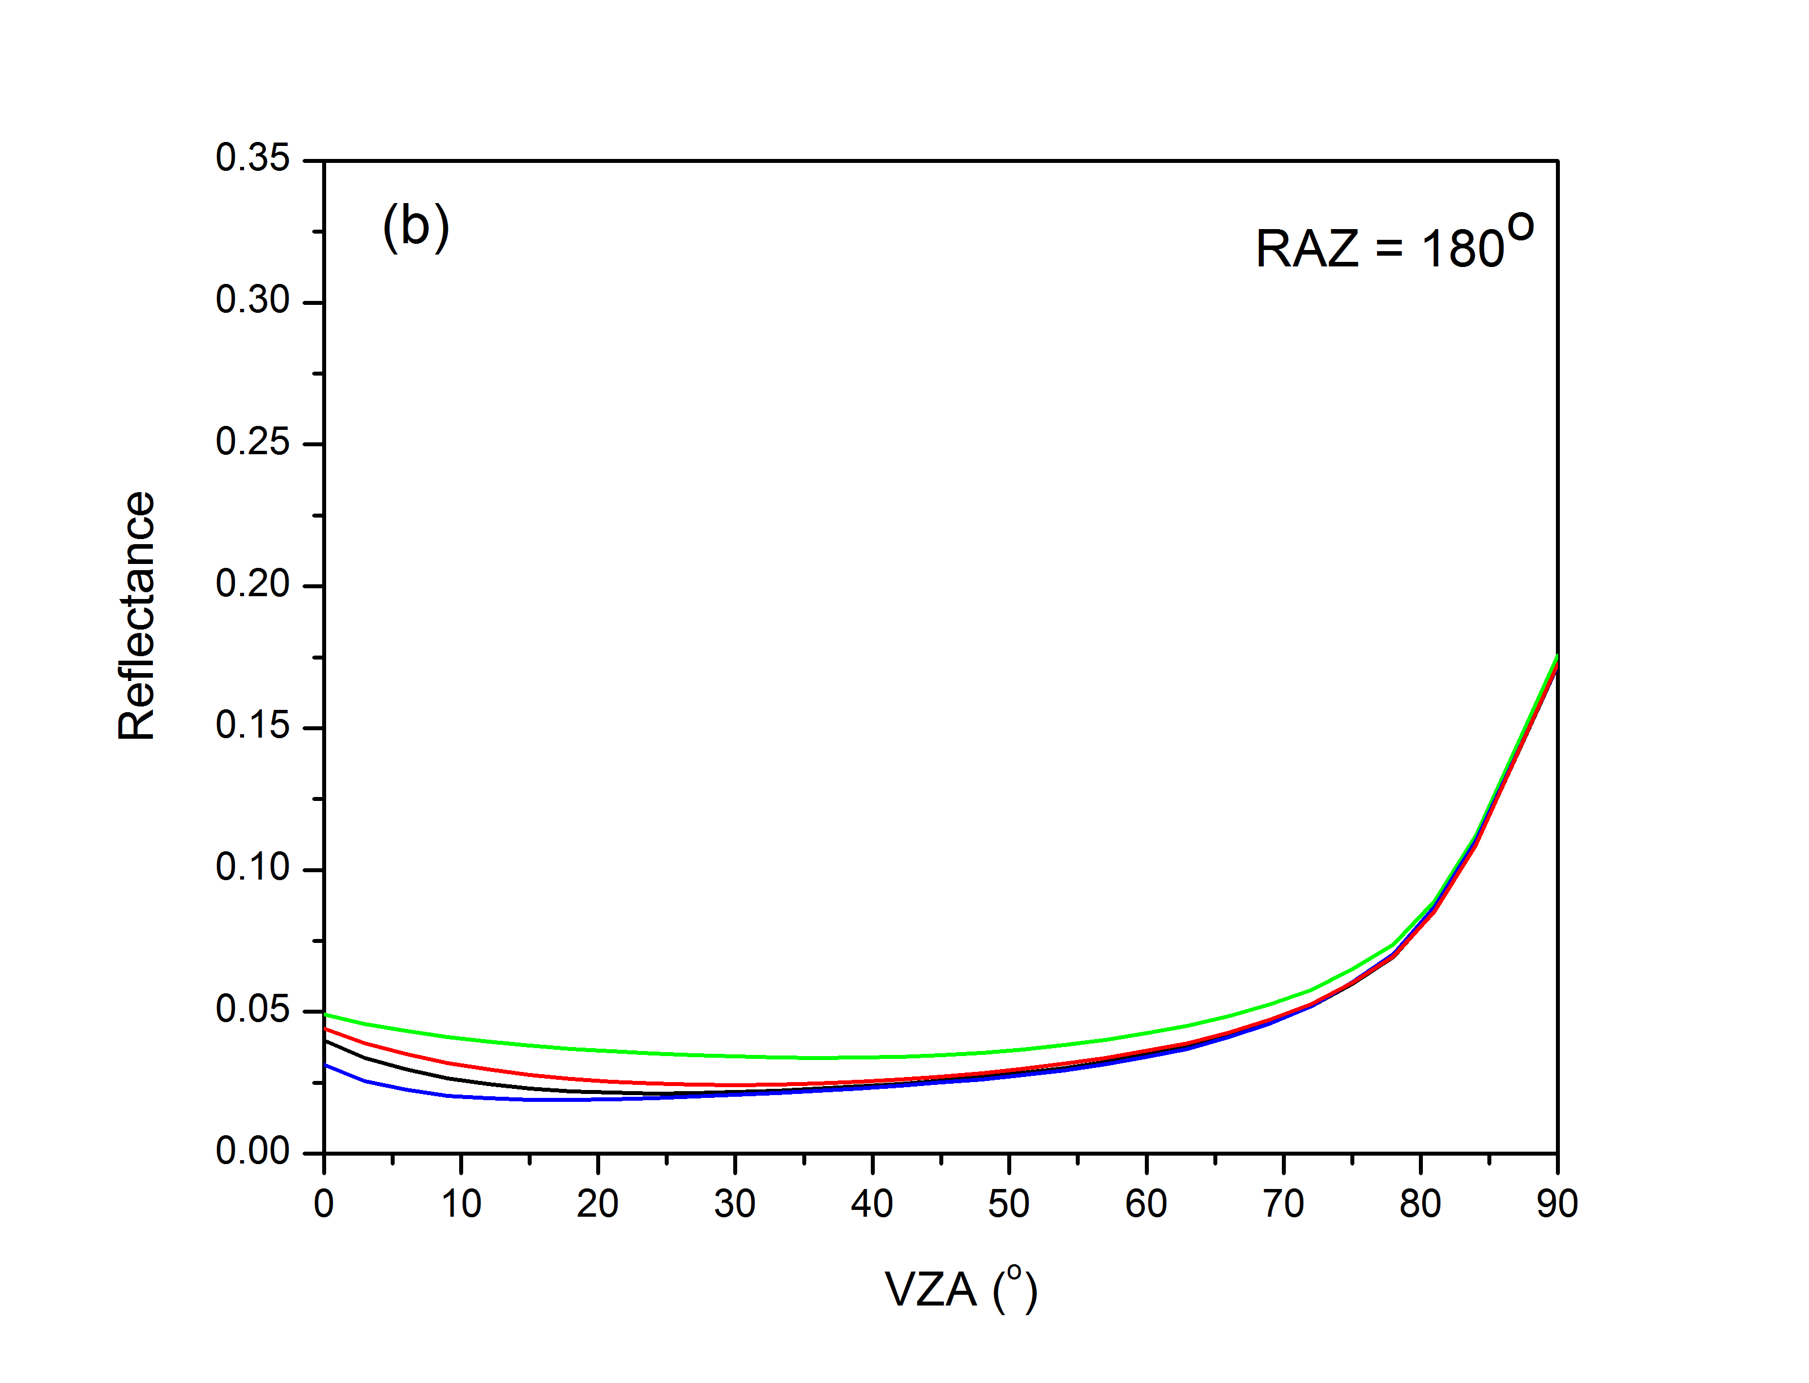
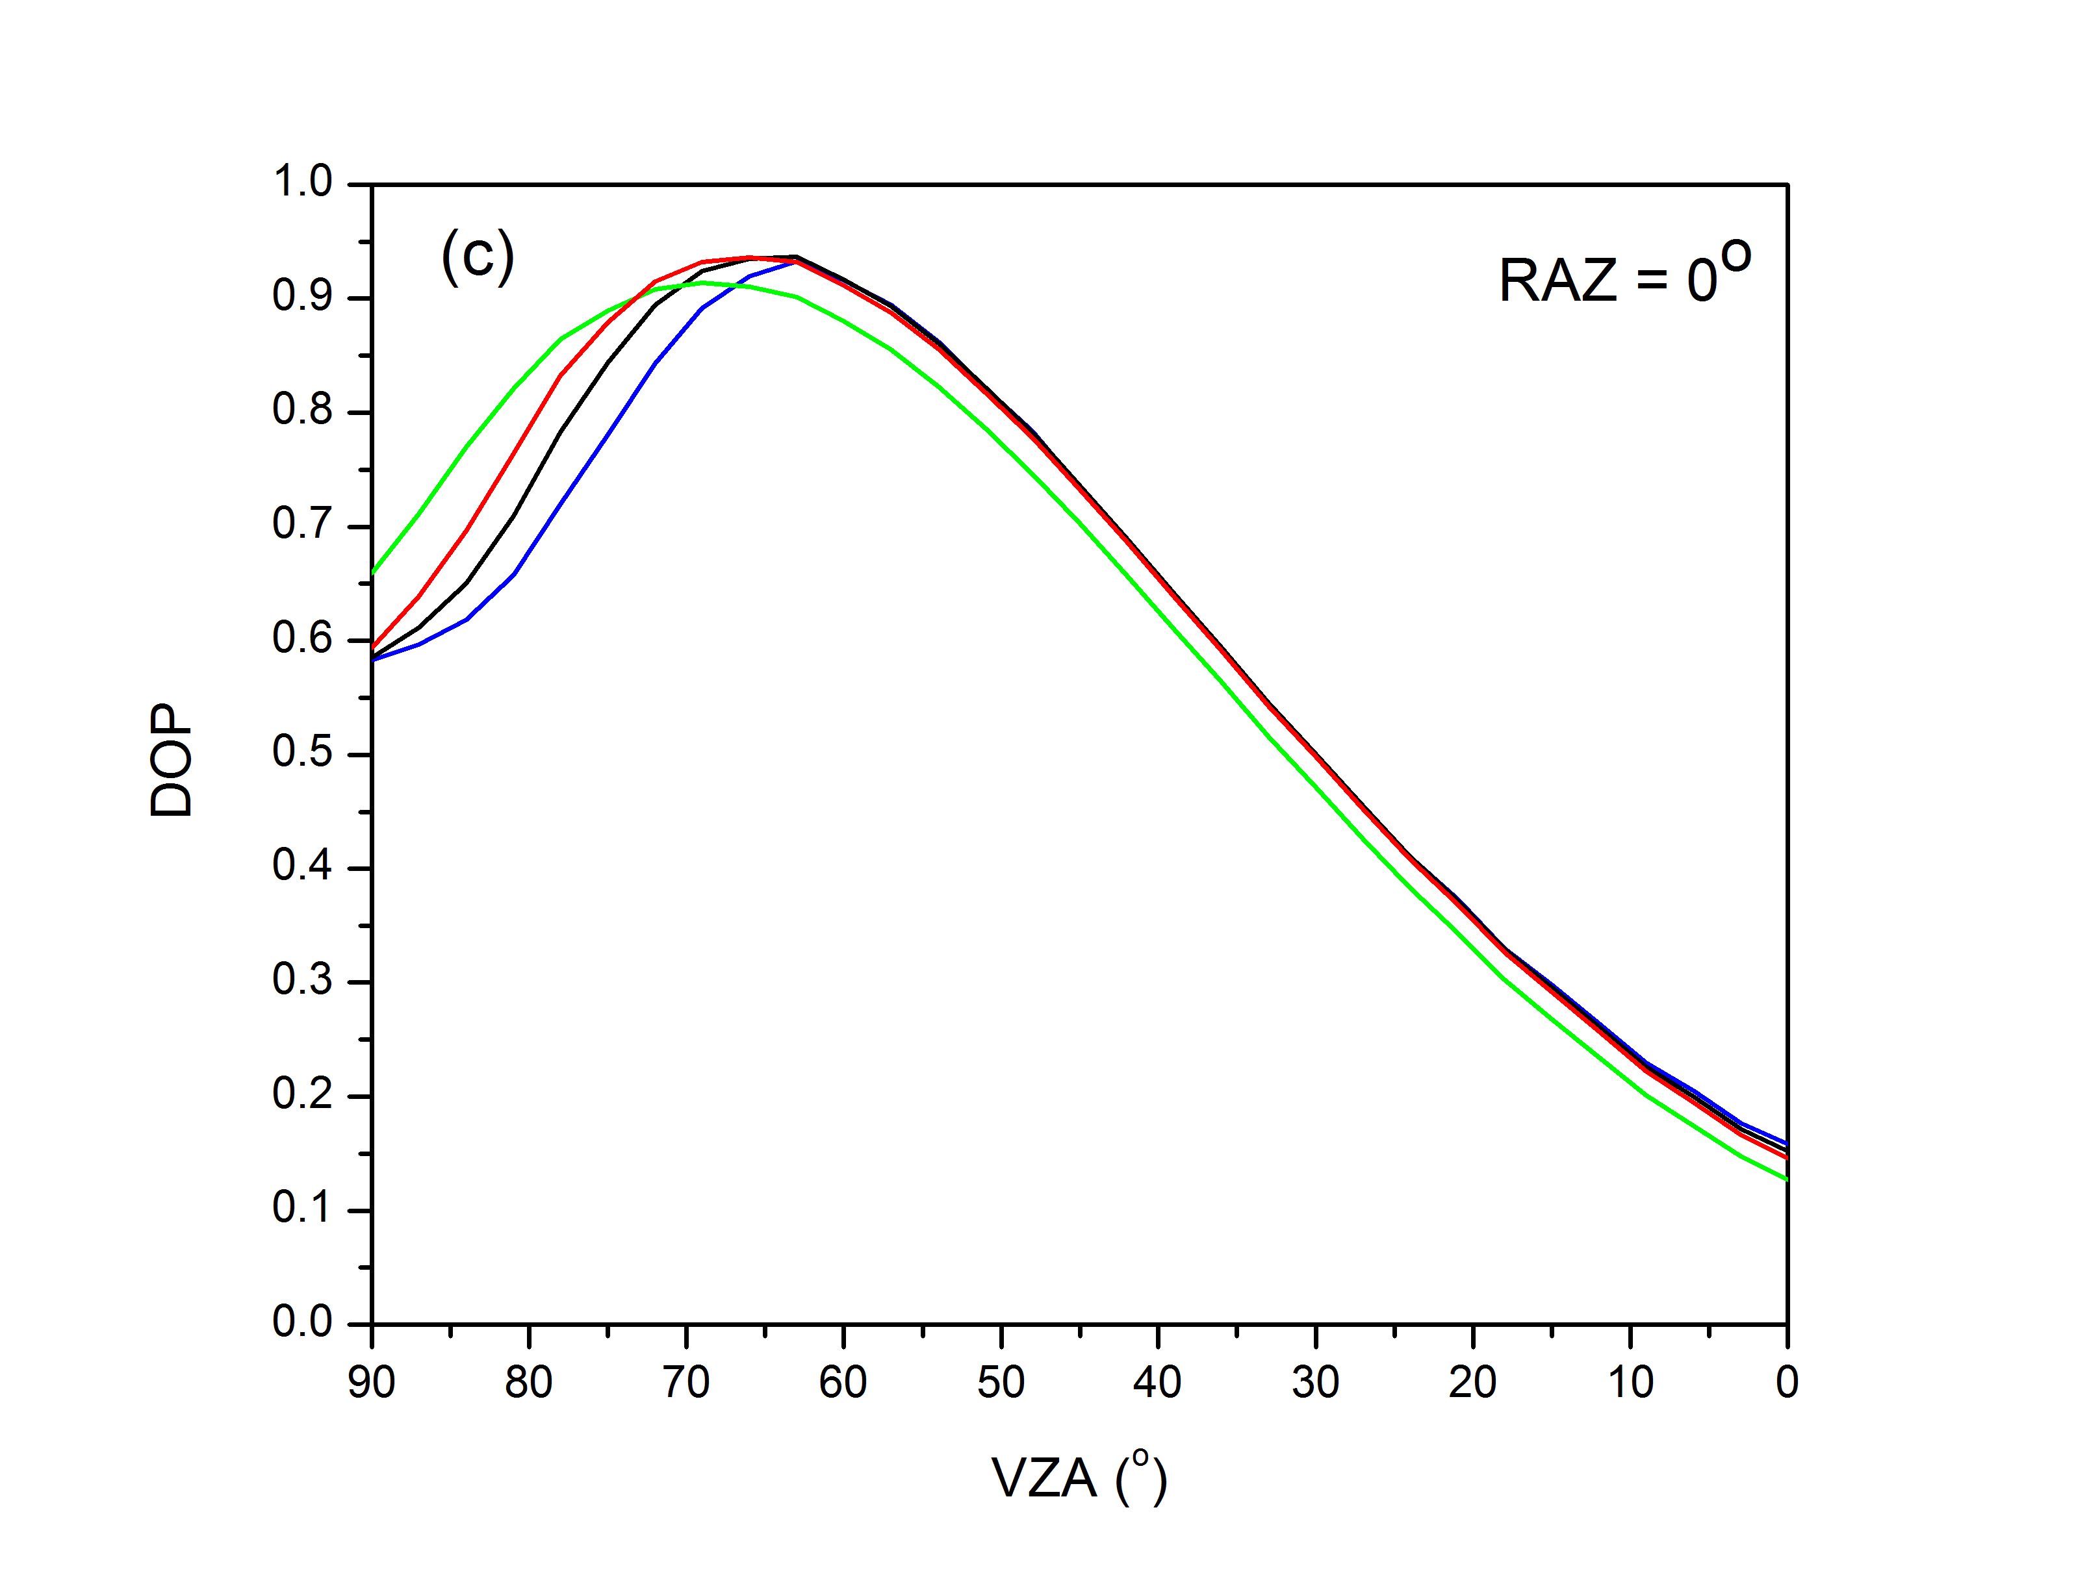
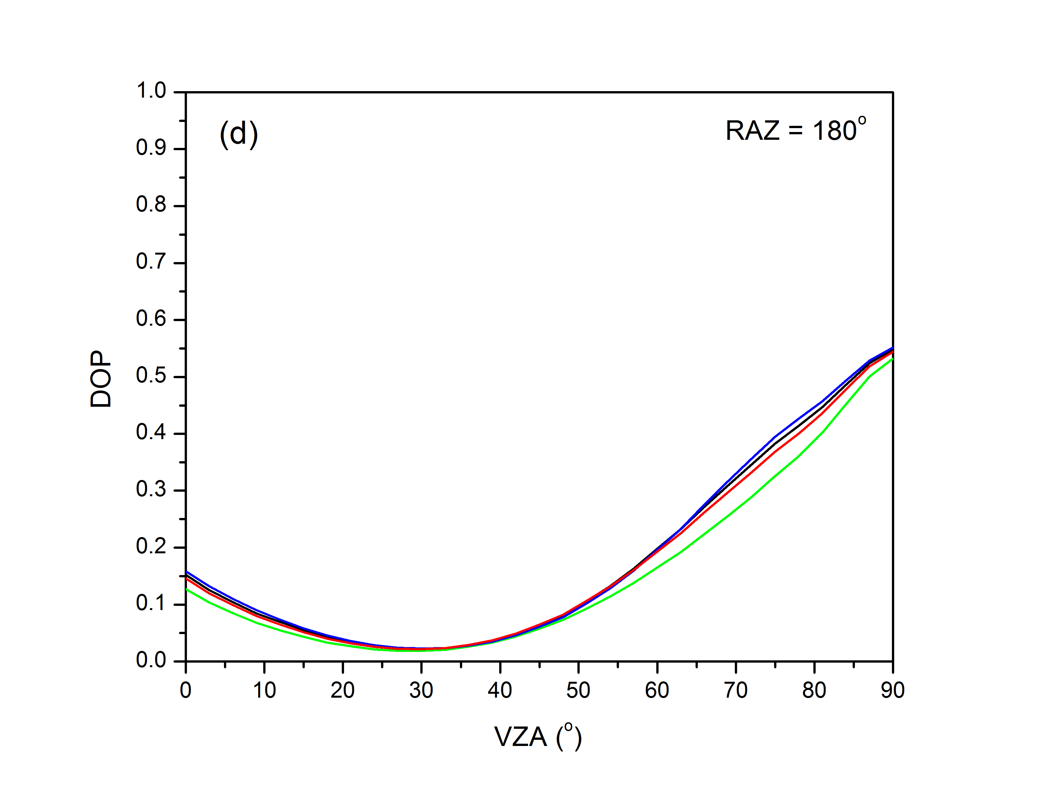
Examples of Theoretical PDMs (clear-sky ocean)
Calculations by Wenbo Sun
The total reflectance and DOP at the principal plane calculated with the ADRTM
at a wavelength of 670 nm. Pristine clear atmosphere with the mid-latitude summer
atmospheric profile is assumed. The solar zenith angle is 33.3º. Wind direction is at 0º.
Wind speeds are 5.0 m/s, 7.5 m/s, 10.0 m/s, and 15.0 m/s, respectively.

Slide 21
CLARREO RSS / Imager Inter-Calibration Formalism
Constraints for CLARREO/Imager RI samples on orbit:
CLARREO/Imager reflectance difference (scalar and linear terms):
A₀ and G₀ - for samples with not polarized reflectance
A_{p} and G_{p} - for samples with polarized reflectance
Let us call A’s and G’s reference inter-calibration offset and gain…

Slide 22
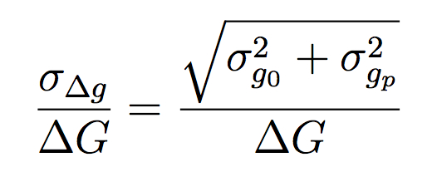
CLARREO RSS Inter-Calibration: Imager Sensitivity to Polarization
RI gain difference for non-polarized and polarized
reflectance is attributed to sensitivity to polarization
Imager sensitivity to polarization on orbit
Relative uncertainty of sensitivity
to polarization on orbit
- First term is relative uncertainty of RI gain
difference (RI sampling).
- Second term is relative uncertainty of the PDMs.

Slide 23
CLARREO/Imager Inter-Calibration: Resulting Radiometric Uncertainty
For fixed θ and χ values, assuming no correlation, reflectance variance:
Then, relative radiometric uncertainty:
First term is uncertainty for
non polarized reflectance.
Second term is from polarization
effects.
The first term is combined accuracy of CLARREO, RI random error, and remaining
Imager uncertainty (e.g. month-to-month stability).

Slide 24
Numerical Estimates of Inter-Calibrated
Imager Uncertainty:
Single measurement of m on orbit
Inputs for calculation:
m = 3% (k=1)
σ_{pdm} = 5%, 10%, 15% (k=1) ← Uncertainty in Polarization
σ_{g0} = 0.10% (k=1)
σ_{gp} = 0.15% (k=1)
σ_{clarreo} = 0.15% (k=1)
σ_{residue} = 0.10% (k=1)

Slide 25
Numerical Estimates: Imager Sensitivity to Polarization Single measurements of m on orbit
Inputs for calculation:
m = 3%, 5%, 10%
σ_{pdm} = 5%
σ_{g0} = 0.10%
σ_{gp} = 0.15%
σ_{clarreo} = 0.15%
σ_{sensor} = 0.10%

Slide 26
Summary on CLARREO RSS Polarization Approach
(1) CLARREO RSS instrument radiometric accuracy at 0.15% (k=1).
(2) CLARREO RSS 2-D data matching on-orbit (azimuth and elevation): constant in azimuth and varying in elevation within matching tent.
(3) Polarization Distribution Models are required for inter-calibrating
sensor’s sensitivity to polarization, and further its stand-alone
operation. A global all-sky set of models should be built for DOP
and polarization angle χ .
References:
C. Lukashin, B.A. Wielicki, D.F. Young, K. Thome, Z. Jin, and W. Sun, “Uncertainty Estimates for Imager
Reference Inter-Calibration With CLARREO Reflected Solar Spectrometer”, IEEE TGRS, Special Issue on
Instrument Inter-calibration, DOI: 10.1109/TGRS.2012.2233480, 2012.
Wenbo Sun, B.A. Wielicki, D. F. Young, and C. Lukashin, “Modeling polarized solar radiation from
ocean-atmosphere system for CLARREO inter-calibration applications,” in preparation for submission
to Journal of Geophysical Research, 2013.
C. Lukashin, Z. Jin, D.G. Macdonnell, K. Thome, W. Sun, B.A. Wielicki, D.F. Young , “Requirement for
Instrument Sensitivity to Polarization for Climate Observing System in Reflected Solar,” in preparation
for submission to Journal of Geophysical Research, 2013.

Slide 27
Multi-Instrument Inter-Calibration (MIIC) Framework
C. Currey (PI, NASA LaRC), A. Bartle, C. Lukashin, D. Doelling, C. Roithmayr
The MIIC Framework Objectives:
(1) Climate quality measurements require accurate instrument calibration.
Inter-calibration ties the calibration of one instrument to a more accurate
reference instrument.
(2) The MIIC Framework predicts near co-incident measurements with matched viewing geometries for instruments on separate spacecraft and efficiently acquires these data from remote data servers using OPeNDAP and server-side functions.
(3) New server-side functions will complement those now in place for format translation and subset selection to minimize the computation and network demands placed on instrument teams that perform multi-instrument inter-calibration in the distributed and heterogeneous context of the NASA Earth Science ACCESS infrastructure.
(4) The current MIIC project will demonstrate LEO-GEO and LEO-LEO
inter-calibrations use cases.

Slide 28
The MIIC Framework Features
Intelligent Event Prediction software (including sensor’s operation mode):
Based on SGP4 orbit propagator (Java implementation).
Predict when/where footprint viewing geometries match criteria – geolocate pointing
vectors in sensor’s scan plane (+/- 50°), calculate viewing angle relative to both -
spacecraft and the sun.
- Identifies data filenames and Lat-Lon bounding boxes for events (IC plan).
Efficient access to remote data based on the OPeNDAP:
- Develop OPenDAP server-side functions (gridding, spectral & spatial convolution).
- Using OPeNDAP Hyrax server.
- Using OPeNDAP Freeform and HDF4 handlers.
- Significant reduction in data volume by transferring gridded data.
Client-side (local) filtering and science algorithm processing:
- Web interface to allow users to optimize matching criteria.
- Automatically executes inter-calibration plans.
- Computes inter-calibration coefficients and persists to database.
- Persists matched radiances on client-side for further processing.
- Develop science library for inter-calibration and comparative analysis.

Slide 29
The MIIC Framework Architecture

