Slide 1
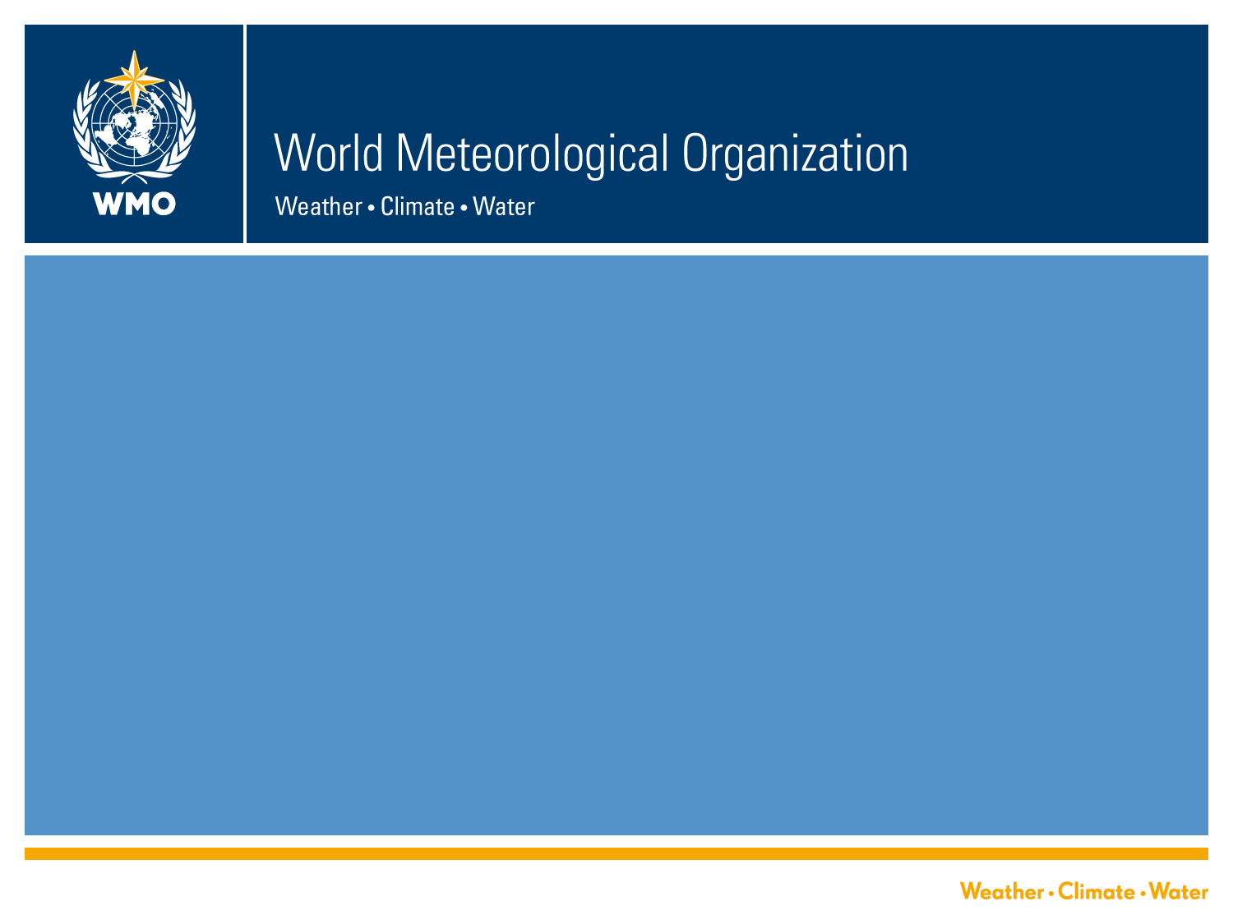
Input from WMO
Joint Meting of the GDWG and GRWG, 5-8 March 2013
Jérôme Lafeuille (WMO)
WMO / OBS / Space Programme

Slide 2
On behalf of WMO…
Welcome to all of you at this Joint meeting of the
GSICS Data Management Working Group and GSICS Research Working Group!

Slide 3
Outline
GSICS Executive Panel outcome
  EP-12 (College Park, 30 May -1 June)
  EP-13 (Lugano, 4 November 2012)
GSICS in the WMO strategic framework
  WIGOS Implementation Plan
  Commission for Basic Systems (CBS-XV, Jakarta, Sept. 2012)
  Global Framework for Climate Services (GFCS)
  Architecture for Climate Monitoring from Space

Slide 4
GSICS Executive Panel 12 (College Park, May/June 2012) 1/2
Endorsed exempt clauses of GPPA for swift progress
Urged to complete steps to reach operational product stage
Endorsed principle that GSICS corrections be applied to compute corrected calibration coefficients to be disseminated in L1 data in parallel to the operational calibration
Supported proposed concept of CLARREO-type mission on ISS
Recognized value of ROLO model and expected USGS to provide continuity of this service with required technical documentation. Suggested to explore direct provision of the ROLO model
Endorsed the on-line GSICS Product Catalogue + congratulations
Endorsed recommendation to implement netCDF format
Emphasized the benefit of IASI as a reference instrument, strongly supports developments to improve traceability for next generation instrument

Slide 5
GSICS Executive Panel 12 (College Park, May/June 2012) 2/2
Recommended the NESDIS Integrated Calibration Validation System (ICVS) as a model for on-line instrument performance monitoring
Endorsed GSICS principles, Scope of GSICS, GSICS disclaimer…
Initiated enquiry on the Vision of GSICS on 5-10 years
Welcomed excellent cooperation with WGCV
  Acknowledging differences in respective scope and priorities
  Keep each other systematically informed, consolidate findings
  Adopt common practices/procedures when relevant
Welcomed presentation on CSA’s PCW in HEO, noting potential for intercalibration
Welcomed ESA report on Cal/Val Interest Group
Welcomed the Socrates (now named OSCAR ) resource developed by WMO: www.wmo.int/oscar

Slide 6
GSICS Executive Panel 13 (Lugano, 4/11/2012)
Welcomed the work done to prepare IEEE TGRS special issue and recommended funding open accessibility of papers
Adopted draft Statement on collaboration with GRUAN
  The GSICS EP sees potential for mutual benefit of GRUAN and GSICS activities, and therefore recommends conducting coordinated activities in specific areas (Statement to be finalized).
Agreed that GRWG should seek to distribute lead responsabilities according to technical areas
Reviewed feedback on the Vision for GSICS in 5-10 years
  To be finalized
Welcomed offer of Dr Ashok Kumar SHARMA (IMD) to serve as vice-chair
Next EP meeting envisaged in Japan on 14-15 July (TBC)

Slide 7
GSICS in the WMO strategic framework
WIGOS
CBS-XV conclusions
GFCS
Architecture for Cliimate Monitoring from Space

Slide 8
WMO Integrated Global Observing System
WIGOS Implementation Plan outline
(addresses both surface and space-based observations)
Management
Collaboration with co-sponsored observing systems
Design, planning and evolution
Integrated observing system operation and maintenance
Integrated quality management
Standardization, system interoperability and data compatibility
  Develop guidance for WIGOS standards
  Document the implemented standards, including best practices, procedures on instruments, methods of observations, data & products, etc
WIGOS Information Resource
Data Discovery, delivery and archival
Capacity development
Communication and outreach

Slide 9
Commission for Basic Systems (Jakarta, 10-15 Sept. 2012)
4.2.60 Satellite instrument calibration and inter-calibration (GSICS)
The Commission emphasized the importance of satellite instrument calibration and inter-calibration to ensure interoperability of space-based measurements throughout the space-based component of WIGOS.
In this regard, it welcomed the progress made within the Global Space-based Inter-calibration System GSICS (http://gsics.wmo.int) in establishing globally agreed best practices and procedures for improved on-orbit calibration, and making calibration corrections routinely available through the online GSICS product portal.
It invited GSICS members to bring these products to an operational stage and to incorporate GSICS calibration information into their near-real time Level 1 data dissemination streams.

Slide 10
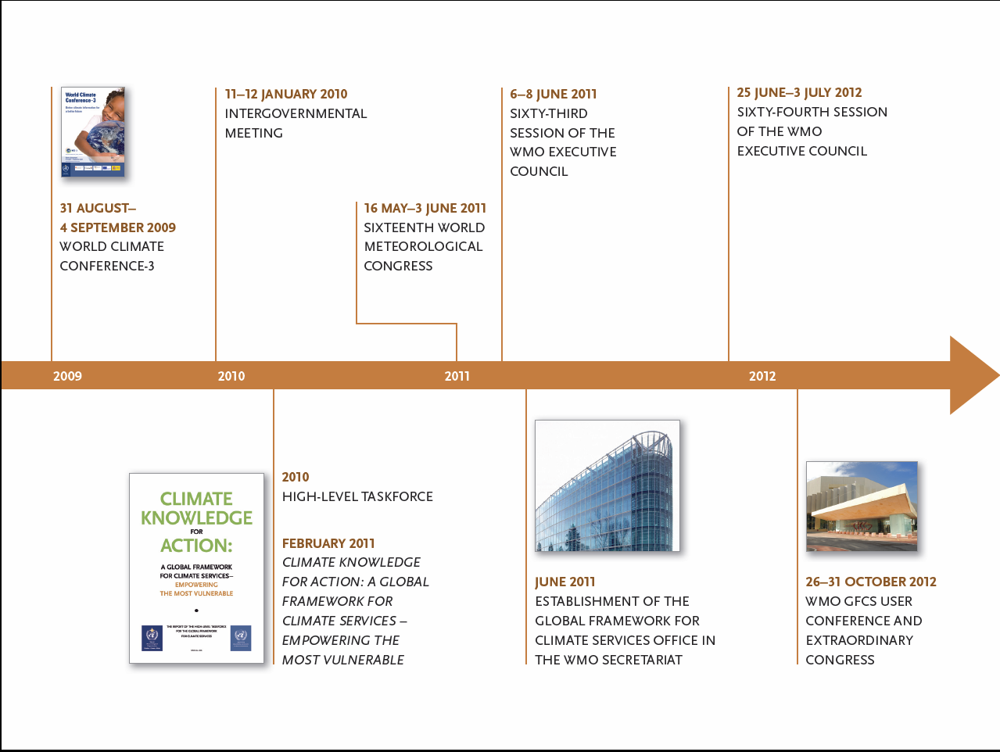
The Global Framework for Climate Services (GFCS)—A New Partnership Process
Notes:
10

Slide 11



Climate Services will Require an Unprecedented Level of Collaboration
Research, Modeling
& Assessments
Observations &
Monitoring
Climate Services
Resource Risk
Management
Adaptation & Mitigation
Notes:
11
11
No single agency is capable, however, of providing all of the information and services needed to inform decision-making. Meeting the climate challenge will require an unprecedented level of coordination among federal agencies, along with our nongovernmental partners, to pull together our collective expertise to accomplish the goal of providing high quality climate information and services that are user-friendly, responsive, and relevant.

Slide 12

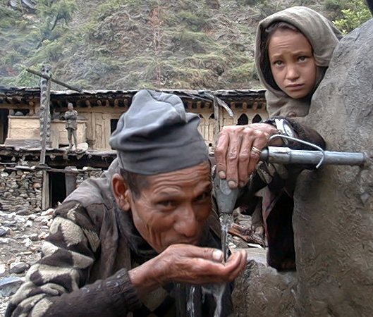
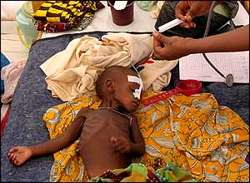
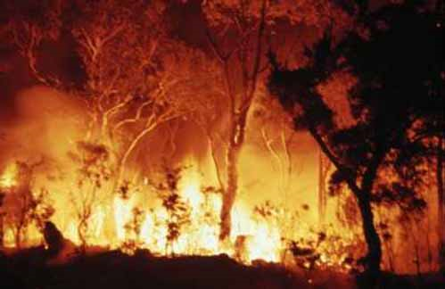

Initial GFCS priority areas
New partnership to address new observational requirements through user communities
Agriculture
Water
Disaster Risk Reduction
Health
http://www.wmo.int/gfcs
Notes:
12
All climate-sensitive sectors can and will benefit from climate services. However, four areas have been identified by the High Level Task Force as urgent priorities and where the most short-term benefits could be obtained. Thus Climate Services targeted particularly in enhancing the ability to cope with climate related incidents shall be the main focus.
(Click) First of all Agriculture and food security:
With a better analysis of climate risks and availability of seasonal forecasts, farmers can plan optimal planting dates, the best mix of crops to grow and which disease- and pest-resilient varieties to choose. This can help to improve food security and reduce poverty. Climate scientists and farmers must develop close partnerships to effectively use seasonal forecasts and develop coping strategies in the event of natural disasters.
(click) Secondly, Water:
Water availability can provide or deny life-supporting needs. It can lead to enhanced food production but also to extreme water stress, high levels of poverty and even loss of life. Improved climate predictions give water resource managers the necessary information to plan and operate their systems more efficiently.
(click) Thirdly, Health:
Weather and climate conditions have direct and indirect impacts on health. They can increase the risk of epidemics of airborne and waterborne diseases, as well as malnutrition, heatstroke and respiratory problems. Climate prediction and information facilitate early warnings and surveillance, as well as interventions and resource allocation management
(click) Lastly, Disaster Risk Reduction:
Climate-related disasters such as flooding or drought have great impacts on communities and their socio-economic activities. Early warning systems can prevent loss of life, livelihood and property by alerting people to specific threats and enhancing the level of preparedness.
Thus, it is in these four areas that climate services will be developped in the short term until 2017.

Slide 13
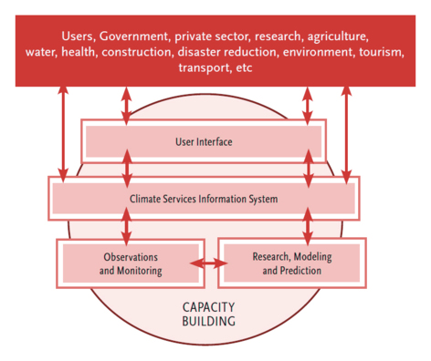
GFCS components

Slide 14
GFCS: Observations & Monitoring Pillar
Existing capabilities for climate observation and data exchange provide a strong basis for improving climate services globally.
In this respect, the Framework will benefit from existing surface-based and satellite-based observing systems that already provide a wealth of data
In recent decades, satellite data have contributed very significantly to climate datasets and are the only way to provide global coverage of some parameters
The Architecture for Climate Monitoring from Space is a key component of GFCS
Notes:
14

Slide 15
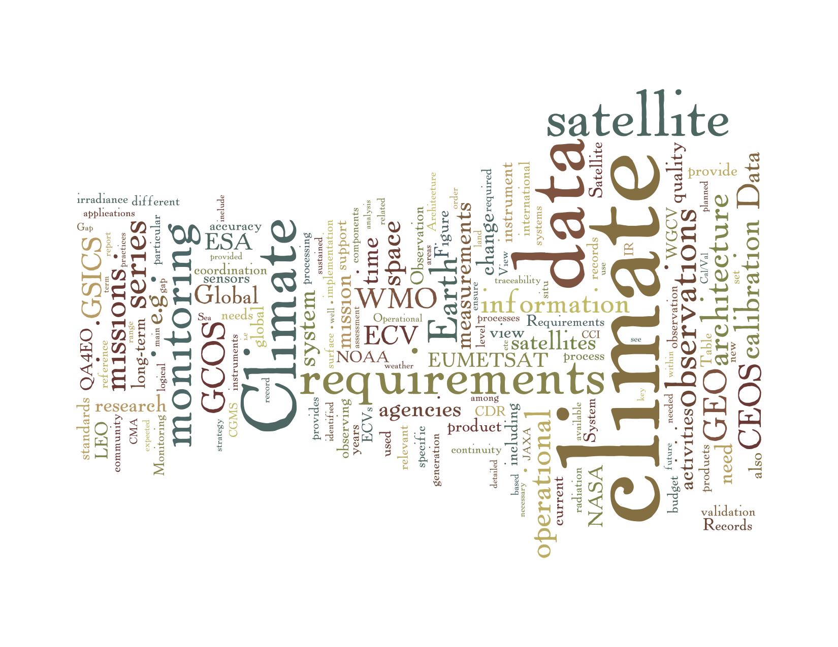
Architecture for Climate Monitoring from Space
A joint initiative of CEOS, CGMS and WMO, seen as a foundation for the GFCS Observation and Monitoring
Strategy document available in line
Includes detailed references on GSICS and WGCV calibration activities
Strategy towards an Architecture
for Climate Monitoring from Space
CEOS, CGMS, WMO

Slide 16
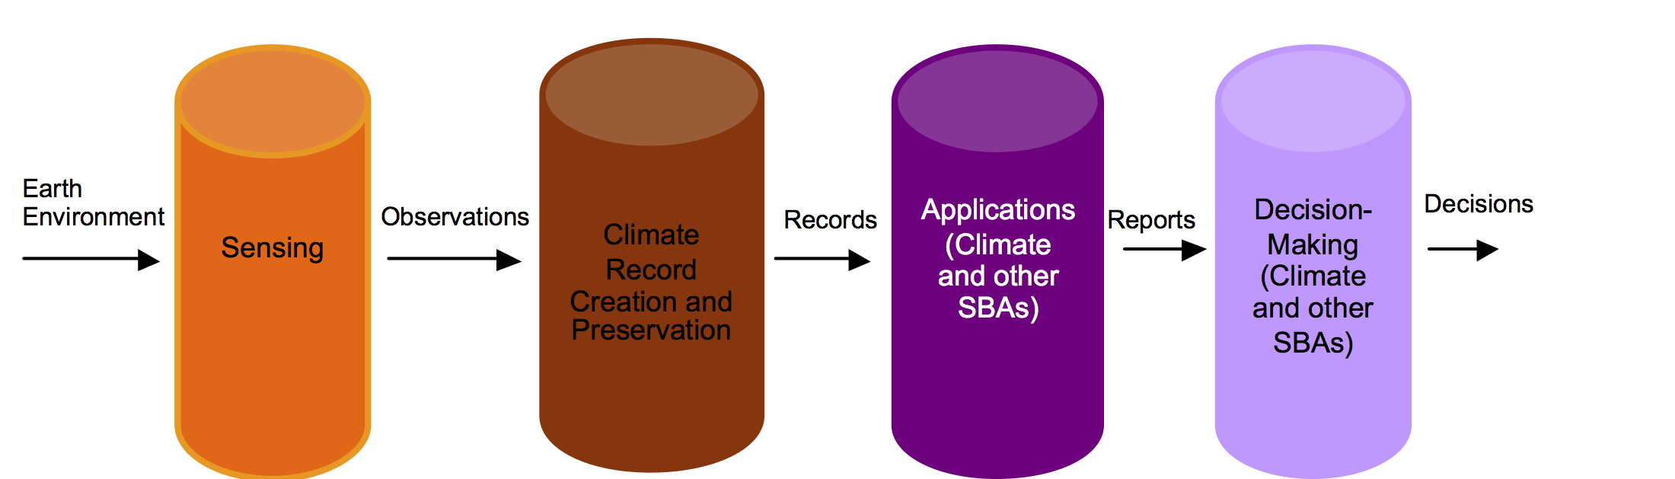
Architecture Pillars

Slide 17
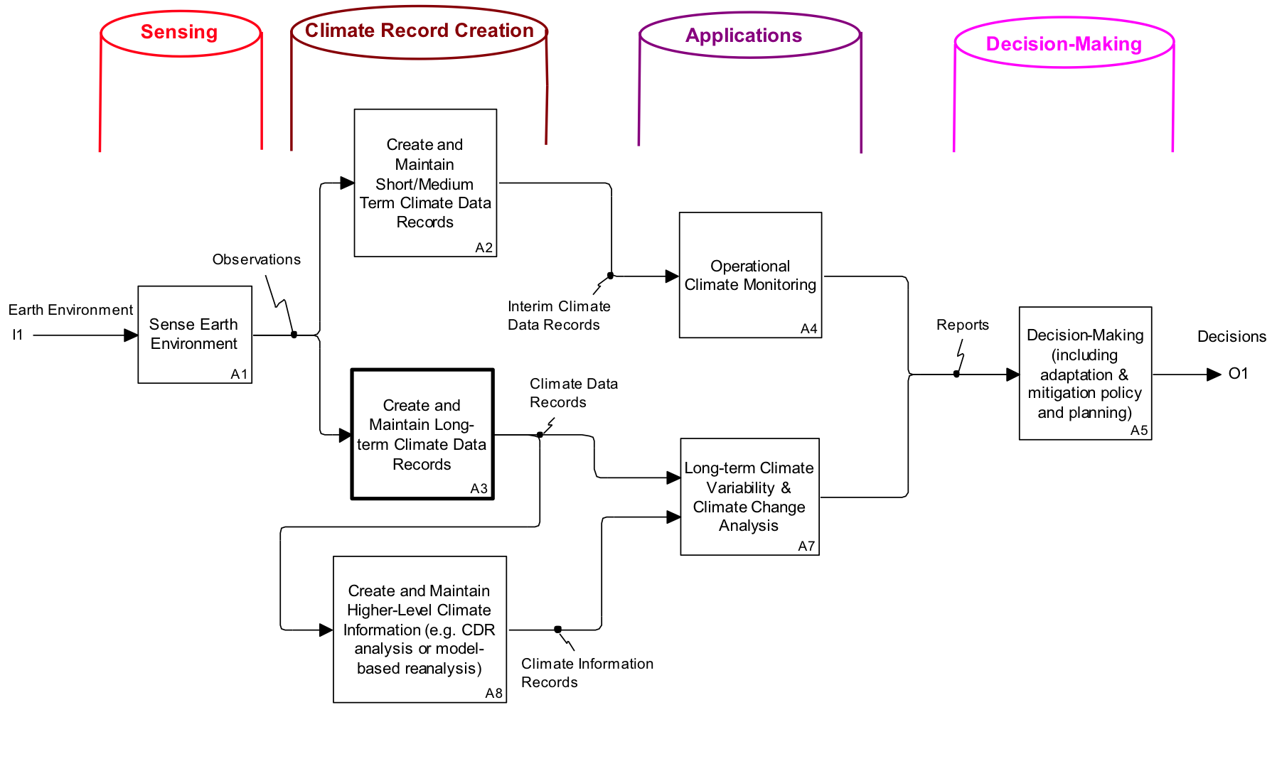
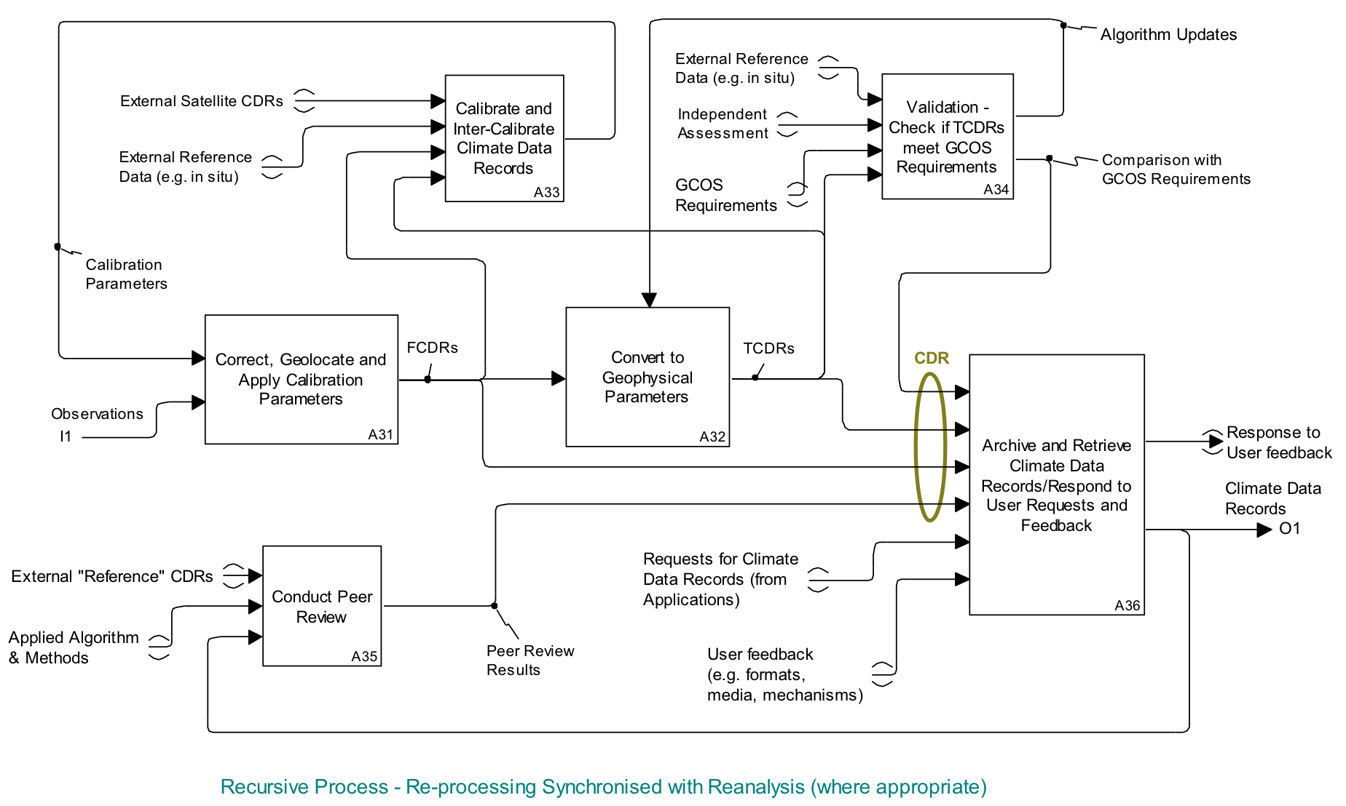
Logical representation
Traceable to GCOS Guidelines and GCOS Climate Monitoring Principles
Traceable from ECV Inventory and physical representation of Climate Monitoring Architecture

Slide 18
Conclusions
GSICS is –more than ever – an important building block of the space-based observing system and related major undertakings: WIGOS, GFCS, Architecture for Climate Monitoring from Space
Recognized by WMO CBS who recalled the need to bring products to operational stage and make them routinely available like the « operational » calibration
Thanks to all GSICS member organizations, and all experts involved in the work of GSICS through GDWG and GRWG.
Have a nice and fruitful week !

