Slide 1
The Global Space-based Inter-Calibration System
Mitch Goldberg, NOAA/NESDIS
GSICS Executive Panel chair
NOAA/NESDIS

Slide 2
GSICS Mission
To provide sustained calibration and validation of satellite observations
To intercalibrate critical components of the global observing system to climate quality benchmark observations and/or reference sites
To provide corrected observations and/or correction algorithms to the user community for current and historical data
2

Slide 3
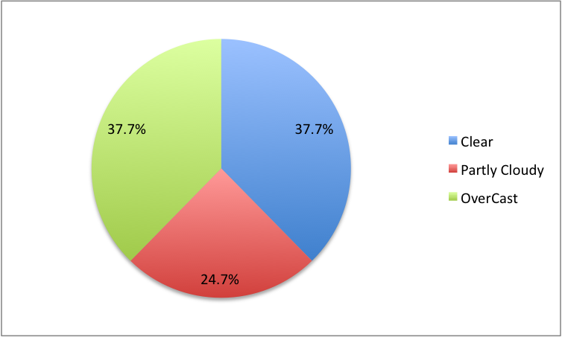
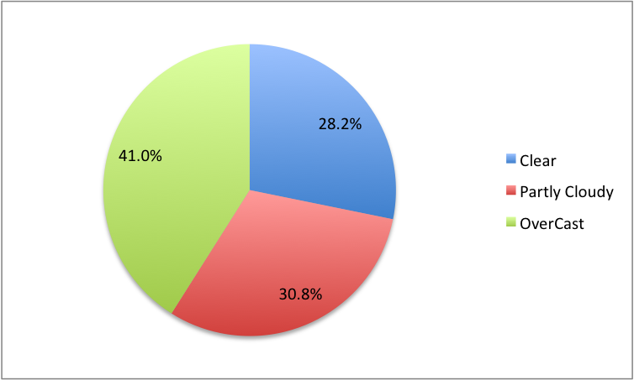
IMPACT on Cloud Coverage Classification MSG March 2009
Before GSICS correction
After GSICS correction

Slide 4
GSICS Official Members
NOAA
NIST
NASA
EUMETSAT
CNES
CMA
JMA
KMA
WMO
ISRO
IMD
JAXA
USGS
Roshydromet
ESA (observer)
CEOS Precipitation Constellation is working with GSICS via
GPM X-Cal Working Group.
GSICS current focus is on the intercalibration of operational satellites,
and makes use of key research instruments such as AIRS and MODIS
as reference instruments for the operational instruments
4
Notes:
4

Slide 5
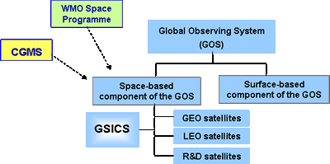
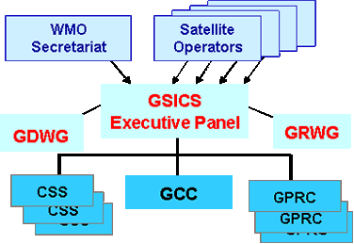
GSICS organization
Overseen by GSICS Executive Panel
Supported by Research Working Group
and Data management Working Group
GSICS activities rely on:
GSICS Coordination Centre (GCC)
operated by NOAA/NESDIS
Processing & Research Centres (GPRC)
operated by each satellite operator
Calibration Support Segments (CSS)
including field sites and laboratories
GSICS as an element of the space-based component of the Global Observing System
Coordination Center
Calibration Support Segments (reference sites, benchmark measurements, aircraft, model simulations)
Regional Processing Research Centers at Operational Space
Agencies
Notes:
GSICS activities rely on a GSICS Coordination Centre (GCC) operated by NOAA/NESDIS, several GSICS Processing and Research Centres (GPRC) operated by each satellite operator, and will benefit of Calibration Support Segments including field sites and laboratories.
Activities are overseen by a GSICS Executive Panel assisted by a Research Working Group and a Data management Working Group.

Slide 6
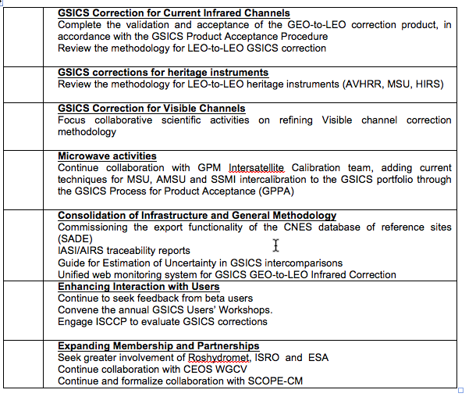
High Level Priorities

Slide 7
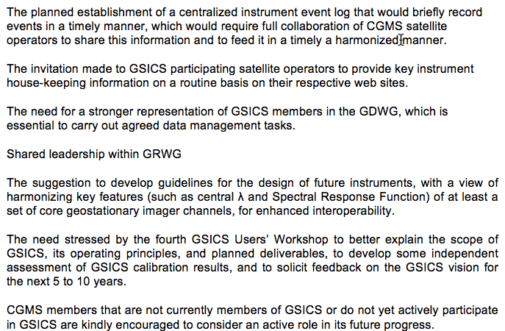
Important Measures

Slide 8
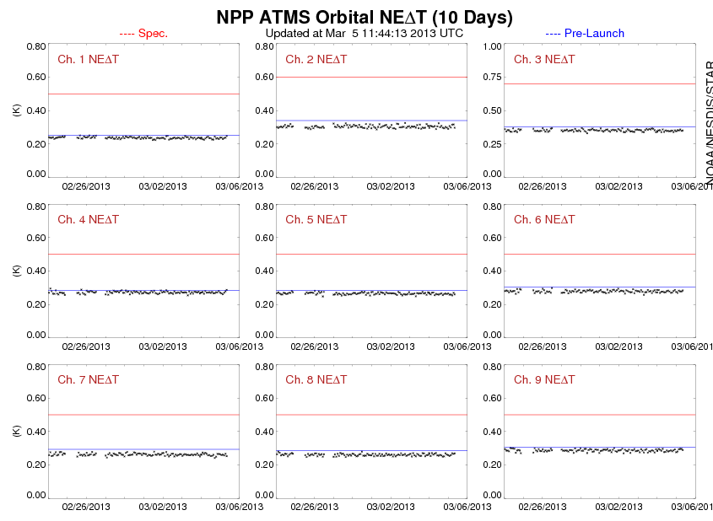

Slide 9
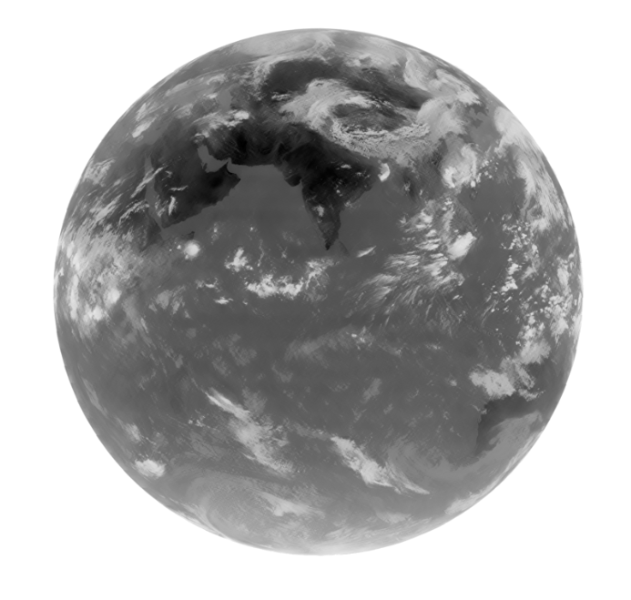
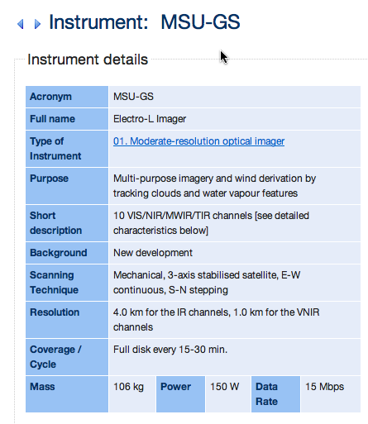
RUSSIA’s ELECTRO-L Channel 9 10-11 microns

Slide 10
CGMS-40 Actions

