Slide 1
GSICS Data Management Working Group Report
Aleksandar Jelenak
NOAA Satellite and Information Service

Slide 2
Outline
Membership update
GSICS User Messaging Service status update
Review of the activities since the last meeting
Highlights of the breakout session agenda

Slide 3
Membership Update
New JMA representative:
Mr. Tetsuro Kurita

Slide 4
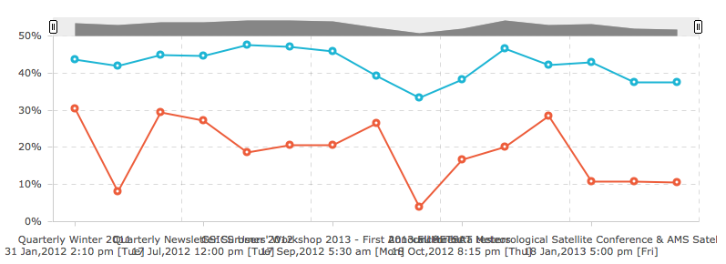
User Messaging Service Update
218 subscribers
Since last meeting:
28 new subscribers added
14 messages sent
Message open (blue) and click (red) rates:
Scan to sign up!

Slide 5
Action Items Review
33 action items from the last Joint Meeting
All completed!
Not aware of any older action items still not completed or closed
Given low participation by member organizations it is likely the working group will adopt a different approach from this year: a list of open-ended tasks inviting volunteers to take on

Slide 6
Achievements
Product catalog
GEO-LEO-IR netCDF template
Support for the NOAA and EUMETSAT GEO-LEO IR products transitioning into the preoperational phase
Special commendation to: EUMETSAT for providing the resources and Peter Miu for the leadership in developing the bias monitoring plotting web app

Slide 7
Breakout Session Highlights
Common THREDDS configuration
NetCDF format for new data sets
Satellite instrument event log
NetCDF metadata validation tool
Official documents
Preparation for 2013 users’ workshop
Roadmap to 2014 and beyond

Slide 8
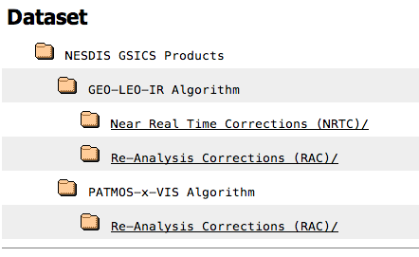
Common THREDDS Configuration
How to organize correction products based on the algorithm type, instrument class, anything else…

Slide 9
Common THREDDS Configuration (cont)
Represent third-part products
Mirror products from other data servers
Create virtual datasets by aggregating multi-file products along time dimension
Dataset viewers
Minimal common content on dataset pages

Slide 10
New Data Sets NetCDF Format
If any new data sets are planned notify your GDWG representative or chairman as soon as possible
Hint: this meeting is an excellent opportunity

Slide 11
Instrument Event Logging
NOAA proposed an abstract data model but has no resources for an implementation
The model can be used both for storing and exchanging event information
That model is now in the joint NOAA/NASA draft ISO 19115-2 metadata standard revision proposal
EUMETSAT seems to have the resources for an implementation
NOAA and EUMETSAT will continue to collaborate towards a common concept

Slide 12
NetCDF Metadata Validation Tool
Objective validation – takes humans out of the process
Modular design allows for validation of both common and data producer specific content
Works with local and remote netCDF files
Executed as a typical UNIX command line program

Slide 13
Official Documents
Use of the wiki as document preparation and hosting solution is deprecated
Need to migrate a few wiki pages into documents
At the last year’s meeting GDWG tasked to come up with a process for numbering official documents (standards, technical reports/notes, white papers, etc.)

Slide 14
2013 Users’ Workshop
15-min slot reserved for data management
Live demonstration on how to find, plot, and use our data rather then a presentation
Any feedback received from your users can help us plan

Slide 15
Roadmap
The data production and distribution framework is almost complete
Long term data life cycle
Processing history of each individual file
Services for improving understanding of GSICS data
Interfacing with SCOPE-CM

