Slide 1
IEEE TGRS Special Issue on “Inter-Calibration of Satellite Instruments”
GSICS Annual Meeting
Williamsburg, Virginia
March 4–8, 2013

Slide 2
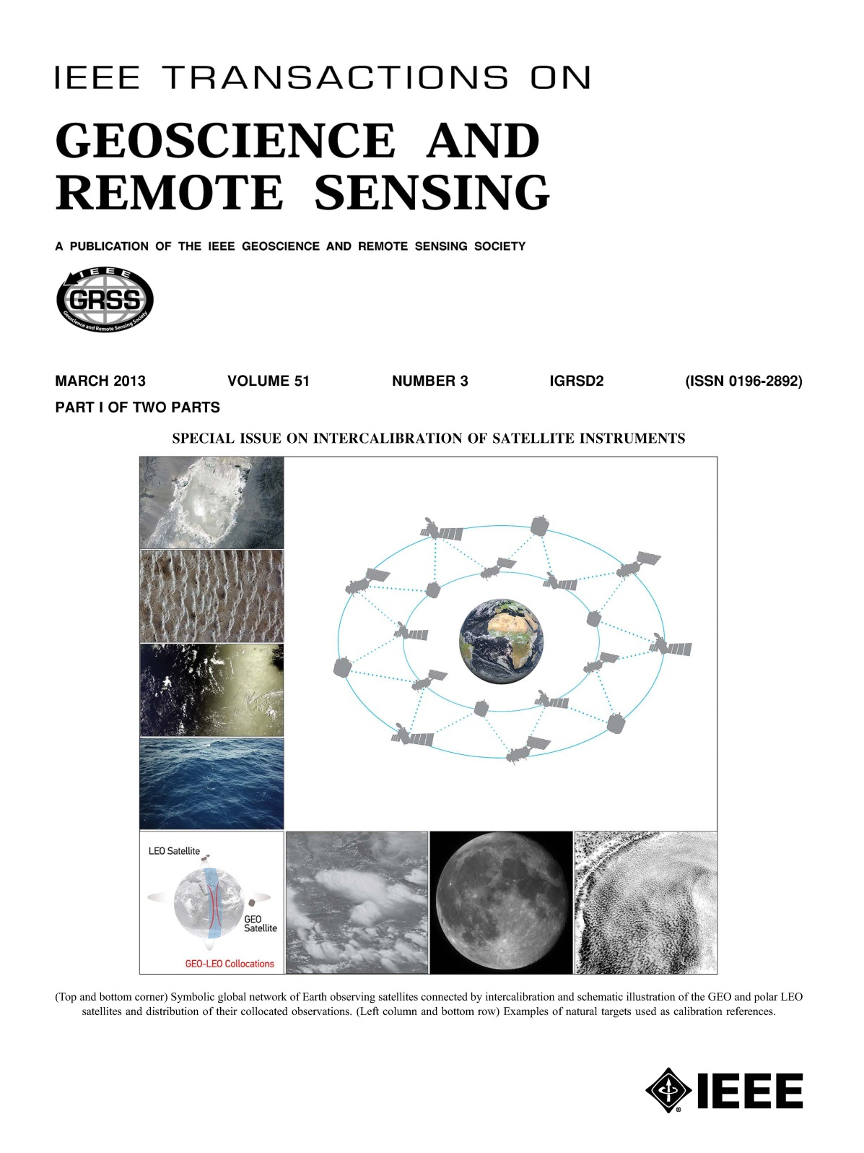

Slide 3
Special Issue Foreword
This special issue focuses on how intercalibration and comparison between sensors can provide an effective and convenient means of verifying their postlaunch performance and correcting their measurement differences
The papers contained within this special issue include topics that explore pseudoinvariant calibration sites (PICS), instrumented sites, simultaneous nadir observations (SNO) and other ray-matching comparisons, lunar and stellar observations, deep convective clouds (DCC), liquid water clouds (LWC), Rayleigh scattering, and sunglint
The goal of this special issue is to capture the state-of-the-art methodologies and results from intercalibration of satellite instruments, including full end-to-end uncertainty analysis

Slide 4
Manuscripts Received
There has been a lot of interest in the community with regards to the special issue topic
There was an overwhelming response and close to 60 manuscripts were submitted
40 Manuscripts were accepted for publication
Example of the contributors
ARGANS, CAS, CMA, CNES, ESA, EUMETSAT, ISRO, JAXA, KMA, JMA, MIT, NASA, NOAA, SDSU, USG, etc.
Example of the sensors covered
AVHRR, AMSU, (A)ATSR, CLARREO, ETM+, FY-2/2C/D/E/3B, GOES, HIRS, Hyperion, IASI, Jason-2/OSTM, MODIS, PROBA, SCAIMACHY, Sentinel-2, etc.

Slide 5
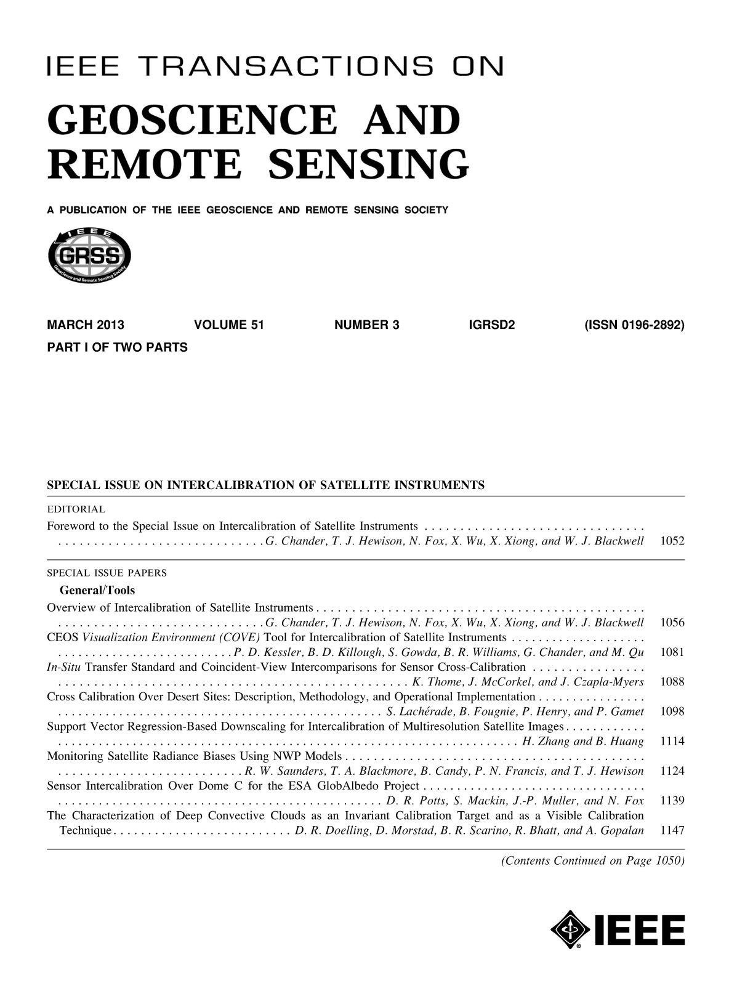
Table of Contents:
General/Tools 8
Geostationary 10
Spectral 7
LEO 8
Microwave 7
Total 40

Slide 6
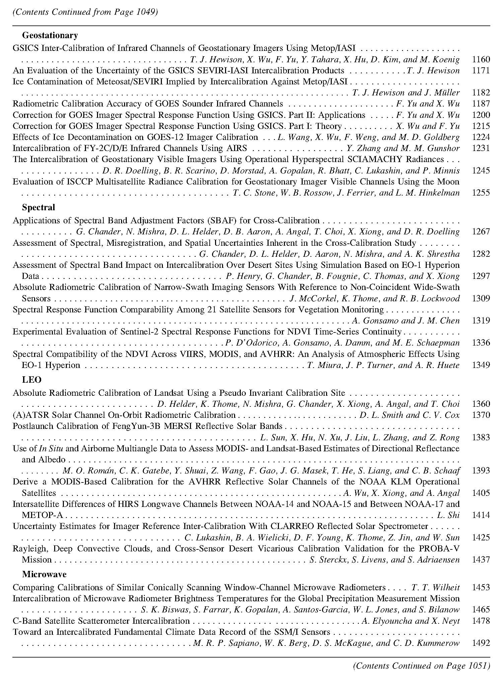

Slide 7
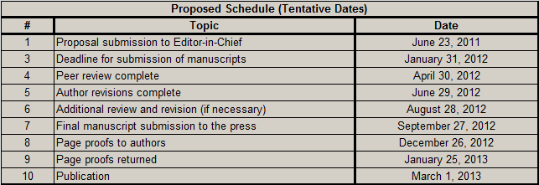
IEEE TGRS Schedule

Slide 8
IEEE Xplore
Available online through the IEEE Xplore website at http://ieeexplore.ieee.org/xpl/tocresult.jsp?isnumber=6469257&punumber=36
Open Access fee is $1750/paper for the authors and they get unrestricted distribution
There are 40 papers published in this issue. You'll see a number of contributions from the GSICS and CEOS community. Several of these are being published with Open Access, so you can download them freely!
This 500-page special issue will become a reference anthology for the remote sensing community
Notes:
Open Access is a different business model for the distribution of journal articles. In the traditional model, page charges to authors are typically voluntary (aside from overlength and color charges) and reader access charges (to either individuals or libraries and institutions) are mandatory. The roles are reversed with Open Access - charges to authors are mandatory and there are no charges to readers. Some publishers use only one or the other model. IEEE uses a hybrid model in which each author can choose whether to pay the Open Access fee ($3000/paper) and have unrestricted distribution or pay nothing (except mandatory overlength and color charges) and have the standard restrictions apply to distribution. So having an Open Access special issue would require that every author pay the $3000 Open Access fee. The GRS Society has a new "Editor's Choice" policy, begun with its Jan 2012 issues of TGRS, GRSL and JSTARS, under which one paper in each issue is selected by the Editor to be Open Access at no charge to its authors. The Society underwrites the fee. For Special Issues, the Guest Editors can chose which paper this will be. For the SMOS Special Issue (ToC appended below), one of its three Open Access papers was the Editor's Choice selection and the other two were chosen and paid for by its authors.

