Slide 1
2012 GSICS Users’ Workshop Report
Dr. Fuzhong Weng (GCC Director) and Dr. Fangfang Yu (Deputy)
2013 GSICS Annual Meeting
Williamsburg, VA, USA
March 5, 2013

Slide 2
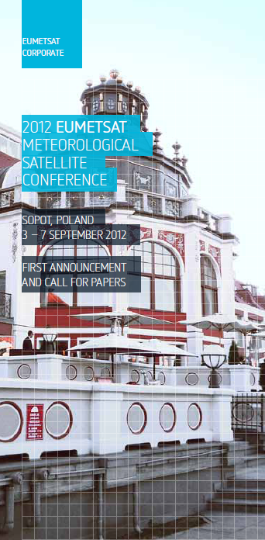
4th GSICS Users’ Workshop
When: Sept. 6, 2012 at 13:00-18:00
Where: Sopot, Poland, in conjunction with EUMETSAT Meteorological Satellite Conference
Attendance: about 50 attendees from >20 organizations
Agenda and slides are available at GSICS wiki webpage:
https://gsics.nesdis.noaa.gov/wiki/Development/20120305

Slide 3
Users Feedback and Requests - 1
Needs for the correction for solar bands
in accordance with GSICS on-going effects on the GEO solar channel calibration with community best practices and standards
Access to the intermediate data
GSICS will consider it as a potential product to be analyzed with beta users
Need of AVHRR infrared (IR) channel cross-calibration
From the work of GHRSST team
Encouraging the on-going development of products and services
Instrument inter-calibrations: Metop-B/IASI, CrIS …
Instrument event log
Online tools

Slide 4
Users’ Feedback and Requests - 2
Recommended validating the uncertainty estimation methodology with climate community
Need for common reference channel
GSICS community will consider recommending methodology for user to use such common reference channels
The question of whether to supply calibration correction, or recalibrated archives
will be addressed on a case-by-case basis
Need to move the products to “operational” stage
Increased interaction with user community

Slide 5
Discussion on the future Vision - 1
Discussion on GSICS vision for the future five to ten years
Should GSICS scope be expended to address other measurements (e.g. active, GPS Radio Occultation)?
This should be discussed by the Executive Panel
Expected GSICS community to provide the access to pre-launch calibration data
Users should precise the type of information needed
Shall GSICS provide a variety of calibration information in addition to one official GSICS calibration ?
Hosting 3rd party calibration information if compliant with GPPA (GSICS Procedure for Product Acceptance)

Slide 6
Discussion on the future Vision (2)
Increased effort on uncertainty evaluation and documentation
Further promote concept of on-orbit absolute reference payload (CLARREO, TRUTHS,…)
Implement the calibration correction in the L1.5 data header when possible
Ensure future data formats allow inclusion of alternative calibration coefficients

Slide 7
Discussion on the future Vision - 2
Should increase effort on uncertainty evaluation and documentation
Further promote concept of on-orbit absolute reference payload (CLARREO, TRUTHS,…)
Discussion on the calibration correction in the L1B like data
Ensure future data formats allow inclusion of alternative calibration coefficients

Slide 8
backup

Slide 9
GSICS Products
GSICS Bias Monitoring
Routine comparisons of satellite radiances against reference
Time series plots of calibration bias with respect to reference
New web-based bias plotting tool
GSICS Correction
Functions to correct issued radiances for consistent calibration with reference
For Near-Real-Time and Re-Analysis applications of operational L1 data
For Archive Re-Calibration of reprocessed datasets to generate FCDRs
GSICS Reports & Guidelines
Investigation to the root cause of bias
Recommendations to modify practices
Design and Operation of future satellite instruments
Online and research paper documentation, e.g. special Issue of IEEE transactions

