Slide 1
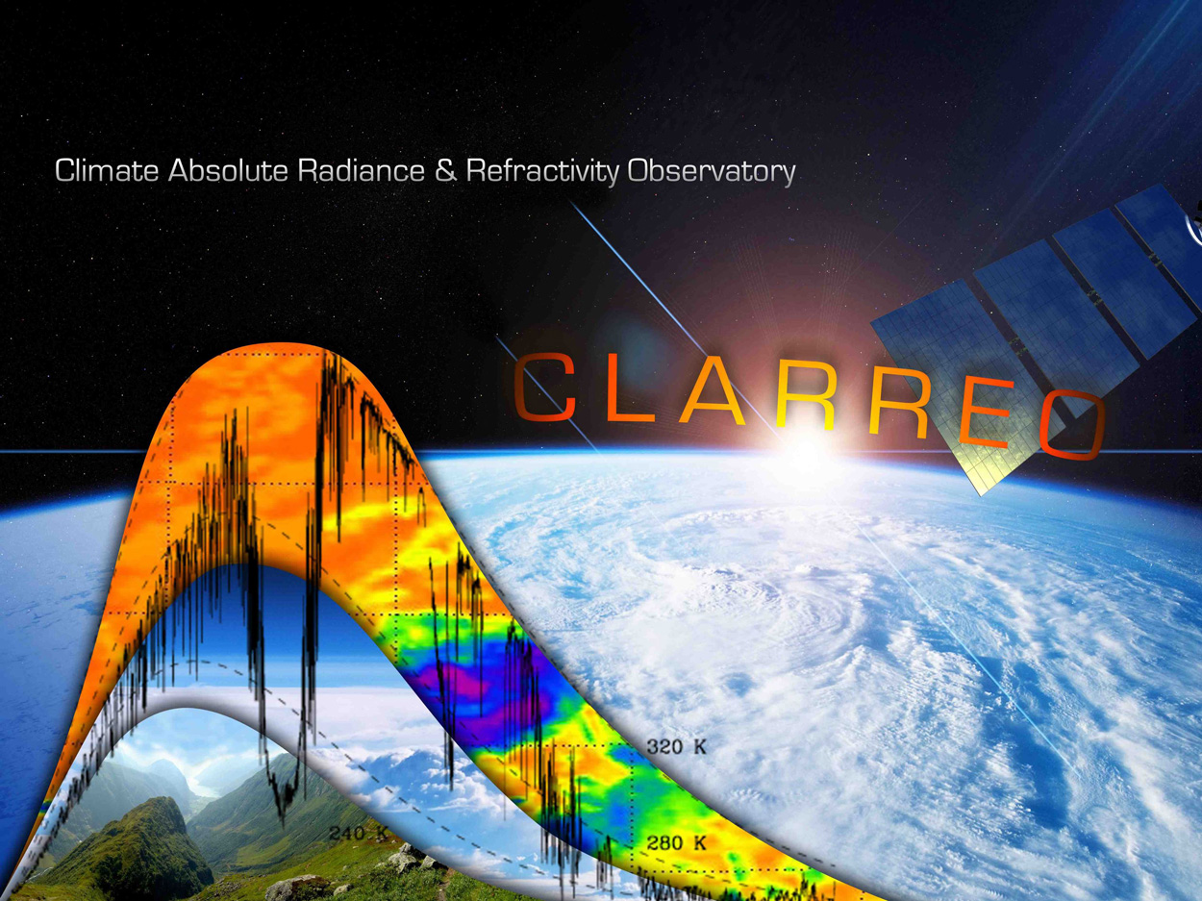
CLARREO Mission Status
GSICS Meeting
William & Mary, Williamsburg, VA
March 5, 2013

Slide 2
What is CLARREO?
CLARREO = Climate Absolute Radiance and Refractivity Observatory
A high-priority mission described in the NRC Earth Science Decadal Survey (2007)
  Recommended in first group of 4 missions (“Tier 1”)
A mission that provides important near-term benefits
  High-accuracy calibration of a wide range of operational sensors and their ocean, land, and atmosphere applications throughout the solar and IR from LEO to GEO
  Improved accuracy and consistency of climate data sets and better understanding and prediction of climate change
  First direct measurement of Earth's greenhouse effect across the entire infrared spectrum (current instruments miss 50% of the infrared energy)
  Improvement and validation of climate models

Slide 3
CLARREO History
July 2007, CLARREO open science workshop. Mission based on white papers from J. Anderson @ Harvard, B. Wielicki @ Langley, and M. Mlynczak @ Langley
2008: NASA Langley directed to lead the mission.
2008 through 2010: mission and science studies, team included LaRC, GSFC, GISS, JPL, NIST, NOAA GFDL, Harvard, U. Wisconsin, U. Colorado, UC Berkeley, U. Maryland, Imperial College, UK, NPL, UK.
November 2010: CLARREO passed Mission Concept Review on first attempt.
    The project successfully demonstrated the need for the CLARREO mission and a feasible mission concept within imposed funding constraints (MCR Board Chair)
February 2011: $2B in NASA Earth Science Budget reductions held CLARREO in pre-phase A instead of phase A. Targeted funding for tech risk reduction and science.
December 2012: NASA Headquarters Guidance Letter
  Support cross mission studies of possible ISS implementation options for advanced instrument demonstrations, including CLARREO-led accommodation studies for the individual IR and RS instruments. (S. Volz)
January 2013: Briefing to Freilich (NASA Earth Science director) and Grunsfeld (NASA Science director) on CLARREO Inernational Space Station (ISS) mission concept. Received “green-light” to initiate discussion with ISS office. First presentation to ISS office, February 21, 2013.

Slide 4
CLARREO Science

Slide 5
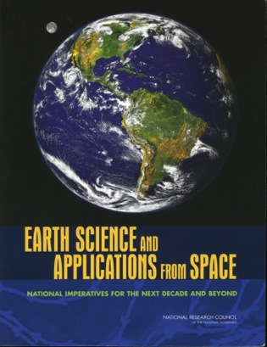
CLARREO Solves the Climate Accuracy Challenge
Insufficient absolute accuracy remains an Achilles Heel for climate change observations and therefore climate model testing, climate model predictions of future change, and societal policy decisions.
Current instruments typically rely on overlap and much lower confidence stability arguments. Gaps seriously degrade climate records
CLARREO is the SI traceable high accuracy rigorous answer for the entire solar and infrared spectrum ("NIST calibration laboratory in orbit") that dominate Earth's climate change. CLARREO bridges gaps.
The economic net present value of advancing climate change
knowledge for societal decisions by CLARREO like accuracy
is estimated using the Interagency Memo on the Social Cost
of Carbon as $3 to $20 Trillion (2007 U.S dollars depending
on discount rate assumed).
CLARREO is the cornerstone of the Climate Observation System. igh Accuracy is a broad system enabler.
CLARREO does for climate change observations what GPS did for navigation

Slide 6
CLARREO Partnerships and Collaborations
World Meteorological Organization (WMO)
  GSICS (Global Space based Inter-Calibration System) has strongly endorsed the need for CLARREO as the in-orbit reference to anchor all space based instruments in the infrared and reflected solar spectrum, both for climate change observations as well as operational weather and earth resources instruments
  These include ABI, AGRI, AHI, ASI, AVHRR, CERES, CrIS, ETM+, FCI, GIIRS, GOME-2, HIRS, IASI, IRAS, IRS, MERSI-2, MODIS, OLCI, SEVIRI, SGLI, SLSTR, VIIRS, and VIRR.)
  Barbara Ryan, WMO Director for Space and GSICS sent a letter (Jan. 2012) to Dr. Freilich at NASA HQ strongly endorsing the need for CLARREO to serve as the calibration anchor for GSICS and the rest of the observing system.
  WMO has also endorsed CLARREO instruments on ISS as the most effective way to achieve these objectives. A joint white paper on this topic was led by Jerome Lafeuille, Chief, Space-based Observing System Division, WMO Space Programme.
United Nations (UN)
  Takao Doi, section chief for the UN Office of Outer Space Affairs has endorsed the white paper let by Lafeuille supporting CLARREO instruments on ISS.
ECMWF (European Center for Medium Range Weather Forecasting)
  ECMWF has written a letter of support for the Zeus proposal (a CLARREO quality IR spectrometer) stating that it needs higher accuracy IR spectra for weather prediction assimilation and climate re-analyses.
CLARREO – A calibration source for the Earth Observing System

Slide 7
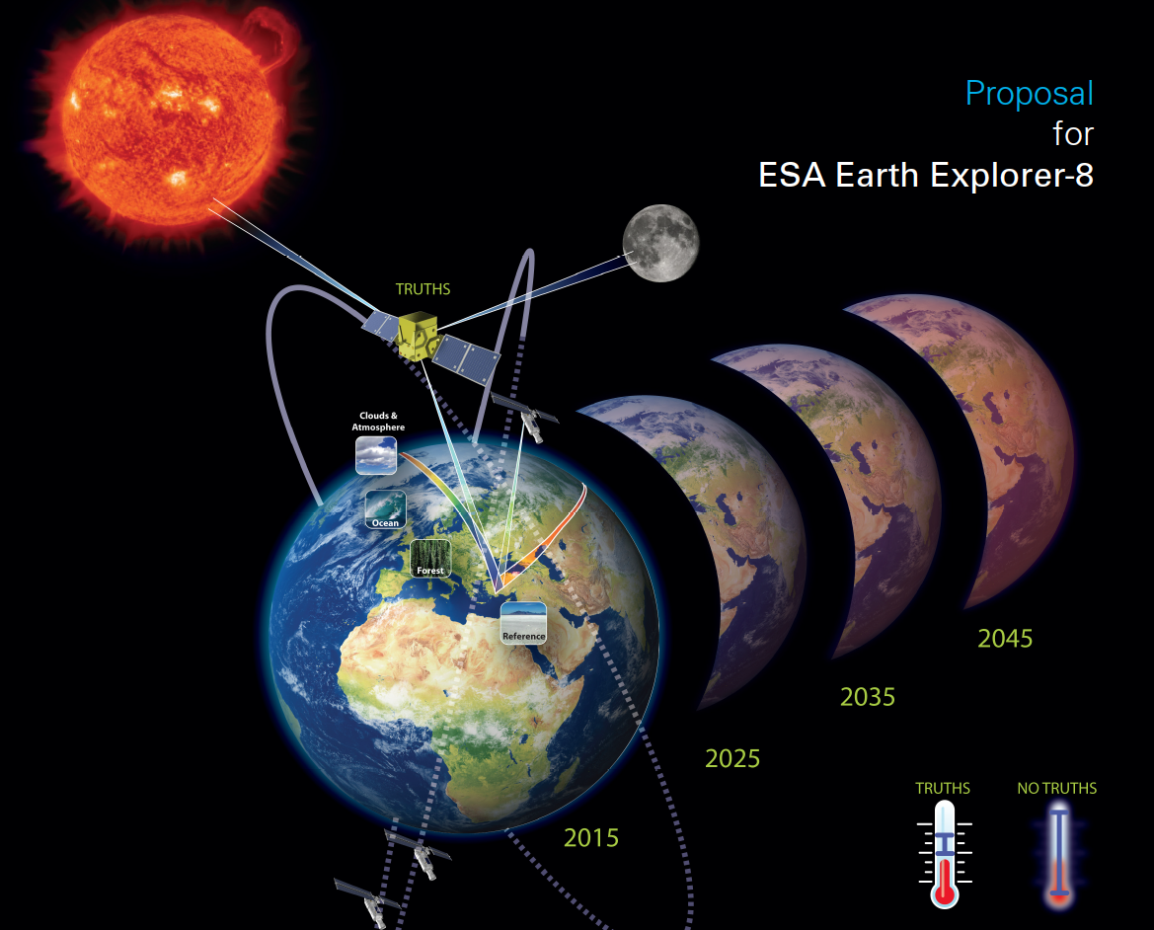
CLARREO Partnerships and Collaborations
Multiple collaborations with organizations in the UK
  Imperial College, National Physical Laboratory, and Hadley Centre (UK climate modeling and prediction center) are partners.
  Formal Letter of Agreement between NASA and Natural Environment Research Council.
  Coordinating with Nigel Fox at NPL on a UK Space Agency funding study of the reflected solar instrument science requirements for a potential TRUTHS demonstration mission. TRUTHS finished 3Rd in the most recent ESA Explorer competition.
Italian collaborations on IR spectrometer
  Working with Italian scientists from the FORUM ESA Explorer proposal on future IR spectrometers for the far-infrared spectra. (FORUM finished 4th).
TRUTHS
Active and engaged international science community

Slide 8
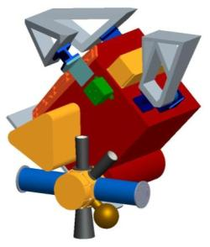
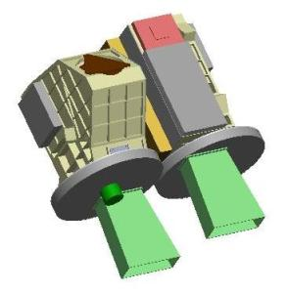
Science Instruments
GNSS
Radio Occultation
Receiver
Infrared (IR) Instrument
Reflected Solar (RS)
Instrument
No GNSS instrument on ISS platform
Sufficient sampling available using Radio Occultation observations on COSMIC-2, GRAS on Metop, ROSA on OceanSat
Refractivity uncertainty 0.03% (k=1) for 5 to 20 km altitude range. (Equivalent to 0.1K (k=3) for temperature
1000 occultations/day
Fourier Transform Spectrometer
Systematic error less than 0.1K (k=3)
200 – 2000 cm⁻¹ contiguous spectral coverage
0.5 cm⁻¹ unapodized spectral resolution
17 km nadir FOV
Mass: 74.8 Kg
Power: 124 W
Two Grating Spectrometers Gimbal-mounted (2-axis)
Systematic error less than 0.3% (k=2) of earth mean reflectance
320 – 2300 nm contiguous spectral coverage
4 nm sampling, 8 nm res
67 km swath
Total Mass: 53.2 Kg
Total Power: 96 W
Small Instruments, Higher Accuracy, On-board Calibration Traceability

Slide 9
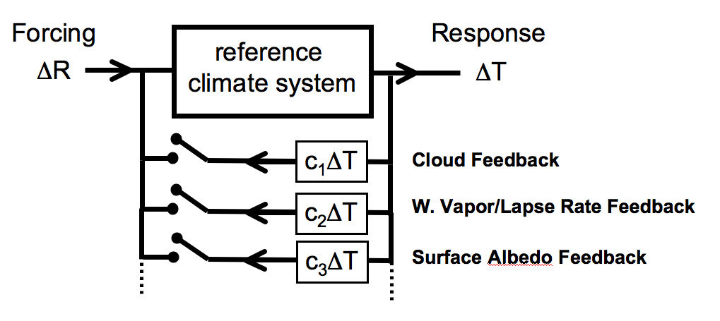
CLARREO Science Value
Climate Forcing, Response, Feedback
Blue = CLARREO Solar Reflected Spectra Science
Red = CLARREO IR spectra
- Temperature
- Water Vapor
- Clouds
- Radiation
- Snow/Ice Cover
Earth's
Climate
Greenhouse Gases
Surface Albedo
Cloud Feedback
Water Vapor/Lapse Rate Feedback
Snow/Ice Albedo Feedback
Roe and Baker, 2007
CLARREO Science Value is in the Accuracy of the Data

Slide 10
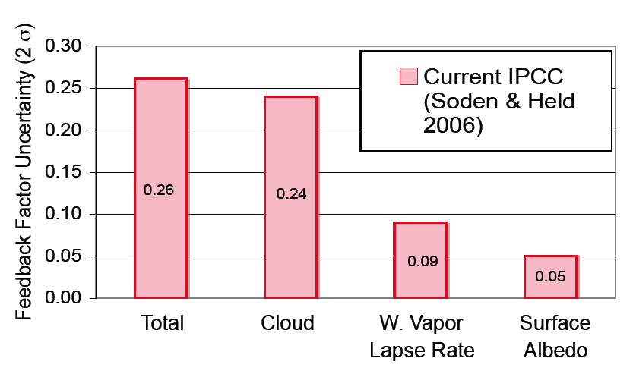
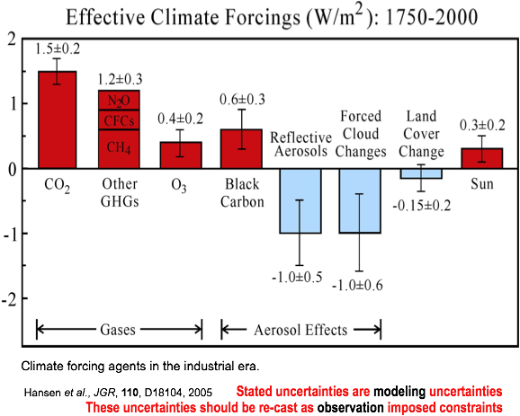
Science Impact
Climate Sensitivity uncertainty is
driven by uncertain Feedbacks:
Factor of 3 uncertainty in response to doubled CO2
Relative uncertainty known
Climate Change Response:
Temperature Profile,
Water Vapor Profile,
Cloud Properties,
Surface albedo (snow, sea-ice, land cover)
Radiative Forcings:
Verify greenhouse gas infrared radiation effects
Aerosols advances by EarthCare, PACE, ACE
0.26
0.24
0.09
0.05
Effective Climate Forcings (W/m²): 1750-2000

Slide 11
Climate Change Uncertainty
Source: U.S. Interagency Memo on the Social Cost of Carbon (2010),
IPCC (2007), and DICE Integrated Assessment Model 2007

Slide 12
Accuracy, Cloud Feedback and
Climate Sensitivity
Climate sensitivity uncertainty (factor of 3) = factor of 9 economic impacts uncertainty.
Climate sensitivity uncertainty ➔ Cloud feedback uncertainty ➔
SW CRF trend uncertainty
Current instruments forced to rely on weaker stability assumptions and data gaps kill climate records.
Current system is high risk and fails to achieve high confidence levels.
CLARREO serves as "NIST in Orbit" to bring this accuracy to both reflected solar instruments like CERES/VIIRS/Landsat as well as infrared instruments such as CrIS/IASI/VIIRS
Climate change requirement is 0.3% absolute accuracy (95% confidence)

Slide 13
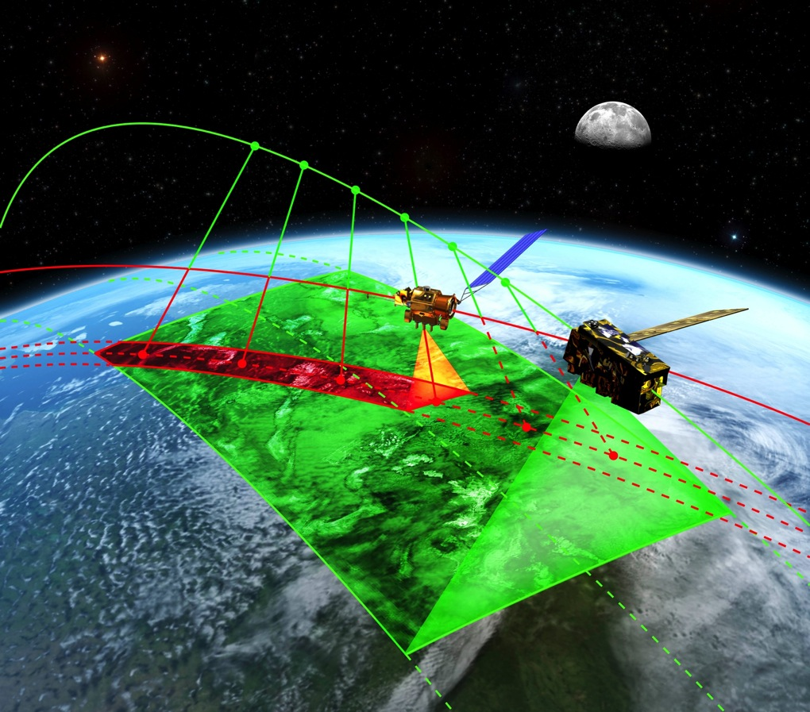
Calibration Reference Spectrometers (IR/RS) for Global Climate, Weather, Land, Ocean Satellite Instruments
Provide spectral, angle,
space, and time matched orbit crossing
observations for all LEO and GEO orbits critical to support reference intercalibration
Endorsed by WMO &
GSICS (letter to Freilich)
Calibrate LEO and GEO
instruments: e.g.
- JPSS: VIIRS, CrIS, CERES
- METOP: IASI, AVHRR
- Landsat, etc land imagers
- Ocean color sensors
- GOES imagers/sounders
- TEMPO geo chemistry
- ESA Sentinel Optical Sensors
CLARREO Provides "NIST in Orbit": Transfer Spectrometers to SI Standards

Slide 14
CLARREO Mission Options
Mission | % of CLARREO MCR Baseline Mission Science | Mission Cost Estimate ($RYM)
Decadal Survey Concept (2007) (11 instruments, 4 spacecraft, 4 launches) | 112% | ~ $1.6B Launches 2017, 2019
MCR Baseline Mission Concept (6 instruments, 4 smaller spacecraft or 2 larger) | 100% | $800 - $1000 + Launch Vehicle(s) Launches 2018, 2020
MCR Minimum Mission Concept (3 instruments, 1 spacecraft, e.g. DAC-4 free flyer) | 62% | $675 - $750 + Launch Vehicle Launch 2021
ISS Mission Concept (2 instruments on ISS, RO is obtained from COSMIC-2) | 73% | $400 - $420 cost includes launch EV-2 ISS full cost guidelines
Cost estimates are full mission cost in real year dollars.
For MCR baseline and minimum mission, launch vehicle not included
ISS is highest science value/cost

Slide 15
Advantages of an ISS Mission
High Science return per dollar spent
  70% of baseline (MCR) mission science value for 1/3 cost of MCR mission
  Reference intercal increases accuracy of entire climate observing system
  Absolute accuracy reduces the need for overlap between successive instruments
  Reduces levels of uncertainty in climate change projections (15-20 years earlier) which leads to large economic benefits (~ $10 Trillion)
  Broad support throughout Science community
  ISS has unique ability to return instruments for calibration verification
Concept is technically credible
  Calibration demonstration breadboards demonstrated the measurement concepts and greatly reduced technical risk
  All Earth Venture proposals of CLARREO-like instruments assessed at TRL 6 or higher; LASP Reflected Solar concept received low risk rating
Concept is feasible and manageable
  Can be implemented within tight fiscal and programmatic constraints
  Applies relevant experience from SAGE III on ISS
  Strong collaboration between Centers

Slide 16
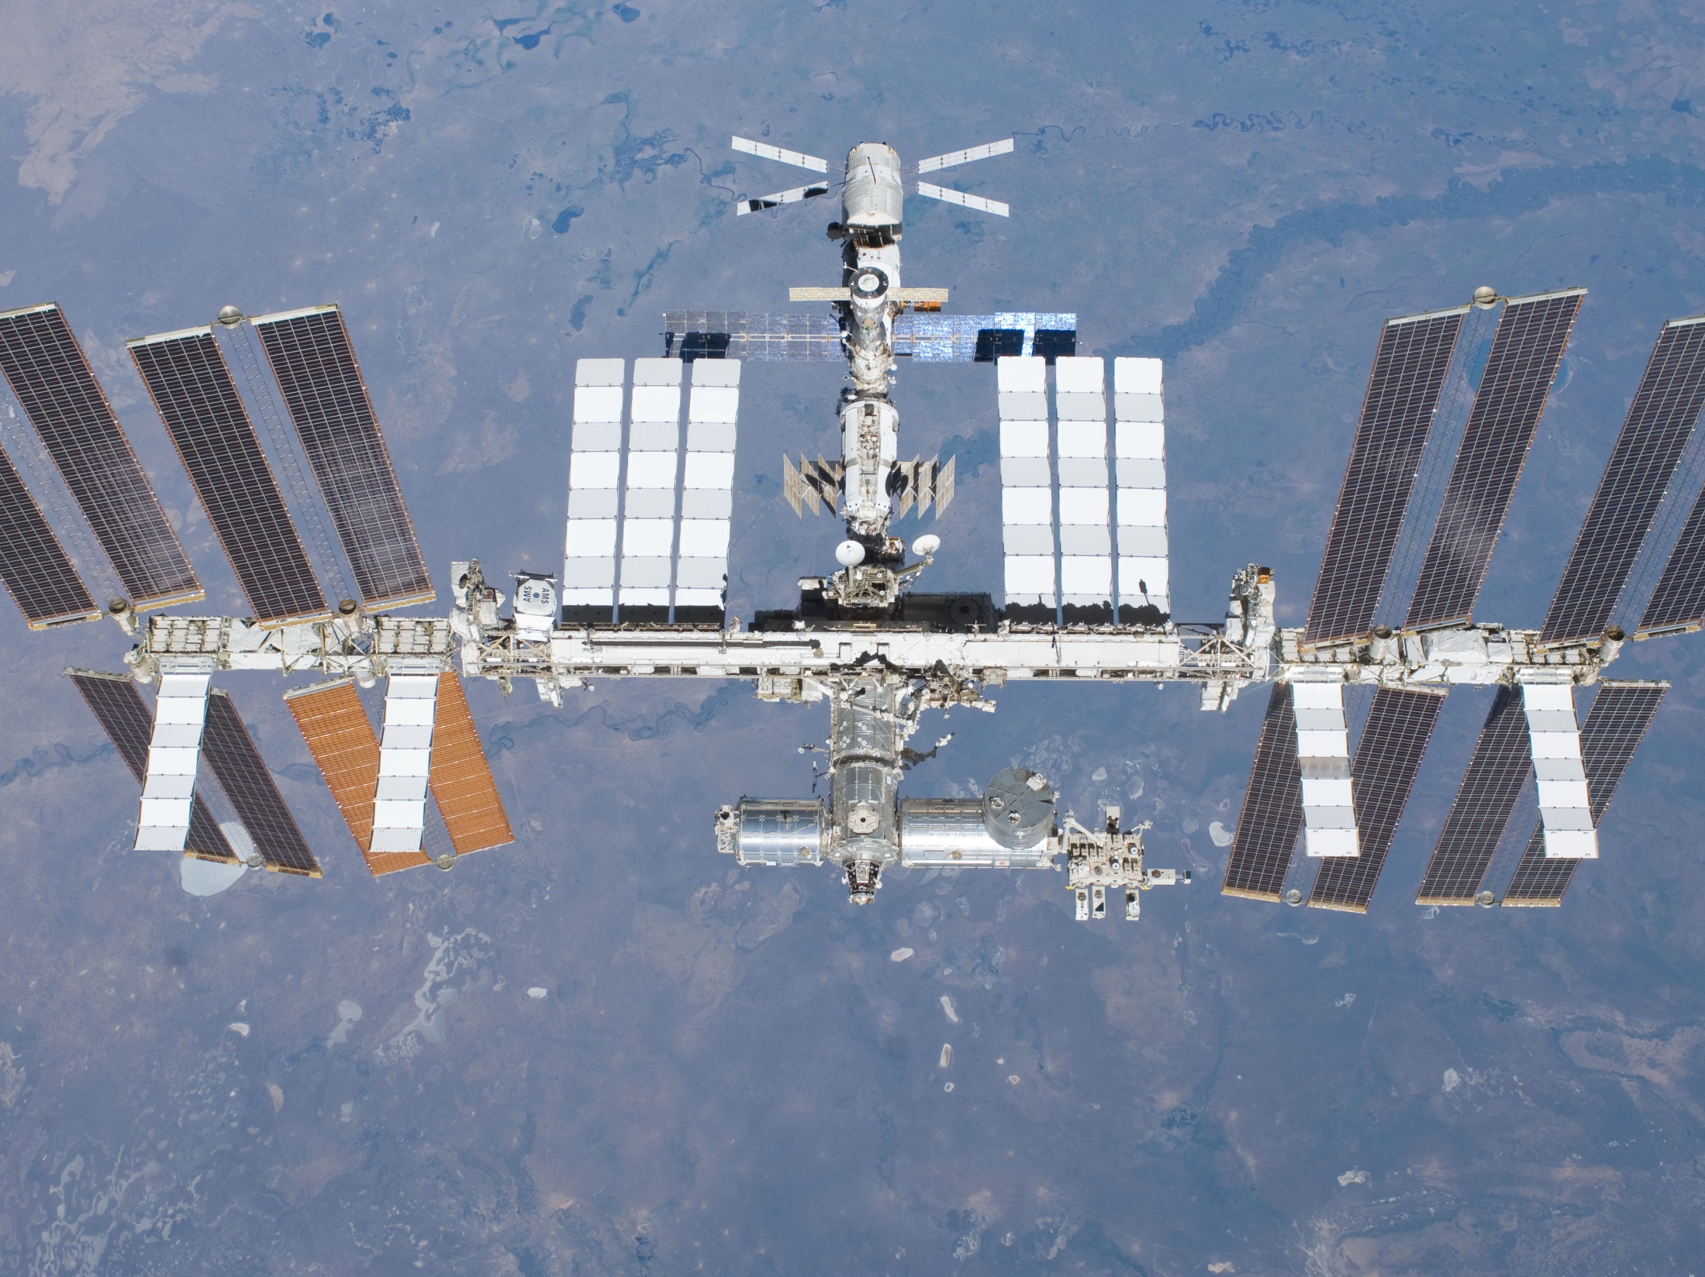

CLARREO on ISS:
Accommodation Feasibility
Barry Dunn
NASA Langley Research Center
Hampton, VA

Slide 17
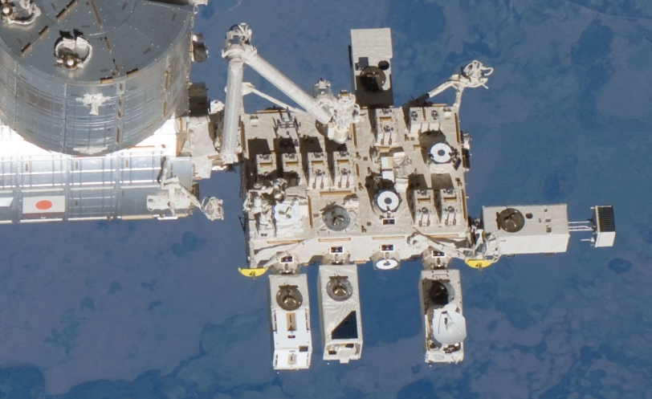

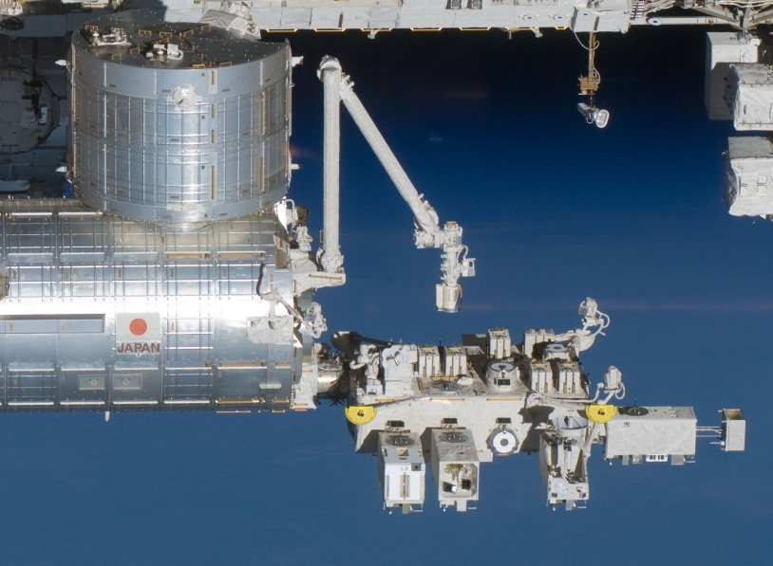
Kibo Module Has Both Pressurized and Exposed Facilities
JAXA provided facility
Modules launched on STS-123, STS-124, and STS-127
Independent communications capability via ICS
JEM Pressurized and Exposed Facilities

Slide 18
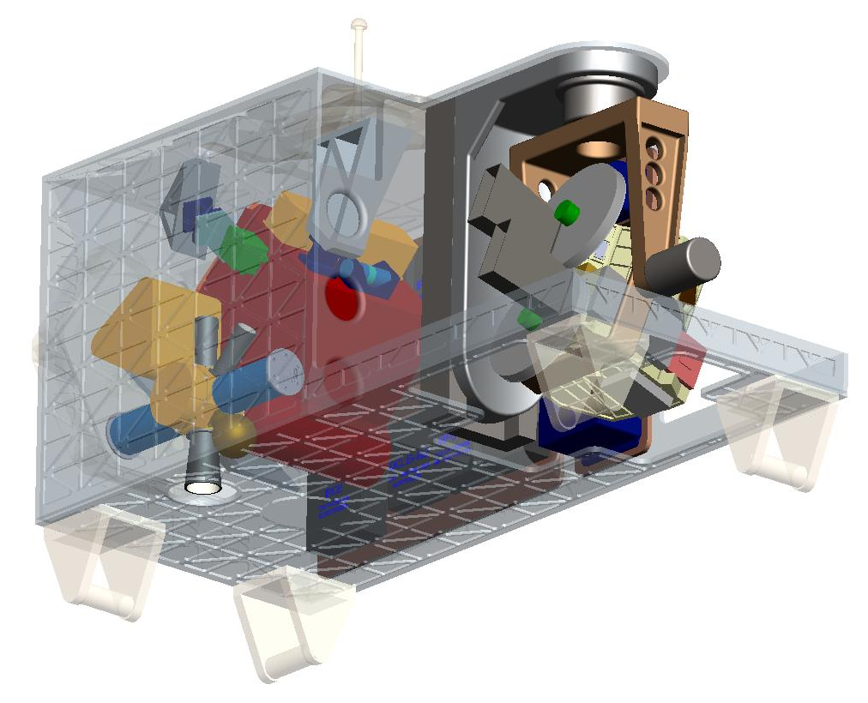
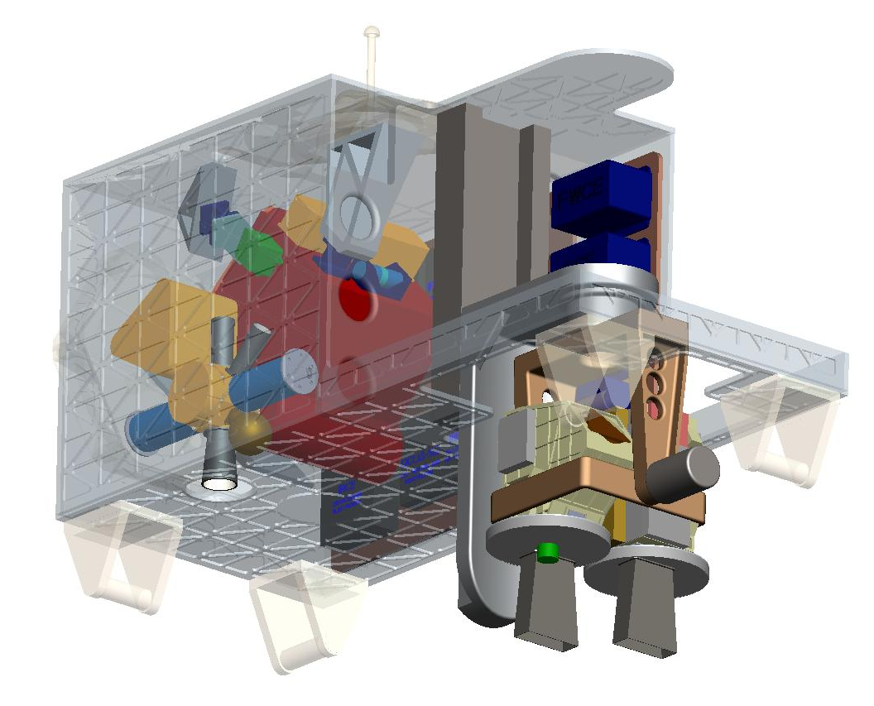
JEM-EF Allows for Deployable Payloads in the Nadir Direction
Due to constraints on maintaining the field-of-view of neighboring ICS payload’s Earth and Sun sensors, the RS cannot deploy through the end (ram deck) but can deploy through the bottom (nadir deck).

Slide 19
CLARREO-ISS Accommodation Compliance Matrix
 | JEM-EF Site Capabilities | CLARREO-ISS Design Summary
Mass | 550 kg (standard site) | ~453 kg with GFE (~20% margin)
Power | 3 kW (standard site) | ~250 W (1100% margin)
Thermal | 3 kW (fluid cooling loop) | ~250 W
Data Rate | 1 Mbps (MIL-STD-1553) 10 Mbps (10 Base-T Ethernet) 43 Mbps (Shared-Negotiated) NTSC Video | ~640 kbps to ~72 Mbps (Highest rate due to RS during solar calibration requires data buffering at the payload)
Data Volume | Negotiable – Up to 1.5 TB | ~90 Gb/day
Volume | 0.8 x 1.0 x 1.85 m | Complies (stowed)

Slide 20
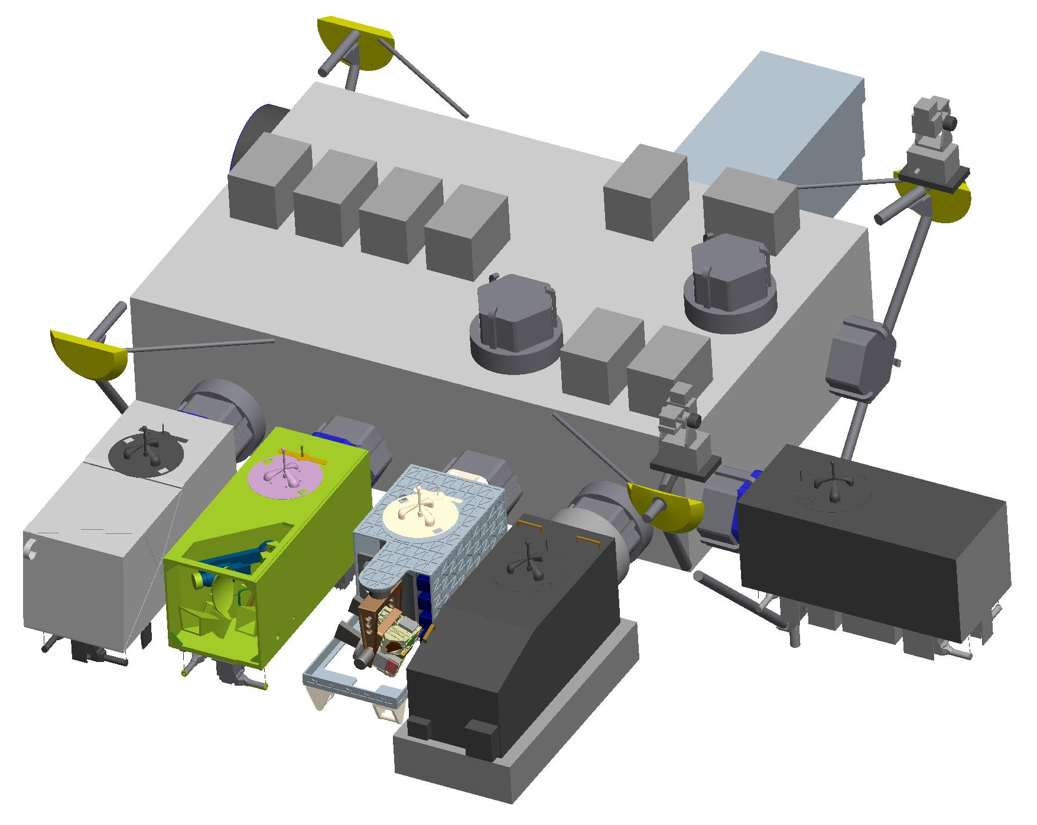
CLARREO-ISS on JEM-EF Configuration
HREP
Port
Ram
Nadir
SEDA
MAXI
SMILES
CLARREO-ISS
ICS-EF

Slide 21
Economic Value of an Advanced Climate Observing System

Slide 22
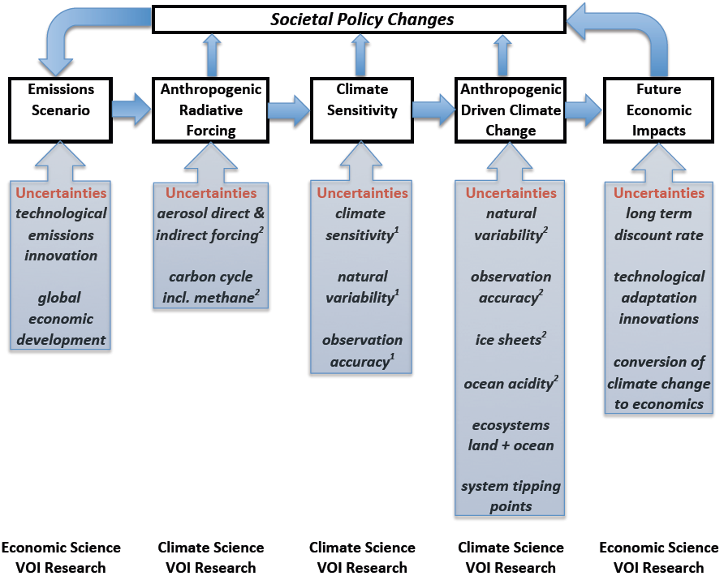
Value of Climate Science Observations
IAMS
IMSCC
CLARREO
Science
IAMS
IMSCC

Slide 23
Value of Information (VOI) Calculation
Global Value of Improved Climate Information
CLARREO Climate Accuracy Framework
Social Cost of Carbon (IMSSC)
Integrated Climate /Economic Model
Current IPCC factor of 3 uncertainty in climate sensitivity = factor of 3² = factor of 9 uncertainty in economic impacts

Slide 24
VOI Calculation
2015
BAU emissions
Assumptions
Discount rate = 3%
Climate Sensitivity = IPCC (2007) uncertainty distribution
2205
SCC = $209 T
Baseline: Business as Usual

Slide 25
VOI Calculation
2015
BAU emissions
2205
SCC = $209 T
Climate Sensitivity = IPCC (2007) uncertainty distribution
Discount rate = 3%
Assumptions
Decision Trigger in 2055
2055
Switch to Reduced Emissions
2205
SCC = $65 T
Current Observing System

Slide 26
VOI Calculation
2015
BAU emissions
2205
SCC = $209 T
Climate Sensitivity = IPCC (2007) uncertainty distribution
Assumptions
Decision Trigger in 2035
Discount rate = 3%
2035
Switch to Reduced Emissions
2205
SCC = $53 T
Improved Accuracy Observing System (2020 launch)
Improved accuracy yields savings of $11.7 T in net present value

Slide 27
Value of Information Summary
Discount Rate | VOI for CLARREO/Improved Climate Observations | Cost of 30 yrs of improved full climate observing system (4X current effort) | Payback Ratio VOI / Obs Improvement Cost
2.5% | $17.6 T | $260B | 65
3% | $11.7 T | $245B | 45
5% | $3.1 T | $200B | 15
All economic values in Net Present Value (NPV) in 2015 U.S. dollars
Even with the most pessimistic discount rate, the return on investment is large: factors of 15 to 65.

Slide 28
Conclusion
  CLARREO has shown it can achieve 70% of science value for 40% of cost by flying as an attached payload on ISS. But still not a commitment by NASA for any launch date sooner than 2022. Earliest possible flight on ISS would be 2019.
  ISS likely to fly until at least 2028. International discussions continue.
  CLARREO Science Definition Team continues to advance CLARREO science:
    Reference intercalibration,
    Spectral fingerprinting of climate change including climate model OSSEs (Observing System Simulation Experiments): IR, RS, and RO (radio occultation)
    Calibration Demonstration Systems at LaRC (IR) and GSFC (RS).
    UW is completing an IIP IR instrument demonstration at CLARREO accuracy.
    CU-LASP is completing an IIP RS instrument demonstration with planned high altitude balloon flight (30 km altitude) in Fall, 2013 to calibrate lunar irradiance.
    NIST continues to work with the CLARREO team on IR and RS standards extensions
  CLARREO continues to collaborate with the international community including GSICS, TRUTHS, FORUM

Slide 29
Questions?

Slide 30
Backups

Slide 31
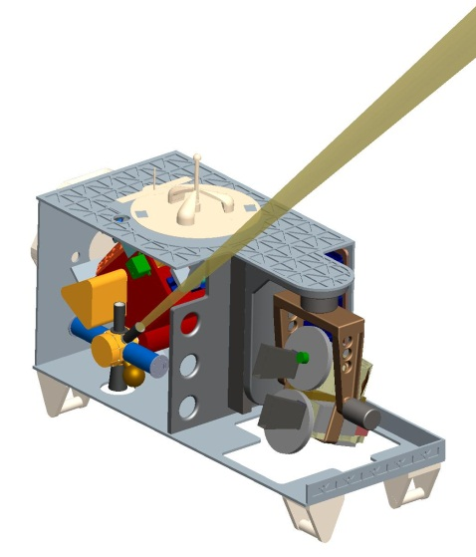
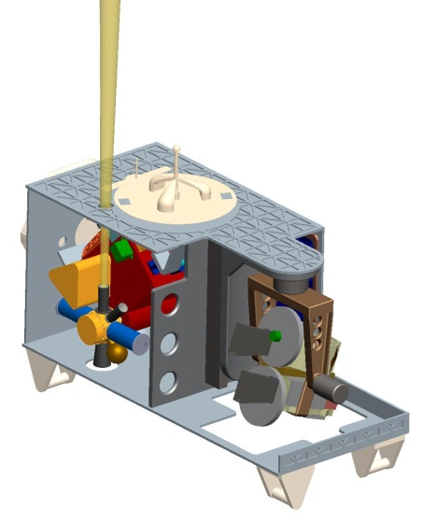
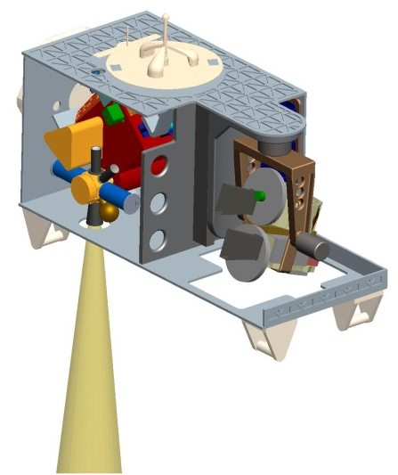
IR Operational Concept Very Similar to Free-Flyer
Port
Nadir (Point-Ahead and Look-Behind for Motion Compensation)
Ram
Nadir
Off-Zenith (Polarization Check)
Zenith (“Cold” Source for Calibration)
**Payload Carrier side removed for clarity
JEM-EF provides unobstructed views for nadir, zenith, and off-zenith collections.
ISS pitch offset from nadir implies an offset of ~4°in the IR mounting interface or in the scene-select mirror zero position.
Error contributions due to ISS roll-yaw offsets needs further evaluation for CLARREO.
An IR-only payload could also function on the opposite (wake) side of JEM-EF.

Slide 32
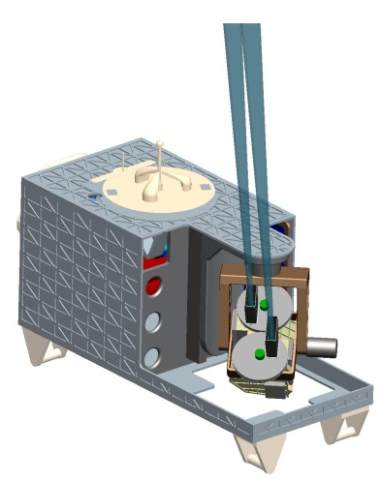
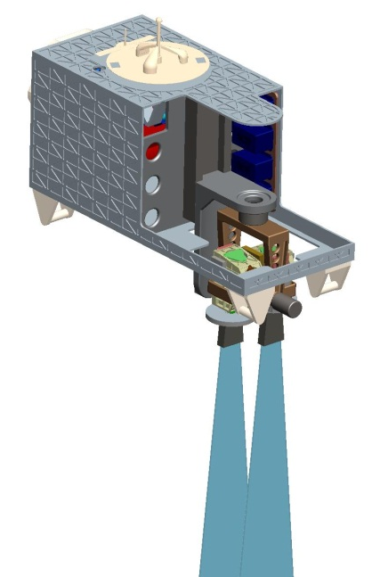
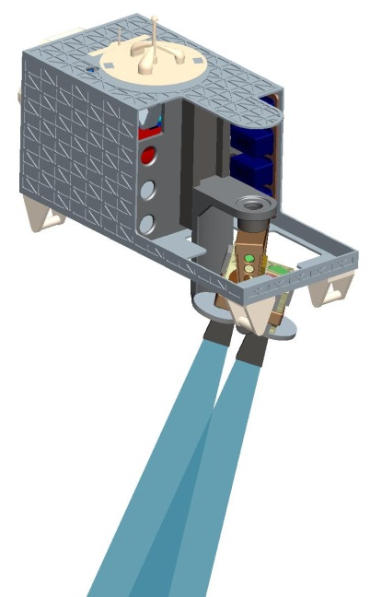
RS Operational Concept Very Similar to Free-Flyer
Nadir Benchmarking
Reference Intercalibration
Solar Calibration – Lunar Verification
Port
Ram
Nadir
NOTE: The deployed position also offers solar calibration capability.
JEM-EF provides predominantly unobstructed views for benchmarking and reference intercalibration with a deployable gimbal-instrument.
Views are more constrictive for solar calibration and lunar verification due to neighboring payloads.
Calibration-verification could be more complex than free-flyer due to timing with solar array positions and ISS roll-pitch-yaw offsets.
IR+RS or RS-only payload probably not viable on the opposite (wake) side of JEM-EF due to additional ISS structure interfering with calibration-verification.

Slide 33
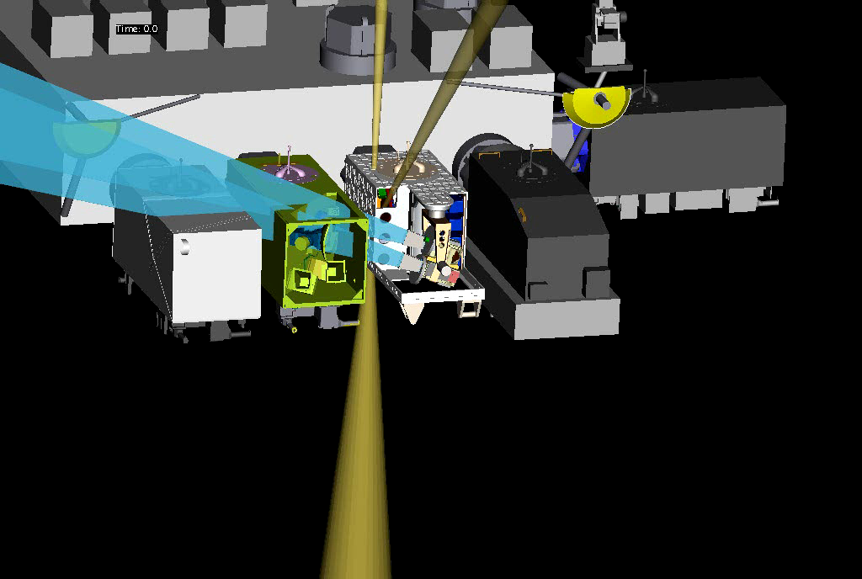
RS Benchmarking-Intercalibration Ops Concept

Slide 34
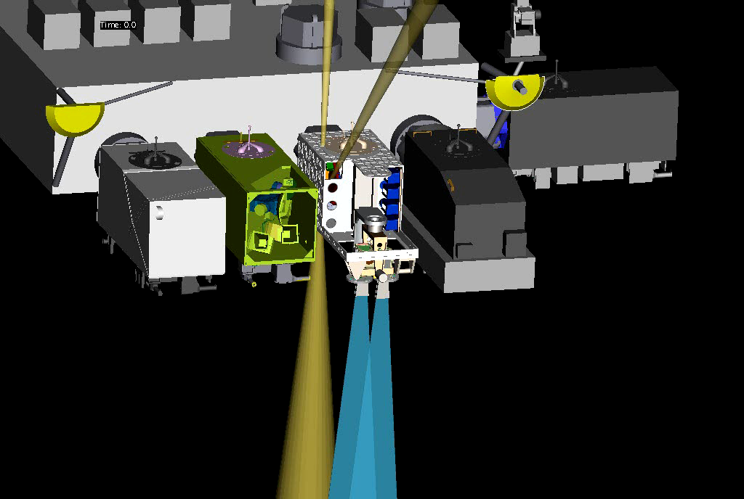
RS Solar Calibration-Lunar Verification Ops Concept

Slide 35
Decadal Change Climate Science
35

Slide 36
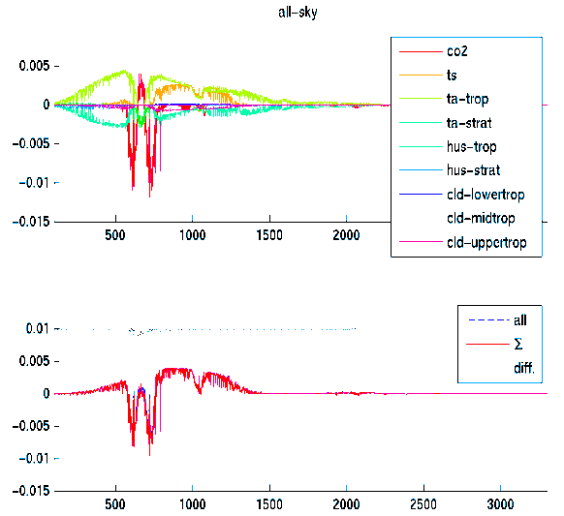
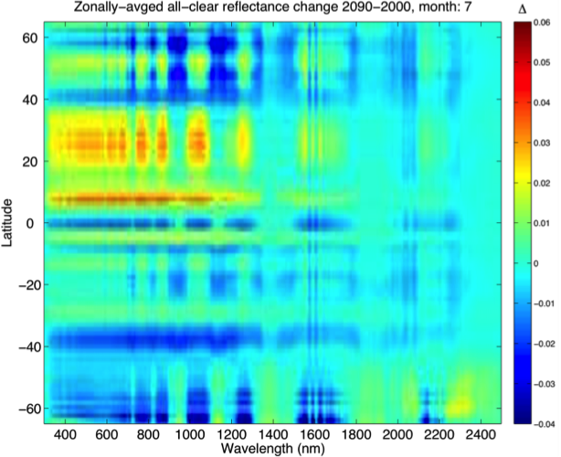
Climate OSSEs-
Observing System Simulation Experiments
Climate modelers were identified by the Decadal Survey as primary data users
OSSEs were begun with 3 modeling groups (GISS, GFDL, U-Cal Berkeley) to determine measurement requirements
Studies include climate change fingerprinting methods using time/space averaged spectral data to define spectral resolution (IR 0.5 cm⁻¹ unapodized, RS 15 nm) & spectral coverage (IR 200 to 2000 cm⁻¹, RS 300 to 2500 nm). 10 journal papers to date.
- Studies by GFDL/ Harvard demonstrate the linearity of all-sky decadal change IR signals
- Eliminates the requirement for global clear-sky observations (Huang and Leroy, 2009)
Studies by U-Cal Berkeley, LASP, and LaRC demonstrate the linearity and information content of the decadal change solar-reflected radiance signals. (Collins & Feldman, 2009)
all-sky

Slide 37
Infrared Accuracy and Climate Trends
IPCC next few decades
temperature trends:
0.16C to 0.34C varying
with climate sensitivity
An uncertainty of half the
magnitude of the trend
is ~ 0.1C. Achieved
15 years earlier with
CLARREO accuracy.
Length of Observed Trend
High accuracy is critical to more rapid understanding of climate change

Slide 38
Accuracy and Climate Trends
Climate Sensitivity Uncertainty
is a factor of 3 (IPCC) which =
a factor of 9 uncertainty in climate
change economic impacts
Climate Sensitivity Uncertainty =
Cloud Feedback Uncertainty =
Low Cloud Feedback =
Changes in SW CRF/decade
(y-axis of figure)
Higher Accuracy Observations =
CLARREO reference intercal of
CERES = narrowed uncertainty
15 to 20 years earlier
High accuracy is critical to more rapid understanding of climate change

Slide 39
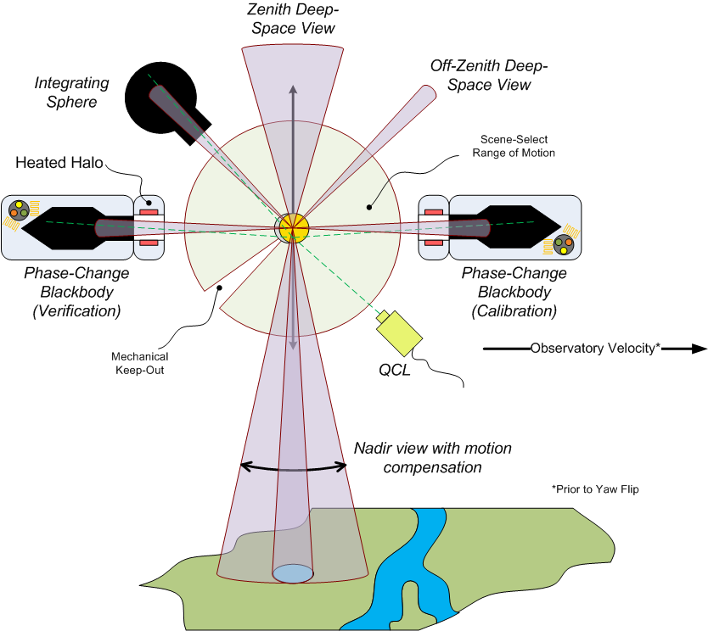
IR On-orbit Verification
Instrument Line
Shape (ILS)
(perpendicular to Beam-splitter polarization axis)
“Ambient” BB
Demonstration instruments:
Univ Wisconsin, NASA LaRC
SI Traceable Accuracy 0.1K (k=3) all Earth Scene Temps (190 to 320K)

Slide 40
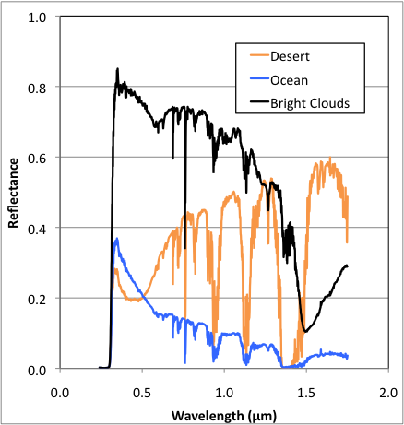
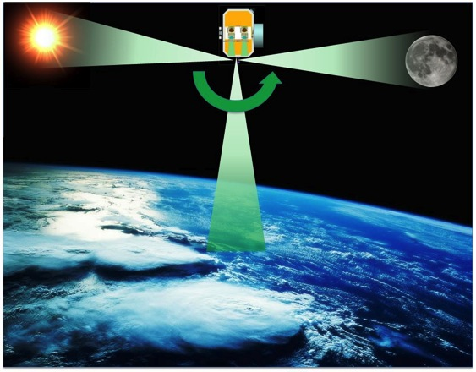
CLARREO Reflected Solar Measurements
  Calibration accuracy attained using the Sun as a calibration reference standard
  Attenuator verification relies on lunar views without attenuator
  Lunar/solar disks and stars used to verify stray light performance
  No scanning mirrors: observe the moon/sun with same optics path as Earth
  Provides reference intercalibration for operational sensors
  Spectral Range 320 – 2300 nm, 8 nm spectral resolution ( 4 nm sampling)
  CU LASP concept (Kopp/Pilewskie) demonstrated with IIP instrument. GSFC CDS
  0.3% with 95% confidence (i.e. k=2)

Slide 41
Societal Benefit | Science Objective | Level 1 Science Requirements | Level 2 Measurement Requirements | Level 2 Mission Requirements
Enable knowledgeable policy decisions based on internationally acknowledged climate measurements and models through: - Observation of high accuracy long-term climate change trends - Use the long term climate change observations to test and improve climate forecasts. | Highly accurate and SI-traceable decadal change observations sensitive to climate radiative forcings, responses, and feedbacks: | CL.PRJ.REQ.1000 - 1005 Verifiable on-orbit accuracy Traceable to SI standards Decadal trends < 20% of perfect observing system 5 yr record, likely overlap 1 yr | CL.SYS.REQ.2000 Accuracy traceable to the relevant standard and maintained throughout the sensors lifecycle. CL.SYS.REQ.2007 and 2008 Calibrated and validated on-orbit with an SI-traceable system | CL.SYS.REQ.2010 Measurements from platforms in polar orbits: Orbit Period: 5812.4 ± 0.25 seconds (609 km ± 200 m) Inclination: 90± 0.1° Eccentricity: ≤0.001 Ground Track Repeat Cycle: 60.83 days (903 distinct paths) Ground Track Error: ±20.0 km cross track at ascending node from target ground track established by the 60.83 day ground track repeat cycle. NOTE Orbit Definition considers science sampling requirements and reference intercalibration requirement
 | Infrared spectra temperature and water vapor feedbacks cloud feedbacks decadal change of: Temperature profiles Water vapor profiles Clouds, radiative fluxes GHG radiative effects | CL.PRJ.REQ.1006 Infrared radiance spectra of the Earth and its atmosphere with: Spectral coverage 200 – 2000 cm⁻¹ Spectral resolution 0.5 cm⁻¹ unapodized Systematic error that corresponds to ≤ 0.1 K radiance calibration uncertainty (k=3) | CL.SYS.REQ.2001 and 2005 Measure the Infrared Spectra: Spectral range 200 – 2000 cm⁻¹ Spectral resolution 0.5 cm⁻¹ unapodized GIFOV no less than 25 km Ground sampling interval no greater than 200 Systematic error ≤ 0.100 Kelvin (k=3)
 | Solar reflected spectra cloud feedbacks snow/ice albedo feedbacks decadal change of: Clouds Radiative fluxes Snow cover, sea ice, land use | CL.PRJ.REQ.1007 Solar spectral reflectance of the Earth and its atmosphere relative to the solar irradiance spectrum with: Spectral coverage 320 to 2300 nm Spectral resolution (8 nm) Absolute uncertainty ≤ 0.3% relative to global mean reflected solar energy (k=2) | CL.SYS.REQ.2002 and 2006 Measure the Solar Reflected Spectra: Spectral range 320 – 2300 nm Spectral sampling 4 nm, resolution 8 nm GIFOV ≤0.5 km by 0.5 km in nadir view SNR > 33 for 380 to 900 nm, >20 elsewhere, for 0.3 reflectance, solar zenith angle 75° Swath width ≥ 100 km Polariz. sens.<0.5% (k=2) <1000nm, else <0.75% (k=2) >1000nm, Radiometric calibration uncertainty ≤0.3% of albedo and within individual bands Angle variation <25%, knowledge <10% IFOV Geolocation knowledge <1 km on ground Match RI sensors’ view <5 min and <1 deg
 |  |  |  | CL.SYS.REQ.2100 Observations made from Earth orbiting observatories
 | GNSS-RO decadal change of temperature profiles | CL.PRJ.REQ.1008 Atmospheric refractivity with: Annual means in 10º latitude zones Uncertainty of 0.03% (k=1) for 5-20 km altitude in these zones | CL.SYS.REQ.2003 Measure the phase delay rate of GNSS transmitted signal occulted by the atmosphere: Altitudes 5-20 km Uncertainty ≤0.5 mm/sec CL.SYS.REQ.2004 Measure averaged microwave refractivity: Over 1 year 10° latitudinal zones, over all longitudes, Altitudes 5–20 km Uncertainty ≤0.03% in these zones
 |  |  |  | CL.SYS.REQ.2103 Consumables for 5 years
 | Reference inter-calibration Broadband CERES Operational sounders (e.g. CrIS, IASI) Operational imagers (e.g. VIIRS, AVHRR, Landsat) | CL.PRJ.1.REQ.1009 Provide data to climate relevant operational sensors that will be used to improve the accuracy of their measurements.

