Slide 1
JMA GPRC Report
Masaya Takahashi
Meteorological Satellite Center/
Japan Meteorological Agency

Slide 2
Contents
Events since the last Joint meeting @ Beijing
Member change
Back up operation by MTSAT-1R
GSICS correction for Infrared channel
Format change GSICS Correction for MTSAT infrared channels
Uncertainty analysis
Visible vicarious channel calibration using RTM
For Pre-MODIS era
Himawari-8/9: Next generation JMA’s geostationary satellites
Overview
NRT distribution of both the operational and corrected calibration information

Slide 3
Events since the last Joint meeting @ Beijing
Member change
New members
Masaya Takahashi: GRWG, contact person JMA GPRC
Tetsuro Kurita: GDWG
Previous members
Arata Okuyama
Yuki Kosaka

Slide 4
Events since the last Joint meeting @ Beijing
Back up operation by MTSAT-1R
October to December 2012:
JMA conducted a maintenance of the MTSAT’s ground system. During the system maintenance, 18 October to 26 December, MTSAT-1R was brought back into meteorological observation.
Observation schedule: http://mscweb.kishou.go.jp/operation/status/mtsat.htm
This event is planned every year in the same season.
MTSAT-2 IR1(10.8um) TB Bias monitoring

Slide 5
GSICS correction for infrared channel
Current status of MTSAT-1R/-2 IR GSICS correction
Demonstration phase, started in July 2010
Reference sensor: Metop-A/IASI and Aqua/AIRS
Toward the implements to Pre-Operational phase
Additions and modifications to the netCDF conventions
data disclaimer statement, id, …:
According to the netCDF template
Tb/Radiance conversion formulas:
To meet the requirement of bias plotting tool
Combine of NRTC files: Will be done by this March
Uncertainty evaluation: see tomorrow’s GRWG session

Slide 6
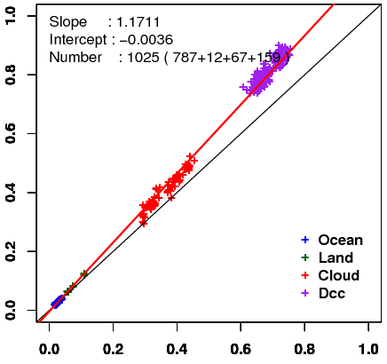
Visible vicarious channel calibration using RTM (Details will be talked on Thursday)
Method: Comparison of observed and simulated radiance for some targets
Target: Wide range of TBB in order to obtain reliable regression line
Cloud-free ocean, Cloud-free land, Liquid water cloud, DCC
Radiative transfer calculation:
RSTAR (Nakajima and Tanaka [1986,1988])
Input data: Independent from GEO data
JMA Re-Analysis atmos. profiles, MODIS L1B, BRDF, Aura/OMI total column ozone, …
Result of MTSAT-2 in Feb. 2011
Simulated reflectivity
Observed reflectivity
Expansion to the pre-MODIS era and near infrared channels of Himawari-8/-9
This work have been done as part of a research program conducted in collaboration with the University of Tokyo, the visible channel calibrations of GMS and MTSAT satellites.

Slide 7
Himawari-8/9: Next generation JMA’s geostationary satellites
Advanced Himawari Imager (AHI)
Band | Central Wavelength [μｍ] | Spatial Resolution
1 | 0.43 - 0.48 | 1Km
2 | 0.50 - 0.52 | 1Km
3 | 0.63 - 0.66 | 0.5Km
4 | 0.85 - 0.87 | 1Km
5 | 1.60 - 1.62 | 2Km
6 | 2.25 - 2.27 | 2Km
7 | 3.74 - 3.96 | 2Km
8 | 6.06 - 6.43 | 2Km
9 | 6.89 - 7.01 | 2Km
10 | 7.26 - 7.43 | 2Km
11 | 8.44 - 8.76 | 2Km
12 | 9.54 - 9.72 | 2Km
13 | 10.3 - 10.6 | 2Km
14 | 11.1- 11.3 | 2Km
15 | 12.2 - 12.5 | 2Km
16 | 13.2 - 13.4 | 2Km
“Himawari”: a nickname of JMA’s GEO satellites, meaning sunflower in Japanese
JMA plans to launch Himawari-8 in 2014 and begin its operation in 2015. The launch of Himawari-9 is also planned in 2016.
AHI (Advanced Himawari Imager) has 16 bands
10 minutes for full disk observation, 2.5 minutes around Japan
●
●
●
NIR
●
●
●
as of MTSAT-1R/2
●
Band | Central Wavelength [μｍ] | Spatial Resolution
1 | 0.55 – 0.90 | 1Km
2 | 3.50 – 4.00 | 4Km
3 | 6.50- 7.00 | 4Km
4 | 10.3 – 11.3 | 4Km
5 | 11.5 – 12.5 | 4Km
●
●
●
●: MSG
●

Slide 8
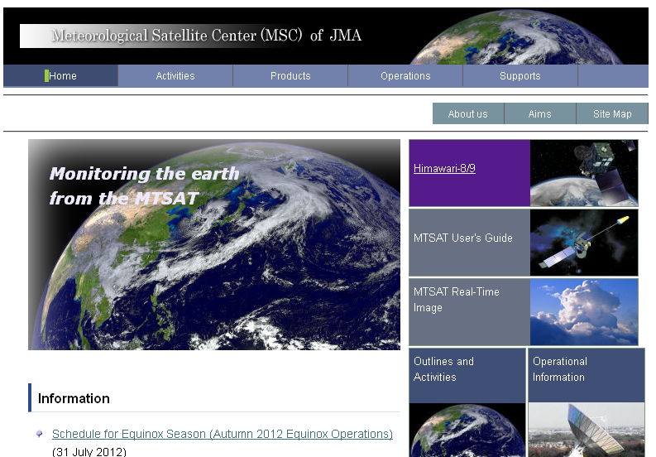
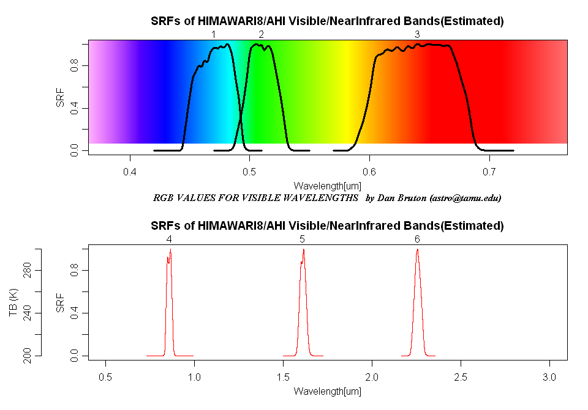
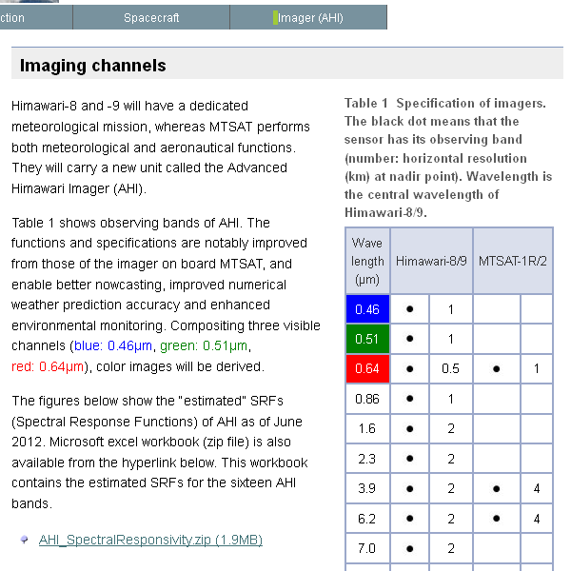
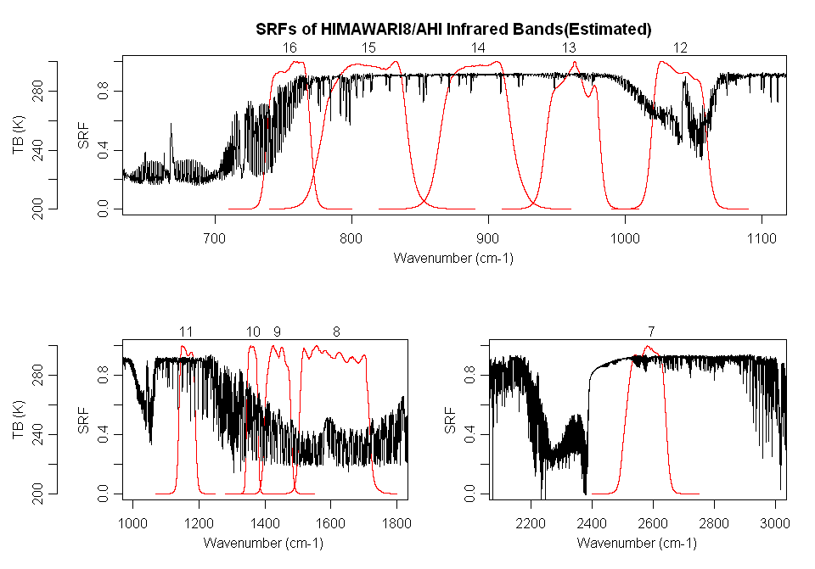
MSC web page for Himawari-8/9 information including “AHI SRFs (Spectral Response Functions)”
http://mscweb.kishou.go.jp/
Himawari-8/9 information web page opened at MSC website
“engineering” SRFs of AHI are available
(1) Click a link: “Himawari-8/9”
(2) Click a link:
“Imager (AHI)”
(3) You can get
“AHI SRFs”

Slide 9
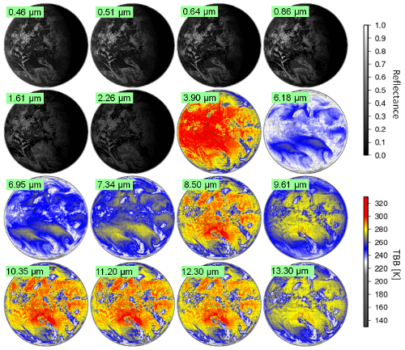
Simulated AHI images for new products development
To support the development of Himawari-8/9 products such as AMV, SST and aerosol, simulated satellite images are necessary.
a
Radiance for each AHI band is calculated by using RTM with JMA NWP and some LEO satellites data.
a
Sample simulation data have been made public for use in AHI research and development on the website.
RT simulated images for Himawari-8/9’s 16 AHI bands
Configuration for RT Simulation
RT Model | RSTAR (Nakajima and Tanaka, 1986)
NWP | JMA GSM (horizontal resolution: 20km)
Surface Parameters | Wind: JMA GSM Albedo: MODIS MOD09

Slide 10
NRT distribution of both the operational and corrected calibration information
Action EP-12.05: “Each GPRC to consider implementing the near real time
distribution of both the operational calibration information and the
corrected calibration information, as part of the L1 data formats”
For MTSAT : Difficult to include it
For Himawari-8/-9: Now under consideration
Tentative plan of calibration information included in Himawari-8/-9 NRT provision data
Correction coefficients against one reference sensor
Coefficients used in a conversion of TBB/radiance
Window period to be used in a regression
Ancillary information (text block)
Calibration method, reference sensor name, …

Slide 11
Summary and future plan
Annual back up operation by MTSAT-1R
From October to December, 2012
Works to move MTSAT IR correction into Pre-operational phase
Visible vicarious calibration
Himawari-8/9
Information of GSICS correction will be included in NRT distribution.
Calibration method for visible channel will be expanded to the NIR channel.
GMS-5 Re-calibration
Planned in the framework of SCOPE-CM phase2 project: “Inter-Calibration”.
JMA’s GSICS products timeline (found on GSICS wiki)

Slide 12
Backup slides

Slide 13
A Sequence of Himawari-8/9 AHI Observation in 10 minutes Time Frame
Full Disk Observation
in every 10 min.
Over Japan (1)
every 2.5 min.
Over Japan (2)
every 2.5 min.
Typhoon monitoring
every 2.5 min.
Land-mark
extraction (1)
every 30 sec.
Land-mark
extraction (2)
every 30 sec.
A combination of one "Full Disk" and "small sectored" Imagery in 10 minutes

