Slide 1
GSICS Annual Meeting(Williamsburg, Virginia / 2013. 3. 4-8)
KMA GPRC Report
Dohyeong KIM
Ho-Seung LEE
Won-Seok LEE
Tae-Hyeong OH
Sunmi NA
National Meteorological Satellite Center
Korea Meteorological Administration
sunmi@kma.go.kr
Notes:
Good afternoon, everyone. I am Sunmi Na. I am working with National Meteorological Satellite Center, Korea Meteorological Administration in Republic of Korea. I am going to talk about the KMA GPRC report.

Slide 2
Current Status of KMA
Notes:
At first, I am going to talk about the current status of KMA.

Slide 3
GSICS Activity of KMA
Infrared channel
Install GSICS GEO-LEO Inter-calibration system
Operate IR calibration system with COMS/MI & Metop-A/IASI data
Visible channel
Install vicarious calibration system using target (moon/desert/ocean/cloud)
Test with target data since 2011
GSICS Webpage
Display GSICS COMS & AIRS/IASI IR Inter-calibration results
RE-Calibration
Re-calibrate COMS SST using GSICS IR calibration coefficients
Notes:
This is the GSICS activity of KMA.
For infrared channel calibration, KMA has installed GSICS GEO-LEO inter-calibration system. And KMA has operated IR calibration system with COMS/MI and Metop-A/IASI data.
For visible channel calibration, KMA has installed vicarious calibration system using target such as moon, desert, ocean, and cloud. And KMA has tested target data since 2011.
For GSICS webpage, KMA has displayed GSICS COMS and AIRS/IASI IR intercalibration results.
In addition, KMA has analyzed COMS sea surface temperature using GSICS IR calibration coefficients.

Slide 4
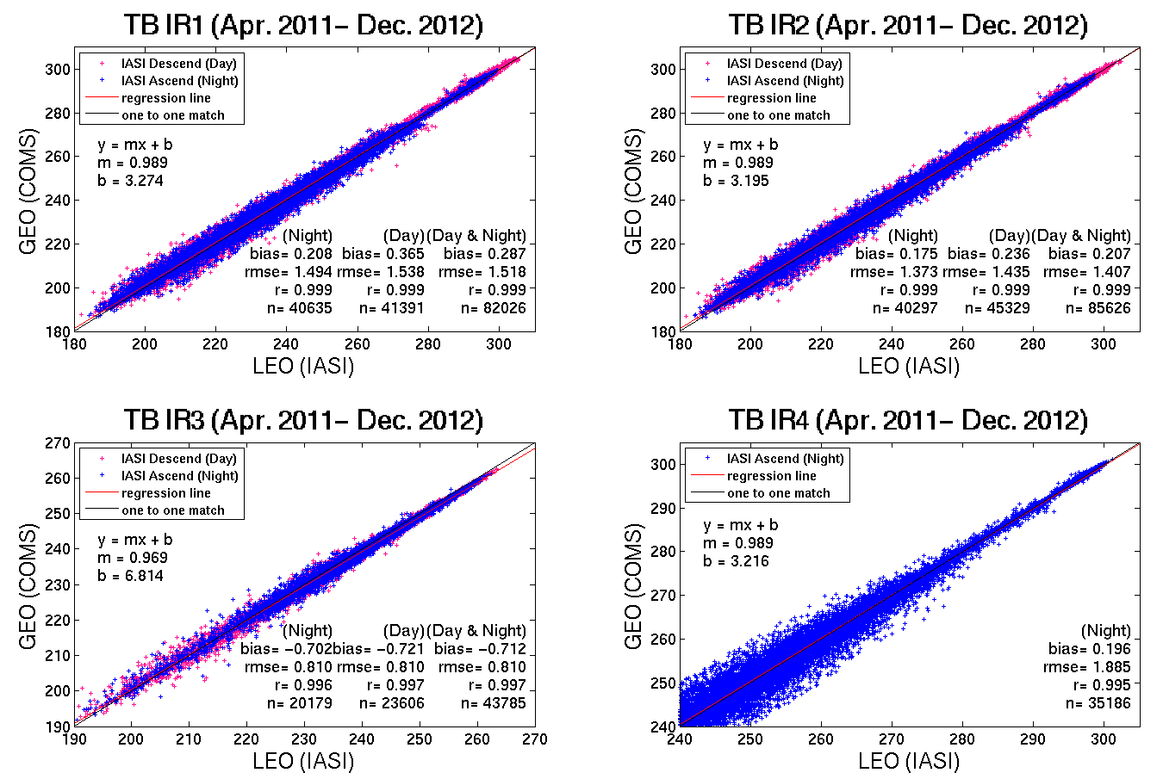
IR Results (1/2)
10.8um
12.0um
6.8um
3.8um
Notes:
This is the IR results.
KMA has compared COMS MI with IASI TB from April 2011 to December 2012.
The x axis is IASI brightness temperature and the y axis is COMS MI brightness temperature.
Blue dots are IASI ascending mode and red dots are IASI descending mode.
For IR4 band (shortwave IR), considering the solar radiance, we used only the night-time data.
Day & night bias for IR1 is 0.28K. IR2 is 0.2K. IR3 is -0.7K and IR4 is 0.2K.
All of Regression coefficient is about 0.99.

Slide 5
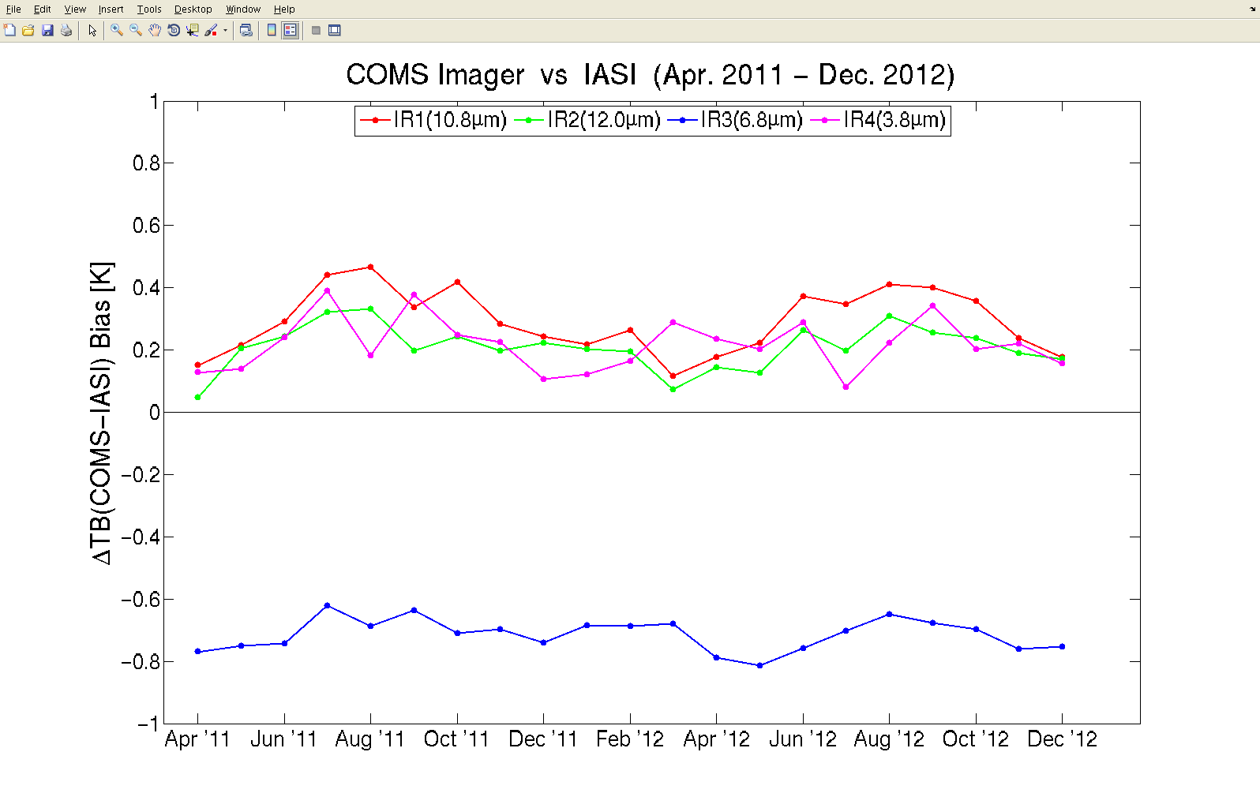
IR Results (2/2)
There is positive bias in IR1 & IR2 & IR4, while negative bias in IR3.
Bias is less than 0.5K except WV channel(0.7K).
Notes:
This is time series of brightness temperature difference between COMS MI and IASI.
The x axis is time from April 2011 to December 2012 and the y axis is delta brightness temperature.
Red line is IR1, green line is IR2, blue line is IR3, and pink line is IR4.
There is positive bias in IR1, IR2 and IR3, while there is negative bias in IR3.
All biases are less than 0.5K except water vapor channel.

Slide 6
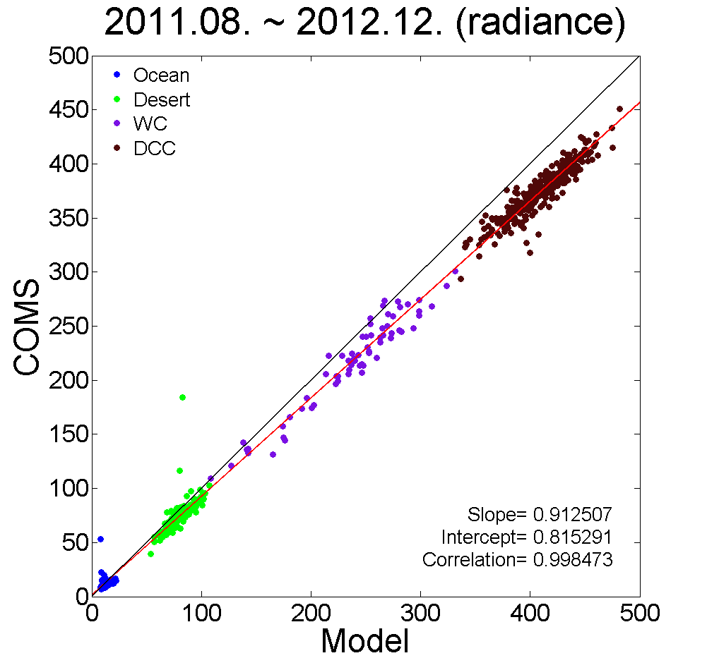
VIS Results (1/2)
(W·m⁻²·sr⁻¹ ·μm⁻¹)
Notes:
This is the radiance comparison with ocean, desert, water cloud, deep convective cloud target. (→ pointing legend box)
X axis is simulated radiance, y axis is observation radiance.
The regression coefficient is 0.99 from August 2011 to December 2012.

Slide 7
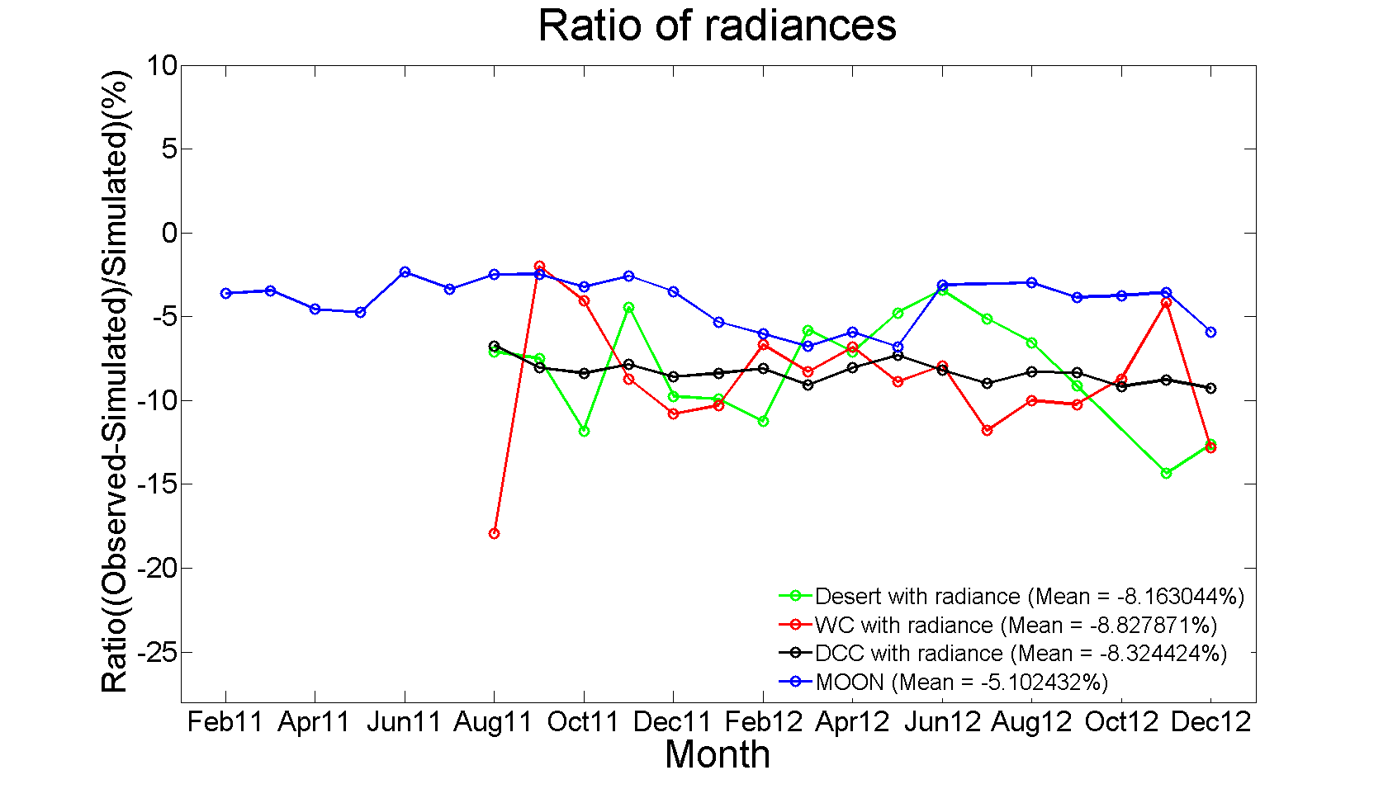
VIS Results (2/2)
Ratio mean value with desert/cloud/moon target is between -5 and -9 from February 2011 to December 2012.
Notes:
This is the results of visible channel vicarious calibration using moon, desert, water cloud, deep convective cloud targets.(→ pointing legend box)
X axis is month, y axis is the ratio of radiance.
Blue line is moon, black line is DCC, red line is water cloud, green line is desert.
For moon target, y axis means the ratio of irradiance.
Ratio mean value with desert,, cloud, moon is between -5 and -9 from February 2011 to December 2012.

Slide 8
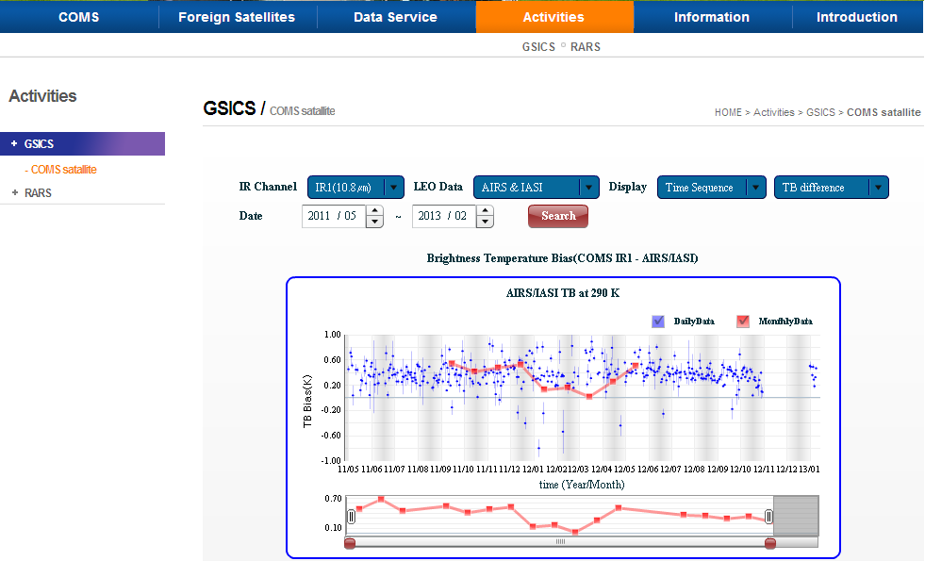
GSICS Webpage of KMA
http://nmsc.kma.go.kr/html/homepage/en/testoperate/gsicsIR.do
Time sequence (TB difference)
Regression coefficients between COMS radiance and IASI radiance
Scatter plot (COMS rad. vs. IASI rad. and IASI TB – COMS TB)
Notes:
KMA has provided the GSICS activity via the following NMSC website address. (→ pointing homepage address box)
You can find the time sequence, regression coefficients between COMS radiance and IASI radiance, scatter plot on our website in near real time.

Slide 9
RE-Calibration (1/3)
How to recalibrate COMS SST using GSICS IR calibration coefficient
IR
IR’
Used Data
COMS/MI Level 1B data
Period: 2011.04. ~ 2012.03.
Equation: Y_{λ} = aX_{λ} + b
GSICS IR Calibration Coefficient
 | a | b
IR1 (10.8㎛) | 1.008 | -2.439
IR2 (12.0㎛) | 1.007 | -1.350
IR3 (6.8㎛) | 1.022 | -5.552
IR4 (3.8㎛) | 1.000 | 0.232
X_{λ} : COMS TBB before calibration
Y_{λ} : COMS TBB after calibration
a, b : calibration coefficient
λ : wavelength
SST
SST’
MCSST45 = C1∙T_{11㎛} + C2∙(T_{11㎛}-T_{12㎛}) + C3∙(T_{11㎛}-T_{12㎛}) ∙(sec(θ)-1) + C4
 | Day Time |  | Night Time
 | C | C’ | C | C’
c1 | 0.985098 | 0.984 | 0.975640 | 0.979
c2 | 2.338343 | 2.547 | 2.496965 | 2.415
c3 | 0.545135 | 0.413 | 0.353631 | 0.484
c4 | -0.321399 | 0.964 | -0.031189 | 2.040
Notes:
This is about the COMS sea surface temperature using GSICS IR calibration coefficient.
We used COMS/MI level 1B data from April 2011 to March 2012.
And it applied to equation with GSICS IR calibration coefficient. (→ pointing table)
We recalibrate SST using MCSST equation with the new constant.

Slide 10
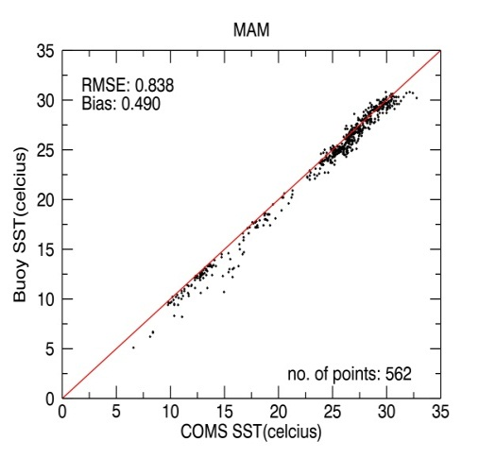
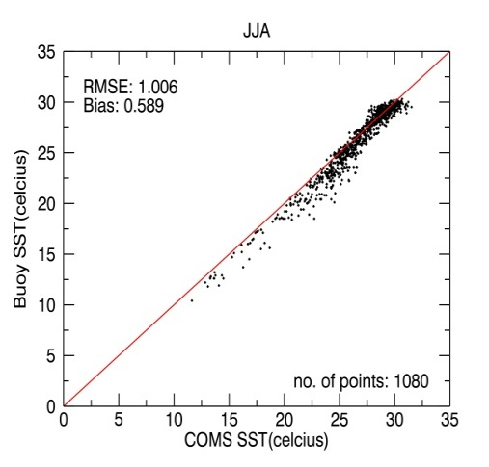
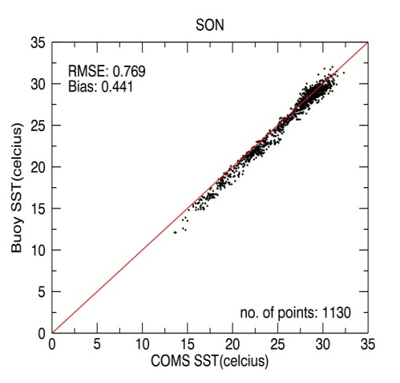
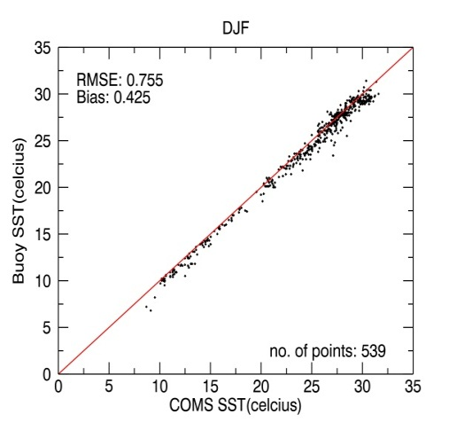
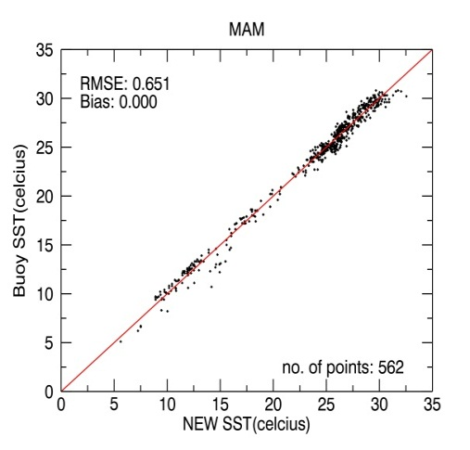
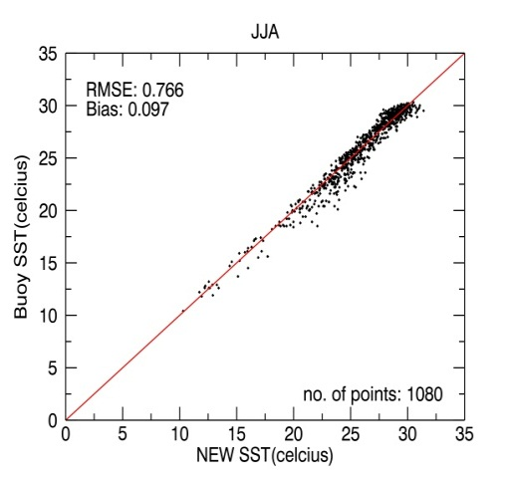
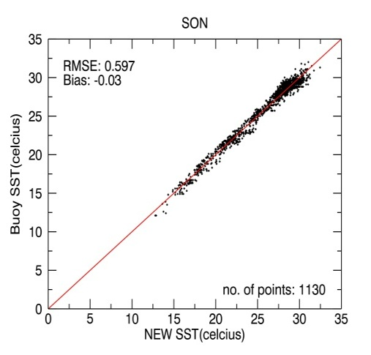
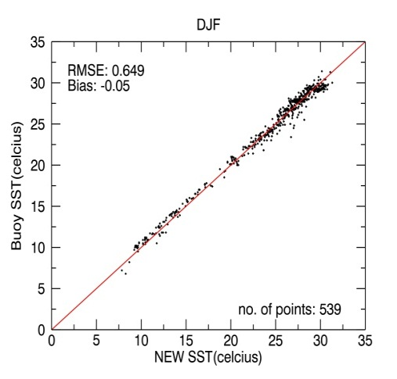
RE-Calibration (2/3)
Comparison of recalibrated SST with buoy SST for day time
SST
Before recal.
MAM
JJA
SON
DJF
SST’
After recal.
For day, the averaged RMSE & bias of SST are 0.86 & 0.49, and those of SST’ are 0.67 & 0.01.
Notes:
This is the results of recalibrated SST for 1-year.
X axis is COMS SST, y axis is buoy SST. (→ pointing graph)
Top graph is SST before recalibration, bottom graph is SST after recalibration.
For day time, the averaged RMSE and bias of SST are 0.86 and 0.49, and those of SST’ are 0.67 and 0.01.

Slide 11
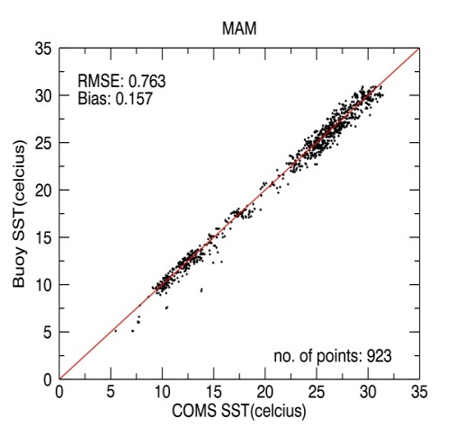
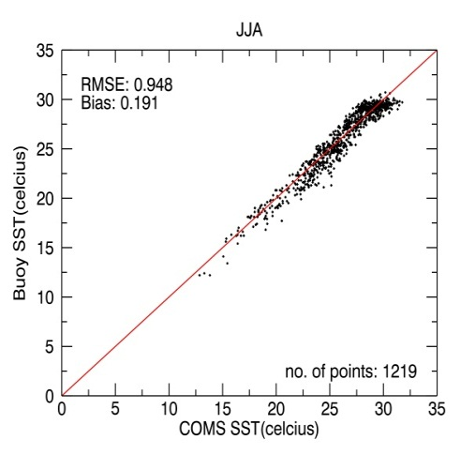
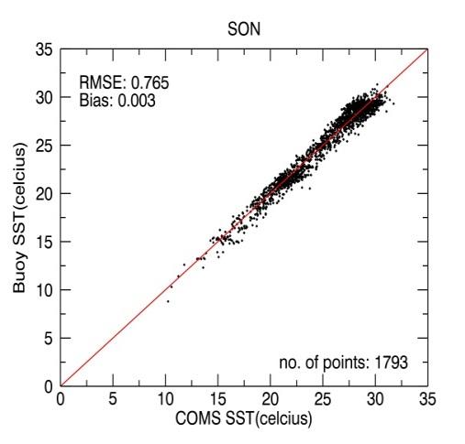
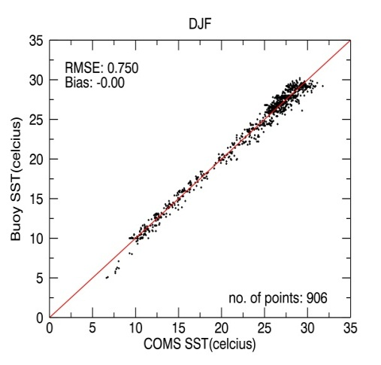
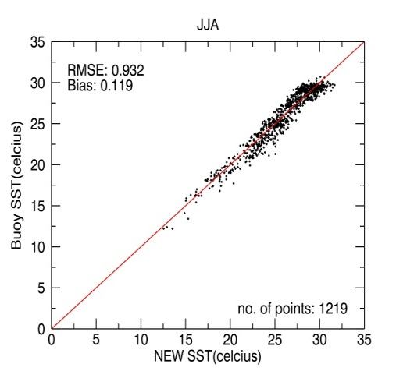
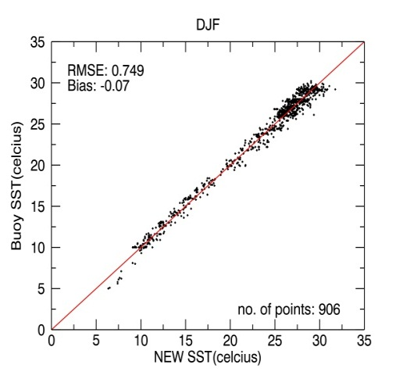
RE-Calibration (3/3)
Comparison of recalibrated SST with buoy SST for night time
SST
Before recal.
MAM
JJA
SON
DJF
SST’
After recal.
For night, the averaged RMSE & bias of SST are 0.81 & 0.08, and those of SST’ are 0.80 & 0.004.
Notes:
This shows the comparison of recalibrated SST with buoy SST for night time.
For night time, the averaged RMSE and bias of SST are 0.81 and 0.08, and those of SST’ are 0.80 and 0.004.

Slide 12
Future Plan of KMA
Notes:
Let me move on the future plan of KMA.

Slide 13
Further Research
Infrared Channel
To further study COMS vs. IASI for WV channel
To inter-calibrate COMS vs. MTSAT2
Visible Channel
To further study trend of ratio using moon/ocean/desert/cloud targets
GSICS Webpage
To display the visible calibration results
RE-Calibration
To analyze the long-term trend of recalibrated SST using GSICS IR coefficients
Notes:
We will further study COMS and IASI intercalibration for water vapor channel.
For infrared channel, we will inter-calibrate COMS and MTSAT2.
For visible channel, we will further study trend of ratio using moon, ocean, desert, cloud targets.
For GSICS webpage, we will display the visible calibration results.
For re-calibration, we will analyze the long-term trend of recalibrated SST using GSICS IR coefficients.

Slide 14
Thank you

Slide 15
Back-up slides

Slide 16
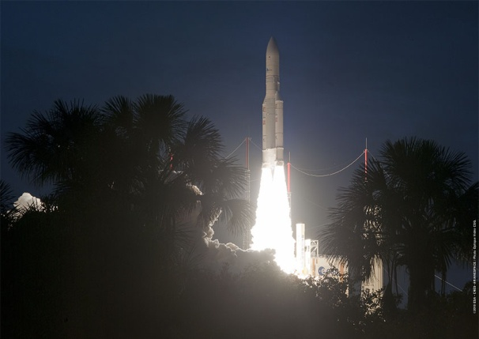
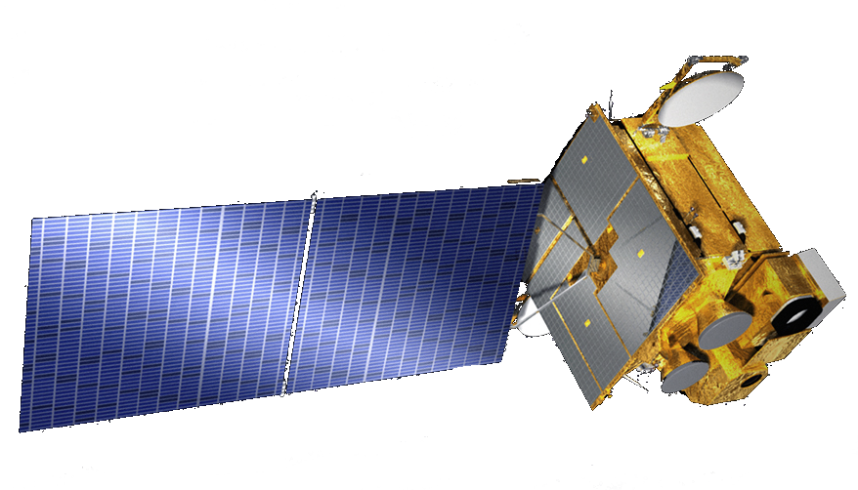
COMS
Communication, Ocean, and Meteorological Satellite (COMS)
8-year program (2003 – 2010)
Launch date : June 26, 2010 (French Guiana Kourou)
Location : 128.2E
Mass : 2,500kg
Design life time : 7 years
Contractor : EADS Astrium (ITT for MI)
S-/L-/Ka-Band Comm
Solar array
channel | Wave length(㎛)
Visible | 0.67
Shortwave IR(IR4) | 3.7
Water Vapor(IR3) | 6.7
IR1 | 10.8
IR2 | 12.0
Meteo Imager
Ocean Color Imager
Bus

Slide 17
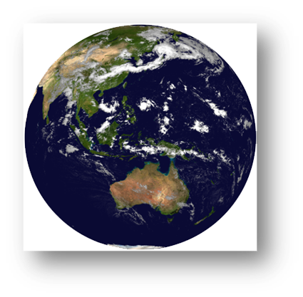
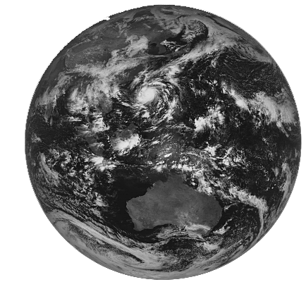
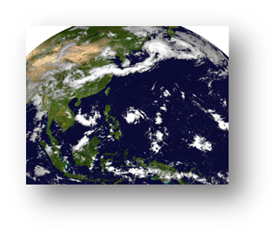
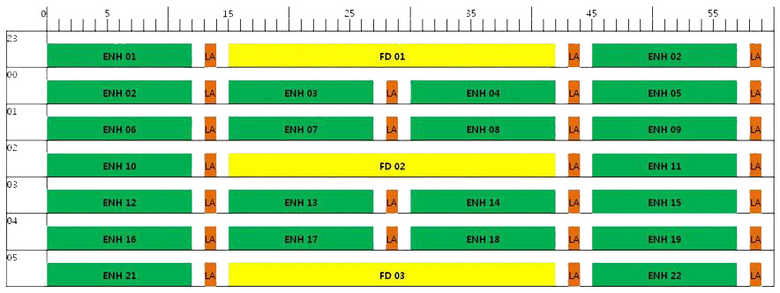
Observation Schedule
FD
ENH
LA
Full Disk : every 3 hr
NH : every 15 min
Korea : ~ 8 min

Slide 18
Method (1/3)
Collocated in space
↓
Collocated in time
↓
Aligned in line-of-sight
↓
Uniform environment
↓
Normal GEO FOV
↓
Spatial averaging
↓
Spectral filling
1. Space collocation:
GEO pixel closest to the LEO granule center
2. Time collocation:
⎪T_{LEO} – T_{GEO}| < 900 s(=15min)
3. Viewing angle alignment:
Notes:
At first we have collocated in space, in time, in line-of-sight. We have selected GEO pixel closest to the LEO granule center. And we have collocated data within 15 minutes. We have collocated data using satellite viewing angle.

Slide 19
Method (2/3)
Collocated in space
↓
Collocated in time
↓
Aligned in line-of-sight
↓
Uniform environment
↓
Normal GEO FOV
↓
Spatial averaging
↓
Spectral filling
Background
Uniform Environment
Collocation target
Not a threat
Potential threat
>11 KM
Uniformity reduces uncertainty
Actual GEO and LEO FOV
Normal sample
Cause unwanted bias → increased noise
Uniform Environment
Advection
LEO FOV
GEO FOV
Notes:
Next, we have performed uniformity check. Uniformity check reduces uncertainty, because unwanted bias increased noise.

Slide 20
Method (3/3)
Collocated in space
↓
Collocated in time
↓
Aligned in line-of-sight
↓
Uniform environment
↓
Normal GEO FOV
↓
Spatial averaging
↓
Spectral filling
Spectral filling method
Constraint method
Least square method using 8-profile
Proposed by JMA
SRFs of COMS (red), METEOSAT-8 (green) and GOES-12 (blue) IR channeㄴls
GEO: COMS
SRFs of IASI (green: valid) and gap channels(orange)
Valid channel
Gap
LEO: IASI
Wavenumber (cm⁻¹)
SRFs of COMS MI IR4(red), IASI (green:valid) and gap channels(orange)
IR4:SWIR
Wavenumber (cm⁻¹)
2820
2942
Notes:
Finally, we have performed spectral filling. We have used constraint method. This is the spectral response function of COMS IR channel. This is the spectral response function of IASI. There is gap channel in shortwave IR. We have filled gap channel using constraint method.

Slide 21
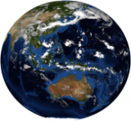
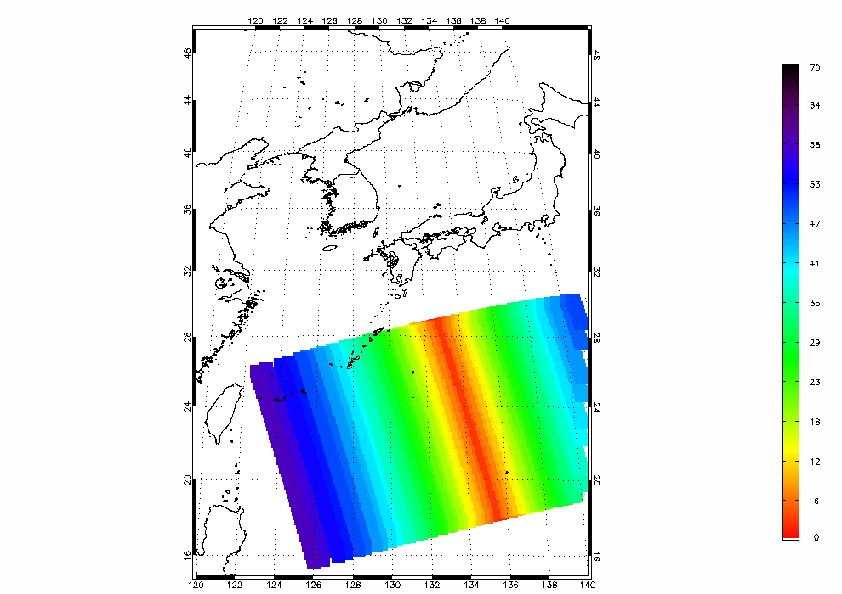
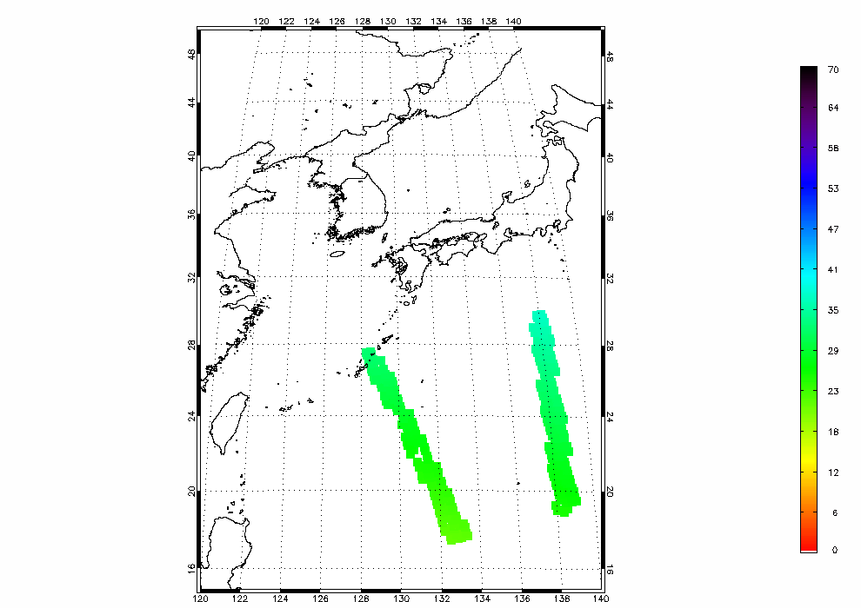
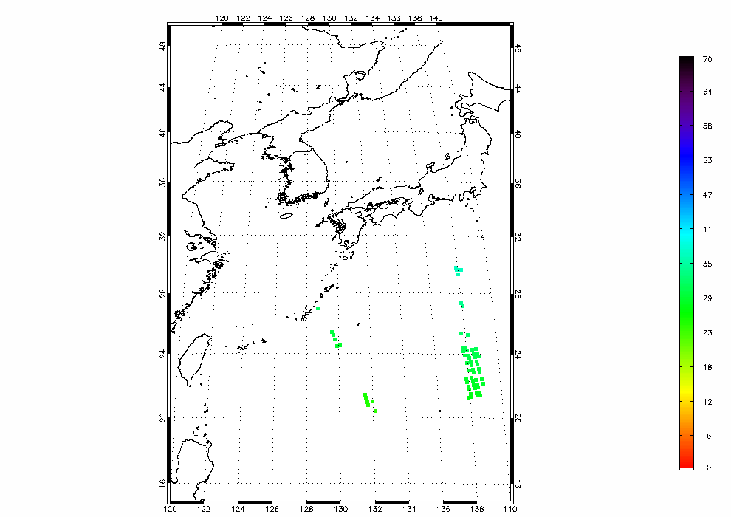
Collocation
Inter-calibration methodology(1/2)
COMS channel | Weather Condition | Dt_{max} (minutes) | ε1 | ε2 | Gaussian
IR1 (10.8 μm) | Clear | 5 | 0.01 | 1.65 | 2
 | Cloudy | 5 | 0.03 | 3.31 | 2
IR2 (12.0 μm) | Clear | 5 | 0.01 | 1.82 | 2
 | Cloudy | 5 | 0.03 | 3.64 | 2
WV (6.8 μm) | All | 5 | 0.01 | 0.311 | 1
SWIR (3.8 μm) | Clear | 5 | 0.01 | 0.0151 | 2
 | Cloudy | 5 | 0.03 | 0.0302 | 2
TIME
|T_{LEO} – T_{GEO}| < 300s
SZA : θ
SZA
2011.8.1 1215UTC COMS SZA
2011.8.1 1215UTC IASI SZA
COS(θ_{IASI})
< ε1
- 1
COS(θ_{coms})
Uniformity
Non-uniform features
SZA
SZA & Uniformity
STDV(L_{E}) < ε2
|MEAN(F)-MEAN(E)|Ⅹ9
< Gaussian
STDV(E)
F : FOV_BOX (COMS 3 X 3 pixels)
E : ENV_BOX (COMS 9 X 9 pixels)
L_{E} : COMS radiance in ENV_BOX
4
Notes:
In this page, I will explain collocation method.
We used the collocation algorithm provided by the GSICS research working group.
We choose the COMS and IASI data using table that shows the criteria used in inter-calibration between COMS and IASI.
In this table, first column is COMS channel. second column is Weather condition.
and third column is time threshold values. and fourth column is SZA. and,
fifth and sixth are uniformity threshold values.
The threshold values change by weather conditions.
If the brightness temperature of IR1(1 0.8um) is higher than 275K, the scene condition is clear. otherwise, cloudy
We checked the three types of condition.
First, to check difference of observation time, we verified that the observation time difference is within 5 minutes.
Second, SZA difference check
In this check, We selected pixels which less than threshold values using SZA data both COMS and IASI
The third, environment uniformity check
To reduce differences between the observation conditions of two satellites due to time difference,
SZA difference, etc., only measurements over uniform scenes are selected.
It must be satisfy by this relation.
The right figures show example of collocation result.
This(the upper left) figure is SZA of COMS MI. and this(upper right) figure is IASI SZA.
and the(the bottom left) figure shows the result of SZA difference check between COMS and IASI data.
and this(the bottom right) figure shows the result of SZA difference check and environment uniformity check.

Slide 22
Collocation (Angle)
IR channels are often insensitive to difference in azimuth angle

Slide 23
Inter-calibration methodology(2/2)
Simulated COMS MI radiance from IASI observations
Constraint method
Generate a super channel consisting of combination of the hyper channel to imitate a broadband channel. Proposed by Tahara (JMA)
SRFs of COMS (red), METEOSAT-8 (green) and GOES-12 (blue) IR channeㄴls
GEO: COMS
SRFs of COMS MI IR2(red), IASI (green: valid) channels
SRFs of IASI (green: valid) and gap channels(orange)
Weights of IASI super channel simulating COMS MI IR2
Valid channel
Gap
LEO: IASI
Weights
Wavenumber (cm⁻¹)
SRFs of IASI super channel simulating SRF of COMS MI IR2
SRFs of COMS MI IR4(red), IASI (green:valid) and gap channels(orange)
Wavenumber (cm⁻¹)
IR4:SWIR
Wavenumber (cm⁻¹)
2820
2942
I_{i} : Radiances of IASI
w_{i} : Weights for IASI
I_{v} : Radiance of the super channel
i : Channel index numbers of IASI
5
Notes:
The collocated COMS and IASI data cannot be compared without considering the sensor’s
spectral response difference.
I’ll explain how to convert IASI radiance to simulated COMS MI radiance in accordance with
the spectral response of COMS MI infrared channels using constraint method.
constraint method is generate a super channel consisting of combination of the hyper
channel to imitate a broadband channel.
In first figure, red line is SRF of COMS MI IR2 and green is IASI channel over the
observing range of the COMS MI IR2(12.0-micron).
next figure shows the SRF of the IASI super channel simulating SRF of COMS MI IR2
next figure shows the weights of the super channels.
So, we could calculate the radiance of super channel using by this formula.
(where Wi is weights for IASI. Ii is radiance of IASI.)
but, As you can see in right figures, the spectral range of IASI data does not cover
the spectral range of COMS SWIR channel data.
So, radiances of gap channels estimated by using valid hyper channel observations and
beforehand simulated radiances for 8 profiles.

Slide 24
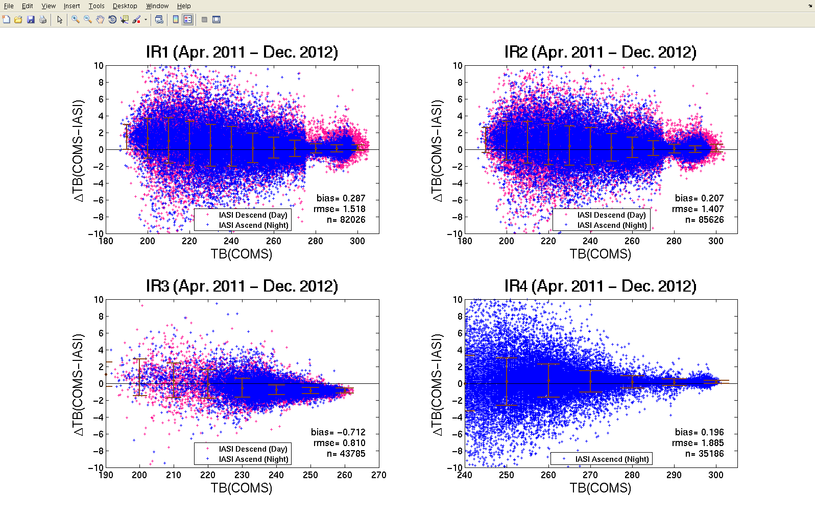
ΔTB(COMS MI - Metop-A IASI)
7
Notes:
Next, this figure show the differences between COMS MI and IASI with brightness temperature.
The x axis represents COMS TB and the y axis represents TB difference between COMS MI
and IASI.
For IR1 band, the difference in low TB around 200K is about 1.4K, while the difference in high TB around 290K decrease in 0.2K.
Namely, In low range of Temp., the TB of COMS data is higher than IASI.
But the difference is smaller and to zero in high TB .
On the other hand, for IR2 band, differential TB between COMS MI and IASI tend to negative bias.
The difference in low TB around 200K is about 0.3K, while the difference in high TB around 290K decrease in -0.4K.
For IR3, tendency of the bias is similar to IR1.
For IR4, differential TB is large in low TB, but the bias is small about -0.2K.

