Slide 1
NOAA GPRC Report
2013 GSICS Annual Meeting
Williamsburg, VA
03/04/2013-03/08/2013

Slide 2
Outline
Operation
Research
Actions
Outlook

Slide 3
Operations
GOES Imager GEO-LEO IR correction products promoted to pro-operational status
Product access
Bias monitoring
Retro-processing status report
DCC calibration

Slide 4
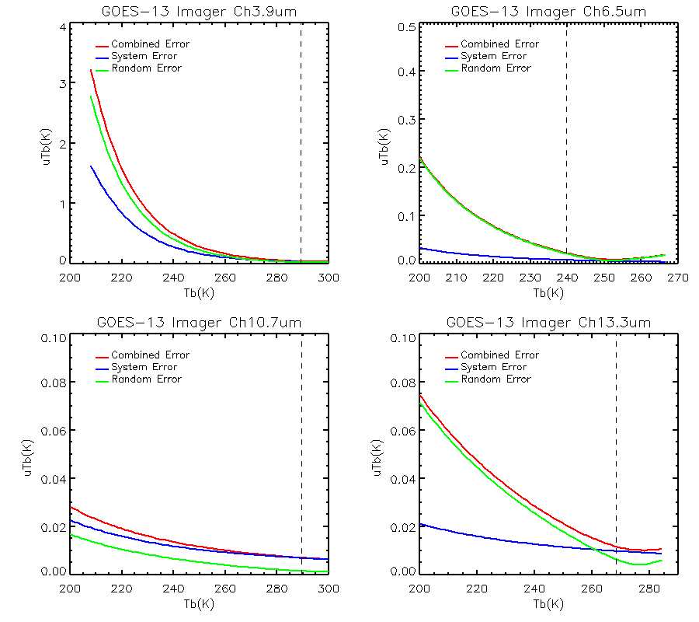
Product promotion
GOES Imager GEO-LEO IR correction product promoted in pre-operational status
Progress in 2012:
End-to-end and system levels of uncertainty analyses traceable to Metop-A/IASI, following Hewison (2013, TGRS)
Implemented the version control for the softwares

Slide 5
GEO-LEO Inter-Calibration Products
Pre-operation GEO-LEO correction products download server:
http://gsics.nesdis.noaa.gov/thredds/nesdisResults.html
Near Real-time Correction – update everyday
Re-analysis Correction – updated once per month
Product monitoring wiki-website:
https://gsics.nesdis.noaa.gov/wiki/GPRC/WebHome
Add the monitoring of GOES-15 Imager IR correction

Slide 6
Ongoing NOAA GPRC GEO-LEO inter-calibration
Aqua/AIRS
Metop-A/IASI
Aug2003
Jun2007
Dec 2011
GOES-11
GOES-12
GOES-13
Apr 2010
GOES-14
GOES-15
Dec 2011
Meteosat-7
Aug08
Meteosat-9
Aug08
Jan2013
Meteosat-10
Jan2013
MTSAT-1R/MTSAT-2
Aug08
FY-2C
Aug08
Apr2011
FY-2D
Apr2011

Slide 7
GEO-LEO Retro-Processing (CIMSS/University of Wisconsin)
GEO vs. AIRS Collocations
Satellite | Begin Date (year/jday) | End Date (year/jday) | Total number (Days) | Status
GOES-8 | 2002/224 | 2003/090 | 143 | Completed
GOES-9 | 2003/113 | 2005/321 | 854 | Completed
GOES-10 | 2002/224 | 2009/334 | 2350 | 95% Completed
GOES-11 | 2006/152 | 2011/340 | 1975 | Completed
GOES-12 | 2003/016 | 2010/364 | 2746 | 95% Completed
Meteosat-9 | 2007/101 | 2011/364 | 1464 | 95% Completed

Slide 8
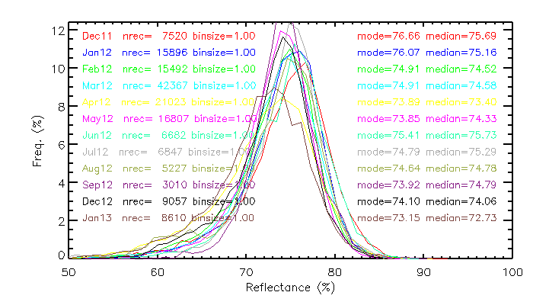
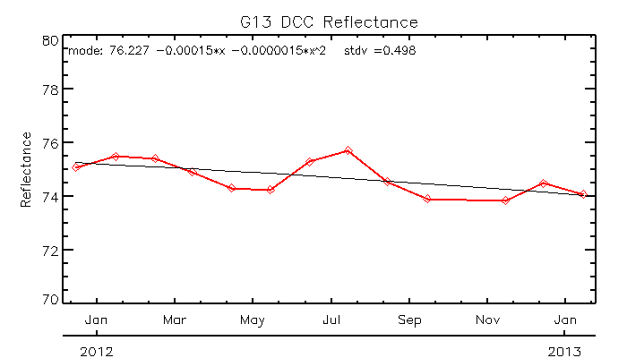
DCC Calibration for GOES-13 Imager
Uncertainty components (from D. Doelling, DCC ATBD)
GEO satellite | Aqua-MODIS (%) | Calibration Transfer (%) | Trend (%) | SBAF (%) | Total Uncertainty (%)
GOES-13 | 1.64 | 1.2 (?) | 0.5 | 0.27 (GOME) 0.30 (SCI)A | 2.2
GOES-15 | In-sufficient DCC pixels. Need multiple months of DCC pixels for a robust DCC histogram

Slide 9
Research
GOES calibration anomaly investigation
GOES Imager band-to-band co-registration error correction
GOES vs. AIRS/CrIS/IASI
Desert-based vicarious calibration for GOES Imager (to be presented later)
Lunar calibration – ROLO vs. M-T model
Combined vicarious calibration method
METOP-A/B AVHRR vis (Chang) (to be presented later)

Slide 10
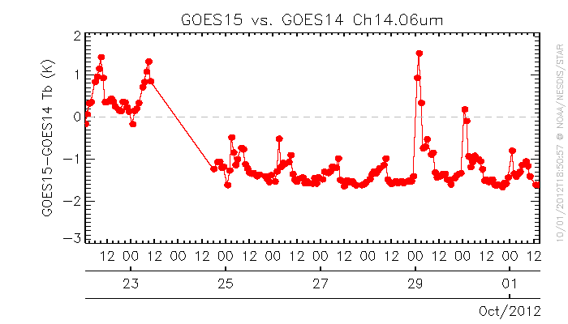
GOES Calibration Anomaly Investigation
GOES-15 Sounder LW radiance anomaly, 29/09/2012-01/10/2012
GSICS GEO-GEO inter-comparison showed the radiance anomaly only occurred at LW channels, Jumped suddenly at ~00:00z – 12:00z on 29/10/12. The diurnal anomaly reduced and back to normal at 01/10/12.
Root cause: pre-mature change of calibration mode
Calibration Anomaly
Patch temperature change/variation

Slide 11
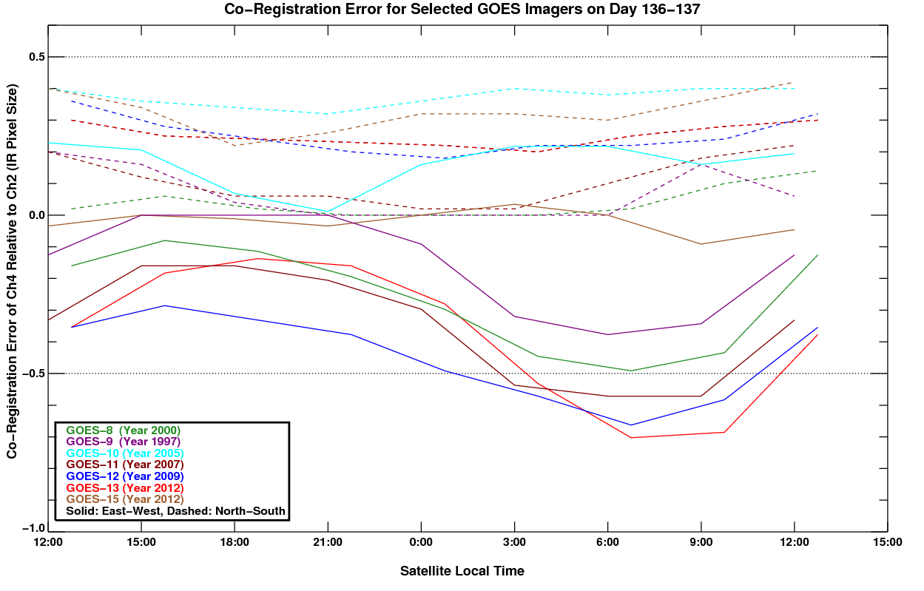
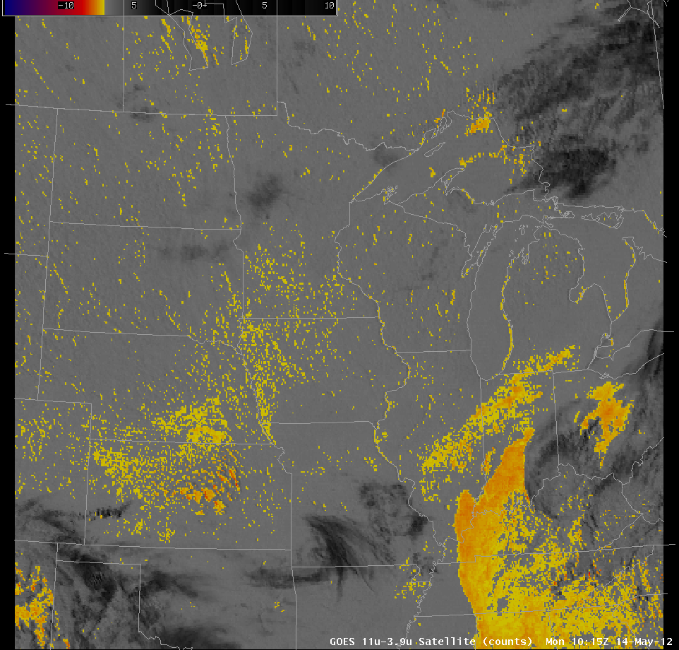
GOES Imager band-to-band co-registration error correction
Accuracy of Spatial calibration is essential for meaningful interpolation of geophysical parameters and radiance inter-comparison
Band-to-band co-registration error out of specification can be observed at certain time of day at some GOES Imager instruments due to diurnal heating variation of the optics’ components
Operational correction algorithm is being implemented.
“False” fog products, courtesy of U. Wisc.
Diurnal co-registration errors at G8 thru G15 (by M. Grotenhuis, NOAA/NEDIS/STAR)

Slide 12
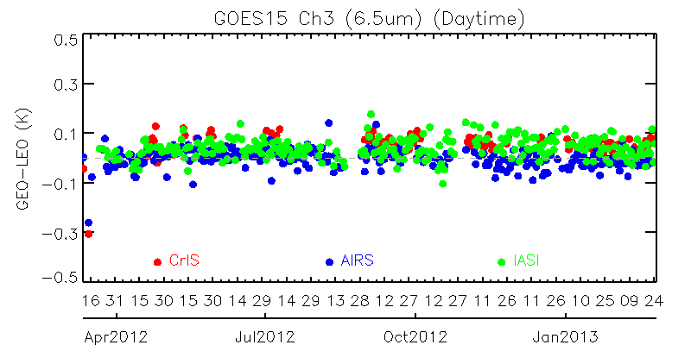
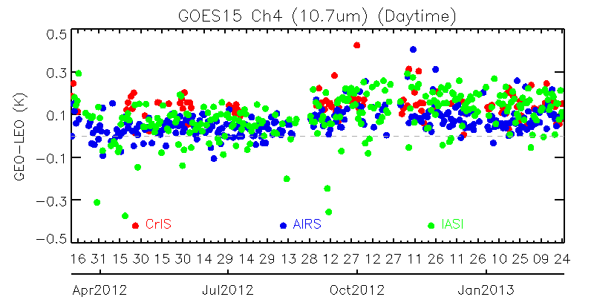
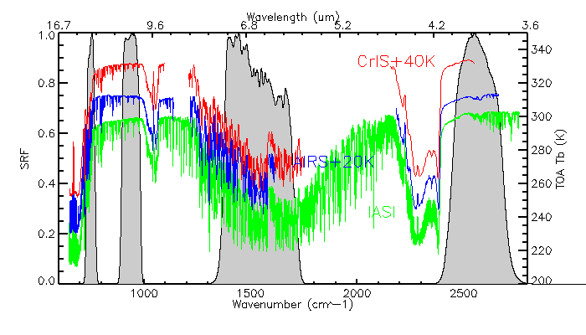
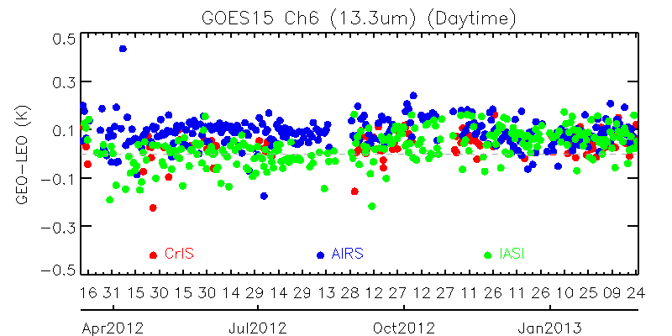
GOES vs. AIRS/CrIS/IASI Inter-Calibration – long-term monitoring
Notes:
Consistent diurnal Tb difference in between AIRS and CrIS
The difference among AIRS/CrIS/IASI in general is less than 0.2K
AIRS is slightly warmer than CrIS at ~0.2K at Ch6.5um
AIRS is slightly warmer than CrIS at Ch10.3um, however, the Tb difference seems smaller at Jun-July than Apr-May at night-time data
Among the three GOES IR channels, Tb difference between AIRS and CrIS is smallest at Ch13.3um
CrIS overall radiometric calibration accuracy is very stable and comparable with AIRS/IASI during the study period

Slide 13
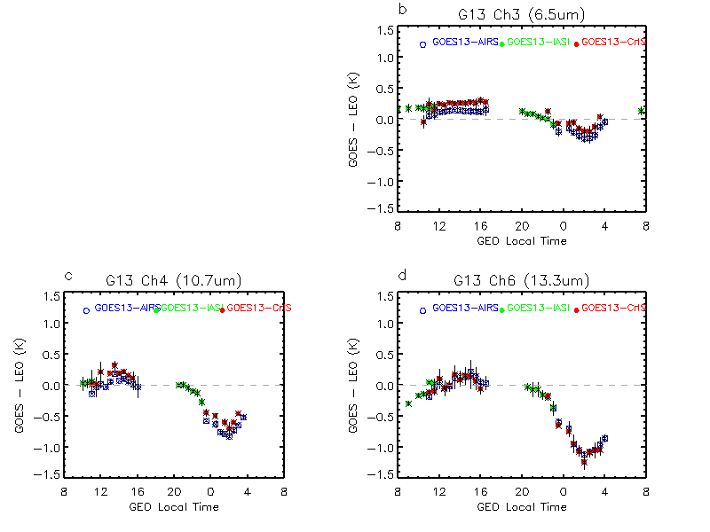
GOES vs. AIRS/CrIS/IASI Inter-Calibration – Diurnal Variation
Data: 04/18/2012 – 05/28/2012
Notes:
Consistent diurnal Tb difference in between AIRS and CrIS
The difference among AIRS/CrIS/IASI in general is less than 0.2K
AIRS is slightly warmer than CrIS at ~0.2K at Ch6.5um
AIRS is slightly warmer than CrIS at Ch10.3um, however, the Tb difference seems smaller at Jun-July than Apr-May at night-time data
Among the three GOES IR channels, Tb difference between AIRS and CrIS is smallest at Ch13.3um
CrIS overall radiometric calibration accuracy is very stable and comparable with AIRS/IASI during the study period

Slide 14
GOES vs. AIRS/CrIS/IASI Inter-Calibration – day/night difference
Notes:
Consistent diurnal Tb difference in between AIRS and CrIS
The difference among AIRS/CrIS/IASI in general is less than 0.2K
AIRS is slightly warmer than CrIS at ~0.2K at Ch6.5um
AIRS is slightly warmer than CrIS at Ch10.3um, however, the Tb difference seems smaller at Jun-July than Apr-May at night-time data
Among the three GOES IR channels, Tb difference between AIRS and CrIS is smallest at Ch13.3um
CrIS overall radiometric calibration accuracy is very stable and comparable with AIRS/IASI during the study period

Slide 15
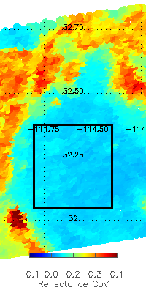
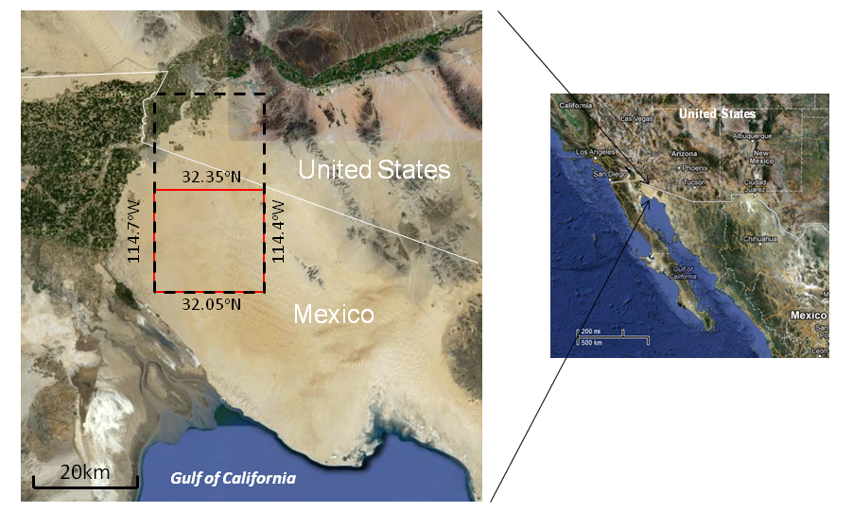
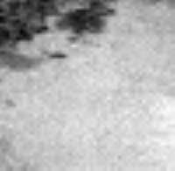
Desert Calibration
Seasonal variability
GOES image
[32.05N-32.35N, 114.4W-114.7W]
25 pixels

Slide 16
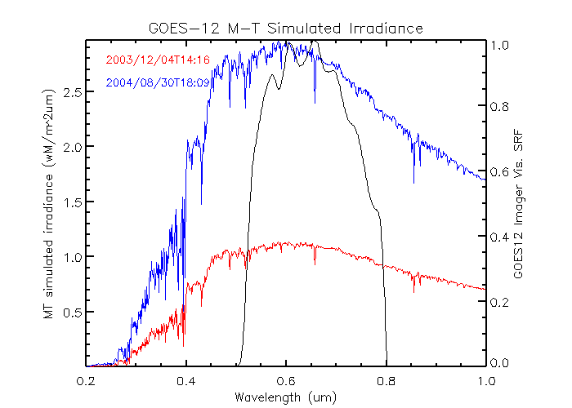
Lunar Calibration: MT vs. ROLO model
Miller-Turner model, an independent lunar irradiance model (Miller and Turner, TGRS, Vol. 47(7), 2009)
Hyperspectral, covering 0.2-2.8um with 1nm resolution
Benchmarked against observation and ROLO model
Publically available
Relative calibration
Doesn’t account for lunar libration impact
Difference between MT and ROLO model <5%

Slide 17
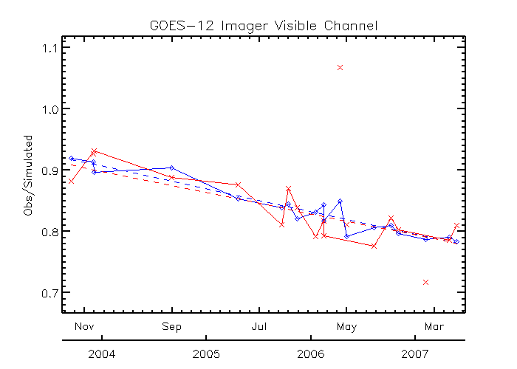
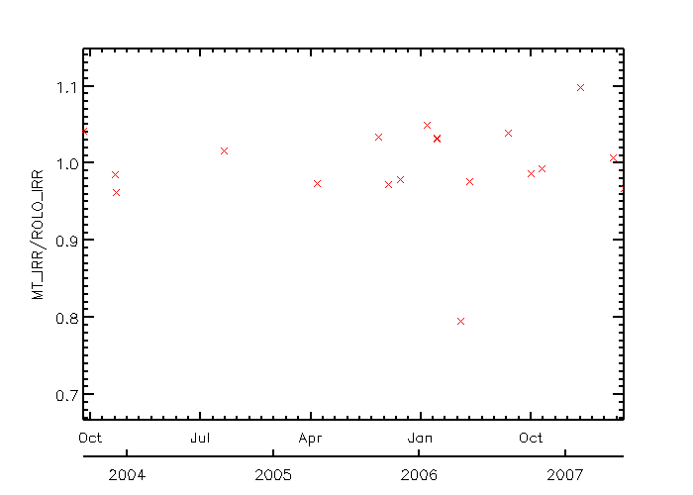
Obs-MT vs Obs-ROLO
Two moon images observed on 02/14/2006 at ~1 hour difference (in the dark circles)
The MT Irr./ROLO Irr. ratios at the two observations are identical (right)
The consistent large obs/simulation ratios with both simulations (left) indicate that the ratio difference comes from the observation variation, most likely due to the impacts of incident angle dependent scan mirror reflectance and variation in space background.
Trending uncertainty using the 20 observations
MT: 2.5%, data with phase angle (>5º and <60º) excluded.
ROLO: 1.3% , all the 20 data.
Notes:
1. Confirmed that the relative large variation of the obs/simulation ratios at the one-hour-different-observation-pairs is attributed to the uncertainty in the GOES measurements.
2. GOES Trending uncertainty with current MT model result is larger than that of ROLO results (2.5% vs 1.3%, k=1)
3. Confirmed that when phase angle (>5 and <60) excluded, MT and ROLO irradiance difference is within 5%, however, the difference seems phase-angle dependent.

Slide 18
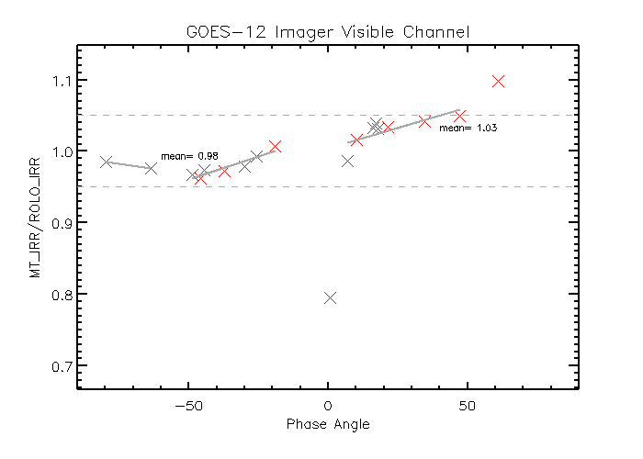
MT vs. ROLO
Confirmed that the MT and ROLO model irradiance difference is <5% if abs(phase angle) is within the range of [5 , 60]
In this case, the difference seems phase angle dependent

Slide 19
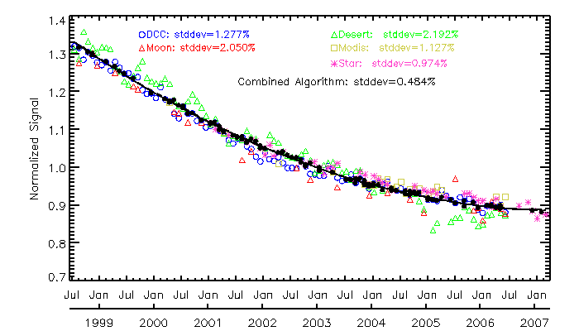
Combined Vicarious Calibration Algorithm
average the daily degradation at monthly scale
 | Valid # | Total # | Usage Frequency | trending uncertainty
DCC | 54 | 96 | 56.25% | 1.277%
Desert | 26 | 87 | 29.86% | 2.129%
Moon | 4 | 27 | 14.82% | 2.050%
MODIS | 11 | 25 | 44.00% | 1.127%
Star | 28 | 56 | 50.00% | 0.974%
Combined method |  |  |  | 0.484%
Anchor the smoothed trending with one GOES-MODIS inter-calibration result
Fit with a quadratic function
Recursive filtering algorithm to remove the outliers

Slide 20
Metop-A/B AVHRR VNIR Calibration
Details presented by Dr. T. Chang on 03/04/2013

Slide 21
Actions
Actions
GOES instrument information (Action…)
Action Ref | Description | Due Date | State/Update
GRWG06_16 | Compile a list a existing activities concerning composite satellite imagery | Jun 2011 | No activity
GRWG06_17 | GEO satellite overlap time overlaps | Dec 2011 | https://gsics.nesdis.noaa.gov/wiki/Development/InstrumentInformation; closed
Joint07_05 | Reports on what events can be made available from legal point of view | Mar 2013 | Open, had some email discussions
EP-12.05 | Each GPRC to consider implementing NRT distribution of calibration correction information at Level1B data | Sept 2012 | Closed. NOAA cannot do it.
Joint06_01 | Recommend a signal AIRS flag file to be adopted by all AIRS users | Dec 2011 | Need clarification for this action
Joint07_09 | Check and provide comments to provide shortlist of instrument events to be logged | Mar 2013 | Open, had some email discussions with action lead and GDWG chair

Slide 22
Outlook
GOES-R ABI
To be launched in 2015
ABI covering 16 spectral channels, 6 VNIR + 10 IR, onboard calibration for solar reflective channel, improved spatial resolution
NPP/JPSS instruments
CrIS ⬅➔ Aqua
VIIRS ⬅➔ MODIS
Metop-B/IASI ⬅➔ Metop-A/IASI
Challenging
Bridging the multiple references

Slide 23
Summary
Operation status
normal
Looking forward to the operation for the GOES GEO-LEO IR products
MT model is valuable to validate the ROLO results
Combined method can improve the relative calibration accuracy better than 0.5%.
Need to continue to work on the absolute calibration (traceable to Aqua MODIS) of current existing vicarious calibration methods
NPP and Metop-B provide more opportunities.
Distractions – bridging over the multiple reference requires thoroughly understand the calibration differences on all-sky data at various temporal scales, from diurnal to long-term scales.

