Slide 1
On Thin Ice?
Contamination Effects on Meteosat/SEVIRI Calibration
Tim Hewison, Johannes Müller, Rebeca Gutierrez
Presentation by Tim Hewison

Slide 2
Global Space-based Inter-Calibration System
What is GSICS?
Global Space-based Inter-Calibration System
Initiative of CGMS and WMO
An effort to produce consistent, well-calibrated data from the international constellation of Earth Observing satellites
What are the basic strategies of GSICS?
Improve on-orbit calibration by developing an integrated inter-calibration system
Initially for GEO-LEO Inter-satellite calibration
Being extended to LEO-LEO
Using external references as necessary
Best practices for prelaunch characterisation (with CEOS WGCV)
This will allow us to:
Improve consistency between instruments
Reduce bias in Level 1 and 2 products
Provide traceability of measurements
Retrospectively re-calibrate archive data
Better specify future instruments
EUMETSAT | CNES | JMA
NOAA | CMA | KMA
ISRO | NASA | WMO
USGS | NIST | JAXA
ROSHYDROMET | IMD | ESA
Notes:
Well, what is GSICS?
The Global Space-based Inter-Calibration System (GSICS) is an initiative of CGMS and WMO, which aims to ensure consistent calibration and inter-calibration of operational meteorological satellite instruments.
One of the basic strategies of GSICS is to develop an integrated on-orbit cal/val system - initially by LEO-GEO Inter-satellite/inter-sensor calibration.
This will then allow us to provide corrections to improve the consistency between instruments, produce less biased level 1, and therefore, level 2 data, and ultimately, retrospectively re-calibrate archive data, which is of great interest in the climate monitoring community

Slide 3
GSICS Products
GSICS Bias Monitoring
Routine comparisons of satellite radiances against reference
GSICS Correction
Function to correct issued radiances
For consistent calibration with reference
GSICS Reports & Guidelines
Recommendations to modify practices
Design and Operation of future satellite instruments
For Operational Environmental Satellites
✓ Infra-red recalibration (GEO and LEO) ✓ Demonstration status
(current operational satellites) ✓ Near real-time and re-analysis
✓ Visible and near-infrared recalibration (GEO and LEO) ✓ In development within GSICS
✓ Microwave – Conical & Cross-track Scanners (LEO) ✓ In development with GPM XCAL
✓ Historic Instruments ✓ In development at EUMETSAT…

Slide 4
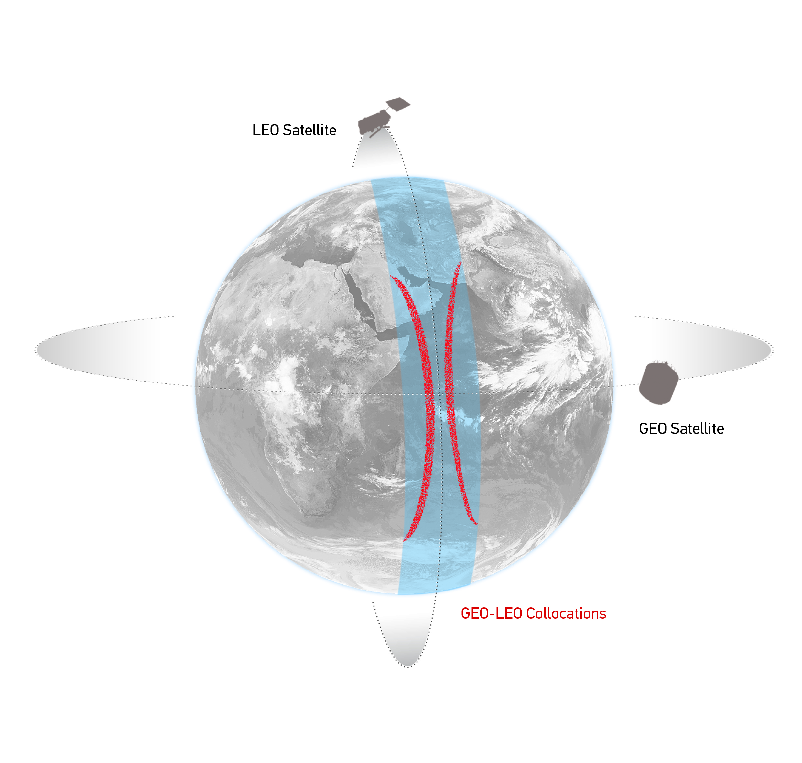
Comparison of Collocated Radiances
Simultaneous near-Nadir Overpass
of GEO imager and LEO sounder
Collocation Criteria:
ΔLat<35° ΔLon<35°
Δt < 5 min
Δsecθ < 0.01 (Atmospheric path diff.)
Concentrated in tropics
~1000 collocations/orbit
~1-4 orbit/night
Schematic illustration of the geostationary orbit (GEO) and polar low Earth orbit (LEO) satellites and distribution of their collocated observations.

Slide 5
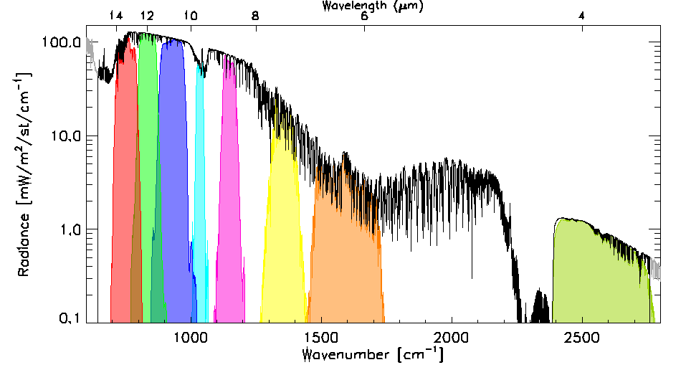
Data Transformations (Spectral and Spatial)
Spectral Convolution:
Convolve LEO Radiance Spectra with GEO Spectral Response Functions
to synthesise radiance in GEO channels
Spatial Averaging:
Average GEO pixels in each LEO FoV
Estimate uncertainty
due to spatial variability
as Standard Deviation of GEO pixels
Use in weighted regression
LEO FoV~12km
~ 5x5 GEO pixels
Example radiance spectra measured by IASI (black) and modeled by LBLRTM (grey), convolved with the Spectral Response Functions of SEVIRI channels 3-11 from right to left (colored shaded areas). n.b. The IASI observations (645 – 2760 cm⁻¹) do not quite cover the full spectrum observed by SEVIRI.
Illustration of spatial transformation. Small circles represent the GEO FoVs and the two large circles represent the LEO FoV for the extreme cases of FY2-IASI, where nxm=3x3 and SEVIRI-IASI, where nxm=5x5.
Notes:
The next step is to transform the collocated data to allow direct comparisons between the instruments.
Firstly, the IASI radiance spectra is convolved with the Spectral Response Functions of the Meteosat channels, to calculate the expected radiance in each Meteosat channel.
Then the Meteosat pixels within each IASI iFoV are averaged.
Their variance is also calculated to quantify the uncertainty due to spatial variability and
is used to weight each collocation in a linear regression …

Slide 6
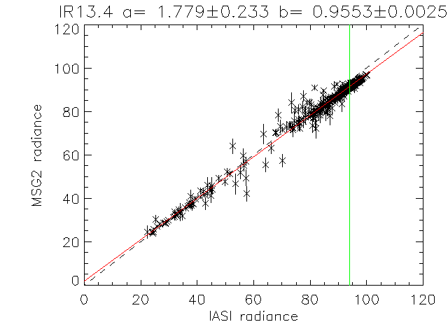
Comparison by Regression
Compare collocated obs:
GEO radiance
Spatially averaged
Regressed against
LEO radiance spectra,
convolved with GEO SRF
Using Variance of GEO radiances + Noise
to estimate uncertainty on each collocation
Weighted linear regression of L_{GEO|REF} and <L_{GEO}> for Meteosat-9 13.4μm channel based on single overpass of IASI

Slide 7
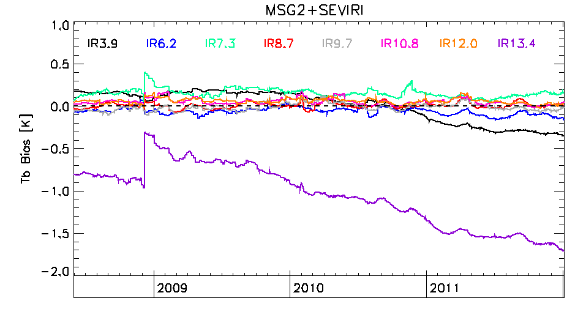
Inter-calibration Bias Changes in Meteosat-9/SEVIRI
Most channels show small (<0.4 K) and stable biases during this period.
13.4 μm channel shows a negative bias,
grew larger until decontamination event in early December 2008,
when bias was reduced by about 0.7 K.
It continues to degrade thereafter.
The fact that the bias does not return to zero immediately after the decontamination suggests either some contaminants remain after the decontamination or an inaccurate representation of the nominal SRF.
Time series plot showing relative bias of IR channels of Meteosat-9/SEVIRI (MSG2) wrt Metop-A/IASI, expressed as brightness temperature difference for standard radiance scenes (1976 US Standard Atmosphere with clear sky).

Slide 8
Decontaminations Change Gains
Decontaminations also change gain
And reduce noise
By increasing loss in optics
For all IR channels
Largest Changes in early in life
Faster rate of outgassing
Channels near 12μm ice libration band most affected:
+35% in 2008 Decontamination event

Slide 9
Theory
Hypothesis:
Change in bias due to a build-up of ice,
condensing on the surfaces of the cold optics
Outgassing & condensation rates unknown
Cannot predict ice thickness theoretically
Not known exactly where ice condenses
Unknown surface coatings’ characteristics
Contamination affects IR channels’ gain and Spectral Response Functions (SRFs),
which influences radiometric noise and bias of instrument’s final calibrated radiances
Differential absorption by ice modifies SRF
Mostly compensated by calibration processes,
viewing cold space and a hot black body,
Unidentified SRF changes bias radiances

Slide 10
Ice Absorption Model
Composite model of ice optical constants compiled from various observations by Warren and Brandt [JGR, 2008].
Strong absorption in ice libration band at λ~12μm
Where 1μm thick ice transmission τ~0.65
These ice optical properties are strictly only valid at 266 K and are temperature dependent, no quantitative data was found for ice at temperatures close to those of SEVIRI’s cold optics (95K).
Model does not include thin film effects, as optical characteristics of underlying surface are unknown.
Transmittance spectra of ice layers of different thicknesses (black): 0.1 to 1.0 µm layers (thickest layers have lowest transmittance) and Spectral Response Functions (SRFs) of Meteosat-8 infrared channels (red).

Slide 11
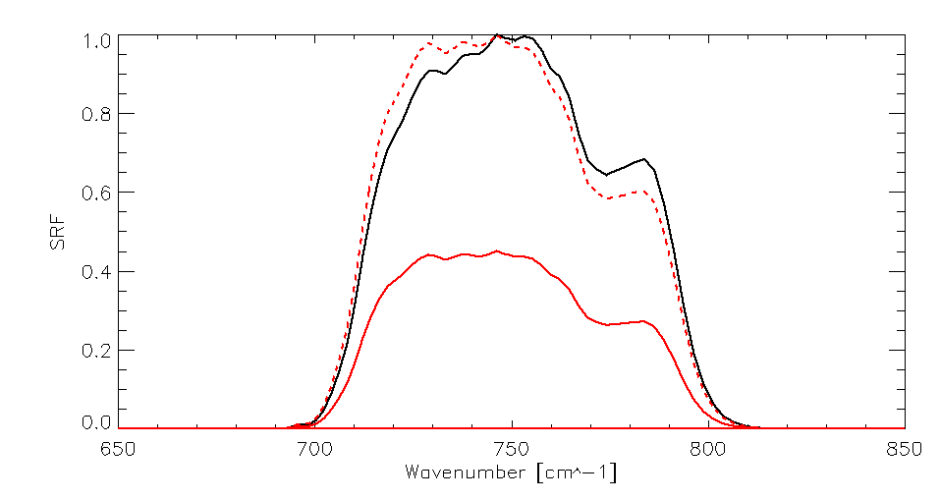
Modelling apparent Bias due to ice absorption
Modifying SRF from assumed value introduces an apparent bias
Depends on scene spectrum
Usually worse in clear sky
Stronger Spectral Contrasts
Evaluate bias for range of modelled scene spectra, L_{ν}, including
US Standard Atmosphere (clear)
Thick Cloud, tops at 194hPa
By convolving assumed SRF with transmission spectra of ice layers
0.1 to 1.0 μm thick
Spectral Response Function of Meteosat-9 13.4μm channel
Black: Nominal SRF, based on pre-launch tests at 95K
Red: SRF convolved with transmission spectrum of ice layer 2μm thick
Red dashed: Normalised SRF after 2μm ice layer
2μm Ice Contamination appears to shift SRF ~2cm⁻¹

Slide 12
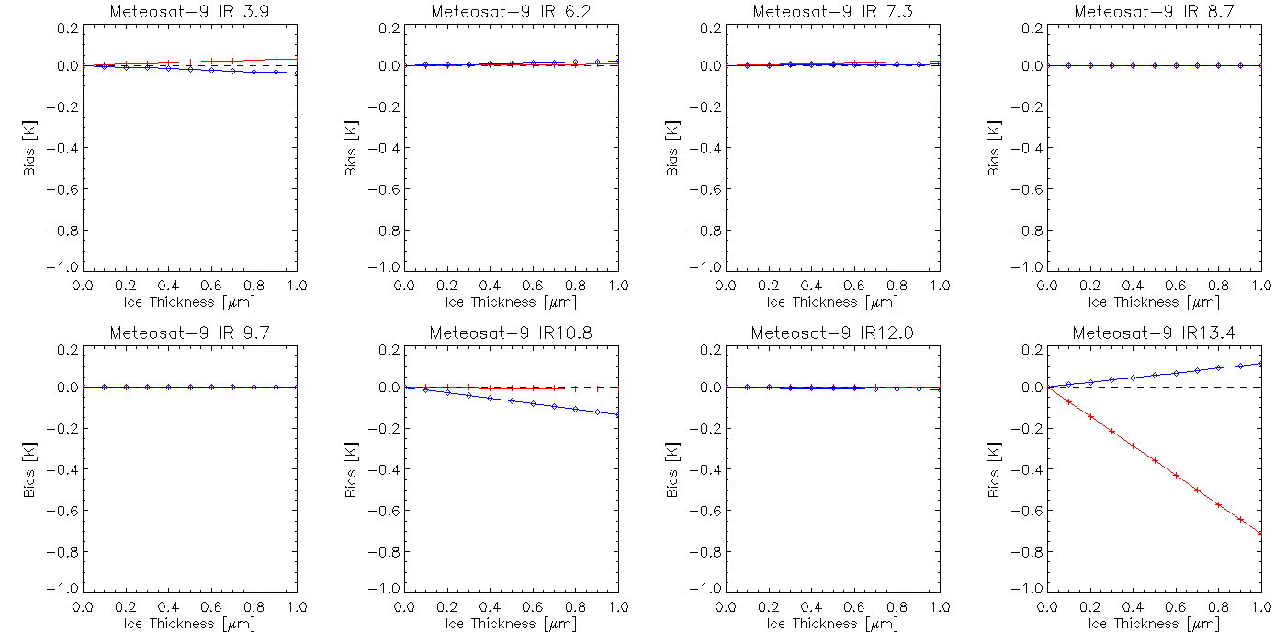
Modelled Bias due to Ice Modification of SRFs
Thin films of ice can also introduce interference effects, which can modify its transmittance – especially where its thickness approaches the wavelength of radiation. However, these have not been accounted for in this analysis, as the optical characteristics of the underlying surface are not known.
Cold Cloud
Clear sky
Bias in brightness temperatures modelled by modifying Meteosat-9’s SRF by transmittance of different thicknesses of ice. Solid lines show predicted biases wrt uncontaminated instrument, accounting for calibration gain changes.

Slide 13
Summary of Ice Absorption Modelling
Contamination by ice absorption can modify radiometer’s SRF:
Reducing instrument gain
Increasing noise
Modifying weighting function
Introducing apparent calibration biases (scene-dependent)
For Meteosat/SEVIRI, largest gain and noise changes in 12μm channel
Where a 1μm ice layer introduces transmission loss of 0.35
But largest biases in 13.4μm channel (edge of CO₂ band)
Where a 1μm ice layer introduces biases of -0.7K for clear sky, (+0.1K for cold cloud)
Predictions match observed trends in gain and bias of Meteosat-9 in 2009
Continued to deteriorate since, but still within specification
Ice contamination for other instruments/channels could also be modelled
But this model did not include reflection – thin film effect

Slide 14
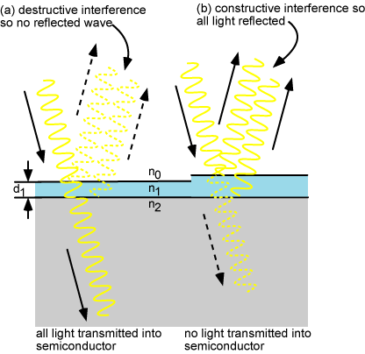
Interference effect in thin dielectric films
Assuming coherent reflections!
IR3.9 IR13.4
Reflectance
Schematic illustration
Layer Thickness
http://pveducation.org/pvcdrom/design/anti-reflection-coatings

Slide 15
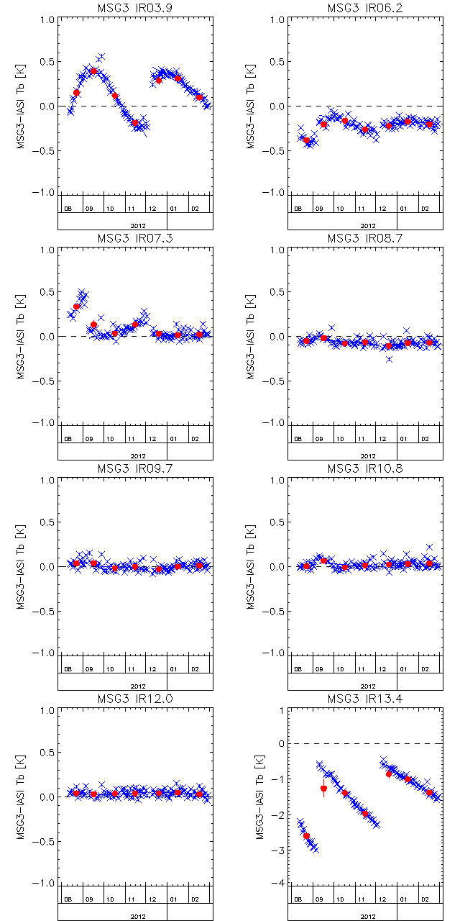
Inter-calibration Bias Changes in Meteosat10/SEVIRI-MetopA/IASI
Now 7 months data since start of MSG-3 Commissioning
Plots show time series of standard biases evaluated daily
Most channels show small (<0.5 K) biases during this period.
13.4 μm channel shows a negative bias,
Grew larger between decontaminations
Then reduced to ~-0.5 K.
Now changes more slowly – lower rate of contamination
3.9 μm channel shows variable bias,
Varies sinusoidally – quickly at first, then slowly
Reset to +0.3K after decontaminations.
6.2 μm and 7.3 μm channel also show slower variations
Reset after decontaminations.
Consistent with thin film ice effects?
Decontaminations

Slide 16
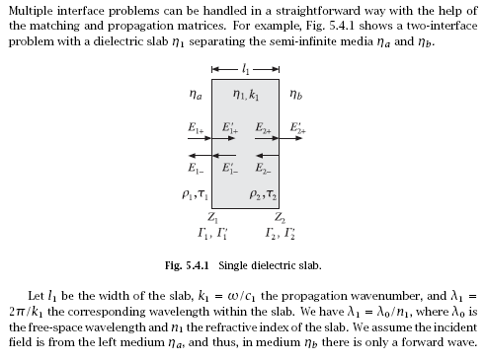
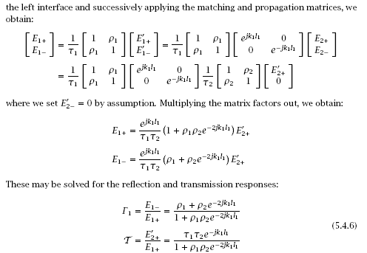
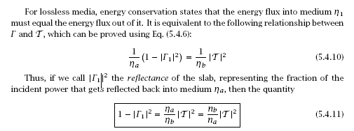
Transmittance through lossless dielectric layer
Electromagnetic Waves and Antennas
Sophocles J. Orfanidis
Calculated assuming n_{b}=1.8
“Furthermore, it is not known exactly where in the instrument optics the ice is likely to condense, although in SEVIRI, the first surfaces to trap contaminants are the optical bandpass filters inside the cold IR optical bench [6]. The effect of contamination is difficult to assess because it depends on the optical surfaces that receive contaminants and their coatings’ characteristics are not known.”

Slide 17
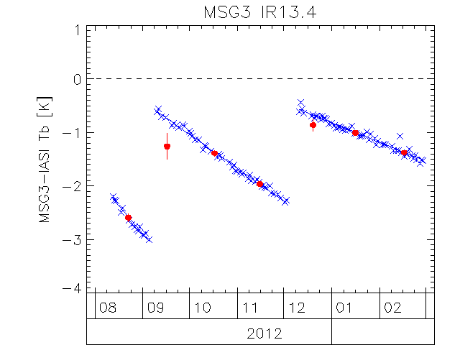
Inter-calibration Bias Changes in Meteosat10/SEVIRI/IR13.4 - MetopA/IASI
During 2012-09-04/12-04
IR13.4 Changed by -1.75K
From ice absorption model, theory says there was 2.5μm ice
Because 1μm ice => -0.7K bias
~1 full reflectivity cycle for IR3.9
Before 2012-09-04
IR13.4 was 2.4K lower than just after decontaminations
Theory suggests 3.5μm ice
Decontaminations

Slide 18
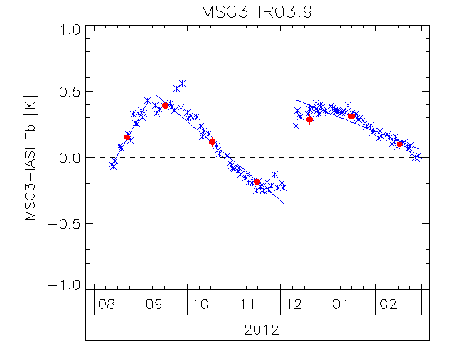
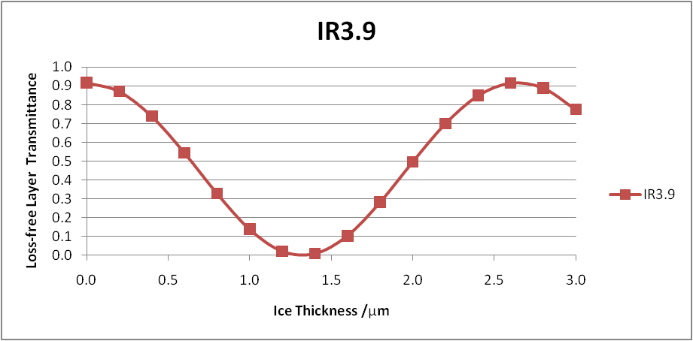
Inter-calibration Bias Changes in Meteosat10/SEVIRI/IR3.9 - MetopA/IASI
During 2012-09-04/12-04
IR3.9 shows variable bias,
+0.15K +/- 0.3K sinusoid
Sinusoidal osc. slowing down
Reset after decontaminations
Consistent with interference from 1.6μm thin film of ice
Not a full cycle!
Bias increases at first
Magnitude of Bias much lower than expected for interference pattern from pure specular surfaces
More like lenses
Not crystalline structures
Decontaminations

Slide 19
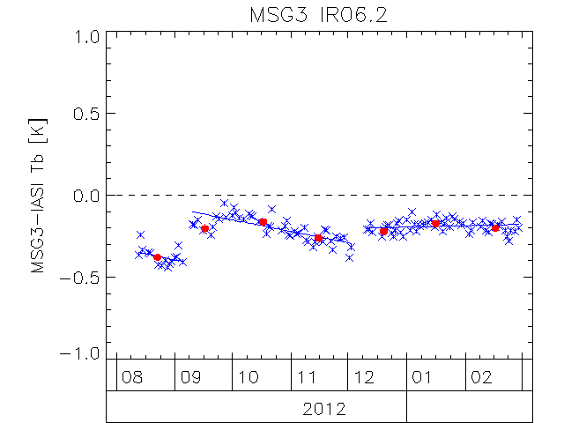
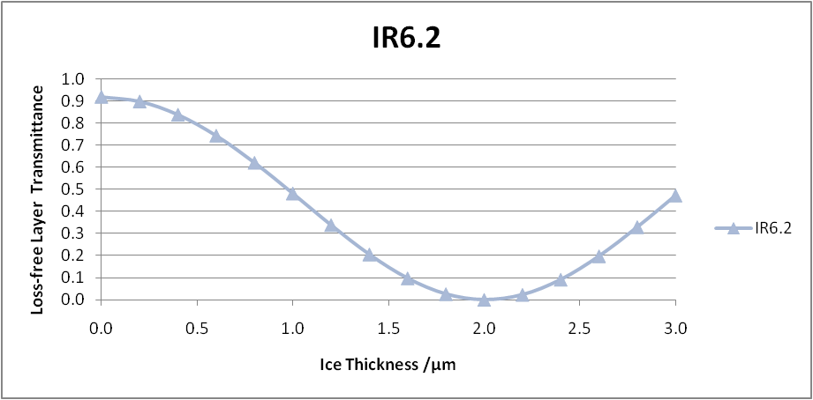
Inter-calibration Bias Changes in Meteosat10/SEVIRI/IR6.2 - MetopA/IASI
During 2012-09-04/12-04
IR6.2 shows variable bias,
Varies more slowly than IR3.9
Reset to -0.2K after decontaminations
Magnitude of Bias much lower than expected for interference pattern from pure specular surfaces
More like lenses
Not crystalline structures
Decontaminations

Slide 20
Long time series of Meteosat-9/SEVIRI Standard Bias
During 2008-12/2013-01
IR13.4 Changed by -1.75K (same as MSG-3 in 3 months!)
From ice absorption model, theory says there was 2.5μm ice
Because 1μm ice => -0.7K bias
~1 full reflectivity cycle for IR3.9
IR3.9 bias varies slowly,
+0.1K +/- 0.3K sinusoid
Consistent with interference from 1.6μm thin film of ice
IR6.2 bias varies very slowly,
-0.15K +/- 0.15K sinusoid?
Similar to interference from 1.2μm thin film of ice?
Decontaminations

Slide 21
Conclusions
It’s ice!
It was thick!
Difficult to model quantatively because of:
Unknown substrate properties
Non-laminar ice build-up
Could be applicable to other instruments

