Slide 1
On the Use of Infrared Spectral Band Adjustment Factors
To Extend IASI to Archived Data
Patrick Minnis¹, Ben Scarino², Arun Gopalan², Dave Doelling¹
¹NASA Langley Research Center, Hampton, VA
²SSAI, Hampton, VA USA
GSICS Annual Meeting, Williamsburg, VA USA
4-8 March

Slide 2
Objectives
• Develop an empirical spectral response function (SRF) radiance data base for each satellite imager channel & create spectral band adjustment factors for each potential pair of imager channels
- solar channels, Ref: Sciamachy (see Scarino talk)
- infrared channels, Ref: IASI, AIRS
• Complete the construction of a satellite inter-calibration algorithm suite
• Apply the algorithms to inter-calibrate meteorological and research satellite imager channels taken since 1976 using the Aqua MODIS as a calibration standard

Slide 3
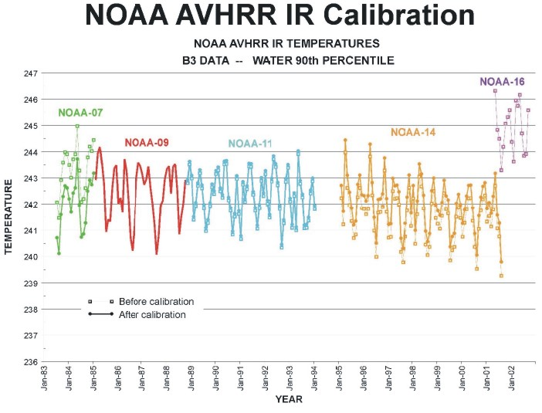
Background
• ISCCP IR calibration: straight transfer of a LEO-to-GEO satellite 11 µm temperature, T_{GEO} = T_{LEO} = a T’_{GEO} + b, with no spectral correction
• Reference LEO imager calibration adjusted using 10th & 90th Percentile mean temperatures
Current GOAL
• Transfer IASI calibration via MODIS to AVHRR and to earlier GEOs
• Retain spectral characteristics of each imager
- “true temperature”, not AVHHR equivalent
• Use trends in various parameters (e.g., percentiles, DCC) to monitor older AVHRRs

Slide 6
Approach
• Derive pseudo-radiances L_{Δλ} for each target satellite channel SRF R_{Δλ} from either SCIAMACHY, IASI, CrIS, or AIRS spectral radiance L_{λ} depending on the satellite channel and time period
L_{Δλ} = Σ R_{λi} L_{λi}’ (λ_{i} - λ_{i-1}) / Σ R_{λi}’ (λ_{i} - λ_{i-1})
• Determine spectral band adjustment factors (SBAF) relative for a target imager, t, to a particular reference, r, from pseudo-radiances
T_{λt} = SBAF_{λrt}(T_{λr}) = a T_{λr} + b
• Apply NSRT method to matched imager data from reference and target satellite imagers for entire overlap period, ‘ indicates data
T_{λt} = SBAF_{λtr}(T_{λt}) = (a T’_{λr} + b) = a’ T_{λt}’ + b’
Force fits denote b and b’ forced to zero

Slide 7
Examples of Pseudo-radiance Sets
Aqua MODIS
NOAA-18 AVHRR
GOES-11 Imager

Slide 8
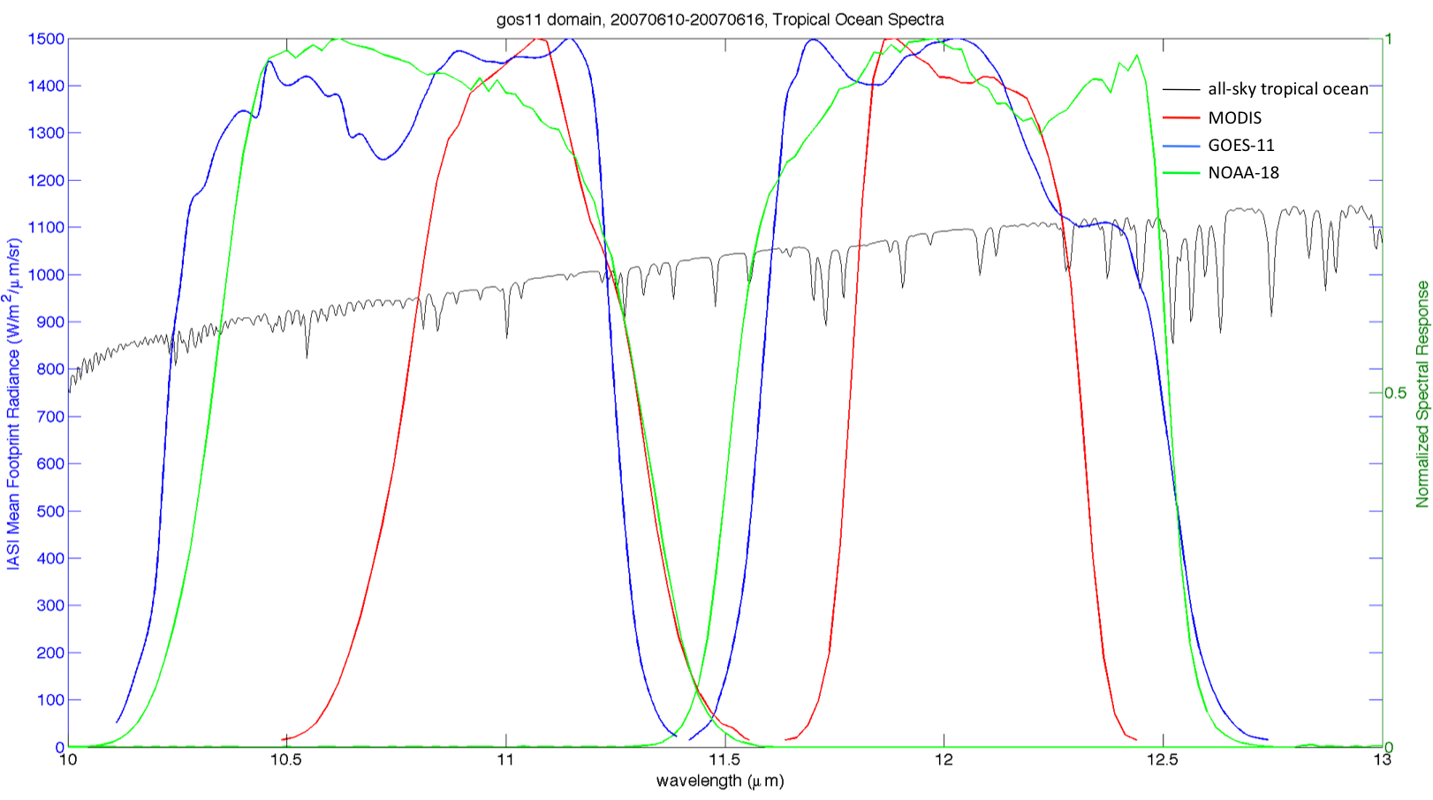
Spectral Response Functions on IASI Mean Footprint Radiance Spectrum
10 – 12 µm Channels, All Sky Tropical Ocean

Slide 9
Pseudo-radiances from IASI, 12-µm Channels, GOES-11/MODIS

Slide 10
Pseudo-radiances from IASI, 12-µm Channels, GOES-11/NOAA-18

Slide 11
Pseudo-temperatures from IASI, 12-µm Channels, GOES-11/MODIS

Slide 12
Pseudo-temperatures from IASI, 12-µm Channels, GOES-11/NOAA-18

Slide 13
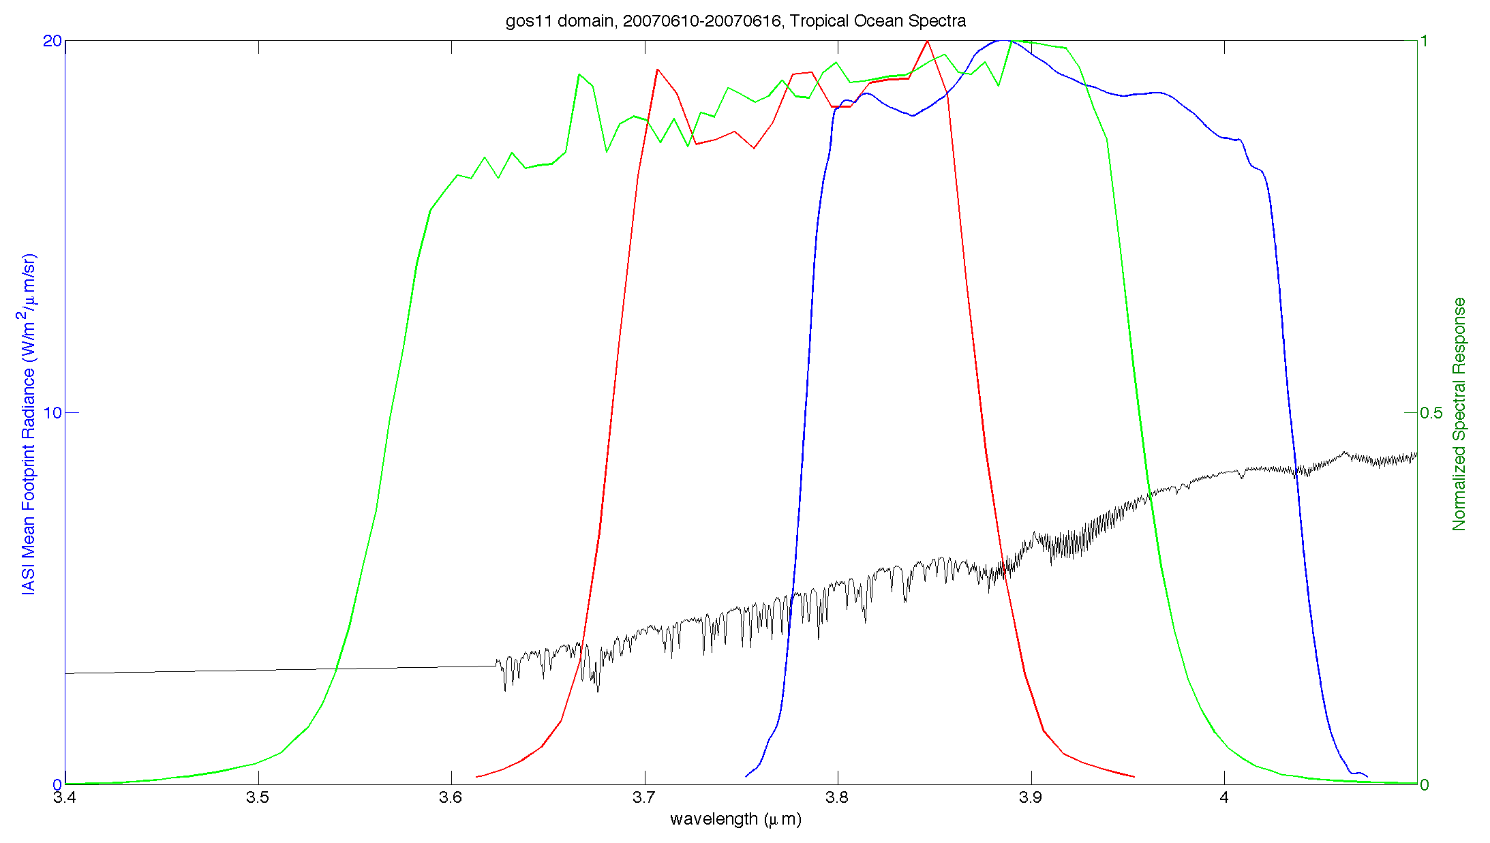
Spectral Response Functions on IASI Mean Footprint Radiance Spectrum
3.7 – 3.9 µm Channels, Night, All Sky Tropical Ocean
AVHRR
MODIS
GOES-11
Use model calculations for fill?

Slide 14
Pseudo-radiances from IASI, 3.8-µm Channels, GOES-11/MODIS

Slide 15
Pseudo-radiances from IASI, 3.8-µm Channels, GOES-11/NOAA-18

Slide 16
Pseudo-temperatures from IASI, 3.8-µm Channels, GOES-11/MODIS

Slide 17
Pseudo-temperatures from IASI, 3.8-µm Channels, GOES-11/NOAA-18

Slide 18
Testing Use of SBAFs & Cross-Calibrations to Extend Record Into Archive
• Three or four way cross calibration, apply SBAF or use raw data only
1) intercalibrate satellites 1 and 2
2) intercalibrate satellites 2 and 3 after first step
3) intercalibrate satellites 1 and 3
4) compare results of steps 1 and 3, does SBAF improve agreement?
• Start with modern satellites, then older imagers, MODIS as reference

Slide 19
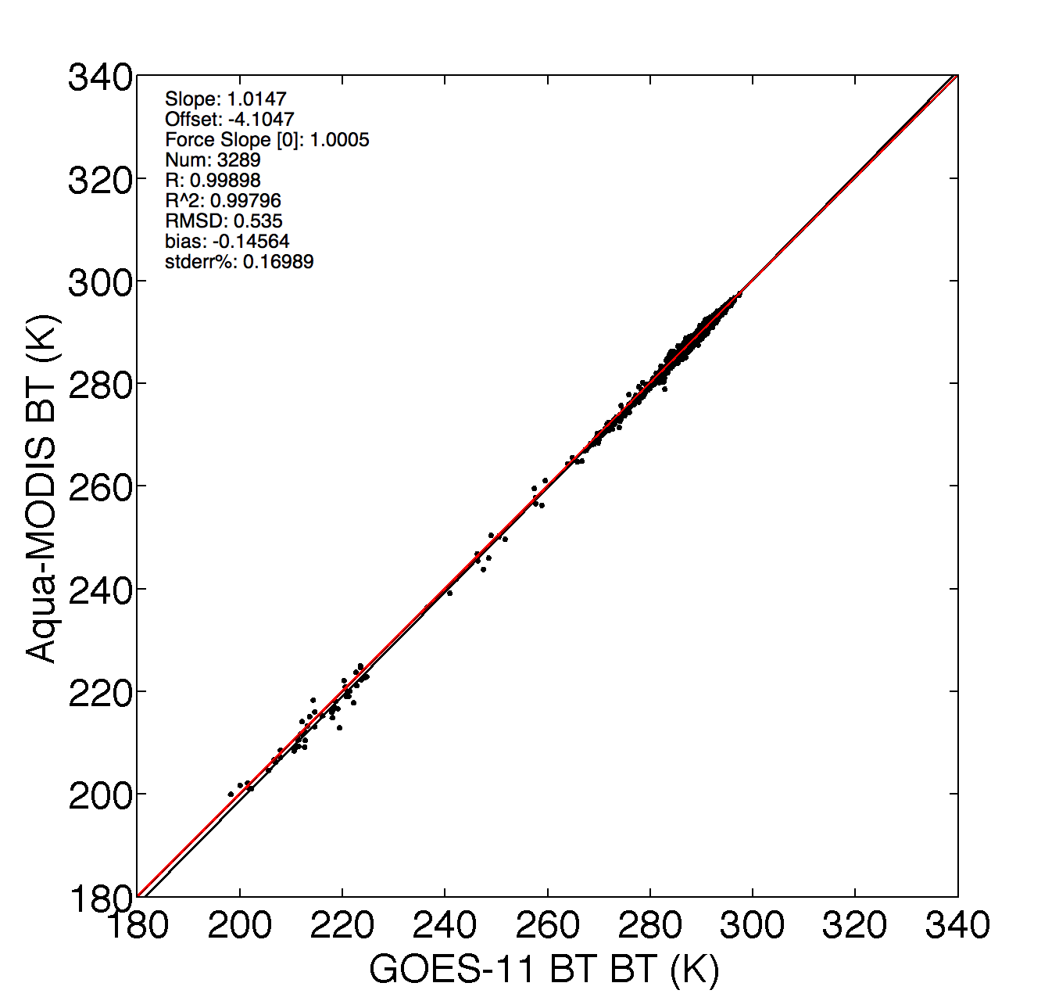
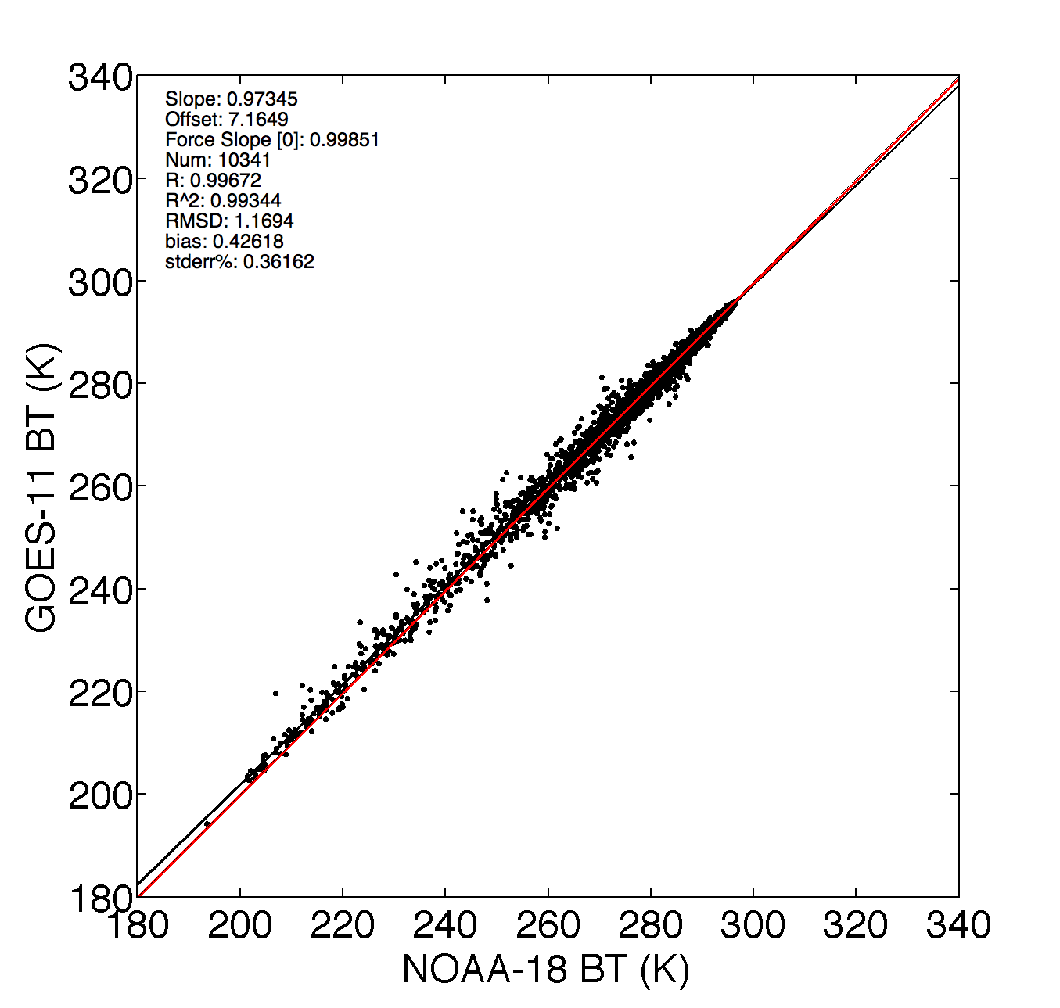
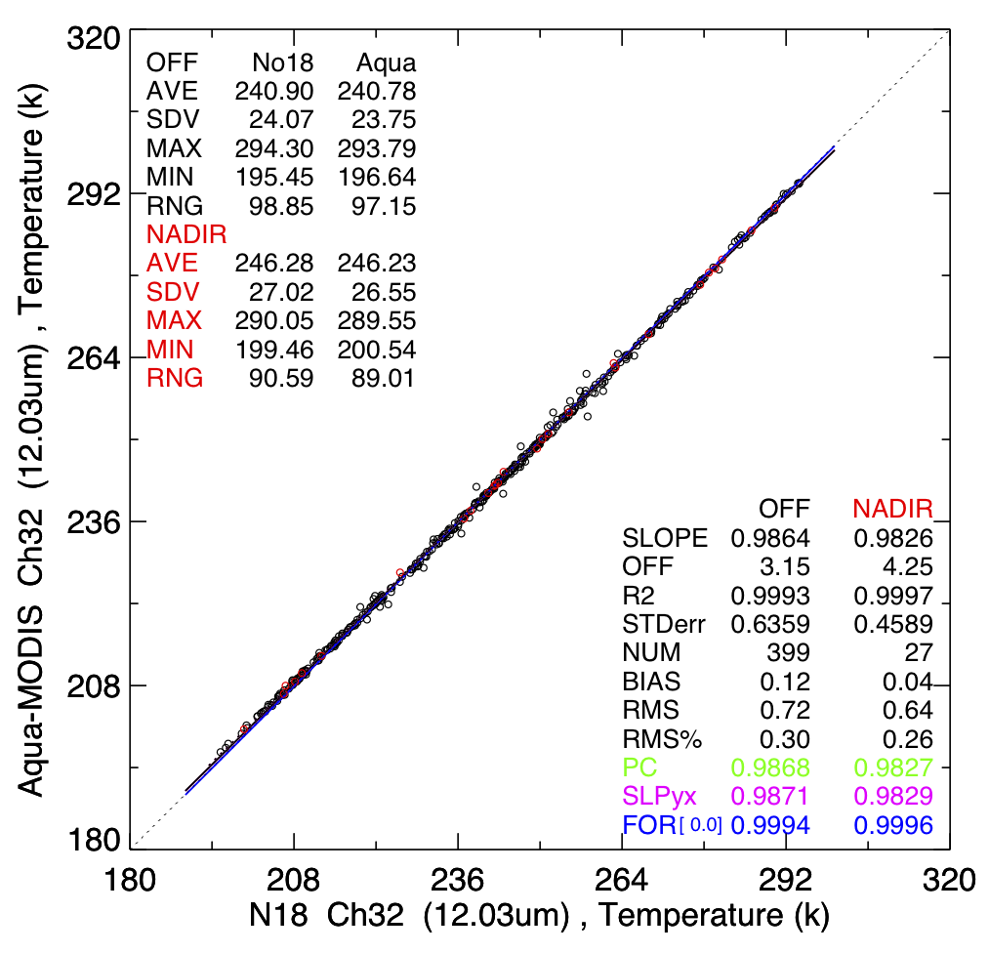
Using SBAFs to extend calibrations: MODIS to N-18 AVHRR; 3 satellites
12-µm channel, night, June 2008
MODIS / GOES-11
direct
MODIS / NOAA-18
direct
GOES-11 / NOAA-18
Force Slope Comparisons
*SBAF slope
Channel | MODIS / GOES-11 | GOES-11 / NOAA-18 | MODIS / NOAA-18 (approx.) | MODIS / NOAA-18 (direct) | Difference | Difference (No SBAF)
12 μm | 1.0005 1.0019* | 0.99851 | 0.9990 | 0.9996 1.0020 | 0.06% | 0.07%
11 μm | 1.0013 0.9989 | 0.99804 | 0.9993 | 1.0011 0.9991 | 0.18% | 0.18%
3.8 μm | 0.99803 0.99810 | 0.99986 | 0.9980 | 1.0008 0.9991 | 0.28% | 0.28%

Slide 20
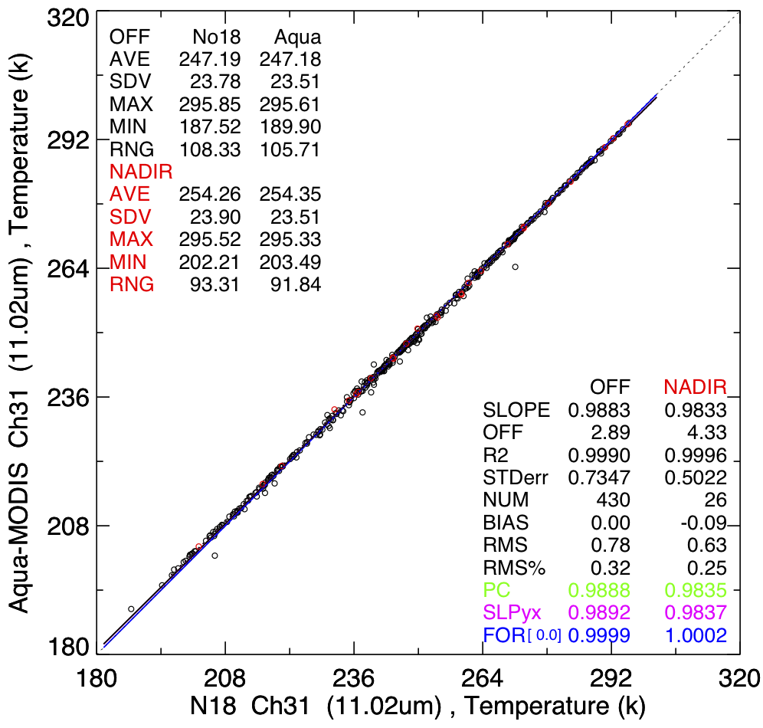
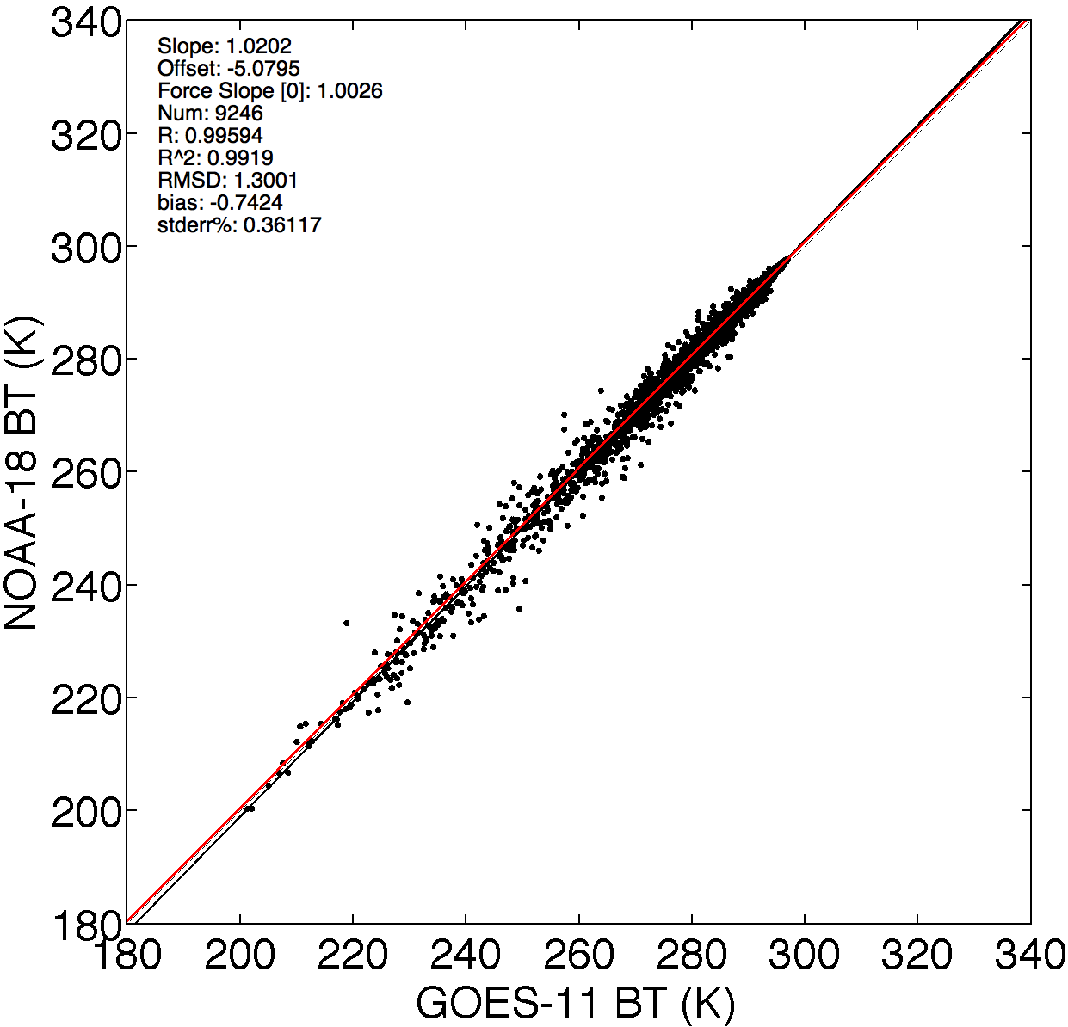
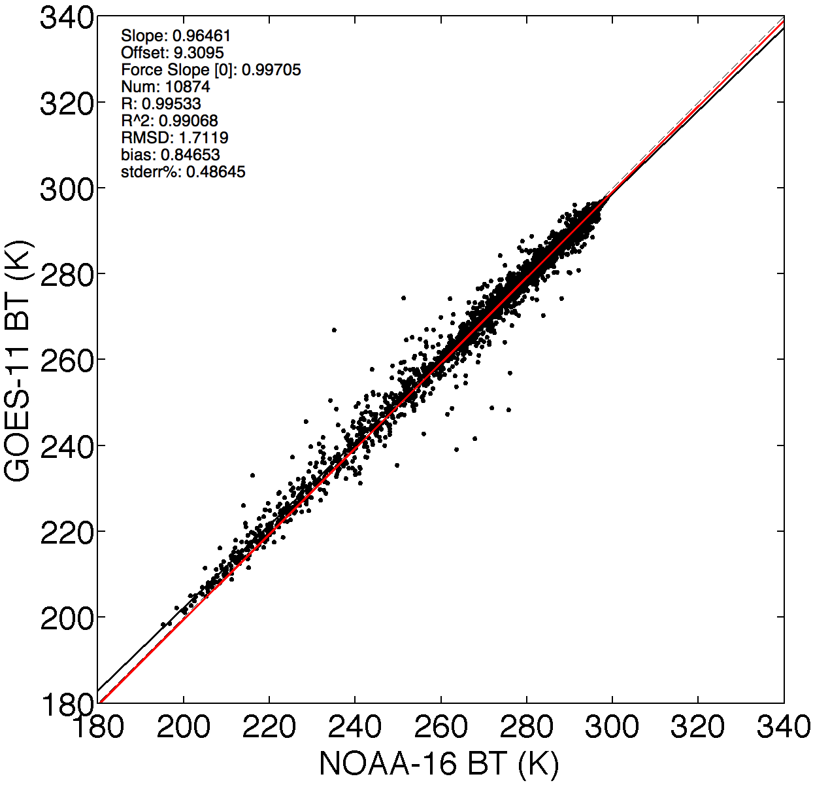
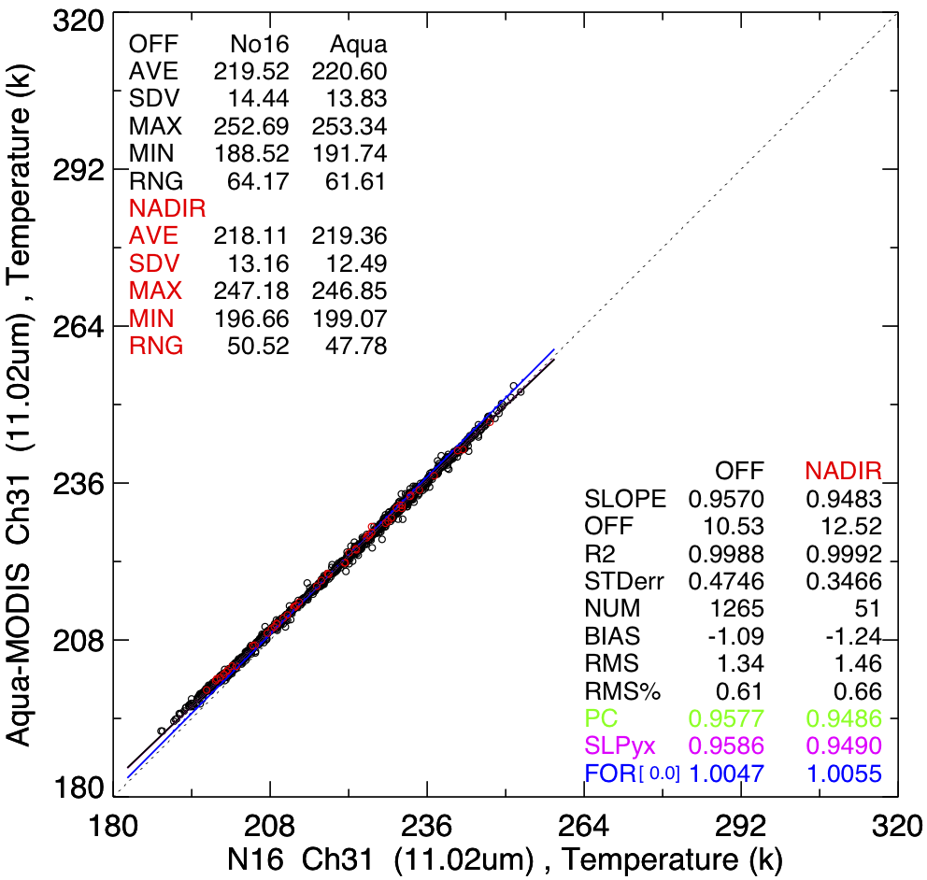
Using SBAFs to extend calibrations: MODIS to N-16 AVHRR; 4 satellites
11 µm channel, night, July 2006
MODIS / NOAA-18
Direct
NOAA-18 / GOES-11
GOES-11 / NOAA-16
MODIS / NOAA-16
Direct
Force Slope Comparisons (numbers are for SBAF application)
Channel | MODIS / NOAA-18 | NOAA-18 / GOES-11 | GOES-11 / NOAA-16 | MODIS / NOAA-16 (approx.) | MODIS / NOAA-16 (direct) | Difference | Difference (No SBAF)
12 μm | 0.9988 | 1.0022 | 0.99825 | 0.9992 | 1.0033 1.0021* | 0.41% | 0.41%
11 μm | 1.0002 | 1.0026 | 0.99705 | 0.9998 | 1.0055 0.9996 | 0.57% | 0.57%
3.8 μm | 0.9997 | 1.0005 | 0.99784 | 0.9980 | 1.0094 0.9983 | 1.13% | 1.13%
*SBAF slope

Slide 21
Summary of Preliminary Results
• SBAF corrections for modern IR channels small
- ~0.2%
- ~0.5K
• Satellite to satellite transfer errors larger than SBAF corrections
- 0.06 – 0.28% error for one generation transfer
- 0.4 – 1.1% error for second generation transfer, 1K error
• Errors can probably be reduced by taking longer time periods to increase sampling
• What about older satellites?

Slide 22
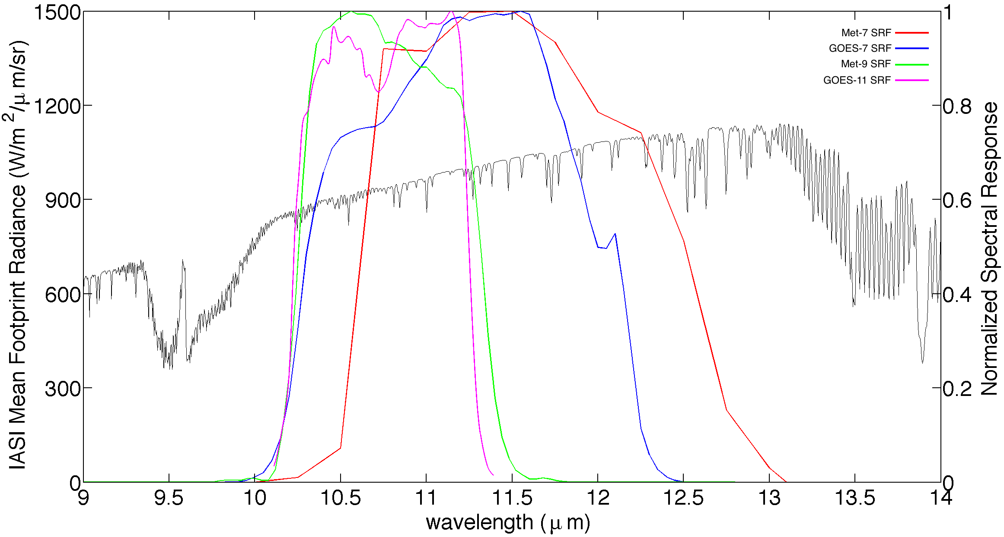
Spectral Response Functions on IASI Mean Footprint Radiance Spectrum
11 Channels, Night, All Sky Tropical Ocean
Meteosat-9
GOES-7
Meteosat-7
GOES-7
• Broader bands on older GEOs

Slide 23
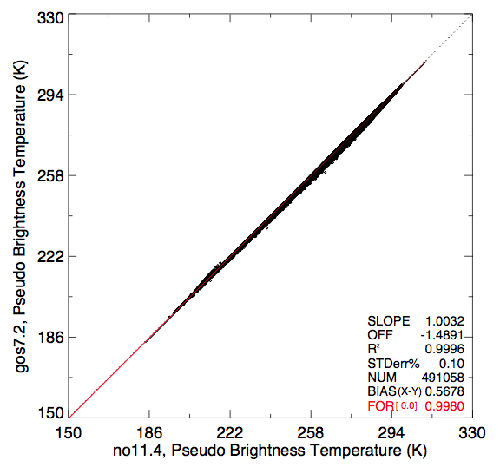
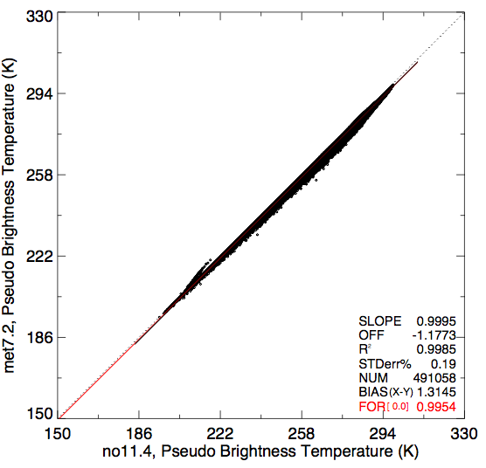
Pseudo-temperatures from IASI, 11-µm Channels
GOES-7/NOAA-11, Meteosat-7/NOAA-11
GOES-7 vs. NOAA-11
Meteosat-7 vs. NOAA-11

Slide 24
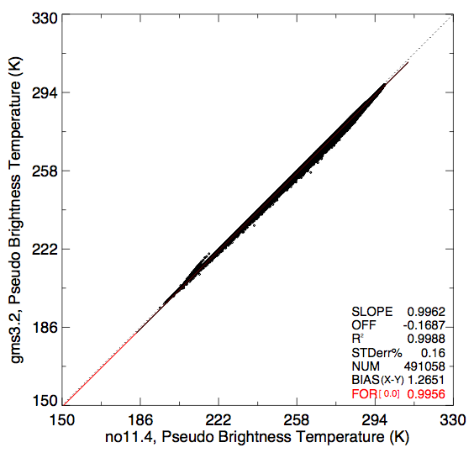
Pseudo-temperatures from IASI, 11-µm Channels
GMS-3/NOAA-11
GMS-3 vs. NOAA-11
Older Satellites
• SBAF difference nearly double that for 2nd generation GEOS
- ~0.4%
- ~1.2 K
• transfer errors will likely be larger also due to navigation, resolution, etc.

Slide 25
Future Work
• Develop SBAFs using larger datasets to determine if there are seasonal or diurnal changes
- fill in AVHRR 3.7-µm spectrum
• Test using multiple months of modern data to establish transfer errors
• Perform tests using year or two of 1st generation matched data
• Determine trend correction method for older satellites
- percentiles, DCC, SSTs?
- GSICS reference?
• Perform normalizations, clean up short term variations

