Slide 1
Migrating from GSICS GEO-LEO IR Products from Metop-A/IASI to Metop-B/IASI Reference
The advantages of using multiple references
The problems of using multiple references
The solutions to using multiple references!

Slide 2
Why Migrate References?
Nothing lasts forever (except GSICS!)
Satellites (and their instruments) have finite life spans
Satellite programs have longer life spans, but still finite
“There can be only one!”
Better, faster, cheaper* instruments come along
(*Choose 2 of the above)

Slide 3
Combining Multiple References
Advantages
Disadvantages
Robustness
In case of failure of one reference
Allows transition between references – e.g. MetopA->B
Greater coverage of diurnal cycle
Both scene and instrument calibration variability
Important for 3-axis stabilized spacecraft
Broader engagement of GSICS members
Segal's law:
"A man with a watch knows what time it is. A man with two watches is never sure." [Bloch, Arthur (2003). Murphy's Law. Perigee. p. 36.]
It refers to the potential pitfalls of having too much conflicting information when making a decision.
User confusion
Not Metrologically Traceable
as the references can never be perfectly consistent
Define only one as the calibration reference
All others are regarded as calibration transfer standards

Slide 4
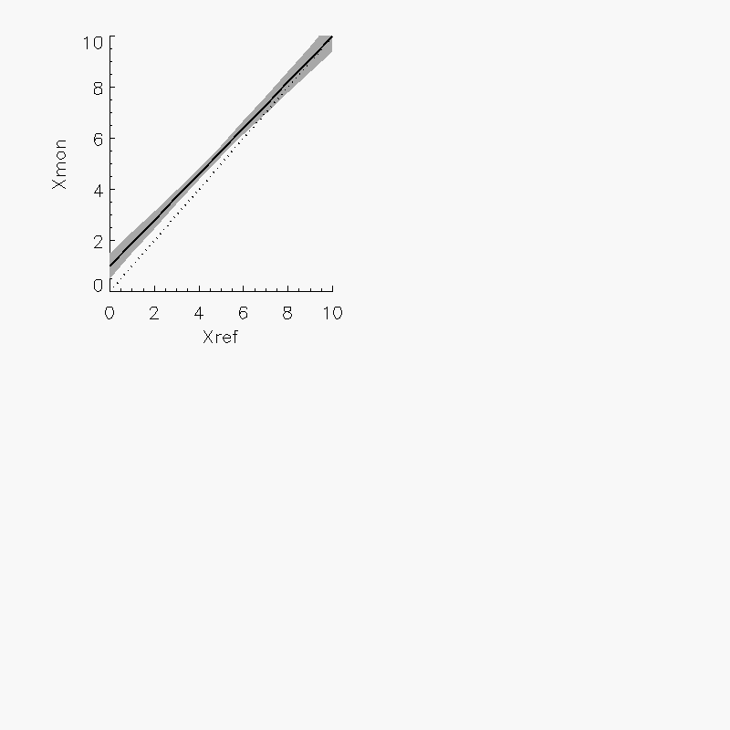
GSICS Correction using Reference 1
GSICS Correction for Monitored Instrument
Based on Reference 1
Function with uncertainty

Slide 5
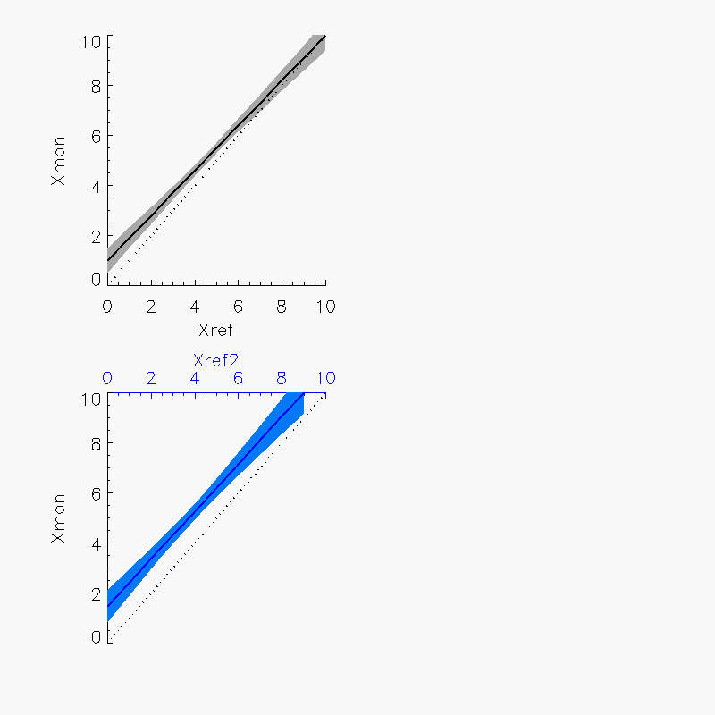
GSICS Correction using Reference 2
GSICS Correction for Monitored Instrument
Based on Reference 2
Different function with different uncertainty

Slide 6
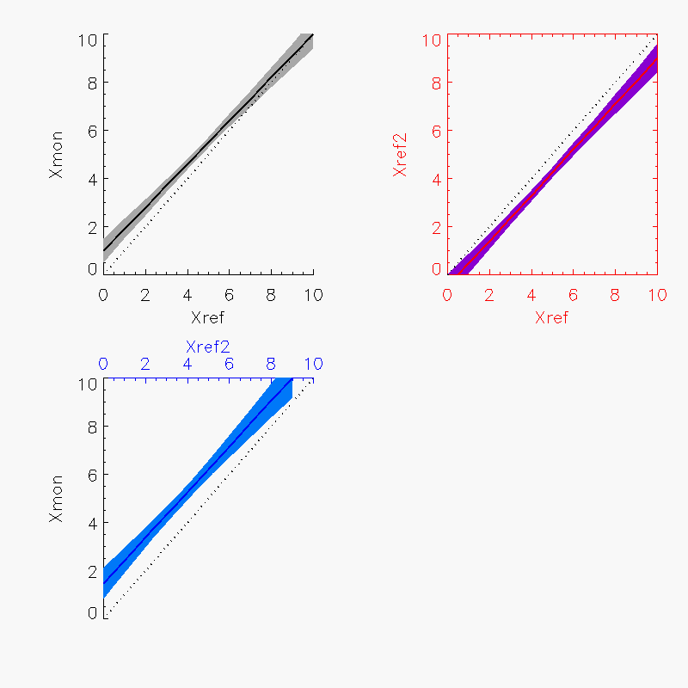
Delta Correction Reference 2->1
GSICS Correction for Reference 2
Based on Reference 1
Function with uncertainty

Slide 7
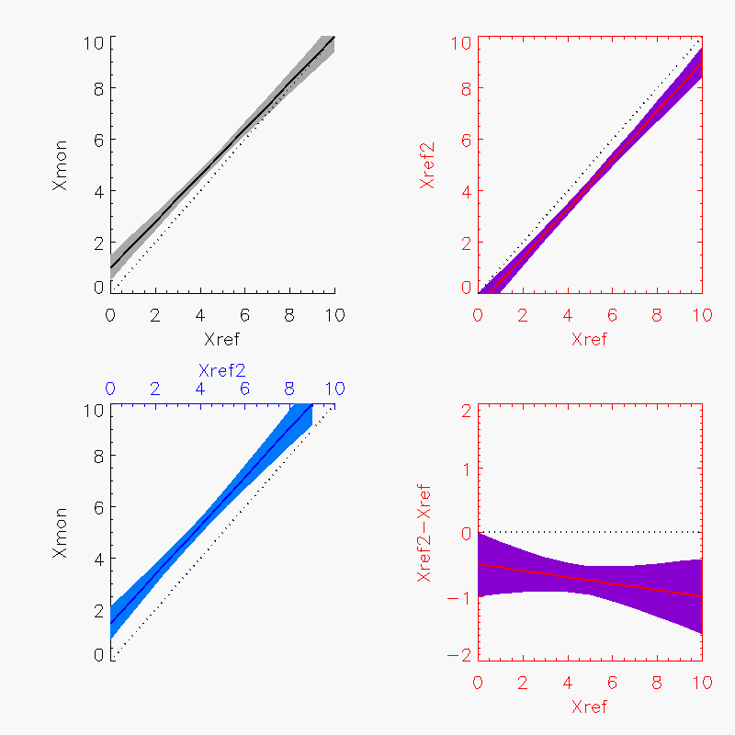
Delta Correction Reference 2->1
Delta GSICS Correction for Reference 2
Based on Reference 1
Function with uncertainty

Slide 8
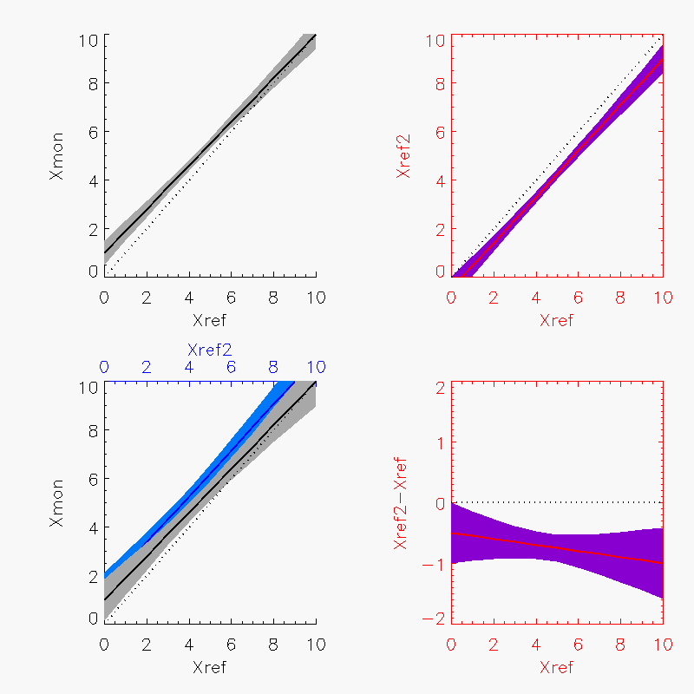
GSICS Correction using Reference 2->1
Add Delta Correction to Reference 2
Maps GSICS Correction based on Reference 2 to Reference 1
Consistent function, but larger uncertainty

Slide 9
Implementation
GSICS Correction
Correction using Reference 1
Correction using Reference 2
Delta Correction Reference 2-1

Slide 10
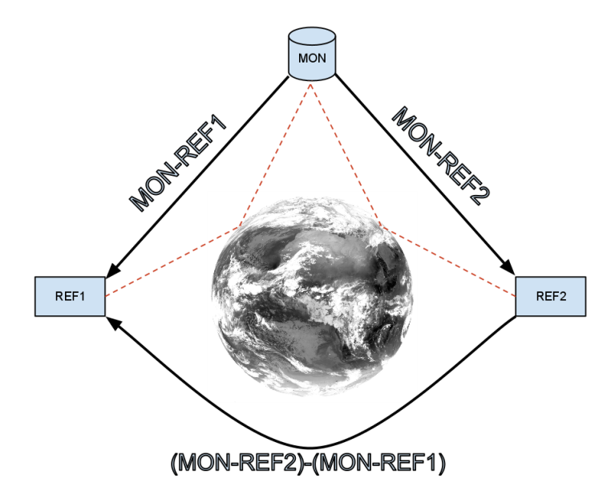
GEO as Transfer Radiometer
Direct Comparison may not be possible
GEOs can be collocated with every LEO overpass
Use as transfer standard
But define Delta Corrections in GEO channel space
Errors from Spectral Band Adjustment tend to cancel out
Wang et al [20011] compared direct SNO method with LEO-GEO-LEO method:
Broad consistency
Mean differences of <0.1K
L. Wang, M. Goldberg, X. Wu, C. Cao, R. A. Iacovazzi Jr, F. Yu, and Y. Li, "Consistency assessment of Atmospheric Infrared Sounder and Infrared Atmospheric Sounding Interferometer radiances: Double differences versus simultaneous nadir overpasses," JGR, vol. 116, no. 11, 2011.
Schematic diagram showing how double differencing against a third sensor as an intermediate transfer reference can be used to inter-calibrate two instruments without requiring direct comparison of their observations. Dashed red lines show collocated observations from pairs of instruments. Black arrows show calibration transfers.

Slide 11
Meteosat-9/SEVIRI as Transfer
Direct Comparison Metop-B & -A impossible
Orbits are 50min/180° out of phase
Meteosat-9/SEVIRI can be collocated with overpasses of both Metop’s
Use as transfer standard
Define Delta Corrections in SEVIRI channel space
Strictly Meteosat-9/SEVIRI
But SRF Differences expected to have negligible impact (TBC)
Meteosat-9/SEVIRI
(Met9/SEVIRI-MetopA/IASI)
(Met9/SEVIRI-MetopB/IASI)
Metop-A/IASI
Metop-B/IASI
(Met9/SEVIRI-MetopB/IASI)-(Met9/SEVIRI-MetopA/IASI)
Schematic diagram showing how double differencing against a third sensor as an intermediate transfer reference can be used to inter-calibrate two instruments without requiring direct comparison of their observations. Dashed red lines show collocated observations from pairs of instruments. Black arrows show calibration transfers.

Slide 12
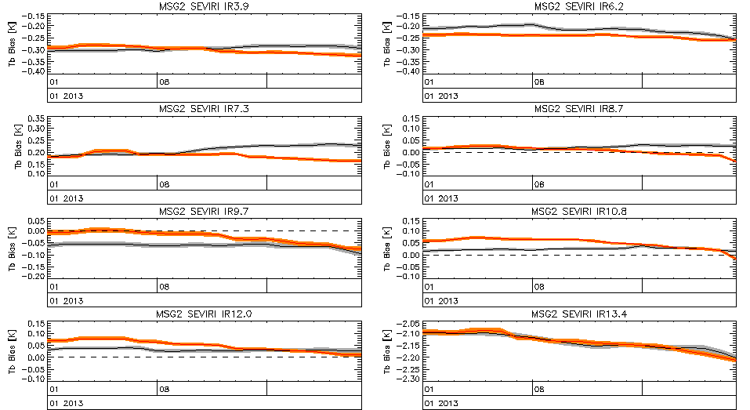
Time Series of Standard Biases (Met9/SEVIRI-MetopB/IASI) & (Met9/SEVIRI-MetopA/IASI)
Change in IASIb processor

Slide 13
Statistics of Double Difference (Met9/SEVIRI-MetopB/IASI)-(Met9/SEVIRI-MetopA/IASI)
Meteosat-9/ SEVIRI Channel | Mean Difference of Standard Biases [K] | Std Dev of Difference of Standard Biases [K]
IR3.9 | +0.006 | 0.022
IR6.2 | +0.028 | 0.009
IR7.3 | +0.025 | 0.029
IR8.7 | +0.014 | 0.021
IR9.7 | -0.036 | 0.019
IR10.8 | -0.025 | 0.022
IR12.0 | -0.017 | 0.020
IR13.4 | -0.000 | 0.010
Biases for standard scene radiances (clear sky)
From Demonstration GSICS Re-Analysis Corrections
From first 2 months data from Metop-B/IASI
Double differences are small (<|40mK|) for all channels
Only statistically significant at 95% level for IR6.2
which was unusually stable during this short 21d period
Good News!
But still need delta correction!
With uncertainties!
Total Uncertainty (k=1) from Uncertainty Analysis ~0.01K

Slide 14
Statistics of Double Difference (Met9/SEVIRI-MetopB/IASI)-(Met9/SEVIRI-MetopA/IASI)
Meteosat-9/ SEVIRI Channel | Mean Difference of Standard Biases [K] | Std Dev of Difference of Standard Biases [K]
IR3.9 | -0.72 | 0.28 (<<u)
IR6.2 | +0.11 | 0.05
IR7.3 | +0.15 | 0.18
IR8.7 | -0.11 | 0.30
IR9.7 | -0.17 | 0.08
IR10.8 | -0.30 | 0.29
IR12.0 | -0.25 | 0.24
IR13.4 | +0.67 | 0.28
Biases for cold cloud radiances (220K)
From Demonstration GSICS Re-Analysis Corrections
From first 2 months data from Metop-B/IASI
Double differences are small (<|1K|) for all channels
Statistically significant only for:
IR6.2 which was unusually stable during this short 21d period
IR3.9, which is very non-linear at the cold end
More Good News!
Total Uncertainty (k=1) from Uncertainty Analysis ~0.7K for IR3.9 ~0.2K for IR10.8

Slide 15
Formulating the Delta Correction
GSICS Correction
L_{MON}=g(L_{REF})=a+b.L_{REF}
Met9-IASIa: L_{Met9}=a₁+b₁.L_{IASIa}
Met9-IASIb: L_{Met9}=a₂+b₂.L_{IASIb}
=> Double Difference:
a₂+b₂.L_{IASIb}=a₁+b₁.L_{IASIa}
L_{IASIb}=(a₁-a₂) /b₂+(b₁/b₂).L_{IASIa}
L_{IASIb}=a₂₁+b₂₁.L_{IASIa}

Slide 16
Propagation of Variances
? terms are unknown
Could assume them to be zero
Implies no correlation between MSG2-MetopA/IASI and MSG2-MetopB/IASI
Let’s try…

Slide 17
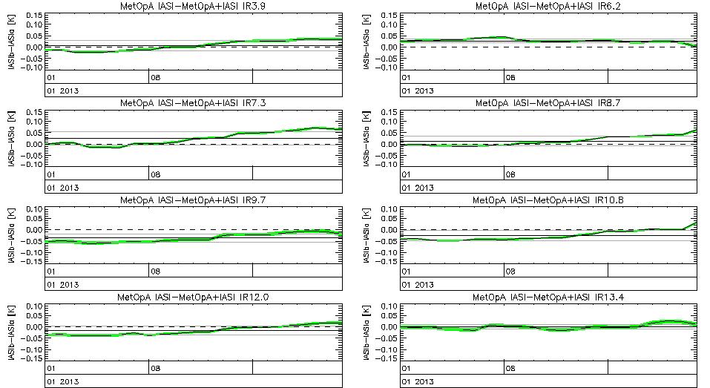
Time Series of Double Differences (Met9/SEVIRI-MetopB/IASI)-(Met9/SEVIRI-MetopA/IASI)

Slide 18
Propagation of Variances
Assuming off-diagonal terms to be zero
Implies no correlation between MSG2-MetopA/IASI and MSG2-MetopB/IASI
Uncertainty calculated theoretically from the propagation of variance tends to underestimate the observed variability of the time series of RACs
for both standard scene radiances
as well as cold scenes (Tb=220K).
This implies the correlation is significant
and cannot be neglected
Although it is not trivial to calculate,
Because two time series are independent
not necessarily on the same dates
Correlation between RAC coefficients?
Generally low
although not independent…

