Slide 1
Regional characteristics of Deep Convective Clouds (DCCs) observed by the Lightning Imaging Sensor (LIS) for July and August 1998-2010
Dennis Buechler

Slide 2
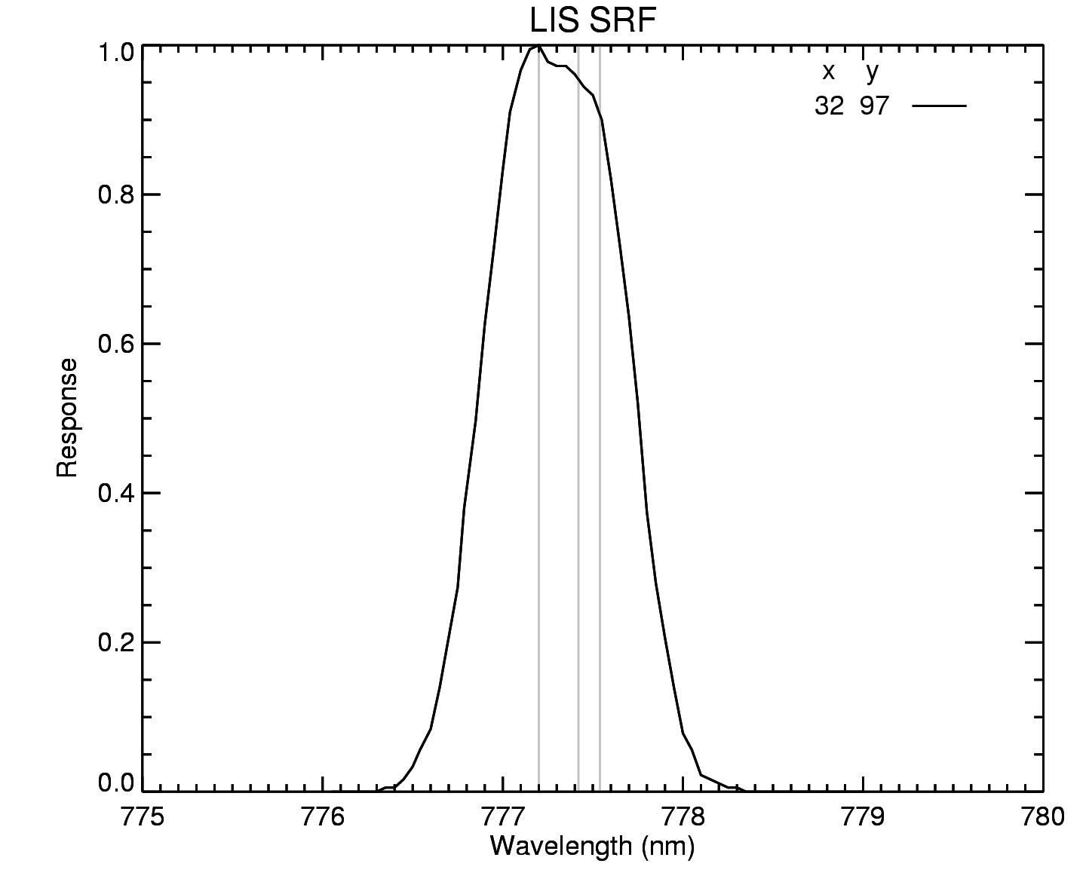
LIS Characteristics
Fast lens, narrowband (~1 nm wide) filter at 777.4 nm
128 x 128 CCD array, 500 fps imaging
~3.5 km nadir to ~7 km at corners
Frame-to-frame subtraction isolates lightning transients against bright daytime background
Backgrounds ~35 seconds

Slide 3
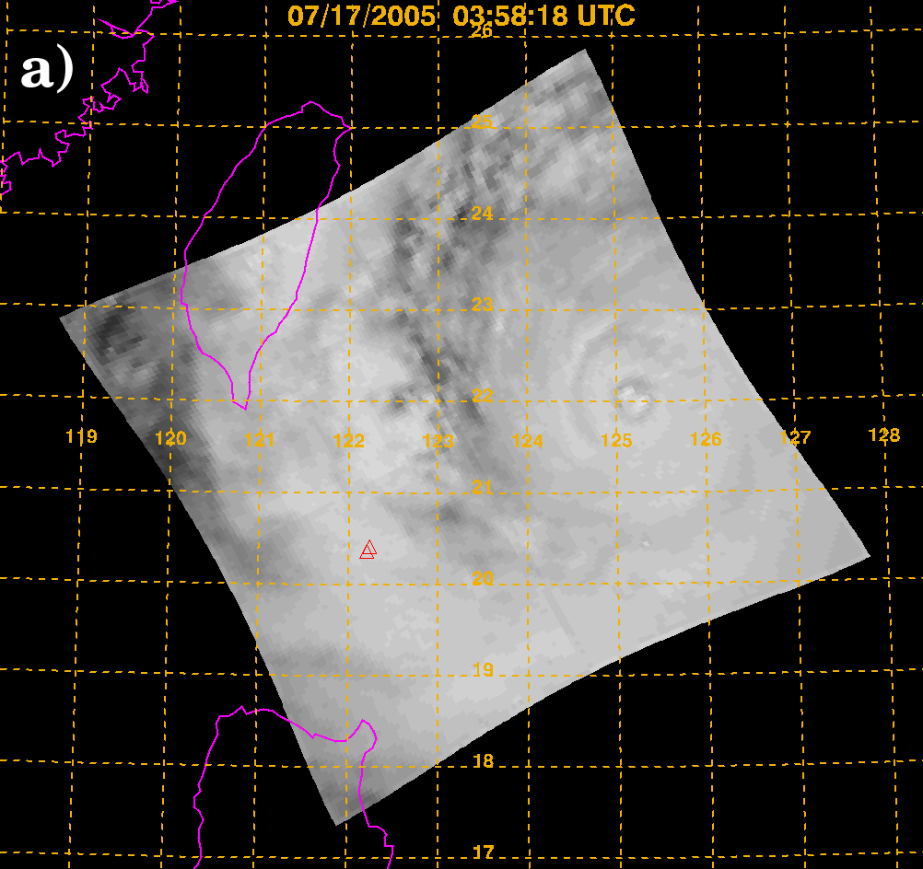
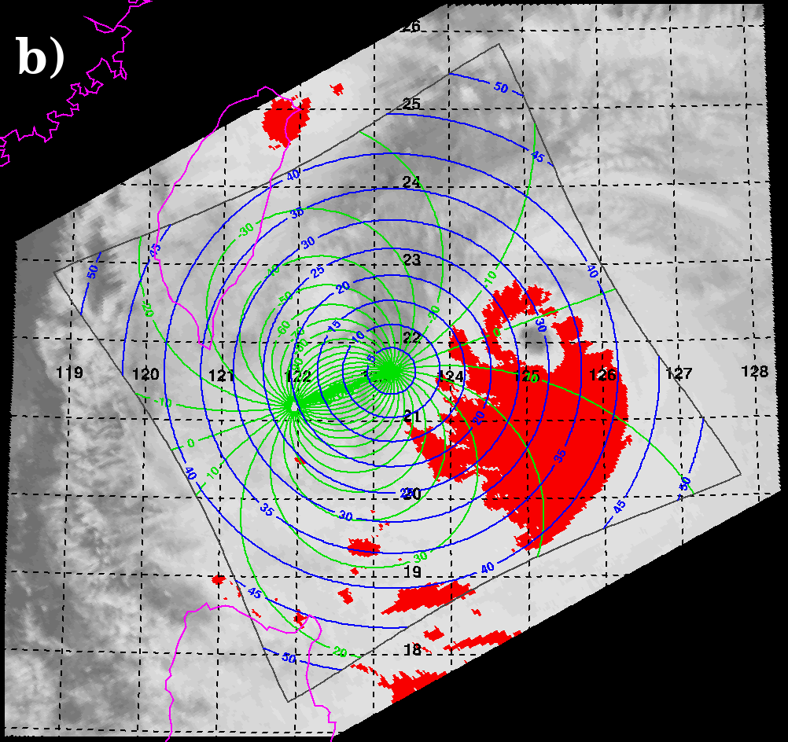
Methodology
Use VIRS (colocated onboard TRMM with LIS) 11 µm to identify DCCs ( > 205K)
Identify colocated LIS Background (BG) pixels
Method being evaluated for use to monitor Geostationary Lightning Mapper (GLM) on-orbit performance
Analyzed each July and August from 1998-2010

Slide 4
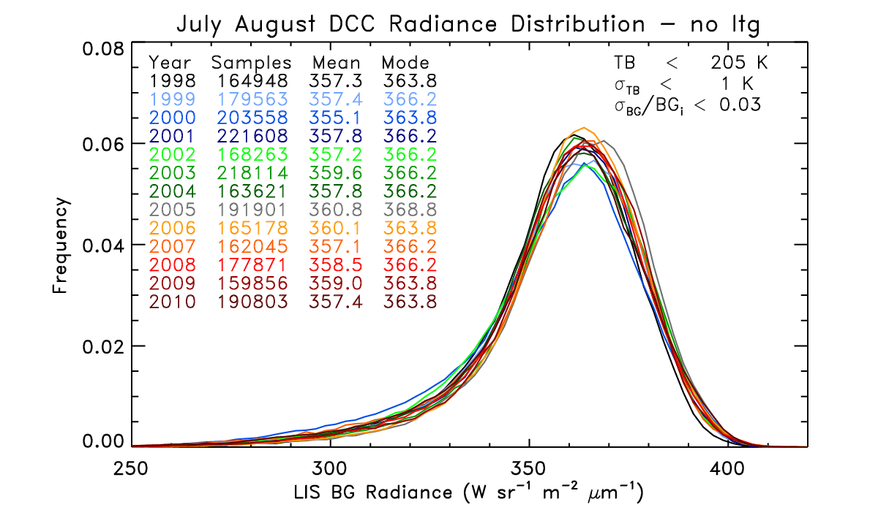
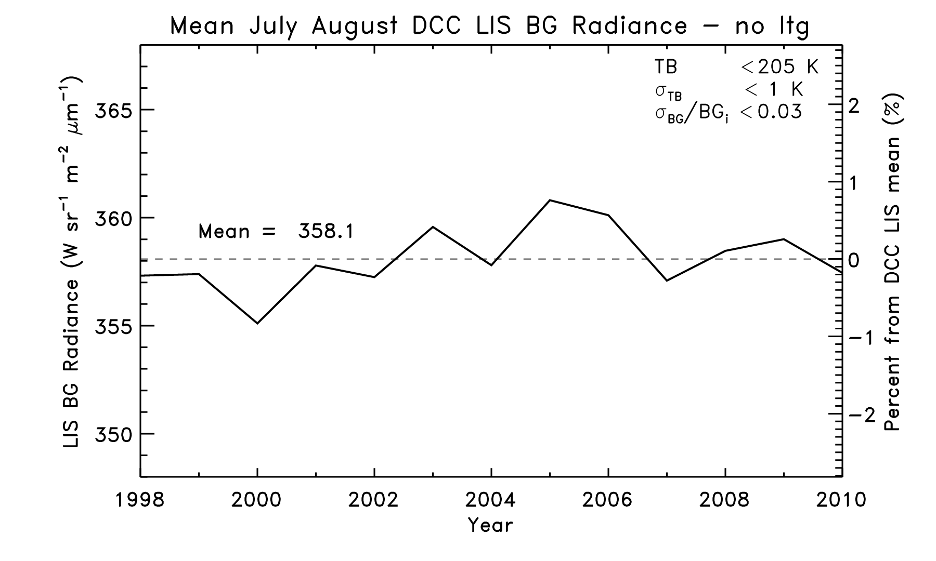
Results
LIS DCC radiance distributions are very similar from 1998-2010
Mean yearly July August LIS DCC radiance values vary little over the period
Atmospheric Research, 2013

Slide 5
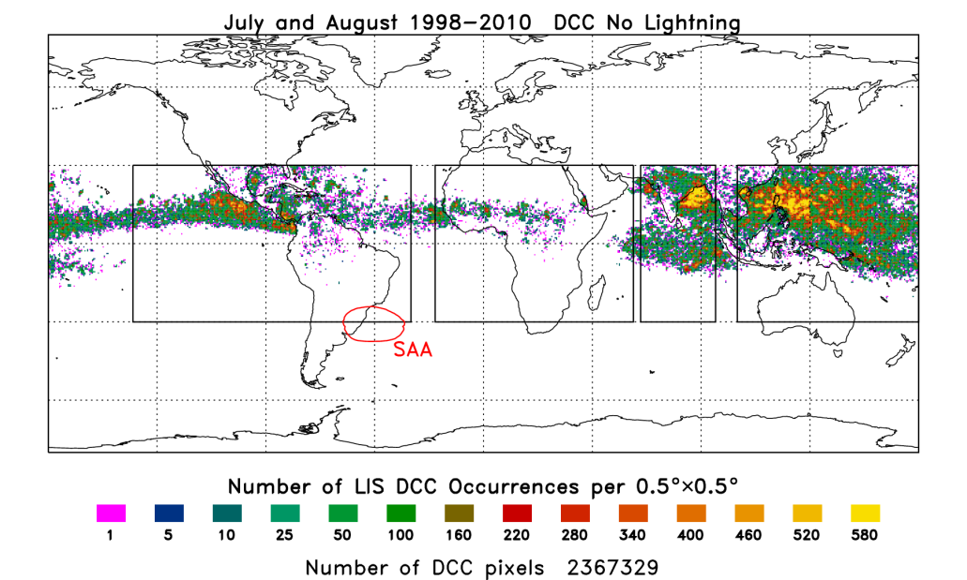
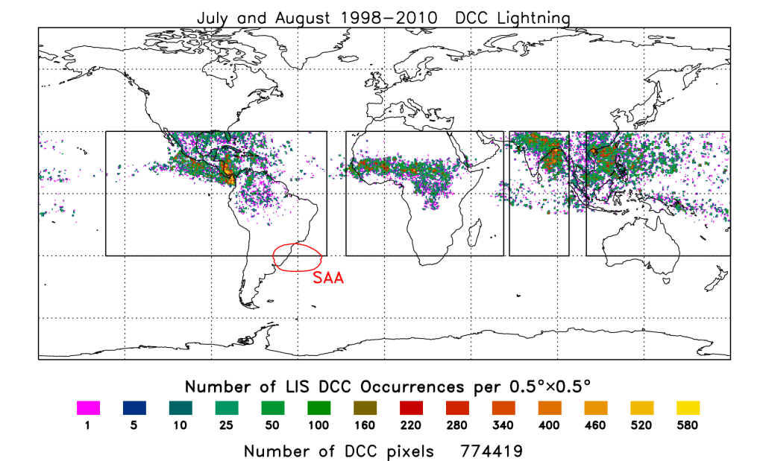
Location of LIS DCCs
91.5% of LIS DCCs occur over oceans
  Western Pacific (WPAC)
  Bay of Bengal and Indian Ocean (IND)
  near central America (AM)
8.5% of LIS DCCs occur over land
  Africa (AFR)
  Near the Himalayas (IND)
31% of LIS DCCs associated with lightning occur over land
  Mostly over Africa (AFR)
AM
AFR
IND
WPAC

Slide 6
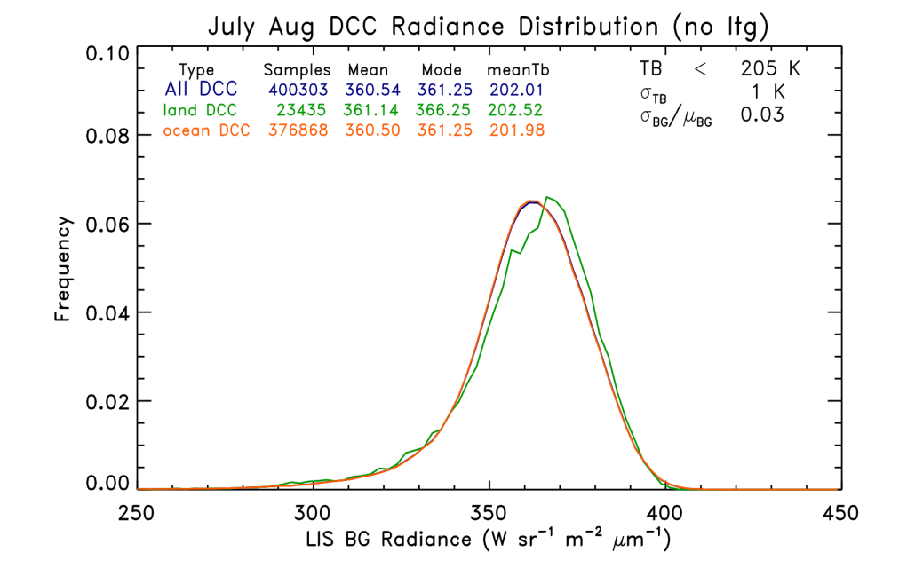
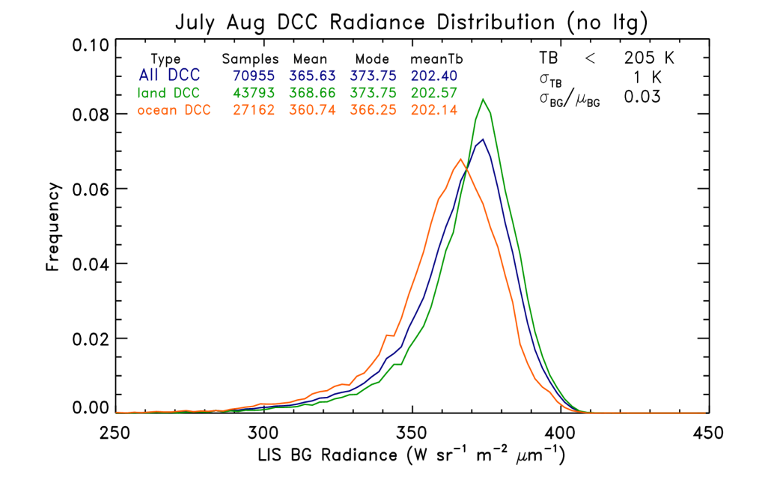
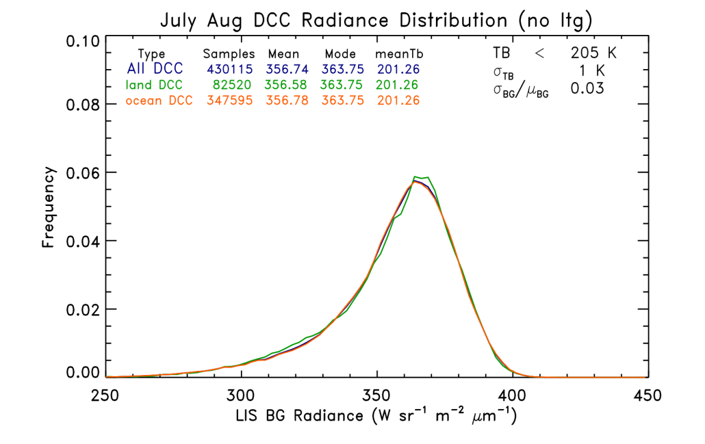
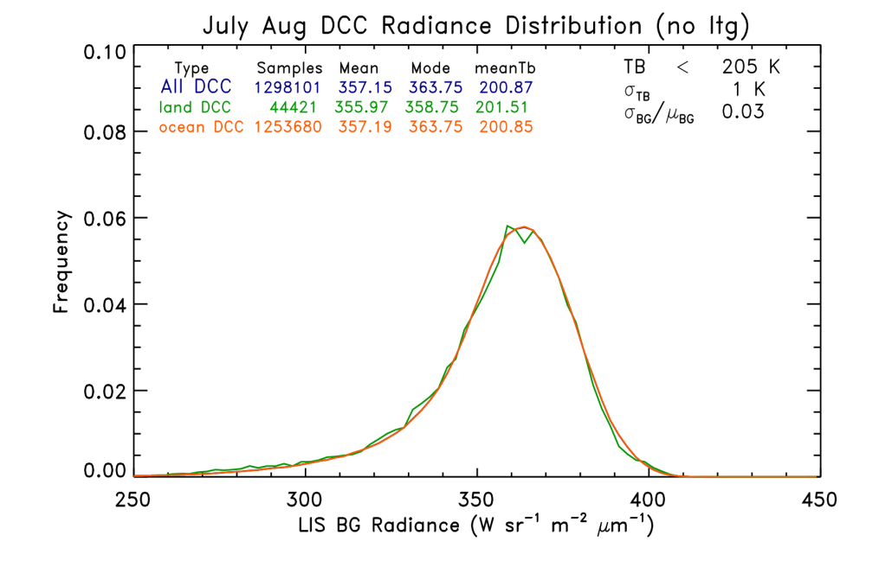
Land/Ocean LIS DCC radiances
AM
AFR
IND
WPAC

Slide 7
Land/Ocean LIS DCCs
LIS DCC radiance distributions are similar in each region except Africa whose land pixels are brighter than any other region (368.7 W sr⁻¹ m⁻² µm)
LIS DCC radiances in AM and AFR are somewhat brighter than those over IND and WPAC (360.5 vs 357.1 W sr⁻¹ m⁻² µm)

Slide 8
Next Steps
Run analysis using TRMM VIRS v7
Apply to other months
Develop and apply an angular distribution model
Examine other stable targets for calibration (e.g., deserts, glint)
Develop procedure for use with GLM
Possibility of using LIS to inter-calibrate other planned GEO lightning sensors

Slide 9
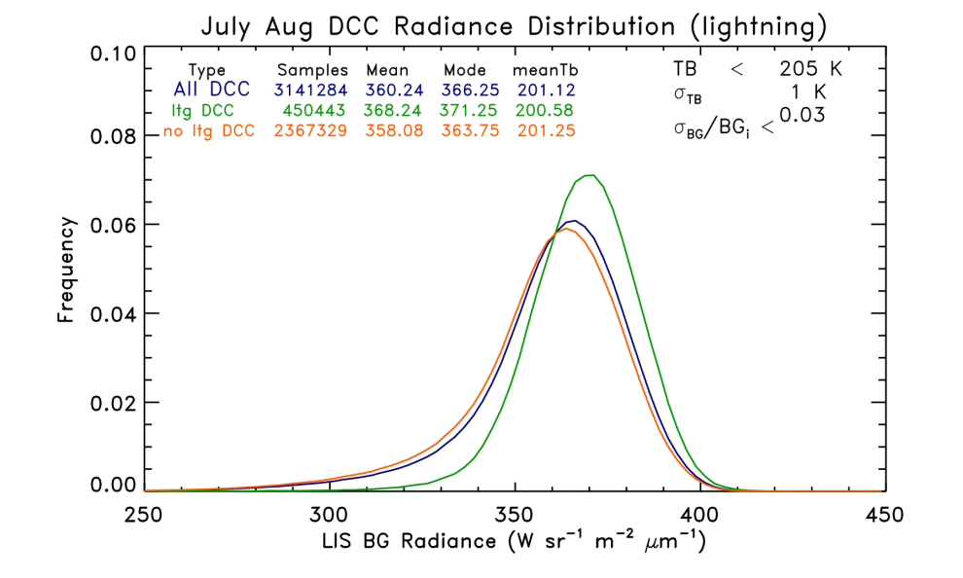
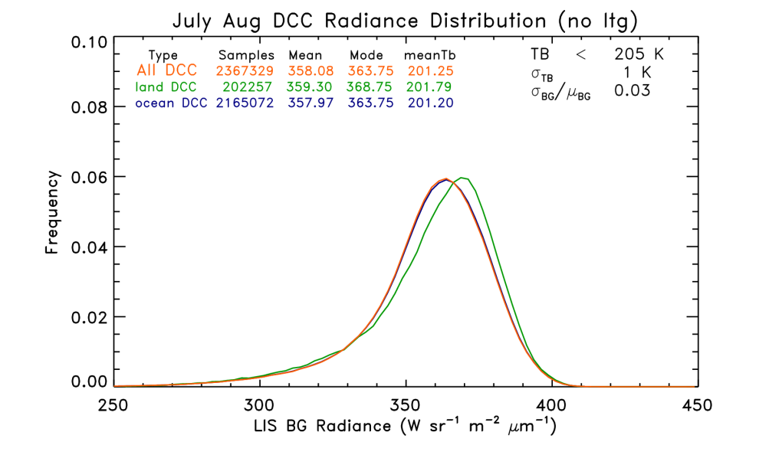

Slide 10
