Slide 1
Desert-based calibration of co-located geostationary visible sensors using a daily exoatmospheric radiance model (DERM)
Raj Bhatt, Dave Doelling, Ben Scarino, Arun Gopalan, Conor Haney
2013 GSICS Annual Meeting
Williamsburg, VA 23185
March 4-8, 2013

Slide 2
Introduction and Motivation
Multiple geostationary satellite data play important role in studying long-term global climate change.
GEO imagers lack onboard calibration; requires vicarious approach.
For the CERES project, current GEO sensors are directly calibrated against MODIS radiances using ray-matching.
Need a technique to calibrate all historical (pre-MODIS timeframe) and current GEO sensors on a consistent radiometric scale.

Slide 3
DERM Concept and Methodology
This approach uses a pseudo-invariant calibration site (PICS) to transfer calibration from a reference GEO sensor to a target co-located GEO sensor.
The reference GEO sensor calibration is obtained from its inter-calibration (ray-matching) with a matching Aqua MODIS band.
The similar daily imaging schedules of the reference GEO provides consistent solar and azimuth angular conditions on a particular day of year.
Multiple years of consistent-time daily TOA radiances observed from the reference GEO over the PICS are used to construct a daily-exoatmospheric radiance model (DERM).
Near local noon-time data is chosen for maximum SNR.
Since the daily angular conditions are repeated annually for any historical or successive co-located GEO, the reference GEO DERM is used to predict the TOA radiance of the co-located target GEO, and calibrate it.

Slide 4
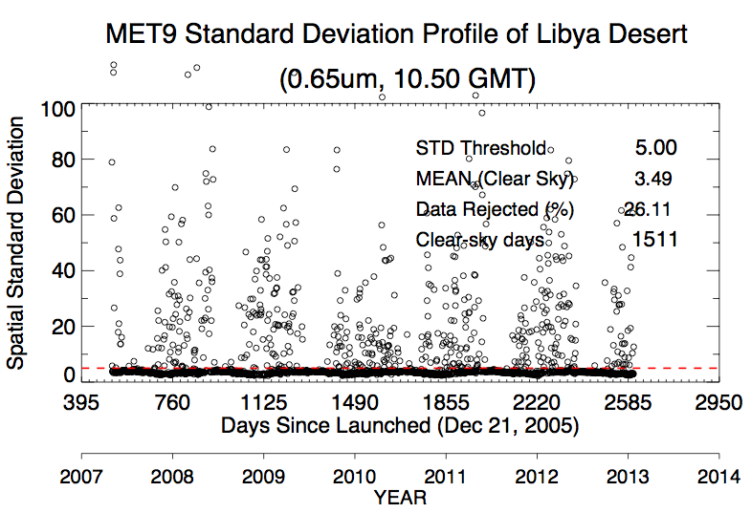
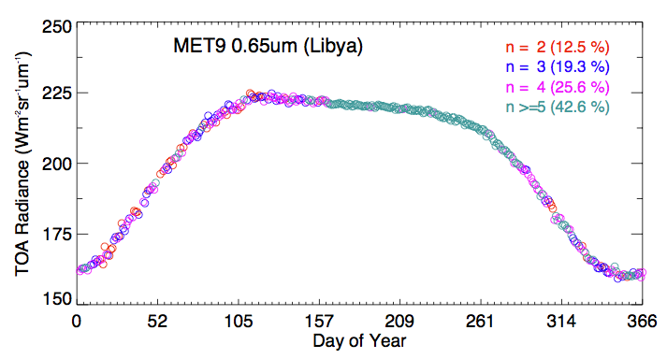
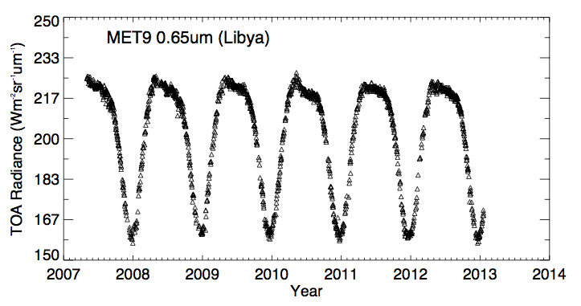
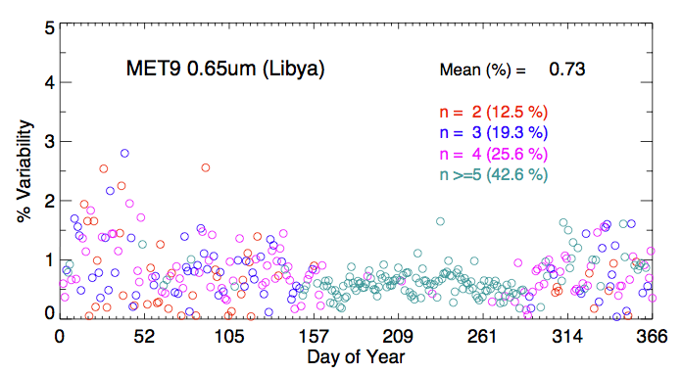
Derivation of DERM
Libya-4 DERM
Clear-sky scenes are identified using a spatial standard deviation threshold.
The MET-9 daily TOA radiance in the 0.65um channel has a consistent repeating
cycle every year with an inter-annual variability of 0.73%.

Slide 5
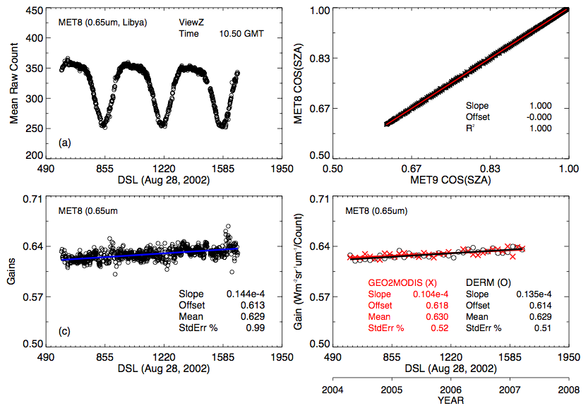
Transferring calibration to MET-8 from MET-9 DERM
The MET-8 gain trends obtained from the DERM and ray-matching approaches show excellent agreement.

Slide 6
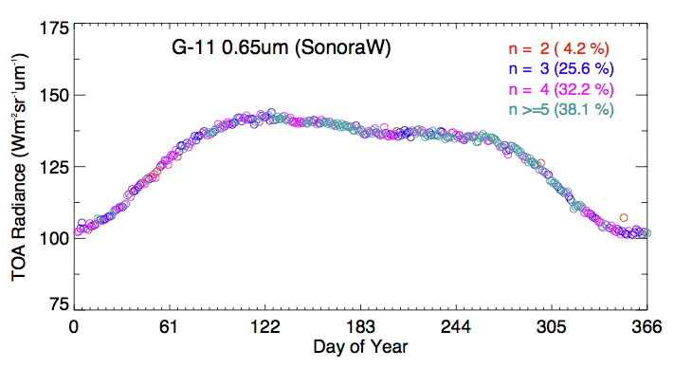
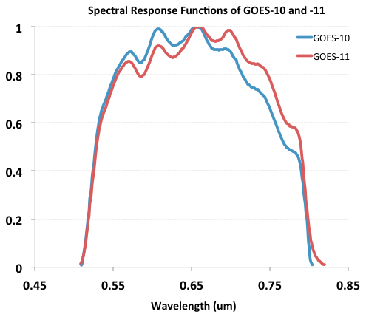
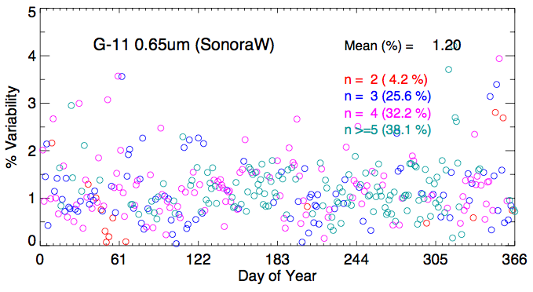
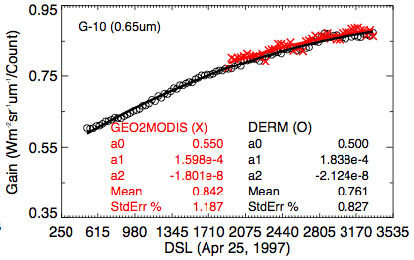
Transferring calibration to GOES-10 using GOES-11 Sonora DERM
GOES-10 gains derived from the GOES-11 DERM and Aqua ray-matching are consistent within 1% during the overlapping timeframe.

Slide 7
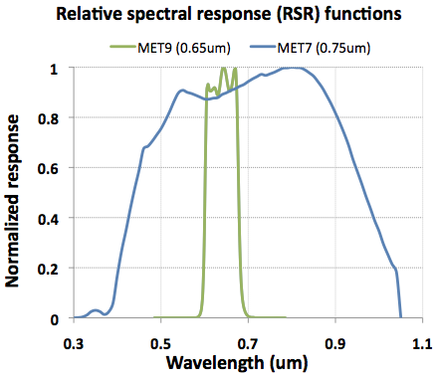
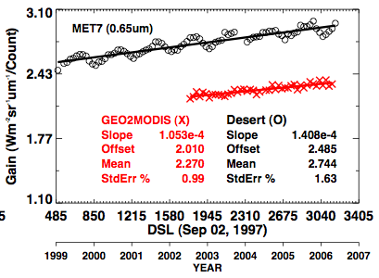
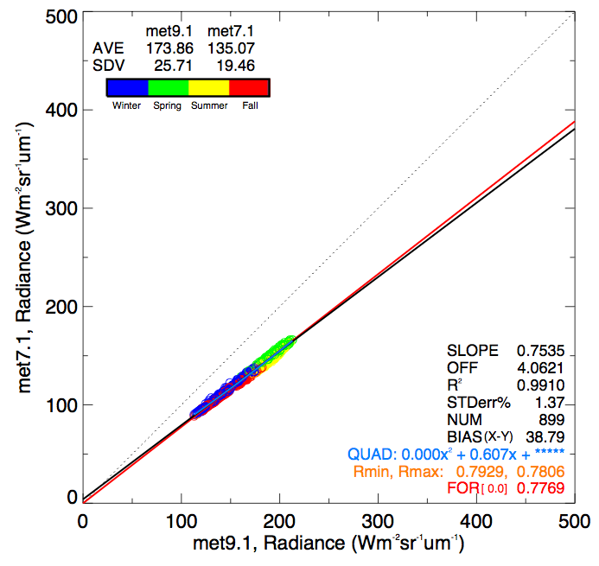
Spectral band difference effects
Spectral correction factors are required while applying the DERM approach between sensors with different SRFs.
Correction factors are scene-dependent, and can be derived from the knowledge of the spectral signature of the target.
High-resolution reflected solar spectra measured by SCIAMACHY over the PICS are to derive the spectral band adjustment factors.
Without SBAF

Slide 8
Summary
The DERM approach uses the consistent, repeating cycle of the PICS daily TOA radiance every year to inter-calibrate co-located GEO sensors.
This approach eliminates the need of PICS BRDF.
The DERM results are consistent with GEO-to-MODIS ray-matching outputs.
The DERM approach has the potential to calibrate historical, current, and future co-located GEO sensors to the same calibration reference (MODIS).
The DERM uncertainty is case dependent:
Sources: temporal stability of the PICS, inter-annual variability in the TOA radiance, SBAF, uncertainty in the SRFs

Slide 9
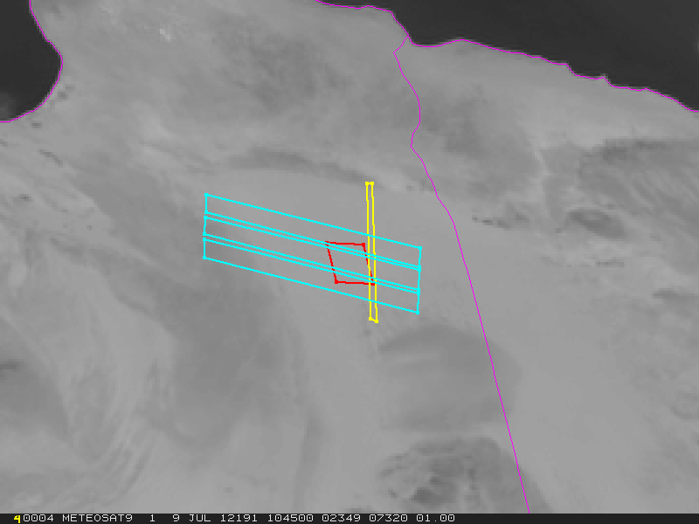
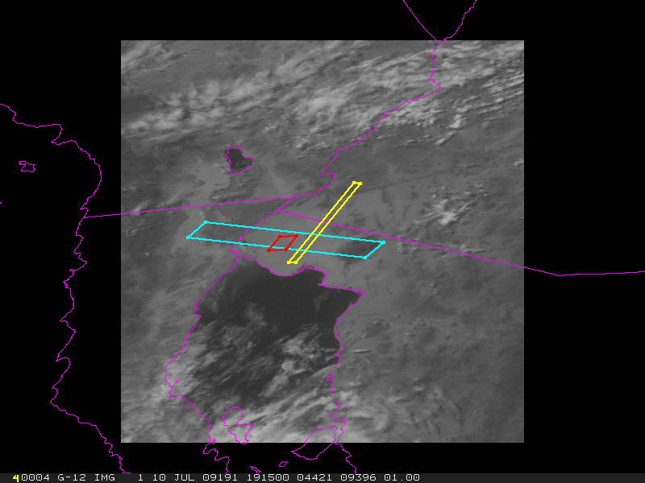
Backup slides
SCIAMACHY
ROI
Hyperion

