Slide 1
Visible vicarious calibration using RTM
Masaya Takahashi
Meteorological Satellite Center/
Japan Meteorological Agency

Slide 2
Contents
Methodology of vicarious calibration using RTM
Target selection
Consideration for DCC
Comparison between Terra/MODIS and Aqua/MODIS
GMS-5 re-calibration during pre-MODIS era
Target selection
Comparison of RT simulation between w/ and w/o MODIS
Summary and future plan

Slide 3
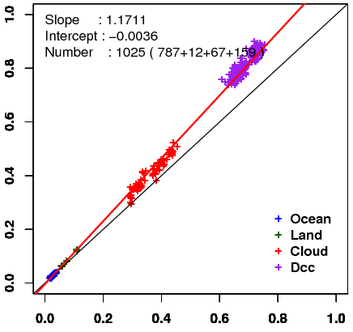
Methodology
Method: Comparison of observed and simulated radiance for four targets
Target: Wide range of TBB in order to obtain reliable regression line
Cloud-free ocean, Cloud-free land, Liquid water cloud, DCC
Radiative transfer calculation:
RSTAR (Nakajima and Tanaka [1986,1988])
Input data: Independent from GEO data
JMA Re-Analysis atmos. profiles, MODIS L1B, BRDF, Aura/OMI total column ozone, …
Result of MTSAT-2 in Feb. 2011
Simulated reflectivity
Observed reflectivity
This work have been done as part of a research program conducted in collaboration with the University of Tokyo, the visible channel calibrations of GMS and MTSAT satellites.

Slide 4
Target selection
Spatially uniform scene
Small standard deviation of DN in a target area
Geometrical condition
Sun zenith angle, satellite zenith angle are < 60 deg.
Exclude near sunglint area
Thresholds used in a target selection for MTSAT
 | Cloud-free Sea | Cloud-free Land | Liquid cloud | DCC
STDV of DN (5x5km mean) | < 6 | < 3 | < 12 | < 15
Optical depth Aerosol for sea, land Cloud for cloud, DCC | < 0.3 | < 0.3 | > 10 & < 40 | > 150
TBB of 10.8um ch. | >273K | > 273K | > 273K | < 205K

Slide 5
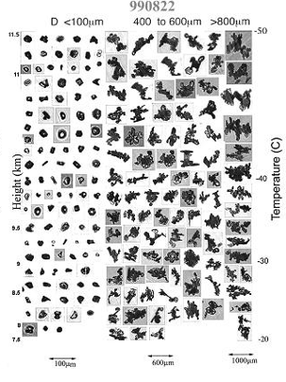
Consideration for DCC
In order to minimize an influence of ice crystal shape uncertainty, hexagonal column for ice crystal shape based on Yang et al. (2000) is adopted.
Example of crystal shape (Heymsfield, 2002)
Large uncertainty in RT radiance calculation is caused by the difference of hexagonal and spherical shape particle phase function.
We introduce the geometrical condition in a target selection: Difference between phase function of hexagonal shape and that of spherical shape is small.
Height
Particle size

Slide 6
Result (MTSAT-2)
Terra/MODIS
Compatible results between Terra and Aqua
Some spikes in a time series
Due to a small number of target selection?
Feb. 2012
Simulated reflectivity
DCC
Cloud
Land
Sea
Time series of regression coefficient: slope
Aqua/MODIS
Feb. 2012
Simulated reflectivity
DCC
Cloud
Land
Sea
2010 2011 2012
Observed reflectivity

Slide 7
GMS-5 re-calibration during pre-MODIS era
Background
Calibration of past satellites data is required for climatological use
GMS-5: JMA’s geostationary satellite which had been operated from June 1995 to May 2003
Problem
Developed calibration technique can’t be applied before 2000 due to a lack of MODIS data
Solution
Find conditions that optical parameter uncertainty on the RT simulation is small
Target: cloud-free ocean, DCC

Slide 8
Target selection and input parameters into RTM w/o MODIS
Cloud-free ocean target
Radiance sensitivity test using RSTAR
”climatological AOD < 0.1 & sunglint angle > 30 deg." meets the reflectivity error < 0.01
Check whether RT simulation w/ retrieved AOD from MODIS under the conditions satisfies a small reflectivity error
70% of simulated reflectivity: reflectivity error < 0.1 (from 6-months test)
DCC
Comparison of simulated radiance
Cases using cloud ice parameters retrieved from MODIS
Cases using constant values: “Cloud ice optical depth: 150, effective radius: log-normal distribution (center: 20um)”
Mean TOA radiance difference ≈ 2 W/m^2/sr/um
Thresholds of DCC selection
TBB of IR 10.8um < 200K, small STDV of DN (for VIS and IR channel)

Slide 9
Preliminary results: w/ MODIS vs. w/o MODIS
w/o MODIS,
w/ climatological aerosol
Tendency looks like
Difference of slope magnitude, some spikes
Need of further investigation
y = 1.0885 x – 0.0039
Sep. 2000
Detector-2
Simulated reflectivity
Time series of regression coefficient: slope
(monthly mean for detector-2)
DCC
Sea
w/ MODIS
y = 1.241 x – 0.0082
Sep. 2000
Detector-2
Simulated reflectivity
DCC
Cloud
Land
Sea
1999 2000
Observed reflectivity

Slide 10
Summary and future plan
JMA has been developing visible channel vicarious calibration technique using RTM in collaboration with the University of Tokyo.
Re-calibration during pre-MODIS period is underway.
Future plan
Comparison of other calibration methods
Expansion of vicarious calibration technique to NIR channel of AHI (Advanced Himawari Imager) on Himawari-8/-9.
use SEVIRI, MODIS, VIIRS as proxy data

Slide 11
Backup slides

Slide 12
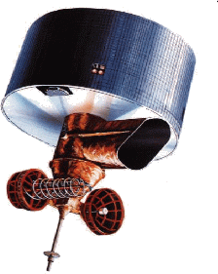
"RSTAR" - Radiative Transfer Code
Developed by Dr. NAKAJIMA’s Lab. (AORI, Univ. of Tokyo)
Algorithm is based on Nakajima and Tanaka [1986,1988]
http://www.ccsr.u-tokyo.ac.jp/~clastr/
General package for simulating radiation fields
k - distribution method
HITRAN2004 database
Wavelengths between 0.2μm to 200μm
Absorption and scattering schemes
Parallel atmosphere divided into sub-layers
Input
Sun and view angles
Sensor's response function
Atmosphere profile
Surface condition
Output
Radiance, irradiance

