Slide 1
Desert Calibration for GOES Imager Visible Channels
Fangfang Yu and Xiangqian Wu
NOAA/NESDIS/STAR
2013 GSICS Annual Meeting
Williamsburg, VA
March 4-8, 2013

Slide 2
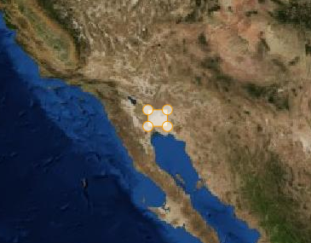
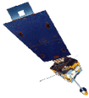
Motivations
Long-term stable desert can be used to monitor sensor degradation trending and facilitate cross-comparisons
If well characterized, can serve as a SI-traceable reference.
The only desert that can be observed by both GOES-West (135W) and GOES-East (75W)
Historical reference target for GOES-8/9/10 operational calibration
Operational target switched to MODIS since 2004 due to the change of desert reflectance (ENSO effect)
Recent studies indicate the desert is stable at decadal scale
Revisit the Sonoran desert calibration for the GSICS project
Traceable to Aqua MODIS C6
Combined method

Slide 3
Challenges for the long-term Instrument Inter-Calibration
Target should be long-term stable, well-characterized, traceable to community best reference (Aqua MODIS C6 data) with low uncertainty
Spatially
Spectrally – smooth target reduces the SBAF uncertainty
Temporal – various scales, from diurnal to long-term
BRDF
Ground target – atmospheric component impacts
Trending within the mission
Degradation pattern(function)
BRDF
Transfer the trending to absolute calibration (reference data)
Bridging the gap between different sensor
Spectral band adjustment factor (SBAF)

Slide 4
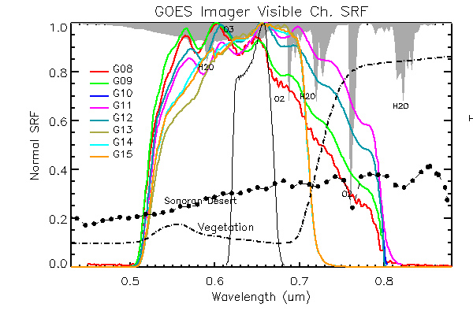
GOES-8 through G15 Imager Ch1 SRFs

Slide 5
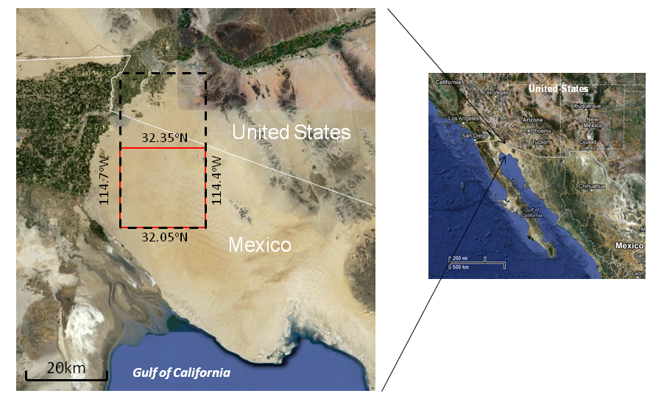
Sonoran Desert
Study area
[32.05N-32.35N, 114.4W-114.7W]
25 pixels
49 pixels

Slide 6
Satellite Data
Satellite | Satellite Location | Observation time (local) | Data Period
GOES-8 | GOES-East, 75W | ~12:35pm | 11/01/1994 – 04/01/2003
GOES-9 | GOES-West, 135W | ~12:15pm | 09/30/1995 – 07/07/1998
GOES-10 | GOES-West, 135W | ~12:15pm | 07/07/1998 – 06/21/2006
GOES-11 | GOES-West, 135W | ~12:15pm | 06/21/2006 - 12/06/2011
GOES-12 | GOES-East, 75W | ~12:35pm | 04/01/2003 – 04/14/2010
GOES-13 | GOES-East, 75W | ~12:35pm | 04/14/2010 –
GOES-15 | GOES-West, 135W | ~12:15pm | 12/06/2011 –
Aqua MODIS | LEO | ~1:30pm | 07/04/2002 – 10/31/2012
Hyperion | LEO | ~10:50am | 2011/10/07UTC17:52:08 2012/05/13UTC17:57:19 2012/06/08UTC17:51:58 2012/10/01UTC17:44:40

Slide 7
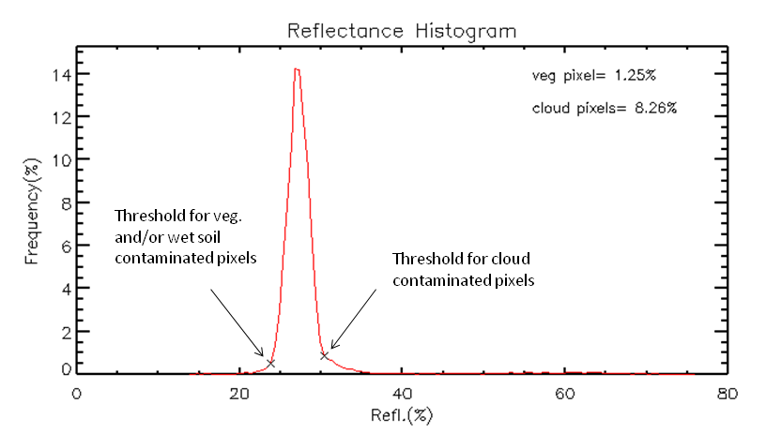
Removal of Cloud/Vegetation Pixel

Slide 8
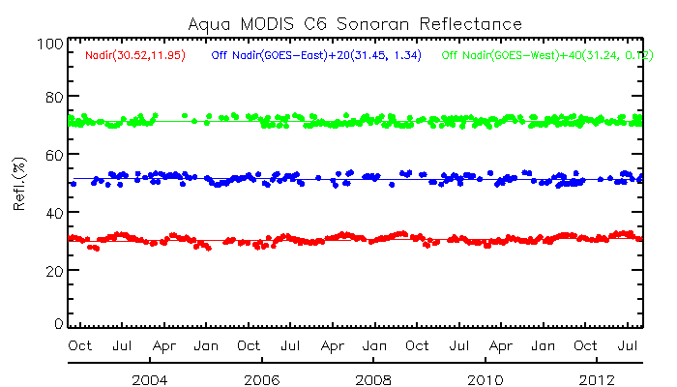
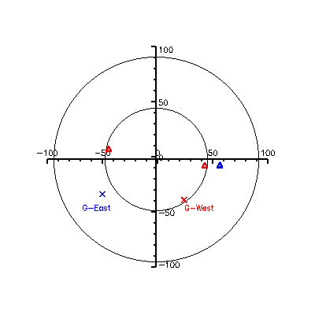
Long-term stability

Slide 9
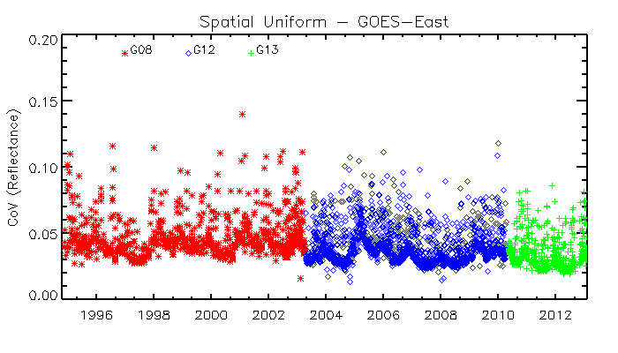
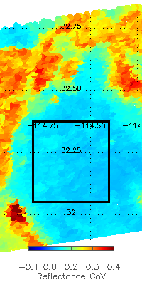
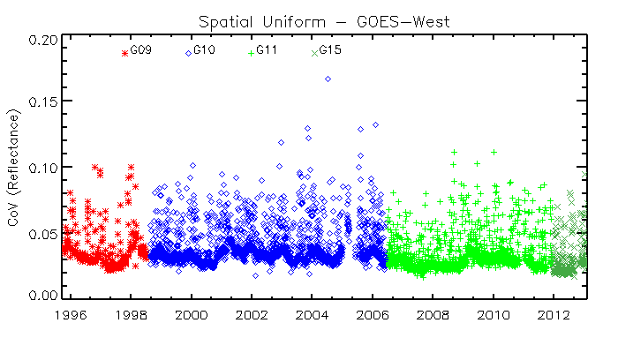
Spatial Uniformity

Slide 10
Challenges in this Study
Large MODIS viewing angle over the desert
Viewing angle range for MODIS calibration uncertainty specification
GOES-East VZN:55.8; GOES-West: 55.6
MODIS 45 scan angle = about 54 vzn
Difference in GOES and Aqua MODIS observation time
~1 – 1.5 hours of observation difference
No collocation with similar viewing/solar viewing geometry
Challenging for Ray-matching method to transfer the calibration to Aqua/MODIS
Need accurate BRDF model to transfer the GEO trending result to MODIS data
Assuming that the azimuth angle impact is negligible
MODIS
MODIS
MODIS

Slide 11
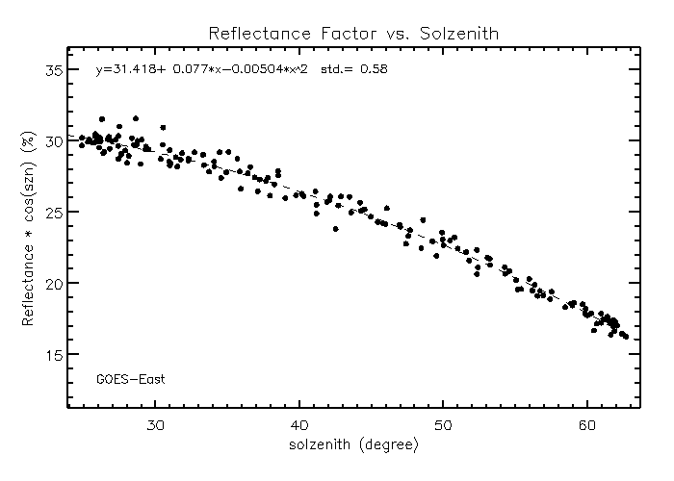
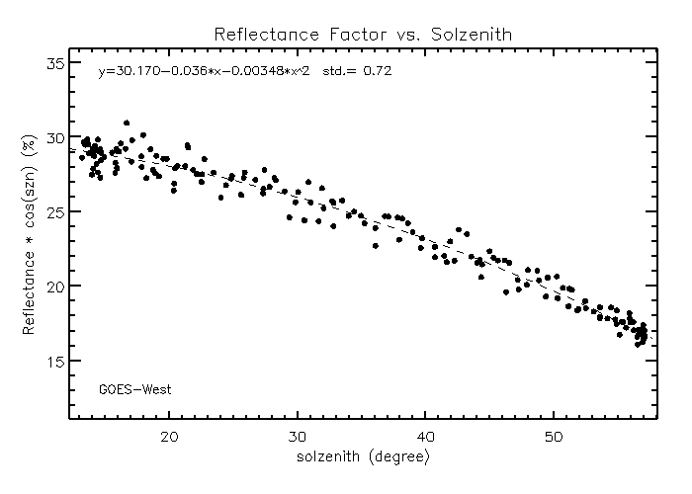
Transferring MODIS to GOES Solar Viewing Geometry
Fixed LEO and GEO viewing geometries
Only the solar viewing geometry affects the BRF
 | GOES-East | GOES-West
Transferring Calibration | 0.58 | 0.72

Slide 12
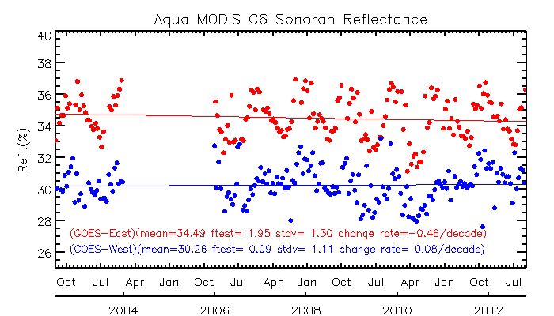
TOA reflectance of Sonoran Desert
 | GOES-East | GOES-West
Long-term stability | 34.49(±1.3) | 30.26(±1.11)

Slide 13
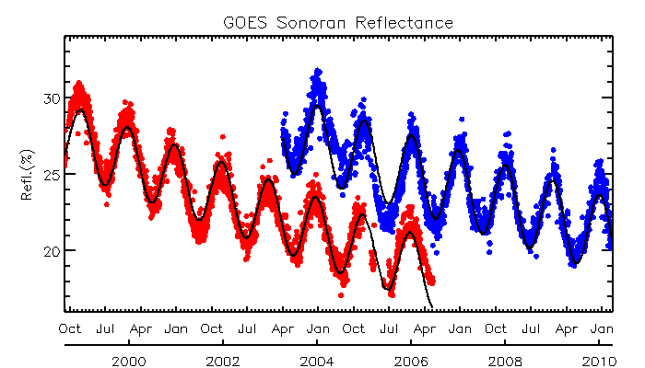
Trending
Wu, 2005, Calcon

Slide 14
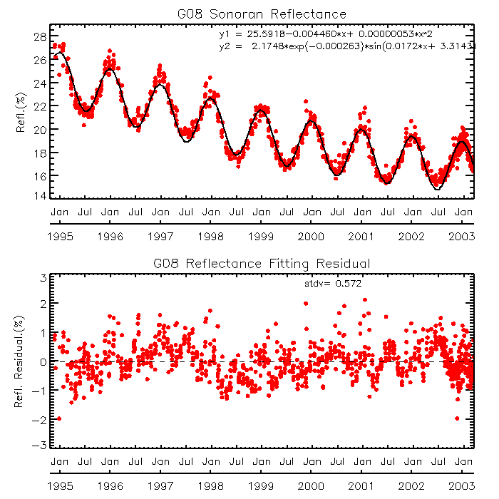
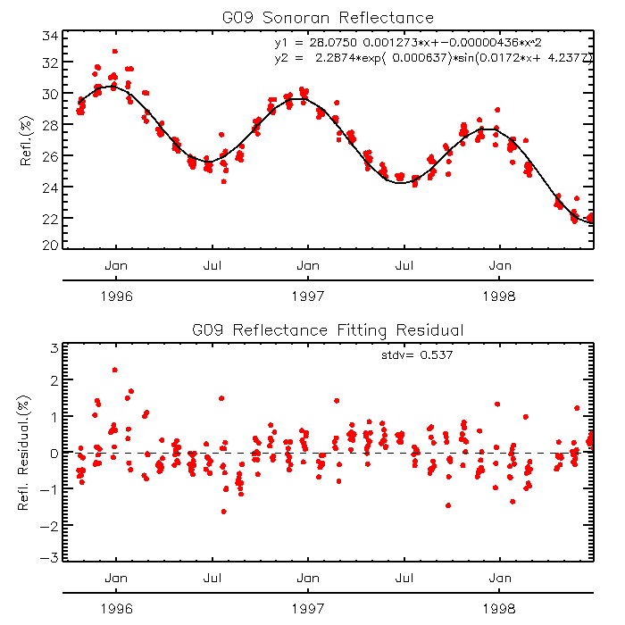
Trending residuals

Slide 15
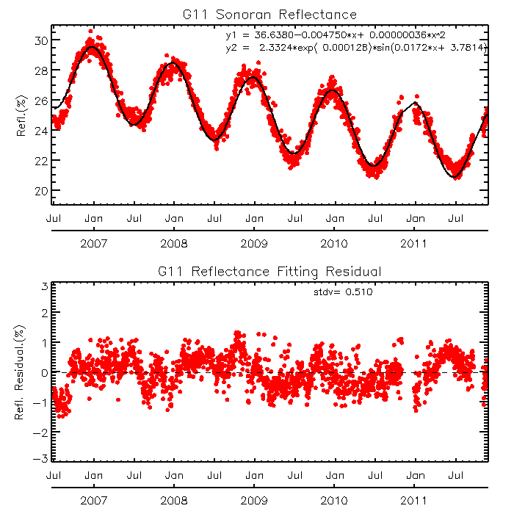
Trending Residuals

Slide 16
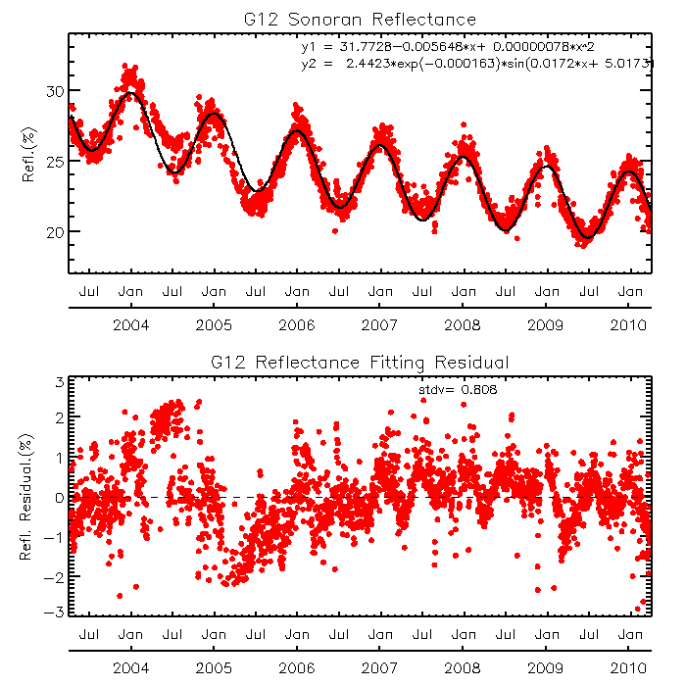
Trending Results

Slide 17
Trending Result
 | Uncertainty
Trending residual | 0.32-0.81

Slide 18
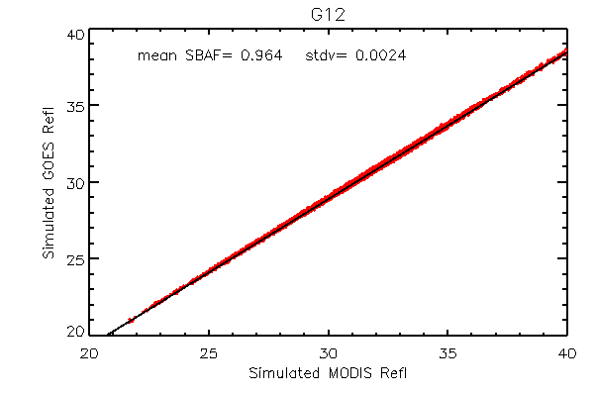
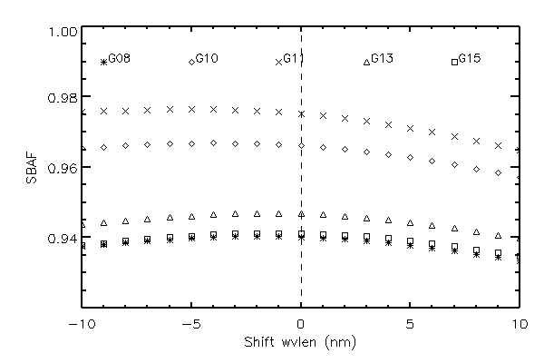
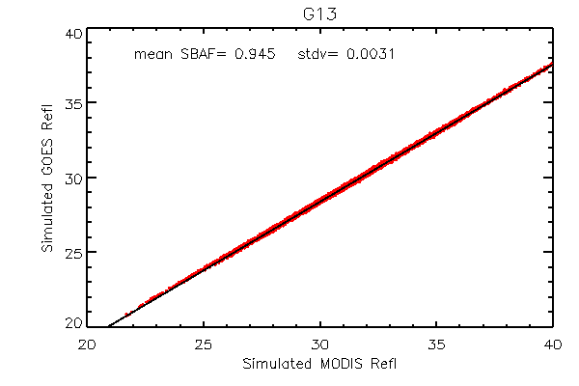
SBAF Correction with Hyperion Data

Slide 19
Uncertainty Budget
 | Aqua/MODIS | Target long-term stability* | Transferring calibration* | Trending | Band Correction | Overall Uncertainty
GOES-East | 1.64* | 1.3 | 0.58 | 0.32-0.81 | 0.25-0.34 | 2.21 – 2.34
GOES-West | 1.64* | 1.1 | 0.72 | 0.32-0.81 | 0.25-0.34 | 2.14 - 2.28
*1: MODIS uncertainty specification is applicable to the GOES VZN
*2: uncertainty of target long-term stability can beat down with BRDF correction
*3: Missing correction transfer calibration to account for the solar/viewing azimuth angle difference , especially for GOES-East

Slide 20
Summary
Use of the sub-area [32.05-32.35N, 114.4-114.7W] as the reference
avoid of vegeted pixels and artificial feature (high-ways)
Not recommended for near-real-time (operational) calibration
Hyperion data can be used to generate the spectral band adjustment factor
Relatively spectrally flat over the target and SRF range
Need accurate BRDF model to account for the impact of relative azimuth angle, especially for GOES-East
Absolute uncertainty is about 2-3%

Slide 21
TOA Reflectance to Dynamic Atm. Components
Nominal TOA refl: G11=28.7%, G13=29.0%

