Slide 1
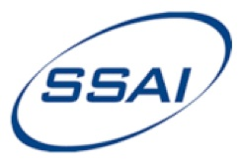
Spectral band adjustment factors in the SW
GSICS Annual Meeting, Williamsburg, VA, 7 March 2013
Benjamin Scarinoª, David R. Doelling^{b}, Patrick Minnis^{b}, Rajendra Bhattª, Arun Gopalanª, Constantine Lukashin^{b}
ªSSAI, One Enterprise Pkwy Ste 200, Hampton, VA 23666 USA
^{b}NASA Langley Research Center, 21 Langley Blvd MS 420, Hampton, VA 23681-2199 USA

Slide 2
Introduction
Motivation
Geostationary satellites (GEOsat) sensors do not have on-board radiometric calibration sources for visible channels
Need exists to develop absolute calibration techniques capable of use with GEOsat sensors
Problem
Cross-calibration is plagued by the differences in the sensor spectral response functions (SRFs)
Scene-dependent spectral absorption discrepancies amplify problem
Objective
Develop calibration-target-dependent Spectral Band Adjustment Factors (SBAFs) using SCIAMACHY hyper-spectral visible radiances
Background
Necessary to standardize geostationary satellite sensors
Hyper-spectral instruments already account for IR SRF differences (IASI, AIRS)

Slide 3
Introduction
Key instruments
SCanning Imaging Absorption spectroMeter for Atmospheric CartograpHY (SCIAMACHY or SCIA)
Level-1b, Version-7.03
MODerate resolution Imaging Spectroradiometer (MODIS)
Collection 6, L1B, 2-km
Meteosat-9 (Met-9)
3-km

Slide 4
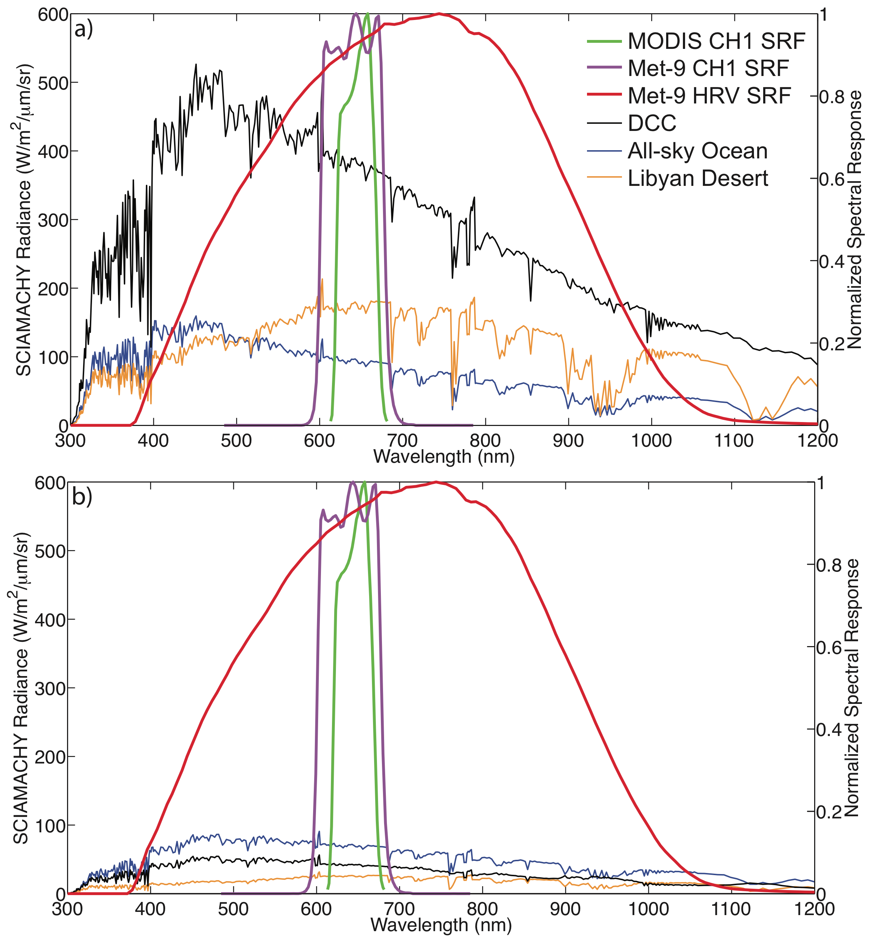
Introduction
Visible-channel spectral corrections
Transfer calibration from MODIS to Met-9 using SCIA
Correction dependent on target and reference SRFs
MODIS: 0.65-μm (CH1)
Met-9: CH1 and High Resolution Visible (HRV)
Scene-specific corrections for independent calibration techniques
Validated with SCIA-Met-9 ray-matched comparisons
Mean Spectra
Small Standard Deviations

Slide 5
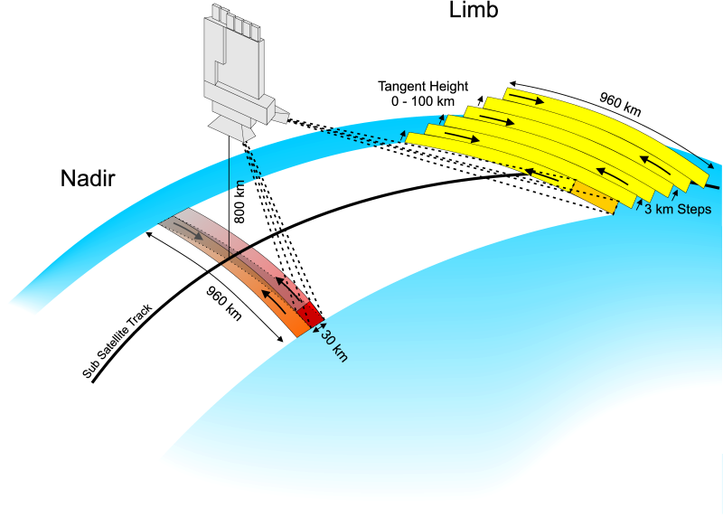
SCIAMACHY Specifications
iup.uni-bremen.de/sciamachy/
Launched on Envisat, 1 March 2002
10:00 AM LST sun-synchronous orbit, 35-day orbit repeat cycle
Shared scan duty between nadir and limb measurements
Eight channels (240 – 2380 nm)
Visible channels 3 – 6 (394 – 1750 nm), 0.44 – 1.48 nm resolution
Four 30-km along-track by 240-km across-track nadir-like footprints
Two nadir-like footprints on either side of ground track within a 30° view angle
Total nadir scan width of 960 km
Absolute on-orbit calibration accuracy between 2% and 6%

Slide 6
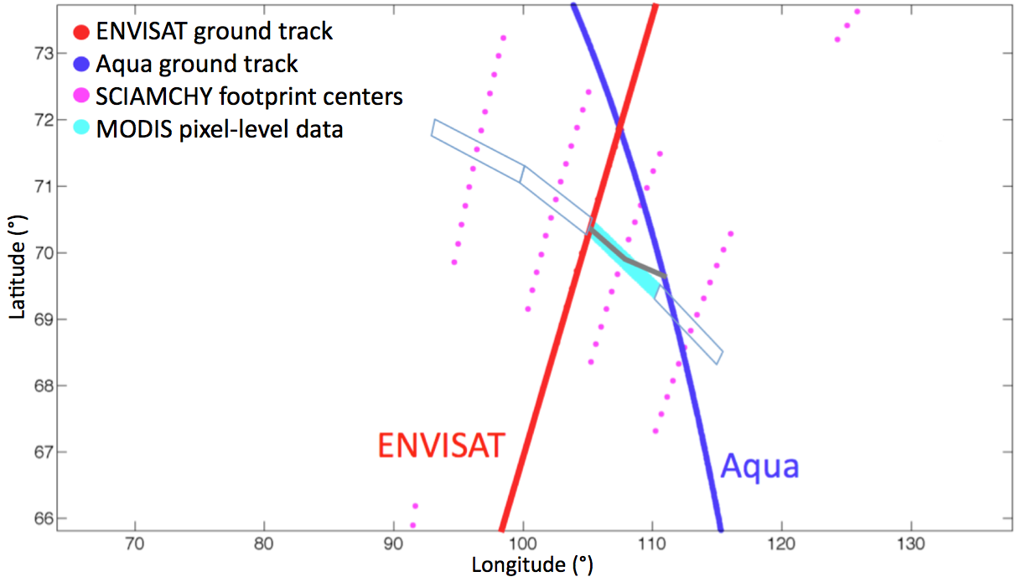
Nearly Simultaneous Nadir Overpass Comparisons with Aqua-MODIS
Establish the stability of SCIAMACHY by radiometrically scaling to Aqua-MODIS
Accomplished using nearly simultaneous nadir overpass (NSNO) comparisons near the north pole during Apr-Sep
About 14 NSNOs per day (dependent on scan duty cycle) at 11:45 am LST
Minimal view angle difference
Near-symmetric solar conditions (corrections for SZA differences applied)

Slide 7
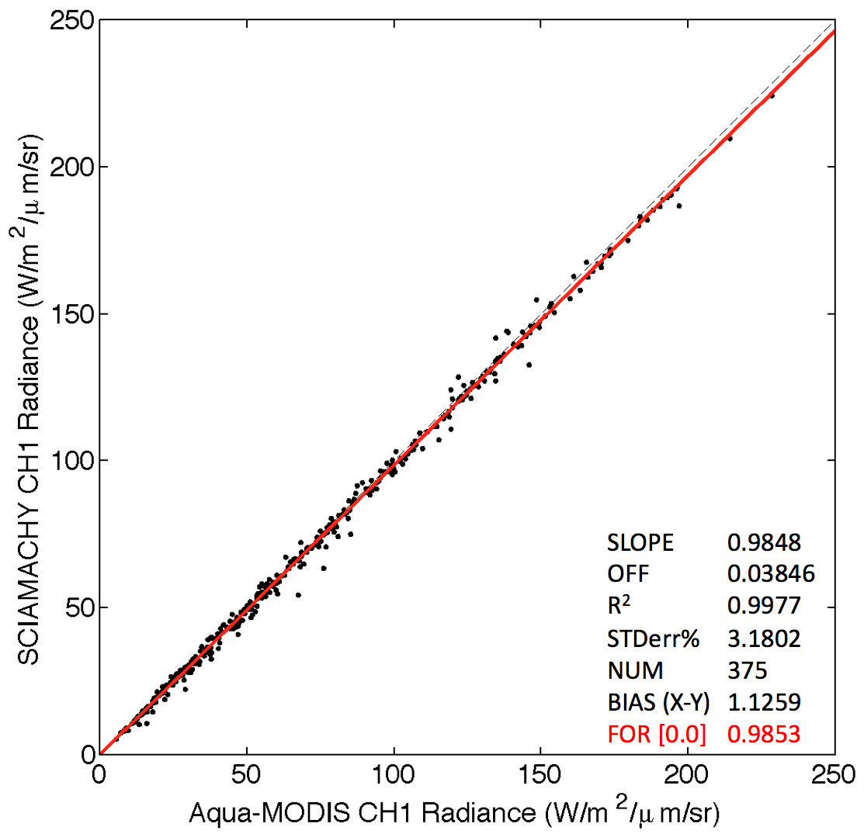
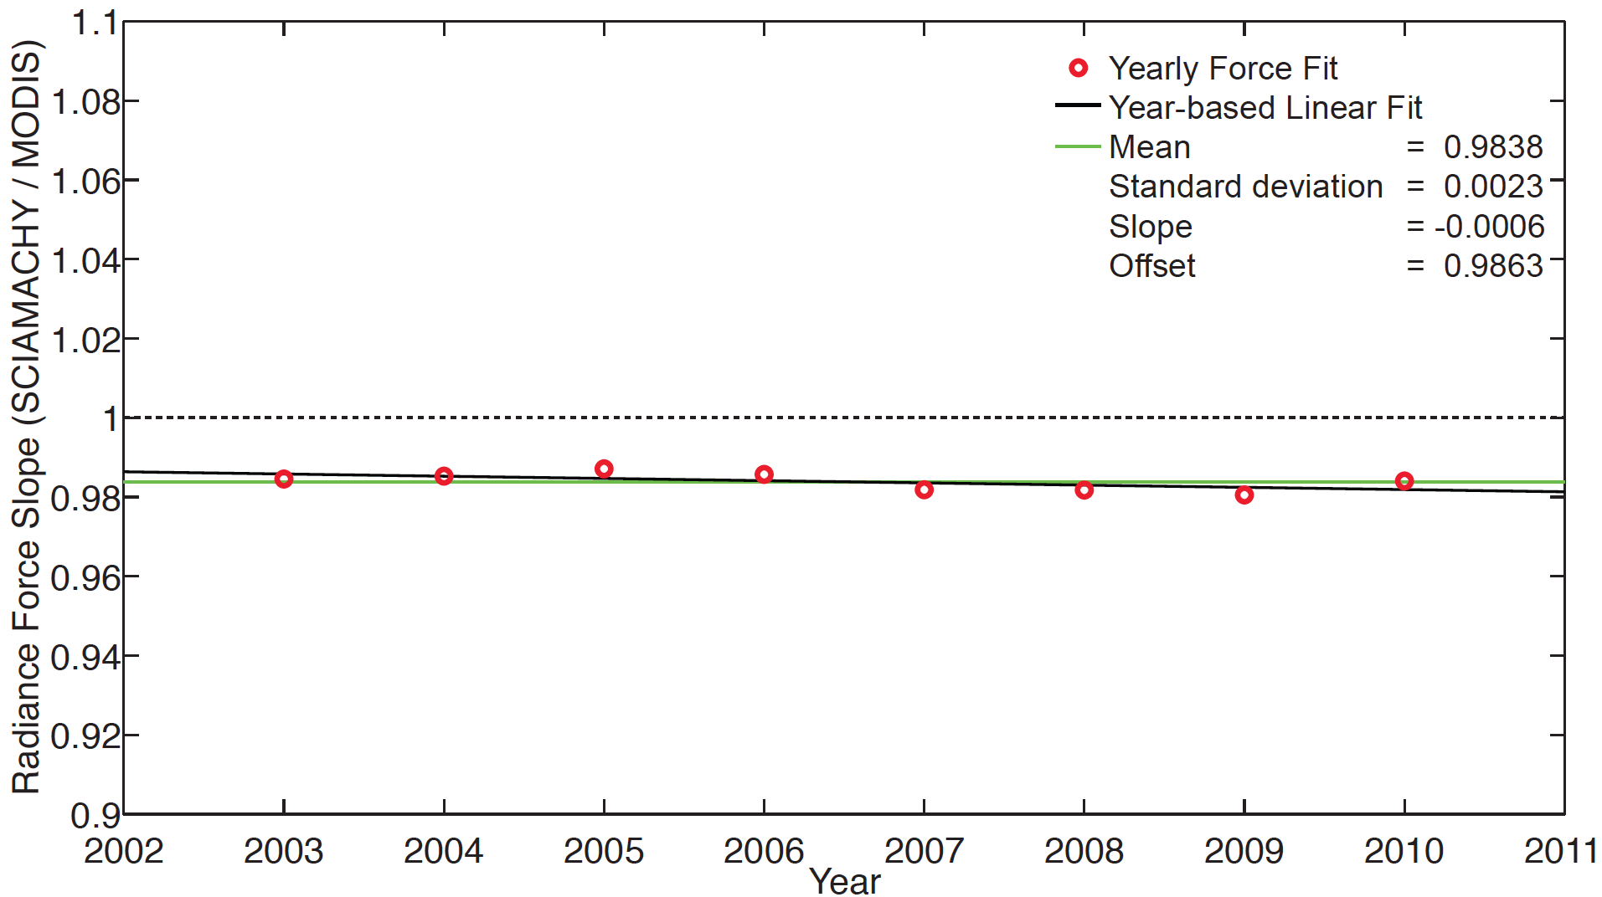
Nearly Simultaneous Nadir Overpass Comparisons with Aqua-MODIS
NSNO Results
Yearly NSNO Regression
RMSE
2.75
SCIAMACHY Radiance is stable to within -0.6% per decade compared to Aqua-MODIS

Slide 8
Spectral Band Adjustment Factors
Spectra from each SCIAMACHY scene-appropriate footprint are convolved with imager SRFs
Yields imager-equivalent (pseudo imager) radiances
(e.g., MODIS RSR)
(e.g., pseudo MODIS radiance)

Slide 9
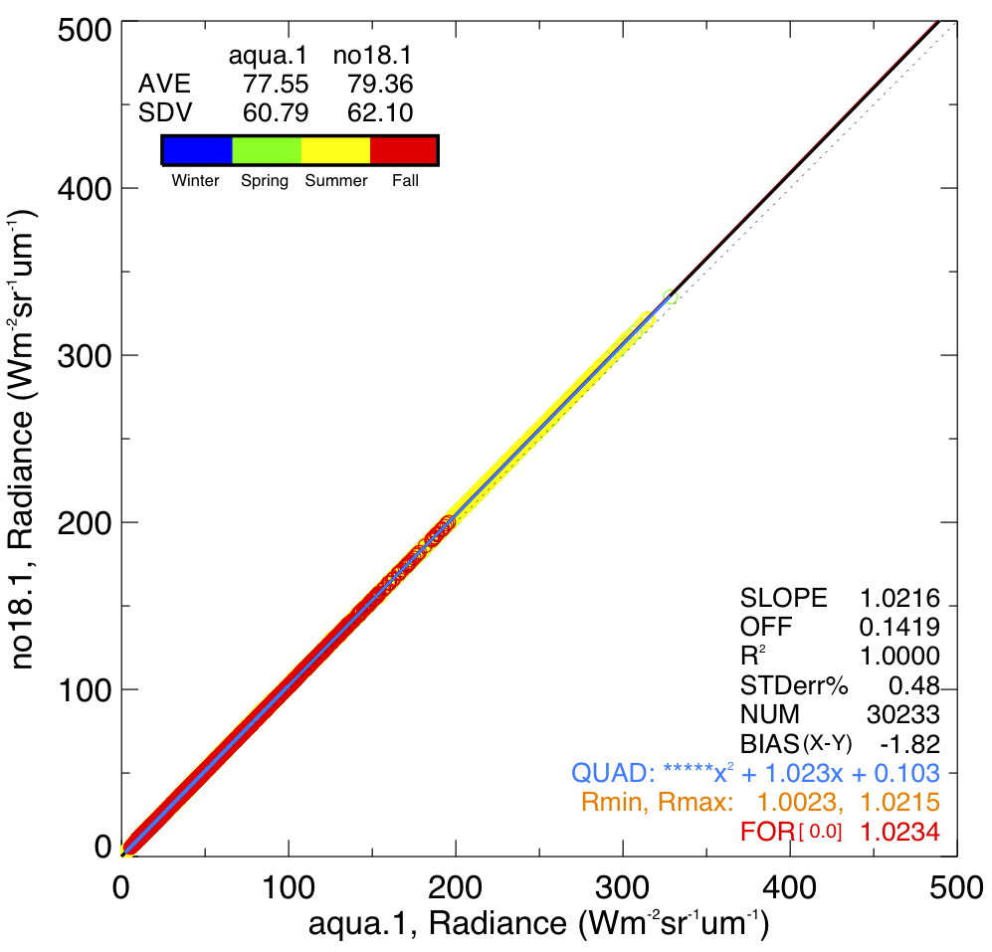
Spectral Band Adjustment Factors
Regression of two pseudo radiances constitutes a Spectral Band Adjustment Factor (SBAF)
Applied to the reference sensor (MODIS) radiance (L_{ref}) to arrive at the predicted target sensor radiance (L_{tar})

Slide 10
Spectral Band Adjustment Factors
SBAFs sensitive to scene-type in the visible
Often necessary to be selective, subject to calibration goals
Land use determined by IGBP
Cloud properties determined by CERES SSF and associated MODIS cloud retrievals
Valid ½-hour after Envisat overpass
All-sky Ocean Criteria
Narrowband only
Footprint is 90% ocean
DCC Criteria
CF > 99%
CTT < 205 K
70 < Tau < 150
SZA < 45°
Clear / Marine Stratus Criteria
CF < 1%
OR entire footprint registers as cloudy AND CTT > 270 K
Desert Criteria
Clear scenes determined by spatial standard deviation threshold using a GEOsat

Slide 11
Narrowband-to-Narrowband SBAFs
DCC
All-sky ocean
Libyan Desert
Regressions well-behaved for narrowband-to-narrowband case
Corrections are small but not insignificant

Slide 12
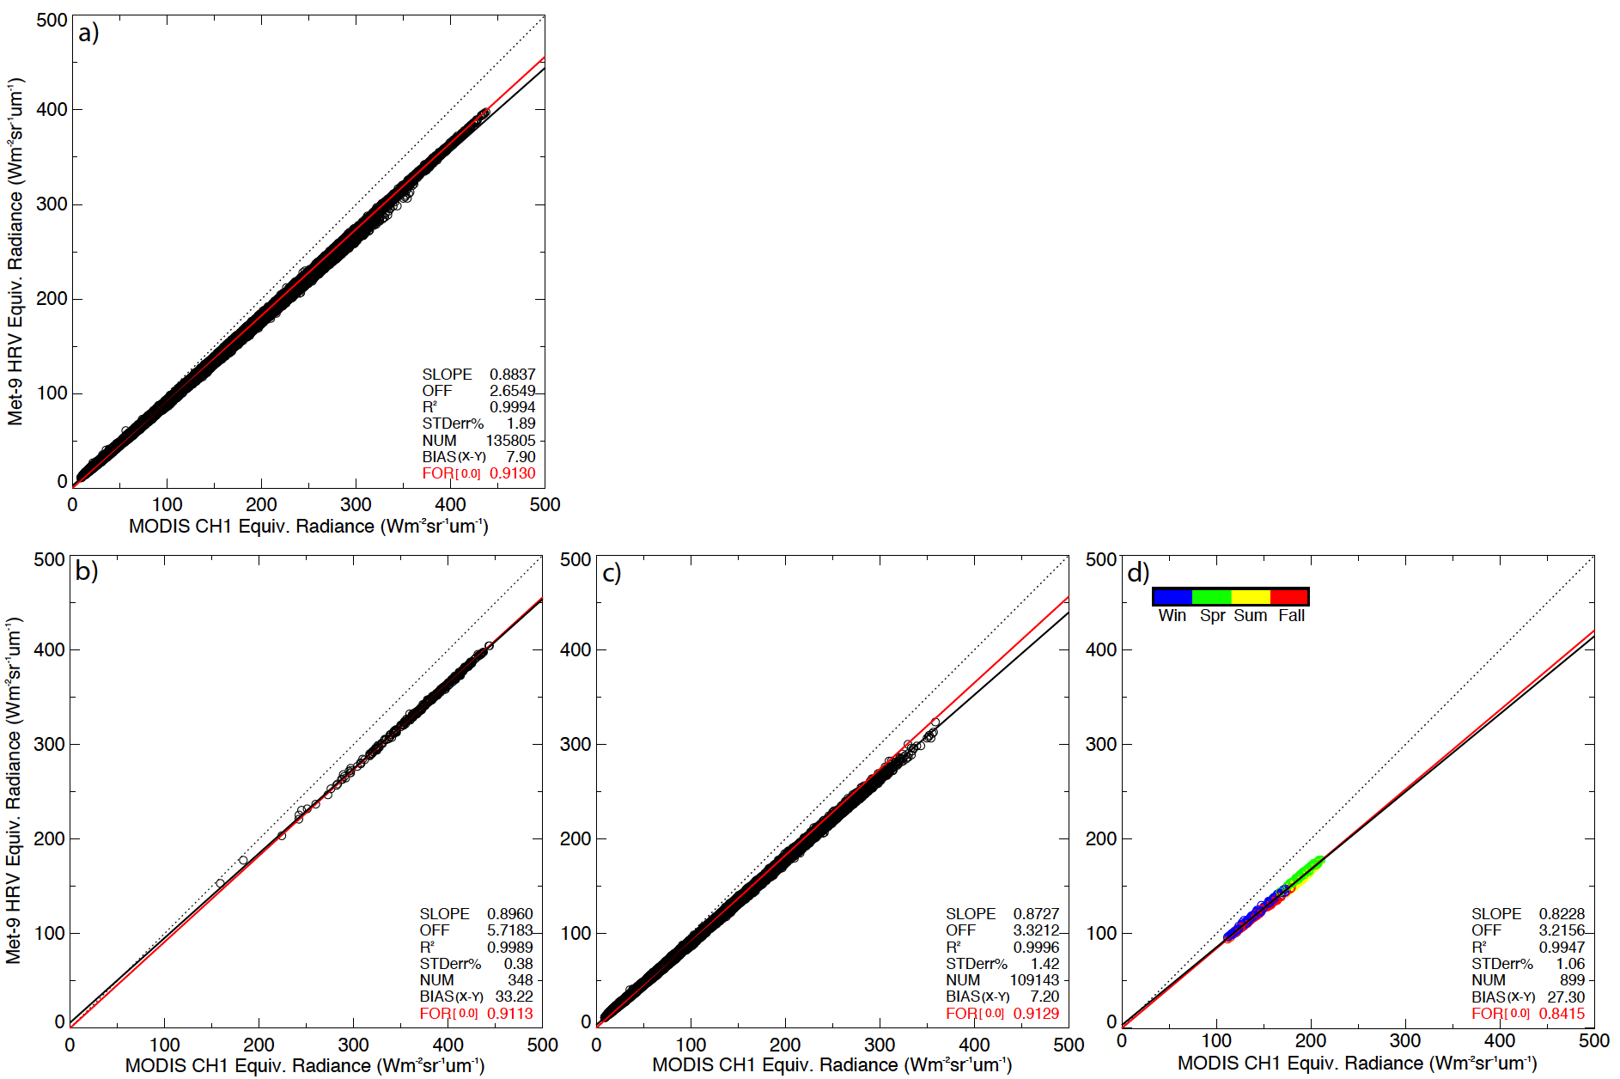
Narrowband-to-Broadband SBAFs
All-sky ocean
Specific scene selection critical for obtaining representative Spectral Band Adjustment Factors when calibrating narrowband to broadband
DCC only
Marine stratus and ocean
Libyan Desert

Slide 13
SCIAMACHY-with-Met-9 Ray-Matching
Average Met-9 10-bit count computed within SCIA footprint bounds
4-km pixels
Count ∝ radiance
Match within 15 min
Three-monthly gains found by regressing SCIA convolved radiances with Met-9 average counts
Regression forced through the Met-9 space count
SCIA radiances scaled to Aqua-MODIS using NSNO comparisons
Figure: Jan – Mar 2008 SCIA-with-Met-9 CH1 gain = 0.557

Slide 14
SCIAMACHY-with-Met-9 Ray-Matching
Standard error of 0.52% means data are well-represented by the linear trend

Slide 15
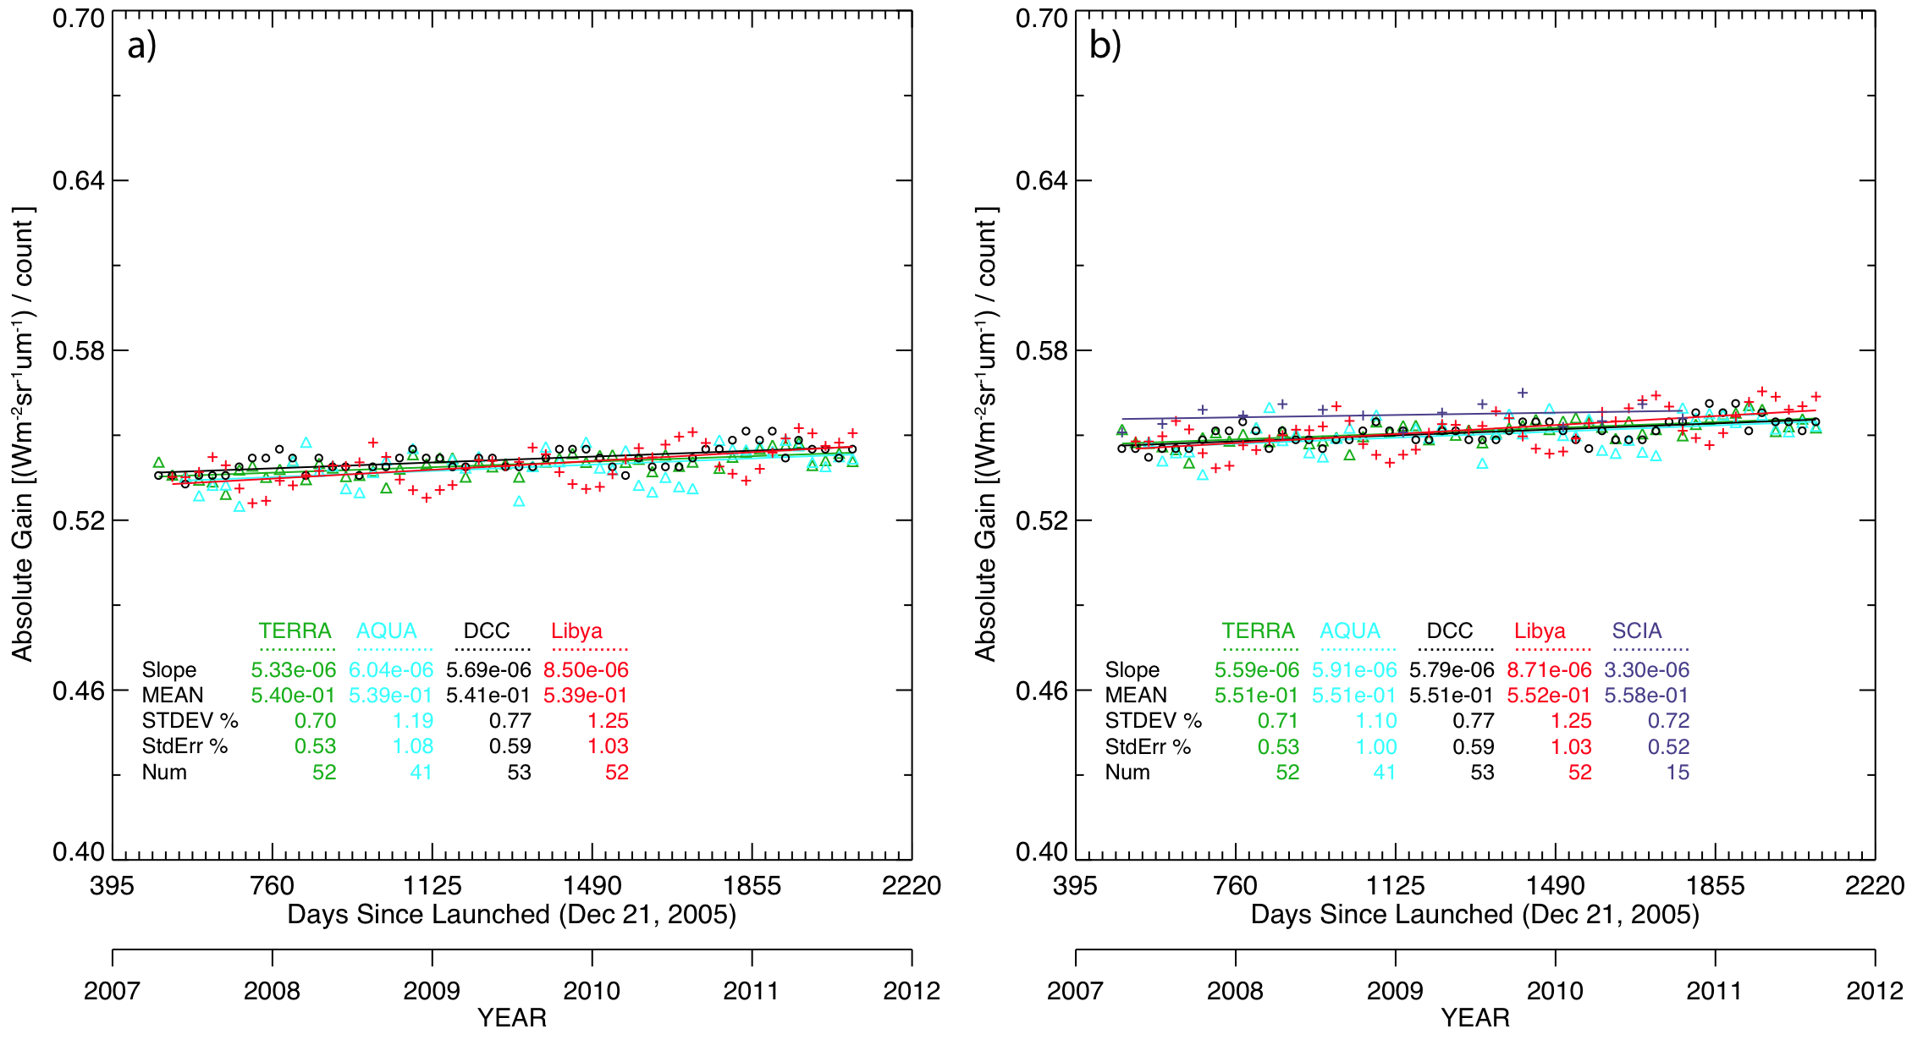
Before and After: Narrow-to-Narrow
Before SBAF
After SBAF
Before the SBAF is applied, the maximum mean difference in absolute calibration between the three methods for Met-9 CH1 0.4%
After the SBAF is applied, the difference reduces to within 0.2%
The mean difference in CH1 gains from before to after application of the SBAF is +2.0%
SCIAMACHY-with-Met-9 CH1 gain is within 1.3% of mean of other methods after the SBAF is applied (~2.4 Wm⁻²sr⁻¹μm⁻¹)

Slide 16
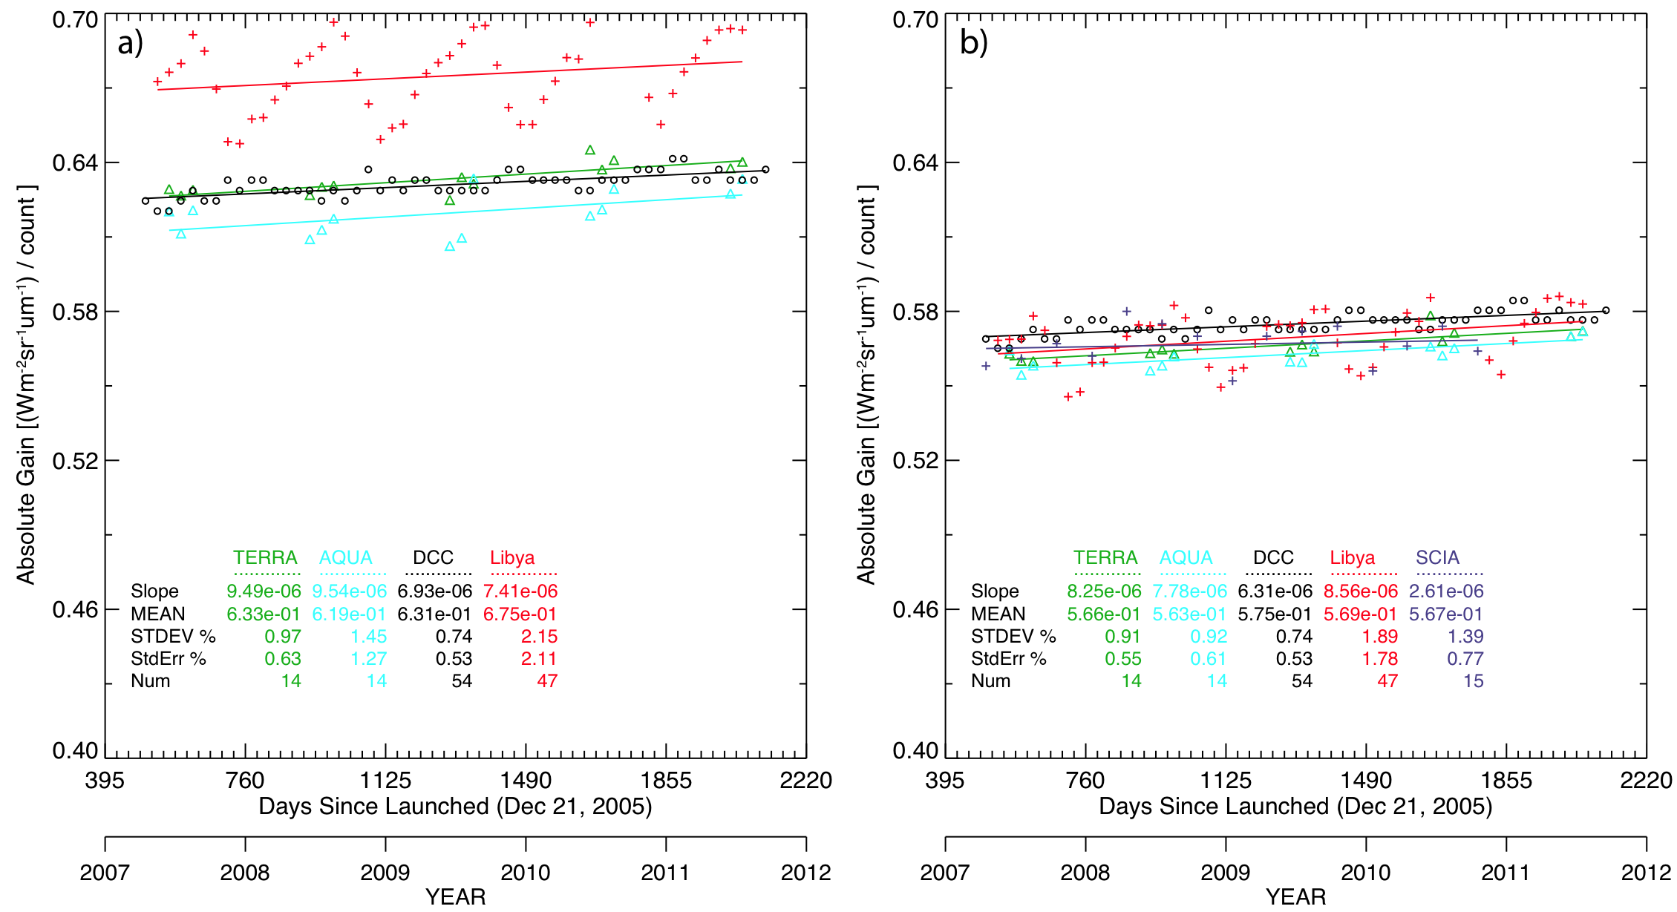
Before and After: Narrow-to-Broad
Before SBAF
After SBAF
Before the SBAF is applied, the maximum mean difference in absolute calibration between the three methods for Met-9 HRV 8.3%
After the SBAF is applied, the difference reduces to within 1.0%; reduced spread
The mean difference in HRV gains from before to after application of the SBAF is -11.3%
SCIAMACHY-with-Met-9 HRV gain is within 0.2% of mean of other methods after the SBAF is applied (~0.3 Wm⁻²sr⁻¹μm⁻¹)

Slide 17
Conclusions & Future Work
SCIAMACHY convolved radiances can account for sensor SRF differences
Atmospheric absorption differences mean that a single SBAF cannot account for all calibration methods
SBAFS are impactful; add value
A unique SBAF is required for each scene type
After SBAF application, three calibration methods within 0.2%-1.0%
Better than 7% improvement in narrowband-to-broadband calibration agreement, illustrates importance of SBAF in deriving a gain
Notes:
Spectral band difference corrections are valuable in obtaining accurate and consistent absolute calibration among multiple independent inter-calibration techniques

Slide 18
Conclusions & Future Work
SCIAMACHY will be used to calculate scene-specific spectral band adjustment factors between MODIS and VIIRS.
Magnitude of the adjustments will help determine the preferred scene types for comparison
Reduction of SRF difference uncertainties between MODIS and VIIRS will leave only the calibration difference to assess the VIIRS on-orbit calibration
Notes:
Spectral band difference corrections are valuable in obtaining accurate and consistent absolute calibration among multiple independent inter-calibration techniques

Slide 19
SCIAMACHY-with-Met-9 Ray-Matching
Match VZA for Met-9 and SCIA FOV
One ray-matched location per FOV, four SCIA FOVs
Four ray-matched locations per GEOsat sub-satellite domain
Match occurs when:
SCIA FOV is within 160 km of corresponding ray-matched location
Scan difference < 15 min
Threshold of 160 km provides sufficient sampling; does not significantly increase standard error relative a tight threshold

Slide 20
Absolute Calibration Methods
MODIS-with-Met-9 ray-matching
Employs co-incident, co-angled, and co-located ocean region pixels
Expected Met-9 radiances from SBAF applied to MODIS
DCC
Treated as invariant targets
Calibration transfer dependent on matched DCC targets between MODIS and Met-9
Libyan Desert
Constant over time
Employs a kernel-based bidirectional reflectance distribution function (BRDF) model
SBAF necessary to account for spectral differences in all three methods

Slide 21
Before and After: Summary
MODIS Characterization Support Team
Met-9 CH1 / Aqua CH1 SC ratio = 1.013
Met-9 HRV / Aqua CH1 SC ratio = 0.883
(+) Increase from previous Column
(-) Decrease from previous column
(+1.3%)
(+0.7%)
(-11.7%)
(+1.3%)
(+1.3%)
(+0.9%)
(-11.6%)
(+2.9%)
(+1.3%)
(+0.5%)
(-11.7%)
(+3.2%)
(+1.3%)
(+1.1%)
(-11.7%)
(-4.5%)
Combination of surface reflectance and atmospheric absorption differences means that a single SBAF cannot account for all calibration methods
SBAFs are impactful and add value

