Slide 1
DCC algorithm application meeting, part 1
May 29, 2013

Slide 2
DCC calibration algorithm components
Stability monitoring
Aqua-MODIS absolute calibration transfer
Spectral band adjustment factor (SBAF)

Slide 3
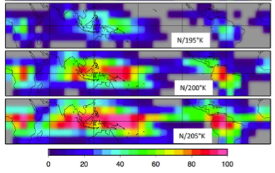
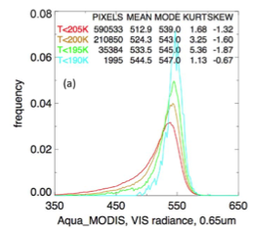
DCC identification (Stability Monitoring)
DCC radiance based on temperature threshold
Regional DCC monthly frequency based on temperature threshold
• DCC radiance is most dependent on Temperature threshold
• Must use constant temperature threshold
• Must find balance between sample size and lowest temperature, to maintain robust peaked PDFs
• Visible and IR homogeneity tests, less effective in obtaining peaks

Slide 4
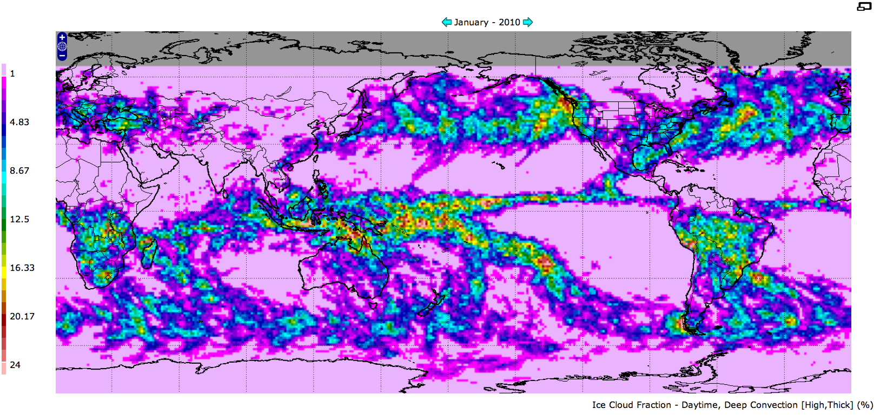
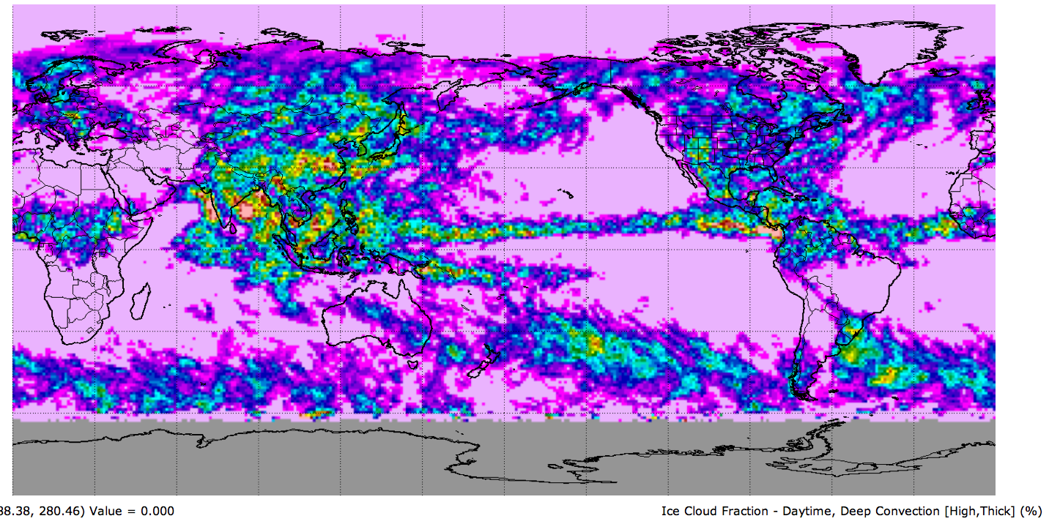
Regional DCC Radiance Variability (Stability Monitoring)
T<205°K
Jan 2010
CERES high thick cloud amount
Jul 2010
• If you assume that the DCC microphysics, diurnal seasonal and regional distribution and radiance is replicated annually, then the choice of GEO domain is arbitrary as long you sample consistently.
• If the GEO domain includes land, you must sample at the same local time

Slide 5
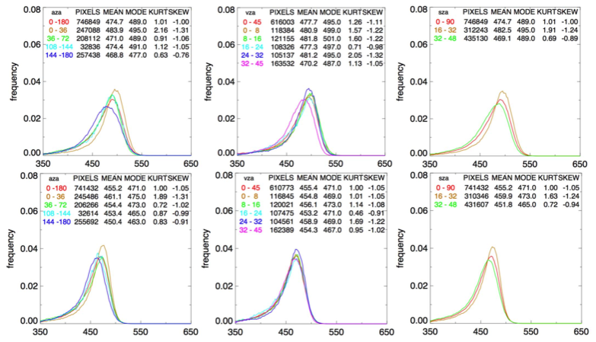
DCC BRDF validation (Stability Monitoring)
• Angular constraints to limit the BRDF to the more Lambertian part
• Find BRDF that works best over GEO domain
• If the GEO calibration stability is known, build BRDF model from GEO measurements, which takes into account DCC dependencies
NO BRDF
Hu BRDF
MODIS BRDF
• A perfect BRDF would show no difference in the mode according to VZA, AZA and SZA

Slide 6
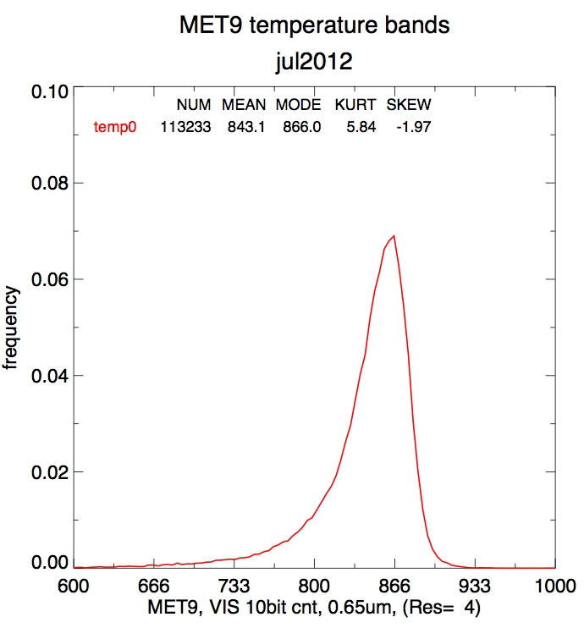
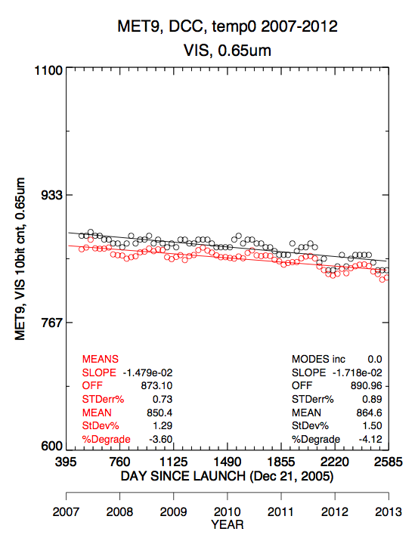
DCC radiance stability (Stability Monitoring)
• Obtain robust monthly PDFs, use least sampled month to set criteria
• Are there other statistical methods that intrinsically capture the change of the PDF change over time
• Monitor improvement by noting reduction in the monthly standard error
about the trendline, (climatology to remove seasonal cycle)

Slide 7
Aqua-MODIS absolute calibration transfer
Two approaches
GSICS ATBD
method, apply the exact filters, BRDF, and coincident MODIS/GEO images
Assume that method captures the coincident collocated (not angle matched) DCC over the month
The MODIS equals GEO mode radiance (over a number of years to capture most of the natural variability
Does not allow DCC filter optimizations over GEO domain and that MODIS and GEO IR temperature is consistent
DCC ray-matching (Doelling 2013 annual meeting)
Match instantaneous coincident collocated co-angled MODIS and GEO regions, emphasize defining same instantaneous spatial domain and less on filters
Angle matching reduces sample size
Regress monthly over GEO domain, If the GEO degrades over time, must first detrend using DCC stability algorithm
Allows independent DCC filter optimizations over GEO domain
Validate
Validated, if both methods give similar calibration transfer
Also validate against general ray-matching Met-9/MODIS since the spectral bands are similar

Slide 8
Spectral band adjustment factor (SBAF)
We have identified some DCC identified SCIAMACHY footprints (30x240km) can easily derive DCC SBAF corrections.
Verify that the SCIAMACHY DCC hyper-spectral radiances are representative of DCC cells
SCIAMACHY footprints are large
Compare with hyper-spectral radiances from GOME-2 and Hyperion, and perhaps other models
IF time, presentation of SCIAMACHY, GOME-2 and Hyperion hyper-spectral radiances over Libya-4

Slide 9
Meeting goals
NASA to deliver to the GSICS archive the following
DCC pixel-level radiance file for each GEO domain during July 2012
Document the DCC filters used over each domain
The DCC BRDF Hu model and implementation code
Plot of the monthly PDF, with the associated histogram count increment
Plot of the monthly modes and linear trend line
GPRCs may (encouraged to) contribute BRDFs or spectra for SBAF to the GSICS archive
CNES PARASOL DCC BRDF

Slide 10
GPRC
Each GPRC has its own processing framework
Each GPRC has the opportunity to replicate the NASA-Langley July 2012 PDF to ensure proper implementation of filters and model into their framework
Set goal by summer DCC web meeting
Then each GPRC can optimize DCC filters and BRDF models over their GEO domain
GRPC can then present their results at either the summer or fall DCC meeting to share their expertise with other groups

Slide 11
Summer DCC meeting
Invite GRPC to present their results and share their expertise either with the NASA algorithm or their own
Discuss DCC BRDFs
Discuss plotting packages, GSICS correction files that are uniform across GPRCs
Other suggestions welcome

Slide 12
Fall DCC meeting
NASA to present DCC ray-matching to transfer the Aqua-MODIS calibration to GEO
Discuss application of the complete procedure implementation and goals for 2014 annual meeting
DCC SBAF correction presentation/discussion
Invite GRPC to present their results and share their expertise

