Slide 1
GSICS DCC Verification Data
Raj Bhatt, David R. Doelling, Conor Haney, Benjamin R. Scarino
DCC algorithm application meeting, part 1, May 29,2013

Slide 2
Outline
GEO DCC calibration methodology
DCC pixel identification
Angular transformation (Hu model)
Monthly PDF transformation
Long-term radiometric trending
Monthly DCC file description
Monthly PDF and temporal trending results
Absolute calibration using DCC referenced to Aqua-MODIS
Data availability

Slide 3
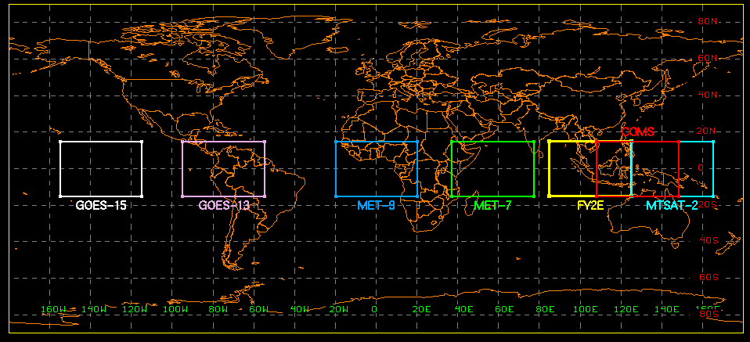
GEO DCC domain
A fixed DCC domain confined to ±15° latitude and ±20°E-W longitude, and centered at the GEO sub-satellite point is defined for each GEOSat.
 | GOES-15 | GOES-13 | MET-9 | MET-7 | FY2E | COMS | MTSAT-2
Orbit | 135°W | 75°W | 0W | 57°E | 105°E | 128°E | 145°E

Slide 4
DCC pixel identification
DCC pixels are identified within the DCC domain using the following criteria [Doelling et al, 2013]:
GEO parameter | DCC threshold
Window brightness temperature | BT11μm < 205°K
Brightness temperature homogeneity | Standard deviation of 3x3 pixels BT11μm < 1°K
Visible radiance homogeneity | Standard deviation of 3x3 pixels visible radiance < 3%
Solar zenith angle | SZA < 40°
View zenith angle | VZA < 40°
Local time range at GEOSat longitude | 12:00 PM < image time < 3:00 PM

Slide 5
Angular transformation
DCC response is dependent upon viewing and solar geometry
GEO DCC counts are normalized using Hu model [Hu et al 2004]
Before applying the Hu model,
Subtract the space-count from each DCC pixel count
Apply Earth-Sun distance and COS(SZA) factors
Corrected count = Measured Count/(d²*COS(SZA))
Normalized count = Hu(SZA, VZA, RAZ, Corrected count)
Note: A Hu-model subroutine package (written in Fortran) will be provided with the dataset.

Slide 6
Monthly DCC binary files
Sequence of parameters
Sigma VIS (0.65 um)
Sigma IR BT (11 um)
SZA
VZA
RAZ
Channel data (Count or BT)
Latitude
Longitude
GMT time
Day of Year
All DCC pixels within a month are compiled into a binary file (big-endian format).
Examples: MET9_cold_2012_07, COMS_cold_2012_07, etc.
Number of parameters included into the binary files are GEO specific
Each parameter is written as a 4-byte floating-point number

Slide 7
Number of parameters
GOES-15 monthly file parameters
Parameter | 1 | 2 | 3 | 4 | 5 | 6 | 7 | 8 | 9 | 10
Description | σVis | σBT | SZA | VZA | RAZ | 0.65um | Ch2 | Ch3 | 11um | Ch6
11 | 12 | 13 | 14 | 15 | 16 | 17 | 18 | 19 | 20
Lat | Lon | GMT | DOY
GOES-13 monthly file parameters
Parameter | 1 | 2 | 3 | 4 | 5 | 6 | 7 | 8 | 9 | 10
Description | σVis | σBT | SZA | VZA | RAZ | 0.65um | Ch2 | Ch3 | 11um | Ch6
11 | 12 | 13 | 14 | 15 | 16 | 17 | 18 | 19 | 20
Lat | Lon | GMT | DOY

Slide 8
Number of parameters
Meteosat-9 monthly file parameters
Parameter | 1 | 2 | 3 | 4 | 5 | 6 | 7 | 8 | 9 | 10
Description | σVis | σBT | SZA | VZA | RAZ | 0.65um | Ch2 | Ch3 | Ch4 | Ch5
11 | 12 | 13 | 14 | 15 | 16 | 17 | 18 | 19 | 20
Ch6 | Ch7 | Ch8 | 11um | Ch10 | Ch11 | Lat | Lon | GMT | DOY
Meteosat-7 monthly file parameters
Parameter | 1 | 2 | 3 | 4 | 5 | 6 | 7 | 8 | 9 | 10
Description | σVis | σBT | SZA | VZA | RAZ | 0.65um | 11um | Ch3 | Lat | Lon
11 | 12 | 13 | 14 | 15 | 16 | 17 | 18 | 19 | 20
GMT | DOY

Slide 9
Number of parameters
COMS monthly file parameters
Parameter | 1 | 2 | 3 | 4 | 5 | 6 | 7 | 8 | 9 | 10
Description | σVis | σBT | SZA | VZA | RAZ | 0.65um | Ch2 | Ch3 | 11um | Ch5
11 | 12 | 13 | 14 | 15 | 16 | 17 | 18 | 19 | 20
Lat | Lon | GMT | DOY
FY2E monthly file parameters
Parameter | 1 | 2 | 3 | 4 | 5 | 6 | 7 | 8 | 9 | 10
Description | σVis | σBT | SZA | VZA | RAZ | 0.65um | 11um | Ch3 | Ch4 | Ch5
11 | 12 | 13 | 14 | 15 | 16 | 17 | 18 | 19 | 20
Lat | Lon | GMT | DOY

Slide 10
Number of parameters
MTSAT-2 monthly file parameters
Parameter | 1 | 2 | 3 | 4 | 5 | 6 | 7 | 8 | 9 | 10
Description | σVis | σBT | SZA | VZA | RAZ | 0.65um | 11um | Ch3 | Ch4 | Ch5
11 | 12 | 13 | 14 | 15 | 16 | 17 | 18 | 19 | 20
Lat | Lon | GMT | DOY

Slide 11
Monthly PDF
A probability distribution function (PDF) of all DCC pixels within a month is generated after the angular corrections.
The Mode of the monthly PDF shifts towards left as the sensor response degrades over time
Count PDF bin resolutions used are given in the table below
GEO Satellite | PDF count increment
GOES-15 | 5
GOES-13 | 4
MET-9 | 4
MET-7 | 3
COMS | 4
FY2E | 1500*
MTSAT-2 | 5
* Squared count

Slide 12
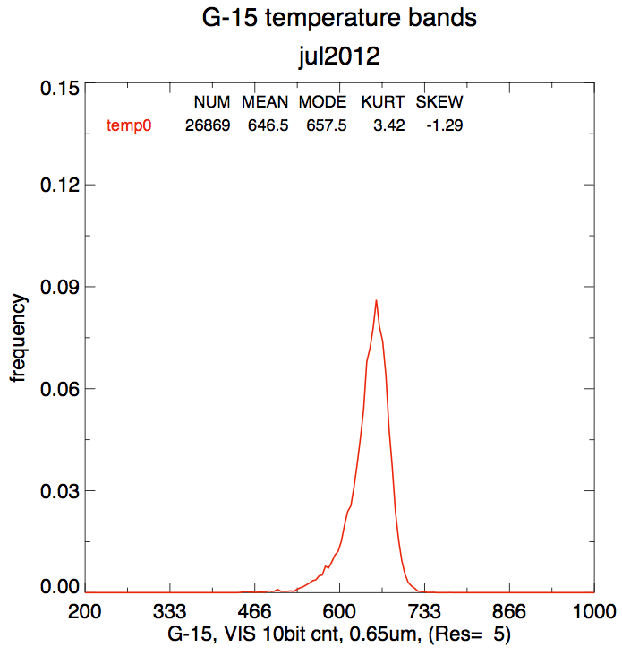
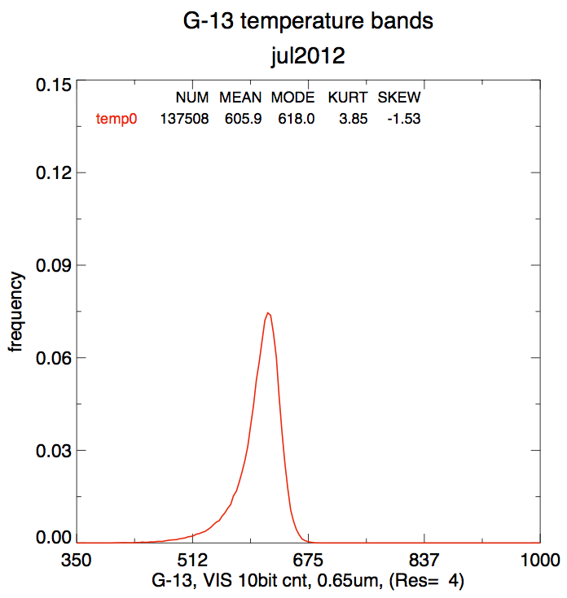
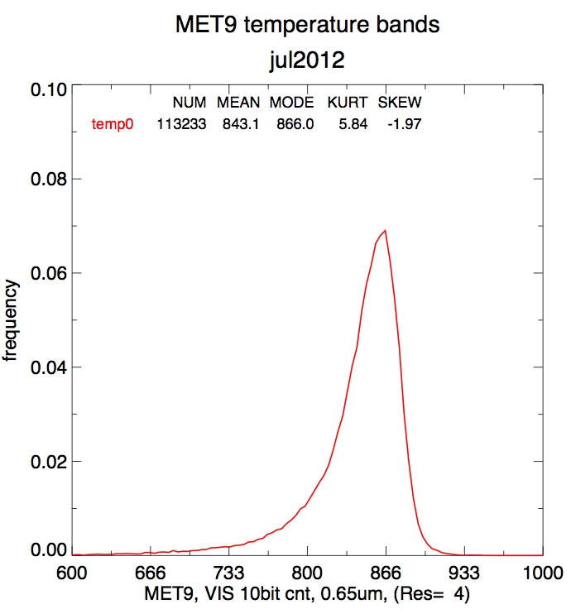
Monthly PDF examples (July 2012)

Slide 13
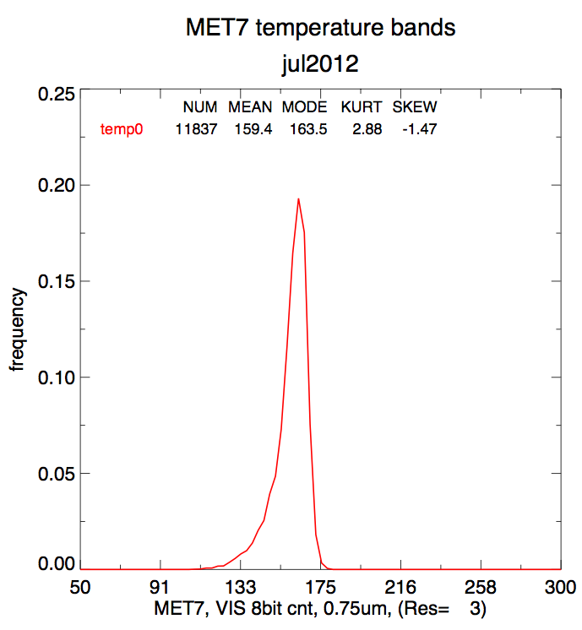
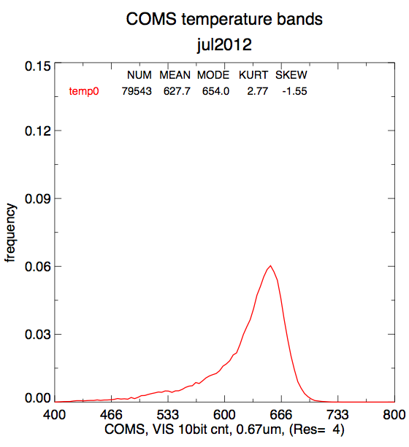
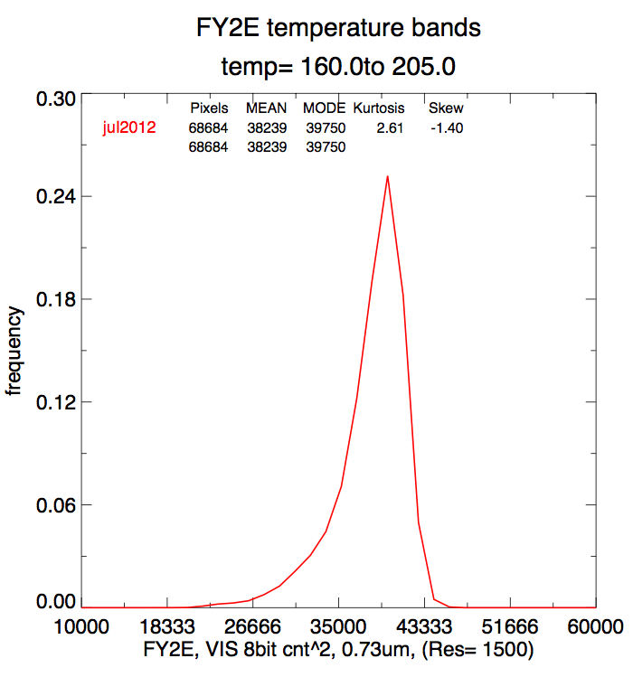
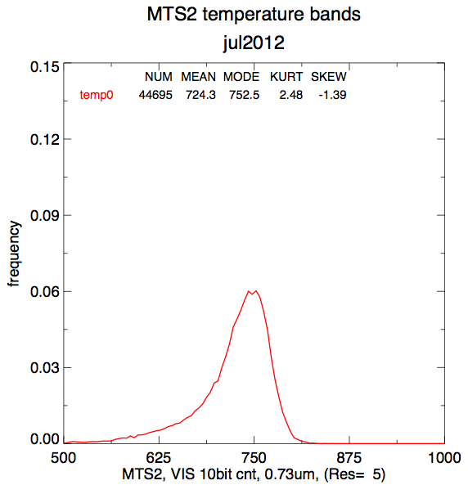

Slide 14
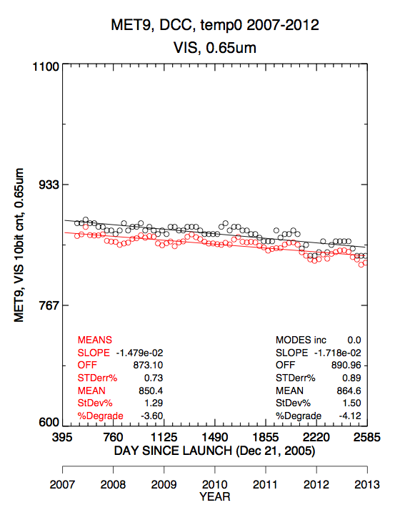
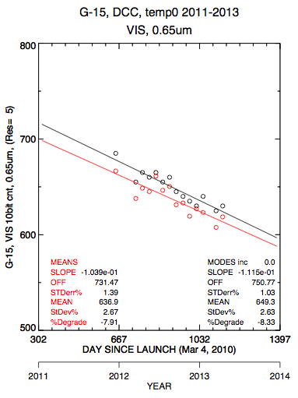
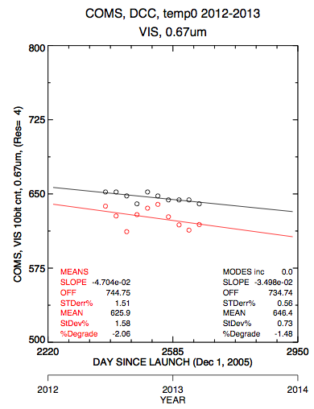
Relative trending
The mode of the monthly PDF is tracked over time to obtain the temporal stability of the GEO visible sensor

Slide 15
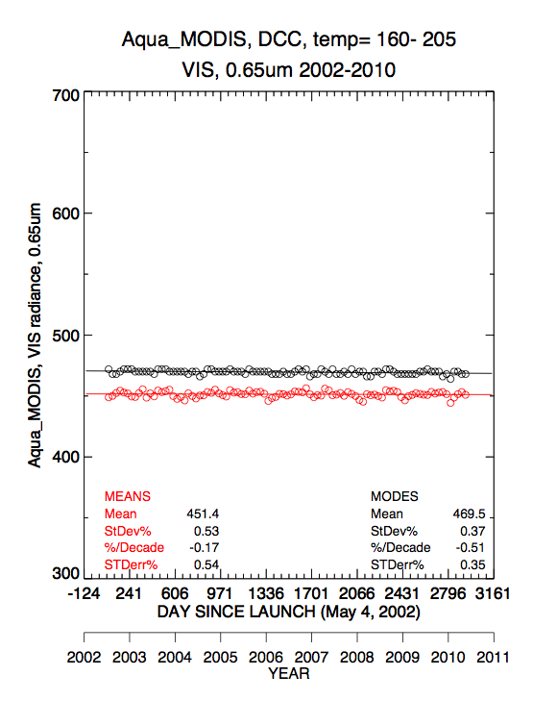
Absolute calibration transformation
The average mode for all 10-years of the Aqua-MODIS (reference sensor) monthly PDFs over the GEO domain is assumed to be the true viewing radiance, and is used to calibrate the GEO counts
Spectral corrections between the MODIS and GEO visible channels are made using SCIAMACHY hyperspectral data [Doelling et al, 2012].

Slide 16
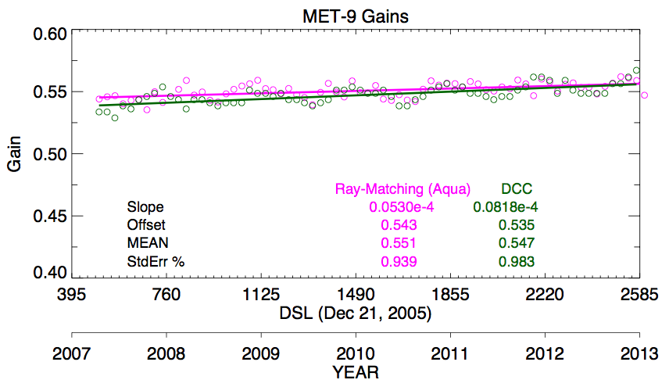
Absolute calibration of Meteosat-9
DCC and ray-matching approaches are consistent within 1%.

Slide 17
Summary
One month (July 2007) of DCC data will be provided to the GSICS archive by June 14, 2013 for GOES-15, GOES-13, Meteosat-9, Meteosat-7, COMS, FY2E, and MTSAT-2 satellites.
References
Doelling, D.R.; Morstad, D.; Scarino, B.R.; Bhatt, R.; Gopalan, A., "The Characterization of Deep Convective Clouds as an Invariant Calibration Target and as a Visible Calibration Technique," Geoscience and Remote Sensing, IEEE Transactions on , vol.51, no.3, pp.1147,1159, March 2013 doi: 10.1109/TGRS.2012.2225066
Yongxiang Hu; Wielicki, B.A.; Ping Yang; Stackhouse, P.W., Jr.; Lin, B.; Young, D.F., "Application of deep convective cloud albedo observation to satellite-based study of the terrestrial atmosphere: monitoring the stability of spaceborne measurements and assessing absorption anomaly," Geoscience and Remote Sensing, IEEE Transactions on , vol.42, no.11, pp.2594,2599, Nov. 2004 doi: 10.1109/TGRS.2004.834765
Doelling, D.R.; Lukashin, C.; Minnis, P.; Scarino, B.; Morstad, D., "Spectral Reflectance Corrections for Satellite Intercalibrations Using SCIAMACHY Data," Geoscience and Remote Sensing Letters, IEEE , vol.9, no.1, pp.119,123, Jan. 2012
doi: 10.1109/LGRS.2011.2161751

