Slide 1
Hyperspectral Instrument Comparisons: Assessing Spectral Band Adjustment Factor Stability
Benjamin Scarino, David R. Doelling, Rajendra Bhatt, Constantine Lukashin, Arun Gopalan, Conor Haney

Slide 2
Outline
Part One: Hyperspectral Instrument Comparisons
SCIAMACHY, Hyperion, GOME-2, and Aqua-MODIS radiance comparisons
SCIAMACHY and Hyperion irradiance comparison
SCIAMACHY, Hyperion, and Aqua-MODIS reflection comparisons
Spectral Band Adjustment Factor (SBAF) calculation
SBAF comparisons from the three instruments
Conclusions
Part Two: Clear-sky ocean SCIAMACHY-based Spectral Band Adjustment Factors
SCIAMACHY clear-sky criteria
Sample distribution and spectra analysis
SBAF examples
Conclusions

Slide 3
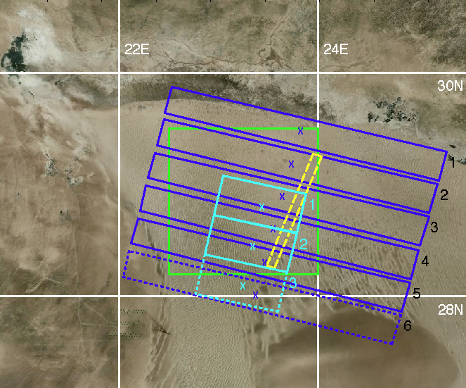
Measurements taken over a Libyan Desert site (28°N to 29.5°N, and 22.5°E to 24°E) during August 2007
Libya-4 ROI
SCIAMACHY Footprints
SCIAMACHY Unused Footprint
GOME-2 Footprints
GOME-2 Unused Footprint
Hyperion Swath

Slide 4
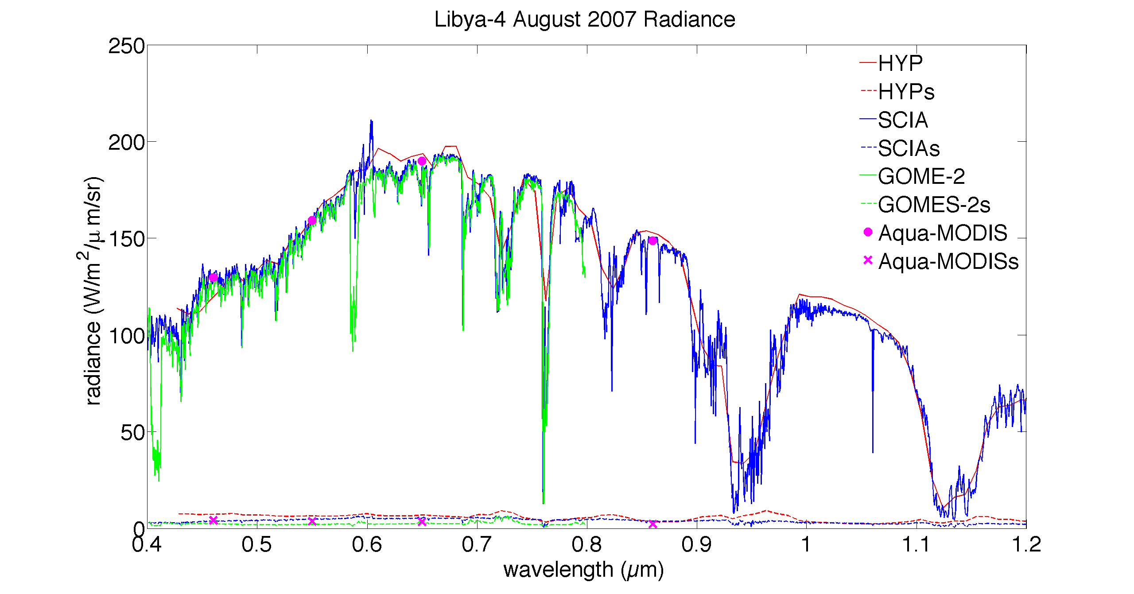
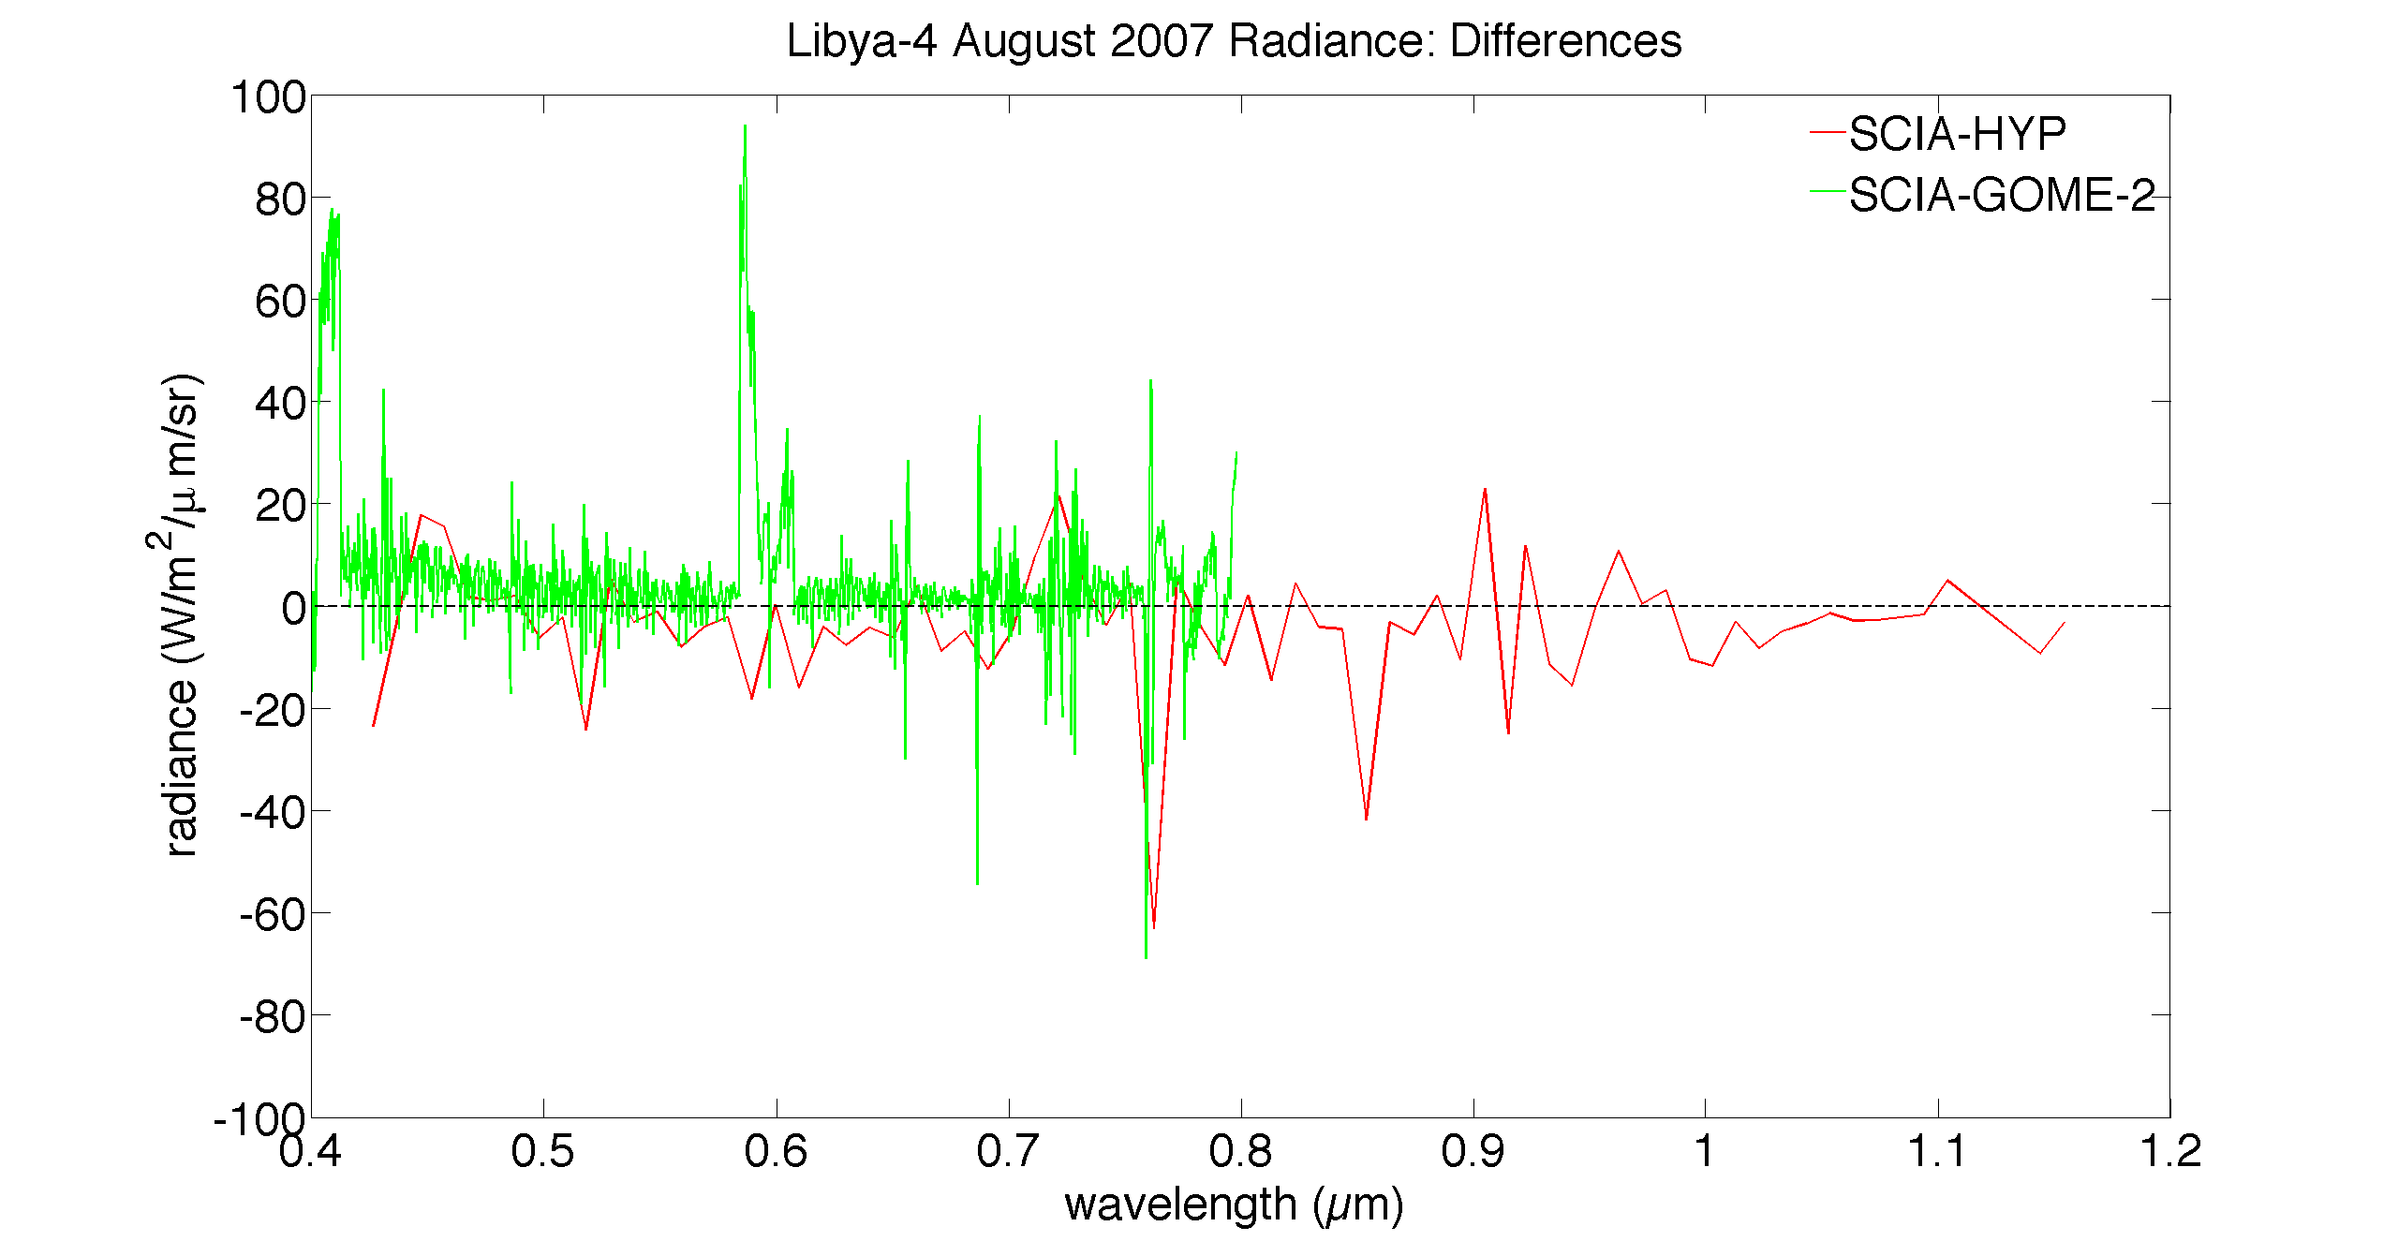
Radiance Comparison
Number of samples:
SCIA: 17
GOME-2: 17
Hyperion: 5
Aqua-MODIS: 4
VZA limited to < 10°
SZA normalized to SCIA (29.0°):
Rad = [Rad / cos(SZA) ] * cos(29°)
Earth-sun distance correction, relative to August 15, applied:
Rad = Rad / 1.0258
Artifacts of GOME-2 channel overlap regions. Low values filtered when calculating SBAF
Mean Diff: -4.2 ± 12.7
Mean Diff: 5.7 ± 15.0
About a 1-2% difference on average

Slide 5
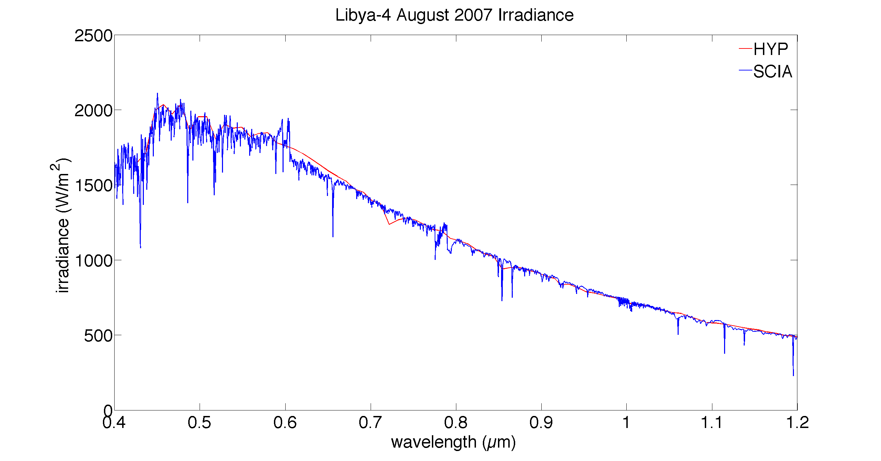
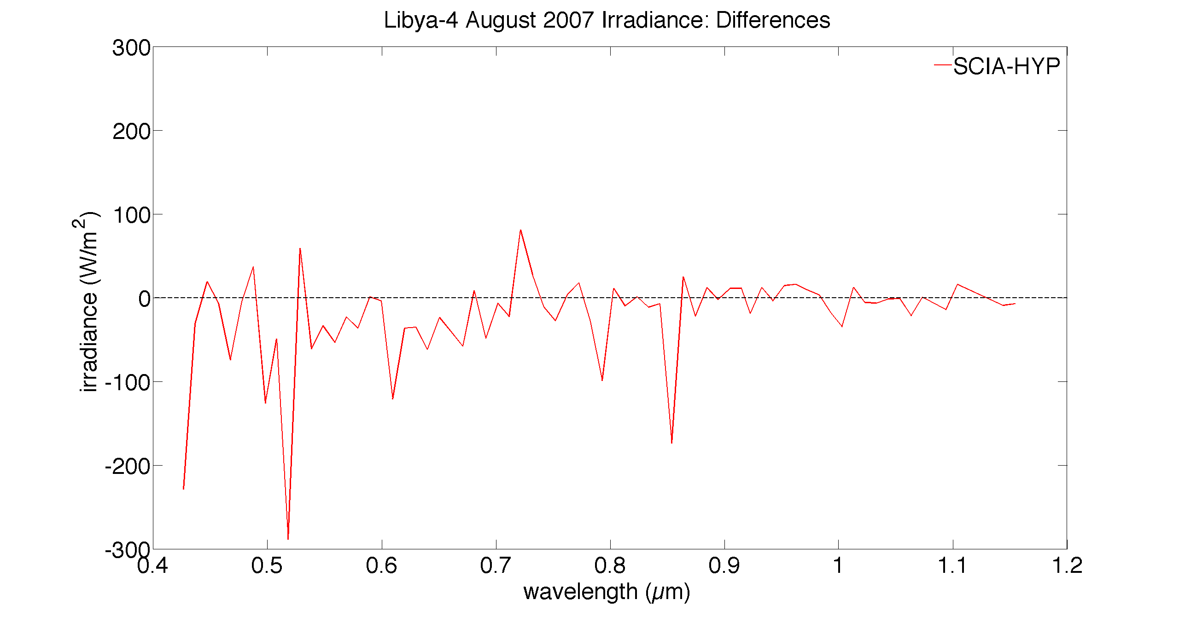
Irradiance Comparison
Number of samples:
SCIA: 17
Hyperion: 5
Hyperion performs on-orbit solar views, an internal calibration source consisting of halogen lamps, lunar views, and vicarious calibration over instrumented sites (Chander)
SCIAMACHY operationally conducts sun observations for degradation monitoring (also moon)
Working on reading GOME-2 Irradiance data
Mean Diff: -23.3 ± 57.3

Slide 6
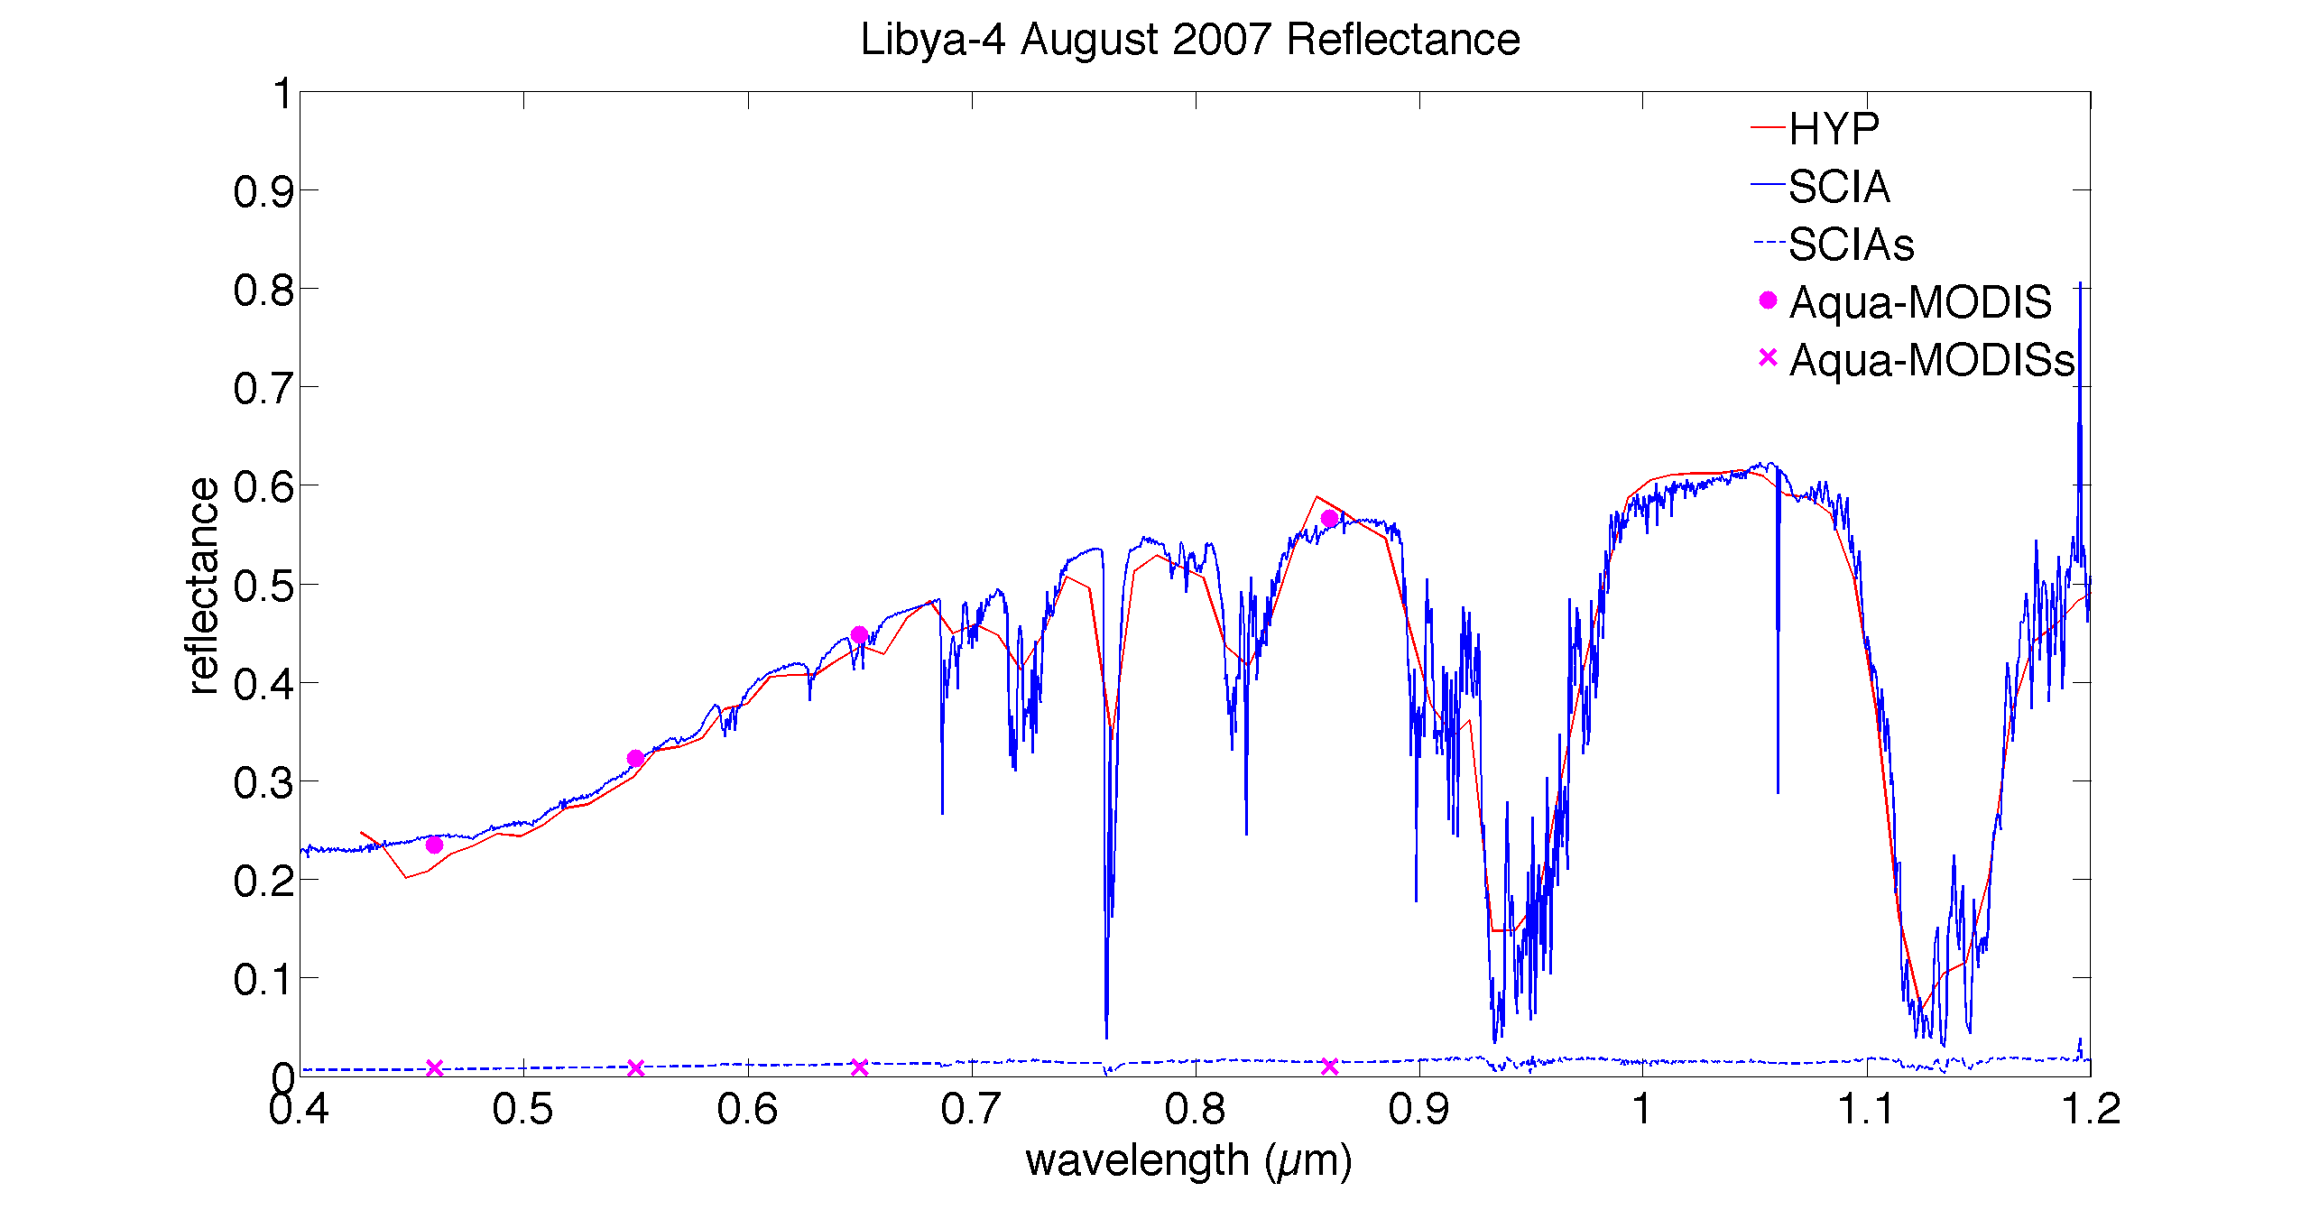
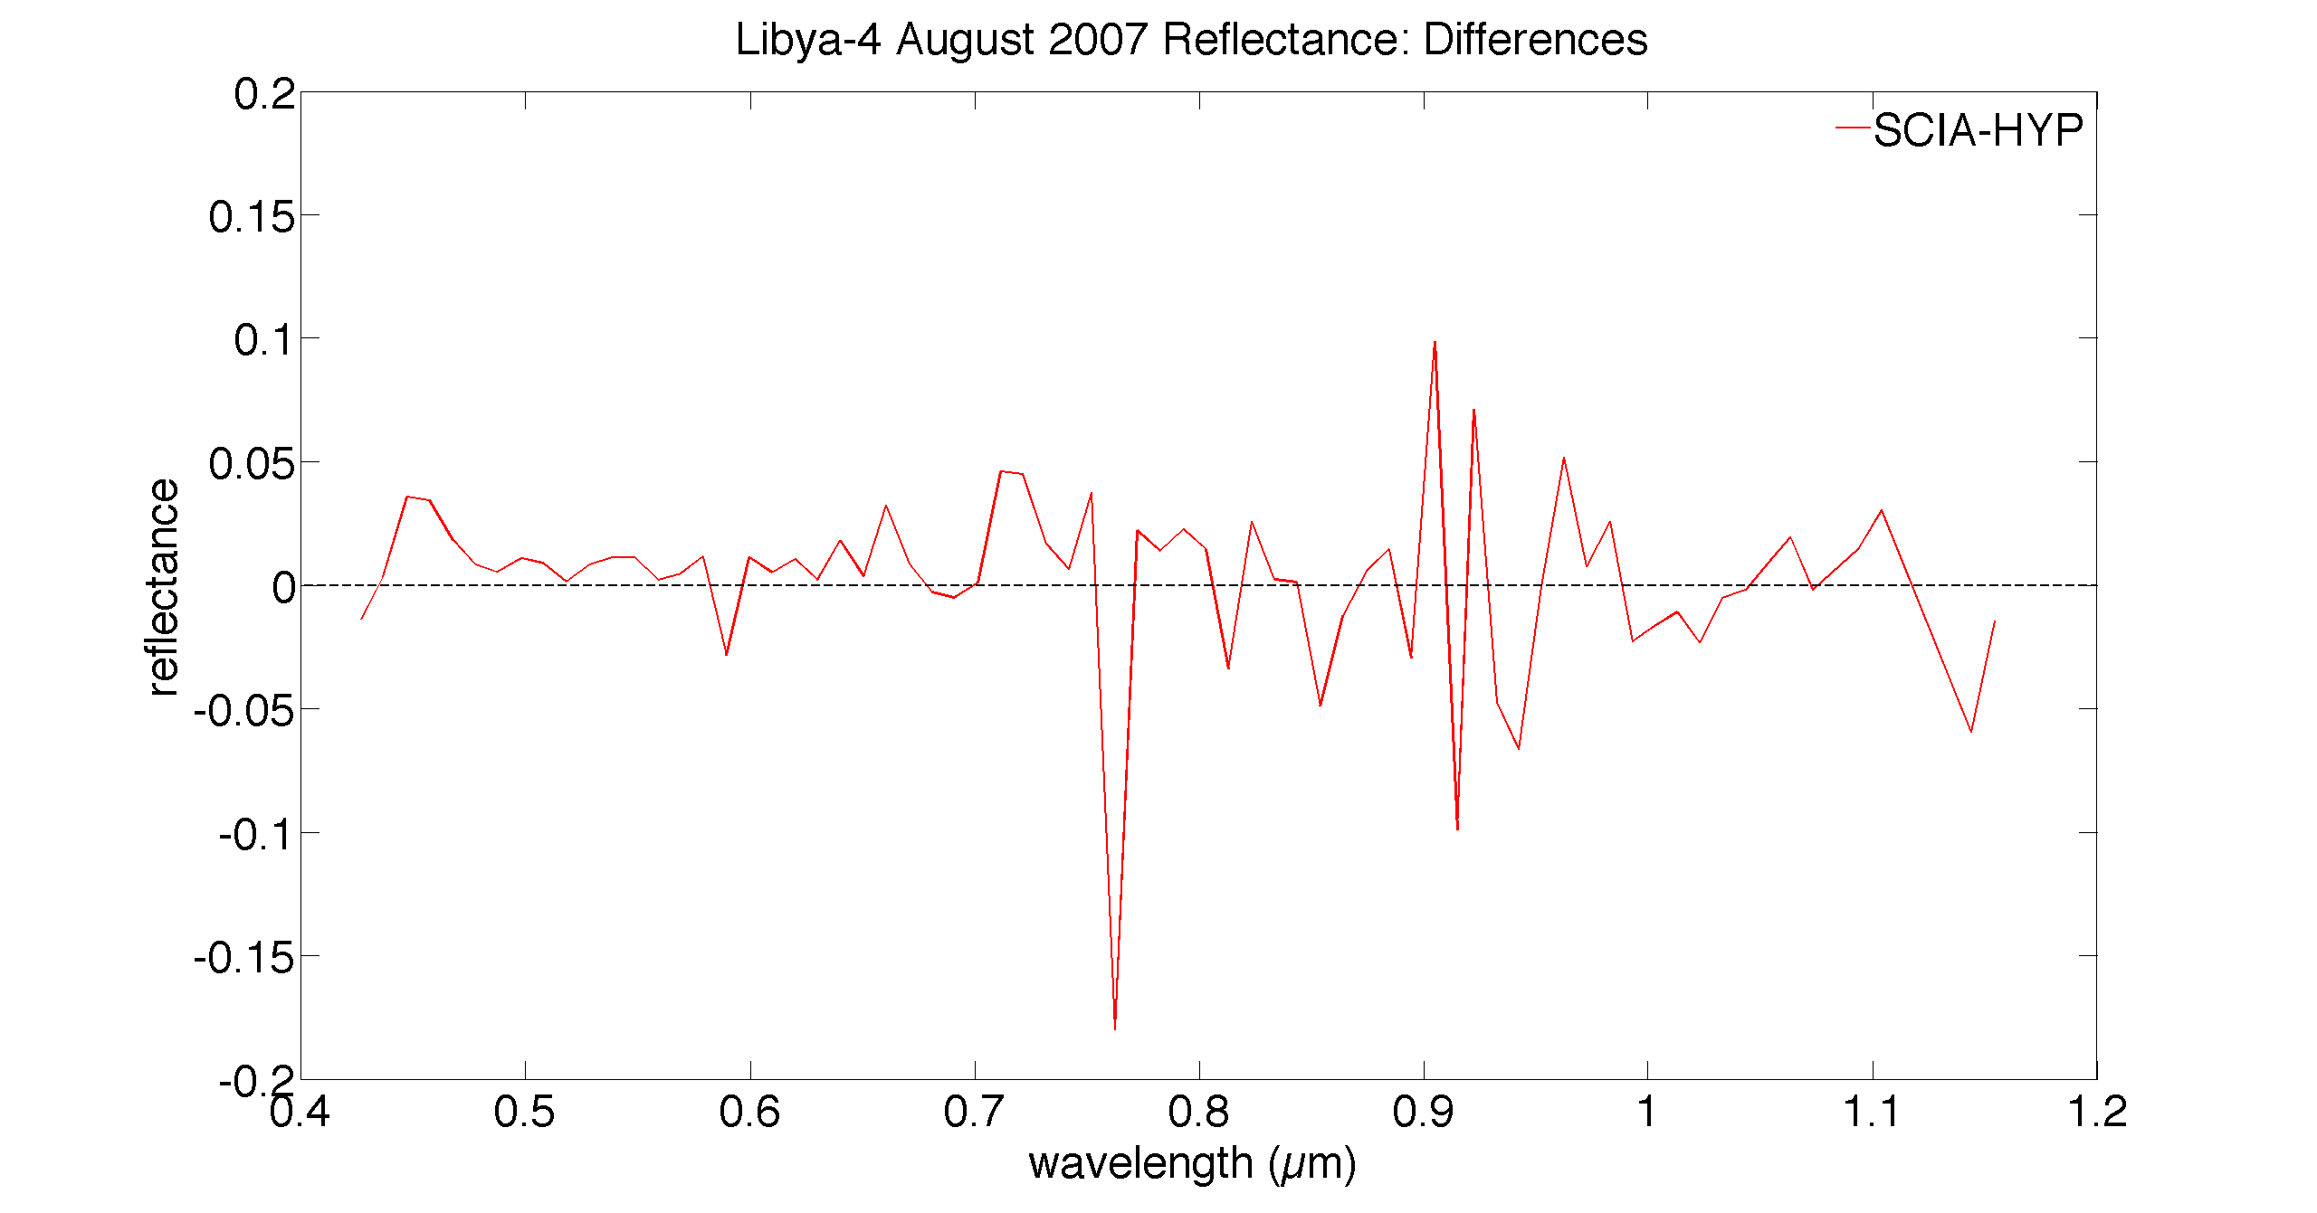
Reflectance Comparison
Number of samples:
SCIA: 17
Hyperion: 5
Aqua-MODIS: 4
VZA limited to < 10°
Plan to compute GOME-2 reflectance spectra once irradiance data acquired
Mean Diff: 0.002 ± 0.037

Slide 7
Spectral Band Adjustment Factors
Spectra from each SCIAMACHY scene-appropriate footprint are convolved with imager SRFs
Yields imager-equivalent (pseudo imager) radiances

Slide 8
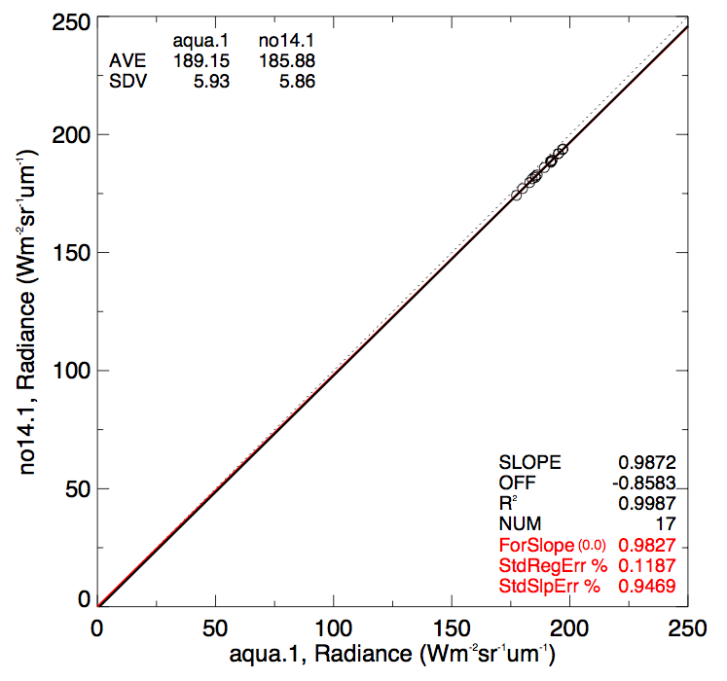
Spectral Band Adjustment Factors
Regression of two pseudo radiances constitutes a Spectral Band Adjustment Factor (SBAF)
Applied to the reference sensor radiance (L_{ref}) to arrive at the predicted target sensor radiance (L_{tar})

Slide 9
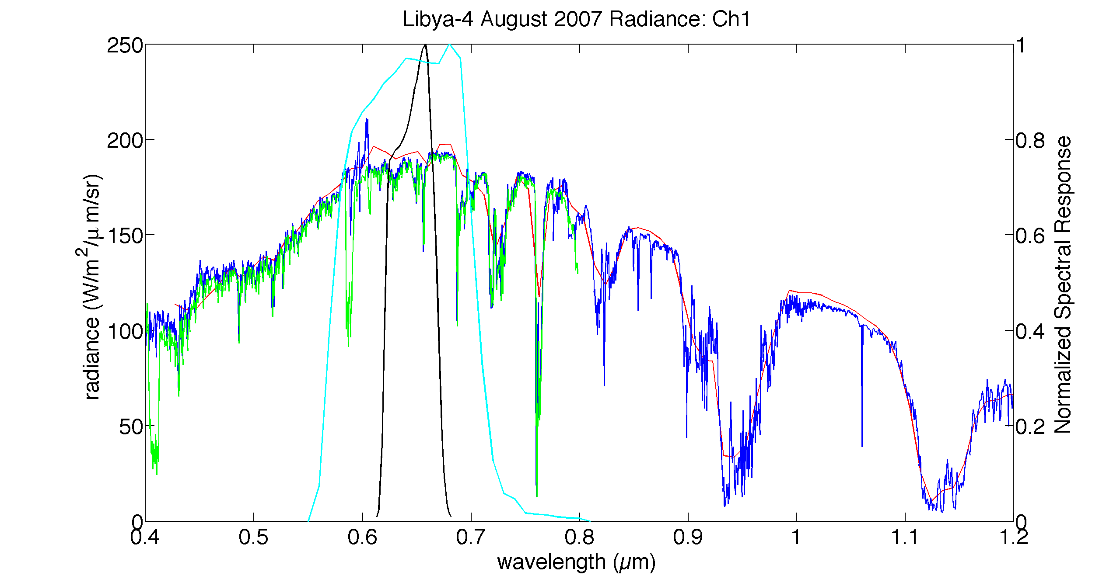
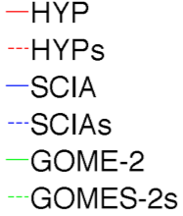
NOAA-14 Band 1
Aqua-MODIS Band 1
SCIAMACHY-Based SBAF = 0.9827
Hyperion-Based SBAF = 0.9789
GOME-2-Based SBAF = 0.9783
0.4% difference
0.4% difference
SCIAMACHY Standard Error of the Regression: 0.12%
Small uncertainty in the SCIAMACHY SBAF based on the 17 independent convolutions

Slide 10
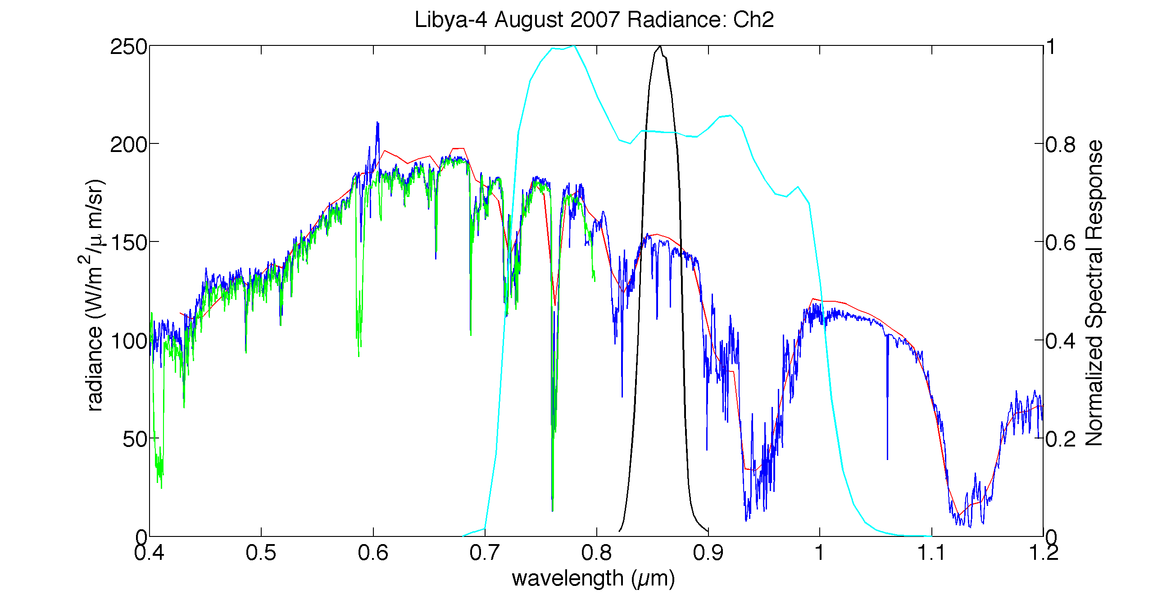
NOAA-14 Band 2
Aqua-MODIS Band 2
SCIAMACHY-Based SBAF = 0.8464
Hyperion-Based SBAF = 0.8474
0.1% difference
SCIAMACHY Standard Error of the Regression: 1.05%
Increased uncertainty in the SBAF likely owed to water vapor absorption bands

Slide 11
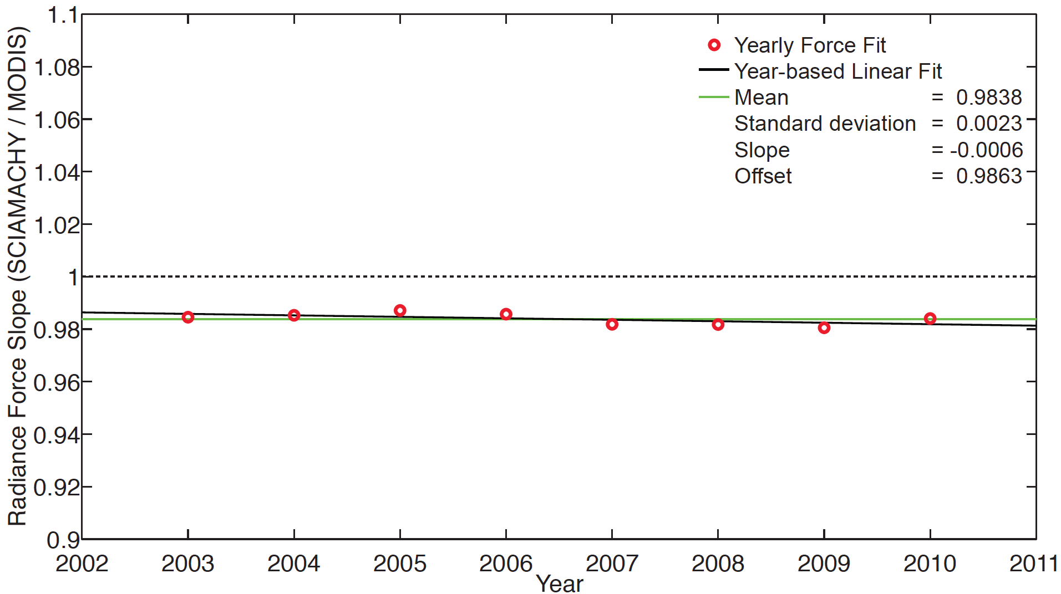
Conclusions
The SCIAMACHY-based SBAF is well within 1% of the GOME-2-based and Hyperion-based SBAFs
SCIAMACHY ideal because high spectral resolution, full coverage of the visible and near-IR channels, and because of its readily available global coverage
SCIAMACHY spectra consistently the best match to Aqua-MODIS radiance and reflectance; already established to be stable compared to Aqua-MODIS (Doelling et al., 2013)
SCIAMACHY Radiance is stable to within -0.6% per decade compared to Aqua-MODIS

Slide 12
Clear-sky ocean SCIAMACHY-based SBAFs

Slide 13
Ocean
100% CLEAR
100% CLEAR
100% CLEAR
100% CLEAR
240 km
30 km
1°
100% CLEAR
1°
SCIAMACHY 240 km x 30 km clear-sky ocean footprints.
Cloud fraction comes from 1° gridded MODIS data 1/2 hour after SCIAMACHY overpass
Clouds still possible owing to advection or certain footprint orientations

Slide 14
Ocean
100% CLEAR
100% CLEAR
240 km
1°
30 km
????
100% CLEAR
1°
SCIAMACHY 240 km x 30 km clear-sky ocean footprints.
Cloud fraction comes from 1° gridded MODIS data 1/2 hour after SCIAMACHY overpass
Clouds still possible owing to advection or certain footprint orientations

Slide 15
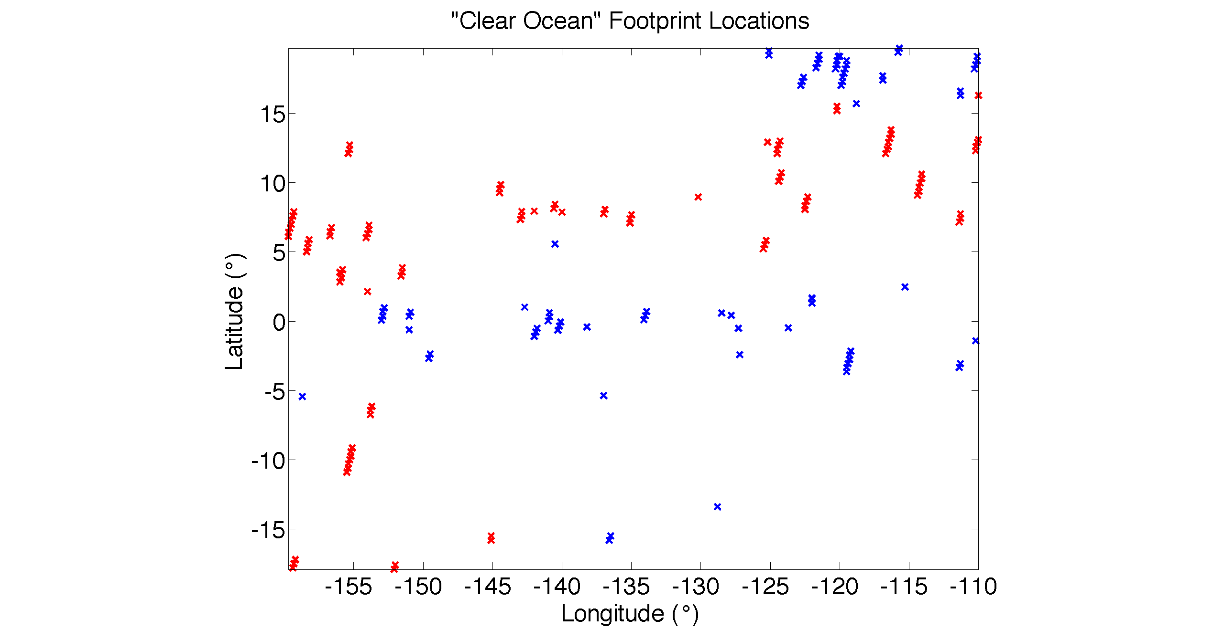
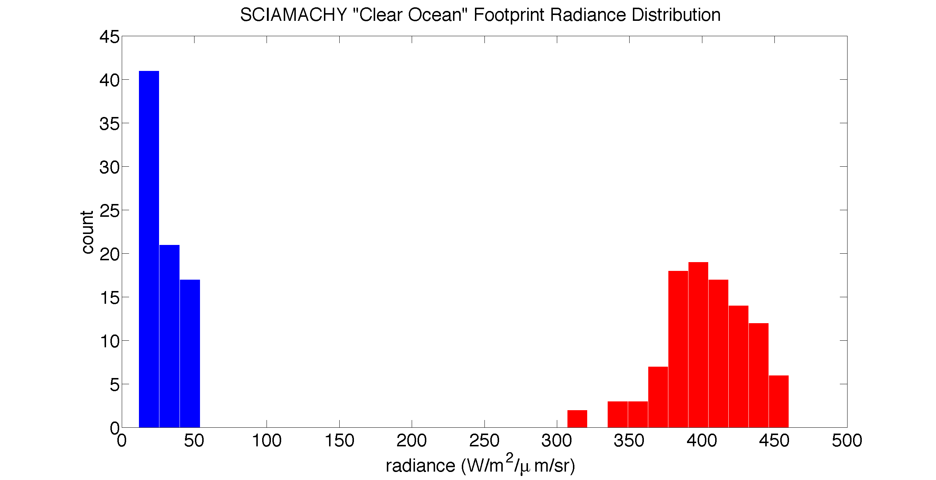
Tropical Pacific Ocean domain, covering 20°N to 20°S, and 110°W to 160°W
Sampling time from August 2002 through December 2012
Of ~500,000 ocean footprints over ~8 years, 180 register as 100% clear
Of those, 79 measure a radiance < 55 W/m²/μm/sr
The remaining 101 footprints have a radiance > 300 W/m²/μm/sr
101 likely instances “clear” footprint is still partially cloudy owing to footprint orientation on 1° MODIS grid

Slide 16
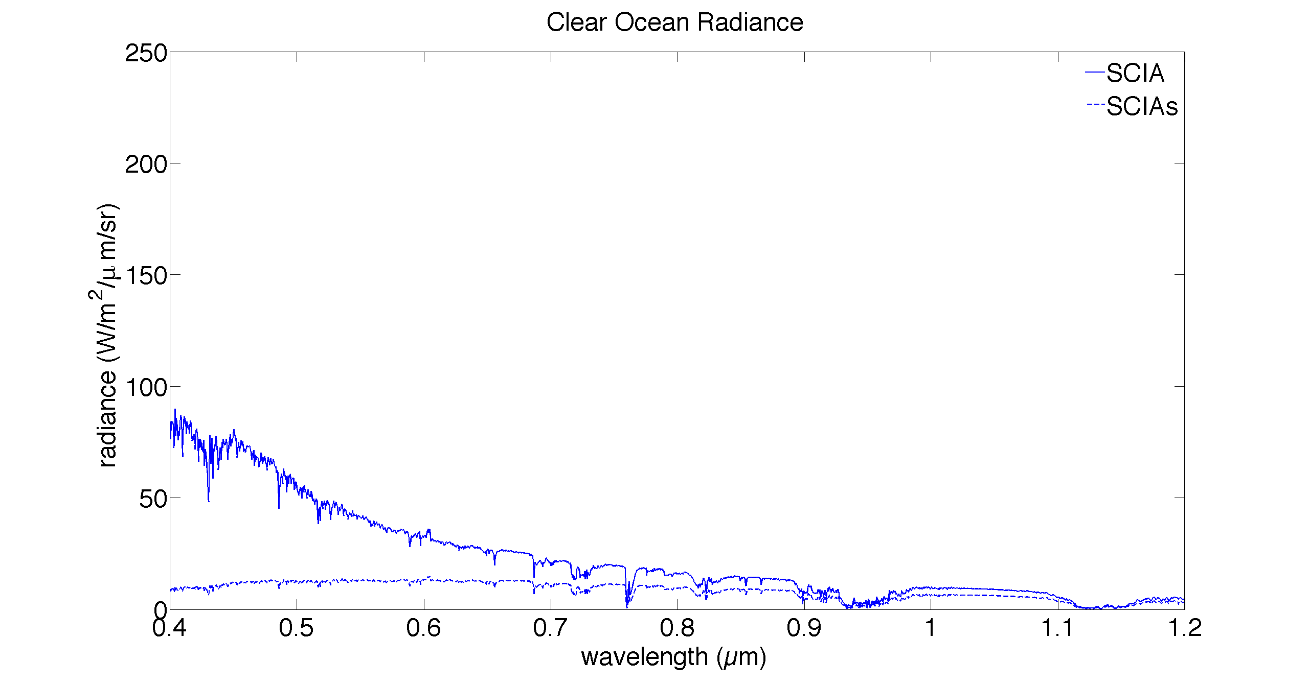
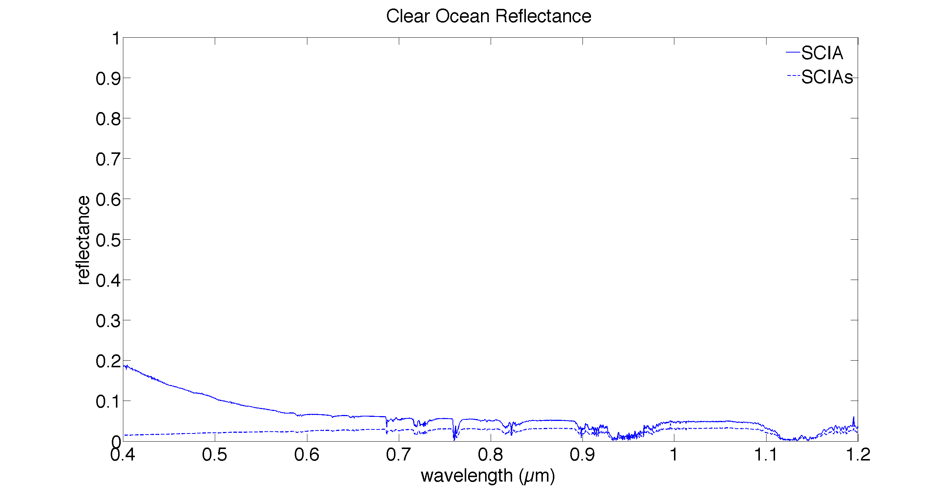
Radiance and reflectance spectra from the 79 clear ocean (< 55 W/m²/μm/sr) SCIAMACHY footprints
There is still a relatively large variance below this break-point, but consider that the overall magnitude of radiance/relfectance is small. Also cannot rule out clouds that are much smaller than MODIS pixel size

Slide 17
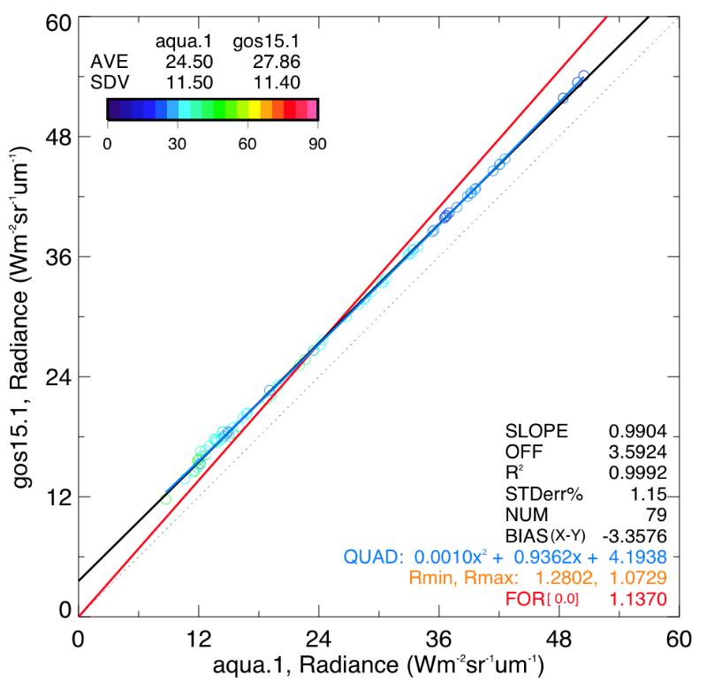
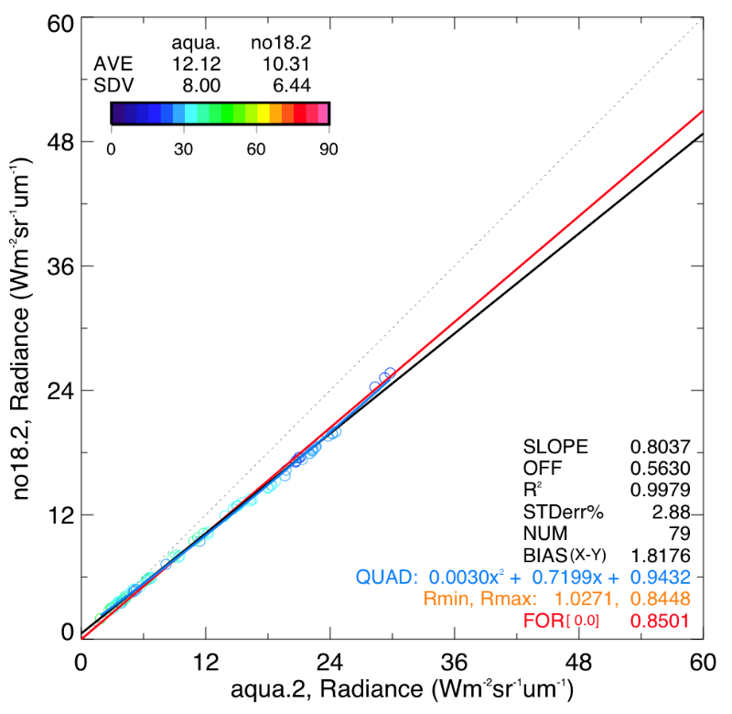
SBAF Examples
Channel 1 Example
Channel 2 Example
SZA
SZA

Slide 18
Conclusions
Difficult to find 100% clear-sky SCIAMACHY footprints owing to their size, unless you have very large sample size
Even those that register as 100% clear can sometimes still be partially cloudy owing to advection or footprint orientation
However, there is an obvious breakpoint between the brighter, cloudy footprints and the footprints one would expect to be associated with clear-sky ocean
An SBAF can be computed using these darker footprints, which probably are the closest representation of a 100% clear-sky ocean footprint that can be found
Will attempt to analyze these clear-sky footprints using GOME-2 data

