Slide 1
GOES Calibration Anomaly Reports – Experience and Lessons
Fangfang Yu , Xiangqian Wu and Mike Grotehuis
June 11, 2013

Slide 2
Calibration Event and Anomaly
Data quality
Radiometric:
Noise: banding/striping, coherent noise, random noise, etc…
Data loss/outage: ground system maintenance, spacecraft housekeeping, outgas/decontamination, standby, loss of signal synchronization …
Abnormal radiance caused by erroneous calibration coefficients: root causes from instruments and ground system
Spatial/geometric: registration/co-registration error
Spectral
Event – expected, sudden or gradual change of data quality during a certain time period
Anomaly – unexpected; users mainly complain about
Both needed to get resolved as soon as possible; inputs to the event log

Slide 3
GOES Current Calibration Anomaly Warning System
ESPCoperations email notifications
Predicted events and expected impacts – warning before events
Decontamination/outgas
Housekeeping
Patch temperature switches
….
Unexpected data outages – notification sent as soon as possible
GOES-13 standby anomalies in Sept 2012 and May 2013
….

Slide 4
Calibration Anomaly and ICVS System
Despite of the multiple-layers of operational monitoring systems, there were still occasions that the calibration errors were reported by the users
Users may prefer no-data if the error is too large
Need to detect the anomaly and alert the users as soon as possible
If anomaly occurs, need to fix it as soon as possible
The Integrated Cal/Val System (ICVS) plays a key role in detecting the calibration anomaly, diagnosing the root cause and assessing the impacts of anomalous events.
ICVS facilitates the communication of instrument anomalies amongst instrument and calibration scientists and user community.
Provide instrument scientists with calibration healthy status
Provide users with regarding the satellite data quality for product generation

Slide 5
GOES ICVS System
GEO-LEO Bias monitoring
GEO-GEO Bias monitoring
noise monitoring (NEDT/NEDN etc)
…
Radiometric calibration related parameters
Telemetry parameters
Calibration coefficients
Space/blackbody counts
….
GOES Instrument Performance Monitoring (IPM) System
GOES Data Quality Monitoring
GOES ICVS will be updated and linked to the NOAA ICVS system (http://www.star.nesdis.noaa.gov/smcd/spb/icvs/) soon

Slide 6
Some Examples …
Near real-time radiometric calibration anomalies
Spectral calibration anomaly
Spatial calibration anomaly

Slide 7
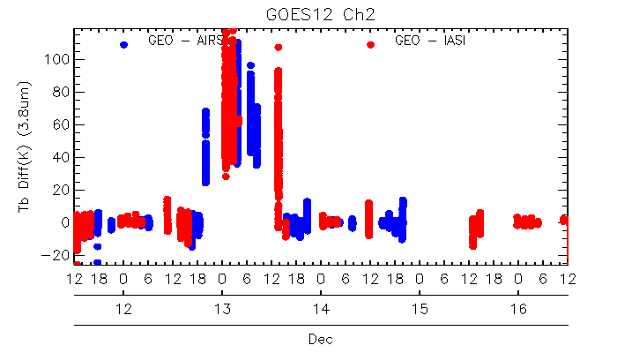
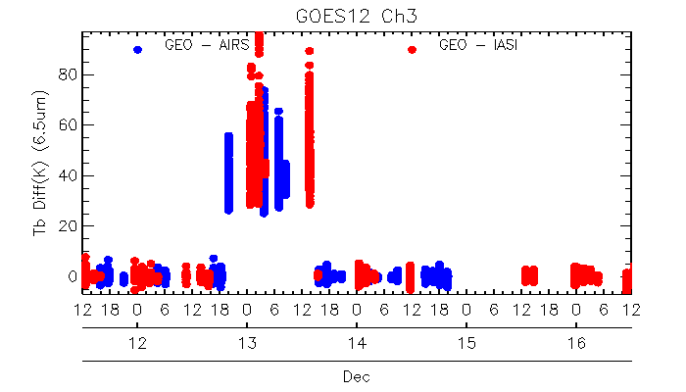
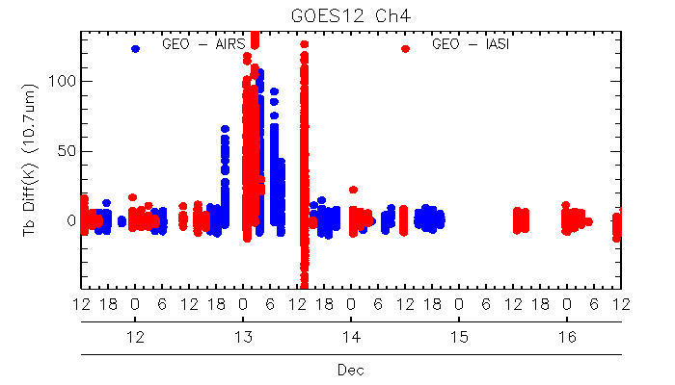
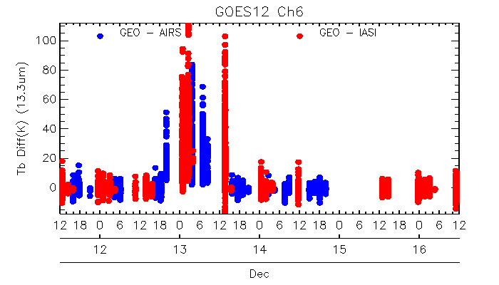
GOES-12 Imager Radiometric Calibration Anomaly
An operation error r occurred at the GOES-12 Imager infrared (IR) calibration from December 12 ~19:30Z to December 13 ~15:00Z, 2011
A powerful to evaluate the impact of anomaly
Yet, it has at least one-day delay (daily mean of the scene dependent bias..)
May miss the anomaly occurred in the collocation gaps
Diurnal mean brightness temperature bias with respect to AIRS and IASI at the half-hour bins from Dec 11 2011 to Dec 16 2011.

Slide 8
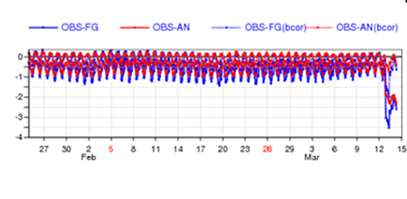
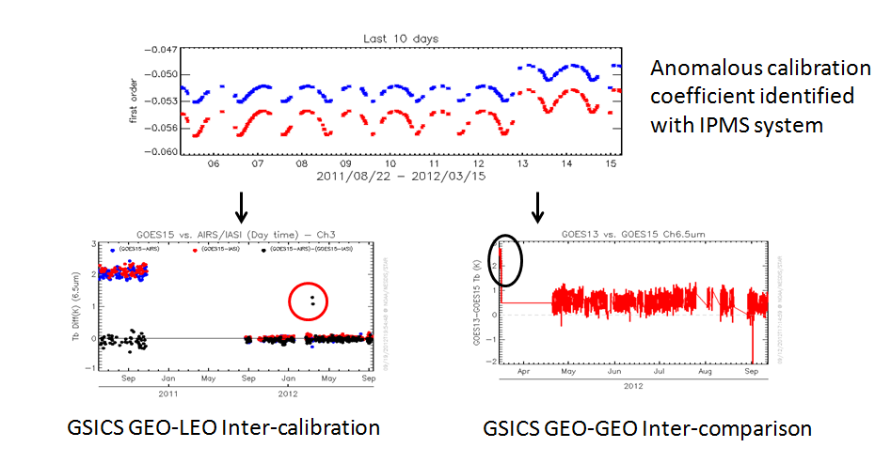
GOES-15 Imager Calibration Anomaly in March 2012
First revealed by ECMWF monitoring of T_{b}
Immediately identified with GOES-IPM monitoring from the change of calibration coefficients.
Evaluated with the GSICS GEO-LEO and GEO-GEO bias monitoring
Notes:
http://cimss.ssec.wisc.edu/goes/blog/archives/9995

Slide 9
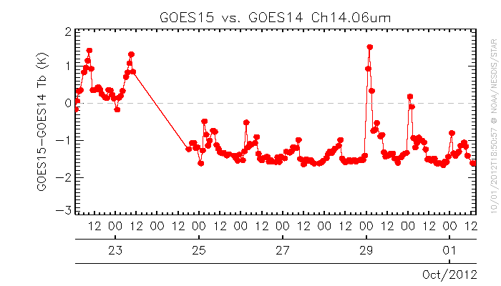
GOES-15 Sounder Radiometric Calibration Anomalies in Sept. 2012
Joint Center for Satellite Data Assimilation (JSCDA) reported increased noise in Sept 2012 and Oct. 2012
Patch temperature change/variation
Pre-mature change of calibration mode

Slide 10
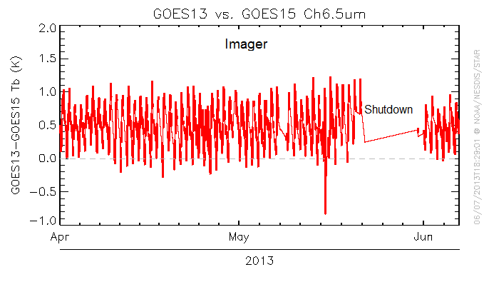
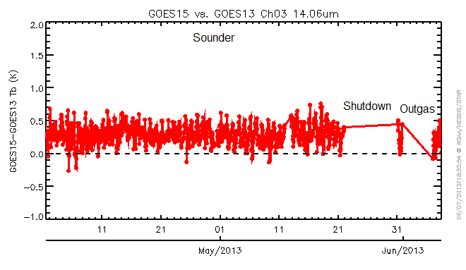
Monitoring the data radiance quality during the GOES-13 Recovery Test Periods
Anomaly due to in-equilibrium thermal environ caused by change of instr. setting
1. GOES-13 recovery test after its shutdown in Sept 2012
Imager
Sounder
2. GOES-13 recovery test after its shutdown in May 2013

Slide 11
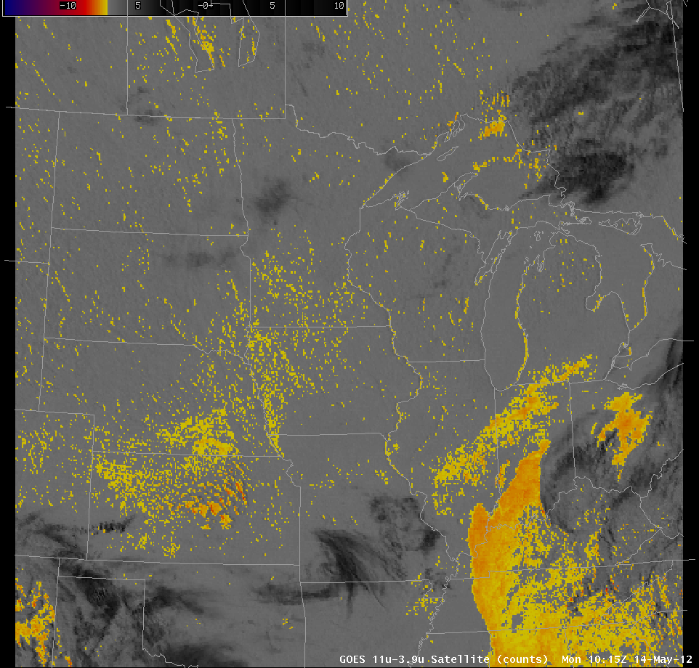
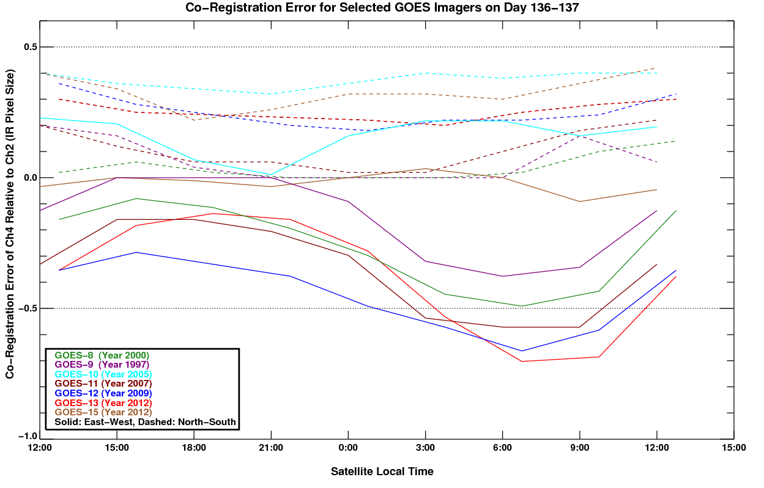
Band-to-Band Co-registration Error Correction
Users (University of Wisconsin) Reported the erroneous fog products of GOES-13 Imager along the edges of geographic features in May 2012
Use of the band-to-band cloud edge statistics to evaluate/characterize the Ch2(3.9um) and Ch4(10.7um) co-registration error. (Wu 1998 and Grotehuis et al. 2012)
“False” fog products, courtesy of U. Wisc.
Provided the spatial and radiometric verification after the operational correction implementation at the ground system
Diurnal co-registration errors at G8 thru G15 (by M. Grotenhuis, NOAA/NEDIS/STAR)
Notes:
http://cimss.ssec.wisc.edu/goes/blog/archives/10341

Slide 12
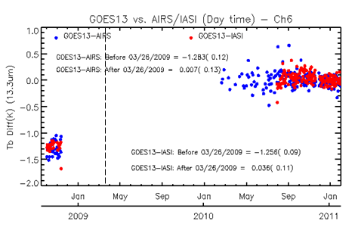
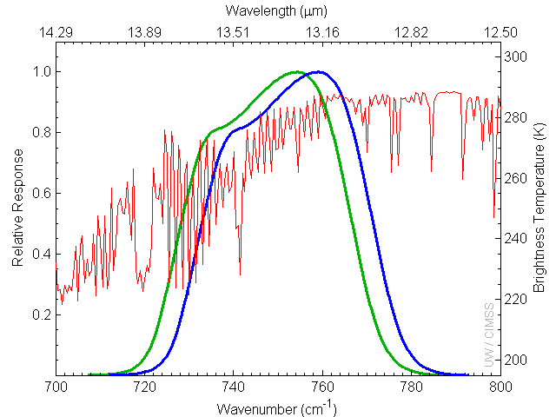
Spectral Calibration Error – GOES-13 Imager Ch6 as an example
Users (University of Wisconsin) reported >1K cold bias at GOES-13 Imager Ch6 (13.3um) during the Post-launch test in 2006 and recommended a shift of 4.7cm⁻¹ - before GSICS project
ITT audited the SRF files and revised the SRF, effectively shifted by about 1cm⁻¹
GSICS GEO-LEO further shift by 2.1cm⁻¹

Slide 13
Summary
The GOES ICVS (IPM+data quality monitoring systems) is a very powerful tool in detecting the anomaly and investigating the root causes.
GSICS GEO-LEO IR bias monitoring plays an important role in evaluating the impact of radiometric calibration anomaly
GSICS GEO-GEO bias monitoring is powerful in calibration anomaly alert
Near real time
At diurnal scale
But cannot tell which satellite has the anomaly with only two GEO inter-comparison
Maintain the fast, health communication with user community
Post-launch test for science is critical to checkout and improve the data quality
Looking forward to working with the synthetic observation sub-group

