Slide 1
GRWG+GDWG Web Meeting on Calibration Change Alerts
2013-06-11
Tim Hewison

Slide 2
2013 GSICS Users’ Workshop
Per the GOES-15 Imager calibration anomaly event in March 2012, users also expressed the desire of satellite operational anomaly alerting system [Tim Schmidt]
See Hot Summary

Slide 4
GEO-LEO IR ATBD §5.d

Slide 5
GEO-LEO IR ATBD §5.e

Slide 6
GEO-LEO IR ATBD §5.f

Slide 7
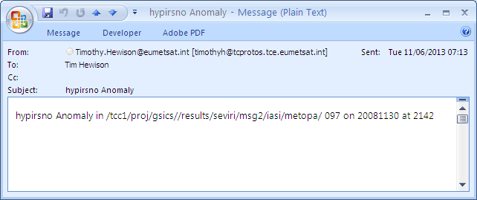
Example E-mail Alert

Slide 8
Basic Contents of Alerts
Date, Time of anomaly
Satellite, Instrument, Channel
Bias of anomaly (current value) in K for IR
Medium-term trend (from Near Real-Time Correction?)
Significance of anomaly (e.g. 5σ)
Number of collocations used, number days in trend
Limits used – soft & hard => Severity
Hyperlink to bias plotting – or include plot
How many alerts within given period
Link to anticipated change notifications – for future v2
Disclaimer:
This alert has been generated by an automatic algorithm and not been checked by human, as a service to users interested in investigating calibration anomalies.

Slide 9
Distribution of Alerts
Through GSICS User Messaging Service?
Would need to be processed centrally
Requires manually adding interested users to mailing lists
Email
Difficult for non-operational groups to send out
Set up another GSICS Google Groups for alerts
Includes RSS feeds
Allows users to subscribe/unsubscribe
Provides archive function
Archive

Slide 10
Update Frequency
Daily From GEO-LEO IR – with more frequent update possible?
Hourly would require GEO-GEO bias monitoring
Don’t need GSICS Corrections from GEO-GEO comparisons
Complicated by SRF differences
Redundant
But potentially good validation of GEO-LEO Corrections
See Three-way Inter-Calibration of SEVIRI on Meteosat-8 and -9 with IASI [Hewison et al., EUMETSAT Conference poster, 2010]
How many alerts do users want per year?
3-sigma threshold should give ~0.3% ≈ 1d/365d
User-selectable thresholds?

Slide 11
Calibration Change Alerts from other GSICS Products
GEO-LEO VIS
Deep Convective Clouds (DCCs)
Rayleigh Scattering
Monthly update cycle
Or rolling average with daily updates?
GEO-GEO VIS?
As GEO-GEO IR?
Any others?

Slide 12
Thank You

