Slide 1
DCC algorithm application meeting, part 2 Agenda and goals for GEO DCC algorithm implementation
Aug 14, 2013
David Doelling, Rajendra Bhatt, NASA

Slide 2
DCC calibration algorithm components
Stability monitoring
Identification, IR 11µm temperature threshold
BRDF model, to define the most isotropic part
PDF statistic
Aqua-MODIS absolute calibration transfer
Working on DCC ray-matching, if successful then the stability monitoring is independent of calibration transfer
If not successful, then the DCC algorithm must be identical to Aqua-MODIS to transfer calibration (current algorithm)
Spectral band adjustment factor (SBAF)
Should be small, since the DCC are at the tropopause
Use SCIAMACHY SBAF

Slide 3
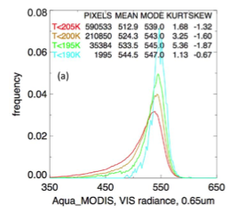

Slide 4
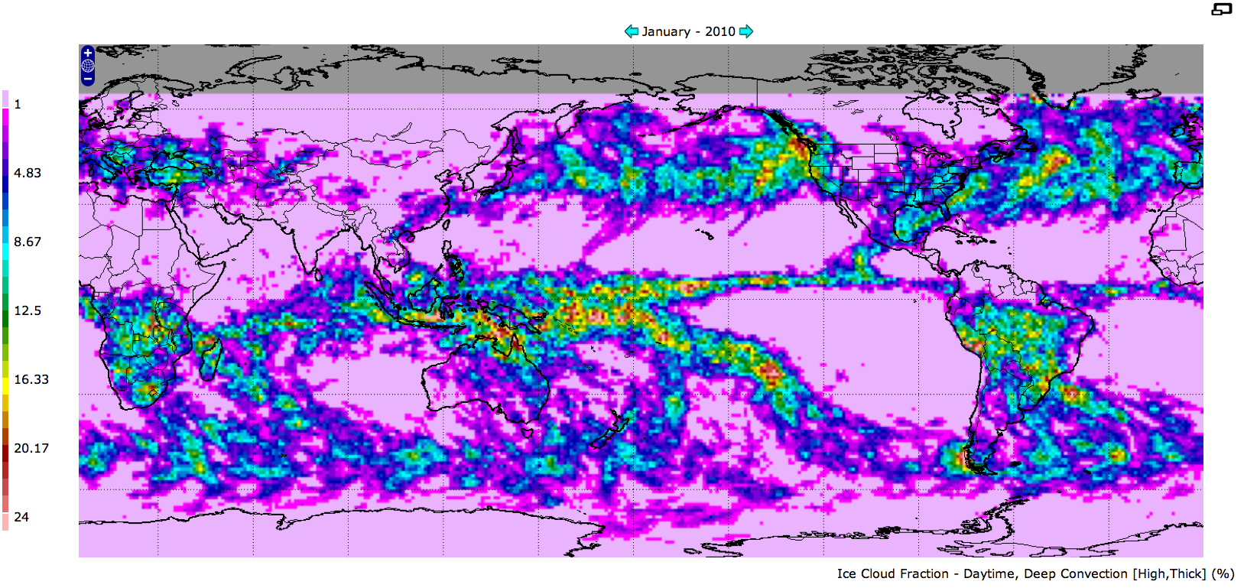
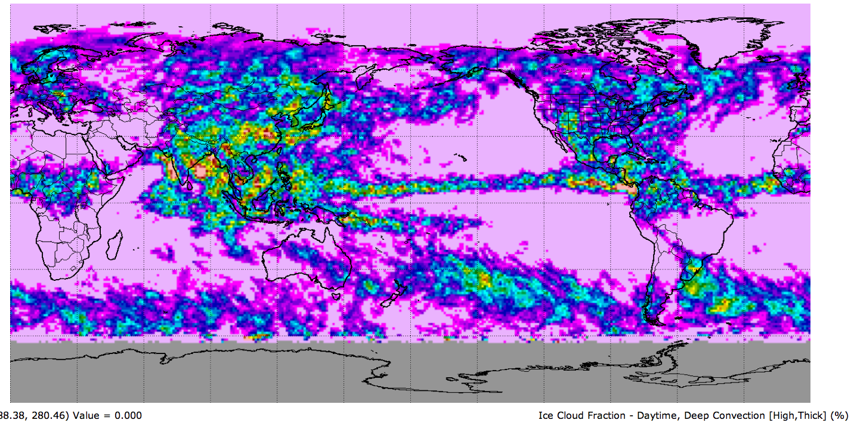
Regional DCC Radiance Variability (Stability Monitoring)
T<205°K
Jan 2010
CERES high thick cloud amount
Jul 2010
• If you assume that the DCC microphysics, diurnal seasonal and regional distribution and radiance is replicated annually, then the choice of GEO domain is arbitrary as long you sample consistently.
• If the GEO domain includes land, you must sample at the same local time

Slide 6
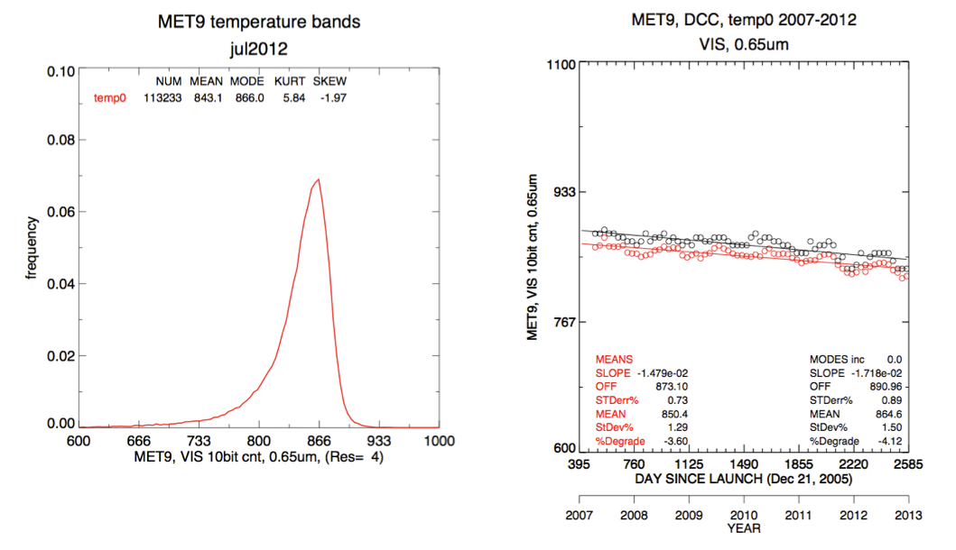

Slide 7
DCC algorithm implementation schedule
May 2013 Meeting
NASA to provide DCC pixel level radiance file for each GEO domain for July 2012
NASA to implement the DCC algorithm for each GEO domain for comparison
Aug 2013 Meeting
Invite GPRC to implement the DCC algorithm and replicate the NASA results
Discuss the DCC components for improvements in stability monitoring over GEO domain
Fall 2013 Meeting
NASA to present DCC ray-matching to transfer Aqua-MODIS calibration to GEO
Discuss SBAF correction
More discussion of the DCC components and harmonize DCC stability monitoring among GPRCs
GSICS Annual Meeting, March 2014
Discuss development of demonstration prototype among GPRC

Slide 8
Agenda
DCC BRDF characteristics produced by SBDART model for COMS visible calibration
Min-Jin CHOI (NMSC/KMA)
Implementation of DCC algorithm for MTSAT-2/Imager
Masaya Takahashi (JMA)
On the comparison of NOAA and NASA DCC selections and the implementation of DCC algorithm for GOES
Fangfang Yu (NOAA)
Review of DCC algorithm for implantation on SEVIRI
Sebastien Wagner (EUMETSAT)
Discussion

