Slide 1
Implementation of DCC algorithm for MTSAT-2/Imager
Masaya Takahashi
Meteorological Satellite Center / Japan Meteorological Agency

Slide 2
Contents
Introduction
Comparison of DCC selection between NASA and JMA
Results of JMA processing frameworks
Threshold dependency
PDF stability
Summary and future plan

Slide 3
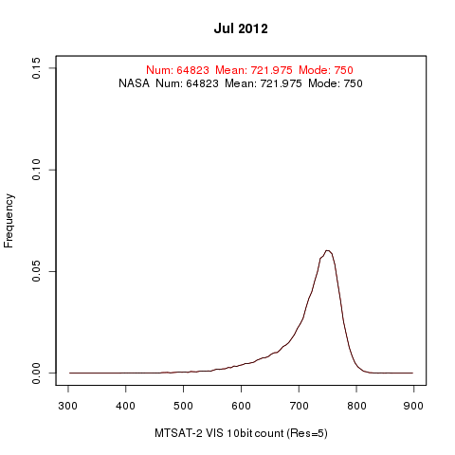
Introduction
First time for JMA to apply NASA’s algorithm to MTSAT-2/Imager
a
Deep gratitude to NASA for providing DCC verification package
a
At first, we checked the package and got good results
JMA
Histograms are
completely overlapped!

Slide 4
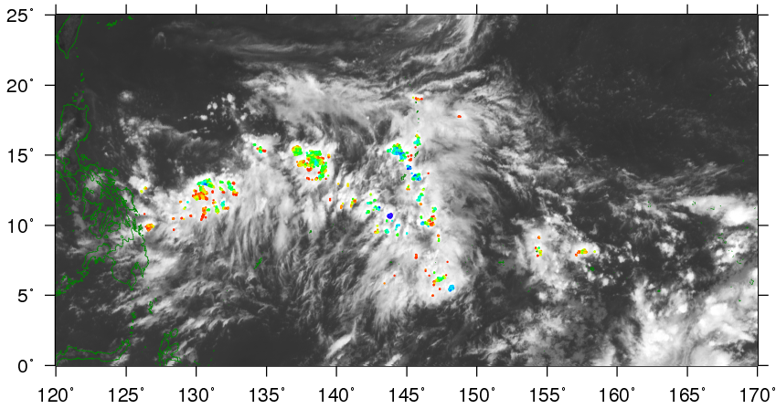
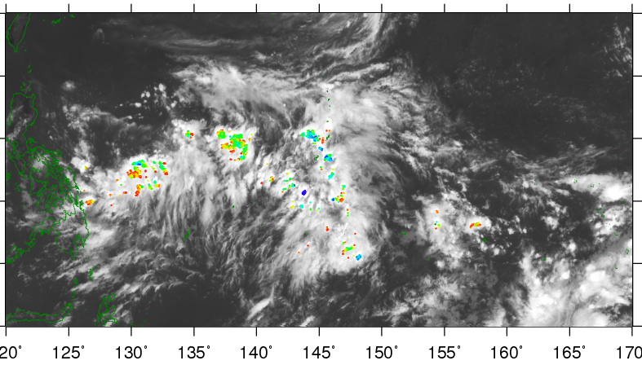
Comparison of DCC selection between NASA and JMA
Thresholds of JMA processing framework:
- Same values in NASA’s DCC verification data document
Similar results, but some differences are found because of:
- Data coverage (latitudinal range of the package: -16[deg] < lat < 16[deg])
- Different input data format? (We do not use MCIDAS format data)
MTSAT-2 DCC detection at 04UTC 1 July 2012
JMA’s own processing program
NASA DCC verification package
MTSAT-2 11μm channel TB [K]
MTSAT-2 11μm channel TB [K]

Slide 5
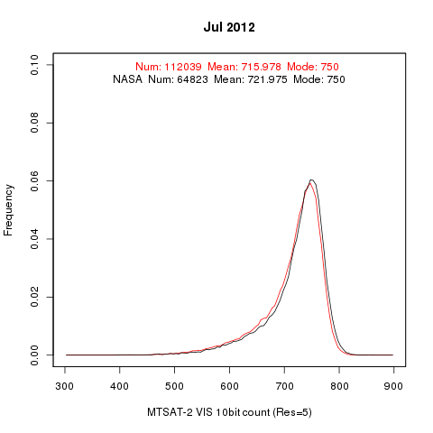
Monthly statistics comparison
Our results:
- About twice as many DCC pixels
- Mode: almost the same
Mean: slightly lower
a
Further investigations may be needed to reveal the cause of differences, but the developed processing program is used for this analysis
a
Angular corrected DN/radiances by Hu DCC BRDF are used in this presentation

Slide 6
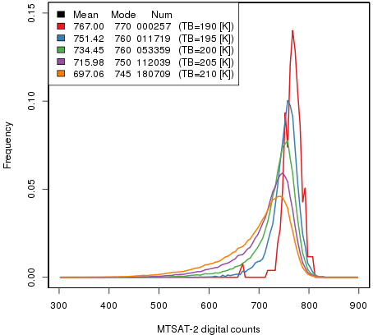
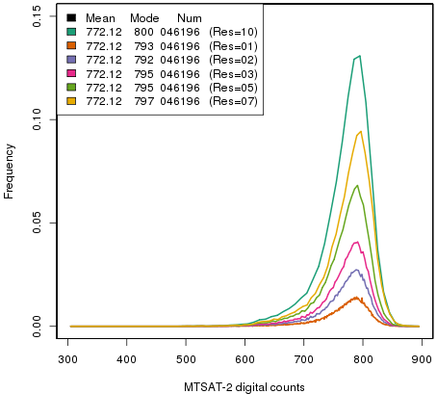
TB threshold for DCC detection and PDF bin size
Parameters described in the ATBD (TB threshold:205K, Bin size:5) are reasonable
In this study, recommended parameters by NASA are used
MTSAT-2 visible channel PDF of angular corrected DCC on July 2012
TB threshold
Bin size

Slide 7
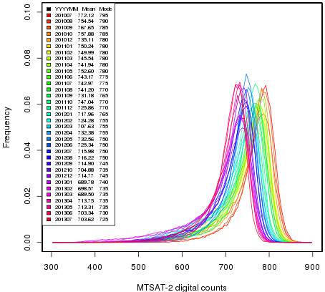
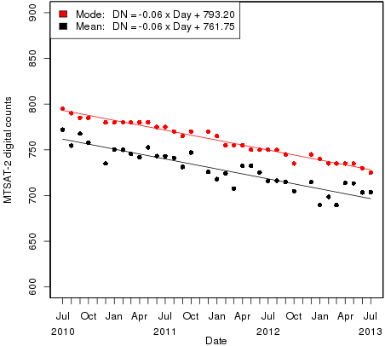
MTSAT-2/Imager PDF variation with time
Consistent results with the ATBD or those of other GEO satellites
Seasonal variation (mode is more stable than mean)
Small sample size or NO observation from October to December every year, due to MTSAT’s ground system maintenance
Monthly PDFs
mode
mean
Time series of mode and mean of DCC pixels

Slide 8
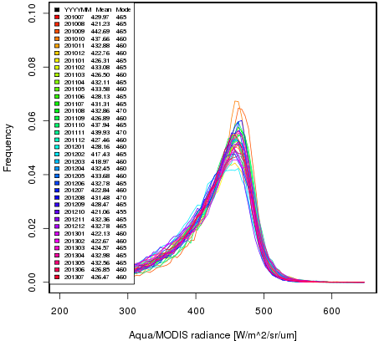
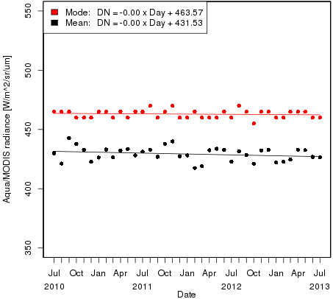
Aqua/MODIS PDF Stability
Input: 5km sub-sampled data (MYD02SSH, Collection 5)
Thresholds for DCC detection: almost same as those for MTSAT-2/Imager
- IR/VIS spatial homogeneity checks are not applied.
Consistent results with Doelling et al. (2013)
Monthly PDFs
mode
mean
Time series of mode and mean of DCC pixels
Doelling et al., 2013: The Characterization of Deep Convective Clouds as an Invariant Calibration Target and as a Visible Calibration Technique. IEEE TGRS , 51, 1147-1159.

Slide 9
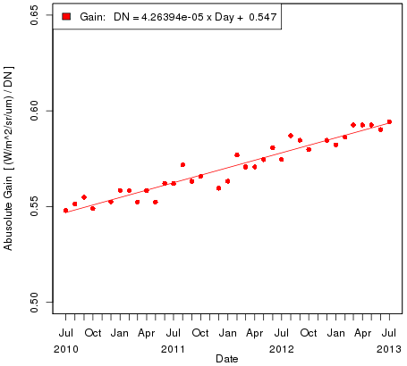
Monthly Gain
SBAF for MTSAT-2: 0.9376 (Described in Dave’s presentation in October 2012 GSICS web meeting)
a
Need to compare with the results based on our RT simulation method
a
Usage of other SBAF or that calculated ourselves will also be considered

Slide 10
Summary and future plans
Summary
Implementation of NASA’s DCC method to MTSAT-2/Imager
Preliminary results: good agreement with the ATBD
Issue of MODIS data archive at JMA: difficult to archive nominal Aqua/MODIS data (MYD021KM) due to our disk space and downloading speed
Needs to consider proper thresholds for homogeneity check using 5km sub-sampled data (MOD02SSH)
Future plans
Investigate the impact of BRDF and SBAF on the calibration results
Comparison of the results using nominal Aqua/MODIS data and those using 5km sub-sampled data
Comparison of the results with those based on RT simulation method
Uncertainty evaluation
Creation of netCDF intermediate data which contain selected DCC pixels for replication (and GSICS Correction netCDF)

