Slide 1
GOES-13/15 Cold/DCC Pixels Comparisons of the NASA and NOAA Datasets
Fangfang Yu and Xiangqian Wu
08/14/2013

Slide 2
Outlines
GOES-13/15 cold pixels comparison
Daily difference
Histograms of szn, vzn, raz, raw count, Tb, standard deviations
Spatial distributions
Possible causes to the differences
DCC pixels comparison
Histograms
Possible causes to the differences
Some sensitivity analyses
Bin size
Bi-mode fitting
DCC number for a robust reflectance

Slide 3
Data Processing
Test data ordered from NOAA CLASS
Input format: McIDAS AREA format
Data are processed with mcidas-x functions
Ingest for lat/lon/satzenith/solzenith/relative azimuth angles
Pixel scan time is assigned with the corresponding scan line time
Standard deviation = sqrt(mean^2/(n-1))
Homo. Test for the visible = stdv/center_count
GOES IR channel
Ch 10.7um Tb is calculated from radiance using non-linear conversion coefficients
http://www.oso.noaa.gov/goes/goes-calibration/gvar-conversion.htm
GOES visible channel processing at NOAA/OSDPD
Visible count at GVAR and mcidas area format
Relativization, that is, relative to the detector’s space reference signal
Adjust with the BOOST value of 29

Slide 4
The Number of Daily Cold Pixels – G13
GOES-13 Cold pixels Diff (NOAA-NASA)
Pixel # Diff (NOAA-NASA)
Monthly number: NASA=396,897 NOAA=396,648
Total Diff (NOAA-NASA)=-249

Slide 5
The Number of Daily Cold Pixels – G15
Monthly number: NASA=82,031 NOAA=83,644
Total Diff (NOAA-NASA)= 1613

Slide 6
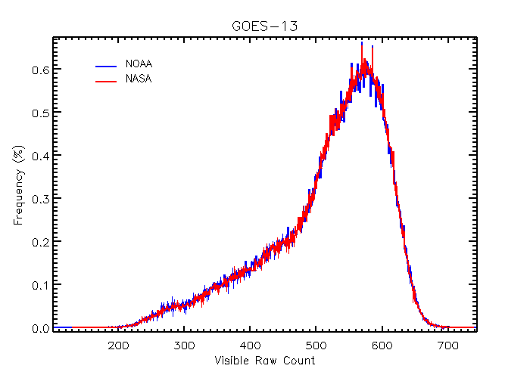
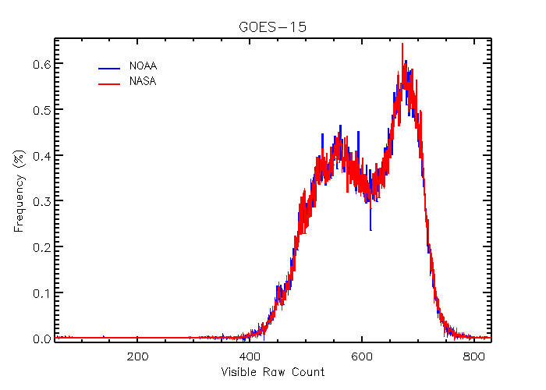
Visible Count Histogram – Month data
G13: 1count=0.116% reflectance
G15: 1count=0.111% reflectance
Bin size = 1 count
NOAA: count = mcidas_raw/32

Slide 7
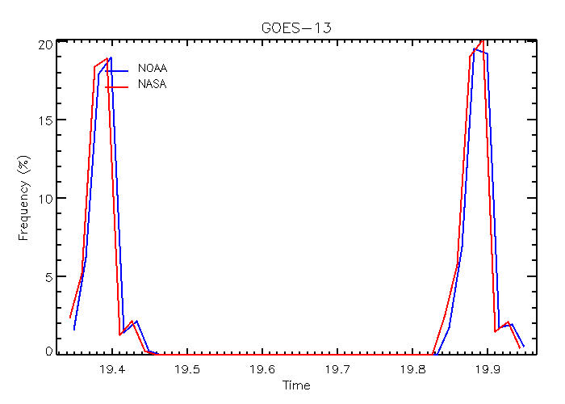
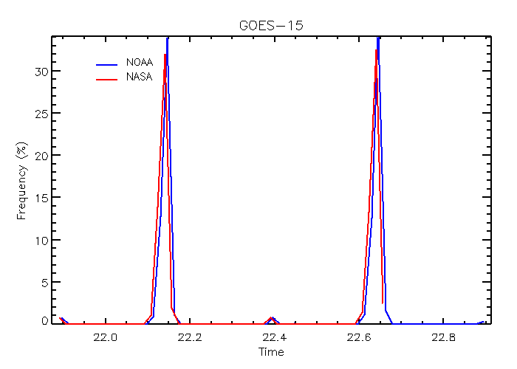
Cold Pixels: Obs. Time Histogram
NOAA: the scan line time of each cold pixel

Slide 8
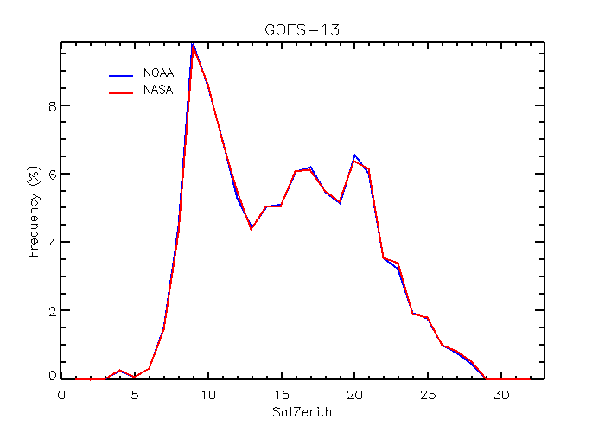
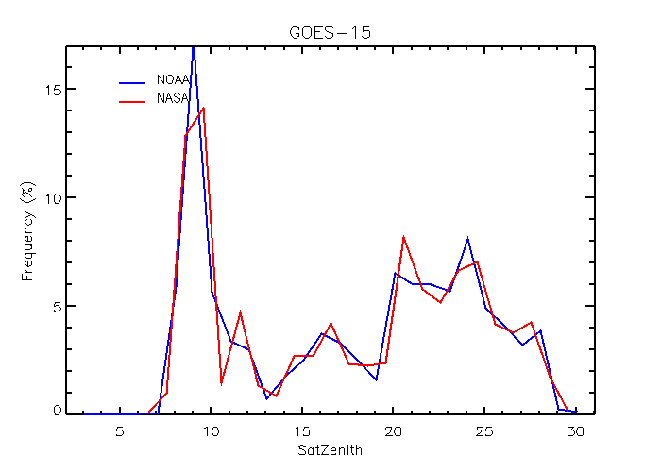
Satellite Zenith Angle Histogram – Month data

Slide 9
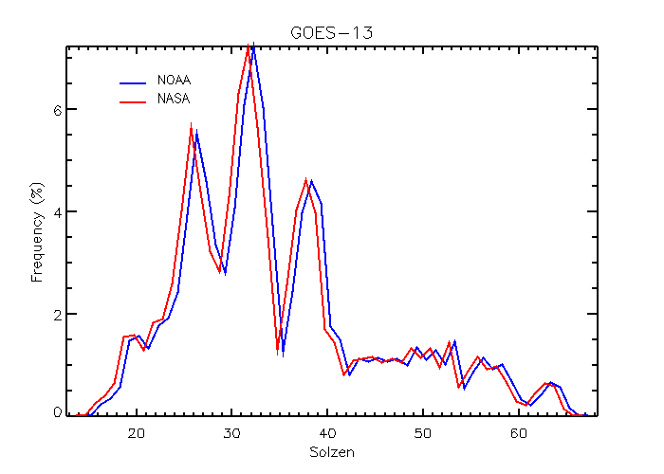
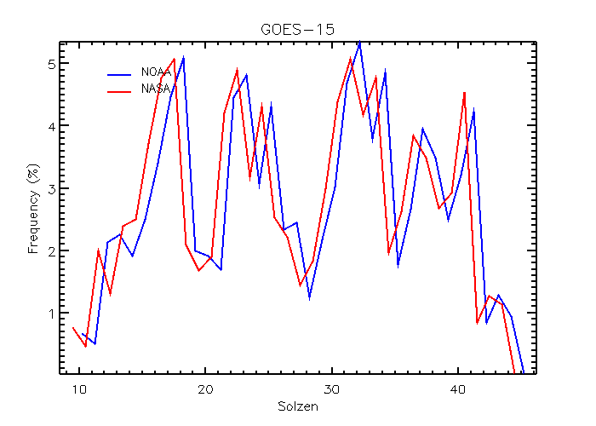
Solar Zenith Angle Histogram – Month data
This difference can result in different reflectance:
Reflectance = count * cal_coeff * d_sun_earth^2/cos(szn)
VZN, SZN and relative azimuth angle are the outputs of mcidas-x function nv1opt

Slide 10
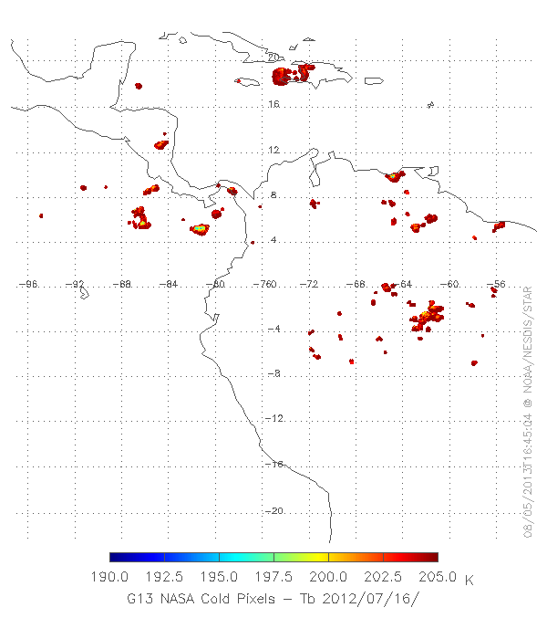
Spatial Distribution – G13
Very Identical for GOES-13 daily data

Slide 11
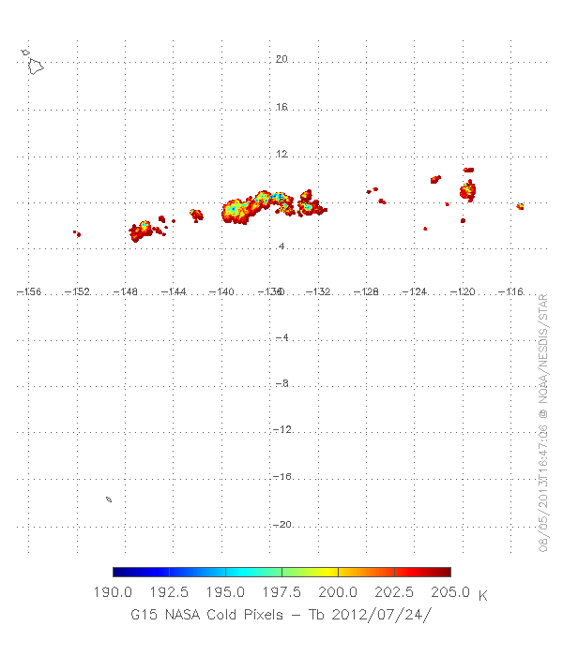
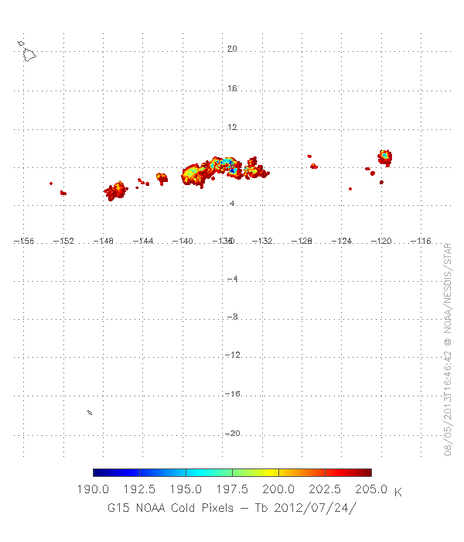
Spatial Distribution – G15 07/24/2012
NASA #=13,480
NOAA #=26,293

Slide 12
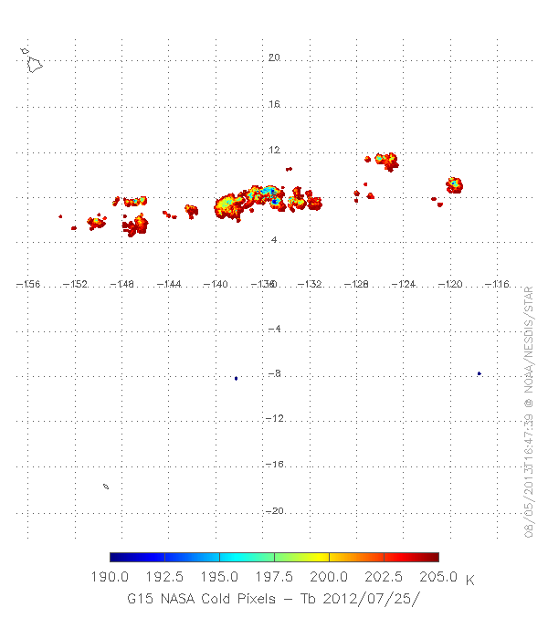
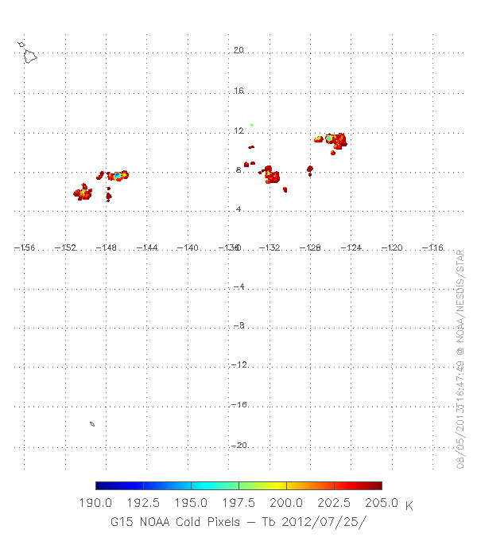
Spatial Distribution – G15 07/25/2012
In this case, it seems that I missed one image
NASA #=16,885
NOAA #=7,897

Slide 13
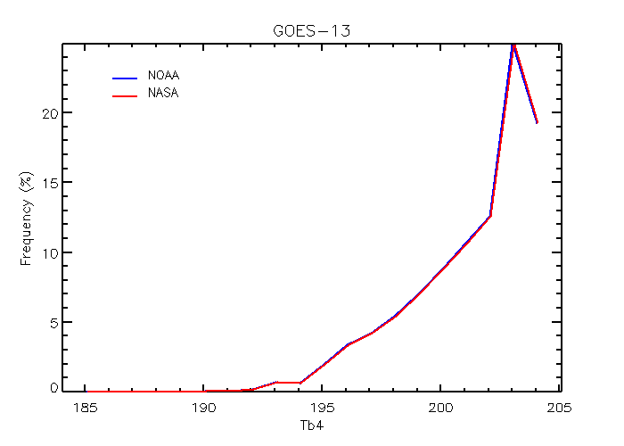
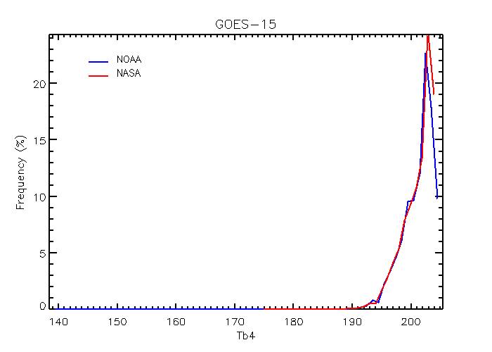
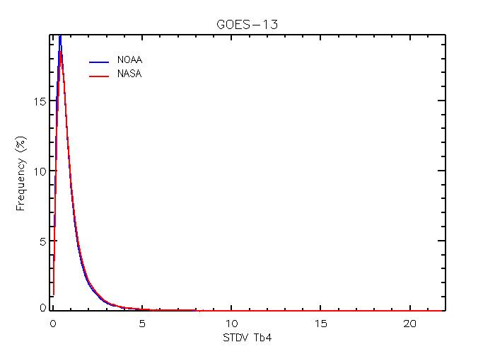
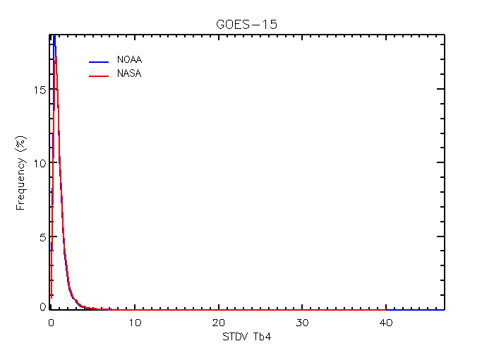
Ch10.7um Tb and Stdv Histogram
NOAA calculated the Tb from the radiance value, using RevH+Star Correction SRFs for GOES-15
http://www.oso.noaa.gov/goes/goes-calibration/docs/table3_8.htm
lower Tb mode
NOAA: one cold pixel Tb=139.4K

Slide 14
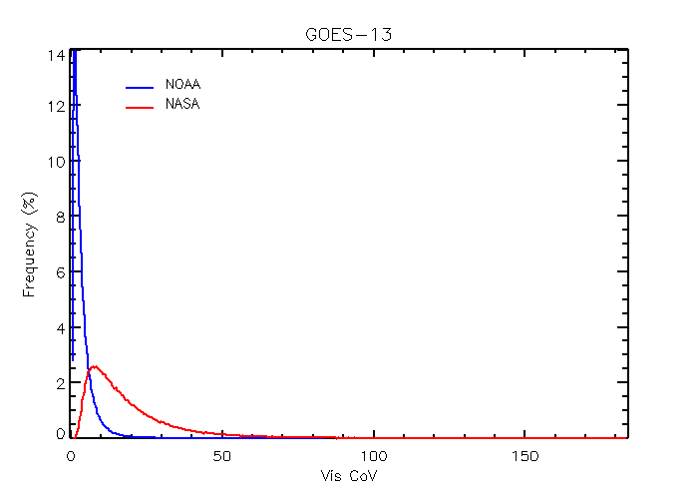
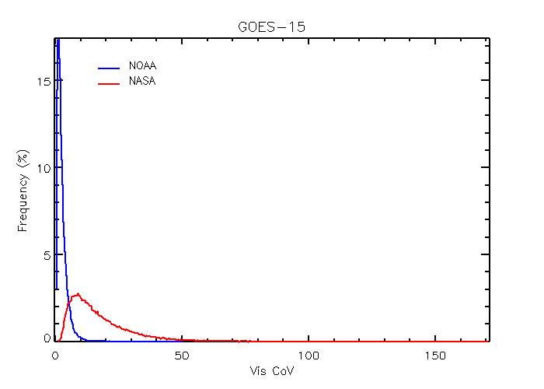
Cold pixels – CoV histogram
??

Slide 15
Possible reasons to the Differences
Tb calculation
Pixels number is sensitive to Tb
Suggest deriving the Tb values from radiance
ITT/NOAA released several versions of GOES-15 SRFs before it became operational in Dec. 2010. Therefore need most recent version of mcidas-x for direct Tb output.
http://www.oso.noaa.gov/goes/goes-calibration/goes-imager-srfs.htm
Need to look into the cause(s) of different solar zenith angles and CoV

Slide 16
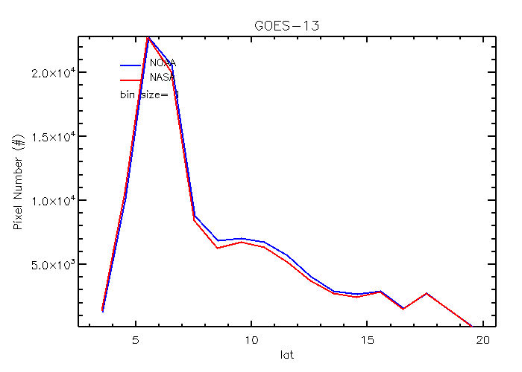
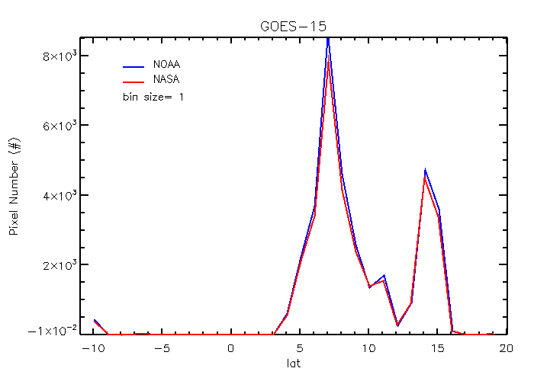
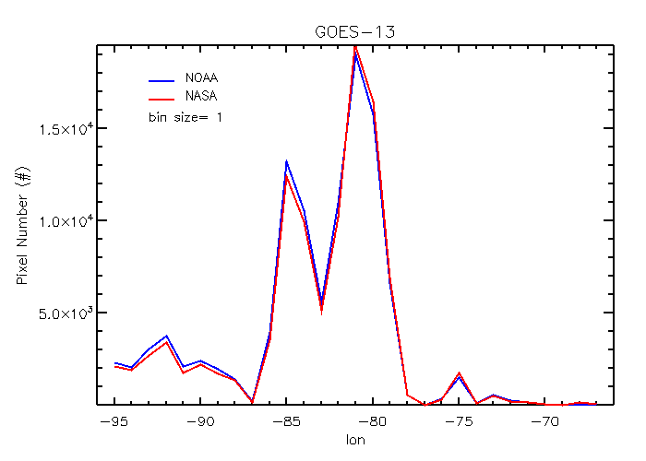
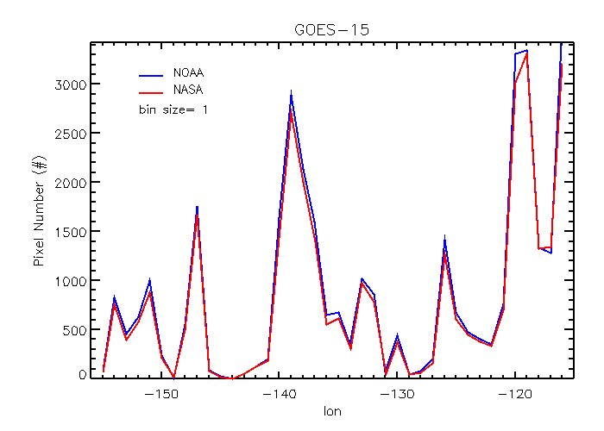
DCC Comparisons
Latitude
Longitude
Notes:
Similar geographic distribution

Slide 17
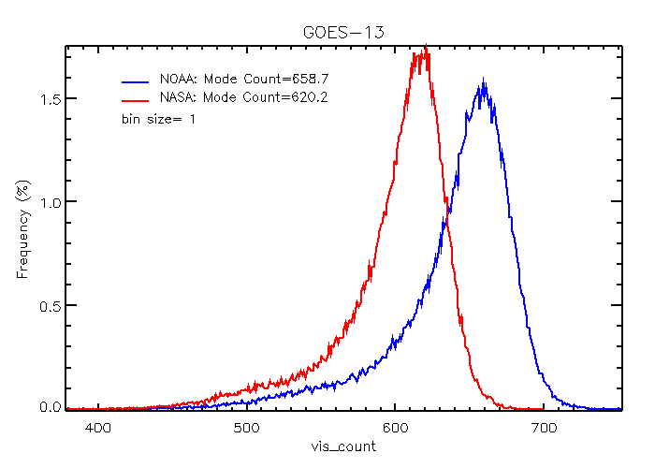
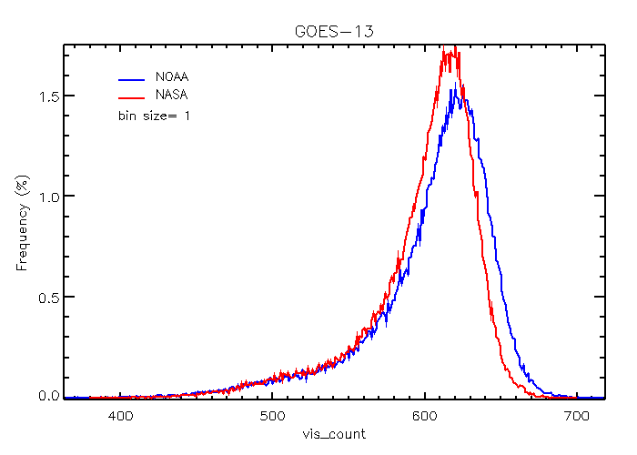
Visible count histograms – G13
Cold pixel count - 29
Cold pixel count – 29 - 29
DCC count = (cold_count * sun_earth_dist ^ 2 / cos(szn) * ADM

Slide 18
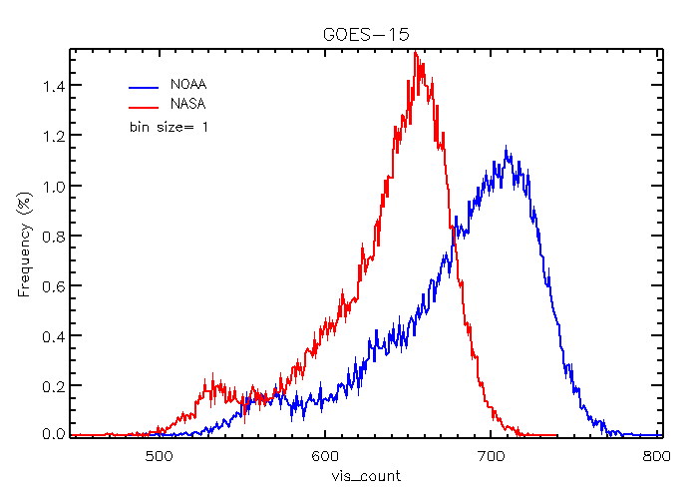
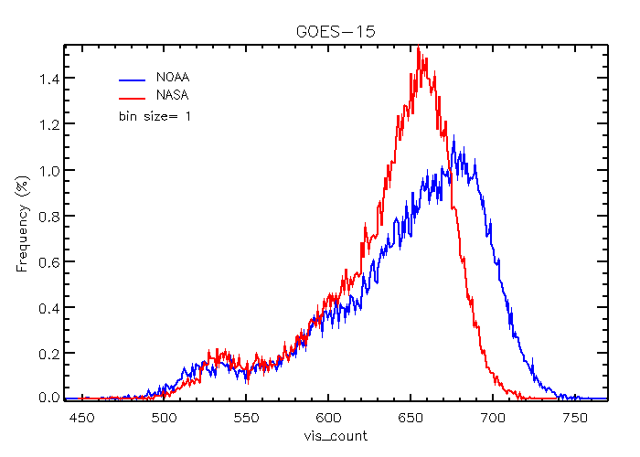
Visible count histograms – G15
Cold pixel count - 29
Cold pixel count – 29 - 29
DCC count = (cold_count * sun_earth_dist ^ 2 / cos(szn) * ADM

Slide 19
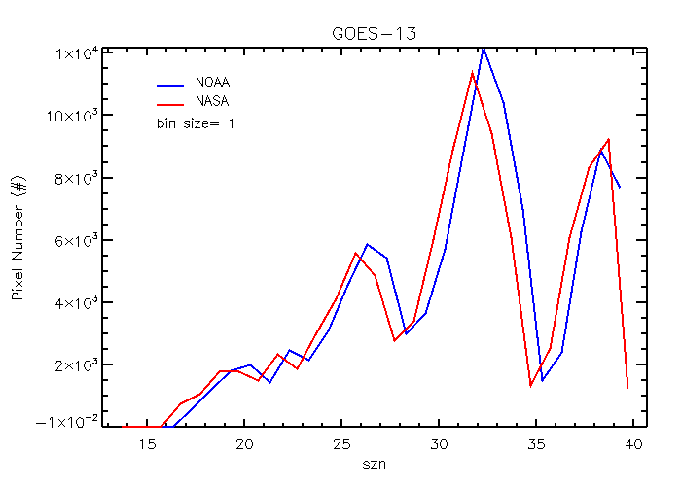
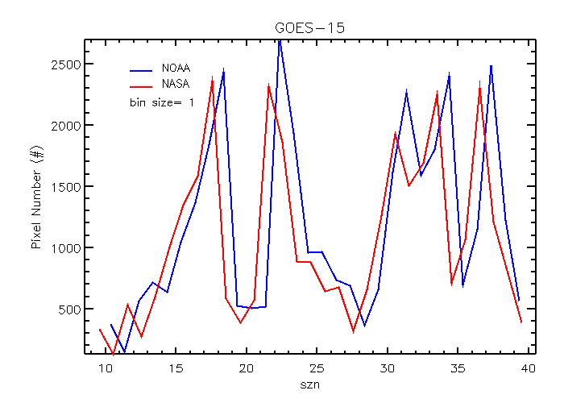
Solar Zenith Angle Difference

Slide 20
Tb Difference

Slide 21
Possible causes to the difference
Similar geographic distribution
The BOOST of 29 seems to be removed twice from the cold count.
Impact of Tb difference is apparent at GOES-15
More warmer scenes at NASA data
The shifted solar zenith angle also affect the visible count

Slide 22
Questions on applying the Hu’s ADM model
It seems that the SZN has much larger weighting than azimuth and viewing angles to interpolate the ADM value.
The valid relative azimuth angle bins to calculate DCC reflectance seems not consistent with the thresholds defined at the documents 10 < RAA < 170.

Slide 23
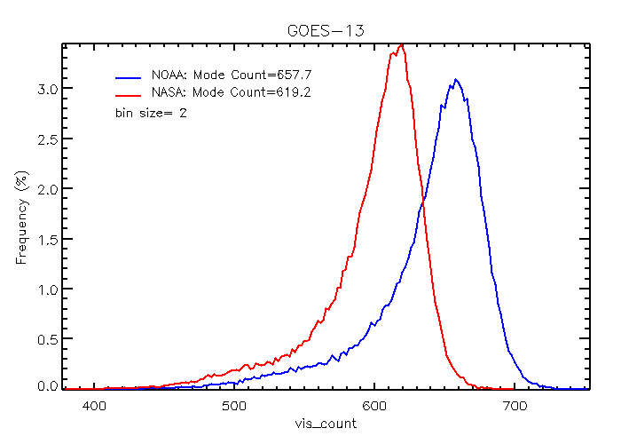
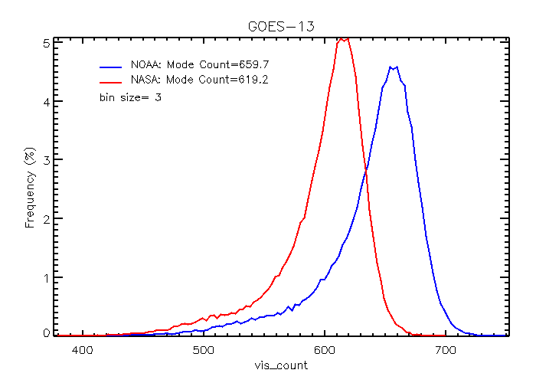
Some Sensitivity Analysis
Bin size
G13: 1count=0.116% reflectance
G15: 1count=0.111% reflectance
Bin size = 3 count or 0.3-0.4% reflectance

Slide 24
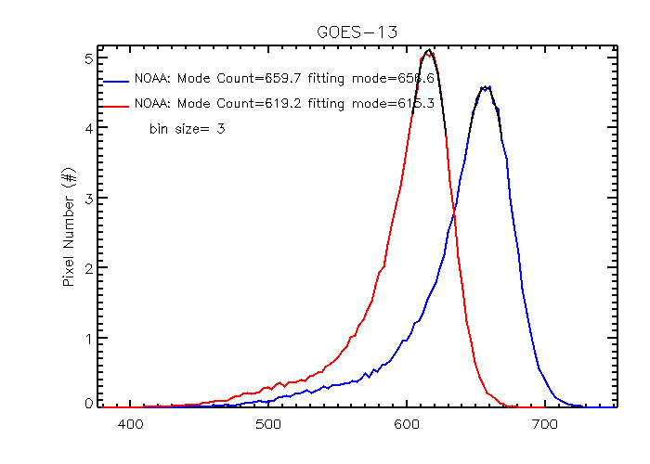
Shall we fit the bi-mode histogram?
Polynomial fitting:
Y = a + b * x + c * x^2
Could be 1-2 bin size difference from the mode value (highest frequent value)
For operation, suggest avoiding of fitting bi-mode histograms, if sufficient DCC pixels are available
If multiple counts with the same highest frequency, suggest using the mean of the counts.

Slide 25
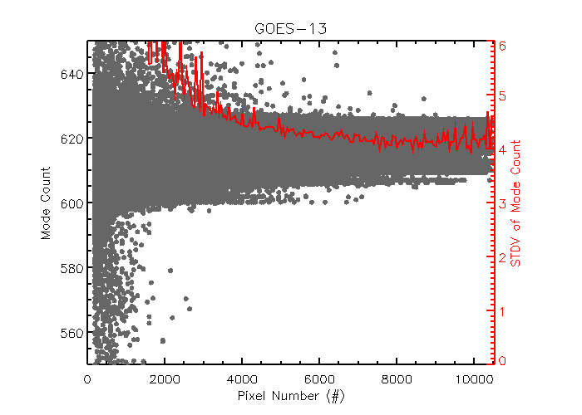
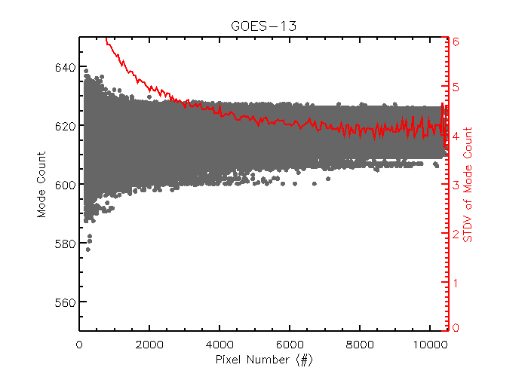
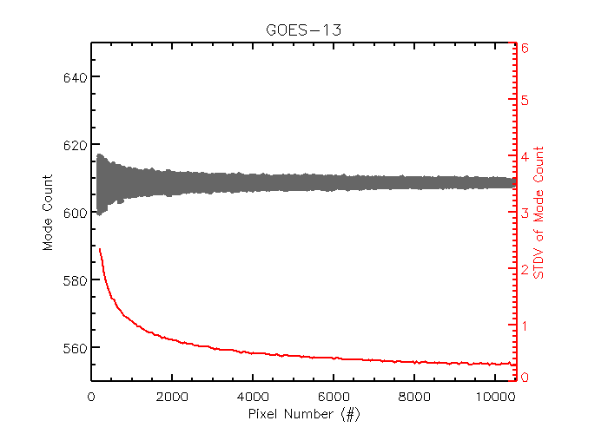
Minimum DCC pixels for a robust mode reflectance Preliminary Results
Polynomial fitting of bi-mode
No-fitting Mode
DCC#>4,000, 1-sigma stdv = 0.5%
Median reflectance of DCC pixels

Slide 26
Conclusions
Cold pixels:
GOES-13: Cold pixels agrees very well
GOES-15: Difference seems mainly from the different Tb. Tb should be converted from radiance or use of most recent version of mcidas-x
Need to investigate the difference in solar zenith angle and CoV
DCC
A shift of 29 between NASA and NOAA visible count
Differences in Tb and solar zenith angle may both attribute to the DCC reflectance at GOES-15
Confirm that the optimal histogram smoothing bin size for GOES is 3-5 count or corresponding reflectance (~0.4-0.5%)
Confirm that a minimum of about 4,000 DCC pixels is needed for a robust DCC mode reflectance
Suggest avoiding of bi-mode fitting if there is sufficient DCC pixels.

Slide 27
Minimum DCC pixels for a robust mode reflectance Preliminary Results
Polynomial fitting of bi-mode
Mode without any fitting
DCC#>4,000, 1-sigma stdv = 0.5%

