Slide 1
“Is it good enough?”
Manik Bali

Slide 2
Introduction
Reference instrument characteristics change in space.
Target Instrument characteristics change in space.
We cannot ensure traceability in space either
If in space, traceability is not possible should we detect pre-launch like behavior from target instrument.

Slide 3
Introduction
Magnitude of climate signals
Expected Accuracy and Stability of EO instrument
~±( 0.1 K–0.2 K)
(Allen et al. 1994, Kidwell 1998)
Temperature trends as
small as 0.1⁰ C/dec
Accuracy Criterion
~ 0.1K( 1 w/m2).
Stability criterion
~0.05 K ( 0.3 w/m2/dec).
GCOS(2011)
Leroy et al, 2007 , 34 Yrs of continuous observation at this level of accuracy to get climate signal.
Instruments that conforms to these accuracy and stability criterion are called Climate Ready. Example A/ATSR series.
Notes:
The fundamental aim of the CDR is to fuel the research on climate change.

Slide 4
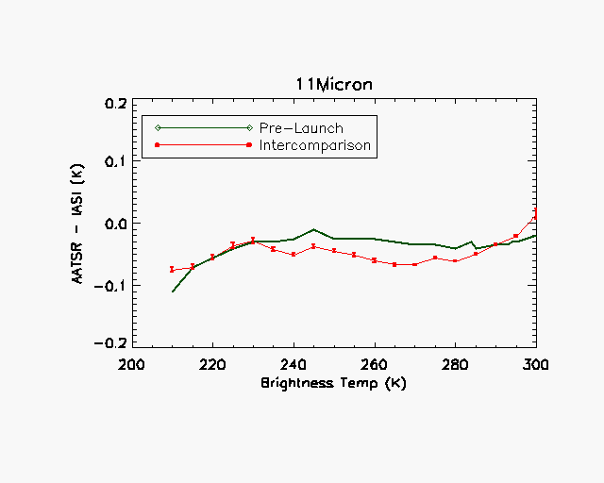
Prelaunch Vs Post Launch
IASI captures some of the prelaunch features
IASI relates well with SI –traceable standard
Bali & Mittaz
Notes:
State why the offset was made???

Slide 5
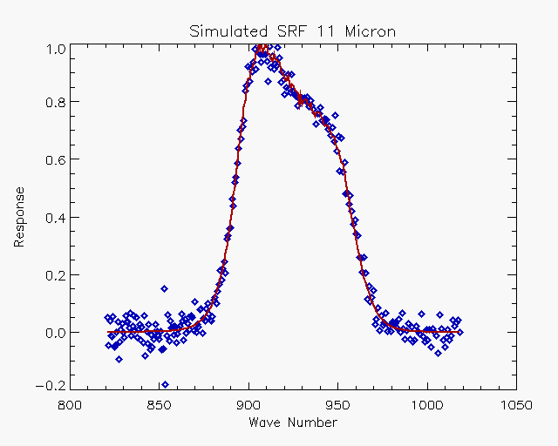
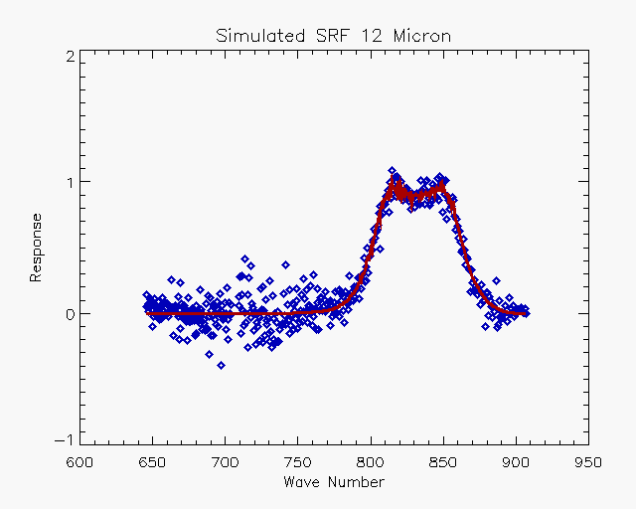
Can we retrieve pre-launch variables such as SRF’s by comparing with reference instrument ?
If yes then it becomes a good candidate

Slide 6
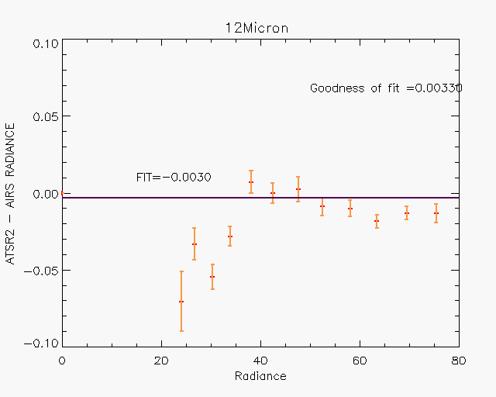
AIRS ATSR2
AIRS captures some of the prelaunch features
Of ATSR2.
Bali & Mittaz

Slide 7
Conclusion
Accuracy Criterion ~0.1K and Stability criterion of 0.05 K/Decade could be a starting point
A good reference should be able to replicate pre-launch behavior when in orbit.
IASI and AIRS have acted as good references.

