Slide 1
Self-Introduction
Potential contribution to
Global Space-based Inter-Calibration System (GSICS) Research Working Group (GRWG) UV Sub-Group
Mark.Weber@Uni-Bremen.de
www.iup.uni-bremen.de/UVSAT
Web meeting, 13 Nov 2013

Slide 2
Name
Mark Weber, Institute of Environmental Physics, University of Bremen
Senior Scientist, UVSAT group leader (4 postdocs, 6 graduate students)
Experience:
GOME, SCIAMACHY, GOME-2, TROPOMI/S5P scientific algorithm development and trace gas validation
Solar science: variability and trends in solar spectral irradiance
Ozone-climate interaction
Laboratory spectroscopy (O3 absorption cross-section)
Other commitments:
Member of the WMO Ozone Science Advisory Group (since 2005) and International Ozone Commission (IOC) of IAMAS (since 2012)
Participation in the upcoming WMO/UNEP Scientific Ozone Assessment

Slide 3
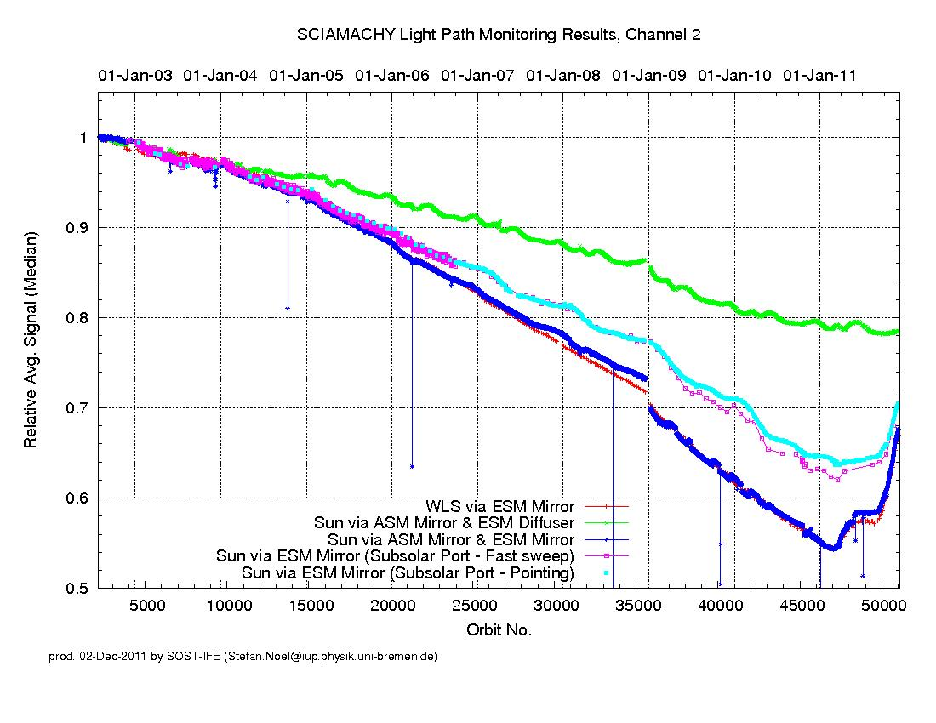
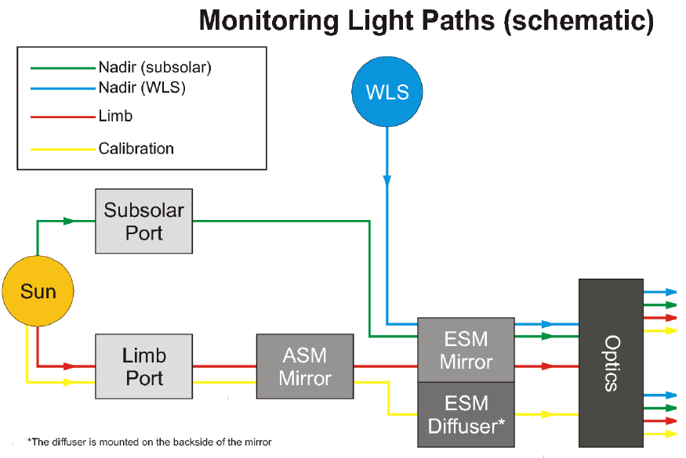
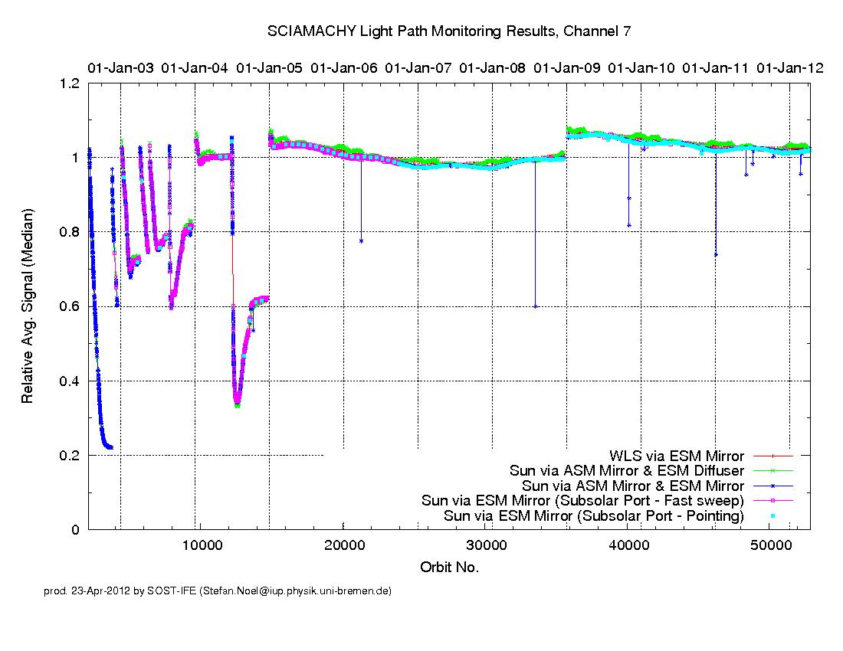
SCIAMACHY optical throughput monitoring
Ch. 2: 300-400 nm
Radiation damage (deposits of comtaminants on optical surfaces)
Improvements in in-flight degradation monitoring
In-flight absolute radiometric calibration concepts
Ch. 7: 1.94-2.04μm

Slide 4
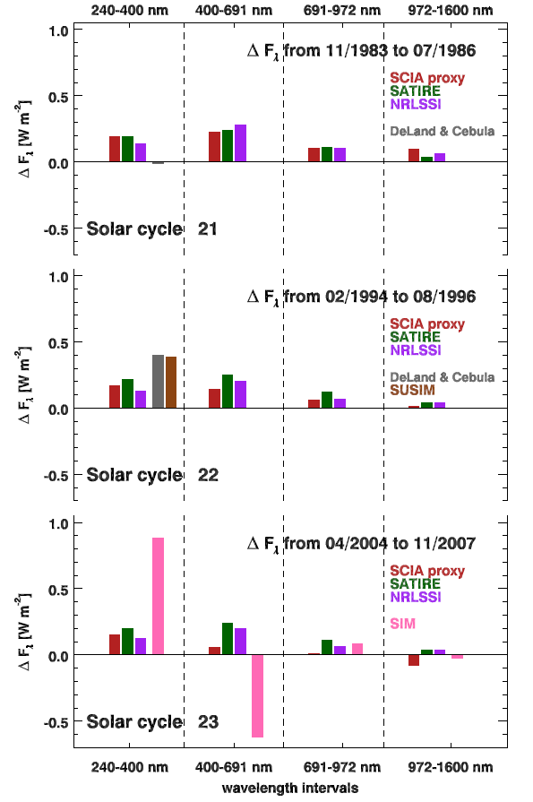
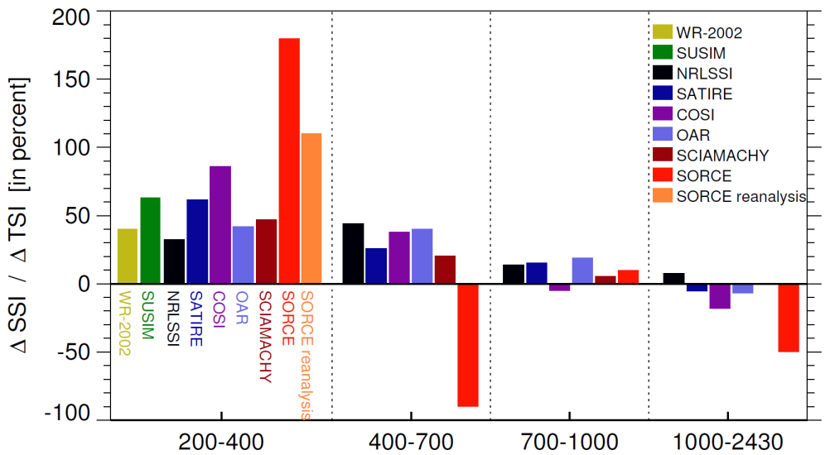
SSI solar cycle changes
Long-term stability of solar spectral irradiance (SSI) measurments
Reduce uncertainties in long-term trends
large impact on atmospheric heating rates (Calahan et al. 2010, Haigh et al. 2010) and mesospheric ozone (Merkel et al., 2011) → climate impact
2004/01 minus 2007/01 (not a full solar cycle)
Pagaran et al., 2011
Ermolli et al., 2013

Slide 5
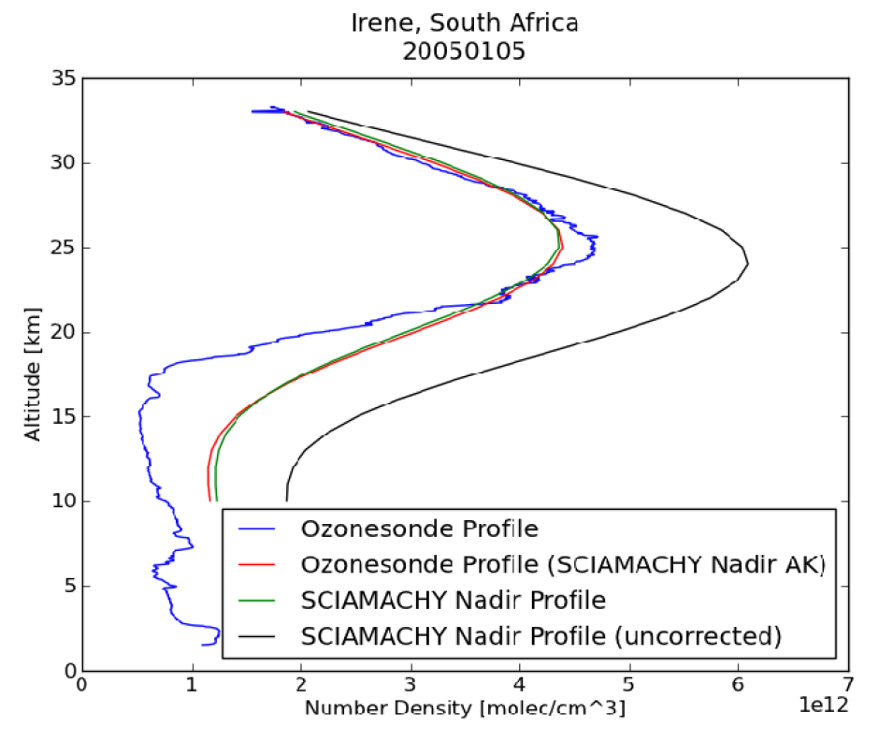
Impact of level-1 on trace gas retrievals
SBUV-type nadir ozone profiles strongly affected by optical degradation
common approaches for radiance corrections across sensors
Improved long-term ozone profile record from nadir sounders
without radiance corrections
Bötel et al., manuscript in preparation, 2013

