Slide 1
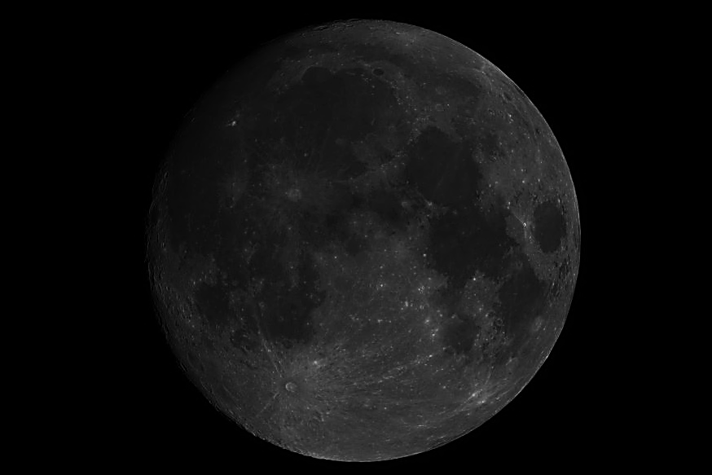
Tom Stone
United States Geological Survey
Flagstaff, Arizona
Lunar Calibration Project Scientist
Representative Publication: The Spectral Irradiance of the Moon Astronomical Journal 129, 2887-2901 (2005)

Slide 2
Message to the GRWG UV Sub-group
Lunar calibration works using radiometric models of the Moon.
The USGS system employs a model for lunar spectral irradiance, which was built from a dataset of measurements acquired by the Robotic Lunar Observatory (ROLO).
The capabilities of lunar calibration include inter-calibration of reflected-solar instruments that have viewed the Moon.
Lunar calibration could be extended to the UV, given a sufficient set of Moon characterisation measurements.
Currently the short wavelength limit is 350 nm.
The SOLSTICE instrument on SORCE has collected a large set of spectrally resolved lunar irradiance measurements in the range 115-300 nm (Holsclaw et al., 41st LPSC (2010) abstract #2696).
The SOLSTICE dataset could be used to extend lunar calibration capabilities; this would require buy-in from LASP (Univ. Colorado).

