Slide 1



In-orbit Calibration of The Total Ozone Unit on FY-3B(FY-3B/TOU)
Weihe Wang (wangwh@cma.gov.cn)
Yuan Li (liyuan@cma.gov.cn)
National Satellite Meteorological Center(NSMC)
China Meteorology Administration(CMA)
Inaugural Meeting of GSICS/UV Subgroup, November 13, 2013

Slide 2
Experience
Research: Spaceborne UV ozone instrument calibration and retrieval algorithm development;
Missions:
Total Ozone Unit (TOU): Total ozone mapper on FY-3A (May 27, 2008 - ), FY-3B (November 5, 2010 - ) and FY-3C (September 23,2013-);
Solar Backscatter Ultraviolet Sounder(SBUS): Nadir profiler on FY-3A(failed in Dec. 2008 due to chopper failure), FY-3B and FY-3C;
Ozone Monitoring Suite: Hyperspectral ozone instrument suite including total ozone mapper, nadir profiler and limb profiler onboard FY-3E(2017-)
Publications:
W. Wang, X. Zhang, X. An, Y. Zhang, F. Huang, Y. Wang, et al., “Analysis for retrieval and validation results of FY-3 Total Ozone Unit (TOU),” Chinese Science Bulletin, vol. 55, pp. 3037–3043, 2010.
W. Wang, X. Zhang, Y. Wang, Y. Wang, Z. ZHANG, L. Fu, et al., “Introduction to the FY-3A Total Ozone Unit(FY-3A/TOU): instrument, performance and results,” International Journal of Remote Sensing, vol. 32, pp. 4749-4758, 2011.
Weihe Wang, Lawrence Flynn, Xingying Zhang et al, Cross-Calibration of the Total Ozone Unit (TOU) With the Ozone Monitoring Instrument (OMI) and SBUV/2 for Environmental, IEEE Transactions on Geoscience and Remote sensing, 50(12): 4943-4955

Slide 3
Current work on FY-3B/TOU Calibration
Degradation rates of the diffusers;
Instrument degradation estimated from solar irradiance observations;
Degradation rate of the detector estimated from nadir radiance observation of channel 6;
Cross-track dependence correction;
Examples of product;

Slide 4
Degradation of The Diffusers
Periodical oscillation degradation

Slide 5
Periodical oscillation degradation
Causes: the difference of the illumination angle of diffusers and other unknown reasons.
Strategy:
  Calculate the periodical formula of oscillation by nonlinear least-squares
    f=f1*f2
    f1(x)=p(1)*power(t,4)+p(2)*power(t,3)+p(3)*power(t,2)+p(4)*power(t,1)+p(5)
    t=x-T*t0
    x0=360,t0=365.25,T＝ceil((x-x0)/t0)
    f2=lp(1)*x^2+lp(2)*x+lp(3)
  Angle correction, need to built a model because of the unknown angle of diffuse plane to the satellite plat.(next work)

Slide 6
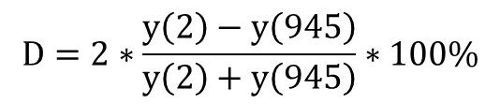
The periodical oscillation corretion
Coefficients of 4 orders least squares polynomial curve fitting of f1
p(1) | p(2) | p(3) | p(4) | p(5)
5.3635E-11 | -3.7256E-08 | 9.5554E-06 | -1.0989E-03 | 1.0396E+00
Coefficients of 2 orders fitting of f2(A2r CH6)
lp(1) | lp(2) | lp(3)
1.74E-05 | -0.0307 | 110.2324
$$D=2∗\frac{y\left(2\right)−y\left(945\right)}{y\left(2\right)+y\left(945\right)}∗100\%$$

Slide 7
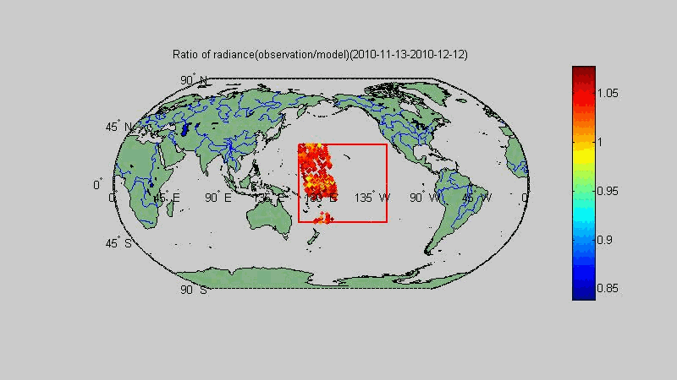
Ocean vicarious calibration
Latitude: S 30 ~ N30 Longitude: E 160~ W 120
Trend of observation radiance
Trend of the radiance ratio of observation and model
The TOMRAD was used and the total ozone assumed to be 300

Slide 8
3 years data analysis
(13-Nov-2010 to 17-Jul-2013)

Slide 9
Monthly minimum and 2 order polynomial curve fitting
The detector degradation monitored by diffusers and ratio is close(0.61%)
Consistency hint the degradation of diffuser A3 is small

Slide 10
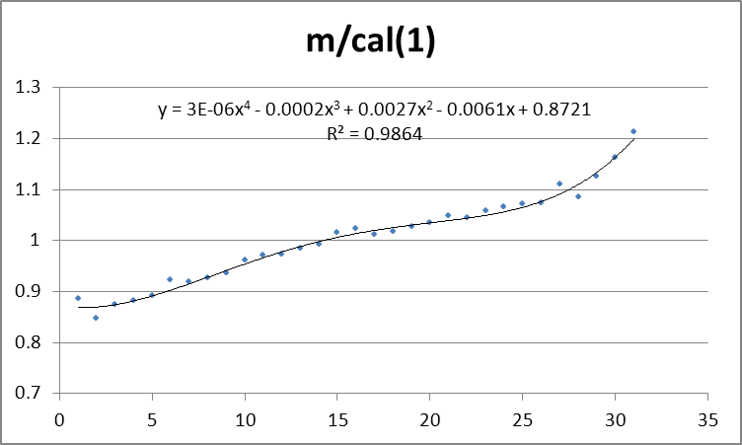
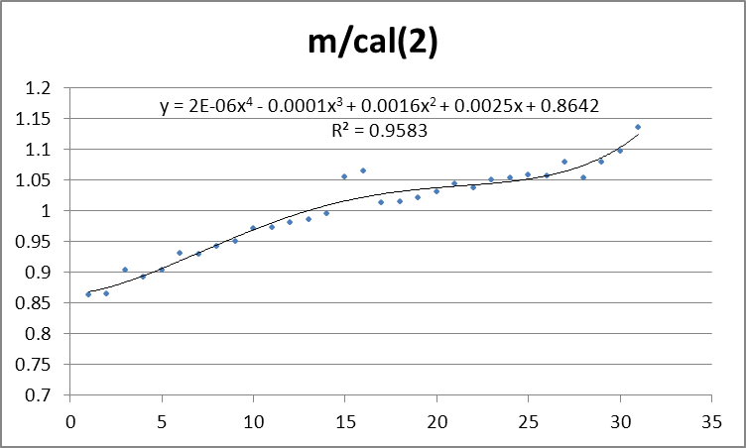
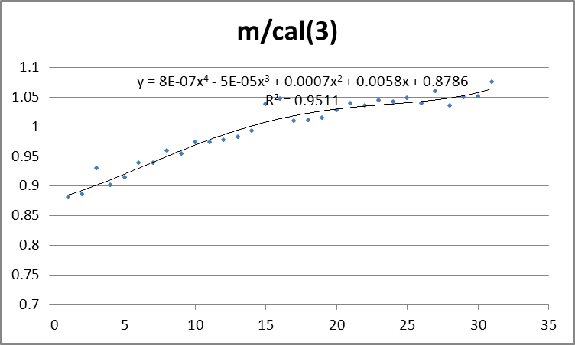
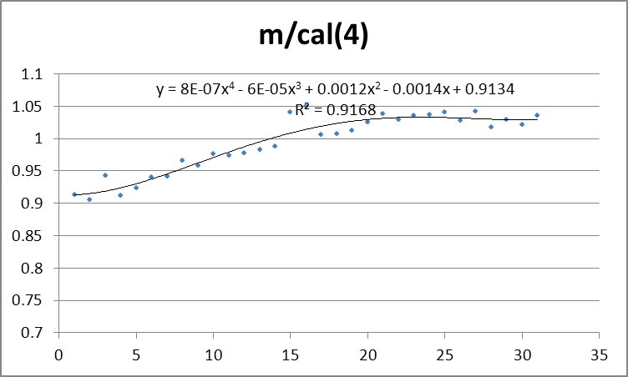
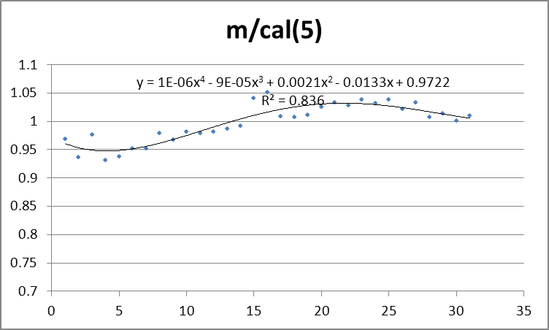
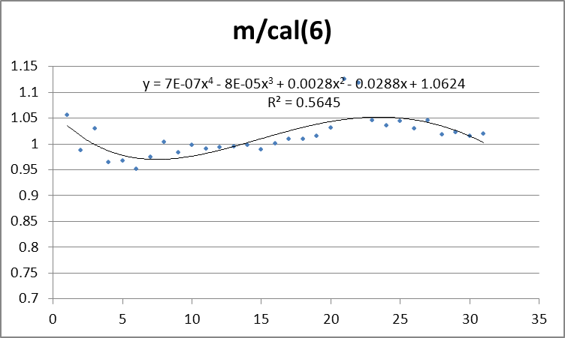
Cross track dependence correcction
The Cross track dependence of radiance is corrected by comparing the observed clear–sky radiances with RTM predicted radiances over the tropical Pacific Ocean, with the GOME-2 L3 (DOAS) ozone products as input. The clear-sky FOVs are chosen by taking the minimum radiometrically equivalent cloud fraction.

Slide 11
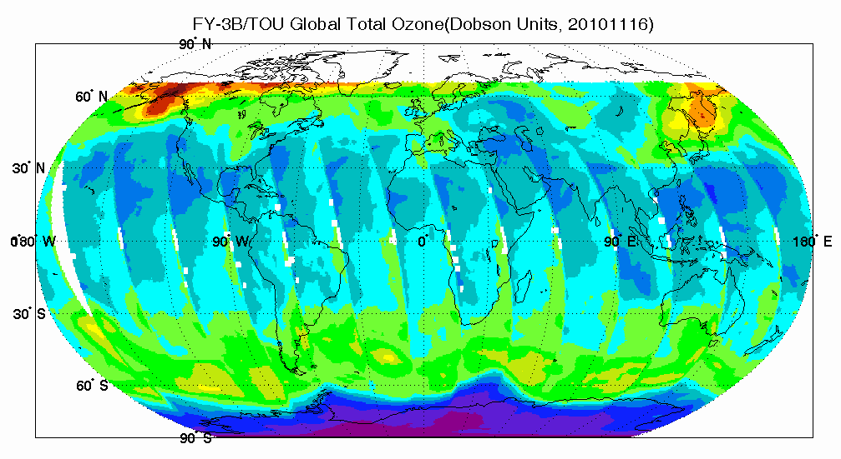
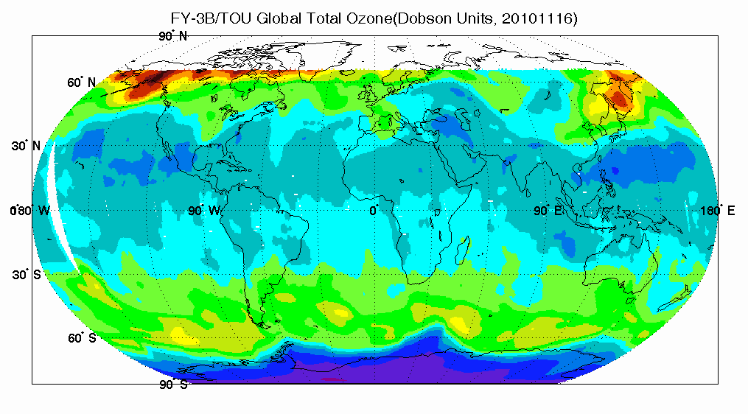
Effect of cross-track dependence
Top left: before correction
Bottom left: after correction
FY-3B was launched on Nov. 15, 2010, the diffusers didn’t have apparent degration.

Slide 12
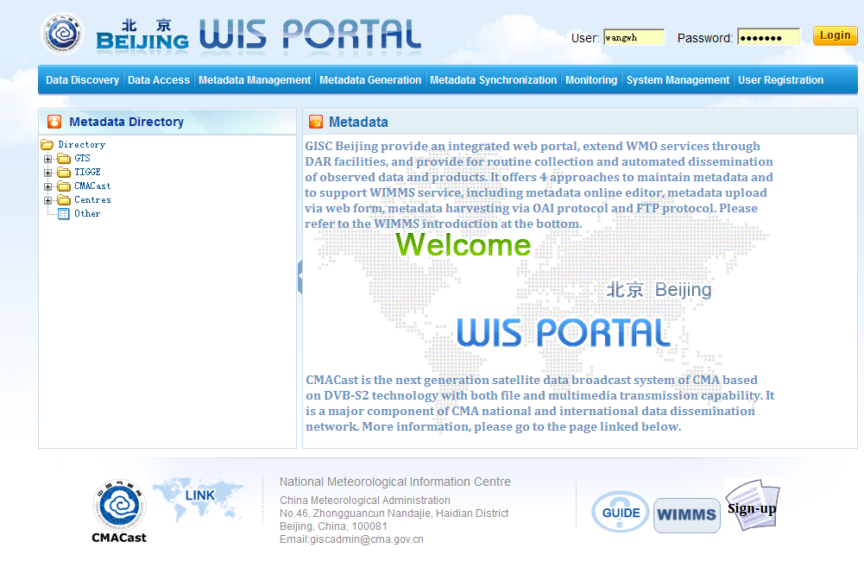
FY-3B/TOU Total ozone Product
FY-3B/TOU global ozone product is provided to WOUDC from Aug. 12, 2013 via the web:
http://www.wmo.int/pages/prog/www/WIS/
The FY-3B/TOU Global ozone products can be downloaded from the following link:
http://wisportal.cma.gov.cn:8080/nsmc/FY3B.P_TOUXX_GBAL_L2_TOZ_MLT_GLL_POAD_110KM_MS_TXT.BAWX/
Parent Directory
201308/
201309/
201310/
201311/

Slide 13

Thanks

