Slide 1
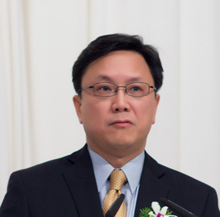
Jhoon Kim
Director, Global Environmental Satellite Center (GESC)
supported by the Ministry of Environment, Korea
Professor, Department of Atmospheric Sciences, Yonsei University,
Seoul, Korea
Member, IO3C(International Ozone Commission)
Member, Satellite WG, NDACC
Member, CEOS ACC(Atmospheric Composition Constellation)

Slide 2
Experience
P.I., UV-Visible radiometer, Korea Sounding Rocket Program
KSR-I, II, III
Station Manager of Dobson and Brewer Spectrophotometer, Yonsei University, Seoul, Korea
Aerosol product lead, GOCI(Geostationary Ocean Color Imager) and MI(Meteorological Imager) onboard COMS launched in 2010.
P.I., GEMS(Geostationary Environment Monitoring Spectrometer), scanning UV-Visible spectrometer, onboard GeoKOMPSAT-2B to be launched in 2018

Slide 3
Radiance Comparison

Slide 4
Recommendation
UV intercalibration
With the GEO constellation of UV-Visible spectrometer in 2018-2020 time frame, LEO mission such as OMPS, TROPOMI can serve as a intercalbration platform
Any preflight calibration activities with an international standard?
Can the UV sub-group make a recommendation regarding the pre- and post-flight intercalibration of the scheduled UV-Visible spectrometer mission?

