Slide 1
Diego Loyola German Aerospace Center (DLR) Remote Sensing Technology Institute (IMF)
Global Space-based Inter-Calibration System (GSICS) Research Working Group (GRWG) UV Sub-Group
Web meeting, November 13, 2013

Slide 2
Relevant Experience – Missions
GOME/ERS-2
Responsible for the operational L1 and L2 products on behave ESA
SCIAMACHY/ENVISAT
Responsible for the operational L1 and L2 products on behave ESA
GOME-2 on MetOp-A and MetOp-B
Responsible for the operational L2 total column products in the framework of EUMETSAT O3M-SAF
TROPOMI/Sentinel 5 Precursor
Co-lead of the L2 working group for the operational L2 products
Responsible for the S5P PDGS
Sentinel 4 and Sentinel 5
Member of the Mission Advisory Group
ATBD and prototype processor for L1

Slide 3
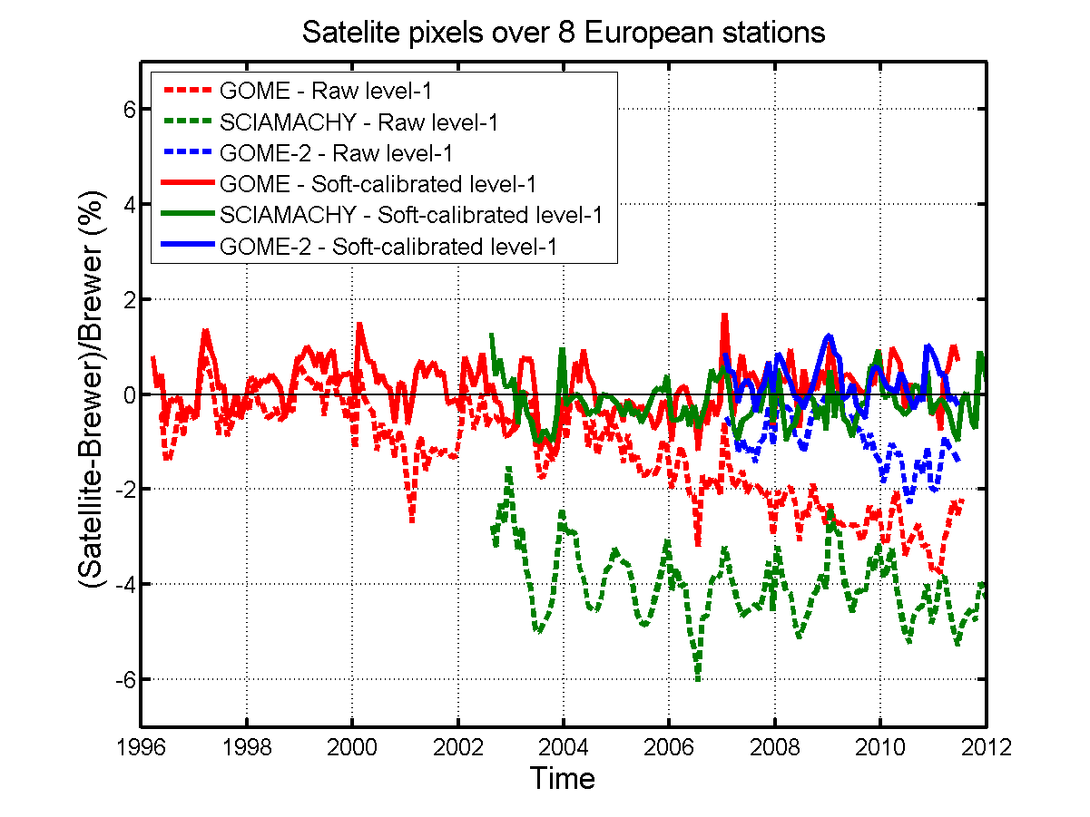
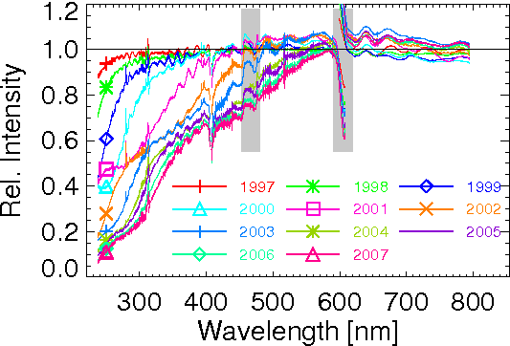
Relevant Experience – Publications (L1)
Lerot C., Van Roozendael M., Spurr R., Loyola D., Coldewey-Egbers M., Kochenova S., van Gent J., Koukouli M., Balis D., Lambert J.-C., Granville J., Zehner C., “Homogenized total ozone data records from the European sensors GOME/ERS-2, SCIAMACHY/Envisat and GOME-2/MetOp-A", submitted to Journal of Geophysical Research, 2013.
Coldewey-Egbers M., Slijkhuis S., Aberle B., Loyola, D., "Long-term analysis of GOME in-flight calibration parameters and instrument degradation", Applied Optics, vol. 47, no. 28, pp. 4749-4761, 2008.

Slide 4
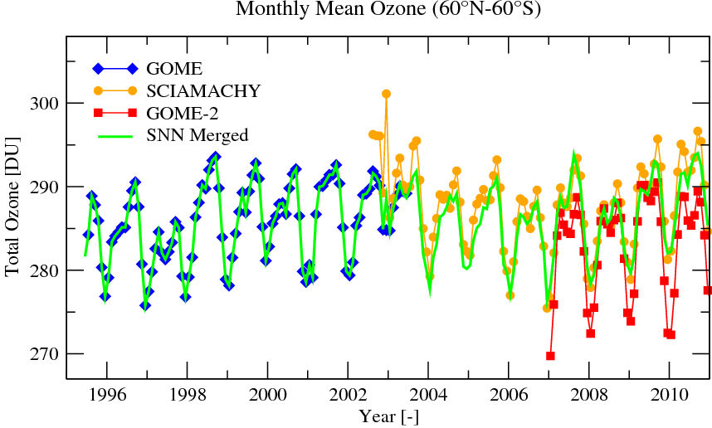
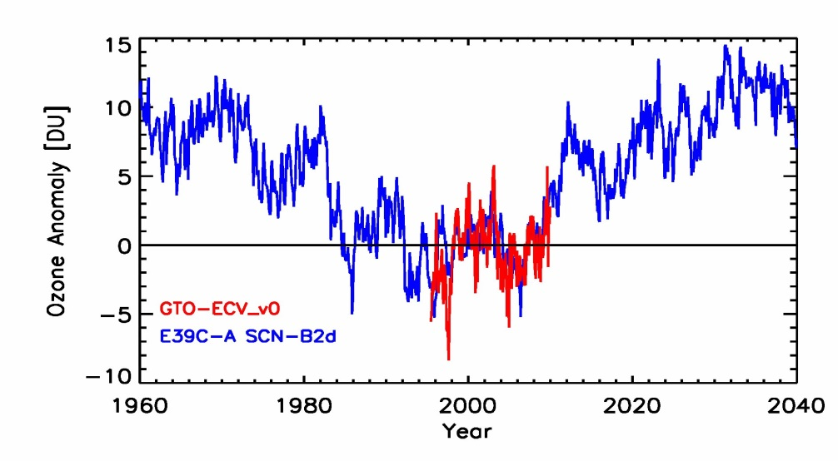
Relevant Experience – Publications (L2)
Loyola D., Coldewey-Egbers M., "Multi-sensor data merging with stacked neural networks for the creation of satellite long-term climate data records", EURASIP Journal on Advances in Signal Processing, vol. 2012, no. 1, 2012.
Loyola D., Coldewey-Egbers M., Dameris M., Garny H., Stenke A., Van Roozendael M., Lerot C., Balis D., Koukouli M., "Global long-term monitoring of the ozone layer - a prerequisite for predictions", International Journal of Remote Sensing, vol. 30, no. 15, pp. 4295-4318, 2009.

Slide 5
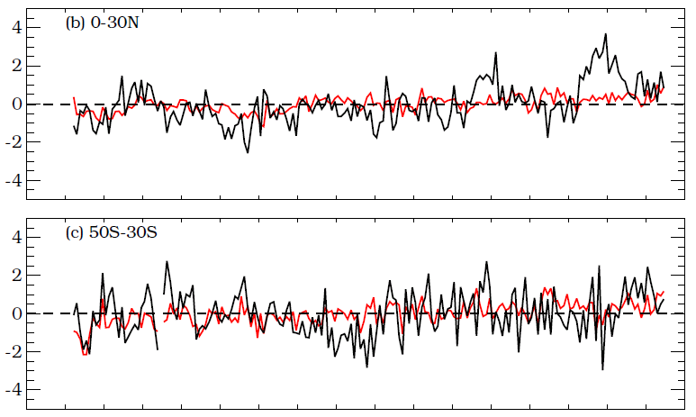
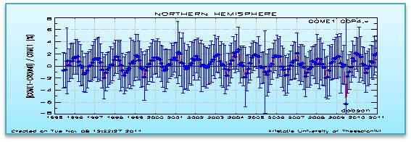
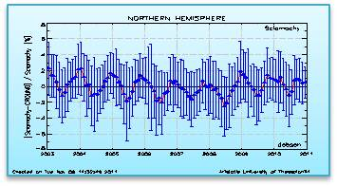
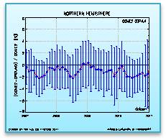
Relevant Experience – Publications (Validation)
Chiou E.W., Bhartia P. K., McPeters R. D., Loyola D., Coldewey −EgbersM., Fioletov V. E., Van Roozendael M., Lerot C., Spurr R., Frith S., "Comparison of profile total ozone from SBUV(v8.6) with GOME-type and ground-based total ozone for the 16-year period (1996 to 2011)", submitted to AMT, 2013.
Koukouli M.E., Balis D.S., Loyola D., Valks P., Zimmer W., Hao N., Lambert J.-C., Van Roozendael M., Lerot C., Spurr R.J.D., "Geophysical validation and long-term consistency between GOME-2/MetOp-A total ozone column and measurements from the sensors GOME/ERS-2, SCIAMACHY/ENVISAT and OMI/Aura", Atmospheric Measurement Techniques, vol. 5, pp. 2169-2181, 2012.
GTO – SBUV
GROUND - SBUV
Anomaly Differences (%)
1995 2000 2005 2010

Slide 6
Objectives and Recommendations
Share lessons learned and best practices
Inter-Calibration of UV missions
LEO – LEO
GEO – LEO
GEO – GEO

