Slide 1
Ruediger Lang
EUMETSAT

Slide 2
Experience
UV-N Satellite Instrument Calibration
  GOME-1/SCIAMACHY
  Pre-launch on-ground/in-orbit calibration, commissioning and operations of GOME-2 level 1B
Inter-calibrations with AVHRR and Seviri on Metop/Meteosat
Reprocessing, long-term trending and degradation characterization of UV-N instrument radiances
Lunar calibrations (GOME-2)

Slide 3
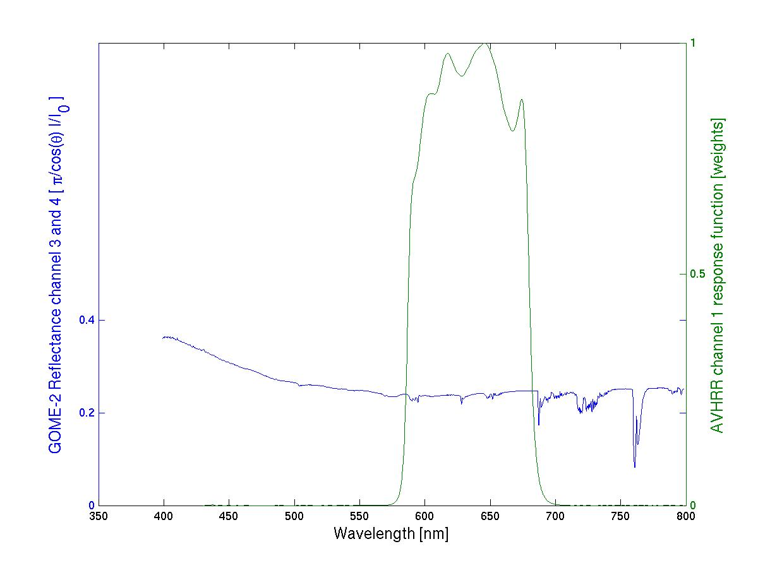
GOME-2 reflectivity inter-calibration
AVHRR ch 1/ Metop-A
AVHRR ch1
response function
GOME-2 Ch:4 (Band 6)
1024 measurements
GOME-2 Ch:3 (Band 5)
1024 measurements

Slide 4
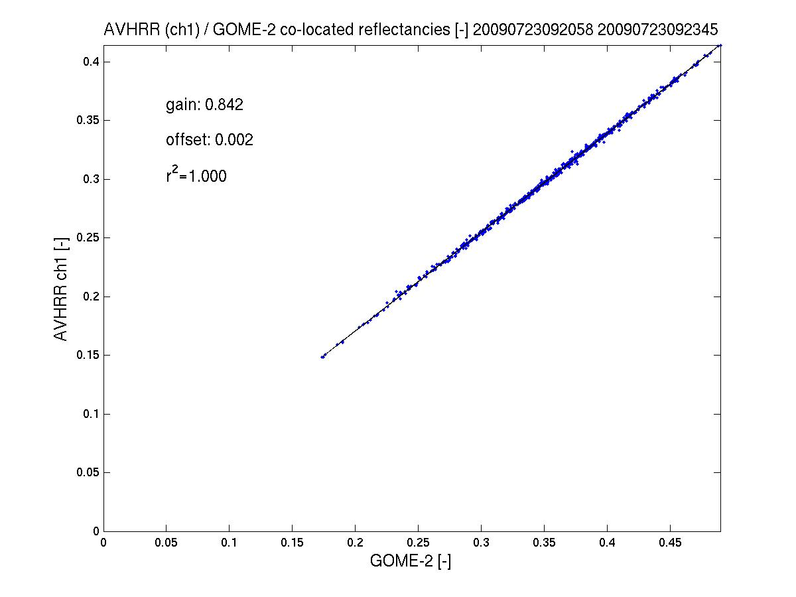
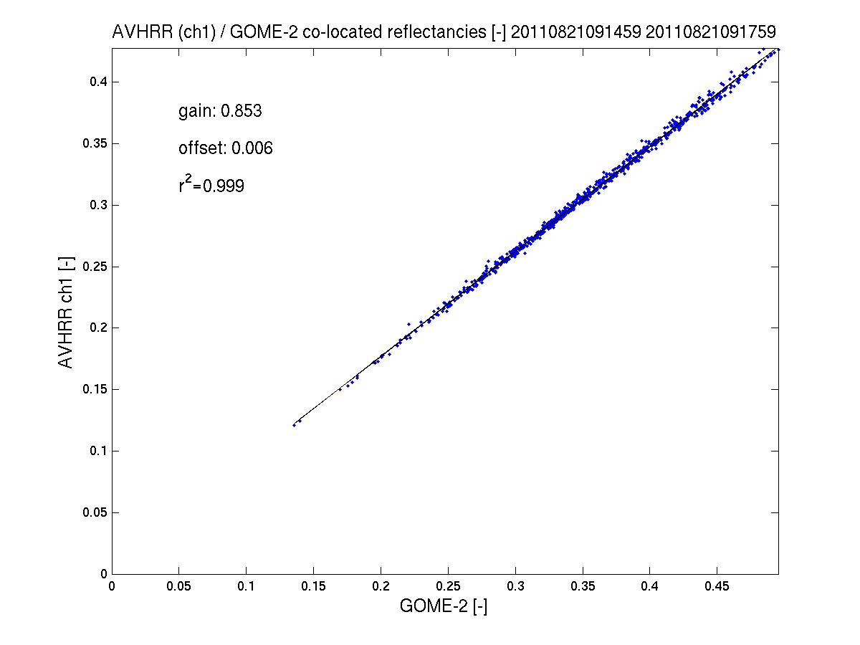
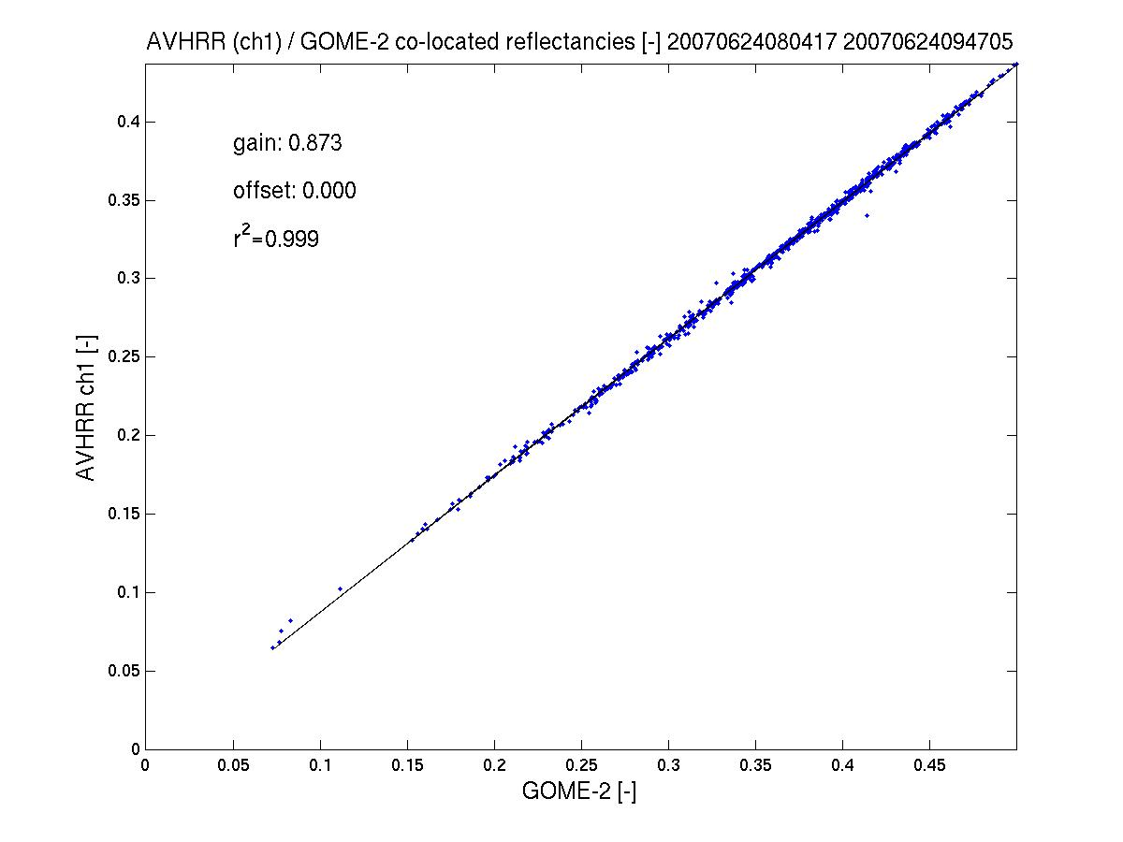
GOME-2 reflectivity inter-calibration
AVHRR ch 1/ Metop-A
AVHRR channel 1 to GOME-2 offset in reflectivity of ~9%
(AVHRR < GOME-2)
Preliminary results indicate that the offset has been quite stable during the last four years.
see GSICS Quarterly Newsletters, vol 5, number 3, Latter et al.
2011
2007
2009

Slide 5
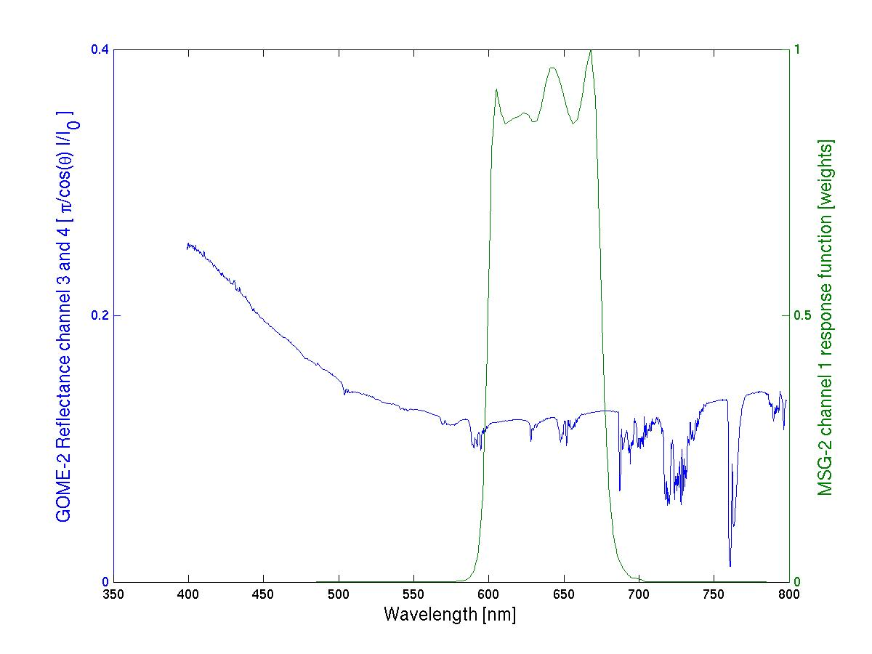
GOME-2 reflectivity inter-calibration
SEVIRI ch1/ MSG-2 – preliminary results
Seviri ch1
response function
GOME-2 Ch:4 (Band 6)
1024 measurements
GOME-2 Ch:3 (Band 5)
1024 measurements

Slide 6
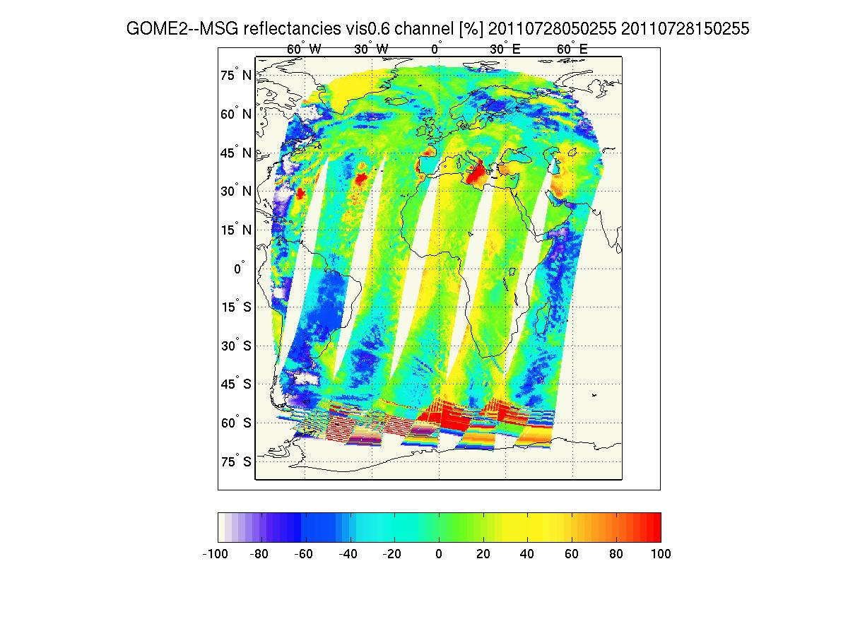
GOME-2 reflectivity inter-calibration
SEVIRI ch1/ MSG-2 – preliminary results
Co-location of GOME-2 Metop-A with Seviri / MSG data.
Spatial collocation: Average of all Seviri measurements (~4km) in one GOME-2 ground pixel (40 by 80 km)
Temporal collocation: Within +- 7.5 min of sensing time.

Slide 7
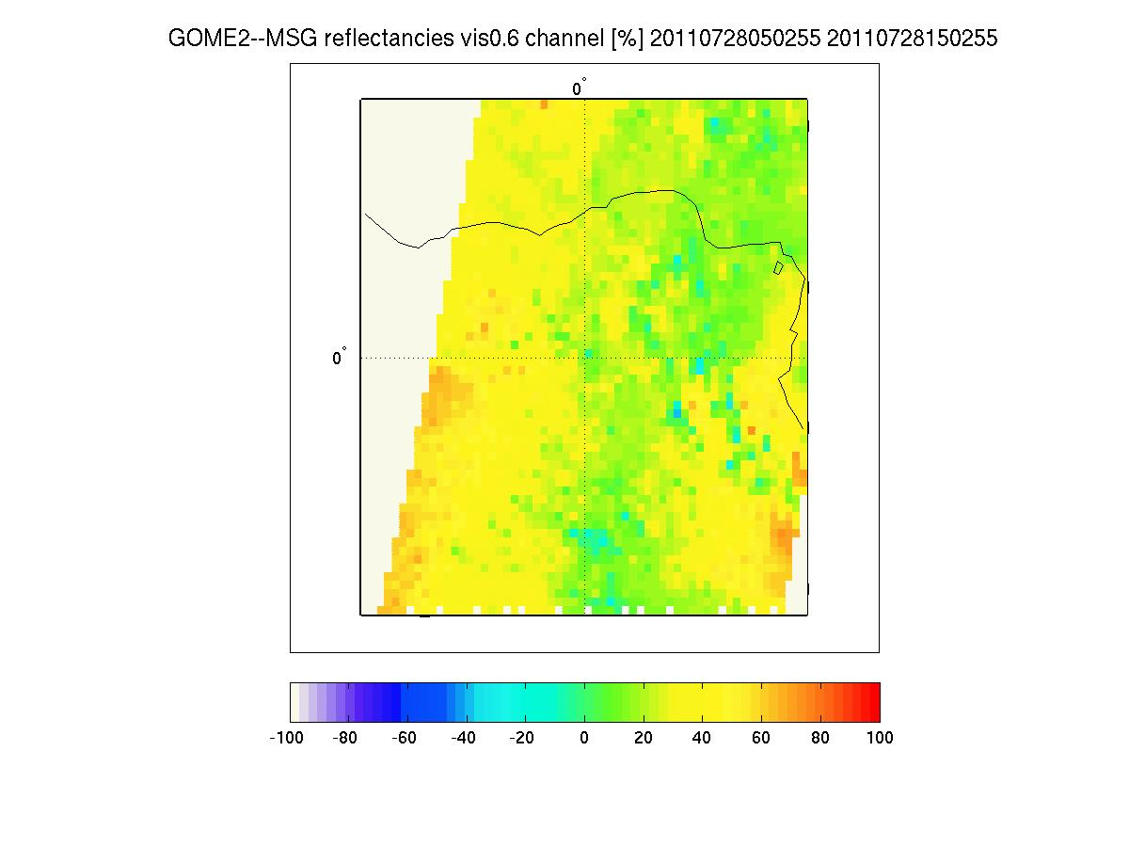
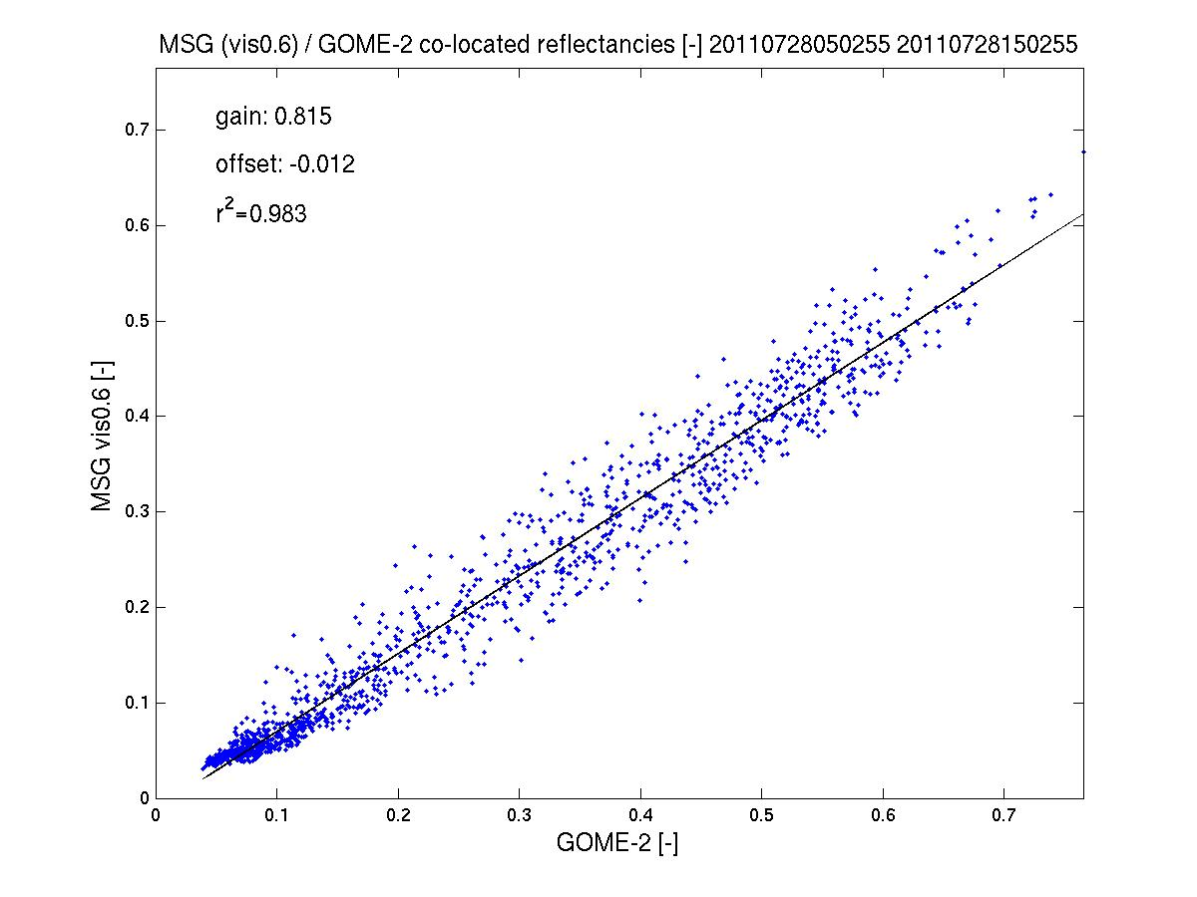
GOME-2 reflectivity inter-calibration
SEVIRI ch1/ MSG-2 – preliminary results
More work needed!!!
Improve spatial co-location by taking spatial aliasing into account
Improved temporal co-location still possible at the expense of worse statistics
Filter for low variability, low path length difference, etc..

Slide 8
Metop-A/B GOME-2 Radiometric accuracy and calibration
Earthshine measurement co-location FM2 to FM3 / Co-location criteria
Metop-A (M02): FM3
Metop-B (M01): FM2
Co-location criteria:
Area overlap > 80%
Geo. AMF diff < 2%
Relative O₂ A-Band residual (ROR) smaller than empirical threshold
Time difference:
49 min (half an orbit)

Slide 9
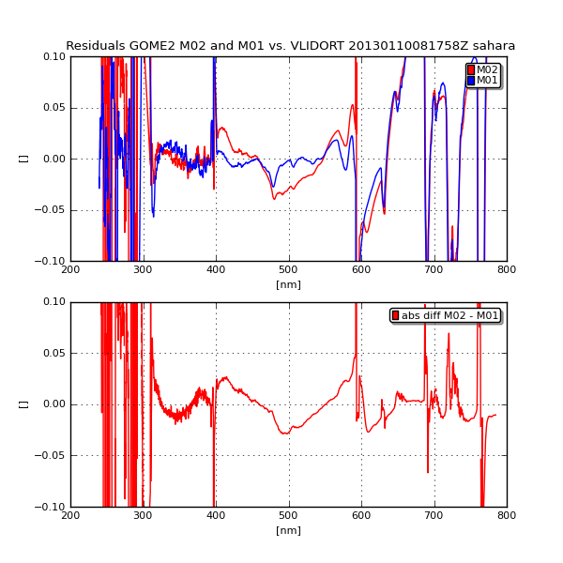
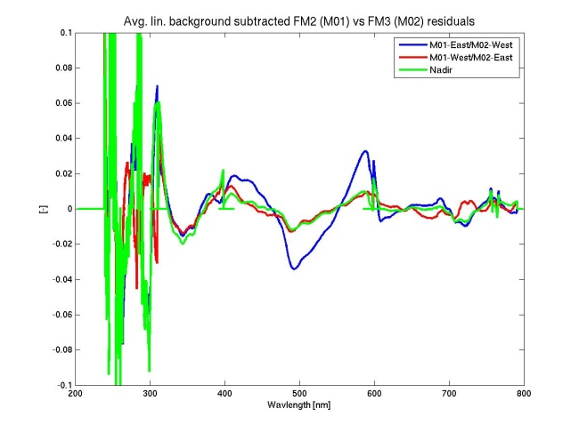
Metop-A/B GOME-2 Radiometric accuracy and calibration
Earthshine co-located Metop-A/B residuals /
Interpretation with forward model – V-LIDORT
Left up: Residual Metop-B with V-LIDORT
Residual Metop-A with V-LIDORT
Broad-band structure in M-A channel 3
Small-scale structures in M-B channel 3
Bottom: Residuals between M-A and M-B

Slide 10
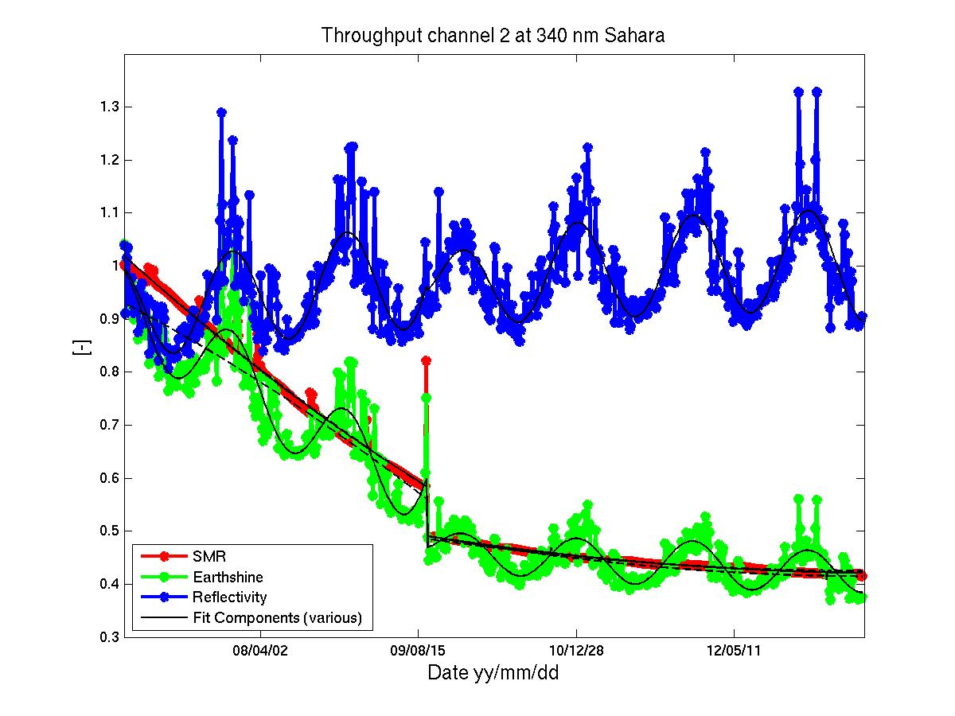
GOME-2 Metop-A degradation component modelling
Sahara at 340 nm – temporal domain
R2 campaign
Jan 2007– Jan 2012
340 nm
Reflectance
Solar Reference
Earthshine
Model/Fit-Results

