Slide 1
Xiangqian (Fred) Wu
National Oceanic and Atmospheric Administration (NOAA)
National Environmental Satellite, Data, and Information Service (NESDIS)
Center for Satellite Applications and Research (STAR)

Slide 2
Experience
Satellite Instrument Calibration Scientist for 10+ years
Was a data user before
Ozone Mapping and Profiler Suite (OMPS) Sensor Data Record (SDR, or “Level 1b”) team lead since 2011.
Has little experience with anything related to UV before then
X. Wu and co-authors, 2014: Preliminary Evaluation of Sensor Data Record from Nadir Instruments of Ozone Mapping Profiler Suite (Submitted to the Special Issue of AGU JGR-Atmospheres on “Suomi NPP Cal/Val Science Results”)

Slide 3
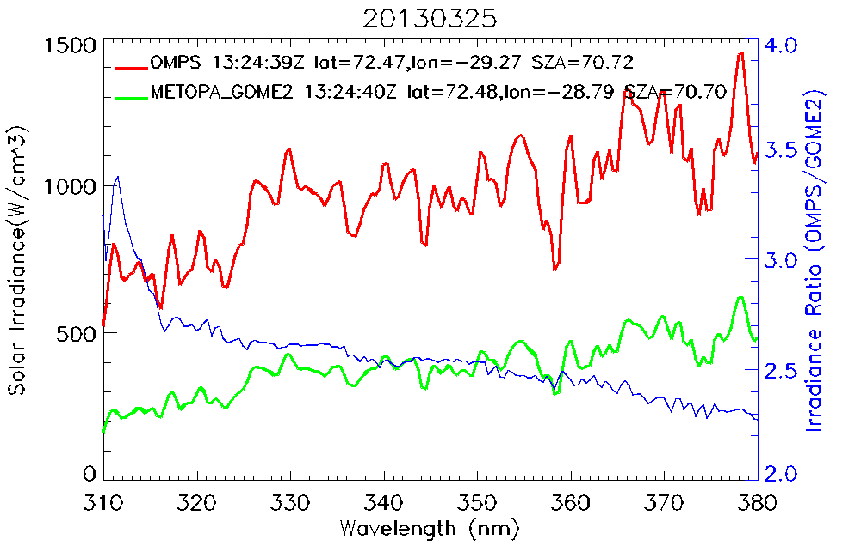
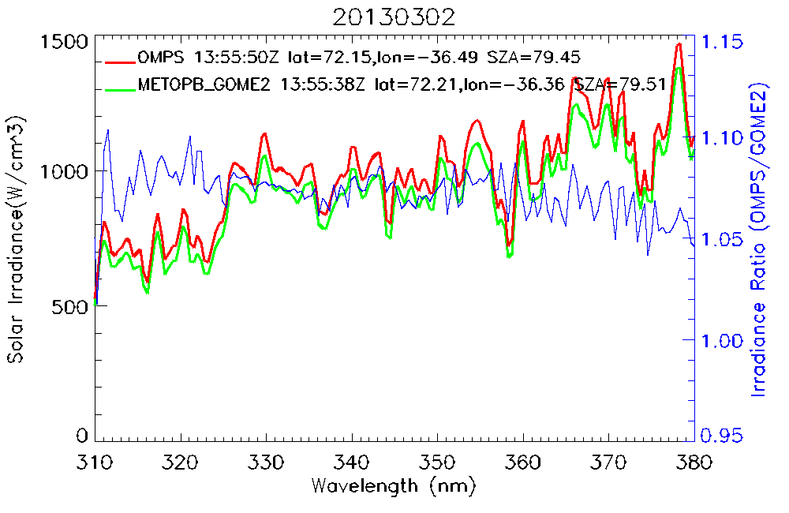
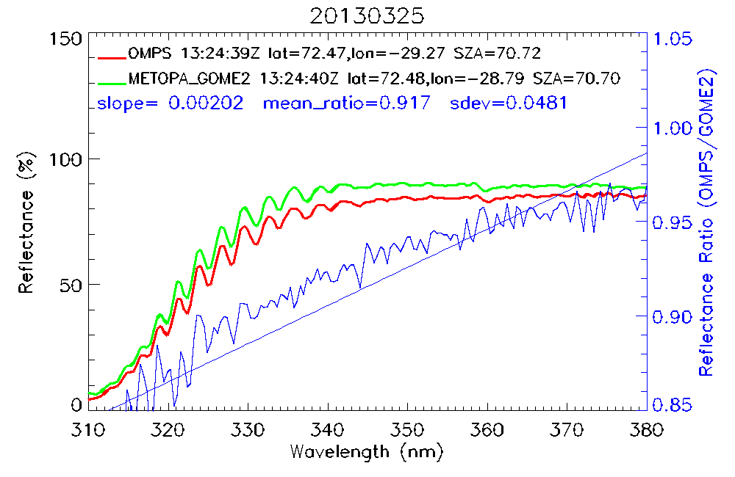
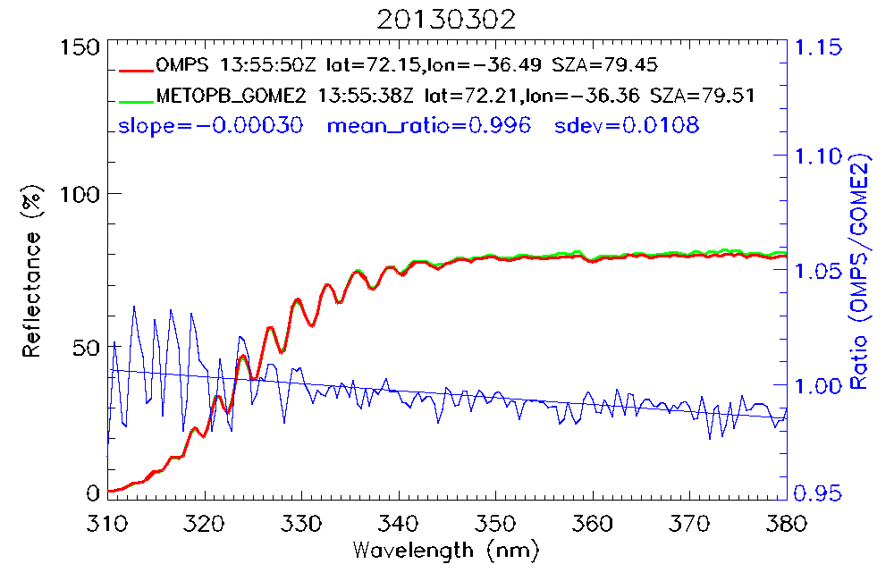
Radiance Comparison

Slide 4
Recommendation
Radiative Transfer Model
Do we need a “reference” RTM, or any one is as good on average?
If we do, how to select?
Can the UV sub-group make a recommendation regarding the use of RTM in SDR/L1B evaluation?

