Slide 1
Matthijs Krijger
Scientist, Gamer, Fighter
Me, in my younger years

Slide 2
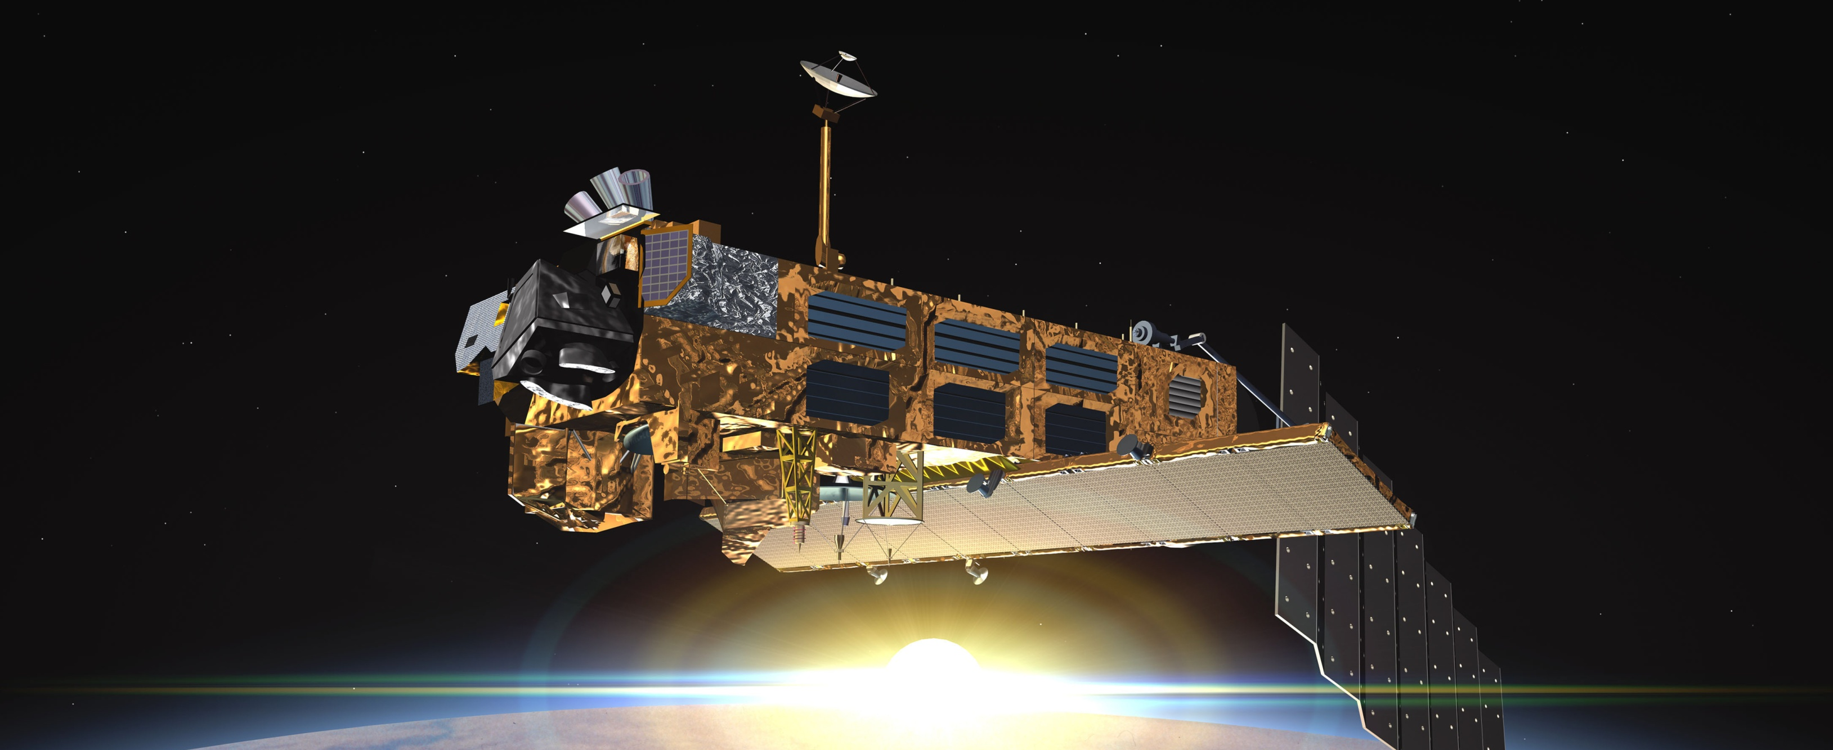
Relevant Experience
Satellite Calibration since 1998
Satellite Calibration UV (SOHO,TRACE) 1998-2002
Co-I Solar Orbiter
Satellite Calibration UV-VIS-IR (SCIAMACHY, SQWG) since 2002
Currently Project-lead Lv1
Satellite Calibration UV-VIS (GOME) 2002-2007
UV Ozone retrieval & radiative transfer modelling
Polarisation retrieval
Cloud counting

Slide 3
Relevant Publications
Krijger, J.M., Aben, I., Landgraf, J., "CHEOPS-GOME: WP2.1: Study of Instrument Degradation", TROPOMI study, SRON-EOS-RP-06-012, SRON, Utrecht, 2005
Krijger, J.M., Tanzi, C., Aben, I., Paul, F., "Validation of GOME polarisation measurements by method of limiting atmospheres", J. Geophys. Res. 110 D07305 2005, doi: 10.1029/2004JD005184
Krijger, J.M., Snel, R., Aben, I., Landgraf, J., "Absolute Calibration and Degradation of SCIAMACHY/GOME Reflectances", Conference CDROM, Envisat Symposium, SP-636, 2007
Tilstra, L.G., Acarreta, J.R., Krijger, J.M., Stammes, P., "Verification of Sciamachy's polarisation correction over the Sahara desert", Envisat Validation Workshop, ESA Proc. SP-531, CDROM, 2003
Krijger, J.M., Tilstra, L.G., Aben, I., Broek van den, M.M.P., Gloudemans, A.M.S., Houweling, S., Laat de, A.T.J., "SCIAMACHY validation 2003-2005: Dutch contribution", External funding report, Final report, 40 pages, 2006

Slide 4
Relevant Publications (recent)
Lichtenberg, G., Kleipool, Q., Krijger, J.M.,et al, "SCIAMACHY Level 1 data : calibration concept and in-flight calibration", Atmos. Chem. Phys., 6, p. 5347-5367 , 2006
Snel, R.C., Krijger, J.M., ed. H. Lacoste, "An improved scanner model for SCIAMACHY", Atmospheric Science Conference Proceedings, SP-676, CD-rom, ESA Communication Production Office, 2009
Snel, R.C., Krijger, J.M., Meer van der, P., ed. H. Lacoste, "In-flight calibration of the bidirectional reflectance distribution function of the SCIAMACHY ESM diffuser", Atmospheric Science Conference Proceedings, SP-676, CD-rom, ESA Communication Production Office, 2009
Krijger, J.M., Snel, R., Slijkhuis, S., ed. H. Lacoste, "Revised polarisation calibration of SCIAMACHY", Proceedings of Atmospheric Science Conference 2009, SP-676, CD-rom, ESA Communication Production Office, 2009
Krijger, J.M., Snel, R. et al, "Mirron Contamination in Space I: New Approach", to be published

Slide 5
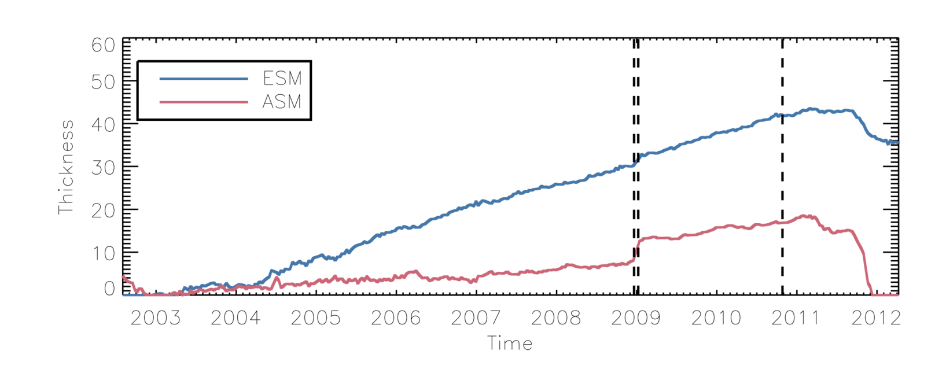
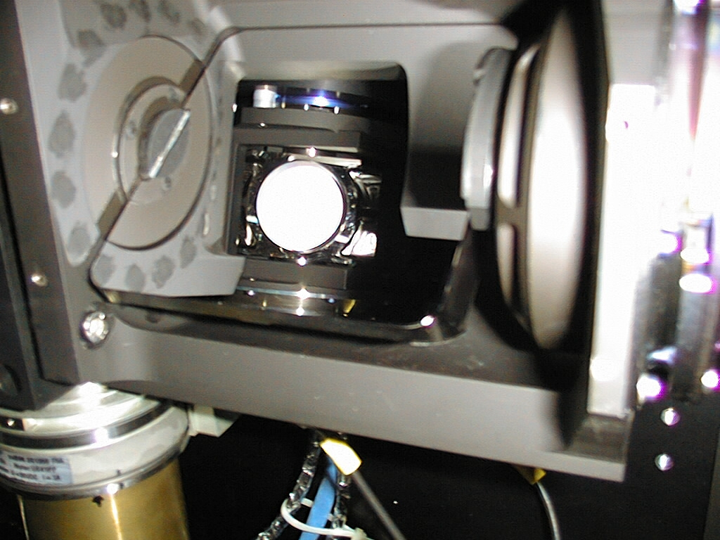
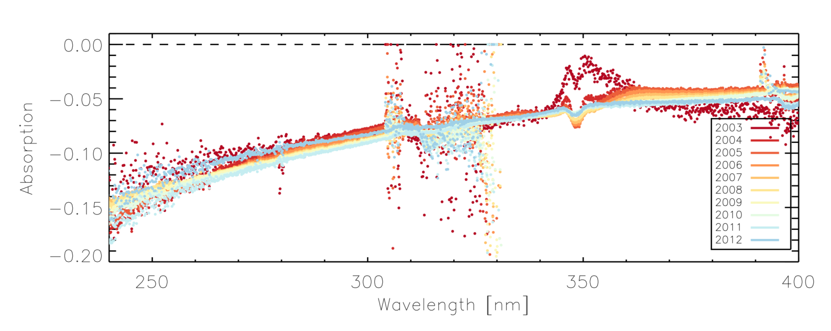
Current work
Scan-angle-dependent degradation correction
by scan mirror contamination modelling
SCIAMACHY
(GOME)
(GOME-2)

Slide 6
Objectives/Recommendation
Absolute Solar Reference Spectrum (250-800/2400nm, HR)
Degradation experience/literature exchange
Degradation modelling/correction exchange
FTP-Server for my pretty movies

