Slide 1
GSICS Procedure for Product Acceptance (GPPA) WorkFlow
GCC
Presented by Fangfang Yu
12/03/2013

Slide 2
Fundamental Capabilities of GPPA
GPPA was originally developed by Dr. Bob Iacovazzi, following the QA4EO guidelines
The GPPA is the GSICS:
Product developers pathway to obtain a “Stamp of Approval” for a potential product
Data users window to GSICS product quality and “fitness for purpose”
Governing body reference for judging GSICS product fitness
The GPPA defines and documents:
Scope of product within the GSICS product portfolio – correction of level1b data
Theoretical basis, traceability, and implementation and distribution strategy
Product quality (uncertainty, quality indicators, data user’s guide, etc)
The GSICS Product Acceptance Form (GPAF) is available at GSICS wiki
https://gsics.nesdis.noaa.gov/wiki/Development/GppaWorkflow

Slide 3
Four Product Phases
Submission Phase
Demonstration Phase
Pre-operational Phase
Operational Phase

Slide 4
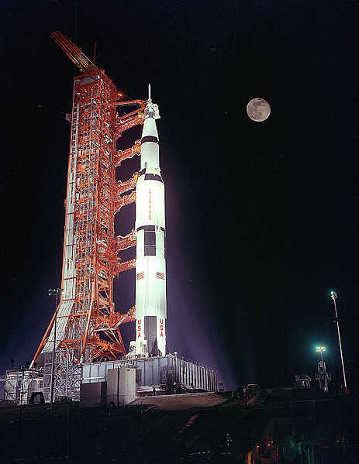
GPPA: Submission Phase
Phase Progress:
GSICS Product Acceptance Form (GPAF) is satisfactory,
Sample data files conform to GSICS file and parameter naming and format standards,
Verified to be within GSICS scope, and
Theoretical basis is understood at a high-level.
Documents & Data to GCC:
GPAF sections that detail product name, POC, brief description, and relevance to GSICS.
Preliminary version of the product algorithm theoretical basis document (ATBD)
Sample product files that adhere to GSICS file and parameter naming conventions
Reviewers: GSICS Product Acceptance Team (GPAT)
Maximum Time Period: 90 Days

Slide 5
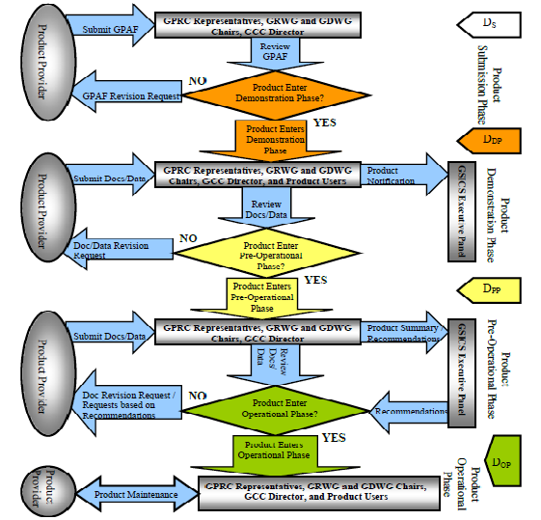

Slide 6
GPPA: Demonstration Phase
Phase progress:
Founding concepts, supporting models and measurements, and implementation are documented and fully understood,
Traceability to community reference standard is documented,
Quality Indicator is documented and well-defined,
Tested and reviewed by potential product users, and
Data released to GSICS members and potential users.
Documents & Data to GCC:
Routine product upload to a GSICS data server and agree on file retention policy.
Baseline versions of four documents critical to product quality assurance –
Algorithm Theoretical Basis Document,
Document describing product traceability to standards
Product supporting radiative transfer model and cal/val supporting measurements description
Product quality indicator description and justification
Reviewers: GPAT & potential product users
Maximum Time Period: 365 Days

Slide 8
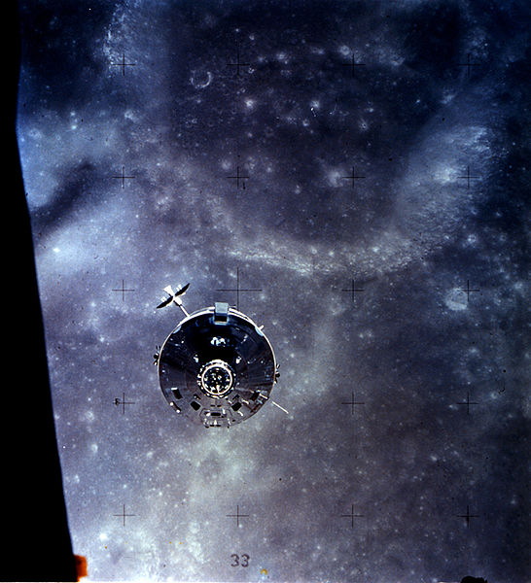
GPPA: Pre-operational Phase
Phase progress:
Generation, distribution, version control and archive strategies are fully documented and implemented.
Users’ Guide with clear implementation instructions made available to data users,
Data released to public with disclaimer.
Documents associated with product data stewardship in an operational environment to GCC:
product version control plan,
operations and distribution plan, and
data user's guide
Reviewers: GPAT & GSICS Executive Panel (EP)
Maximum Time Period: 180 Days

Slide 10
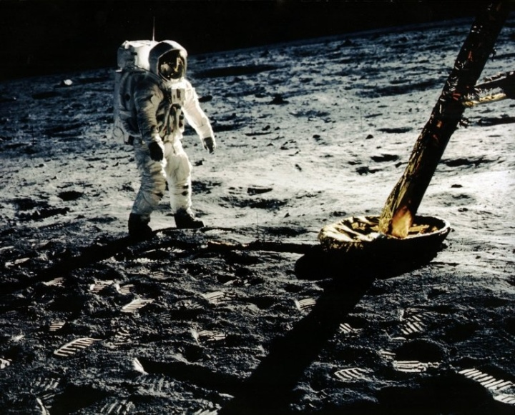
GPPA: Operational Phase
Goal:
Product is fully accepted by GSICS Executive Panel (EP) and maintained within GSICS and distributed to the public.
Maximum Time Period: Periodic Reviews
Milestones: The following are made available by the product provider to the GCC and the GPAT for periodic inspection and review
Product logs and usage reports
Updated documentation/software as necessary

Slide 12
Status of MSU/AMUS Product – As of August 2013
The 3rd party product was first submitted for GPPA review in Jan 2010.
Issue in the Product Submission Phase: the product may not be archived at the GSICS server(s) as requested and different name conventions.
Solution: EP granted an exempt clause for the GISCS server to link the (A)MSU product and GDWG will be working to resolve the name convention issue.
Resubmitted for the GPPA review in June 2012
GCC disseminated the review documents to GPAT in June 2012
the GPAT members for the MW product included the GPRC representatives and GRWG+GDWG chairs
Product was promoted to Demonstration phase in August 2012
Base don the critical review comments and suggestions from GPAT (3 reviewers)
Sent to external review in November 2012
MW subgroup
Very few feedback received
Another call for product test in July 2013
Potential users
MW subgroup members

Slide 13
GCC Staff Change
GCC Director
Dr. Larry Flynn (Dr. Fuzhong Weng stepped down)
GCC Deputy Director
Dr. Manik Bali (Dr. Fangfang Yu stepped down on Sept. 1 2013)

