Slide 1
GSICS Review Summary
Manik Bali

Slide 2
Review Criterion
Methodology in draft ATBD
Testing of the Potential GSICS Inter-Calibration Product

Slide 3
Methodology in draft ATBD
 | Reviewers
 | Viju | Wenze | Suleiman | Thorson+Chedly | Issaac | Chabitha | Tanvir
Method Clarity
Method Utility
Method Reproducibility

Slide 4
Testing of the Potential GSICS Inter-Calibration Product
 | Reviewers
 | Viju | Wenze | Suleiman | Thorson & Chedly | Issaac | Chabitha | Tanvir
Data Accessibility
Availability
Data Ease of Use
Product Suitability
Product Reliability

Slide 5
Individual comments
Thorsen & Chedly = “I consider this the most advanced MSU/AMSU L1 dataset available for climate purposes. This is an important contribution and will be important in helping to understand discrepancies between current MSU/AMSU climate datasets. “
Viju = “This is a great work and serves as an example for climate data record development”
Wenze =” The only concern is that the method is quite sensitive to the quality of the input data, so it is important to do some pre-screen before applying the method”.
Suleiman =“I strongly believe that the method accomplished its purpose as the authors clearly showed.”
Tanvir = “Overall, the product can be recommended for CDR users. The method is very effective, and suitable for climate study, especially for the purpose of maintaining a consistent climate data record.”

Slide 6
Four Product Phases
Submission Phase
Demonstration Phase
Pre-operational Phase
Operational Phase

Slide 7
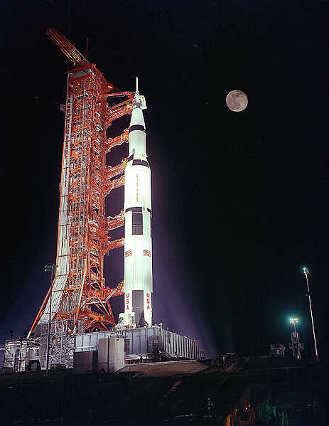
GPPA: Submission Phase
Phase Progress:
GSICS Product Acceptance Form (GPAF) is satisfactory,
Sample data files conform to GSICS file and parameter naming and format standards,
Verified to be within GSICS scope, and
Theoretical basis is understood at a high-level.
Documents & Data to GCC:
GPAF sections that detail product name, POC, brief description, and relevance to GSICS.
Preliminary version of the product algorithm theoretical basis document (ATBD)
Sample product files that adhere to GSICS file and parameter naming conventions
Reviewers: GSICS Product Acceptance Team (GPAT)
Maximum Time Period: 90 Days

Slide 8
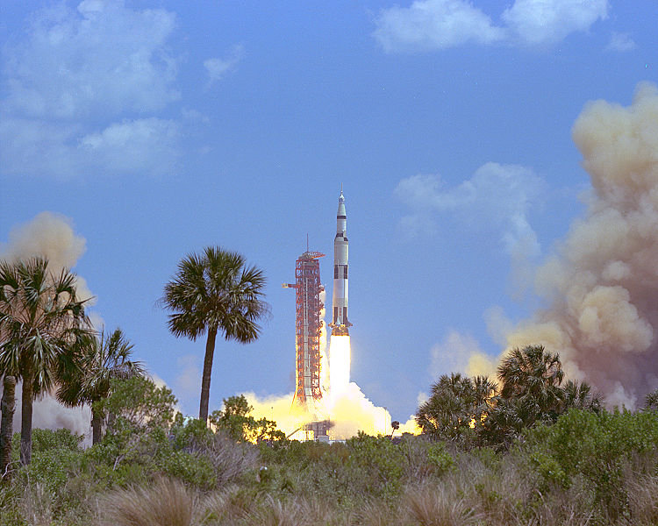
GPPA: Demonstration Phase
Phase progress:
Founding concepts, supporting models and measurements and implementation are documented and fully understood
Traceability to community reference standard is documented
Quality Indicator is documented and well-defined
Tested and reviewed by potential product users
Data released to GSICS members and potential users.

Slide 9
Documents & Data to GCC:
Routine product upload to a GSICS data server and agree on file retention policy.
Baseline versions of four documents critical to product quality assurance
Algorithm Theoretical Basis Document
Document describing product traceability to standards
Product supporting radioactive transfer model and cal/val supporting measurements description
Product quality indicator description and justification q1`

Slide 10
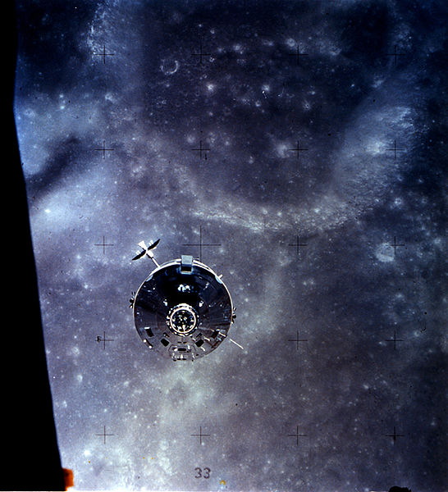
GPPA: Pre-operational Phase
Phase progress:
Generation, distribution, version control and archive strategies are fully documented and implemented.
Users’ Guide with clear implementation instructions made available to data users,
Data released to public with disclaimer.
Documents associated with product data stewardship in an operational environment to GCC:
Product version control plan,
Operations and distribution plan, and
Data user's guide
Reviewers: GPAT & GSICS Executive Panel (EP)

Slide 11
Final Comments and Recommendation to GCC Director
GPPA recognizes that the AMSU/MSU product has fulfilled all the conditions for the demonstration Phase.
GPPA recognizes the fact that the MSU/AMSU product is already distributed by NCDC in Near Real Time. NCDC Product Maturity Matrix was diligently followed by Cheng-Zhi to continue NRT production of product at NCDC.
GPPA recognizes the fact that most of the conditions of the pre-operational phase have also been fulfilled .
GPPA recommends to the Director GSICS Co-Ordination Center ( Larry Flynn) to accept the product in demonstration phase in the GSICS Catalogue and layout criterion to make it operational Upon receipt of a key user guide from Cheng-Zhi Zou.

Slide 12
Over To GCC Director
Larry Flynn

Slide 13
GCC Decision
GCC Director’s decision
MW MSU/AMSU Product are accepted in GSICS in Demonstration Phase
Would take a decision on going directly to Pre-Operational Phase after EP approval.

Slide 14
Certificates of Appreciation

Slide 15
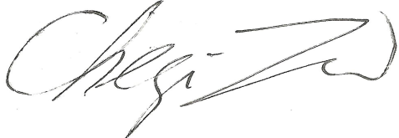
Certificate of Appreciation
With the support of WMO and CGMS, we present this certificate to
Dr. Chabitha Devaraj
for her outstanding contribution to the review of GSICS Microwave FCDR product. GSICS
recognizes the extensive effort involved in this review that was completed at no cost to GSICS
Awarded: Dec 03, 2013
Dr. Lawrence E. Flynn
Director GSICS Co-ordination Center
Dr. Cheng-Zhi Zou
Chair GSICS Microwave Sub-Group
Dr. Mitch Goldberg
Chair GSICS Executive Panel

Slide 16
Certificate of Appreciation
With the support of WMO and CGMS, we present this certificate to
Dr. Tanvir Islam
for his outstanding contribution to the review of GSICS Microwave FCDR product. GSICS
recognizes the extensive effort involved in this review that was completed at no cost to GSICS
Awarded: Dec 03, 2013
Dr. Lawrence E. Flynn
Director GSICS Co-ordination Center
Dr. Cheng-Zhi Zou
Chair GSICS Microwave Sub-Group
Dr. Mitch Goldberg
Chair GSICS Executive Panel

Slide 17
Certificate of Appreciation
With the support of WMO and CGMS, we present this certificate to
Dr. Wenze Yang
for his outstanding contribution to the review of GSICS Microwave FCDR product. GSICS
recognizes the extensive effort involved in this review that was completed at no cost to GSICS
Awarded: Dec 03, 2013
Dr. Lawrence E. Flynn
Director GSICS Co-ordination Center
Dr. Cheng-Zhi Zou
Chair GSICS Microwave Sub-Group
Dr. Mitch Goldberg
Chair GSICS Executive Panel

Slide 18
Certificate of Appreciation
With the support of WMO and CGMS, we present this certificate to
Dr. Isaac Moradi
for his outstanding contribution to the review of GSICS Microwave FCDR product. GSICS
recognizes the extensive effort involved in this review that was completed at no cost to GSICS
Awarded: Dec 03, 2013
Dr. Lawrence E. Flynn
Director GSICS Co-ordination Center
Dr. Cheng-Zhi Zou
Chair GSICS Microwave Sub-Group
Dr. Mitch Goldberg
Chair GSICS Executive Panel

Slide 19
Certificate of Appreciation
With the support of WMO and CGMS, we present this certificate to
Dr. Suleiman Alsweiss
for his outstanding contribution to the review of GSICS Microwave FCDR product. GSICS
recognizes the extensive effort involved in this review that was completed at no cost to GSICS
Awarded: Dec 03, 2013
Dr. Lawrence E. Flynn
Director GSICS Co-ordination Center
Dr. Cheng-Zhi Zou
Chair GSICS Microwave Sub-Group
Dr. Mitch Goldberg
Chair GSICS Executive Panel

Slide 20
Certificate of Appreciation
With the support of WMO and CGMS, we present this certificate to
Dr. Viju John
for his outstanding contribution to the review of GSICS Microwave FCDR product. GSICS
recognizes the extensive effort involved in this review that was completed at no cost to GSICS
Awarded: Dec 03, 2013
Dr. Lawrence E. Flynn
Director GSICS Co-ordination Center
Dr. Cheng-Zhi Zou
Chair GSICS Microwave Sub-Group
Dr. Mitch Goldberg
Chair GSICS Executive Panel

Slide 21
Certificate of Appreciation
With the support of WMO and CGMS, we present this certificate to
Mr. Stephen Po-Chedley
for his outstanding contribution to the review of GSICS Microwave FCDR product. GSICS
recognizes the extensive effort involved in this review that was completed at no cost to GSICS
Awarded: Dec 03, 2013
Dr. Lawrence E. Flynn
Director GSICS Co-ordination Center
Dr. Cheng-Zhi Zou
Chair GSICS Microwave Sub-Group
Dr. Mitch Goldberg
Chair GSICS Executive Panel

Slide 22
Certificate of Appreciation
With the support of WMO and CGMS, we present this certificate to
Mr. Tyler Thorsen
for his outstanding contribution to the review of GSICS Microwave FCDR product. GSICS
recognizes the extensive effort involved in this review that was completed at no cost to GSICS
Awarded: Dec 03, 2013
Dr. Lawrence E. Flynn
Director GSICS Co-ordination Center
Dr. Cheng-Zhi Zou
Chair GSICS Microwave Sub-Group
Dr. Mitch Goldberg
Chair GSICS Executive Panel

Slide 23
THANKYOU

