Slide 1
GSICS Microwave Sub-Group Web Meeting Dr. Tanvir Islam 03-Dec-2013

Slide 2
Overview of the SNO Calibration Method
The calibration method is developed based on Simultaneous Nadir Overpass observations (confined to the polar regions).
But, the method/coefficients are applied globally.
The inter-satellite bias is claimed to be reduced by the SNO calibration method.
Moreover, it is claimed that after re-calibration, inter-satellite biases at the SNO matchups are exactly zero.

Slide 3
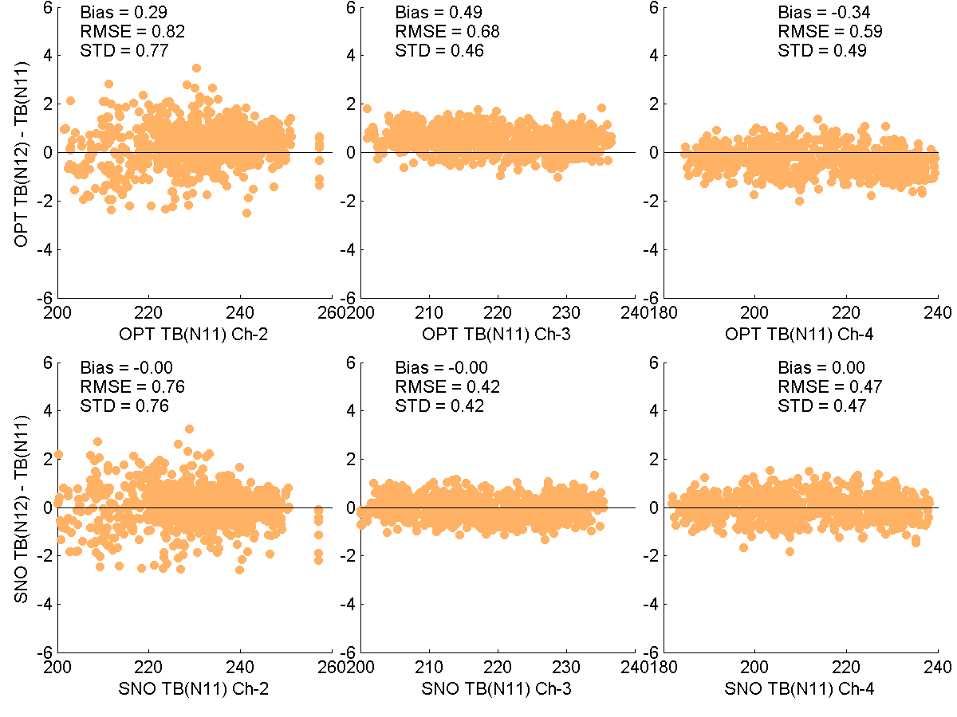
Operational
SNO

Slide 4
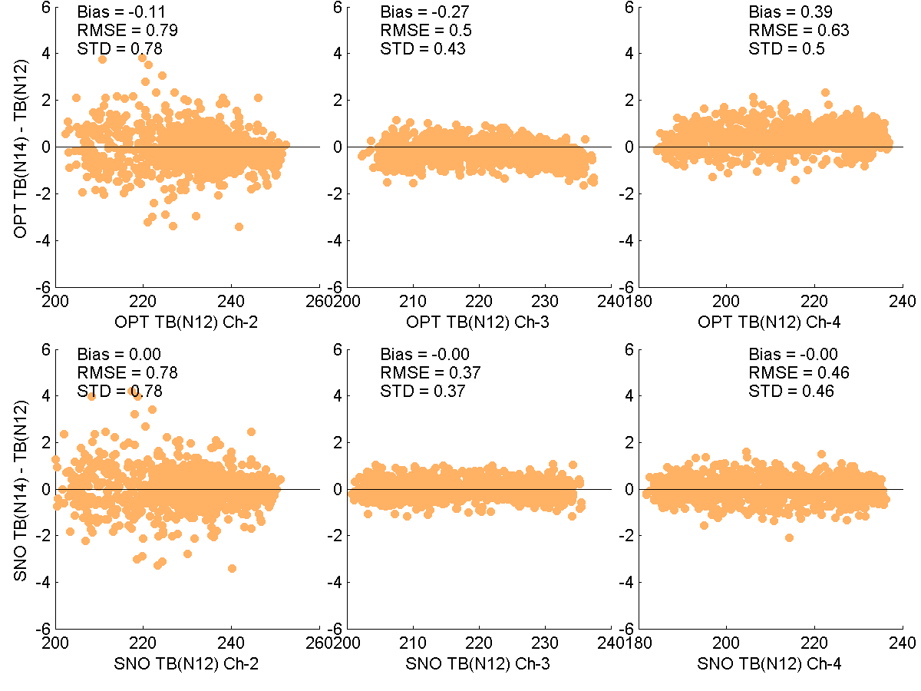
Operational
SNO

Slide 5
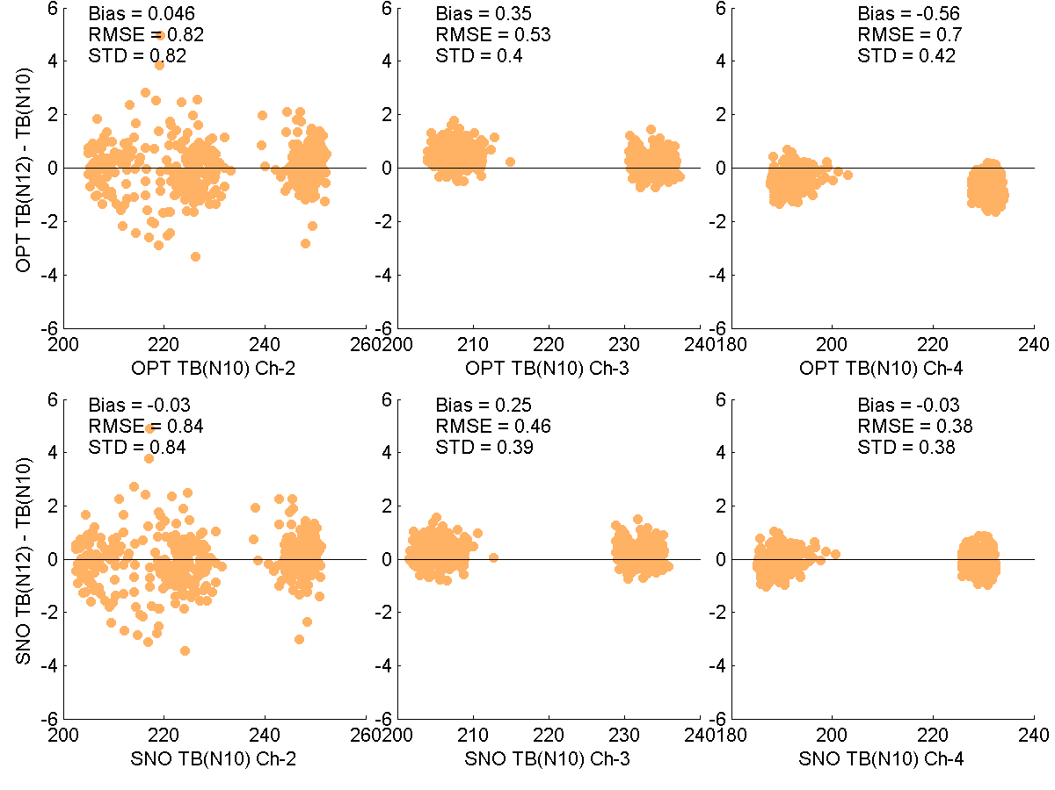
Operational
SNO

Slide 6
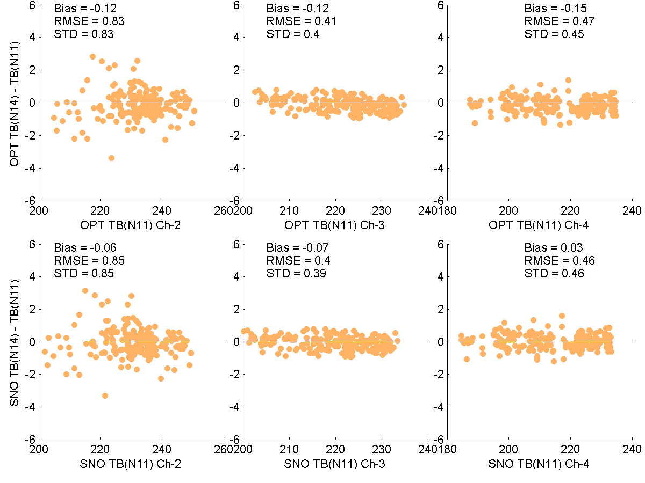
Operational
SNO

Slide 7
Review/Comments
The inter-satellite biases become smaller than the NOAA operational calibrated product after applying the SNO correction method.
Nevertheless, the bias is NOT exactly zero.
This is an effective method, suitable for climate study, especially for the purpose of maintaining a consistent climate data record.
The method is well validated for the entire globe (indirect validation, Zou et al.).

Slide 8
Risks
It is not clear that, how the SNO calibration method would perform for new satellite measurements, if there are any systematic biases (also unstable bias drift) present in the measurements. It is understood, same coefficients are applied globally, and even on new radiometric measurements when available.
The coefficients obtained from past record may not guarantee good calibrated TBs on future datasets, if there are any systematic biases on the datasets. Thus, the SNO calibrated products may not be applicable for real/near-real time applications, more importantly, within variational retrieval/data assimilation framework.

Slide 9
Risks
The SNO product has not been extensively validated with the radiative transfer model simulated TBs. Statistically, the inter-calibrated products may agree with other satellite measurements; however, one should be very careful so that the natural variations in TB measurements are not removed in the inter-calibrated product.
How the inter-calibration method performs on precipitation conditions?

Slide 10
Overall Remarks
Overall, the product can be recommended for CDR users. The method is very effective, and suitable for climate study, especially for the purpose of maintaining a consistent climate data record.
Extending the method to other passive microwave sensors (SSMI/S, TMI, AMSR-E/AMSR2 continuity)?

