Slide 1
Comparison of NASA DCC method with the vicarious method using RT simulation
Masaya Takahashi
Meteorological Satellite Center / Japan Meteorological Agency

Slide 2
Contents
NASA DCC method for MTSAT-2
Vicarious calibration using RT simulation
Comparison of gain between NASA DCC method and RT simulation method
Summary / toward demonstration phase

Slide 3
NASA DCC method for MTSAT-2/Imager
DCC selection thresholds: same as Doelling et al. (2013) except for homogeneity check for MODIS
5km sub-sampled MODIS L1B (MYD02SSH) are used in this analysis instead of the nominal data (MYD021KM)
DCC domain:
20° S < latitude < 20° N
125° E < longitude < 165° E
Presentation by R. Bhatt at the DCC Part I web meeting
Doelling et al., 2013: The Characterization of Deep Convective Clouds as an Invariant Calibration Target and as a Visible Calibration Technique. IEEE TGRS , 51, 1147-1159.

Slide 4
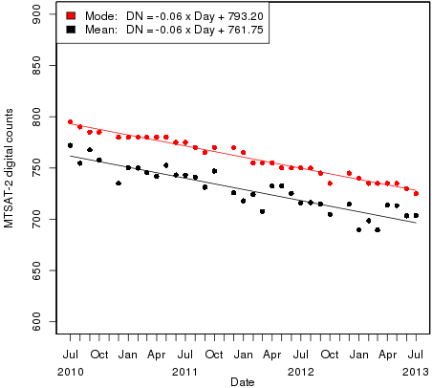
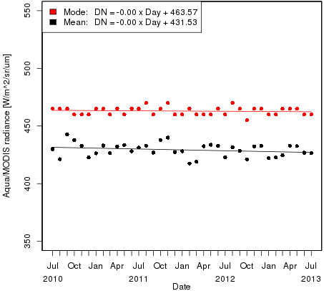
Results of NASA DCC method
Good agreements with the ATBD or those of other GEO satellites
Seasonal variation (mode is more stable than mean)
Time series of mode and mean of DCC pixels
mode
mode
mean
mean
MTSAT-2/Imager
Aqua/MODIS

Slide 5
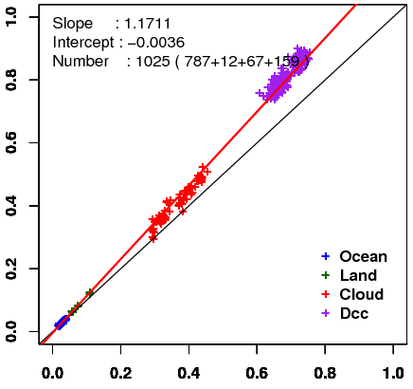
Vicarious calibration using RT simulation
Method: Comparison of observed and simulated radiance for some targets (collaboration research with the University of Tokyo)
Target: Wide range of radiances
Cloud-free ocean / land, liquid water cloud, and DCC
Radiative transfer calculation:
RSTAR (Nakajima and Tanaka [1986,1988])
Input data: Independent from GEO data
JMA Re-Analysis atmos. profiles (JRA-25/JCDAS)
Aerosol/Cloud optical thickness retrieved from MODIS L1B (MYD02SSH)
MODIS BRDF (MCD43C2) for land target
Aura/OMI total column ozone, …
Result of MTSAT-2 in Feb. 2011
Simulated reflectivity
Observed reflectivity

Slide 6
Target selection for the RT simulation
Spatially uniform scene
Small standard deviation of digital counts in a target area
Geometrical condition
Solar/satellite zenith angle < 60°
Exclude data around sunglint area
Ice crystal shape for DCC simulation: Hexagonal column (Yang et al. 2000)
To minimize the uncertainty, cloud with large optical thickness are used.
Thresholds used in the target selection for MTSAT-2/Imager
 | Ocean | Land | Liquid cloud | DCC
Standard deviation of digital counts (5x5km mean) | < 6 | < 3 | < 12 | < 15
Optical thickness Aerosol for sea and land Cloud for cloud and DCC | < 0.3 | < 0.3 | > 10 & < 40 | > 150
TBB of 10.8um ch. | >273K | > 273K | > 273K | < 205K

Slide 7
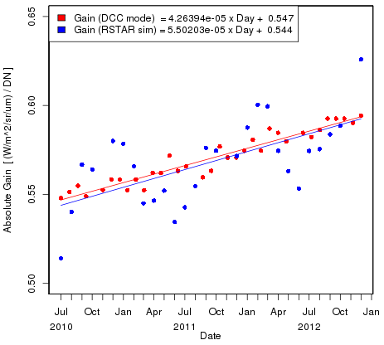
Comparison of gain between NASA DCC method and RT simulation method
Time series of monthly visible channel gain
SBAF (0.9376* for MTSAT-2) is applied to NASA DCC method
Gains by RSTAR simulation are derived from direct comparisons between observation and simulation
Similar trends, but large variance (seasonal variation) in results of the vicarious method
NASA DCC method
Vicarious method using RT simulation
* Described in Dave’s presentation in October 2012 GSICS web meeting

Slide 8
Summary / Toward demonstration phase
Summary
Implementation of NASA’s DCC method to MTSAT-2/Imager
Good agreement with the ATBD
Comparison of NASA DCC method with vicarious method on RT simulation
Similar gain trend
Need to improve vicarious method
Toward demonstration phase
MODIS DCC selection / data archiving
Difficult to archive nominal Aqua/MODIS data (MYD021KM) due to downloading speed. Alternatively, we use 5km sub-sampled data.
Very useful if someone creates those data (e.g., MTSAT-IASI/AIRS IR collocation NetCDF data on EUMETSAT THREDDS server)
GSICS product (NetCDF) format
What attributes/variables should be contained? DCC selection thresholds, monthly results (mean/mode) of DCC, and …?

