Slide 1
Can DCC Radiance Distributions be Sharpened using Lightning Data?
Dennis Buechler

Slide 2
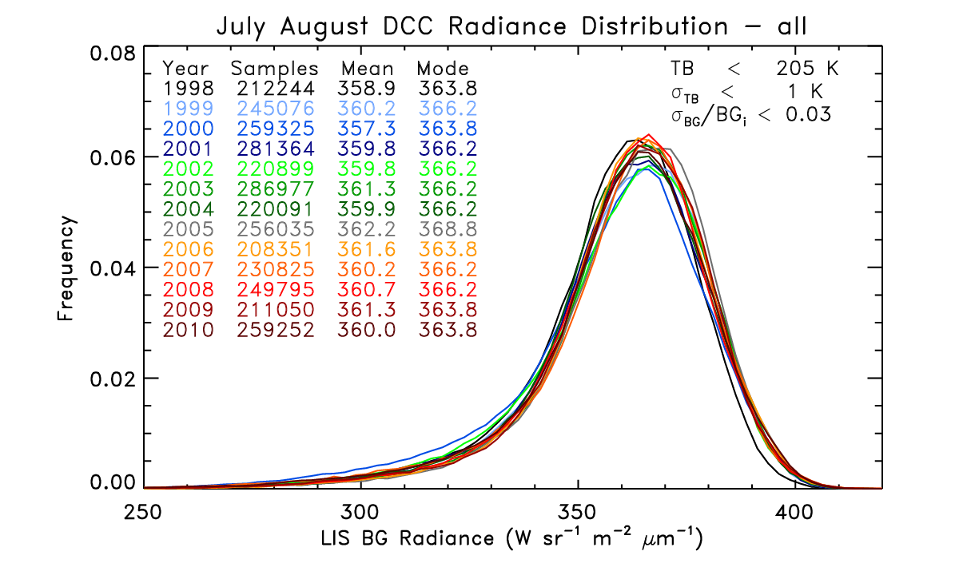
Example
Dark tail in distribution caused by anvil spreading
Lightning occurs in deep convection
LIS DCC research began to develop way to monitor GLM

Slide 3
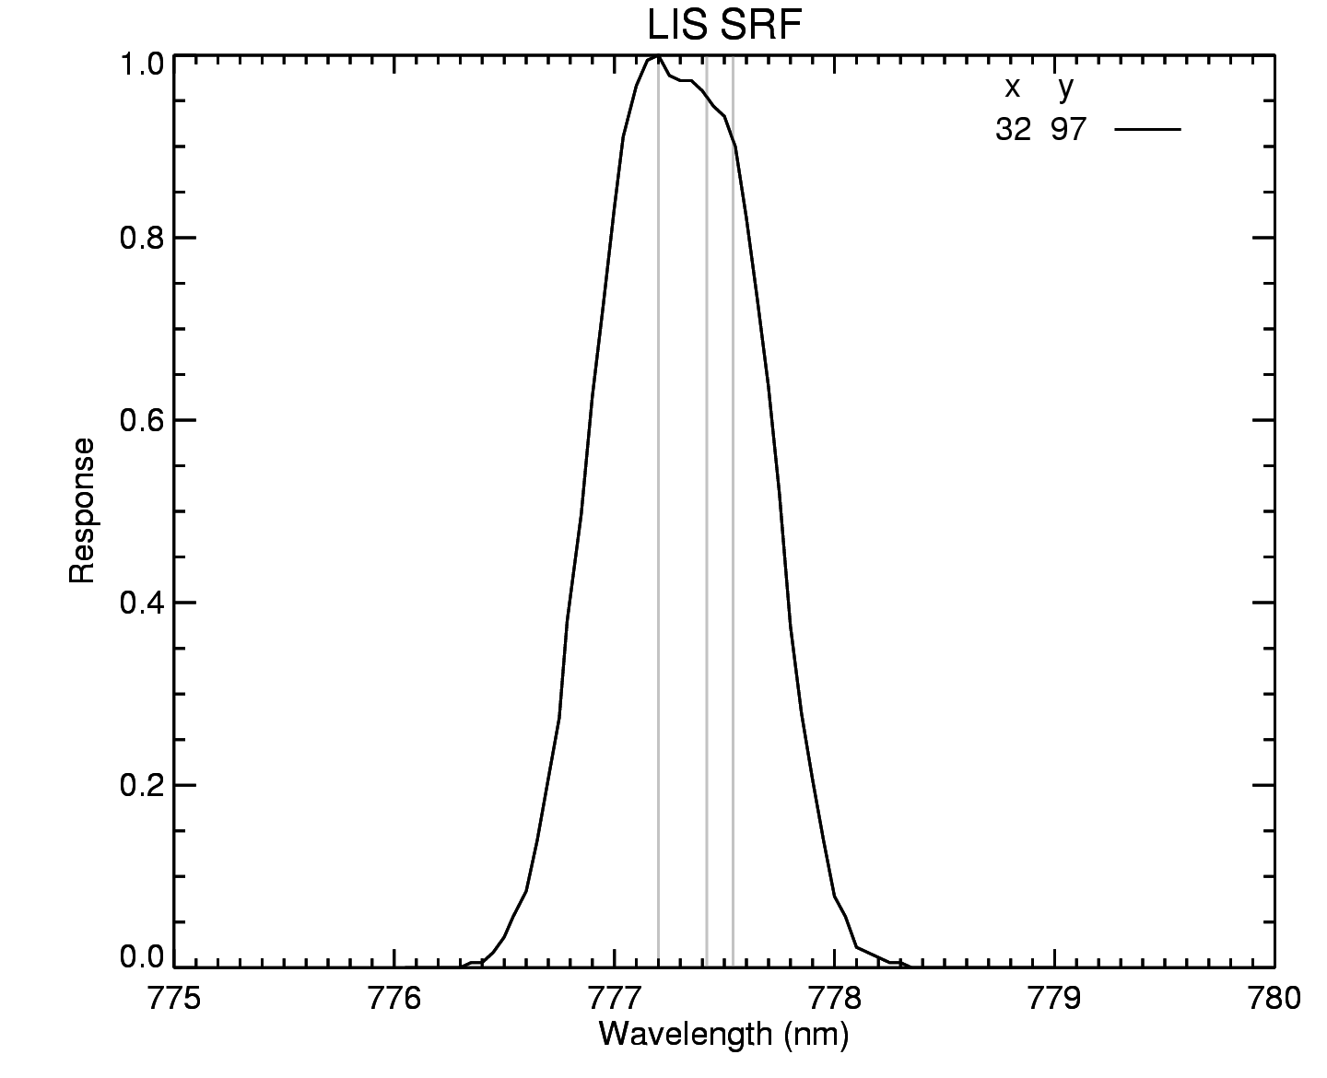
TRMM LIS Characteristics
Fast lens, narrowband (~1 nm wide) filter at 777.4 nm
128 x 128 CCD array, 500 fps imaging
~3.5 km nadir to ~7 km at corners
Frame-to-frame subtraction isolates lightning transients against bright daytime background
Backgrounds ~35 seconds

Slide 4
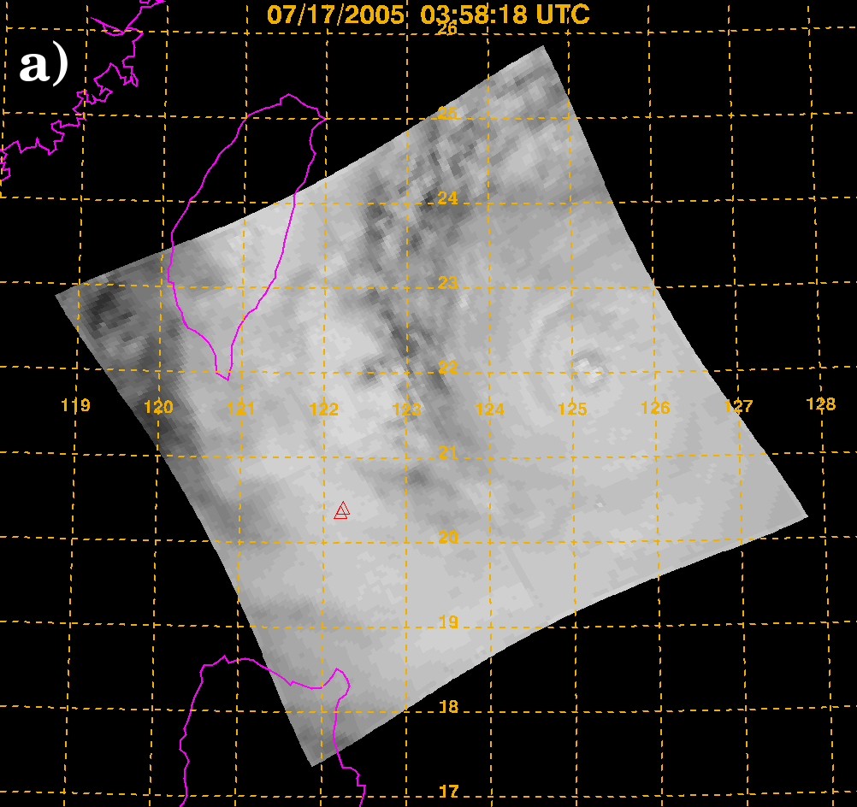
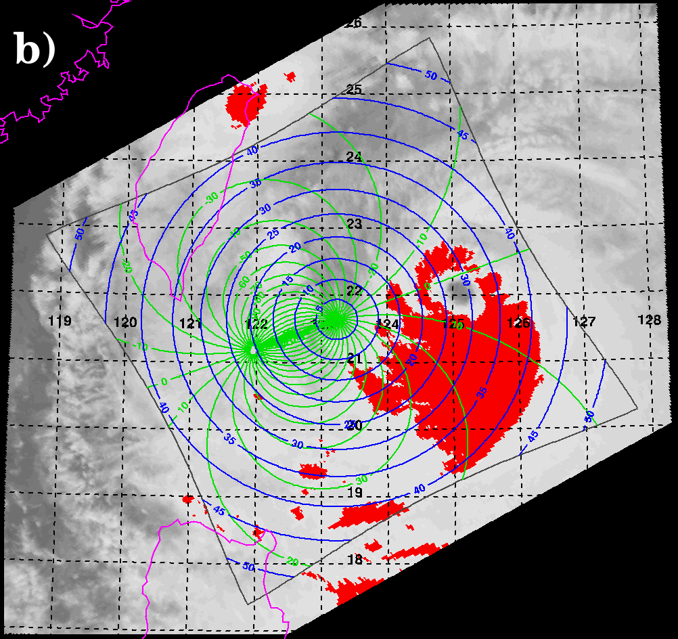
Methodology
Use VIRS (also on TRMM with LIS) 11 µm channel to identify DCCs (TB > 205K)
Identify colocated LIS Background (BG) pixels (SZA < 40°,VZA < 40°, and 10° < RAA < 170°)
Analyzed each July and August from 1998-2010
Used previously identified DCC database and examined DCC radiance for pixels with and without associated lightning activity (lightning within 10 km)

Slide 5
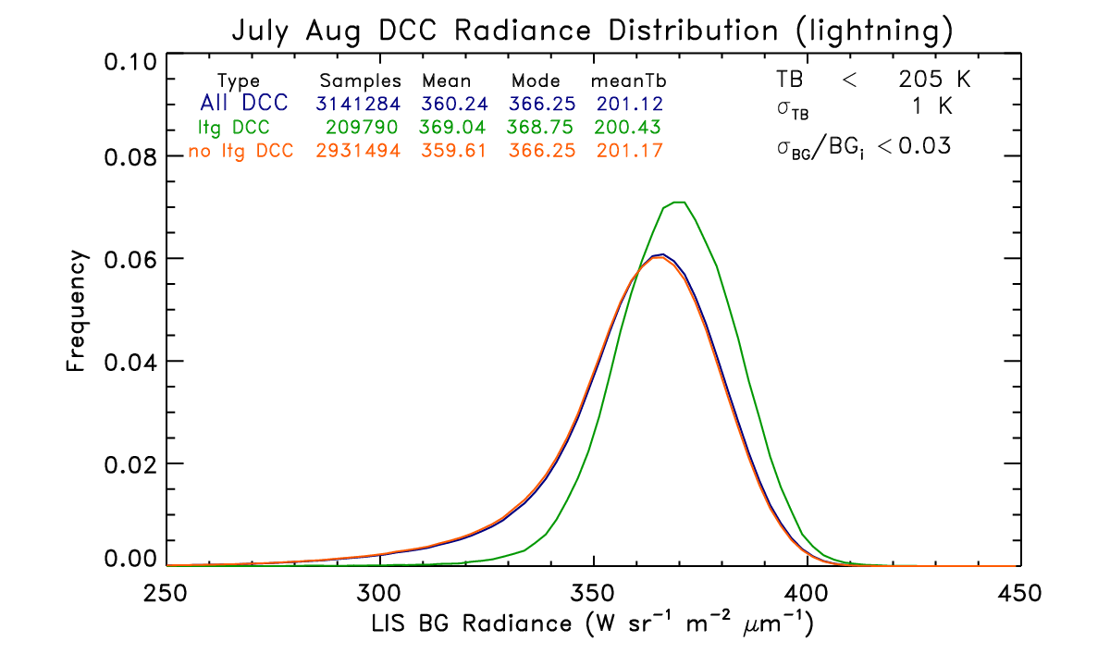
Results
Using lightning criteria narrowed the distribution and helped reduce the dark tail
The DCC with lightning are brighter than those without
Reduced the number of DCCs by 93% of all DCCs

Slide 6
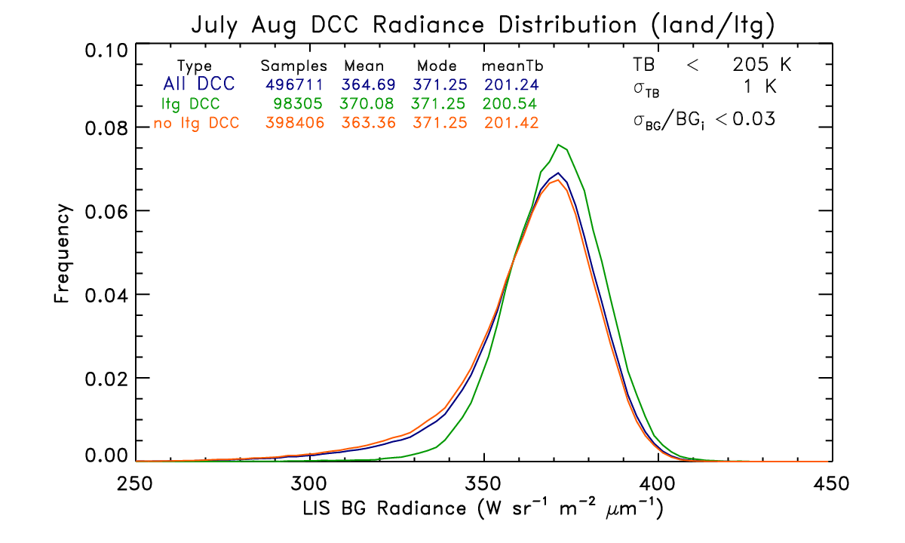
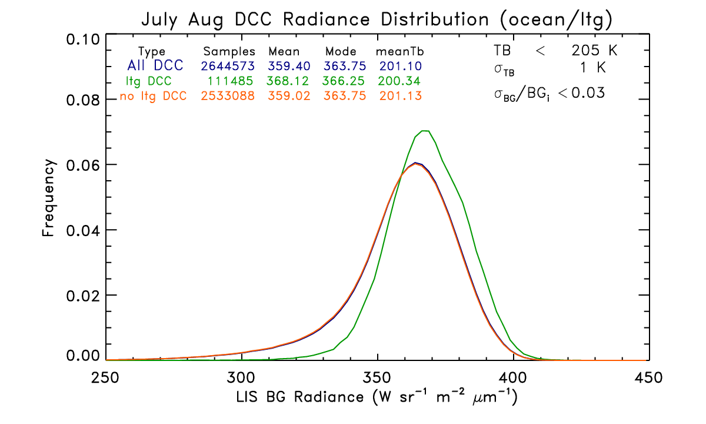
Results: Land vs Ocean
20% of land DCCs have lightning activity within 10 km
Only 4% of oceanic DCCs have lightning activity within 10 km
Both land and oceanic DCC radiance distributions are sharpened, more so for land DCC than the ocean DCC
Land DCCs are brighter than oceanic DCCs for with and without lightning cases
The VIRS TB is colder for lightning cases for both land and ocean DCC

Slide 7
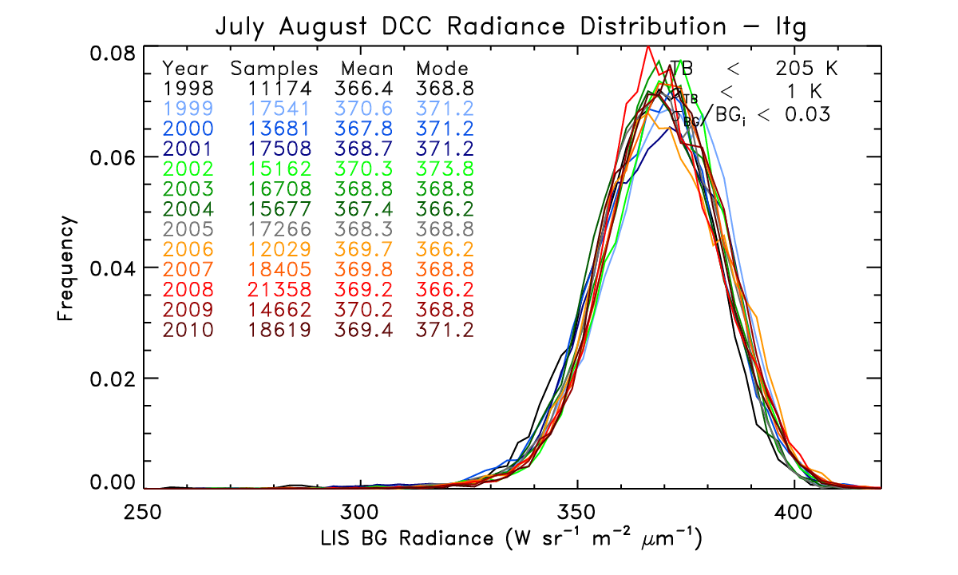
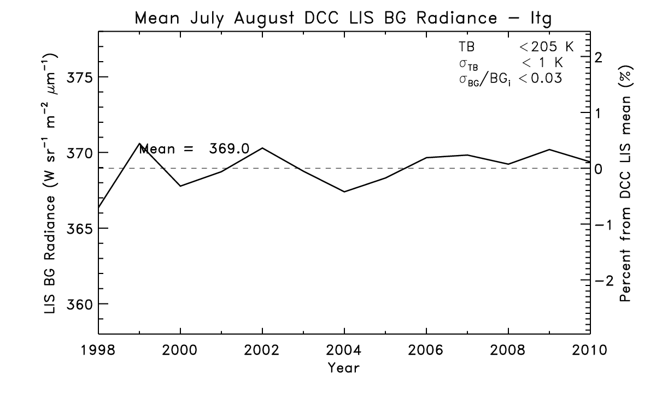
Results: Yearly LIS DCC Radiance (LTG)
Yearly distribution of LIS BG DCCs with lightning activity are consistent from year to year
Distributions noisy due to low number of samples each year
The yearly mean DCC radiance (with lightning) exhibits little year to year variation (similar to results when all or no lightning DCC cases are considered)

Slide 8
Summary and Conclusions
Yes, using lightning data to refine DCC sharpens the radiance distribution
Number of DCCs with lightning is about 93% of all DCCs
The yearly change in DCC radiance is very similar whether lightning occurs nearby or not
May or may not be useful- depends on application
These results used DCC identified using VIRS TB
This showed that lightning data could narrow distribution- can DCC be identified using lightning data alone?

Slide 9
Other?
See if results are similar for VIRS DCC associated with lightning

