Slide 1
Introduction to Mini Conference & GSICS
Special Issue of the IEEE TGRS on “Inter-Calibration of Satellite Instruments”:
Special Issue of the IEEE TGRS on “Inter-Calibration of Satellite Instruments”:
Tim Hewison
(EUMETSAT) (GRWG Chair)

Slide 2
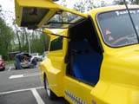
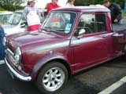
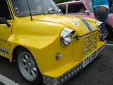
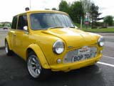
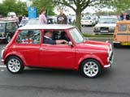
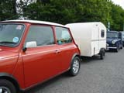
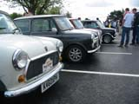
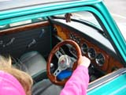
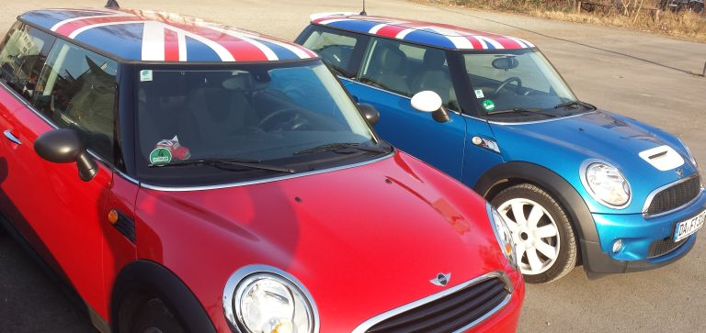
Not that sort of Mini Conference ☹

Slide 3
Global Space-based Inter-Calibration System
What is GSICS?
Global Space-based Inter-Calibration System
Initiative of CGMS and WMO
Effort to produce consistent, well-calibrated data from the international constellation of Earth Observing satellites
What are the basic strategies of GSICS?
Improve on-orbit calibration by developing an integrated inter-comparison system
Initially for GEO-LEO Inter-satellite calibration
Being extended to LEO-LEO
Using external references as necessary
Best practices for calibration & characterisation
This will allow us to:
Improve consistency between instruments
Reduce bias in Level 1 and 2 products
Provide traceability of measurements
Retrospectively re-calibrate archive data
Better specify future instruments
EUMETSAT | CNES | JMA
NOAA | CMA | KMA
ISRO | NASA | WMO
USGS | NIST | JAXA
ROSHYDROMET | IMD | ESA
Notes:
3
Well, what is GSICS?
The Global Space-based Inter-Calibration System (GSICS) is an initiative of CGMS and WMO, which aims to ensure consistent calibration and inter-calibration of operational meteorological satellite instruments.
One of the basic strategies of GSICS is to develop an integrated on-orbit cal/val system - initially by LEO-GEO Inter-satellite/inter-sensor calibration.
This will then allow us to provide corrections to improve the consistency between instruments, produce less biased level 1, and therefore, level 2 data, and ultimately, retrospectively re-calibrate archive data, which is of great interest in the climate monitoring community

Slide 4
GSICS Principles
Systematic generation of inter-calibration products
for Level 1 data from satellite sensors
to compare, monitor and correct the calibration of monitored instruments to community references
by generating calibration corrections on a routine operational basis
with specified uncertainties
through well-documented, peer-reviewed procedures
based on various techniques to ensure consistent and robust results
Delivery to users
Free and open access
Adopting community standards
To promote
Greater understanding of instruments’ absolute calibration, by analysing the root causes of biases
More accurate and more globally consistent retrieved L2 products
Inter-operability for more accurate environmental, climate and weather forecasting products
TRACEABILITY / UNBROKEN CHAINS OF COMPARISONS

Slide 5
GSICS Organisation
CGMS
WMO
GSICS Exec Panel
GSICS Coordination Center
GSICS Research Working Group
GSICS Data Working Group
VIS/NIR Sub-Group
Microwave Sub-Group
UV Sub-Group
Future Sub-Groups...
WGCV IVOS
WGCV MWSG
GPM X-CAL
WGCV ACSG
CEOS ACC

Slide 6
GSICS User Community
Satellite Application Community
CDR generation for climate monitoring “SCOPE-CM” framework, national/international programs WCRP/GEWEX/ISCCP - (Planned beta-testing of GEO GSICS Corrections)
Reanalysis community for climate modelling (ECMWF reanalysis – 2012/15)
Operational NWP: direct radiance assimilation
Other users interested in accurate/consistent calibration to generate stable (composite) L2 quantitative products or imagery
Satellite Operators
Prelaunch instrument characterization guidelines
Cal/Val Plans
Best practices for instrument monitoring and improved calibration

Slide 7
GSICS Products
GSICS Bias Monitoring
Routine comparisons of satellite radiances against reference
GSICS Correction
Function to correct issued radiances
For consistent calibration with reference
GSICS Reports & Guidelines
Recommendations to modify practices
Design and Operation of future satellite instruments
For Operational Environmental Satellites
✓ Infra-red recalibration (GEO and LEO) ✓ Pre-Operational & Demo status
(current operational satellites) ✓ Near real-time and re-analysis
✓ Visible and near-infrared recalibration (GEO and LEO) ✓ In development within GSICS
✓ Microwave – Conical & Cross-track Scanners (LEO) ✓ In development with GPM XCAL
✓ Historic Instruments ✓ In development at EUMETSAT…

Slide 8
GSICS Products: (1/3) Bias Monitoring
x_{MON}
Comparing samples of x_{MON} , x_{REF}
− Over fixed domain
− Period (e.g. 1 orbit/1 day)
− Typically ~ 1000 comparable samples/day
Regression
Calc bias, ∆x=x_{MON}-x_{REF}
− ∆x at standard scene, x_{STD}
− with uncertainty
Plot time series of bias ∆x
− Compare recent results with long-term trend
− Valuable for instrument monitoring
∆x
x_{STD}
x_{REF}
∆x
t
Notes:
8

Slide 9
Example of GSICS Bias Monitoring
From EUMETSAT: Time Series of Meteosat-10/SEVIRI-IASI
Standard Biases [K]
Interactive plotting tool under development

Slide 10
GSICS Products: (2/3) GSICS Correction
Compare all x_{REF} , x_{MON} samples
− over smoothing period (e.g. 2 weeks)
Regression coefficients
with uncertainty (covariance)
Provide a function users can apply
to convert level 1 data, x_{MON}
to be consistent with calibration of reference, x_{REF}
Two versions:
Near Real-Time (asymmetric time window)
Re-Analysis (symmetric time window)
x_{MON}
GSICS Correction function
x_{REF}
Notes:
10

Slide 11
GSICS Products: (3/3) Guidelines
Underlying assumption of GSICS Correction:
Small errors (e.g. SRF errors, blackbody temperature, ...) introduce small departures from ‘true’ calibration
If these are linearly related to a predictor (radiance, time, ...) we can apply empirical correction based on inter-calibration
Guidelines can analyse GSICS products
to diagnose root causes of calibration errors
Can derive recommendations to modify
operating practices (e.g. adopt new SRF definition),
pre-launch characterisation, etc.
These GSICS Guidelines are distributed as written reports

Slide 12
GSICS Procedure for Product Acceptance
Based on QA4EO
Products progress from
Demonstration Mode
Through
Pre-Operational Mode
To
Operational Mode
By a series of reviews
Over period of ~1.5yr
Subject to meeting acceptance criteria

Slide 13
GSICS Product Status 2014-03
GPRC | Monitored Instrument | Reference Instrument | GSICS NRT Correction | GSICS Re-Analysis Correction | GSICS Bias Monitoring
EUMETSAT | Meteosat-8 – 10 } Meteosat-7 | Metop-A/IASI | Pre-operational | Pre-operational | Prototype
JMA | MTSAT-1R } MTSAT-2 } | IASI (+ AIRS) | Demonstration | Demonstration | Prototype
NOAA | GOES-13 & -15 Imager GOES-11 & -12 Imager | IASI (+ AIRS) | Pre-operational | Pre-operational Demonstration | Prototype
 | GOES Sounder | IASI (+ AIRS) | In development | In development | In development
CMA | FY2C – E | IASI (+ AIRS) | In development | In development | Prototype
NOAA | AMSU/MSU | NOAA14/AMSU | In development | Pre-Operational | In development
NOAA Patmos-X | TIROS-N – NOAA – Metop /AVHRR | Aqua/MODIS | - | Demonstration | -
Full GSICS Product Catalog available at http://www.star.nesdis.noaa.gov/smcd/GCC/ProductCatalog.php

Slide 14
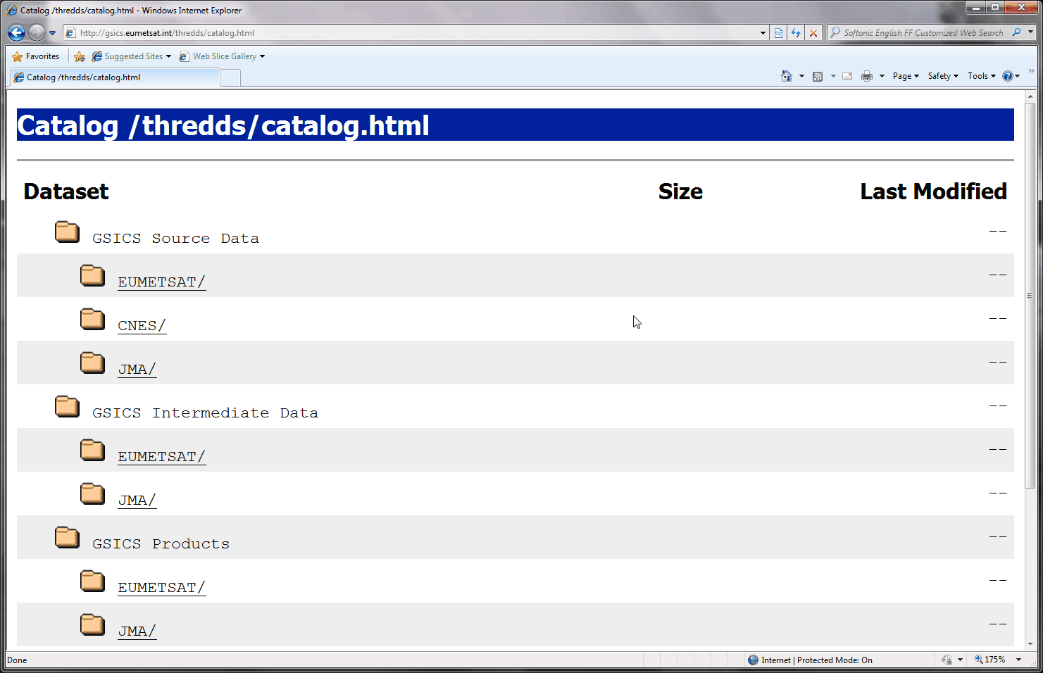
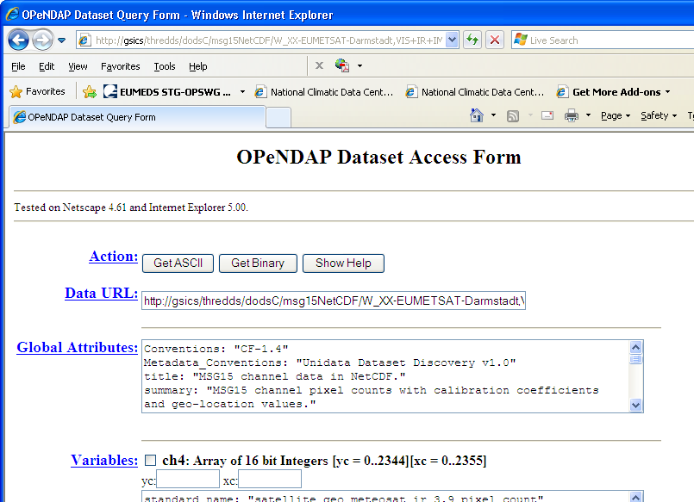
Where to get the data?
GSICS Bias Monitoring (prototype)
Hosted on websites of GSICS Processing & Research Centres (GPRCs)
GSICS Corrections
− GSICS Data & Products Servers
− THREDDS-based system
− NetCDF format
− WMO GTS standard file names
− Unidata & CF conventions
See gsics.wmo.int for links
GTS = Global Telecommunication System
CF = Climate and Forecast

Slide 15
Conclusions
GSICS is maturing into a system for generating inter-calibration products
suitable for integrating into operational processing
First products soon to be declared operational
Continuing to develop new inter-calibration products
While cooperating with related activities
To integrate GSICS into WIGOS
To support Architecture for Climate Monitoring from Space
Today: Examples of potential future activities & interactions
Rest of the Week: Focusing on the development of GSICS products

Slide 16
Thank You
Notes:
16

Slide 17
Agenda for GSICS Mini Conference
8:30 | Tim Hewison | EUMETSAT | Introduction to Mini Conference & GSICS | 1a | 0:20
8:50 | Jo Schmetz | EUMETSAT | Welcome to EUMETSAT | 1b | 0:20
9:10 | Ruediger Lang | EUMETSAT | GOME2 as hyperspectral reference for MSG & AVHRR | 1c | 0:20
9:30 | Fangfang Yu | NOAA | GOES Imager lunar calibration: Angular variation of the scan mirror reflectivity | 1d | 0:20
9:50 | Scott Hu | CMA | FY-3C/MERSI characterization evaluation based on CMA GISCS platform at early time on orbit | 1e | 0:20
10:10 | Coffee Break |  |  |  | 0:30
10:40 | Rob Roebeling | EUMETSAT | VIS/NIR recalibration of Heritage Instruments | 1f | 0:20
11:00 | Marc Schroeder | DWD (CMSAF) | Free Tropospheric Humidity from Ring of Geostationary Satellites | 1g | 0:20
11:20 | Anne O'Carroll | EUMETSAT | AVHRR-IASI & AATSR/SLSTR | 1h | 0:20
11:40 | Rob Roebeling | EUMETSAT | Status of SCOPE-CM inter-calibration projects (IOGEO and AVHRR FCDR) | 1i | 0:20
12:00 | Marc Schroeder | DWD (CMSAF) | FCDR from SSM/I | 1j | 0:20
12:20 | Lunch Break |  |  |  | 1:00
Paste Agenda here!

Slide 18
Agenda for GSICS Mini Conference
13:20 | Tim Hewison for Jerome Lafeuille | WMO | Exec Panel Report & GSICS Vision | 1k | 0:20
13:40 | Pepe Philips | EUMETSAT | METimage calibration concepts | 1l | 0:20
14:00 | Thierry Marbach | EUMETSAT | 3MI calibration concepts | 1m | 0:20
14:20 | Ewa Kwiatkowska | EUMETSAT | Ocean Colour Instrument Calibration | 1n | 0:20
14:40 | Sebastien Wagner | EUMETSAT | EUMETSAT's Lunar Calibration Capabilities | 1o | 0:20
15:10 | Coffee Break |  |  |  | 0:30
15:40 | Nigel Fox | NPL | TRUTHS | 1p | 0:20
16:00 | Dave Doelling for Bruce Wielicki | NASA | CLARREO Update | 1q | 0:20
16:20 | Xavier Calbet | EUMETSAT | GRUAN - SAT v RAOB+RTM | 1r | 0:20
16:40 | Nigel Fox | NPL | CEOS WGCV IVOS - GSICS Interactions | 1s | 0:20
17:00 |  |  | Discussion | 1t | 0:20
17:20 | END
Paste Agenda here!

Slide 19
Notes to speakers
Please follow file naming convention: 1a_Hewison_Introduction.pptx/pdf/ppt
Presentations will be uploaded to the GSICS Wiki
Unless you tell me not to
Each slot is strictly 20min
Please leave at least 5min for questions
I will give a warning after 13min
Thank you!

