Slide 1
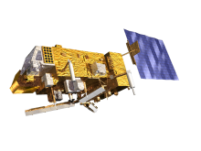

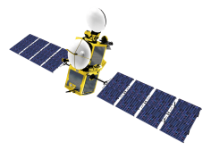
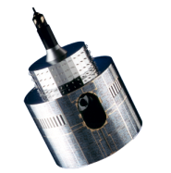
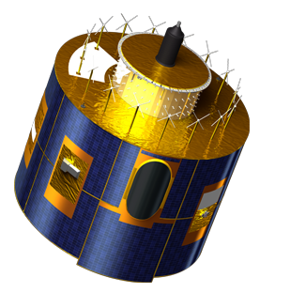
Welcome to the
GSICS Annual meeting
held at EUMETSAT
24 -28 March 2014
Johannes Schmetz
EUMETSAT
Notes:
EUM/STG-SWG/36/14/VWG/15

Slide 2
Content of Talk
Some important ‘events’ on Meteosat and Metop in the last year
The beginning of GSICS => It has been greatly evolved since the early start
Meteosat Third Generation (MTG)
EUMETSAT Polar System – Second Generation (EPS-SG) ; i.e. METOP – follow-on

Slide 3
Selected Highlights from 2013
Meteosat-10 is prime geostationary satellite at 0°
Meteosat-9 at 9.5° E => rapid scan service (5 min)
Meteosat- 8 at 3.5°E => back-up
Super-rapid scan tests with Meteosat-8, an innovation with a view toward MTG (not operational): 2.5 min scans
Both Metop-A and Metop-B are in operational mode (48 mins apart)
=> positive impact on NWP
Examples for improvements of products: Winds (AMVs) from the two Metop satellites, tandem operations of two GOME-2instruments
Meteosat Third Generation: Workshop on the use of the hyperspectral geostationary sounder (IRS) for Nowcasting

Slide 4
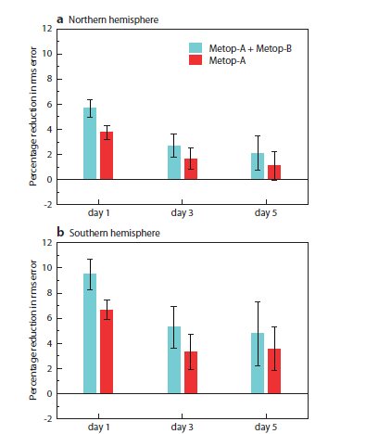
Metop dual operation => beneficial impact on NWP
Impact of adding Metop-A and Metop-B to the baseline data assimilation system
Percentage reduction in rms error of the 500 hPa geopotential heights at days 1, 3 and 5
for Northern and Southern hemisphere
Error bars show the 95% confidence interval representing statistical significance
Healy, English et al., (2013), ECMWF Newsletter No. 137

Slide 5
Roots of GSICS – CGMS 25 in 1997 in St. Petersburg
Action 25.29 - Each CGMS operator to commence satellite intercalibration activities and to identify a coordinator for such activity before CGMS XXVI.
=> Closing of action:
EUMETSAT, NOAA/NESDIS, JMA and PRC commenced intercalibration activities. ….
coordinators selected from NOAA, EUMETSAT, Russia (Roshydromet), China (CMA), Japan (JMA) and India (IMD).
Action 25.30: All CGMS satellite operators to request an AVHRR data set with the assistance of NOAA/NESDIS, for cross-calibration with their geostationary satellite, by 31 October 1997 and NOAA/NESDIS to provide the data on request.
Closing of action: … papers from NOAA, JMA, CMA and EUMETSAT
CGMS-26 in 1998 featured a paper: ‘Program for the Intercalibration of GMS, GOES and Meteosat versus HIRS and AVHRR IR Radiances’
(Working paper USA-WP-21: Lead author Paul Menzel from NOAA)

Slide 6
Formal beginning of GSICS reported in Nature, 2007
Plans forge ahead for better weather monitoring
by Quirin Schiermeier in NATURE, Vol 447, 24 May 2007
Quote:
‘Meeting last week in Geneva, the World Meteorological Organization announced plans for a Global Spacebased Inter-Calibration System (GSICS). The initiative will ask national satellite agencies to take steps to ensure better comparability of satellite measurements made by different instruments and satellites, and to tie these measurements to absolute references.’
Activity since then led by Mitch Goldberg, NOAA as Chair;
Key support from WMO, Jerome Lafeuille.

Slide 7
Meteosat Third Generation (MTG) In-Orbit Configuration
=> An imaging and a sounding satellite
  Payload of MTG-I:
  Flexible Combined Imager (FCI)
  Lightning Imager (LI)
  Data Collection System (DCS) and Search and Rescue (GEOSAR)
  Payload of MTG-S:
    Infrared Sounder (IRS)
    Ultra-violet, Visible and Near Infrared Sounder (UVN).
    (UVN is provided as GMES Sentinel 4 Instruments)
MTG-I Imaging Satellite
MTG-S Sounding Satellite

Slide 8
MTG Provides a Total of Five Missions
FCI - Full Disk Scan Service (FCI-FDSS), global scales (Full Disk) RC = 10 min, with 16 channels at spatial resolution of 1 km (8 solar channels) and 2 km (8 thermal channels)
FCI - Rapid Scan Service (FCI-RSS), local scales (1/4th of Full Disk) RC = 2.5 min with 4 channels at high spatial resolution 0.5 km (2 solar channels), and 1.0 km (2 thermal channels)
    IRS => Repeat Cycle : 15 min per 1/4th of Full Disk; Spatial resolution : 4 km, spectral sampling at 0.625 cm⁻¹;
  Two bands: Long-Wave-IR 700 – 1210 cm⁻¹ ~ 820 spectral samples Mid-Wave-IR 1600 – 2175 cm⁻¹ ~ 920 spectral samples
LI, continuously observing 80% of Full Disk: Integration Time~1.5ms detection/mapping of Intra-Cloud and Cloud-Ground strokes at ~10km spatial resolution DE=90% (night) and DE=40% (overhead sun)
UVN Sounding, implemented as GMES Sentinel 4 Instruments provided by ESA

Slide 9
MTG Programme Status
MTG-I Satellite:
  schedule is stable with FAR (Flight Acceptance Review) in July 2018.
  PDR of the LI is on-going.
MTG-S Satellite
  Most probable date for the MTG-S FAR is January 2021
  Closure of the MTG-S PDR : October 2013
  Closure of the S-4 PDR : November 2013

Slide 10
Calibration / Inter-calibration (GSICS) contributions to MTG/FCI
Many new challenges to tackle
  Three-axis stabilised platform
  Many new bands in the VIS/NIR ➔ 8 solar channels (VIS04 / VIS05 / VIS06 / VIS08 / VIS09 / NIR13 / NIR16 / NIR22)
  Large arrays of detectors ➔ How to equalize? How to define homogeneous targets for the vicarious calibration?
  Stricter requirements on radiometric accuracy:
    VIS/NIR:
      5% (FDHSI) / 10% (HRFI) for NRT services (whereas MSG/SEVIRI has 10% requirement)
      2% yr⁻¹ long-term stability
    IR:
      0.7K (FDHSI) / 1K (HRFI) for NRT services
      0.3K yr⁻¹ long-term stability
  Calibration:
    On-board calibration for VIS/NIR ➔ Metallic Neutral Density Filter (MND)
    Back bodies for IR
Notes:
FDHSI = Full Disc High Spectral resolution Imagery mission
HRFI = High Resolution Fast Imagery mission

Slide 11
Calibration / Inter-calibration (GSICS) contributions to MTG/FCI
Plans for calibration / inter-calibration activities on MTG/FCI
VIS/NIR:
  Lunar calibration: successfully applied to SEVIRI (Met-8, -9 and -10) and MVIRI (Met-7)
  Improving the current vicarious calibration system SSCC to meet new requirements
  Inter-calibration using Deep Convective Clouds as transfer targets: currently applied to Met-9
  Implementing new methods as developed by the GSICS Research Working group
    Development of a calibration monitoring facility for monitoring the instrument(s) between MND calibrations + monitoring the MND degradation
IR:
  Inter-calibration by SNOs with respect to IASI
  Implementing new methods as developed by the GSICS Research Working group

Slide 12
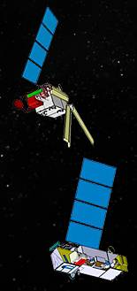
EPS-SG (Second Generation) Payload
Satellite-A Missions | Instrument (and Provider) | Predecessor on Metop
Infrared Atmospheric Sounding (IAS) | IASI-NG (CNES) | IASI (CNES)
Microwave Sounding (MWS) | MWS (ESA) | AMSU-A (NOAA) MHS (EUM)
Visible-infrared Imaging (VII) | METImage (DLR) | AVHRR (NOAA)
Radio Occultation (RO) | RO (ESA) | GRAS (ESA)
UV/VIS/NIR/SWIR Sounding (UVNS) | Sentinel-5 (GMES, ESA) | GOME-2 (ESA)
Multi-viewing, -channel, -polarisation Imaging (3MI) | 3MI (ESA) | -/-
Satellite-B Missions | Instrument (and Provider) | Predecessor on Metop
Scatterometer (SCA) | SCA (ESA) | ASCAT
Radio Occultation (RO) | RO (ESA) | GRAS (ESA)
Microwave Imaging for Precipitation (MWI) | MWI (ESA) | -/-
Ice Cloud Imager (ICI ) | ICI (ESA) | -/-
Advanced Data Collection System (ADCS) | Argos-4 (CNES) | A-DCS

