Slide 1
GOME-2 hyper-spectral reflectance measurements: Inter-comparison with AVHRR and Seviri
Rűdiger Lang, Rose Munro, Antoine Lacan, Christian Retscher, Gabriele Poli, Michael Grzegorski, Andriy Holdak, Rasmus Lindstrot and Jörg Ackermann

Slide 2
Outline
Comparison GOME-2 / Metop-A channel 3/4
with AVHRR / Metop-A channel 1
Impact of GOME-2 / Metop-A degradation
Preliminary comparison GOME-2 / Metop-B channel 3/4
with Seviri / MSG-3 channel 1

Slide 3
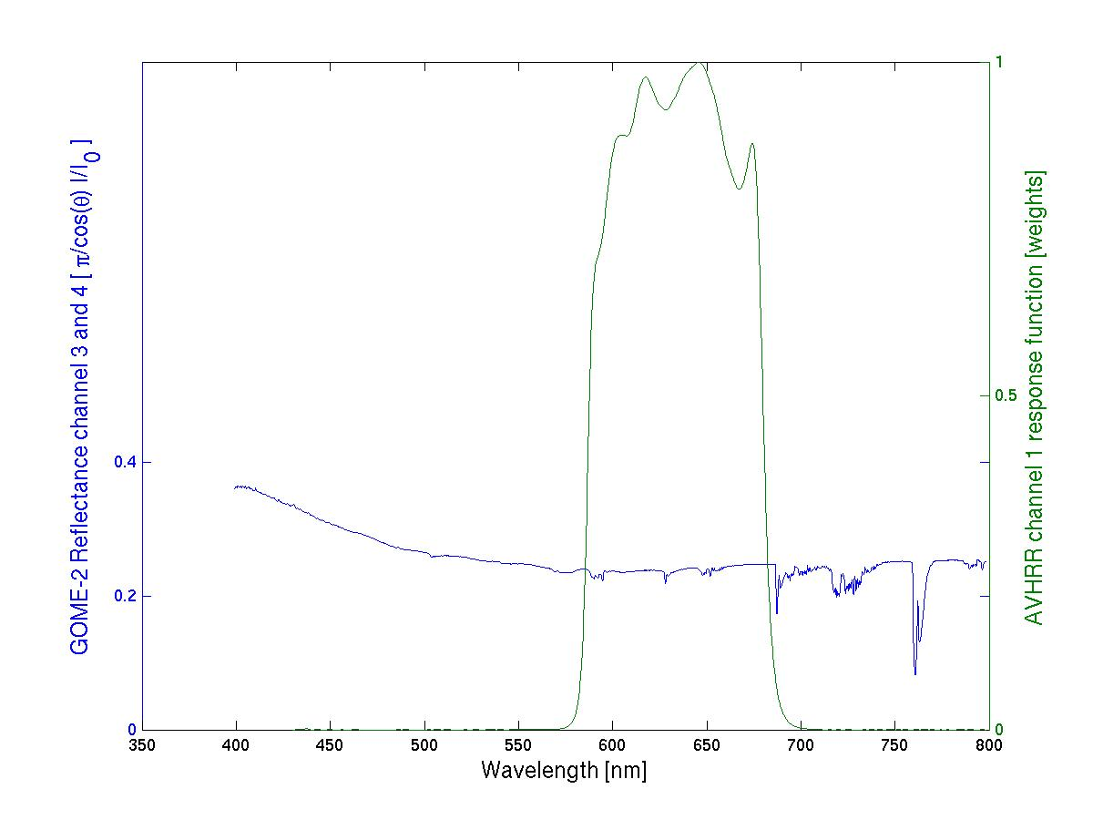
GOME-2/AVHRR reflectivity inter-calibration
AVHRR ch 1/ Metop-A
GOME-2 FM3 Metop-A
AVHRR ch1
response function
GOME-2 Ch:4 (Band 6)
1024 measurements
GOME-2 Ch:3 (Band 5)
1024 measurements

Slide 4
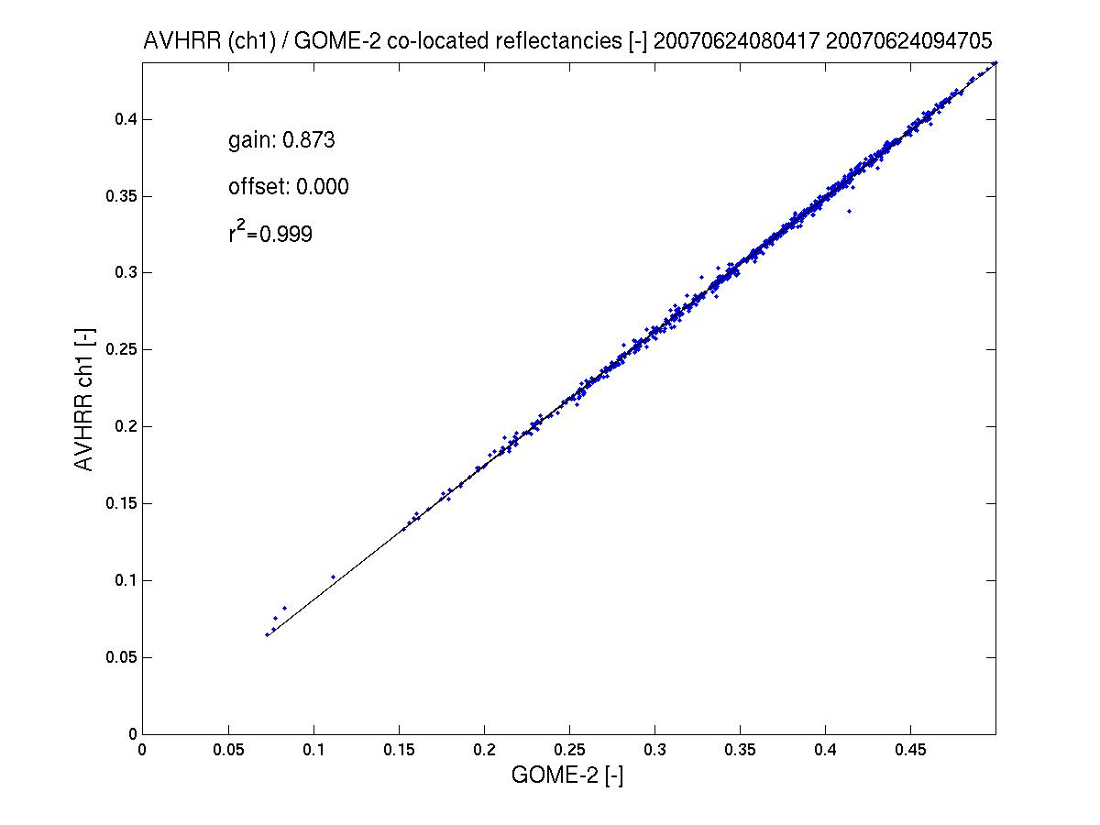
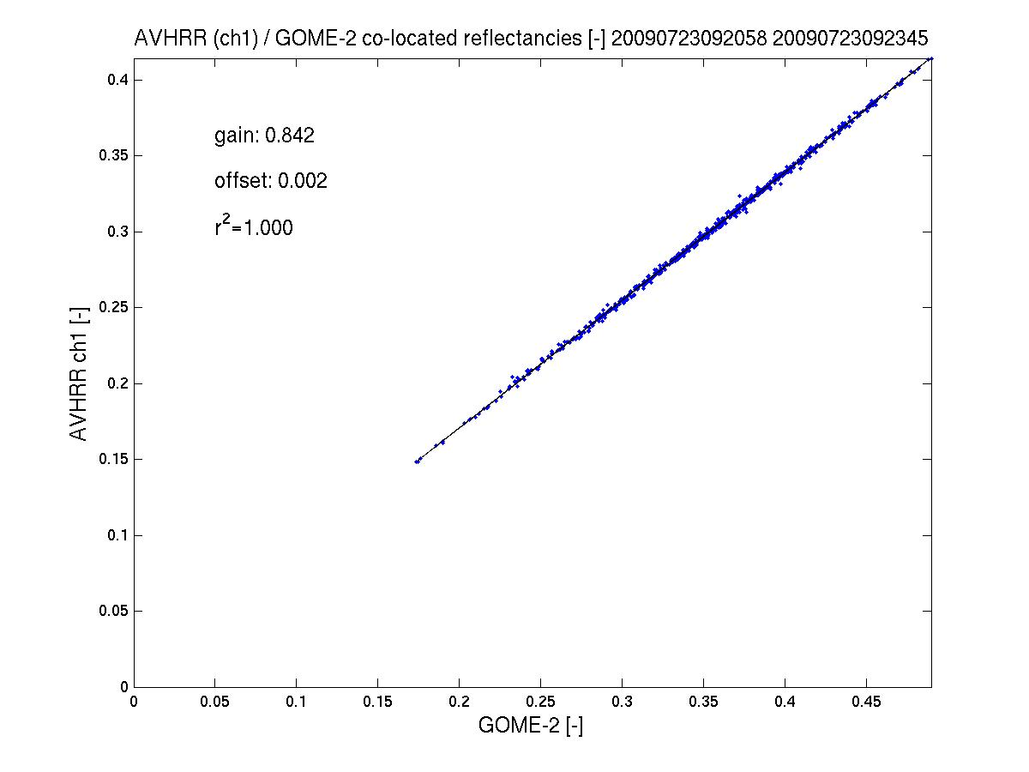
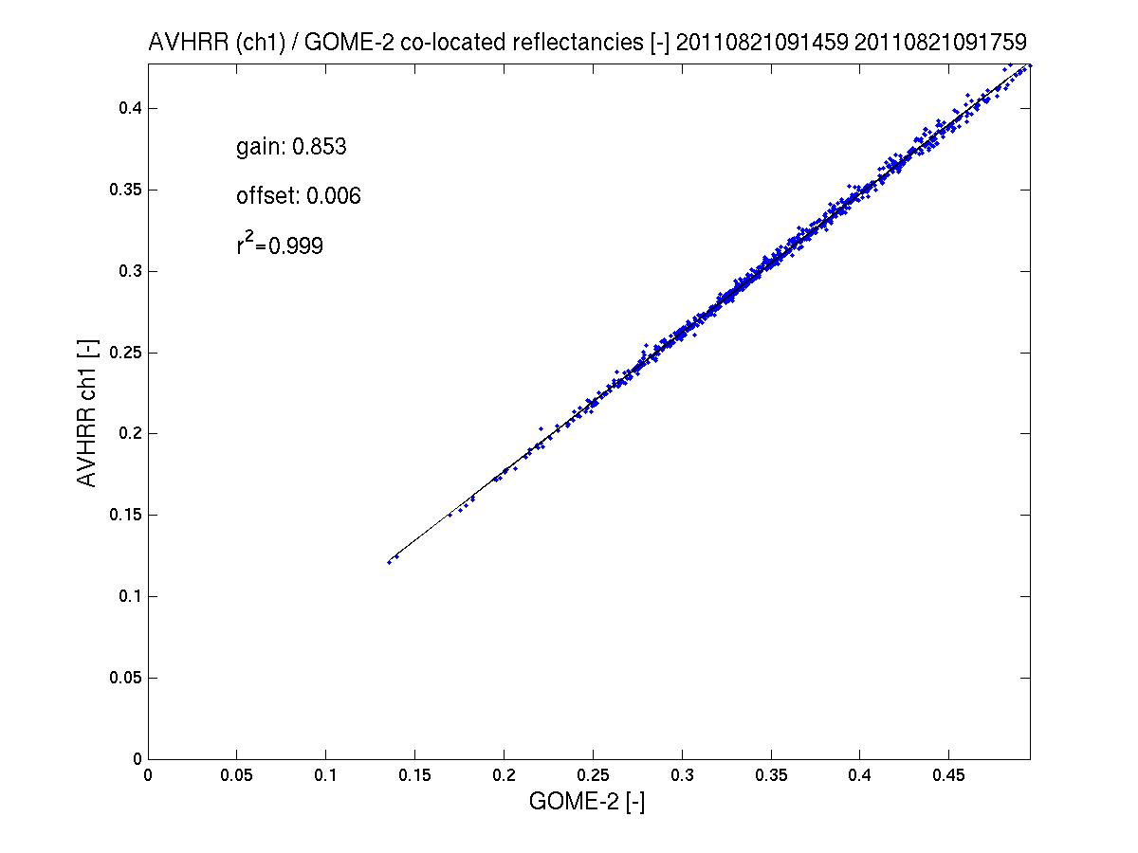
GOME-2 / AVHRR reflectivity inter-calibration
AVHRR ch 1/ Metop-A
GOME-2 FM3 Metop-A
AVHRR channel 1 to GOME-2/Metop-A gain in reflectivity ~10%
(AVHRR < GOME-2)
Results indicate that the gain has been quite stable from 2007 to 2011.
see GSICS Quarterly Newsletters, vol 5, number 3, Latter et al.
2011
2007
2009
spatial aliasing accounted for

Slide 5
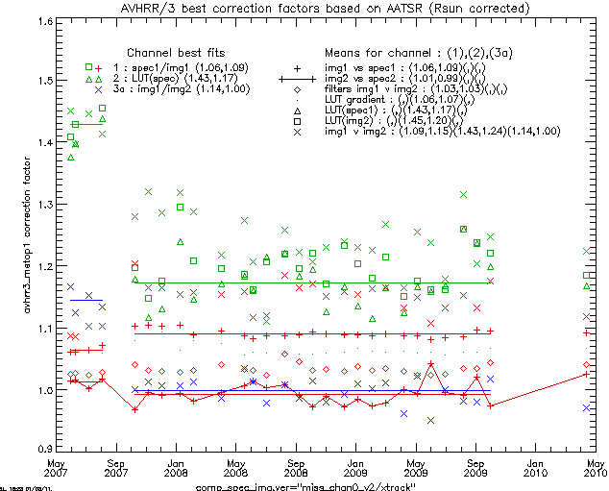
GOME-2 / AVHRR reflectivity inter-calibration
AVHRR ch1-3a / Metop-A and AATSR / Envisat
GOME-2 FM3 Metop-A
AVHRR channel 1-3a offsets in reflectivity
from
GOME-2 /Metop-A
AATSR /Envisat
Results indicate that the offset has been quite stable from 2007 to 2011.
see GSICS Quarterly Newsletters, vol 5, number 3, Latter et al.
AVHRR
Ch2
Ch1
Ch3a
Courtesy Latter et al.
Notes:
Fits shown as (pre-01Oct2007,post-01Oct 2007) as apparent change in processing (thought to be AVHRR/3). Colours indicate AVHRR/3 channel.
Corrected AVHRR/3 = scale factor * AVHRR/3(Calibrated & Rsun_corrected)
Best fit methods taken as:
CH1=scale factors(1.06,1.09) from: img1 vs spec1 (direct comparison with GOME-2 using spatial/spectral averaging)
CH2=scale factors(1.43,1.17) from: LUT(spec1) (Ice cloud properties predicted ch1/ch2 ratio, with CH1 correction applied)
CH3=scale factors(1.14,1.00) from: img1 v img2 (Comparison of AATSR vs AVHRR/3 1.6micron channel, spatially average over GOME-2 scenes)
Note 1: Due to time differences with AATSR, some scatter is expected due to scene variation, but assumed to average out over an orbit. (As the time difference is always in same sense, developing convection or burn-off of sea mist etc. may actually cause a small bias, but neglected here.)
Note 2: For CH2, the CH1 correction applied is that calculated for the same orbit, hence the increased scatter as scene changes effective impact twice (but again should average out over the orbit)
Note 3: AVHRR/3 irradiance corrected for sun-earth distance variation (not included in AVHRR/3 standard calibration)
Comments:
Diamonds (filters img1 v img2) show a bias of ~3% is expected between AVHRR/3 and AATSR if both calibrated correctly. Above (post 01Oct2007) shows AATSR 1% higher than GOME-2, AVHRR/3 9% higher than GOME-2, (i.e. 10% diff), but direct comparison suggest 15% (of which 3% attributable to filter difference (AVHRR/3 lower))
CH2 (x) img1 v img2 shows large scatter, but bands very different and strongly affected by water vapour, so not surprising.

Slide 6
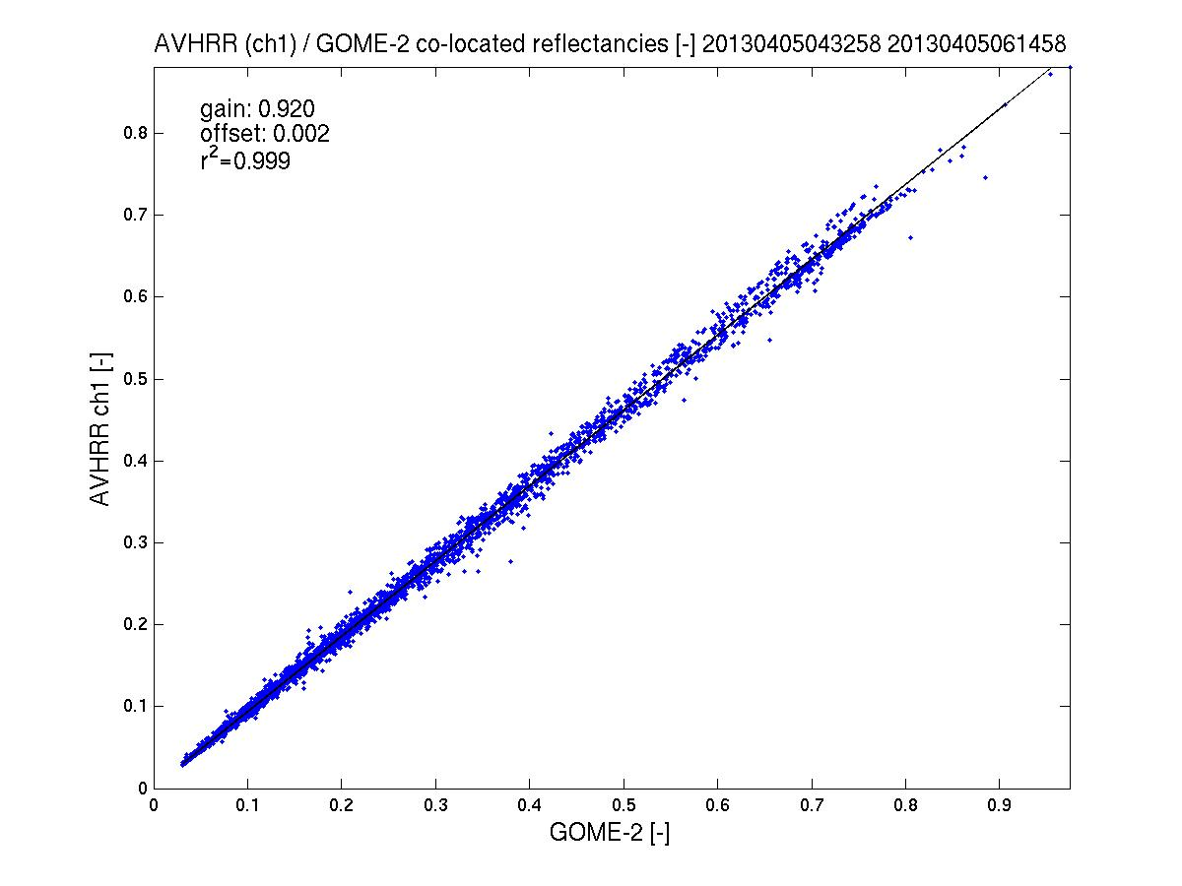
GOME-2 / AVHRR reflectivity inter-calibration
AVHRR ch 1/ Metop-A
GOME-2 FM3 Metop-A
AVHRR channel 1 to GOME-2/Metop-A gain in reflectivity <8%
(AVHRR < GOME-2)
2011 - 2013
see GSICS Quarterly Newsletters, vol 5, number 3, Latter et al.
2013
spatial aliasing accounted for

Slide 7
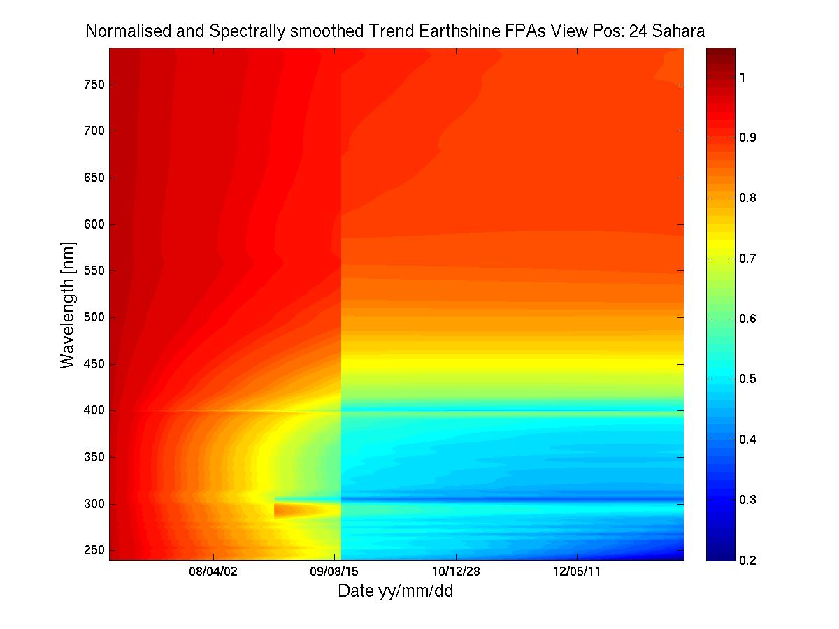
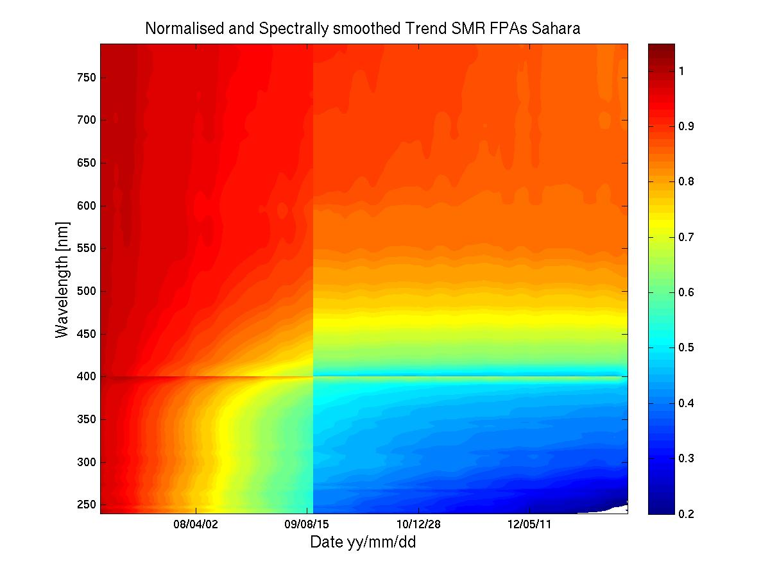
GOME-2 Metop-A degradation component modelling
Sahara – Earthshine and Solar Mean reference Degradation
GOME-2 FM3 Metop-A
Modelled Earthshine degradation
Modelled Solar Path degradation
800 nm
240 nm
Feb 2007
June 2013
Feb 2007
June 2013
R2 campaign Jan 2007– June 2013

Slide 8
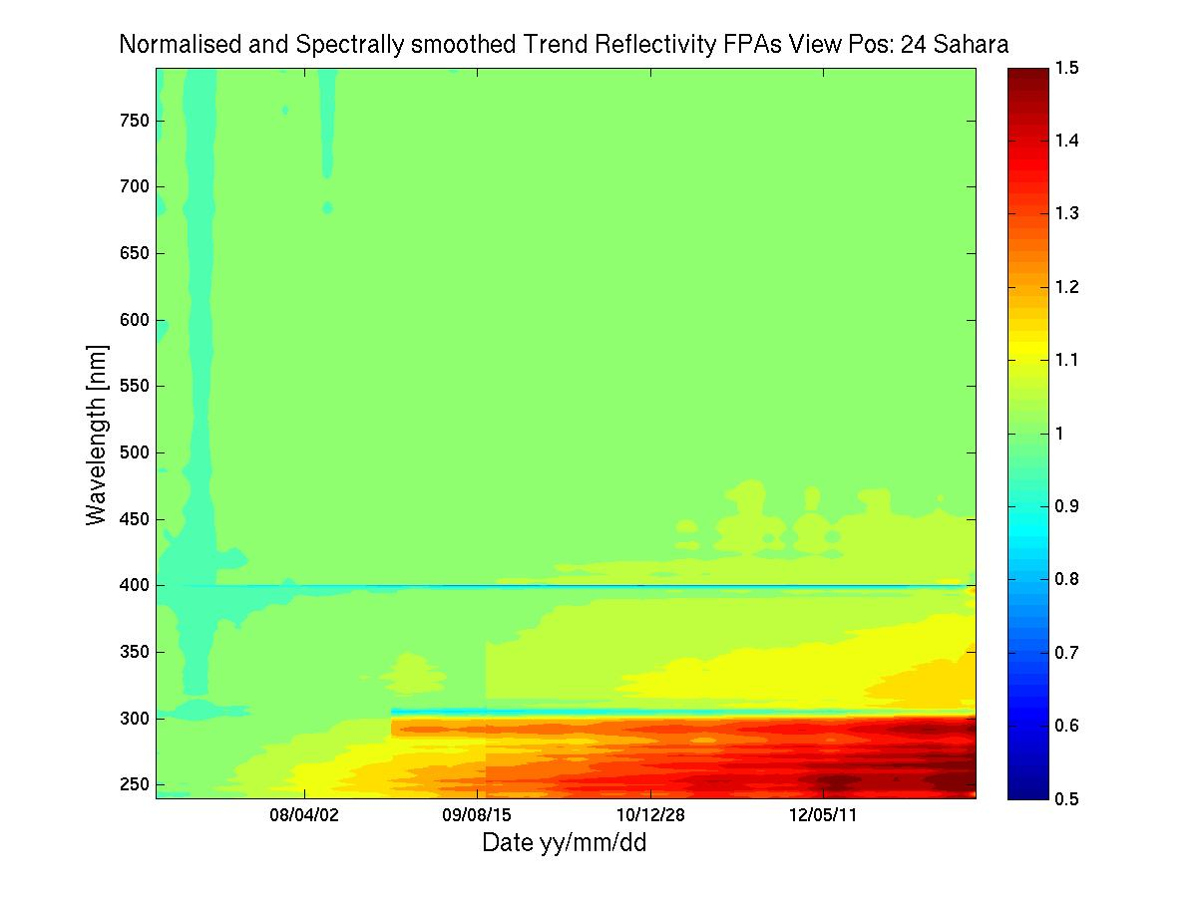
GOME-2 Metop-A degradation component modelling
Sahara – Reflectivity Degradation
GOME-2 FM3 Metop-A
800 nm
R2 campaign
Jan 2007– June 2013
Reflectance Trend
240 nm
Feb 2007
June 2013

Slide 9
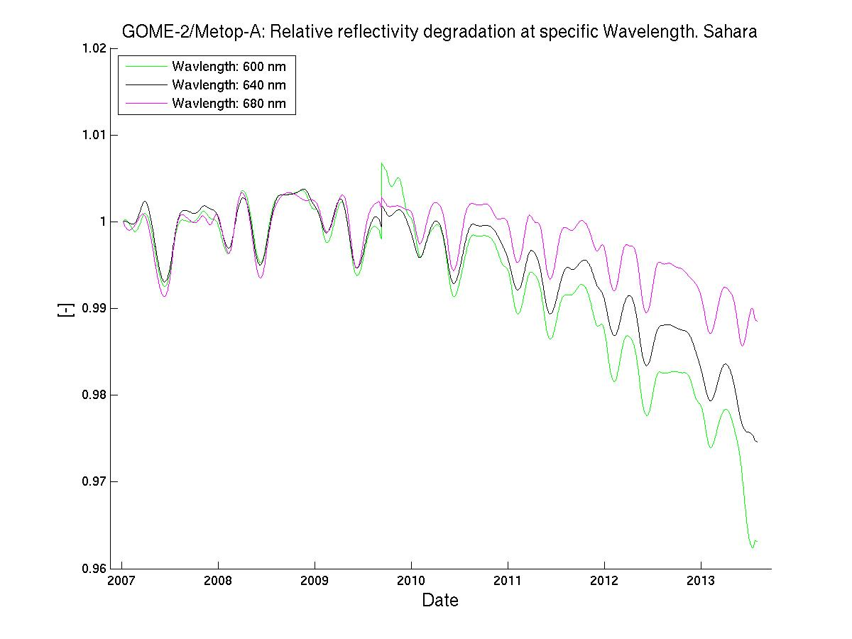
GOME-2 Metop-A degradation component modelling
Sahara – Reflectivity Degradation / AVHRR ch1-domain
GOME-2 FM3 Metop-A
R2 campaign
Jan 2007– June 2013
Reflectivtiy
Degradation
600 nm
640 nm
680 nm
Average over all
GOME-2 viewing angles

Slide 10
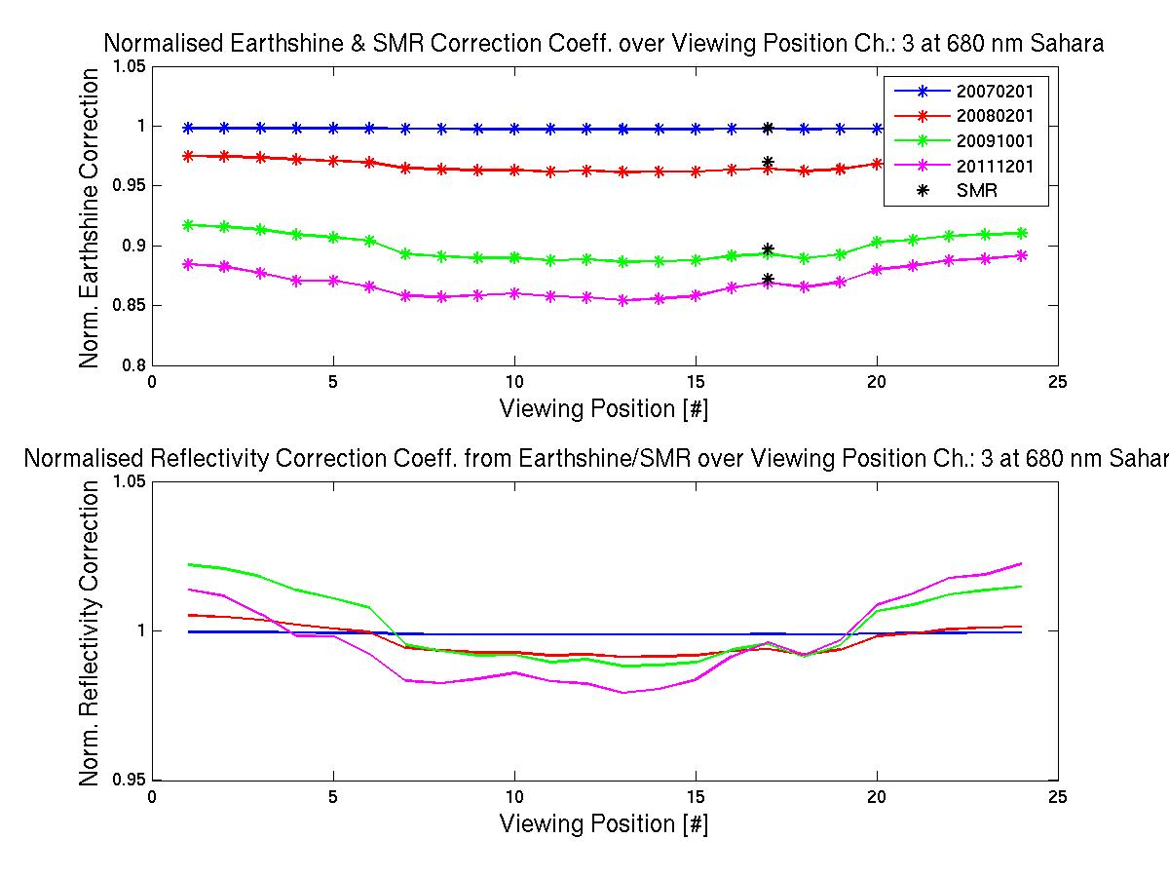
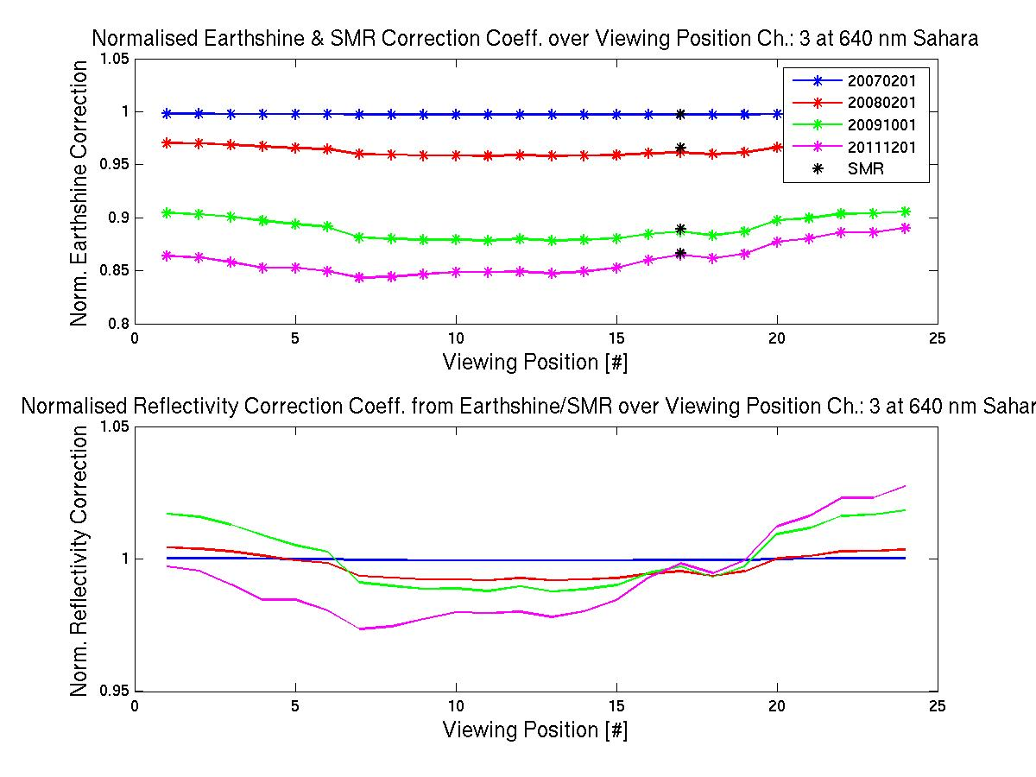
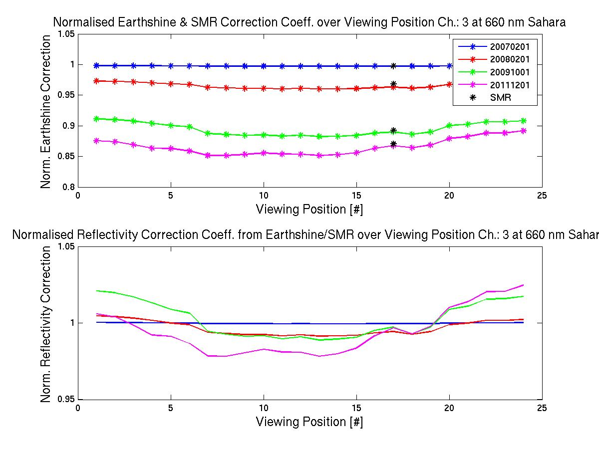
GOME-2 Metop-A degradation component modelling
Sahara – Reflectivity Degradation / AVHRR ch1-domain
GOME-2 FM3 Metop-A
R2 campaign
Jan 2007– June 2013
Reflectivtiy
Degradation
640/660/680 nm
Over all
GOME-2 viewing angles
at
2007/02/01
2008/02/01
2009/10/01
2011/12/01

Slide 11
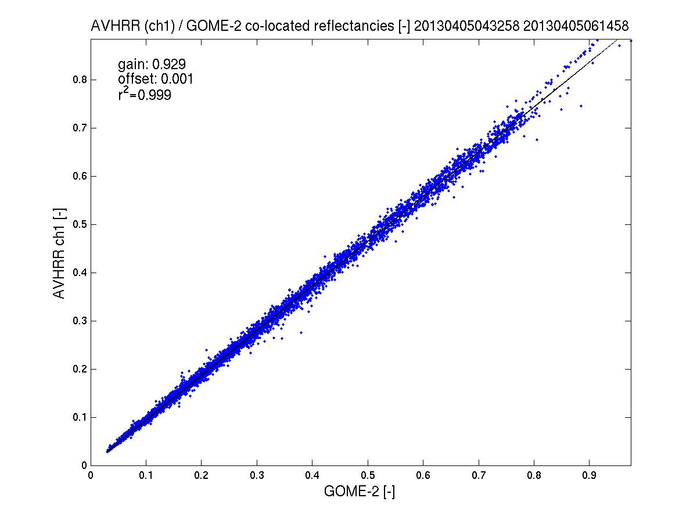
GOME-2/AVHRR reflectivity inter-calibration
AVHRR ch 1/ Metop-A
GOME-2 FM3 Metop-A
AVHRR channel 1 to GOME-2/Metop-A gain in reflectivity <8%
(AVHRR < GOME-2)
2013
Corrected /
Un-corrected
see GSICS Quarterly Newsletters, vol 5, number 3, Latter et al.
2013
spatial aliasing accounted for

Slide 12
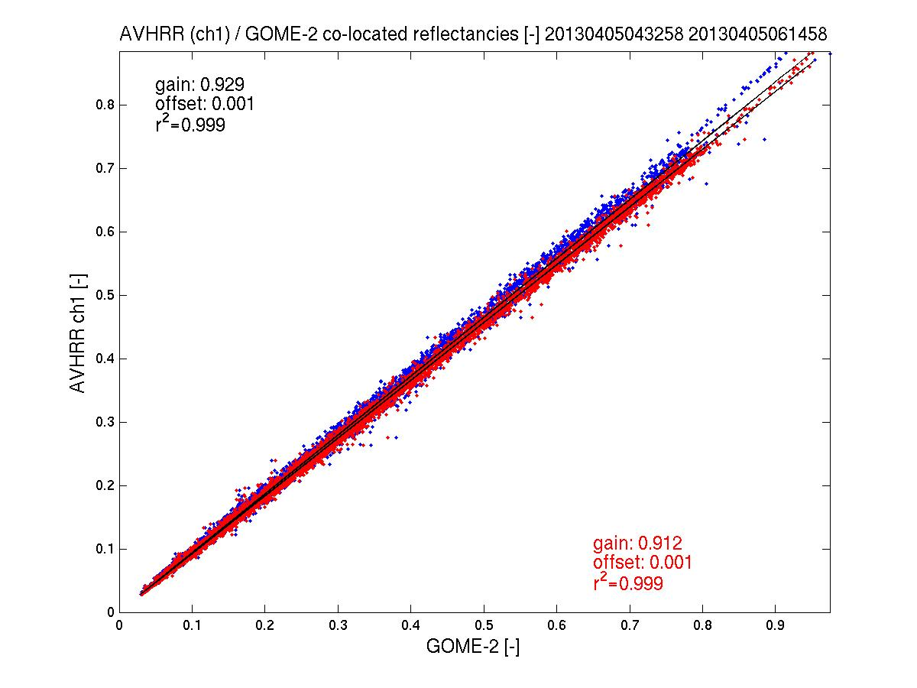
GOME-2/AVHRR reflectivity inter-calibration
AVHRR ch 1/ Metop-A
GOME-2 FM3 Metop-A
AVHRR channel 1 to GOME-2/Metop-A gain in reflectivity <8%
(AVHRR < GOME-2)
2013
Corrected /
Un-corrected
see GSICS Quarterly Newsletters, vol 5, number 3, Latter et al.
2013
spatial aliasing accounted for

Slide 13
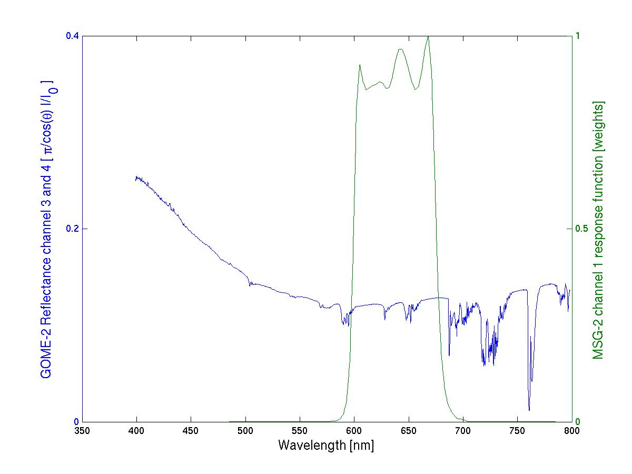
GOME-2 FM3 Metop-A
GOME-2 / Seviri reflectivity inter-calibration
SEVIRI ch1/ MSG-2 – preliminary results
Seviri ch1
response function
GOME-2 Ch:4 (Band 6)
1024 measurements
GOME-2 Ch:3 (Band 5)
1024 measurements

Slide 14
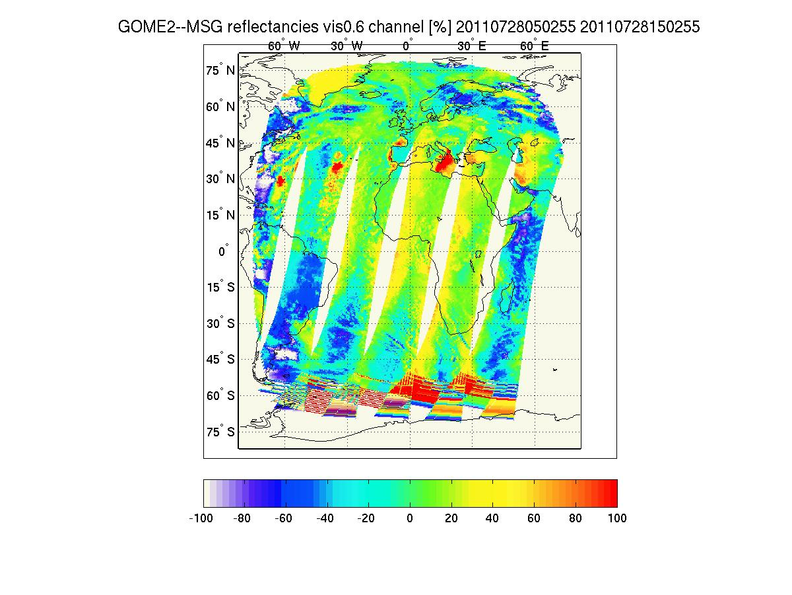
GOME-2 / Seviri reflectivity inter-calibration
SEVIRI ch1/ MSG-2 – preliminary results
GOME-2 FM3 Metop-A
Co-location of GOME-2 Metop-A with Seviri / MSG data.
Spatial collocation: Average of all Seviri measurements (~4km) in one GOME-2 ground pixel (40 by 80 km)
Temporal collocation: Within +- 15 min of sensing time.
No spatial aliasing correction

Slide 15
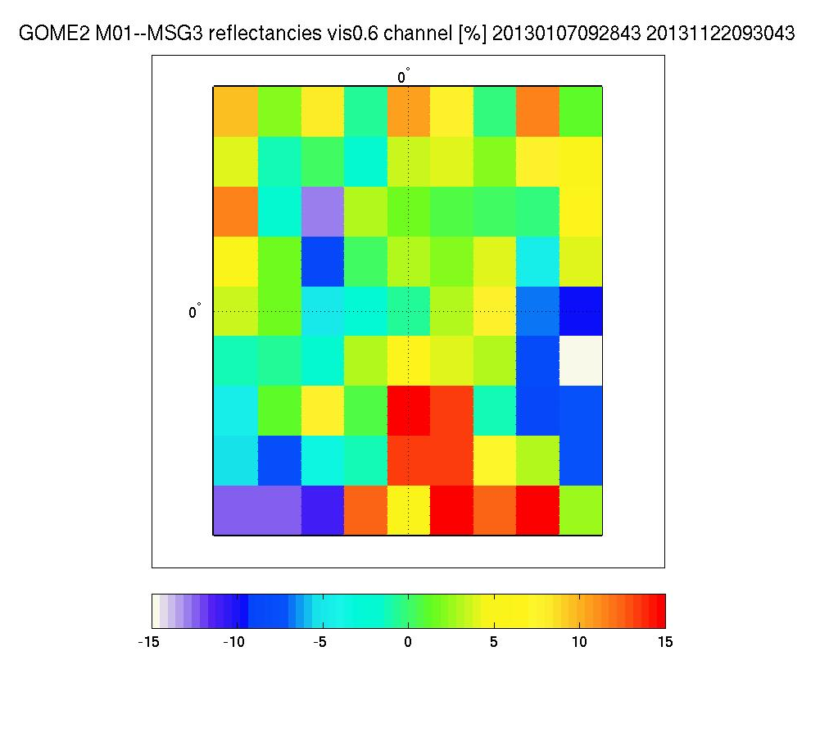
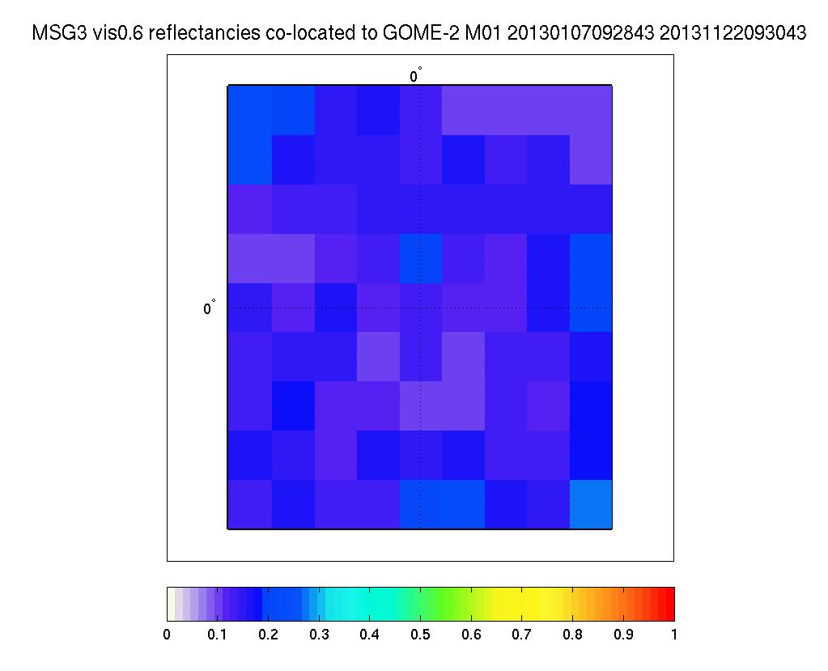
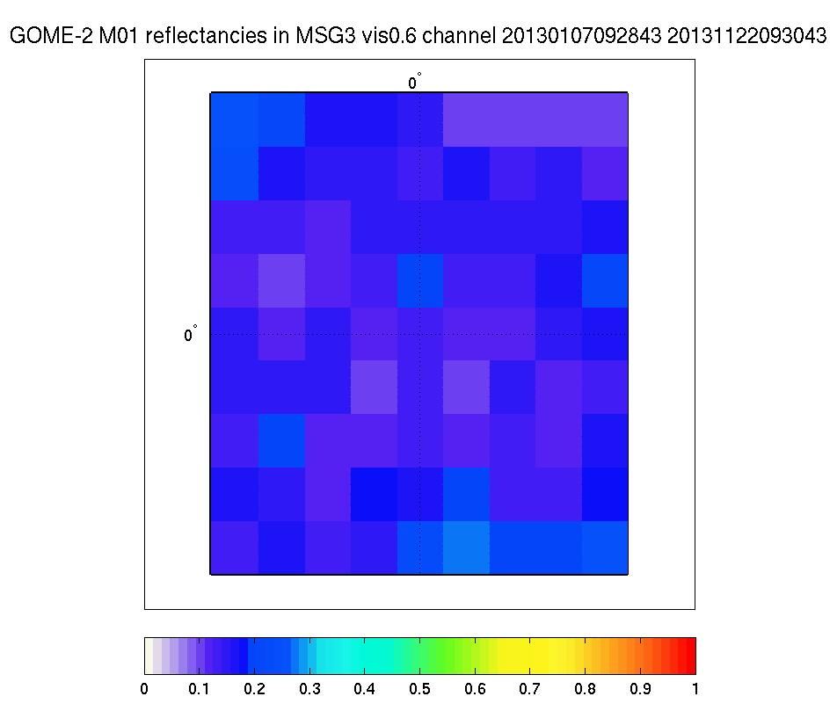
GOME-2/Metop-B reflectivity inter-calibration
SEVIRI ch1/ MSG-3 – preliminary results
GOME-2 FM2 Metop-B
Reflectance MSG3 / Seviri Ch 1
1.5/1.5 degrees box at 0/0º
Reflectance GOME-2 / Metop-B
1.5/1.5 degrees box at 0/0º
Residual MSG-3 /Seviri vs GOME-2 / Metop-B [%]
1.5/1.5 degrees box at 0/0º

Slide 16
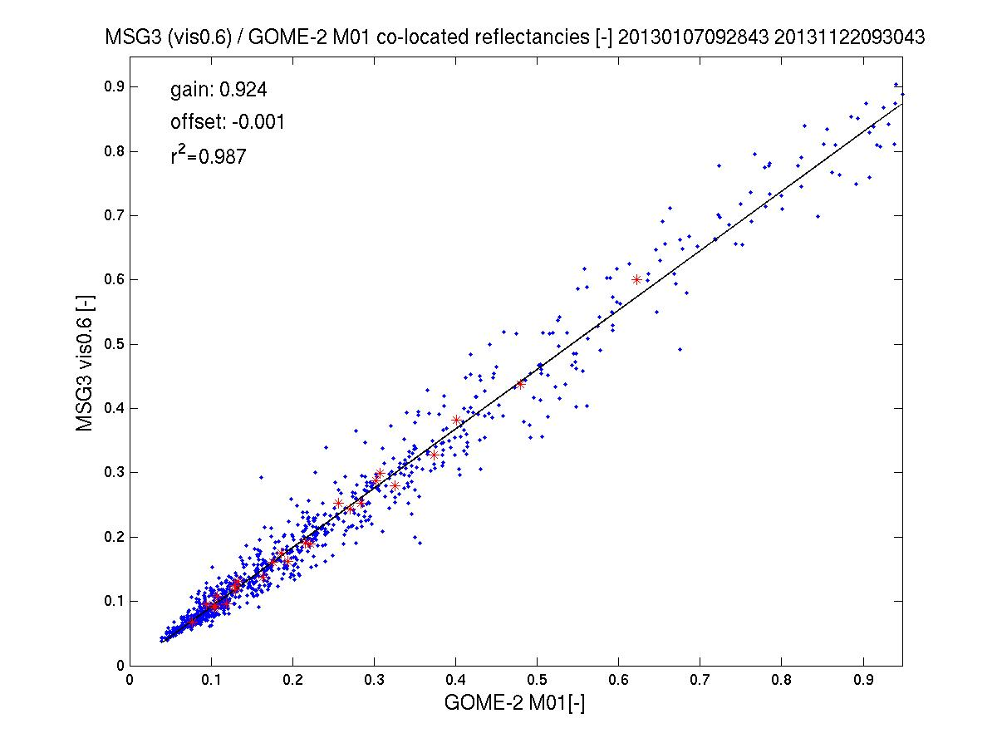
GOME-2/Seviri reflectivity inter-calibration
SEVIRI ch1/ MSG-3 vs GOME-2/Metop-B – preliminary results
GOME-2 FM2 Metop-B
MSG-3 / Seviri ch 1 to GOME-2/Metop-B gain in reflectivity ~8%
(Seviri < GOME-2)
1st Jan to 22nd Nov 2013

Slide 17
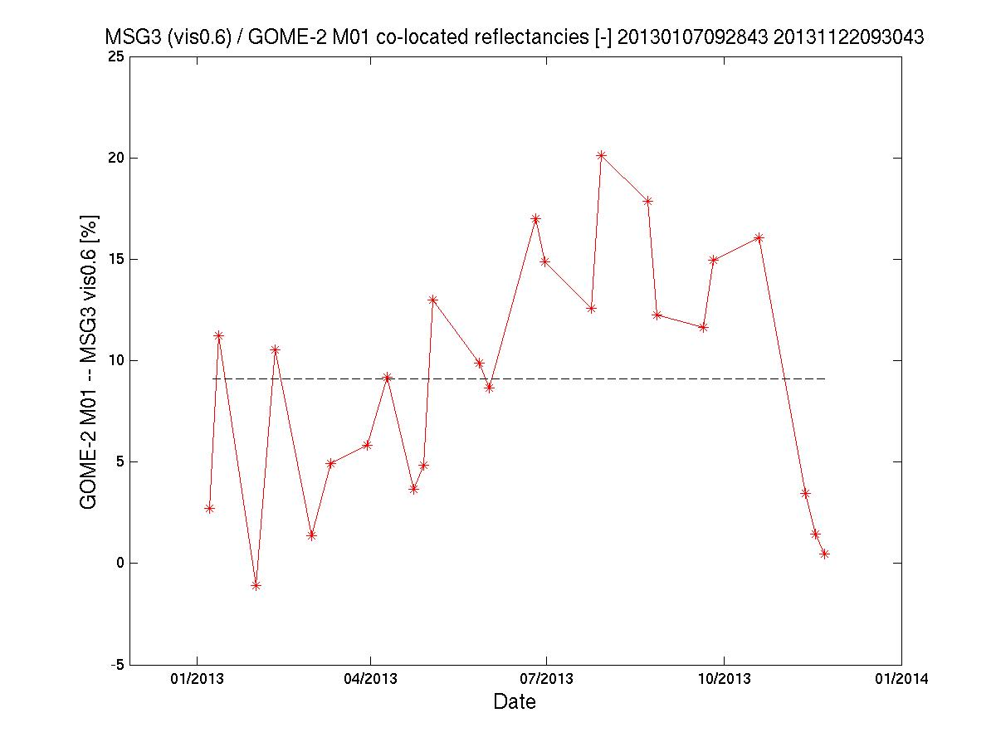
GOME-2/Metop-B reflectivity inter-calibration
SEVIRI ch1/ MSG-3 – preliminary results
GOME-2 FM2 Metop-B
MSG-3 / Seviri ch 1 to GOME-2/Metop-B gain in reflectivity ~8.5%
(Seviri < GOME-2)
1st Jan to 22nd Nov 2013
No spatial aliasing correction yet
No correlation with SZA found

Slide 18
Summary
GOME-2 / Metop-A channel 3/4 vs AVHRR / Metop-A channel 1
Scale factor of 0.89
(2007 to 2011, 2011 to 2013 after correction of GOME-2 data, spatial aliasing accounted for by empirical correlation optimisation)
GOME-2 / Metop-B channel 3/4 vs Seviri / MSG-3 channel 1
Scale factor of ~0.92
(2013, no correction of GOME-2 data, no spatial aliasing)

Slide 19
The end

Slide 20
Geo-referencing
PMD/co-location – spatial aliasing
GOME-2 FM3 Metop-A
GOME-2 FM2 Metop-B
Detector-pixel read-out direction per channel:
GIADR-Channels : CHANNEL_READOUT_SEQ
0: from short to long wavelength
1: from long to short wavelength
See PGS 7, Appendix C
Current setting:
Channel: 1 2 3 4 PMD-P PMD-S (SW-PMD-P SW-PMD-S)
Flag: 0 1 0 1 1 1 ( 1 1 )
Read-out time per detector pixel: 45.78 μs
Read-out time per channel: 46.875 ms (1024 pix) / 11.72 ms (256 pix)
Fraction to (nominal) IT at last pix: 25% (at pix 1024) / 50% (at pix 256)
0
1
0
1
1
1
240
790
312
790
312
790
λ
λ
λ

Slide 21
Geo-referencing
PMD/co-location – spatial aliasing
GOME-2 FM3 Metop-A
GOME-2 FM2 Metop-B
Spatial aliasing:
Shift per detector pixel with respect to with to the first pixel read*.
*for which all geo-referencing parameters and angles are defined
Shift in percentage of (nominal) integration time/ground pixel size
0 3
25 0
0 25
25 0
50 0
50 0
240
790
312
790
312
790
λ
λ
λ
AVHRR ch1 at ~640 nm
-> ~15% across-track shift

Slide 22
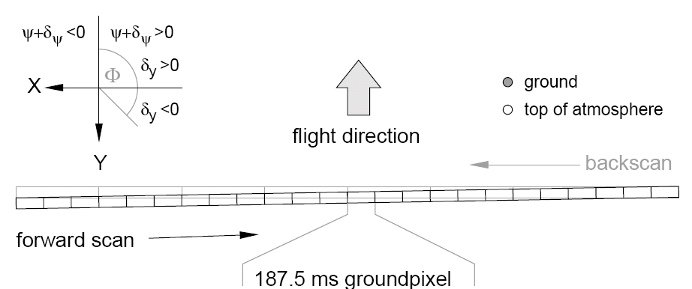
Geo-referencing
Back-scan – spatial aliasing
GOME-2 FM3 Metop-A
GOME-2 FM2 Metop-B
Spatial aliasing:
Shift per detector pixel with respect to with to the first pixel read*.
Back scan mirror movement is 3 times faster than for the forward scan.
> Larger spatial aliasing shift with respect to provided geo-location information (>45% with respect to IT=187.5 ms in forward scan).
0 3
25 0
0 25
25 0
50 0
50 0
240
790
312
790
312
790
λ
λ
λ
Water-vapour retrieval (640 nm)
>15% across-track shift

Slide 23
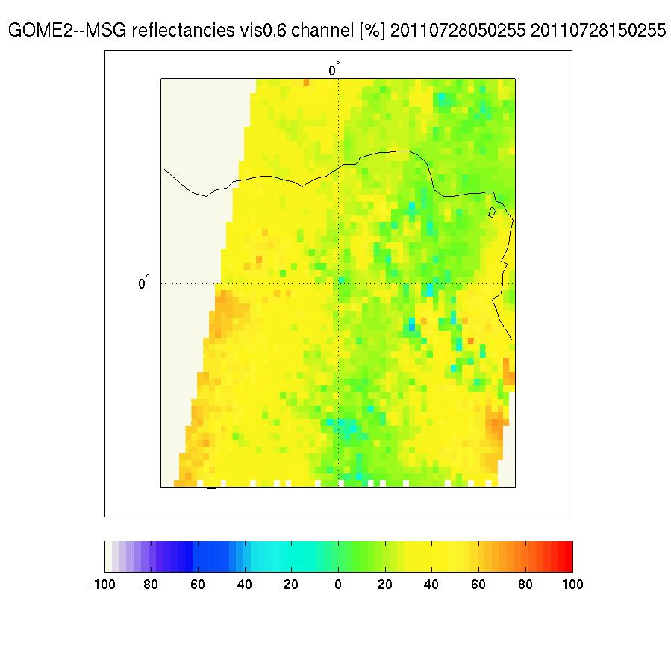
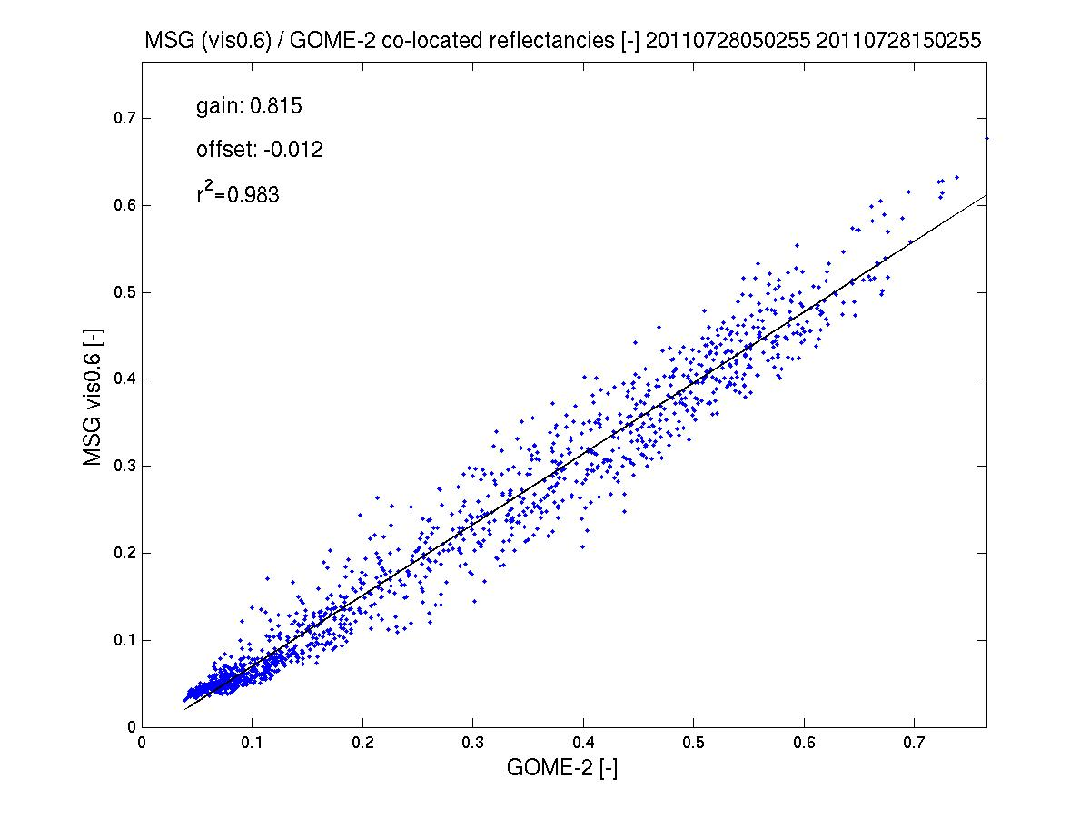
GOME-2/Metop-A reflectivity inter-calibration
SEVIRI ch1/ MSG-2 – preliminary results
GOME-2 FM3 Metop-A
More work needed!!!
Improve spatial co-location by taking spatial aliasing into account
Improved temporal co-location still possible at the expense of worse statistics
Filter for low variability, low path length difference, etc..

Slide 24
Geo-referencing
Back-scan – spatial aliasing
GOME-2 FM3 Metop-A
Mean H₂O SCD 5 March 2013: MetopA narrow mode
Courtesy Wagner et al. MPI-Chemistry, Mainz

Slide 25
Geo-referencing
Back-scan – spatial aliasing
GOME-2 FM3 Metop-A
Mean H₂O SCD 5 March 2013: MetopA narrow mode backscans
Courtesy Wagner et al. MPI-Chemistry, Mainz

Slide 26
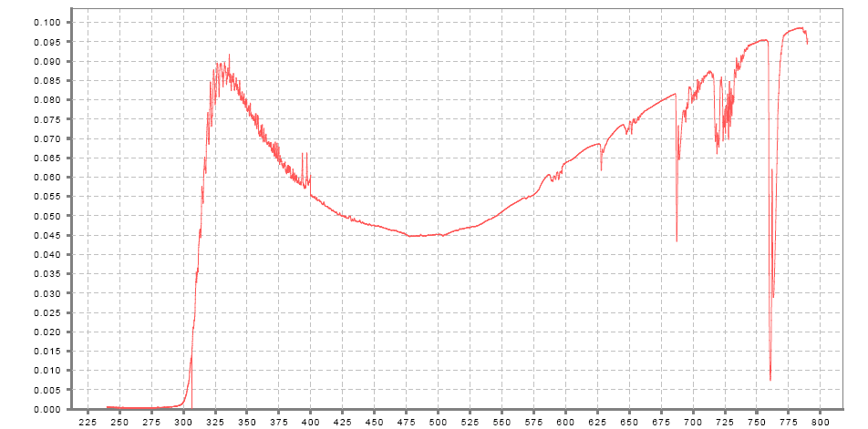
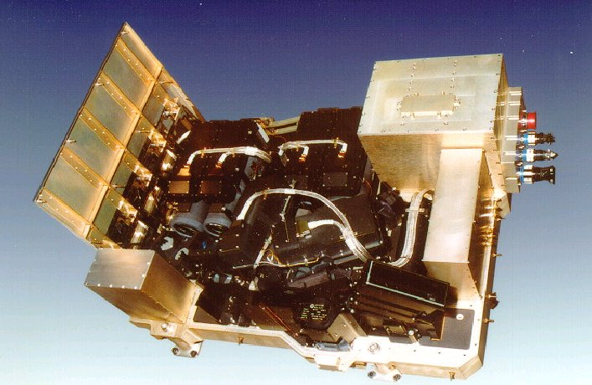
The GOME-2 instrument on Metop Measuring atmospheric composition
GOME-2 main channel transmittance
GOME-2:
series of 3 instruments on Metop (Metop A launched in 10/2006)
sun-synchronous orbit, 09:30
412 orbits (29 days) repeat cycle
Global coverage 1.5 days
240 nm to 800 nm
0.25 to 0. 5 nm spectral resolution (FWHM)
4 channels with 4098 energy measurements of polarisation corrected radiances (40 x 80 km²)
2 channels with 512 energy measurements of linear polarised light in perpendicular direction (S/P) (40 x 10 km²)
HCHO
Aerosol
SO₂
NO₂
O₃
BrO
I/I₀
H₂O
O₃
(O₂)₂
OClO
O₂
Wavelength [nm]
Orbit file sizes
GOME-2 L1B ~ 1GB
IASI L1C ~ 2GB

