Slide 1
GOES Imager Lunar Calibration: Angular Variation of the Scan Mirror Visible Reflectivity
Fangfang Yu (ERT, Inc@NOAA), Xiangqian Wu(NOAA/NESDIS), Tom Stone(USGS), and Gordana Sindic-Ranic(IMSG@NOAA)
2014 GSICS Annual Meeting

Slide 2
Background
The incidence angle dependent emissivity was observed at the infrared channels shortly after GOES-8 began operating in orbit (Weinreb et al. 1997)
  Most apparent when the instrument viewed the space
  Believed caused by the absorption feature of the scan mirror coating material
  Using the space scans as reference, the E-W emissivity variations is characterized with space observations
  No apparent variation in the E-W space outputs for the visible channel
The angular variation of the GOES Imager scan-mirror visible reflectivity had been suspected in the GOES-10 visible lunar calibration (Wu et al. 2006)
  ROLO lunar irradiance model makes high accurate relatively calibration possible
  Relatively large differences in the ratios between measured and modeled lunar irradiance were observed within one hour difference at two earth sides
  Possible to use the stable lunar surface as reference
The angular variation of scan-mirror reflectivity variation was measured in labs (Wu et al. 2011)
During the GOES-15 PLT period, the satellite was rolled northward to trace the Moon to characterize the in-orbit angle dependence of scan-mirror reflectance. (Wu et al. 2011 and Yu et al. 2013)
  Early result showed an unexplained pattern (Wu et al. 2011)
  Revisited the GOES-15 PLT lunar calibration data in 2013. Results were reported in Yu et al. (2013)

Slide 3
This talk summarized the GOES Imager scan-mirror visible reflectivity work conducted at NOAA in 2006 and 2013.

Slide 4
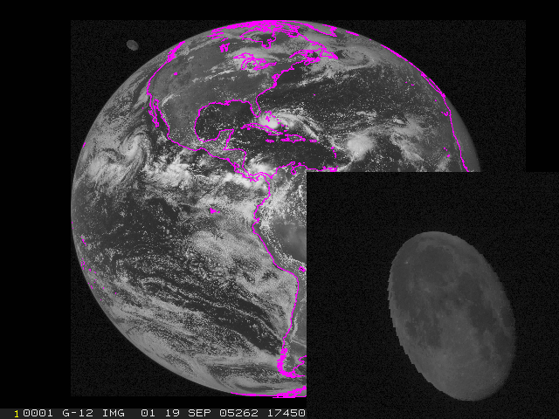
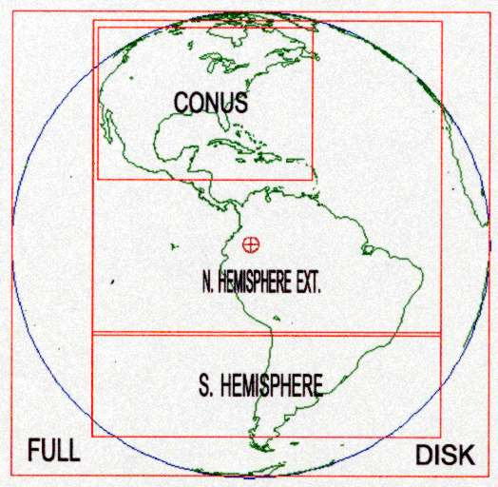
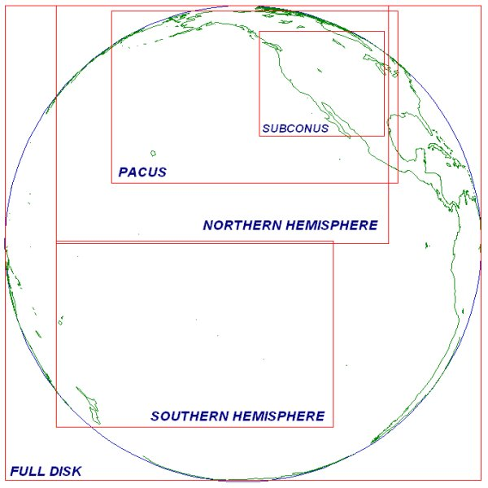
Lunar Observations
Unscheduled moon Obs.
Scheduled monthly moon observation since late 2005
GOES-East routine scanning strategy
GOES-West routine scanning strategy
http://www.ospo.noaa.gov/Operations/GOES/east/routine_strategy.html
http://www.ospo.noaa.gov/Operations/GOES/west/routine_strategy.html

Slide 5
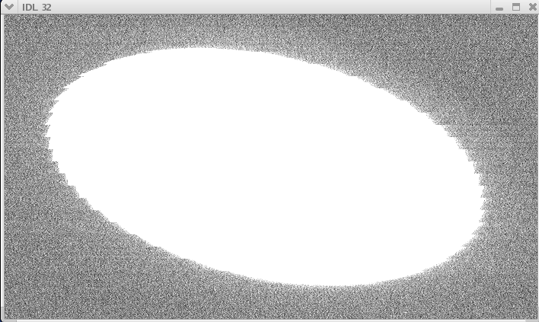
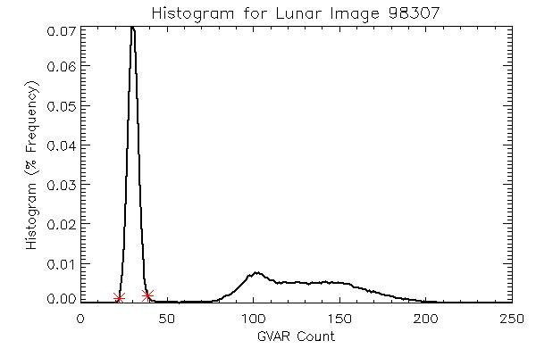
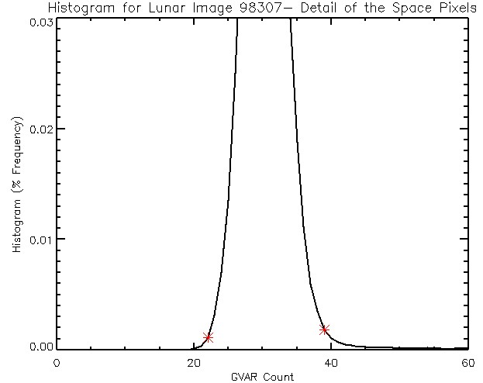
GOES-10 Lunar Calibration – Stray-light effect
Different methods used to characterize the background space count
Increased calibration accuracy with derived space counts
Wu et al. (2006)

Slide 6
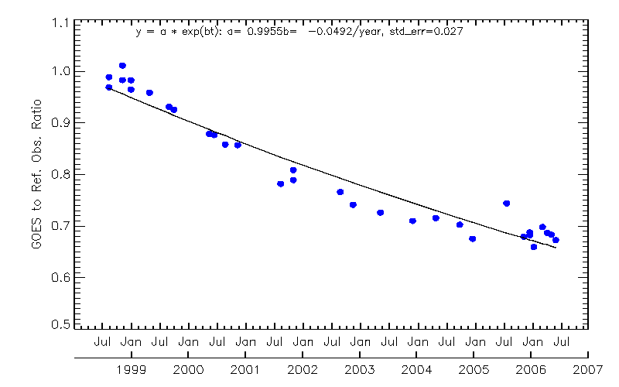
GOES-10 Lunar Calibration – Paired Lunar Observations
Separated within one hour
Relatively large measured to modeled irradiance ratios
Impossible due to instrument degradation
Angular reflectivity was suspected.
Lab measurements showed E-W reflectivity variations at certain scan angles (Wu et al. 2011)
E_{GOES} = ωS∑_{i}((C^{i}_{R} – C_{S})/f_{i})
i: Index of Moon pixel; R_{i}: Radiance from pixel I; S is the pre-launch calibration coefficient to convert count to radiance; ω: Solid angle subtended by pixel i = 28urad x 28urad. EW oversampling factor fi= 1.75
Wu et al. 2006, SPIE

Slide 7
GOES-15 PLT Lunar Tracing Event
~17:54Z-19:20Z on Sept. 24, 2010 (DOY267), G15 rolled northward to trace the Moon.
The moon’s phase angle ranged from ~14.5-~16.5 degrees during the 1.5 hours of test period

Slide 8
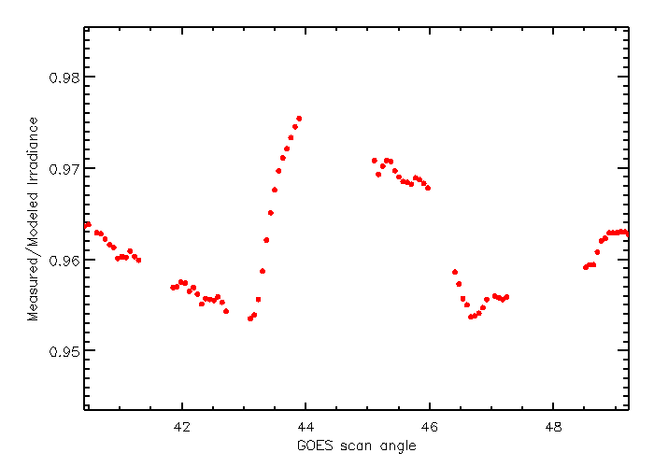
Measured to Modeled Irradiance Ratio
~1.5 counts/moon pixel
E_{GOES} = ωS∑_{i}((C^{i}_{R} – C_{S})/f_{i})

Slide 9
Error Budget Analysis: Uncertainty Components
Space background
  Detector truncation
  Space clamp
Detector noise
Moon pixel number
Stay-light
Oversampling
Incident-angle dependent reflectance
R_{i}: Radiance from pixel I; ω_{i}: Solid angle subtended by pixel I; f _{i}: oversampling factor; S: Prelaunch slope; C^{i}_{R}: Raw count of pixel I; C_{S}: Space count relevant to C^{i}_{R}
Yu et al. 2013, CALCON meeting

Slide 10
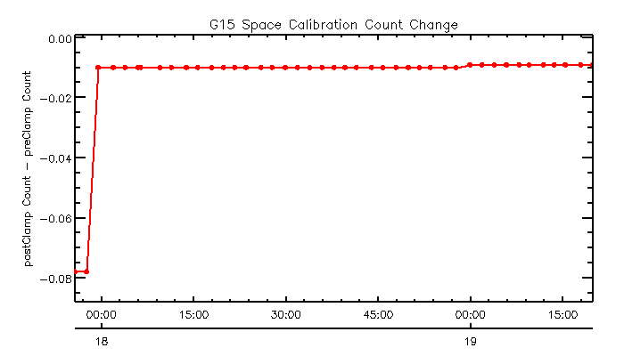
Space background
Detector truncation
  Extreme case of system error
Space Clamp – system error
  Pre-clamp – post-clamp in general < 0.02 count
= 7.9841 x10⁻³ mW/m**2/Sr/m = 0.03 count/pixel
Yu et al. 2013, CALCON meeting

Slide 11
Detector Noise
Random Error
  G15 Imager visible detector noise < 1.5 count
  Monte Carlo method to simulate the random uncertainty
Random uncertainty = 1.34978 * 10⁻⁴ mW/m**2/Sr/m < 0.001 count/pixel
Yu et al. 2013, CALCON meeting

Slide 12
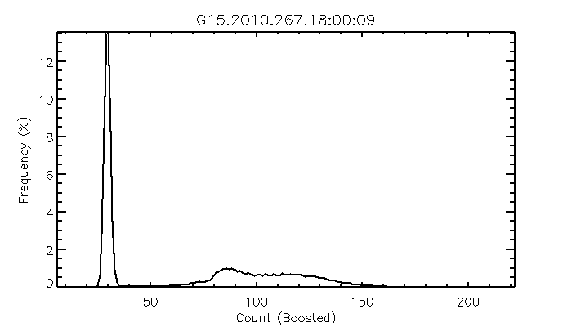
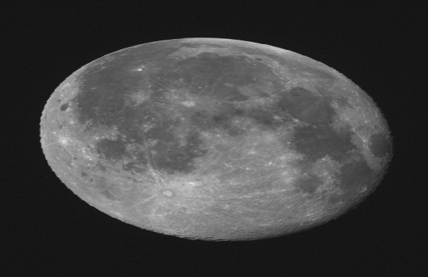
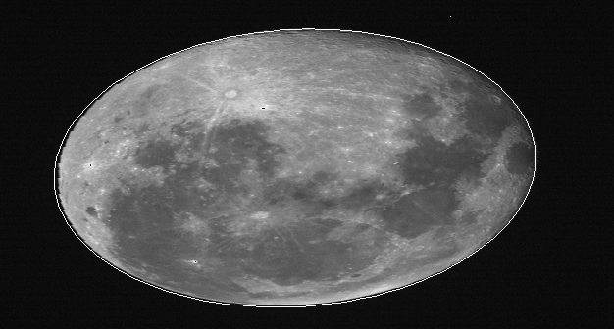
Moon Pixel Numbers
Several methods (thresholds + expanding fitting moon masks) used to calculate the number of moon pixels, the difference of moon pixel < 10 pixels, mainly caused by the high energy “salt pepper” pixels
The impact of this term is negligible
#moon pixel = 106843
Irradiance = 2.142 mW/m^2Sr-1m-1
Yu et al. 2013, CALCON meeting

Slide 13
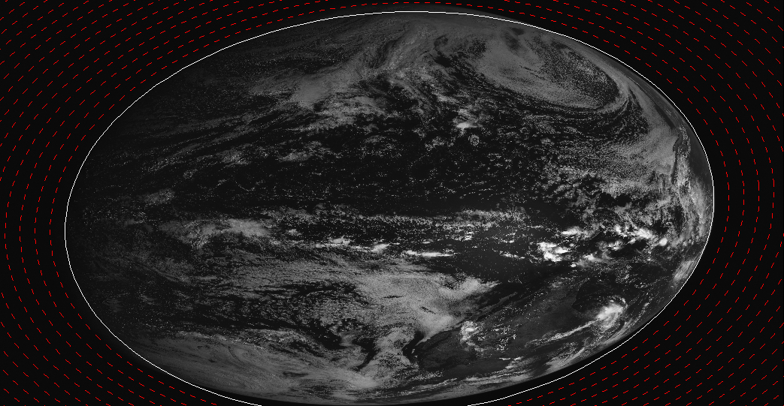
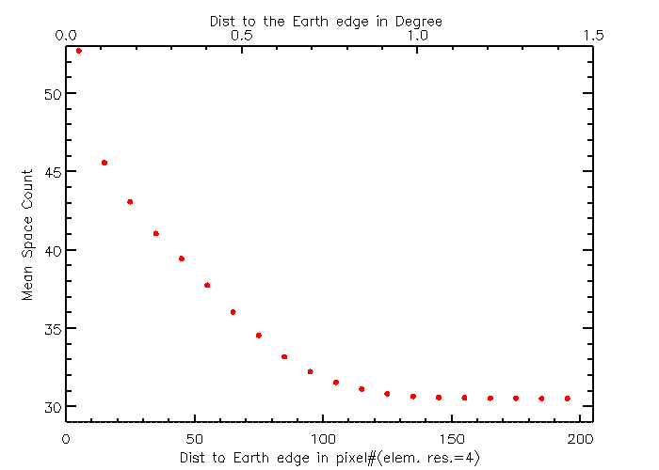
Stray-light Impact
Earth shine leak
Yu et al. 2013, CALCON meeting

Slide 14
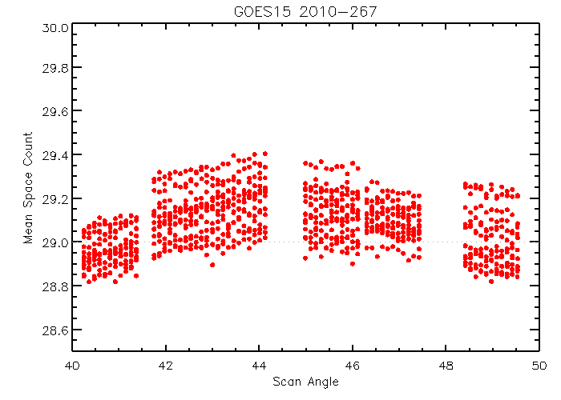
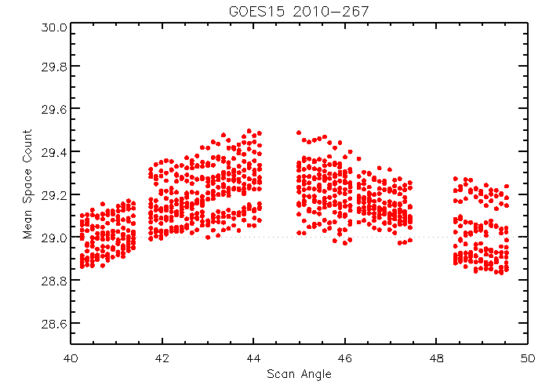
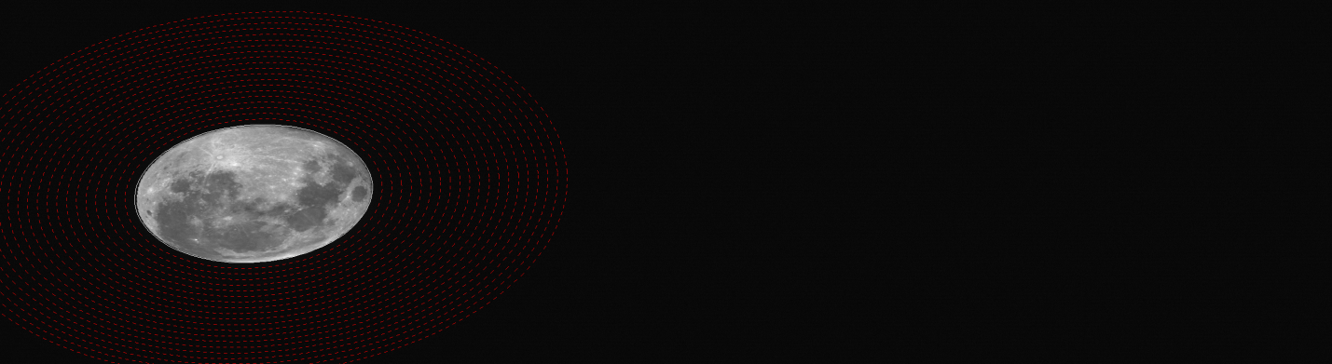
Impact of Earth Shine Leak
F1
F4
Yu et al. 2013, CALCON meeting
<0.4Count/pixel

Slide 15
Uncertainty Components
Space background
  Detector truncation
  Space clamp
Detector noise
Moon pixel number
Stay-light
Oversampling
Incident-angle dependent reflectance
Combined uncertainty < 0.5 count/pixel
Yu et al. 2013, CALCON meeting

Slide 16
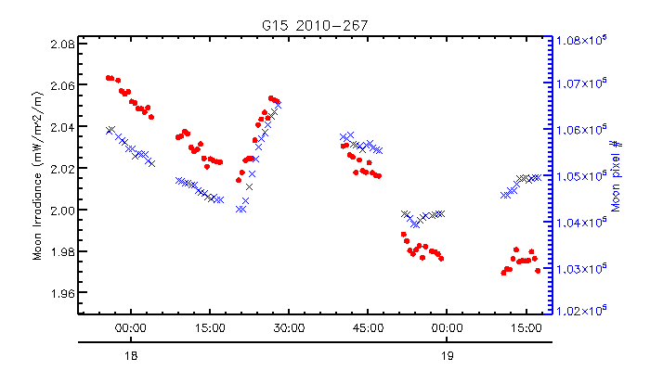
Oversampling Effect
Nominal oversampling factor at EW direction = 1.75
Yu et al. 2013, CALCON meeting

Slide 17
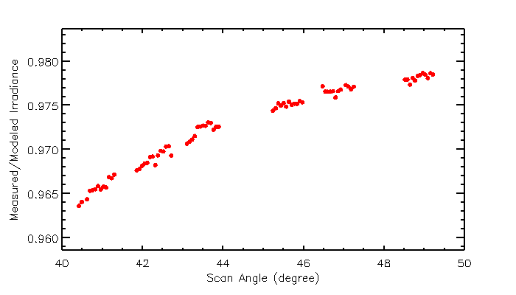
Preliminary Result of Oversampling Correction
Assuming no significant change in the distance between the Moon and the satellite, the mean over-sampling factor for a given image is calculated as:
where A_{t} is the number of moon pixels at time t, A₁ is the number of moon pixels of the first moon image
Yu et al. 2013

Slide 18
Conclusions
The EW oversampling factor is not constant for the GOES-15 Imager visible channel
The incident angle dependent reflectance is the apparent in this study
  About 1.6% reflectance difference was observed between the scan angles at 45º and 50º
  Slightly smaller than the laboratory measurement of 2-3% variation
Three major uncertainty components identified in this study
  Varying EW oversampling factor
  Incident-angle dependent reflectance
  Stray-light (earth + moon shine leak)
Further study is needed to improve the calculation of EW oversampling factor and understand the root causes to the varying oversampling factor

Slide 19
References
Weinreb, M., M. Jamieson, N. Fulton, Y. Chen, J. Johnson, J. Bremer, C. Smith, and J. Baucom, 1997. Operational calibration of geostationary operational environmental satellite-8 and -9 imagers and sounders, Applied Optics, vol.36, 6895-6904.
Wu, X., T. Stone, F. Yu, and D. Han, 2006a. Vicarious calibration of GOES Imager visible channel using the Moon, Proc SPIE, 6296, 62960Z, San Diego, CA.
Wu, X., D. Ryan-Howard, T. Stone, G. Sindic-Rancic, F. Yu, M. Weinreb and M. Grotenhuis, 2011, Angular variation of GOES Imager scan mirror reflectance, Proc. SPIE, San Diego, CA (poster)
Yu, F., X. Wu, T. Stone and G. Sindic-Rancic, 2013a. Revisit of GOES visible lunar calibration: Error budget and scan-angle dependent reflectance, Calcon meeting, Logan, UT (oral).
Yu, F., X. Wu, T. Stone, and G. Sindic-Rancic, 2013b. Angular Variation of GOES Imager scan-mirror visible reflectivity, GSICS Quarterly Newsletter, Vol. 7 (3), 9-10.

Slide 20
Acknowledgements
NOAA/NESDIS/OSPO for the operation of GOES scheduled lunar observations
Drs. Michael Weinreb and Ken Mitchell at NOAA/NESDIS/OSPO for the insights of GOES GVAR data structure and the instrument performance during the radiometric calibration process.

