Slide 1
EUMETSAT
Monitoring weather and climate from space
Preparations of inter-comparisons between AVHRR and IASI towards SLSTR
Anne O’Carroll

Slide 2
Outline
Infra-red LEO inter-comparisons with IASI reference
Background, perspective, examples and previous papers in literature
Cal/Val preparations for Sentinel-3 SLSTR
SLSTR details, Cal/Val plans, Plans for inter-comparisons with IASI (GSICS preparation)
Future benefits and thoughts

Slide 3
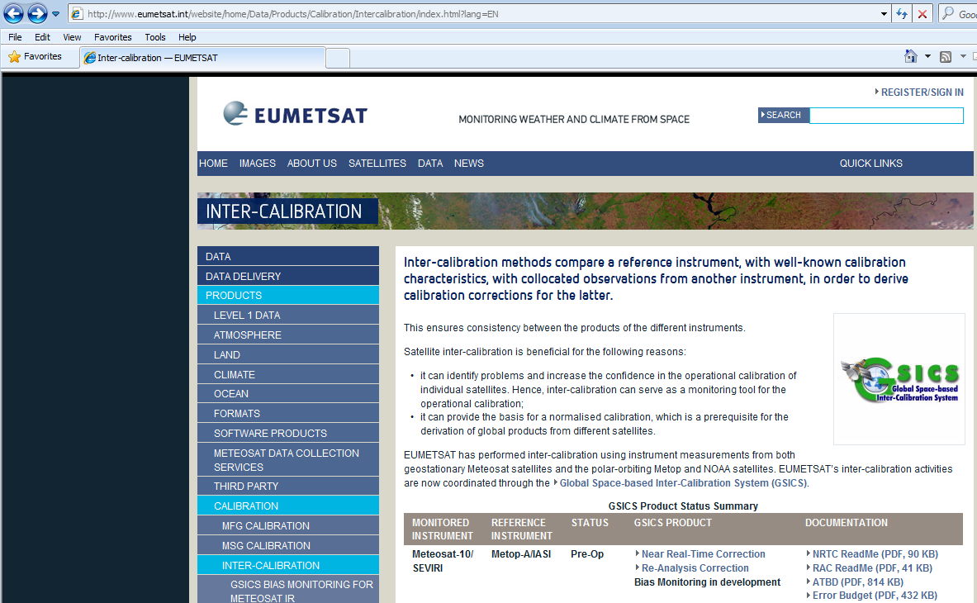
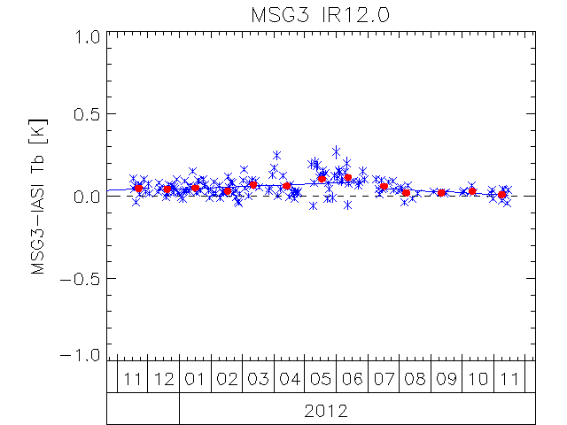
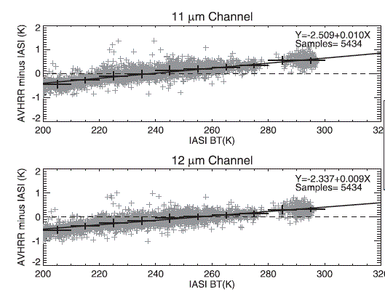
Infra-red LEO inter-comparisons with IASI reference Background and perspective
To extend GSICS system for infra-red LEO/LEO inter-comparisons, firstly for AVHRR-IASI, later for SLSTR-IASI
Important NRT monitoring activities for SLSTR
Example of AVHRR-IASI inter-comparisons in Mittaz et al, 2011

Slide 4
Bridging the gap between AATSR and SLSTR
The loss of ENVISAT in April 2012 had lead to a ‘gap’ in dual-view high accuracy SST data, whose needs include being used as a reference by many L4 SST analyses and important contributions to Climate Data Records.
The gap will continue until the launch of Sentinel-3 SLSTR, currently scheduled for 30 June 2015 (July-September launch window).
Community approach to ‘filling’ the gap and ‘bridging’ the gap will use IASI data due to stability and characterisation. Metop-A data needed for an overlap with AATSR, hopefully Metop-A overlap with SLSTR. Metop-B data needed in contingency.

Slide 5
AVHRR inter-comparisons with IASI
AVHRR inter-comparisons with IASI in GSICS
Build on methodologies and work in the literature for a NRT monitoring capability
Same platform
Important contribution to bridging the AATSR/SLSTR gap and contributing to CDRs in the period.
First LEO/LEO infra-red comparisons.
Provides preliminary preparation for SLSTR.

Slide 6
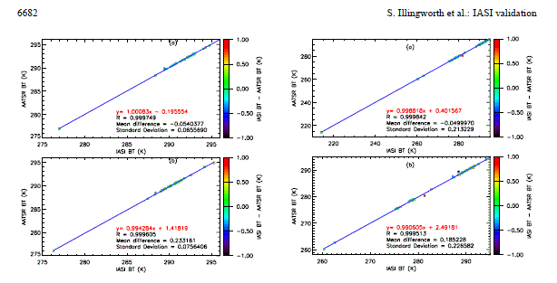
AATSR/IASI inter-comparisons: examples
Inter-comparison of integrated IASI and AATSR radiances at 11 and 12 microns (Illingworth et al, Atmos. Chem. Phys. 2009)
Study by Leicester University on the inter-comparison of IASI/AATSR calibrated radiances (Remedios et al, EUM conf 2013)

Slide 7
Cal/Val preparations for Copernicus Sentinel-3 SLSTR EUMETSAT Sentinel-3 marine centre
ESA – Implementation of Copernicus Space Component
EUMETSAT – Operation of spacecraft during routine operations
Level 0 and Level 1 product generation at ESA and EUMETSAT
ESA – Level 2 land products
Sentinel-3 marine centre -> EUMETSAT (Level 2 marine products)
EUMETCast, EUMETSAT data centre
Launch planned for 30 June 2015 (July to September)

Slide 8
SLSTR instrument and geometry
Based upon AATSR but with a wider swath and nine spectral channels with an additional two optimised for fire monitoring
Conical scanning imaging radiometer with along-track scanning dual-view capability
Wavelengths used are 0.55µm, 0.66µm, 0.87µm, 1.375 µm, 1.6µm, 2.25 µm, 3.7µm, 11µm and 12µm plus fire channels
Accuracy requirement ±0.3K; temporal stability of 0.1K/decade
Donlon et al, RSE, 2012 for further instrument details

Slide 9
SLSTR calibration
Pre-launch (spectral response and radiometric calibration) and geometric calibration Smith et al, SPIE, 2013
Post launch
Vicarious calibration for solar reflectance channels to monitor degradation of VISCAL (viewed once per orbit).
Calibration by on-board black-bodies (viewed once per scan).
Inter-comparisons with other infra-red satellite data and ship-borne radiometers

Slide 10
SLSTR products and algorithms
Core products:
Sea surface temperature
Following AATSR reprocessing (ARC) with TCWV banding
Land surface temperature
Aerosol optical depth and fire radiative power (EC request)
Will be able to support:
Lake surface water temperature, Ice surface temperature
Cloud products
ATBDs available from https://sentinel.esa.int/web/sentinel/home

Slide 11
Sentinel-3 Validation Team
Sentinel-3 Validation Team first meeting November 2013
S3VT call pages http://earth.esa.int./aos/S3VT
Rolling call, more submissions invited
Contains Cal/Val plan, MRTD, ATBD...
Four sub-groups: Temperature, Ocean Colour, Altimetry, Land
Aim and objective:
“To engage world-class expertise and activities, through mutual benefit collaboration, that support the implementation of the Sentinel-3 validation activities and ensure the best possible outcomes for the Sentinel-3 mission. To provide independent validation evidence, experimental data and recommendations”

Slide 12
S3VT-Temperature team members
PI | Team name | Country | Leading institution
Nightingale Tim | Validation by In Situ Infrared Radiometry (VISIR) | UK | STFC Rutherford Appleton Laboratory
Barciela Rosa | Validation of Sentinel-3 Sea Surface Temperature data in Met Office products | UK | Met Office
Minnett Peter | Ship-board radiometric measurements of the ocean skin surface temperature to validate the SLSTR retrievals. | USA | University of Miami
Beggs Helen | Provide Australian Ship Sea Surface Temperature for SLSTR validation | AUSTRALIA | Bureau of Meteorology
Høyer Jacob | Arctic SLSTR Sea and Ice Surface Temperature validation group (ASSIST) | DENMARK | Center for Ocean and Ice, Danish Meteorological Institute
Mittaz Jonathan | Validation of SLSTR radiances using GSICS and low level calibration data | USA | CICS/ESSIC University of Maryland
Wimmer Werenfrid | ISAR-S3V - Infrared Shipborne Autonomous Radiometry for Sentinel-3 SLSTR Validation: Continuity of long-term Biscay validation data set bridging from AATSR | UK | University of Southampton
Dybkjær Gorm | Validation of S-3 SLSTR SST and IST at High Latitudes from buoys by the EUMETSAT OSI SAF | NORWAY | Norwegian Meteorological Institute
Corlett Gary | Continuity of the ARC/SST_CCI SST CDR with SLSTR (CAST) | UK | University of Leicester
DiGiacomo Paul | STAR Validation Support for Sentinel-3: Ocean Color, Sea Surface Temperature and Land Surface Temperature | USA | NOAA/NESDIS

Slide 13
SLSTR Cal/Val Implementation at EUMETSAT
Sentinel-3 Cal/Val plan (V1, V2 under development) available from:
http://earth.esa.int./aos/S3VT
Main EUMETSAT activities include:
Routine monitoring and quality control
OSI-SAF SLSTR SST MDB with drifting buoys, moored buoys, ships, and ability to compare with SST products from other sensors
SLSTR-IASI level 1 inter-comparisons (GSICS)
Close inter-actions with Mission Performance Centre and Expert Support Laboratories

Slide 14
LEO/LEO inter-calibration including L0 counts/temps
Work on LEO/LEO to begin in 2014/2015 in preparation for S3
Development using AVHRR
Prep of methods using AATSR
-> Study by Leicester University on the inter-comparison of IASI/AATSR calibrated radiances provided recommendations for SLSTR collocations (Remedios et al, EUM conf 2013)
-> Output of L0 counts and temperatures with the collocations. This enables new SLSTR calibrations to be derived (University of Reading) e.g. SRF, non-linearity functions, and assessed using GSICS

Slide 15
Future benefits and thoughts
NRT collocations of SLSTR and AVHRR with a IASI reference, including L0 data, within the GSICS framework, enables:
Full uncertainty analysis and stability assessment
Full calibration characterisation and testing of new SRF’s and non-linearity functions
Mutual benefits for SLSTR and AVHRR comparisons with IASI
Also paves the way for possible future analyses using 3-way error analysis (triple collocation) to determine standard deviation of uncertainty on each observation type, assuming uncorrelated uncertainties between observation types.

