Slide 1
Outcome of the 14th meeting of the GSICS Executive Panel (Tokyo, 15-16 July 2013) Vision for GSICS in the 2020s Joint GDWG-GRWG meeting, Darmstadt, March 2014
Jérôme Lafeuille WMO Space Programme
WMO / OBS / Space Programme www.wmo.int/sat

Slide 2
Executive Panel Meeting Background
Executive Panel in charge of strategic guidance
Composed of representatives of all agencies members of GSICS
Also attended by GCC, GRWG, GDWG representatives, and observers
One annual meeting, associated with the CGMS meeting
Agenda includes:
Reports from GCC, GDWG, GRWG
Updates from members (including GPRCs) and observers
Strategic guidance on production, research, data management, user interaction
GSICS membership, partnerships, governance, resources, action plan
Specific strategic issues

Slide 3
Participants in GSICS EP-14
NOAA: M. Goldberg (Chair), A. Jelenak (GDWG), L. Flynn (GCC, remotely)
CMA: P. Zhang
EUMETSAT: J. Schmetz
JAXA: K. Imaoka, K. Umezawa
JMA: T. Kurino, K. Bessho, M. Takahashi, K. Hosaka
NASA: J. Butler, X. Xiong
Roshydromet: V. Asmus, A. Rublev, A. Uspenskyi, Z. Andreeva
GCOS: A. Simmons (Observer)
WMO: W. Zhang, J. Lafeuille (Secretariat)

Slide 4
Discussion highlights (1) General matters
Appreciated progress made in data management (e.g. plotting tool, doc, THREDDS servers), in scientific developments, and user outreach (User Workshop and IEEE TGRS publication)
Encouraged GRWG sub-group structure
Stressed need for stronger involvement in GDWG matters
WMO Ex. Council urged Members to bring GSICS operational
Routine production of GSICS corrections
Metadata, documentation and formats maturity
NRT distribution of corrected calibration of L1 data
User outreach and training on use
GSICS should play a role in the Architecture for Climate Monitoring from Space

Slide 5
Discussion highlights (2) GCOS
GCOS stressed the need for uniform calibration of records from individual satellites
Encouraged GSICS to analyze root causes of discontinuity or drifts in data series, to allow modeling the inter-satellite differences (rather than adjusting the series to reduce bias)
Suggested taking advantage of GRUAN (GCOS Reference Upper Air Network)

Slide 6
Discussion highlights (3) Vision of GSICS in 2020s « Shaping GSICS to meet future challenges »
What are we aiming to?
Scope of GSICS ?
Expected benefits to satellite operators ?
Expected benefits to satellite users ?
Trends in satellite, instrument and information technology ?
Trends in user applications? Role in the future WIGOS ?
Challenges and opportunities
GSICS priority goals
Core principles
Instruments to be addressed
Partnerships
Members and organization
How is the context evolving?
What to do, how and with whom?

Slide 7
A Vision for GSICS in 2020s: Shaping GSICS for future challenges
What is the scope of GSICS ?
Collaborative framework among satellite operators and science teams to develop, implement and share community-agreed best practices and standards, procedures and tools …
…to monitor, improve and harmonize the calibration of GOS environmental satellites
Focus: systematic generation of in-orbit inter-calibration information to correct the individual calibration of Level 1 satellite data

Slide 8
A Vision for GSICS in 2020s: Shaping GSICS for future challenges
GSICS aims to enable satellite operators…
to assess uncertainties, and to assess calibration methods
to deliver state-of-the-art NRT calibration through correcting the « operational calibration »
to understand and mitigate the calibration differences
to share knowledge, development effort, test data sets, calibration references…

Slide 9
A Vision for GSICS in 2020s: Shaping GSICS for future challenges
GSICS benefits to users and WMO programmes
Time-consistent data series for climate monitoring
Consistent multi-satellite data for composite products
Error characterization for NWP
Enable integration of observation systems (WIGOS)
Traceability and comparability for the Architecture for Climate Monitoring from Space, supports GCOS, SCOPE-CM

Slide 10
A Vision for GSICS in 2020s: Shaping GSICS for future challenges
Observed trends in sensors and user applications
More infrared hyperspectral reference sensors, LEO & GEO
Radio-occultation as anchors for NWP upper air temperature
Possible in orbit SI traceable references
Expanded use of MW (active and passive) and NIR/VIS/UV
Increased need of interoperability, and timeliness
Increasing role of NWP with capability to detect/reduce bias
GSICS to explain anomalies, provide SI traceable independent anchors
Several groups are dealing with calibration

Slide 11
A Vision for GSICS in 2020s: Shaping GSICS for future challenges
Strategic Guidelines : overall scope and priorities
Build expertise and develop best practices
Promote understanding of instrument performance and calibration
Deliver the « best calibration information » to facilitate interoperability
Operational maturity: validated products:
NRT, continuous availability, with metadata and documentation
Recalibration in support of climate data sets

Slide 12
A Vision for GSICS in 2020s: Shaping GSICS for future challenges
Strategic Guidelines : core principles
Calibration of satellite instruments is monitored and assessed by comparing with community references, using common methodologies, international standards, best practices, & ultimately SI-traceable standards
Continuous chain of comparisons with stated uncertainties, to ensure metrological traceability.
Calibration corrections are generated for both Near-Real-Time use and retrospective analyses, with specified uncertainties, through documented, peer-reviewed procedures to ensure consistent and robust results (…)
Inter-calibration assessments, comparisons and corrections are delivered through free and open access, adopting community data standards.

Slide 13
A Vision for GSICS in 2020s: Shaping GSICS for future challenges
Strategic Guidelines : instruments to address
Core expertise lies in operational monitoring of passive radiometric sensors and comparison of L1 data, from IR to VIS/NIR and MW
Need to maintain one calibration reference standard
Advocate for in-orbit SI-traceable reference
Involvement in active sensor calibration is not decided
to be evaluated taking into account CEOS/WGCV activities

Slide 14
A Vision for GSICS in 2020s: Shaping GSICS for future challenges
Strategic Guidelines : Partnerships (1)
Be part of the international calibration community with BIPM, WMO/CIMO, CEOS/WGCV
Strengthen interaction with CEOS/WGCV/IVOS
Complementary activities: operational inter-satellite calibration (GSICS), cal/val sites and campaigns (IVOS)
Joint activities: methodology (ATBD, traceability), terminology, outreach (IEEE TGRS publication)
Cross-participation in both groups
GSICS-GRUAN: Seek mutual benefits
GSICS to provide travelling reference standards for GRUAN stations
GRUAN (with RTM) to provide references for MW calibration
RTM community (ITWG, other IRC) to improve use of ground targets

Slide 15
A Vision for GSICS in 2020s: Shaping GSICS for future challenges
Strategic Guidelines : Partnerships (2)
GSICS remains focused on L1 data
Should collaborate with application communities on L2 and beyond: IWWG (winds) , IPWG (precipitation), GHRSST (Sea Surface Temp), ITWG (sounding), WRCP/GEWEX, ISCCP (clouds), PSTG (cryosphere), IOCCG (ocean colour)…
Seek feedback from monitoring or validation activities in order to define priorities on the highest impact topics
Numerical Modeling
Explore the use of NWP bias monitoring statistics for inter-satellite calibration
Exploit Data Assimilation as synergy of observing systems (including tying to GNSS radio-occ)
Climate reanalysis to evaluate GSICS products

Slide 16
A Vision for GSICS in 2020s: Shaping GSICS for future challenges
Strategic Guidelines : Membership and organization
GSICS and CGMS members are governmental agencies ¹
All CGMS Members are invited to participate in, and benefit from GSICS
Active involvement expected, chairmanship rotation
Need to document GSICS processes (ultimately as WMO Guides)
Raise user awareness
Provide guidance/training on the use of GSICS products
VLab, COMET…
¹ Members may nominate experts from private sector for the working groups

Slide 17
Update on GSICS leadership
17
Joint GDWG-GRWG, Darmstadt, March 2014
Peng Zhang (CMA) nominated Vice-Chair of the Exec. Panel
Aleksandar Jelenak moved and resigned as GDWG Chair
Manik Bali (NOAA, GCC) nominated GDWG Interim Chair
Masaya Takahashi (JMA) nominated GDWG Vice-chair
Congratulations !

Slide 18
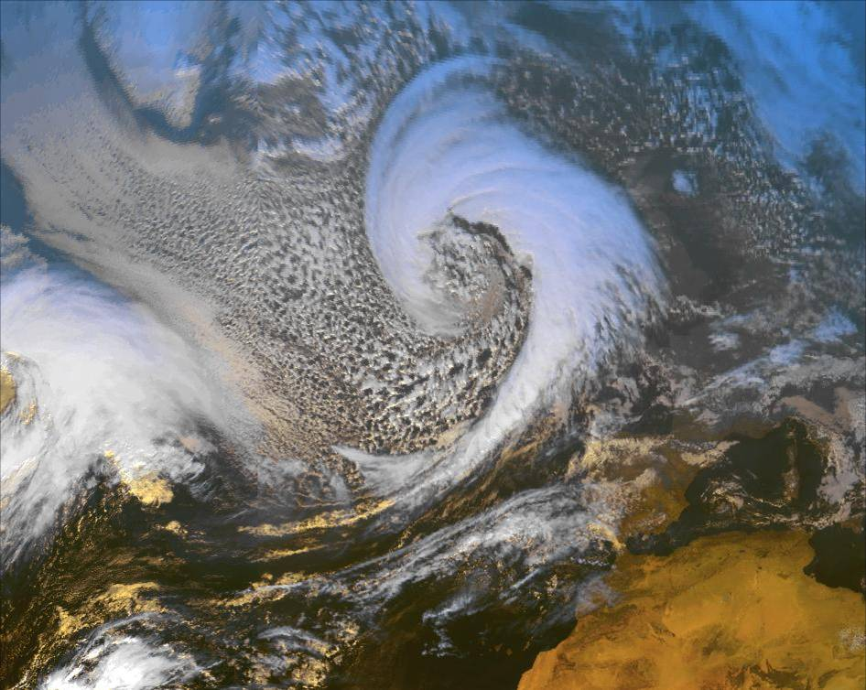
Thank you
jlafeuille@wmo.int
NOAA/AVHRR Colour composite. Courtesy of Meteo-France / Centre de Météorologie Spatiale

