Slide 1
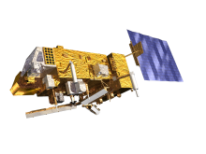

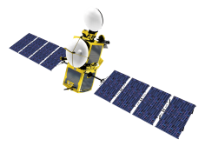
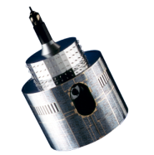
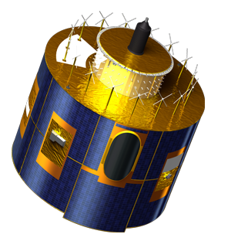
3MI Calibration Concepts
Thierry Marbach

Slide 2
Outline
3MI: Introduction
3MI: Radiometric Instrument Model
3MI: Radiometric Characterisation
3MI: In-flight Calibration

Slide 3
Outline
3MI: Introduction
3MI: Radiometric Instrument Model
3MI: Radiometric Characterisation
3MI: In-flight Calibration

Slide 4
3MI: Multi-View, -Channel, -Polarisation Imager
Dedicated to aerosol characterisation for:
- Climate monitoring
- Air quality monitoring and forecasting
- Numerical Weather Prediction
2D Push-broom radiometer (2200 km swath, 4 km pixel at nadir)
Provide images of the Earth TOA outgoing radiance using:
- Multi-view (10 to 14 views; angular sampling in the order of 10°)
- Multi-channel (12 channels from 410 to 2130 nm)
- Multi-polarisation (9 channels with -60°, 0°, +60° polarisers)
POLDER heritage

Slide 5
3MI Channels
Channel centre and width | Polarisation | Optical head
410 nm 20 nm | Yes | VNIR Optical head
443 nm 20 nm | Yes
490 nm 20 nm | Yes
555 nm 20 nm | Yes
670 nm 20 nm | Yes
763 nm 10 nm | No
754 nm 20 nm | No
865 nm 40 nm | Yes
910 nm VNIR 20 nm | No
910 nm SWIR 20 nm | No | SWIR Optical head
1370 nm 40 nm | Yes
1650 nm 40 nm | Yes
2130 nm 40 nm | Yes
c
c
c
c
c
c
c
c
c
c
c
c
c
c
c
c
c
c
c
c
c
c
c
c
c
c
c
c
c
c

Slide 6
3MI Channels
Channel centre and width | Polarisation | Optical head | Primary Use
410 nm 20 nm | Yes | VNIR Optical head | Absorbing aerosol and ash cloud monitoring
443 nm 20 nm | Yes |  | Aerosols absorption and height indicators
490 nm 20 nm | Yes |  | Aerosol, surface albedo, cloud reflectance, cloud optical depth
555 nm 20 nm | Yes |  | Surface albedo
670 nm 20 nm | Yes |  | Aerosols properties
763 nm 10 nm | No |  | Cloud and aerosols height
754 nm 20 nm | No |  | Cloud and aerosols height
865 nm 40 nm | Yes |  | Vegetation, aerosol, clouds, surface features
910 nm VNIR 20 nm | No |  | Water vapour , atmospheric correction
910 nm SWIR 20 nm | No | SWIR Optical head | Water vapour , atmospheric correction
1370 nm 40 nm | Yes |  | Cirrus clouds, water vapour imagery
1650 nm 40 nm | Yes |  | Ground characterisation for aerosol inversion
2130 nm 40 nm | Yes |  | Ground characterisation for aerosol inversion, Cloud microphysics at cloud top, Vegetation, fire (effects)

Slide 7
3MI Acquisition
up to 14 views: N = 7
c
c
c
c
c
c
c
c
c
c
c
c
View 1
View N
View 2N
Detectors
c
c
c
c
c
c
c
c
c
c
c
c
c
c
c
c
c
c
Wheel
Vsat
Filters
Optical heads
Target

Slide 8
Outline
3MI: Introduction
3MI: Radiometric Instrument Model
3MI: Radiometric Characterisation
3MI: In-flight Calibration

Slide 9
Radiometric Instrument Model
  Qualitative form of the radiometric model linking the digital counts (X) to the normalised radiance expressed by the I, Q, U Stokes vector, considering:
  a given optical head (h), spectral channel (k), integration time (s)
  a given pixel (l,p) from the raw image
  a polarised component (a) of a polarised triplet
Gain
Integration time
Equalization
Polarisation Correction
(contribution from optic and polariser)
Absolute Calibration
In order to cover all the radiometric behaviour of the sensor, the RIM must also consider:
dark current effect,
smearing effect,
stray-light perturbations
non-linearity response of the sensor
Notes:
M = applied gain number associated to the electronic gain G

Slide 10
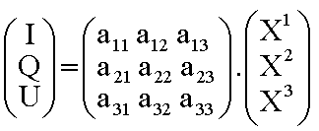
Schematic Level 0-1b processing
For each channel (k,a)
and pixel
Level 0 products
Dark Current correction
Smearing corrections (VNIR CCD detector)
Non-linearity corrections
Stray -light correction
corrected for artefacts
(I,Q,U) retrieval assumes perfect registered (X1, X2, X3) counts
Multispectral, multipolarisation & optical head registration
RIM inversion
Radiometric part of
Level 1B products

Slide 11
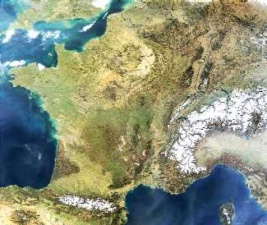
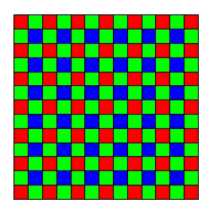
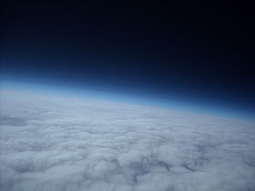
Schematic Artefact Localisation in the Detection Chain
Sensor (CCD matrix)
Level 1B
Electronics (CAN)
Optics
I(x,y): Radiance (continuous value)
Pixel (l,p)
X(ℓ,p): Measured numerical counts (sampled value)
Sensor
Observed scene
Point (x,y)
RIM inversion
Stray light
Non-linearity
Smearing (VNIR CCD)
Dark Current
X(ℓ,p): registered (cleaned geometric distorsions) numerical counts
Corrections
X(ℓ,p): cleaned artifacts numerical counts
Multispectral &
multipolarisation
registration

Slide 12
Outline
3MI: Introduction
3MI: Radiometric Instrument Model
3MI: Radiometric Characterisation
3MI: In-flight Calibration

Slide 13
3MI Calibration
The Level 1b processor has to be well characterised on-ground
i.e artefacts correction, registration, and nominal calibration coefficients to retrieve the L1b radiances (I,Q,U)
The L1b radiances (I,Q,U) will be used for an in-flight updated of the calibration using vicarious calibration methods
Calculation of calibration coefficients is done offline and is fed recurrently into the operational L1b processing
The vicarious calibration needs:
  Well characterised ground targets and atmosphere RT calculations
  Inter-calibration with other satellite instruments

Slide 14
Schematic Level 0-1b processing
For each channel (k,a)
and pixel
Level 0 products
D_{k,a}
Dark Current correction
Smearing corrections (VNIR CCD detector)
Non-linearity corrections
Stray -light correction
corrected for artefacts
(I,Q,U) retrieval assumes perfect registered (X1, X2, X3) counts
Multispectral, multipolarisation & optical head registration
RIM inversion
Radiometric part of
Level 1B products

Slide 15
Outline
3MI: Introduction
3MI: Radiometric Instrument Model
3MI: Radiometric Characterisation
3MI: In-flight Calibration

Slide 16
In-flight Calibration
In-flight calibration using vicarious calibration methods:
  Calibration using natural targets approach
  No on-board device to help
  → rely as much as possible on stability
  Impossible to cover the wide range of calibration through one single method
  (absolute, temporal monitoring, multi-spectral, multi-directional…)
Calibration methods
  Each method is powerful for one or more aspect of the problem:
    accuracy for a given spectral range
      shorter wavelengths, SWIR bands,
    accuracy for spectral calibration using a reference channel
      accuracy for temporal aspect using stable target
  Unique method does not exist
    → it is required to use all possible methods

Slide 17
In-flight Calibration Strategy
The 3MI vicarious calibration is based on the PARASOL heritage
The 3MI additional SWIR channels have to be taken into account as well
Each methods will be used either as nominal or for validation of a nominal methods
Calibration Methods | Applicable Spectral Range | Monitoring Level
Absolute Calibration: Rayleigh | >410 to 670 nm | Nominal
Inter-band Calibration: Sun Glint | >410 to 670 nm | Validation
 | 754, 865, 1650 and 2130 nm | Nominal
 | >763 to 910 nm | Validation
Inter-band Calibration: DCC | >410 to 865 nm (except for 763 nm) | Nominal
Cross-calibration: Desert | >410 to 2130 nm (except for 1370 nm) | Nominal/Validation
Cross-calibration: Antarctica | >410 to 2130 nm (except for 1370 and 1650 nm) | Nominal/Validation
Cross-calibration: METimage | 443, 754, 1650, and 2130 nm | Validation
 | 763, 910, and 1370 nm | Nominal (together with Sun-glint for 763 and 910 nm)
Notes:
The DCC targets seem to be the most promising and could, in addition to the inter-band calibration, be used for multi-temporal and even cross-calibration. However there will be restriction for the use of the DCC in the SWIR channels. This has to be confirmed with sensitivity studies for the SWIR as the cloud reflectance dramatically decreases at longer wavelengths. The sun-glint targets could benefit from information (e.g. ocean roughness, wind speed) provided by other EPS-SG instrument like SCA. Improvements are expected e.g. on the Rayleigh scattering method or the calibration over desert sites and Antarctica. Regarding the current 3MI timeframe, i.e. horizon 2020-2040, the evolution of the scientific knowledge could allow performing an absolute calibration over the full 3MI spectral range with an accuracy close to 2% (depending on the wavelength). Adding multi-temporal calibration information will even allow for an accuracy slightly better than 1% (also depending on the wavelength).

Slide 18
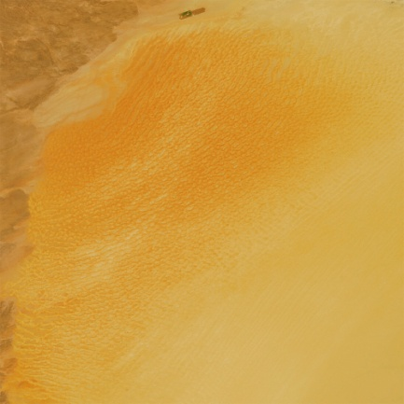

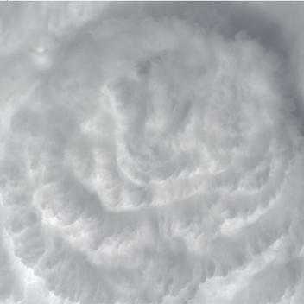
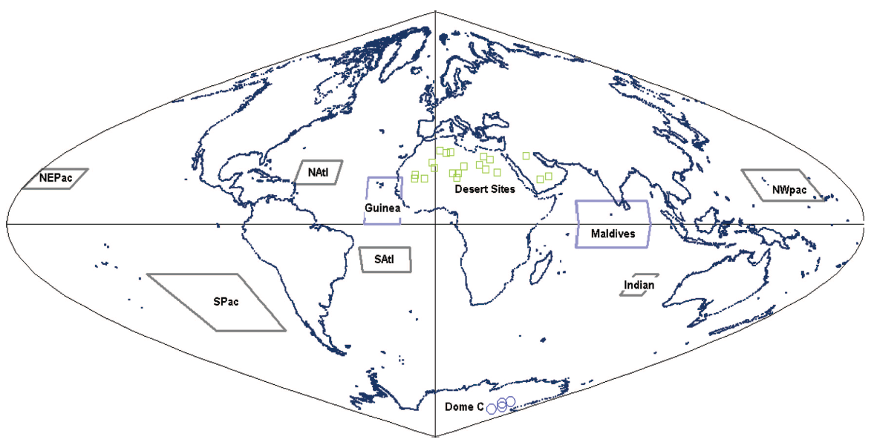
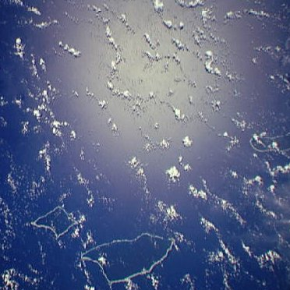
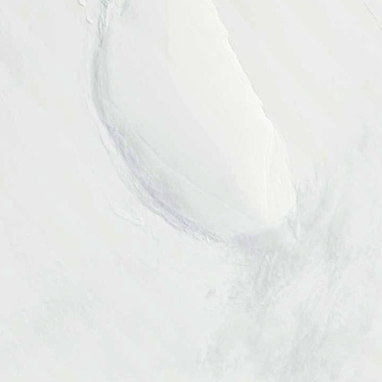
Reference Targets
20 desert sites
Every day
6 main oceanic sites
10 days/month
2 oceanic coudy sites
10 days/month
Modified from:
Fougnie et al., 2007
4 Antarctic sites
every day
during 3 months

Slide 19
Synergy with other EPS-SG Instruments
3MI
Primary objective:
AOD
Aerosol particle size
Aerosol type
Aerosol height index
Aerosol absorption
artefact correction e.g. anisotropy from scattering and multi-polarisation
artefact correction e.g. anisotropy from scattering and multi-polarisation
Channel baseline of 3MI & METimage with respect to the aerosol measurements has been made on the basis they fly together with Sentinel-5 & IASI-NG
spectral calibration – complementary channels
spectral calibration – complementary channels
Some aerosol parameters can be retrieved
BUT
Cirrus cloud observations required
Multi-viewing and multi-polarisation capabilities
METimage
S-5 & IASI-NG

Slide 20
3MI Cross-calibration
3MI |  | METimage |  | Sentinel 5
Channel | Bandwidth (nm) | Channel | Bandwidth (nm) | Band | Spectral Range (nm)
3MI-2b | 400-420 |  |  | VIS | 370-500
3MI-3 | 433-453 | VII-4 | 428-458 | VIS | 370-500
3MI-4 | 480-500 |  |  | VIS | 370-500
3MI-5 | 545-565 | VII-8 | 545-565
3MI-6 | 660-680 | VII-12 | 660-680
3MI -7 | 758-768 | VII-16 | 758-768 | NIR-2 | 750-775
3MI -8 | 744-764 | VII-15 | 747-757 | NIR-2 | 750-775
3MI -9 | 845-885 | VII-17 | 855-875
3MI-9a | 900-920 | VII-20 | 904-924
3MI -10 | 1350-1390 | VII-23 | 1345-1385
3MI -11 | 1630-1670 | VII-24 | 1620-1640 | SWIR-1 | 1590-1675
3MI -12 | 2110-2150

Slide 21

Thank you
for your attention
More information:
http://www.eumetsat.int/website/home/Satellites/FutureSatellites/EUMETSATPolarSystemSecondGeneration/index.html

Slide 22
EPS-SG: EUMETSAT Polar System- Second Generation
Follow the EUMETSAT Polar System (EPS)
2020-2040 timeframe
Contribute to the Joint Polar System being jointly set up with NOAA
Two-satellite configuration: Metop-SG-A and -B flying in the same orbit, separated by 180°
Metop-like orbit: sun synchronous
low earth orbit at 832 km mean altitude
09:30 local time of the descending node

Slide 23
EPS versus EPS-SG
Metop payload | Metop-SG payload | Metop-SG satellite
IASI: Infrared Atmospheric Sounding Interferometer | IASI-NG: Infrared Atmospheric Sounding Interferometer – New Generation | A
AVHRR: Advanced Very High Resolution Radiometer | METimage: Visible-Infrared Imager | A
AMSU-A: Advanced Microwave Sounding Unit A MHS: Microwave Humidity Sounder | MWS: Microwave Sounder | A
GOME-2: Global Ozone Monitoring Experiment 2 | Sentinel-5: UV-VIS-NIR-SWIR Sounder | A
ASCAT: Advanced Scatterometer | SCA: Scatterometer | B
GRAS: Global Navigation Satellite System Receiver for Atmospheric Sounding | RO: Radio Occultation | A and B
- | MWI: Microwave Imager | B
- | ICI: sub-mm wave Ice Cloud Imager | B
- | 3MI: Multi-viewing, -channel, -polarisation Imager | A

Slide 24
Geophysical Products
Primary objectives:
HQ imagery of aerosol variables over ocean and land
• AODs for accumulation, coarse and total modes at high horizontal resolution
• Aerosol particle size for accumulation, coarse and total modes.
• Aerosol type through Ångström exponent, refractive index, non-sphericity index
• Aerosol height index
• Aerosol absorption
Secondary objectives:
• Improved cloud characterisation through cloud imagery, COD, CTH, and cloud microphysics (phase and effective particle size)
• Land surfaces (surface albedo, BRDFs)
• Vegetation (e.g. Leaf area index, Vegetation type, Fraction of vegetated land)

Slide 25
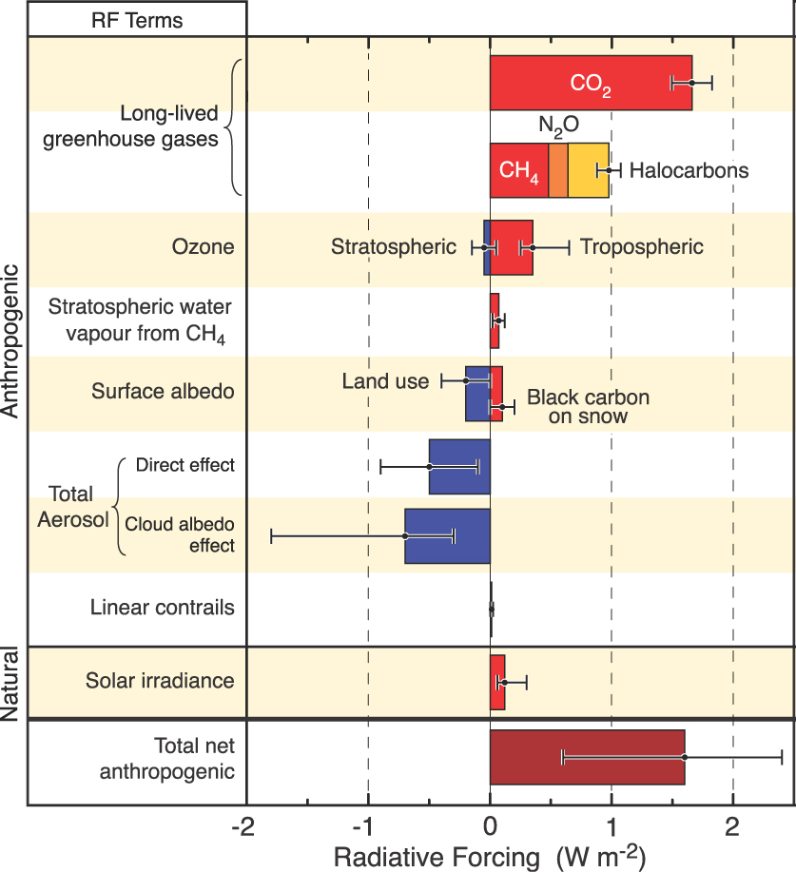
3MI Benefits: Climate Monitoring
Improve knowledge on the aerosol constrain in the radiative forcing of Earth's atmosphere
Using particle size and spatial distribution to separate natural from anthropogenic aerosols
Improvement for model input parameters (e.g. aerosol, cloud, surface characterisation) → Beneficial for other IPCC parameters (e.g. greenhouse gas, albedo)
© IPCC 2007:WG1-AR4

Slide 26
3MI Benefits: Numerical Weather Prediction (NWP)
Identification of cirrus clouds, and cloud cover in general
Correction of deficiencies in the model representation of radiative processes (anisotropy of scattering)
Provision of surface BRDFs, essential for surface radiative variables (e.g albedo, vegetation indices)
Constrain artefacts induced by scattering and polarisation in IASI-NG, METimage , and S-5 measurements

Slide 27
3MI Benefits: Air Quality Monitoring and Forecasting
Monitoring of air quality index
Measurement of particle concentration
(PM2.5 and PM10 aerosol mass load)
Observation of natural hazards, such as volcanic ash or fire plumes
Measurement of land surface variables e.g.
Leaf area index (LAI), Photosynthetically Active Radiation (PAR), Normalised Differential Vegetation Index (NDVI)

