Slide 1
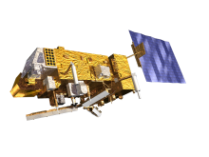

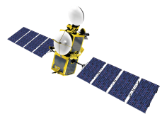
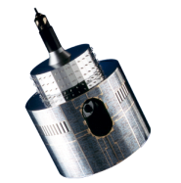
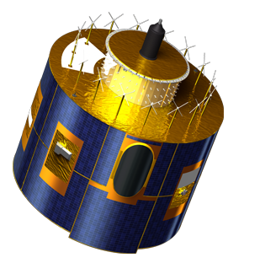
EUMETSAT’s Lunar Calibration Capabilities
Sébastien Wagner, B. Viticchiè, T. Hewison, C. Ledez
Notes:
EUM/STG-SWG/36/14/VWG/15

Slide 2
Outline
Context
Using the Moon as a radiometric calibration source
The EUMETSAT lunar observation archive
Results and detailed analysis
Current limitations
Lunar imagery and MTF characterization
Conclusions

Slide 3
The context

Slide 4
MSG solar band observations
The Instrument: MSG/SEVIRI; 4 solar channels (VIS06, VIS08, NIR16, and HRVIS).
Requirements on the radiance measurements the solar channels:
  10 % for RT/NRT, and
  2 % (per year) for long-term stability.
Calibration method = vicarious calibration via the SEVIRI Solar Channel Calibration system (SSCC, developed by Y. Govaerts and M. Clerici) as implemented in 2003.
SSCC provides the calibration coefficients for MSGs and allows one to monitor the temporal drift of the sensors.
CAVEAT: the drift monitoring is affected by seasonal variations and changes in surface properties.
OPTION: Moon as a complementary target for drift monitoring.

Slide 5
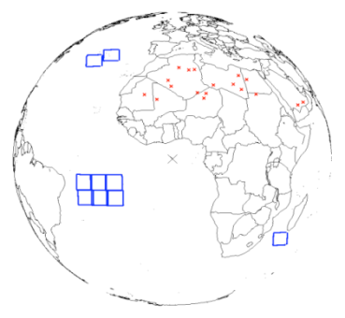
Vicarious calibration: the SEVIRI Solar Channel Calibration system
System in place for SEVIRI (Met-8, Met-9 and Met 10) BUT ALSO for MVIRI (Met-2 till Met-7)
Vicarious calibration:
  Reference = RTM simulations of Top-Of-Atmosphere radiances
  Evaluated against well-calibrated polar-orbiting instruments (SeaWiFs, ATSR2, AATSR, VEGETATION, MERIS)
  Comparison with TOA measured signal
  2 target types used for comparison:
    Desert bright targets (18 targets)
    Dark sea targets (9 targets) (checking purposes)

Slide 6
Using the Moon as a radiometric calibration source

Slide 7
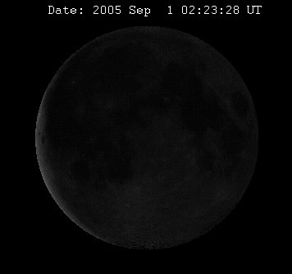
The Moon as a radiometric calibration source
Moon Properties:
Exceptionally stable;
No atmosphere;
Non-uniform appearance, lunar librations;
Non-Lambertian reflectance;
Smooth reflectance spectrum;
Continuous and periodic changes in apparent brightness;
(e.g. phase) ⇒ Can be characterized and modeled.
Moon as a calibration reference
Requires an analytic model with a continuous predictive capability;
Stability of the Moon ⇒ Model valid for any time ⇒
Calibration reference = model
Source : PixHeaven.net / Wikipedia
To date, USGS has the most advanced lunar reference model, based on the ROLO program

Slide 8
The USGS lunar irradiance model
CALIBRATION REFERENCE
  MOON observations ( = ROLO observations):
    More than 8 years of observations done at the RObotic Lunar Observatory (ROLO) (350 – 2450 nm range covered by a total of 32 bands)
    Almost complete range of viewing conditions (geometry + illumination)
  MOON reflectance model ( = ROLO model): empirical model (parameters derived to fit the ROLO observations) in a later stage converted in irradiance (the REFERENCE)
INSTRUMENT TO BE MONITORED
  Extract the lunar imagery
  Calculate the integrated irradiance
  Compare with the ROLO model (REFERENCE)
  Derive the bias and monitor it
ACCURACY OF THE REFERENCE
  5 – 10 % uncertainty in absolute irradiance scale
  ∼ 1 % relative accuracy
⇒
  Good for drift monitoring but not yet for absolute calibration

Slide 9
The EUMETSAT lunar observation archive

Slide 10
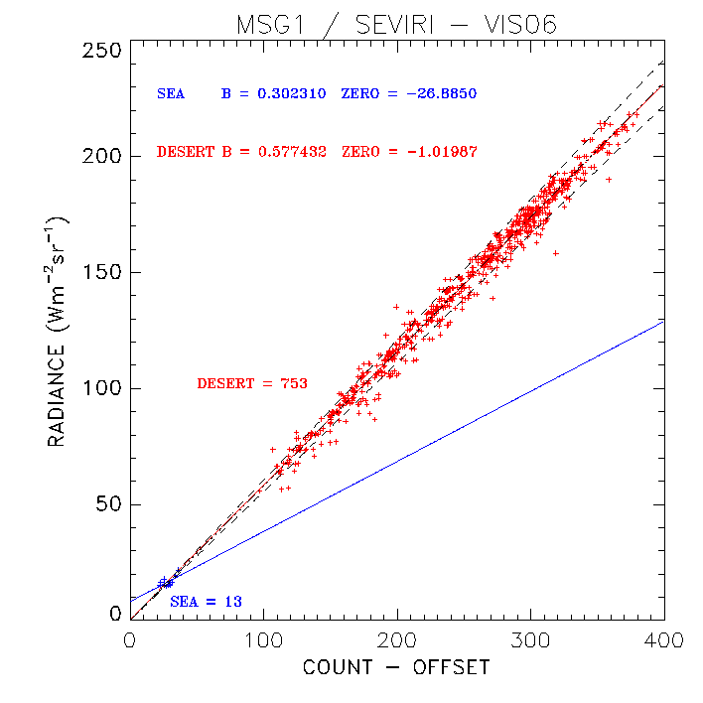
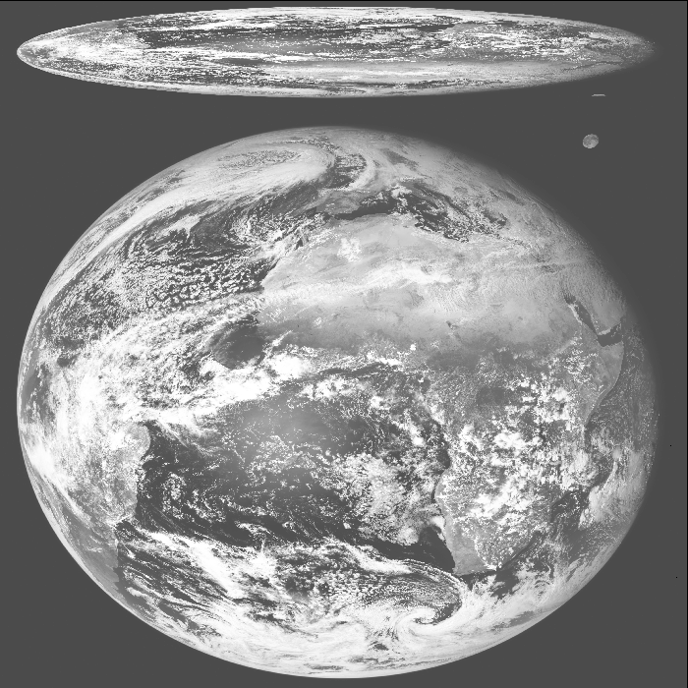
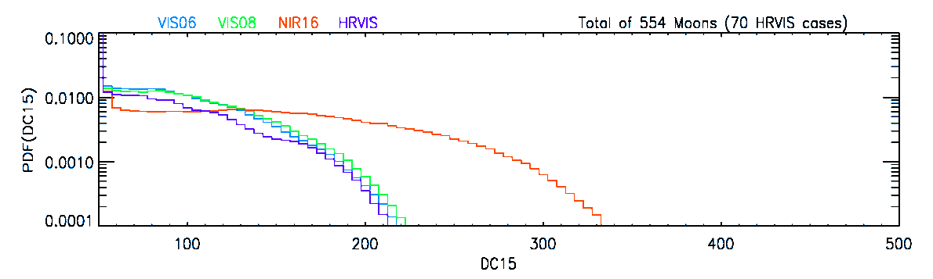
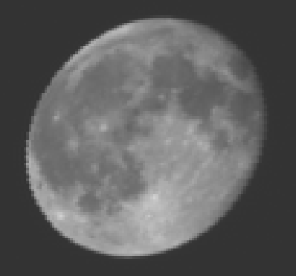
Lunar observations with SEVIRI
    The moon crosses the Field Of Regard periodically
    Up to 4 or 5 observations across the FOR
    About 60 observations / year
    Extraction uses saturation in the IR + detector in-field separation
    ➔ Easy to apply to other instruments
SEVIRI Level 1.0 image
Slide: 10
Notes:
Up to 4 or 5 observations across the FOR in 1h30mm

Slide 11
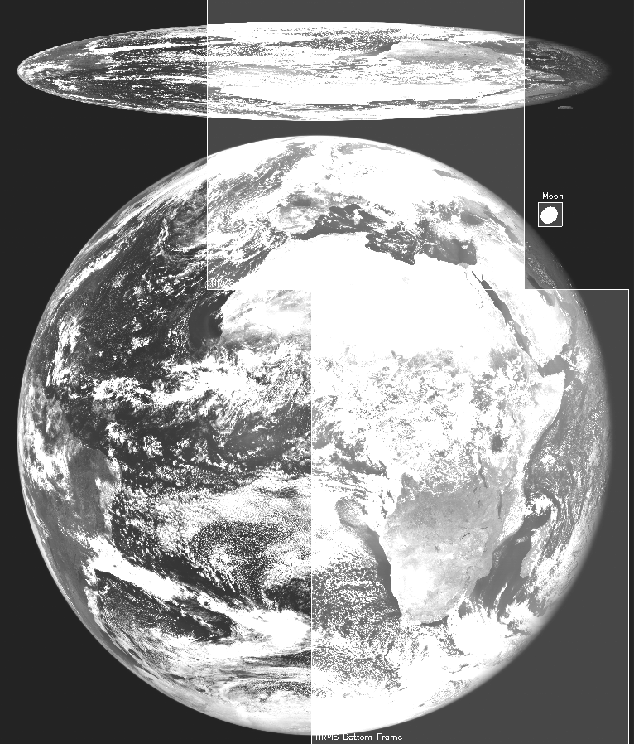
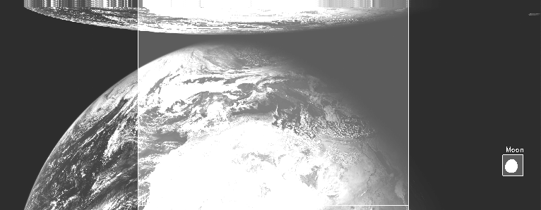
Lunar observations with SEVIRI: availability in the warm channels
Sun-synchronous HRVIS window (super-imposed to low res imagery)
Rapid-Scan Service
Slide: 11

Slide 12
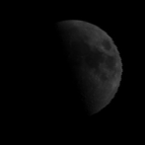
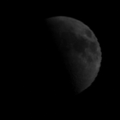
Lunar observations with SEVIRI: analysed datasets
Current datasets:
MSG (1,2 and 3): since beginning 2013: automatic saving of the Moon images + relevant information (including jitter files)
Meteosat 7 (MVIRI)
MSG1: observations used in the MSG1 ROLO run (subset of the archive 2003 - 2012) ordered with increasing phase angles.
 | Time-span | Low-resolution | HRVIS
Meteosat-8 | 2003-present | 549 | 70
Meteosat-9 | 2006-present | 441 | 91
Meteosat-10 | 2013-present | 37 | 3
 | Time-span | VISSN
Meteosat-7 | 1999-2005 | 122
Wide range of illumination (phase angle) + libration covered
➔ Highly relevant for monitoring geostationary instruments
MSG2: observations used in the MSG2 ROLO run (subset of the archive 2006 - 2012) ordered with increasing phase angles.

Slide 13
The Lunar Calibration Prototype at EUMETSAT

Slide 14
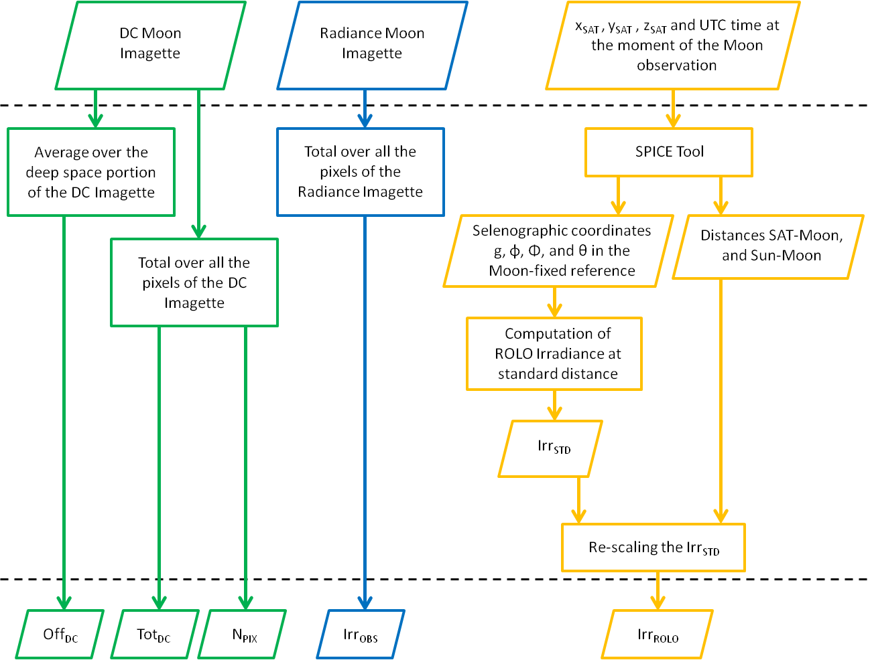
The Lunar Calibration Prototype
Extraction procedure (instrument specific)
Standardized imagette format
External library (JPL) freely available

Slide 15
The Lunar Calibration Prototype
Irradiance bias monitoring ➔ instrument + vicarious calibration monitoring

Slide 16
The Lunar Calibration Prototype
Calibration on the ROLO scale ➔ instrument monitoring

Slide 17
Results and detailed analysis

Slide 18
The Lunar Calibration Prototype
Irradiance bias monitoring ➔ instrument + vicarious calibration monitoring

Slide 19
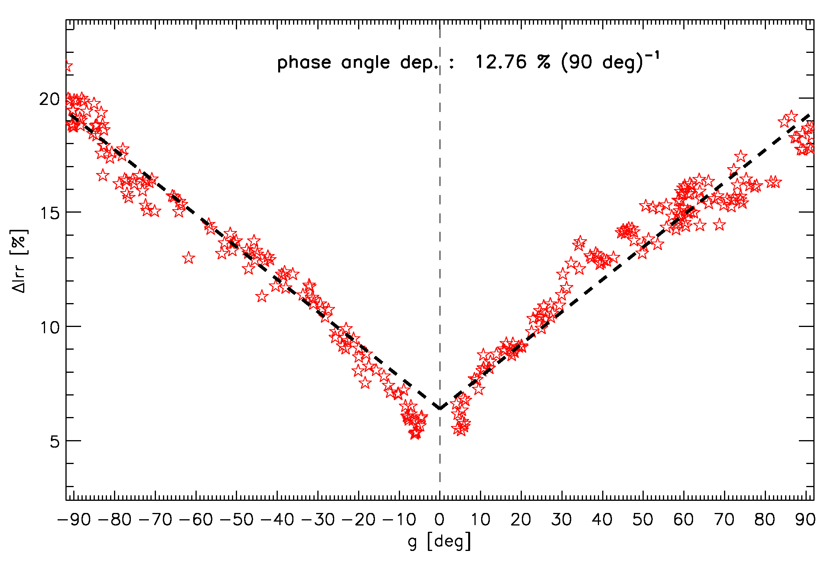
Phase angle dependence
ΔIrr vs. g for the MSG2/NIR1.6 channel
First observed with MSG data
Confirmed by CNES with Pléiades:
  Very agile satellites
  Full coverage of illuminations with dedicated Moon observations
Observed to some extend when adding SeaWifs and MODIS data but considered not critical
  Reduced phase angle interval for dedicated observations
  No monitored bands beyond 0.8 μm
For largely-varying illuminations conditions (as for GEO instruments) correction is critical
 | VIS0.6 | VIS0.8 | NIR1.6 | HRVIS
Meteosat-8 | -0.14 | 1.31 | 12.52 | 4.69
Meteosat-9 | -0.04 | 1.70 | 12.76 | 7.80
Meteosat-10 | -0.76 | 1.15 | 14.56 | N.A.
Phase angle dependence (variation in % in irradiance bias over 90° phase angle for the most complete datasets to date)
Notes:
Important to say that we are looking at another representation of the Delta_Irr (not as a function of time but as a function of the phase angle).

Slide 20
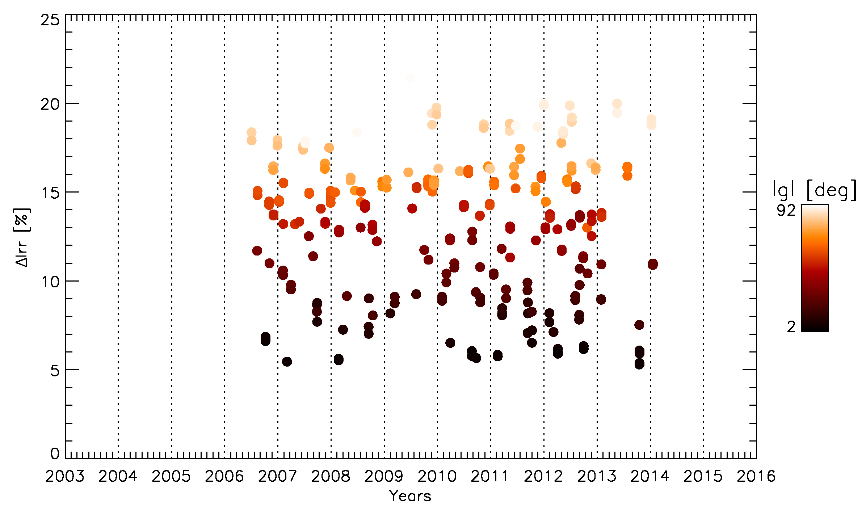
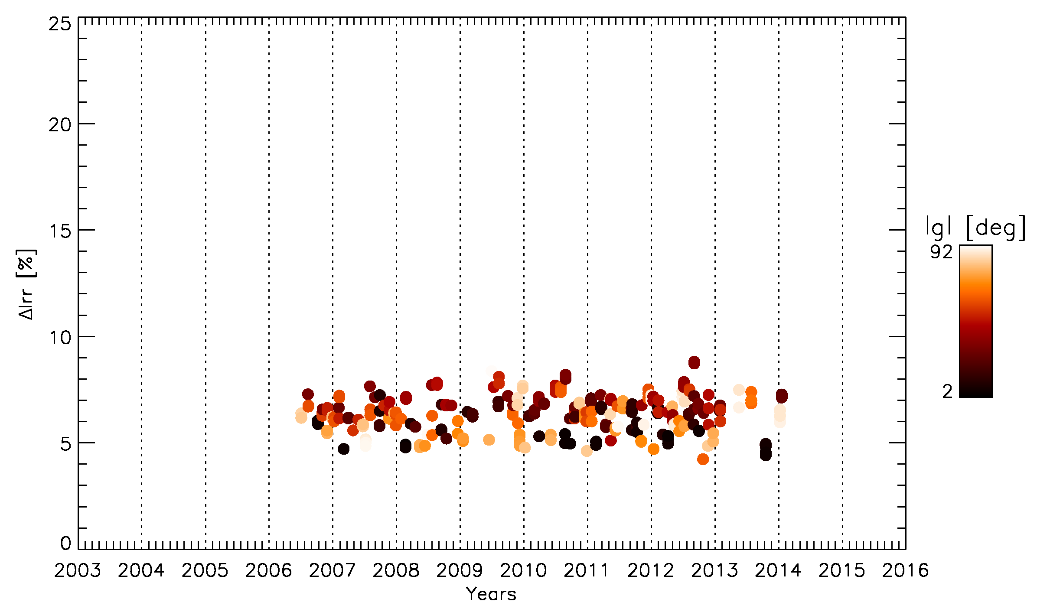
Monitoring the bias in irradiance
Effects of the correction of the phase angle dependence
Before correction
Std Dev = 4.1%
After correction
Std Dev = 0.8%
Irradiance bias as a function of the Moon observation time expressed in years for the MSG2/NIR1.6 channel.
Notes:
Here, we represent the Delta_Irr as a function of time.

Slide 21
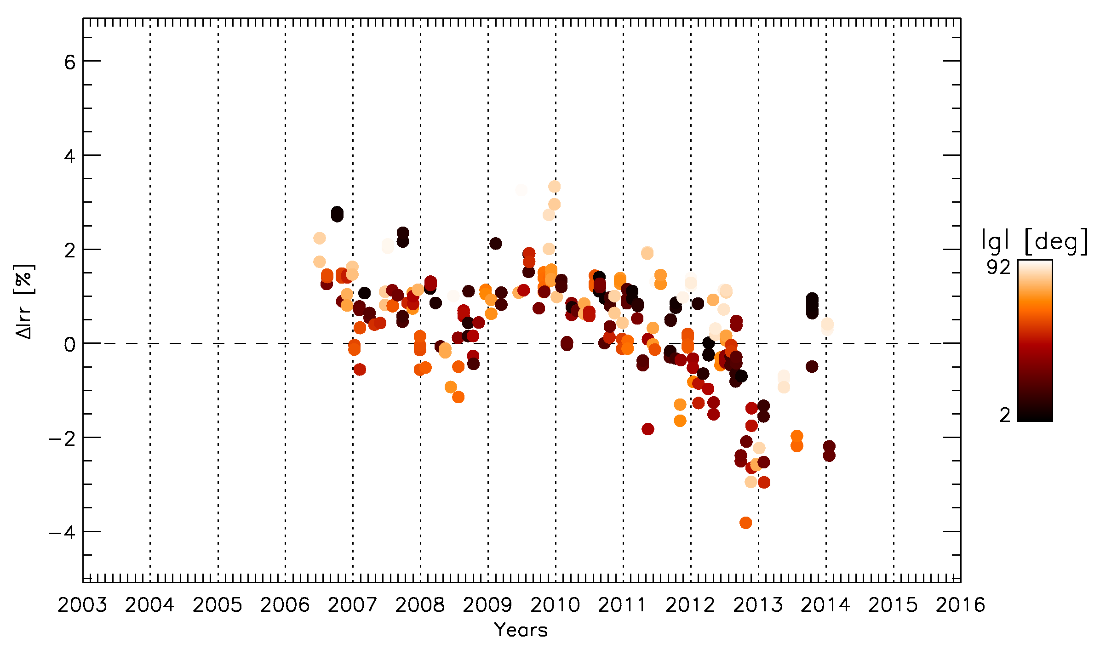
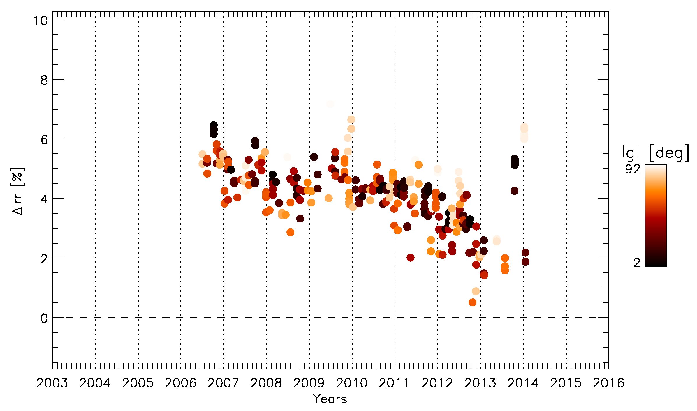
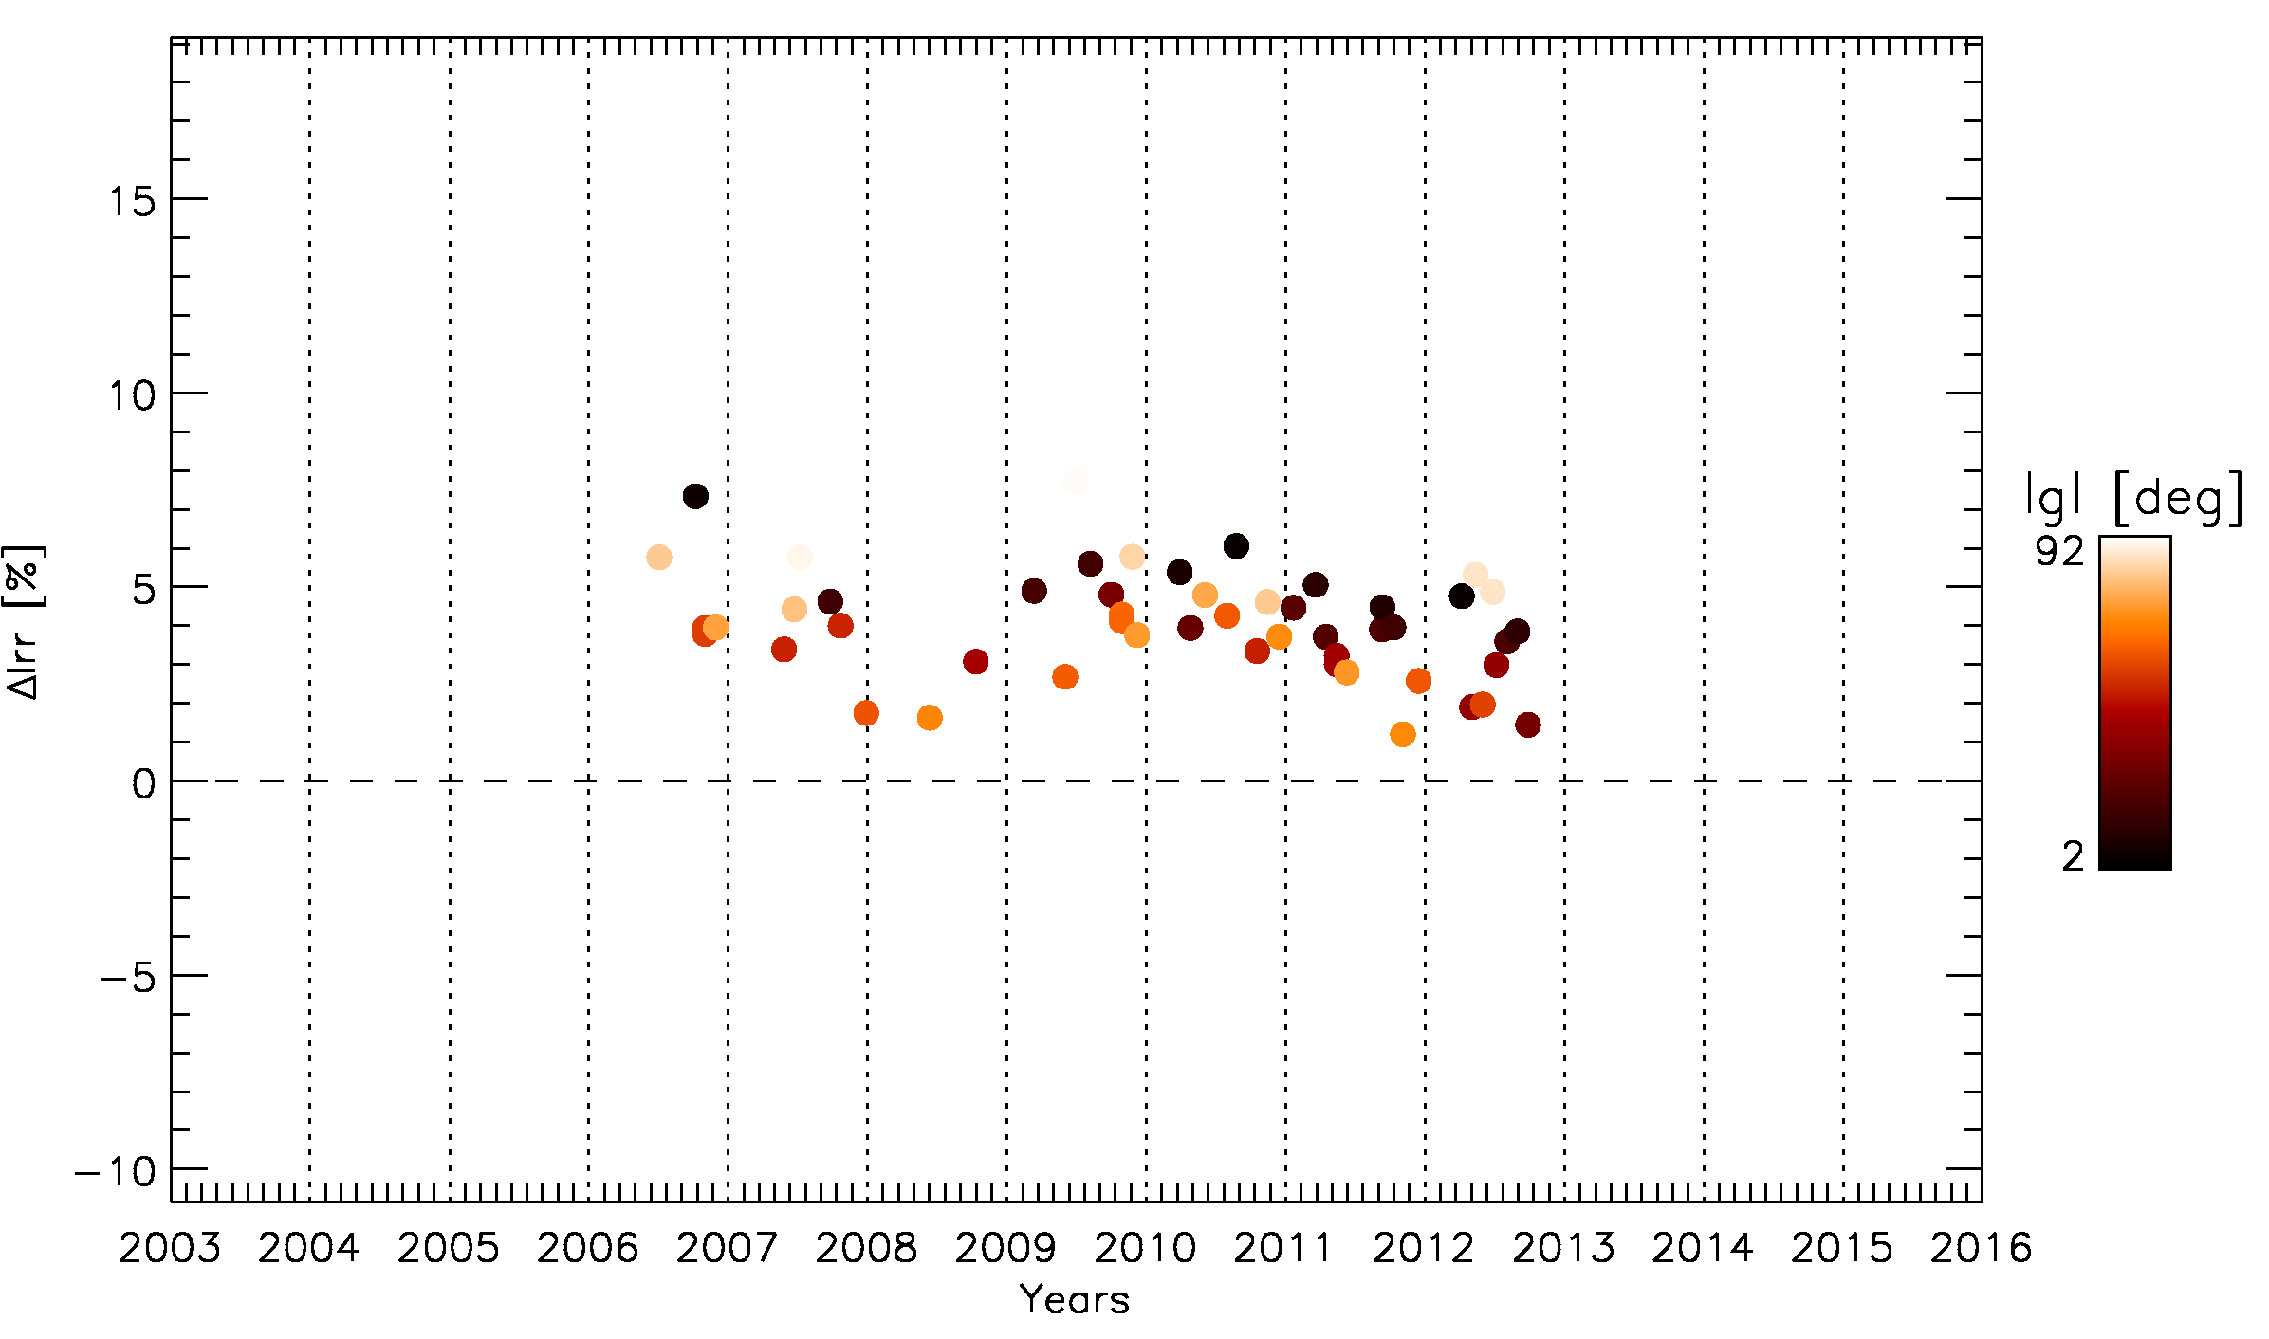
Monitoring the bias in irradiance
Example: Meteosat-9
VIS0.6
VIS0.8
Slope of ΔIrr = 0 ⇒ the calibration compensates the instrument drift
NIR1.6
HRVIS
Example of irradiance bias as a function of the Moon observation time expressed in years for MSG2.

Slide 22
Monitoring the bias in irradiance
Example: Meteosat-9
VIS0.6
VIS0.8
Slope of ΔIrr = 0 ⇒ the calibration compensates the instrument drift
NIR1.6
HRVIS
Example of irradiance bias as a function of the Moon observation time expressed in years for MSG2.

Slide 23
The Lunar Calibration Prototype
Calibration on the ROLO scale ➔ instrument monitoring

Slide 24
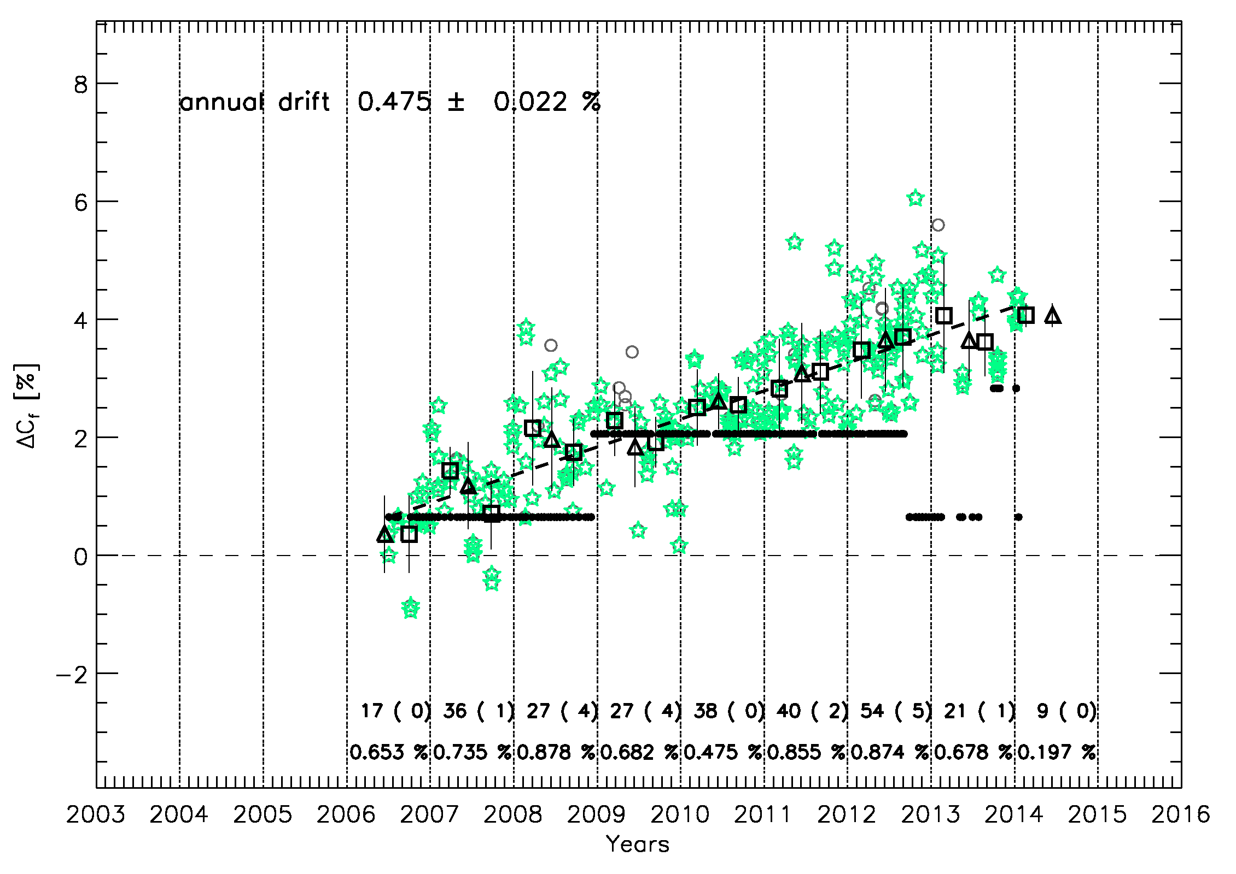
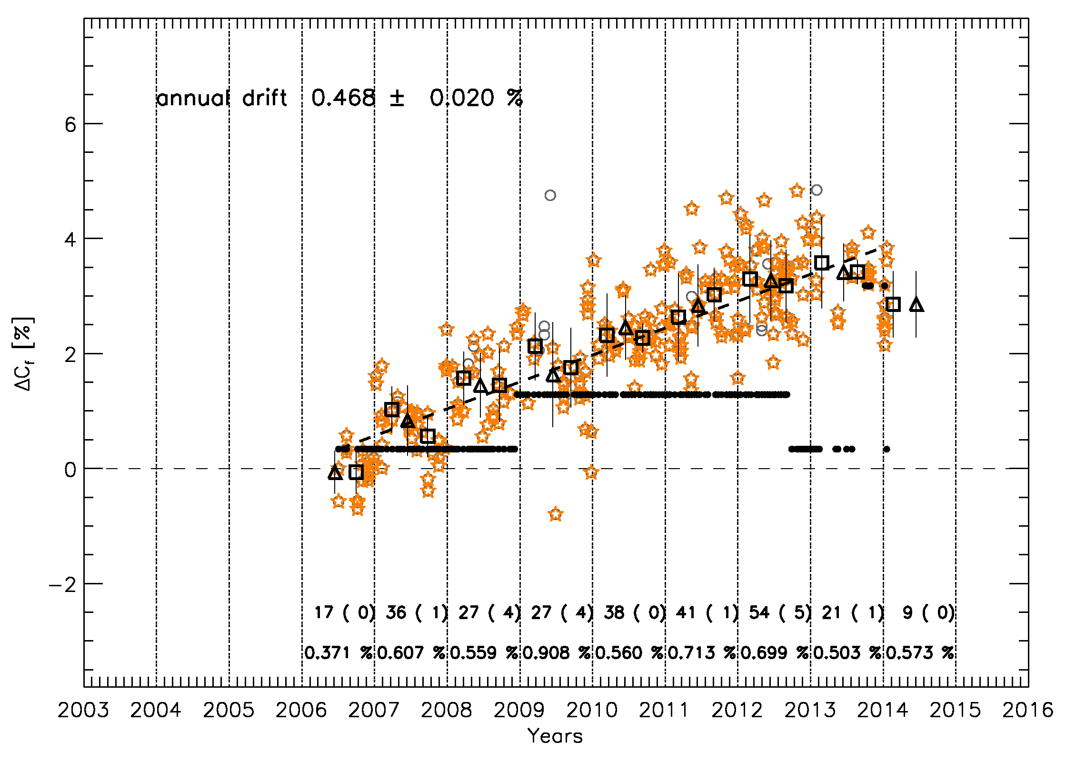
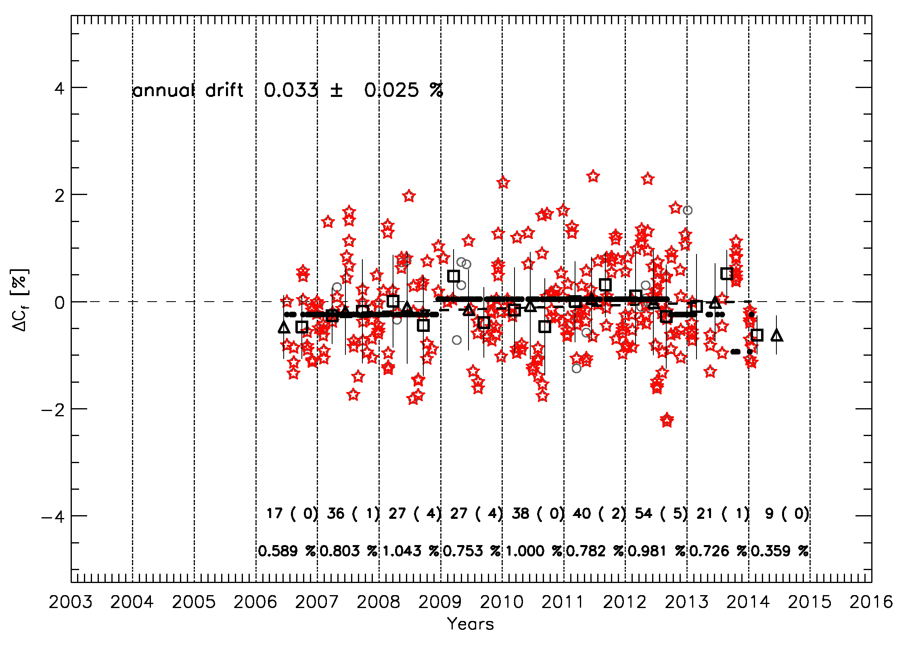
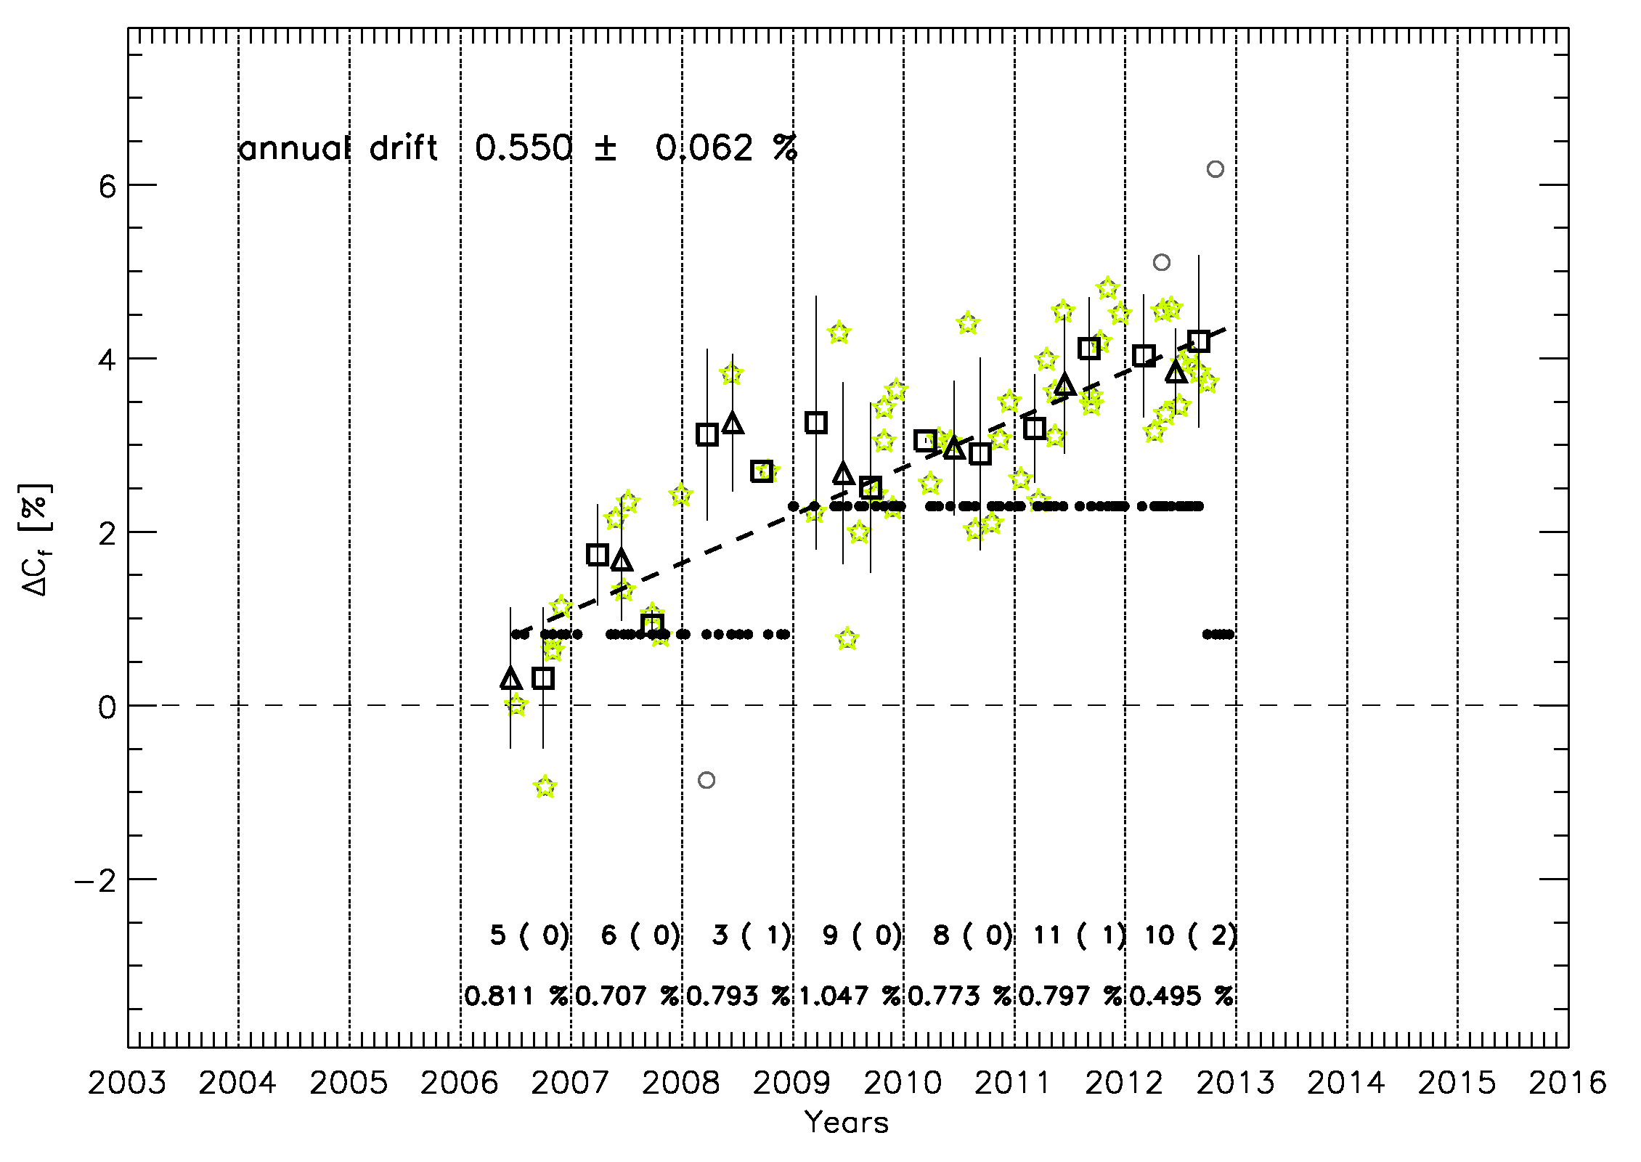
Monitoring the drift on the ROLO irradiance scale
Example: Meteosat-9
VIS0.6
VIS0.8
NIR1.6
HRVIS
Example of gain time series as a function of the Moon observation time expressed in years for MSG2.
Notes:
All channels seem to have a linear drift. So the behaviour in the irradiance bias comes probably from the calibration as provided by the image headers...

Slide 25
Interpreting the results
Example: Meteosat-9
Gain on ROLO scale VIS0.6
Irradiance bias - VIS0.6
Deriving the gain on the ROLO irradiance provides :
An accurate estimate of the instrument drift (after phase dependence correction)
A monitoring tool to evaluate the performances of the vicarious calibration system.
A monitoring tool of the official calibration coefficients provided in the L1.5 image headers

Slide 26
Monitoring the drift on the ROLO irradiance scale
Yearly drift (bold = lunar calibration; between bracket = SSCC)
 | VIS0.6 | VIS0.8 | NIR1.6 | HRVIS
Meteosat-8 | 0.483 ± 0.014 (0.3583 ± 0.228) | 0.444 ± 0.013 (0.3673 ± 0.193) | -0.013 ± 0.018 (0.031 ± 0.180) | 0.493 ± 0.059 (0.398 ± 0.222)
Meteosat-9 | 0.475 ± 0.022 (0.359 ± 0.255) | 0.468 ± 0.020 (0.467 ± 0.249) | 0.033 ± 0.025 (-0.051 ± 0.220) | 0.550 ± 0.062 (0.510 ± 0.285)
Meteosat-10 | -0.841 ± 0.293 (-0.590 ± 2.756) | -0.665 ± 0.203 (-0.318 ± 2.990) | -0.365 ± 0.634 (0.128 ± 2.222) | N.A. (-0.653 ± 2.752)
All current missions are well within the requirements (req. = 2% drift per year).
Results derived from SSCC and from the lunar calibration system are consistent.
The error estimate is an order of magnitude better for the lunar calibration than it is with SSCC.

Slide 27
Current limitations

Slide 28
Phase-angle dependence
Impact depends on:
  The location of the channel on the solar spectrum and the bandwidth
  The range of phase angle in which the Moon is observed
Particularly critical for GEO imagers
2 solutions to remove the phase angle dependence:
  Establish a correction using as many observations as possible ➔ Relies on observation frequency and illumination range.
  Update the ROLO model to remove this dependence ➔ depends on USGS. Recent attempt together with CNES to fund the work failed.
  Impact the monitoring of MTG/FCI and to less extend the monitoring of EPS-SG/METImage

Slide 29
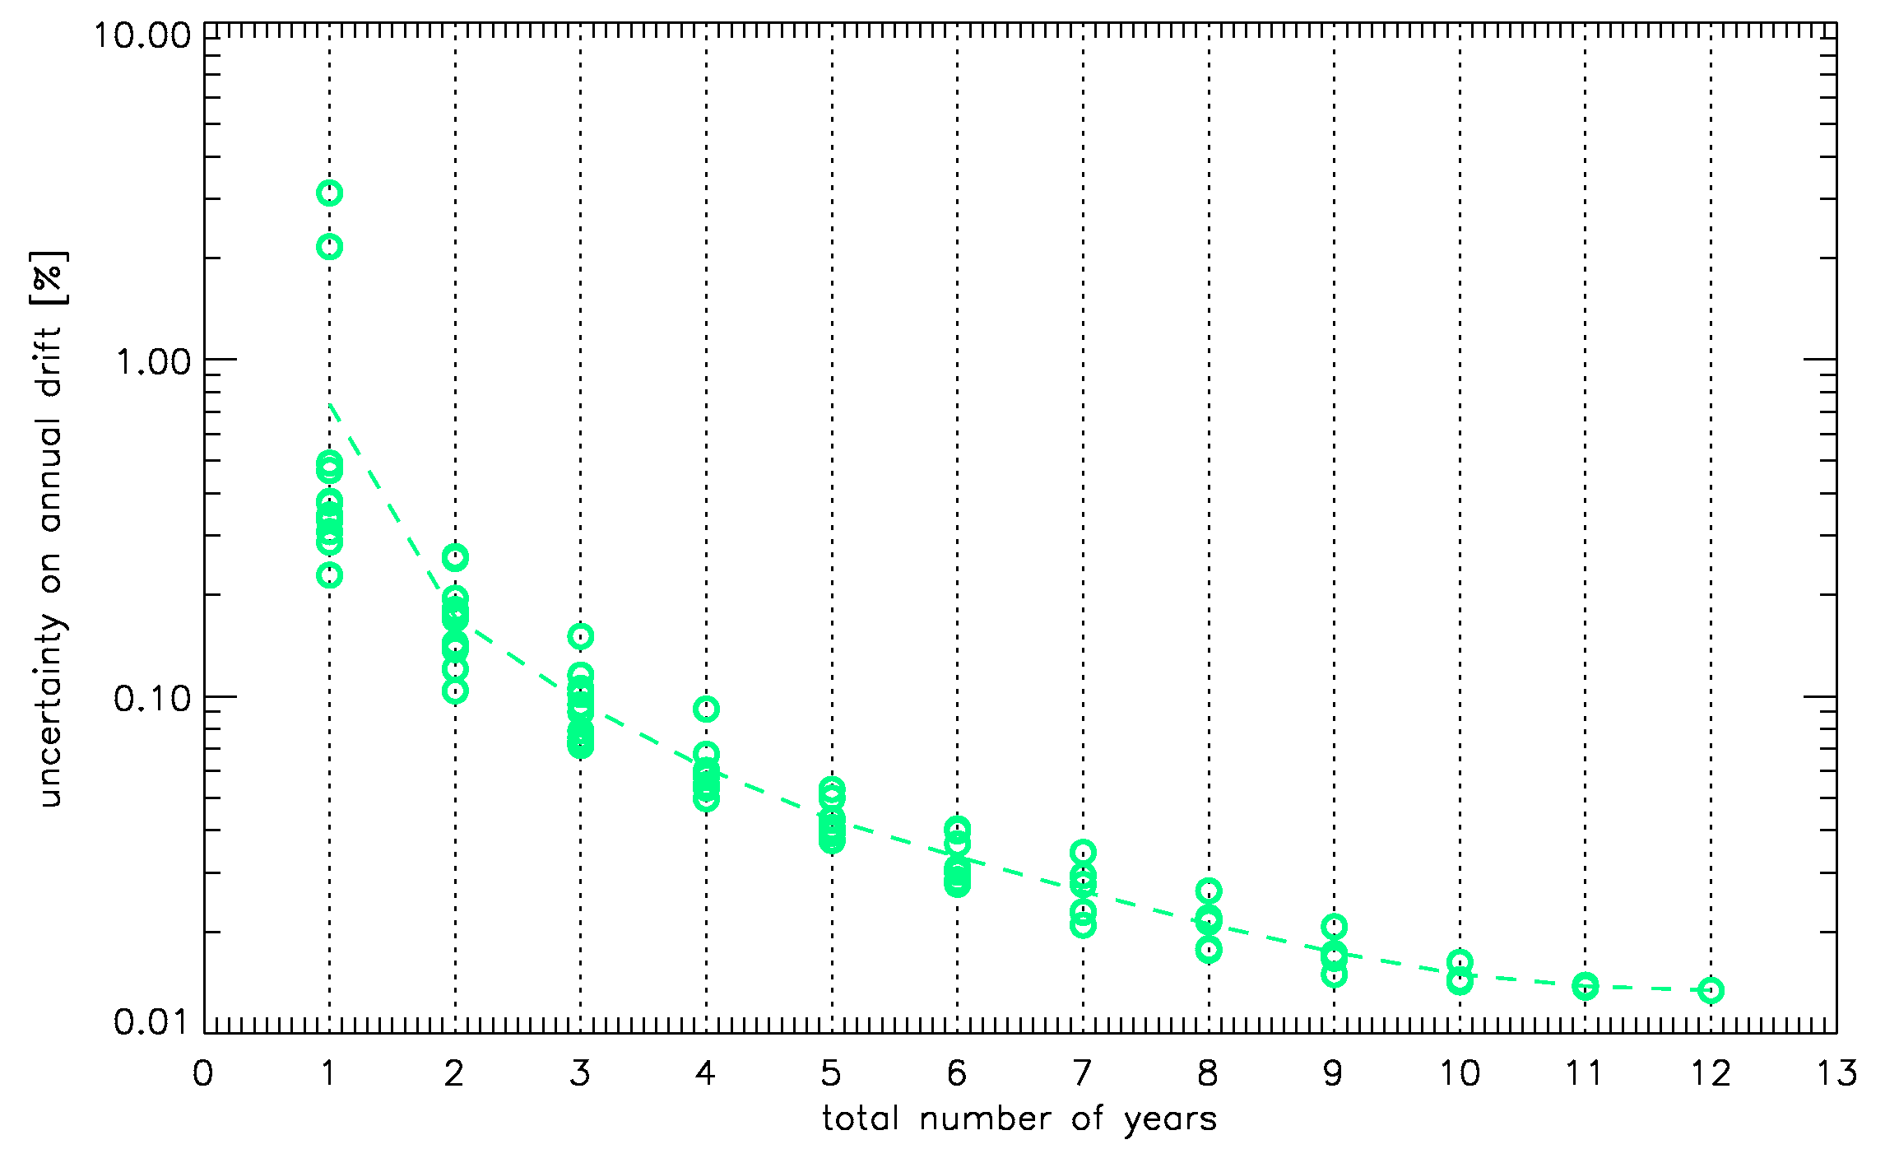
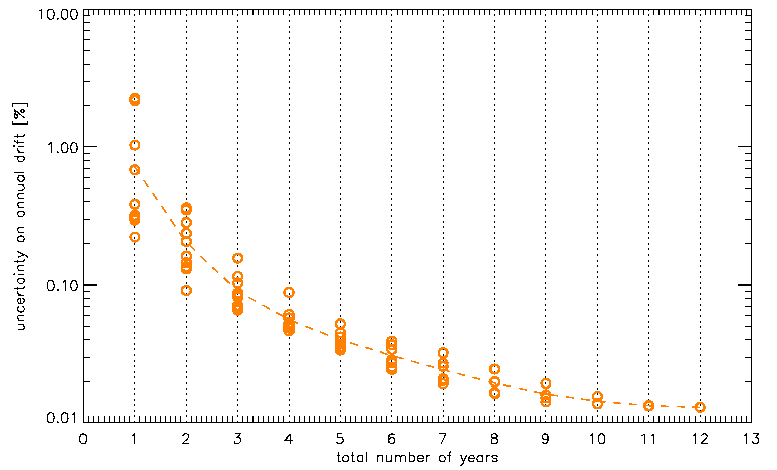
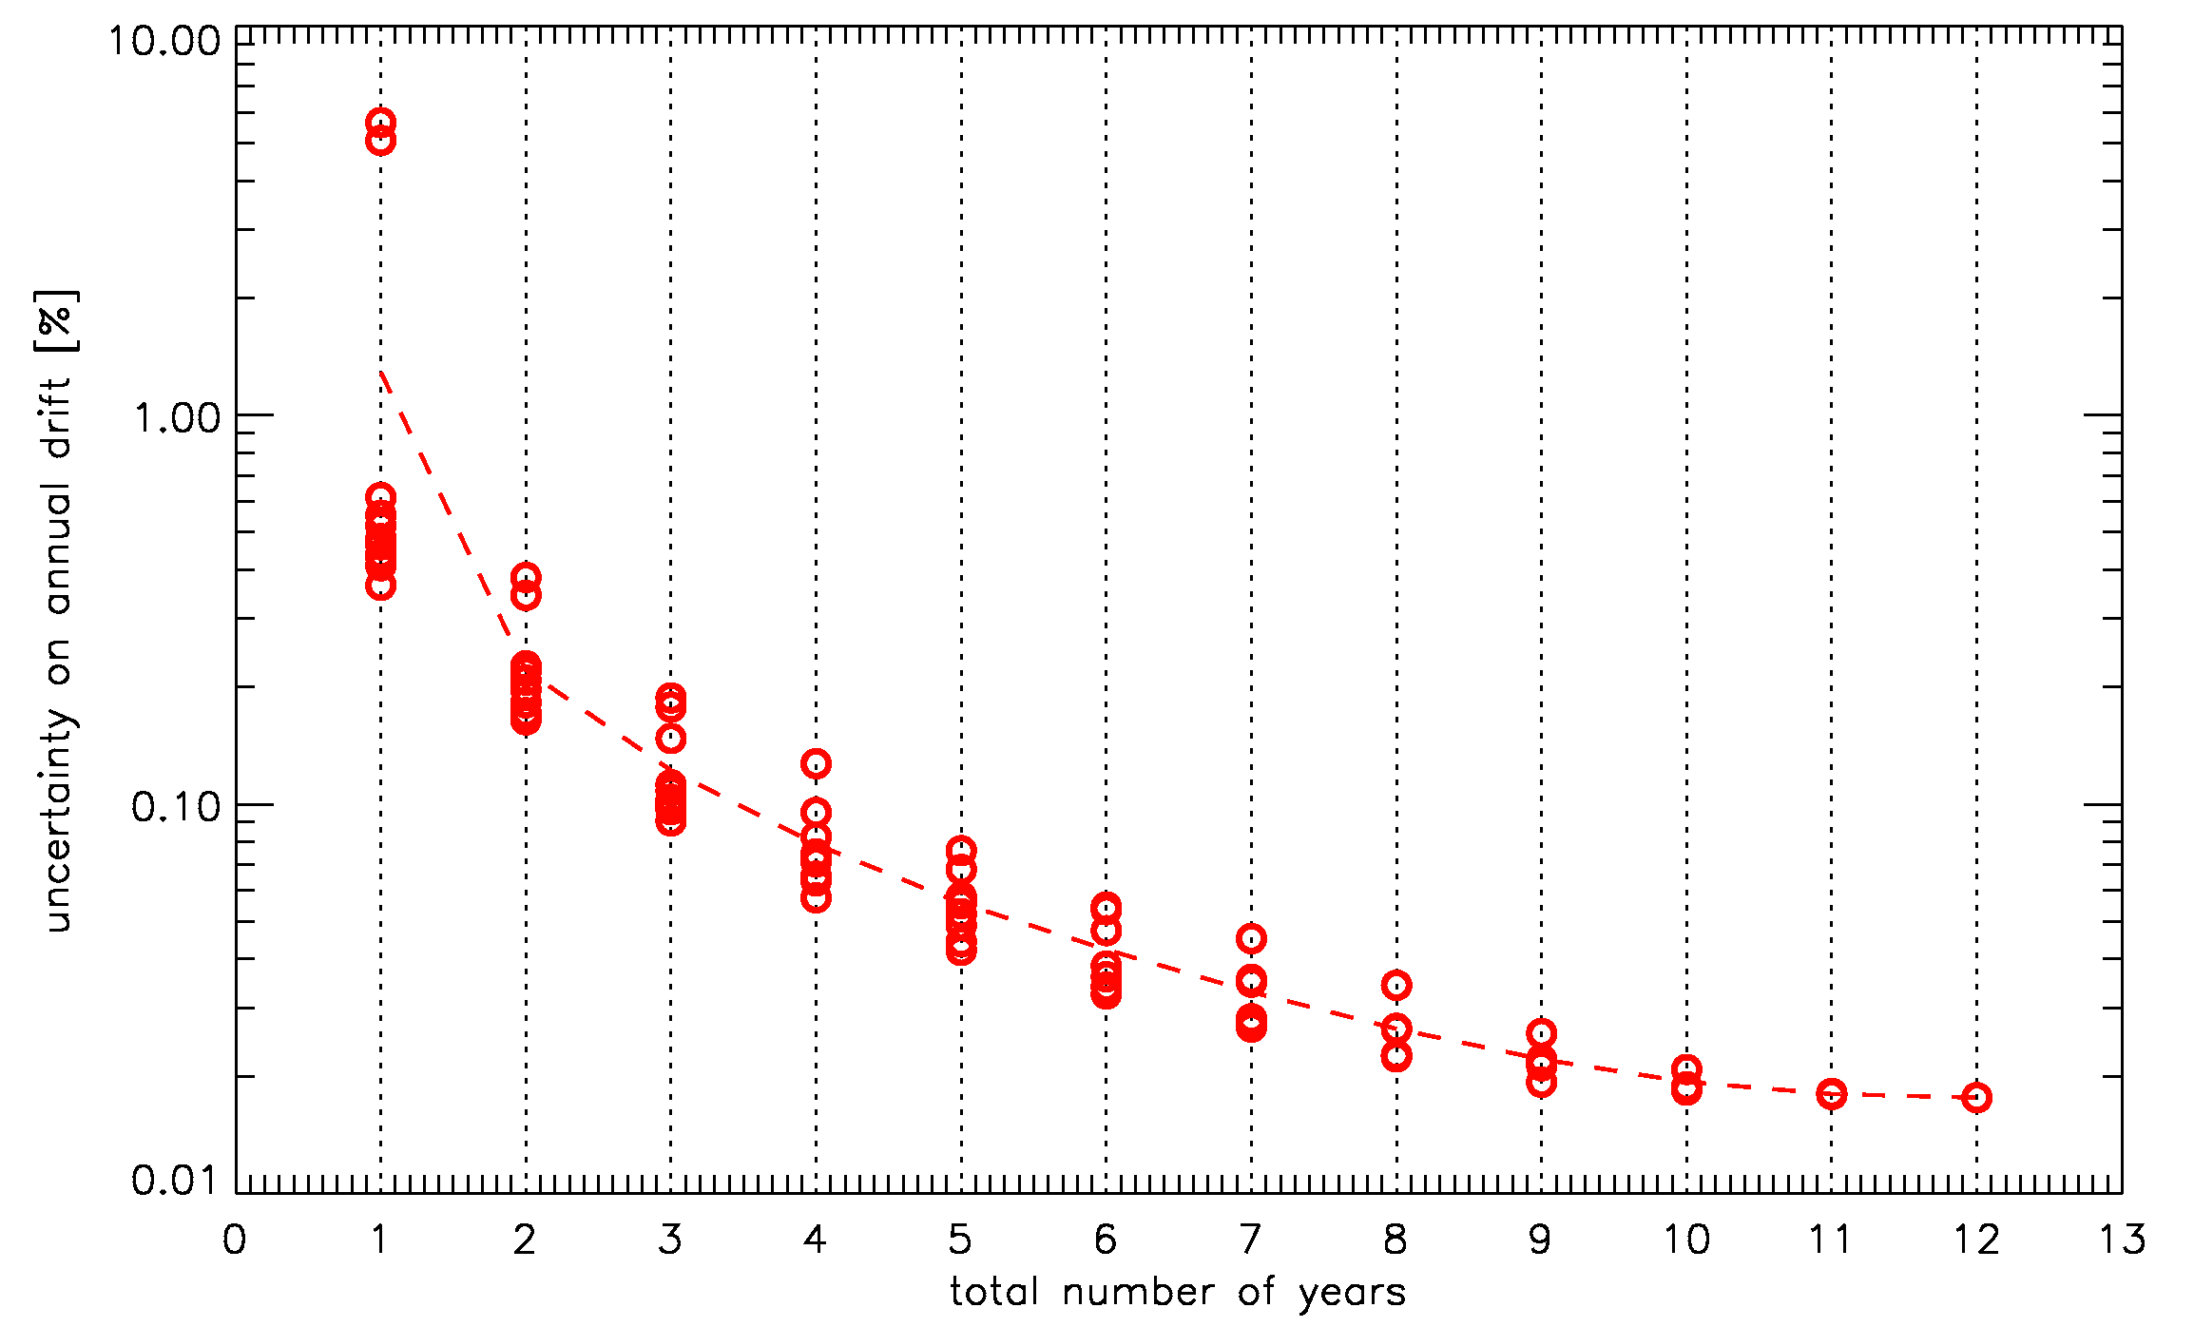
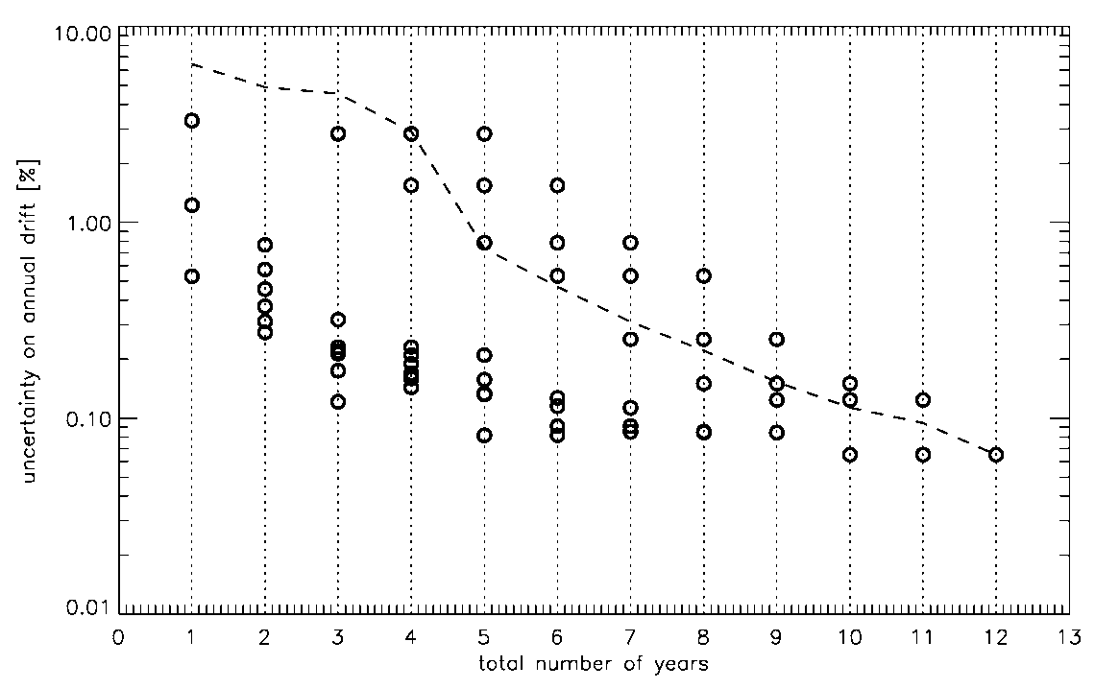
Phase-angle dependence and drift estimate accuracy
Variation of the drift estimate accuracy, using independent time windows including different total number of years
Meteosat-8
VIS0.6
VIS0.8
NIR1.6
HRVIS

Slide 30
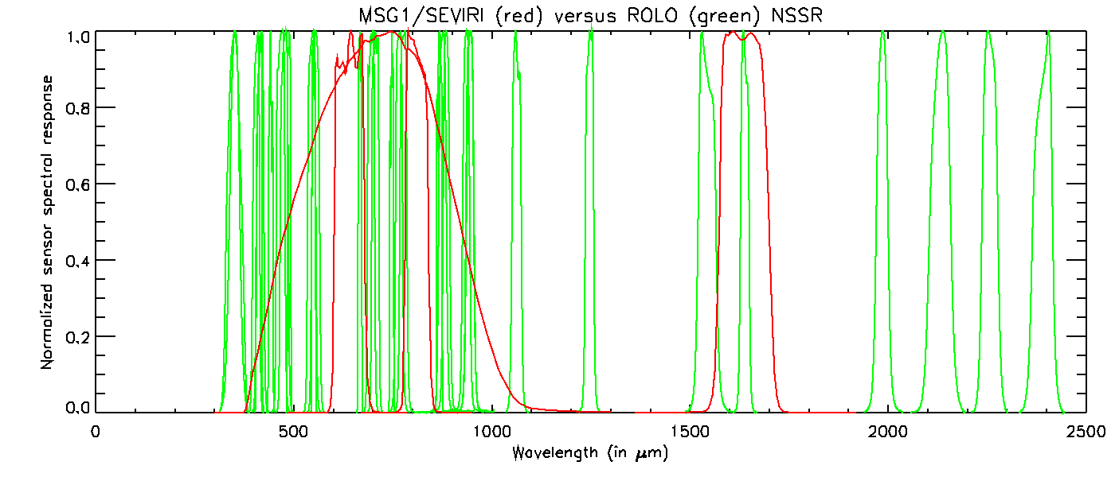
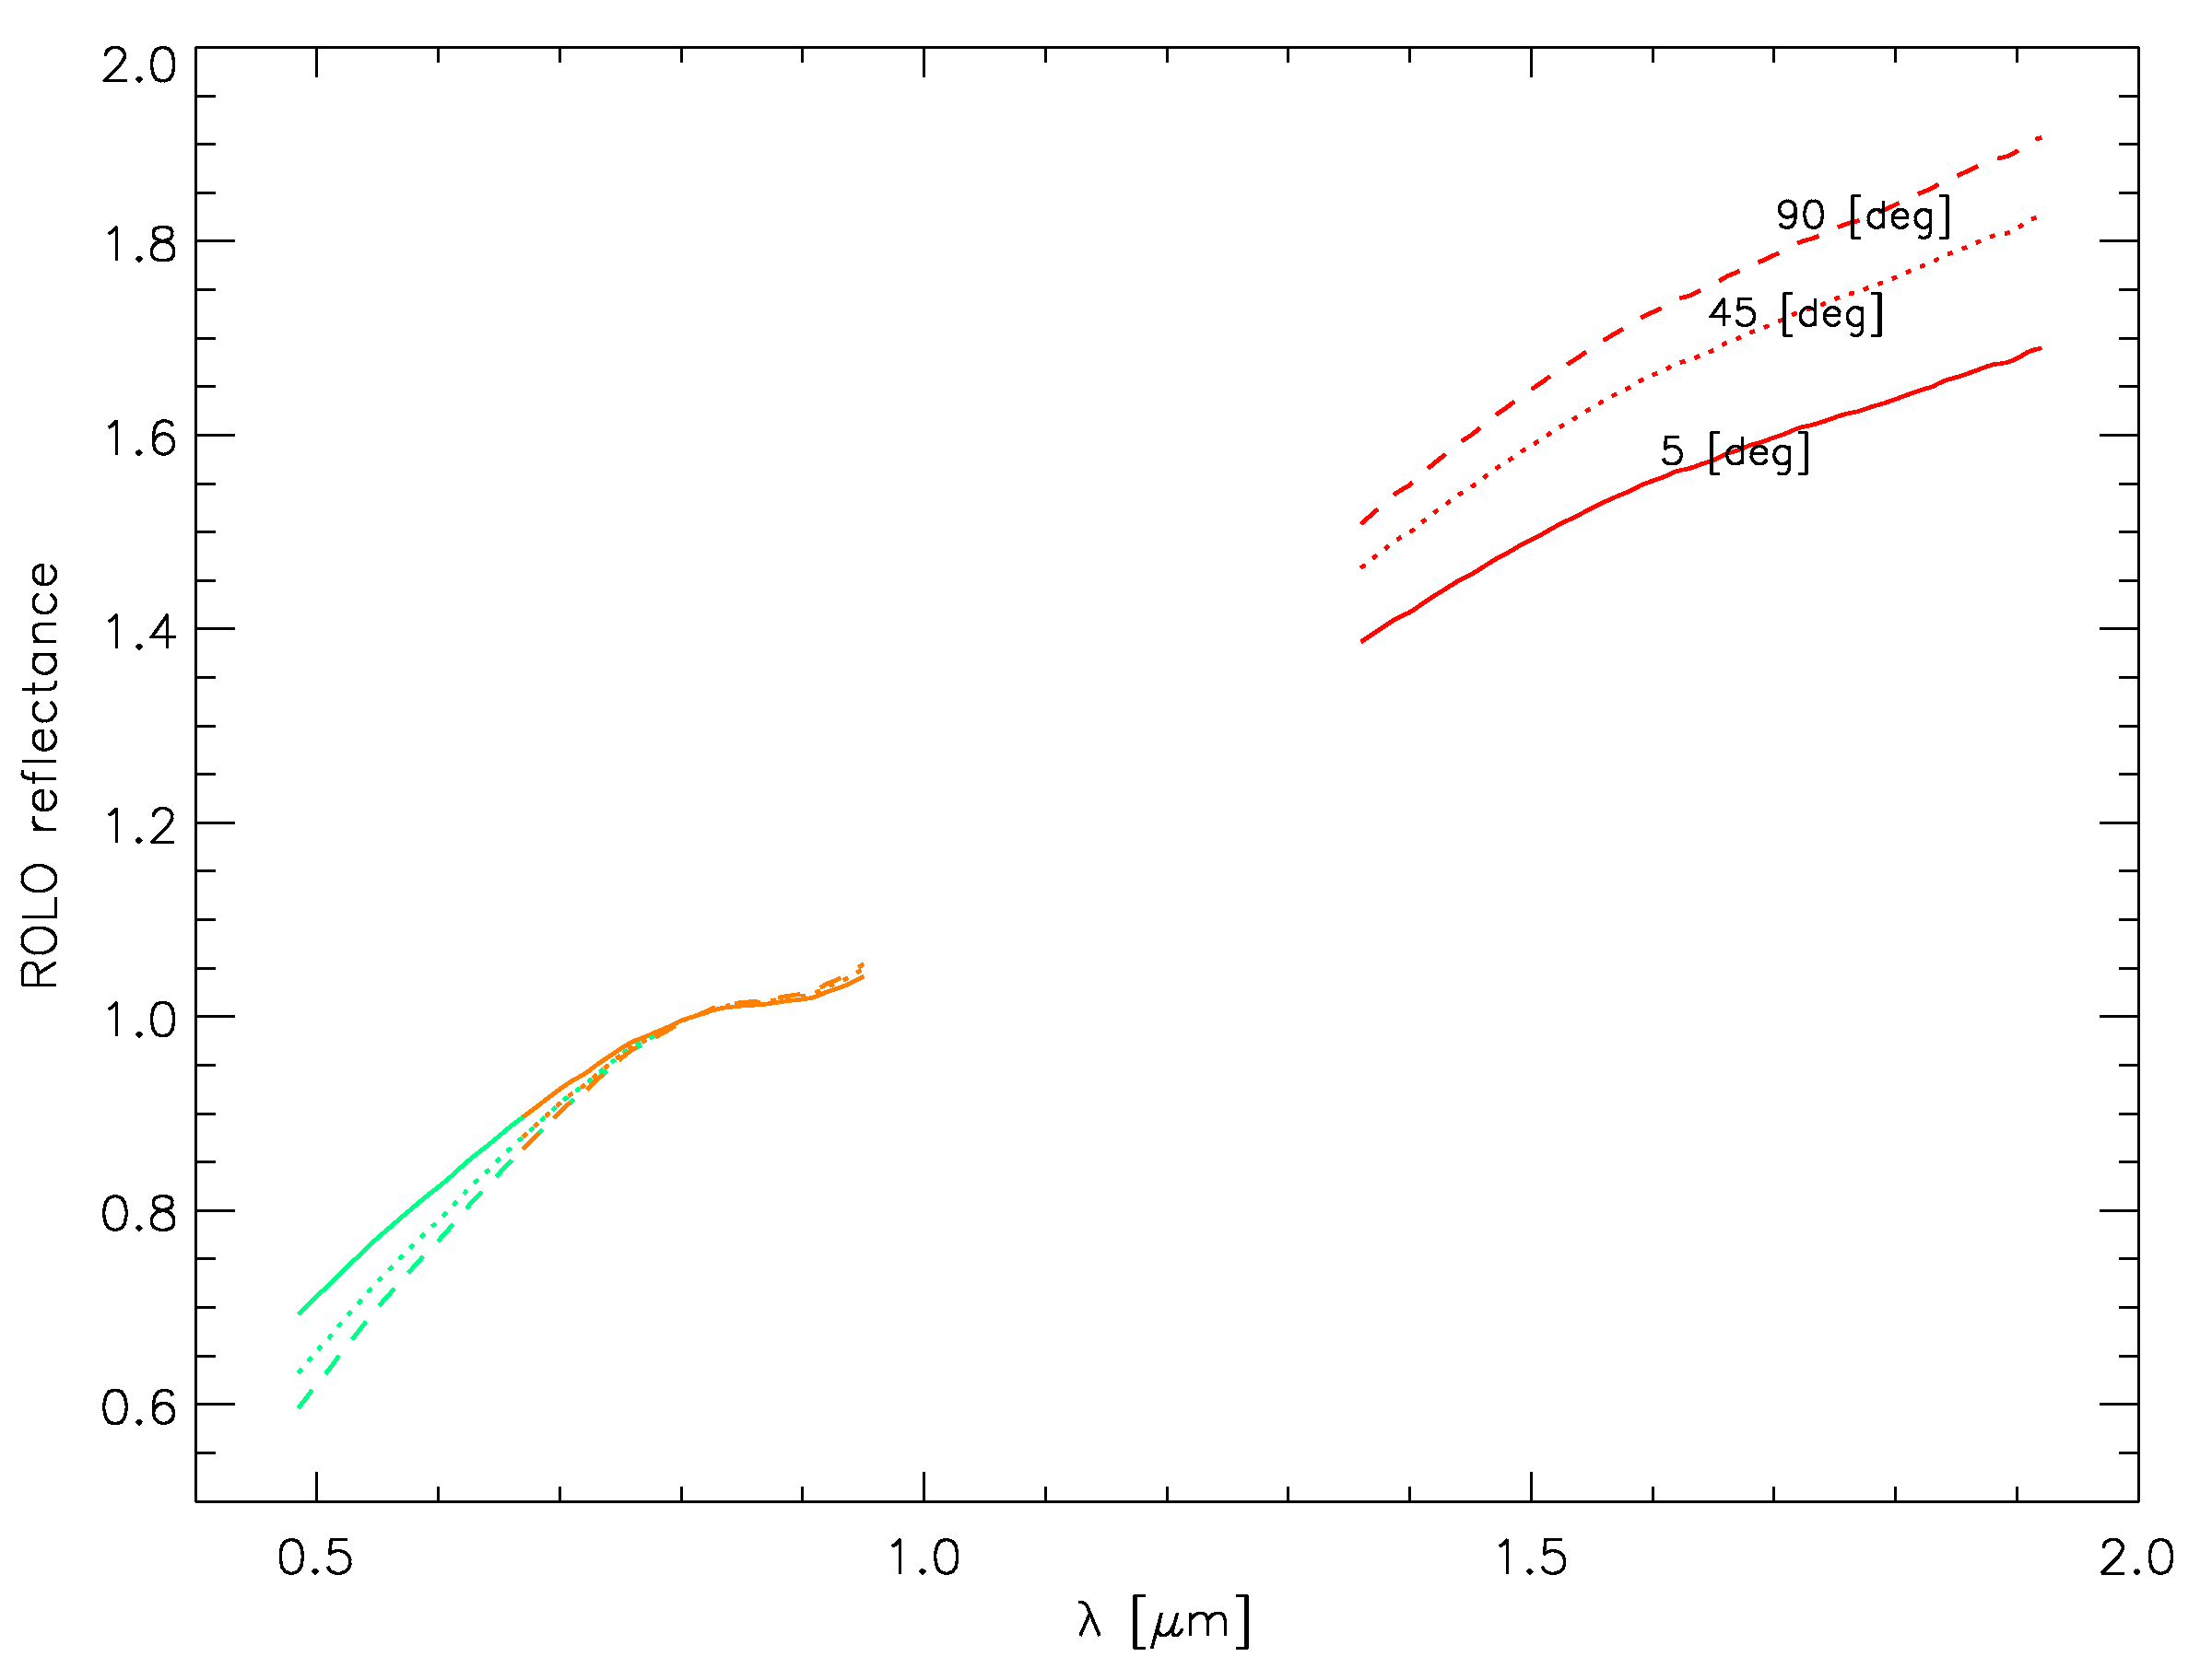
Spectral sampling
To estimate the ROLO irradiance in a specific spectral band of an instrument, the ROLO reflectance spectrum must be estimated for the observation geometry
Lunar reflectance properties + distribution of the ROLO spectral bands ➔ important role in this processing
Lunar colour for 3 phase angles: 5° (plain line), 45° (dotted line) and 90° (dashed line) (normalized to the reflectance at the central wavelength of VIS0.8)
VIS0.8
VIS0.6
Reddening of the Moon when g increases ➔
USGS is aware of this limitation and showed interest in enhancing capabilities
NIR1.6

Slide 31
Future activities

Slide 32
Future activities
Continuing building-up in-house expertise and support to operations
  Continue international collaboration (USGS, CNES, JMA, CMA, etc.)
  Plans for implementing the lunar calibration system into MPSTAR (operational off-line infrastructure)
Support to MTG/FCI and EPS-SG/METImage
  E.g. Moon observation availability in the FOV
Lunar calibration and Meteosat First Generation
  On-going work on MET-07
Inter-calibration and GSICS activities
  Investigate the possibility to inter-calibrate the Meteosat imagers with MODIS using the Moon as a transfer target.

Slide 33
Lunar observations and MTF characterization

Slide 34
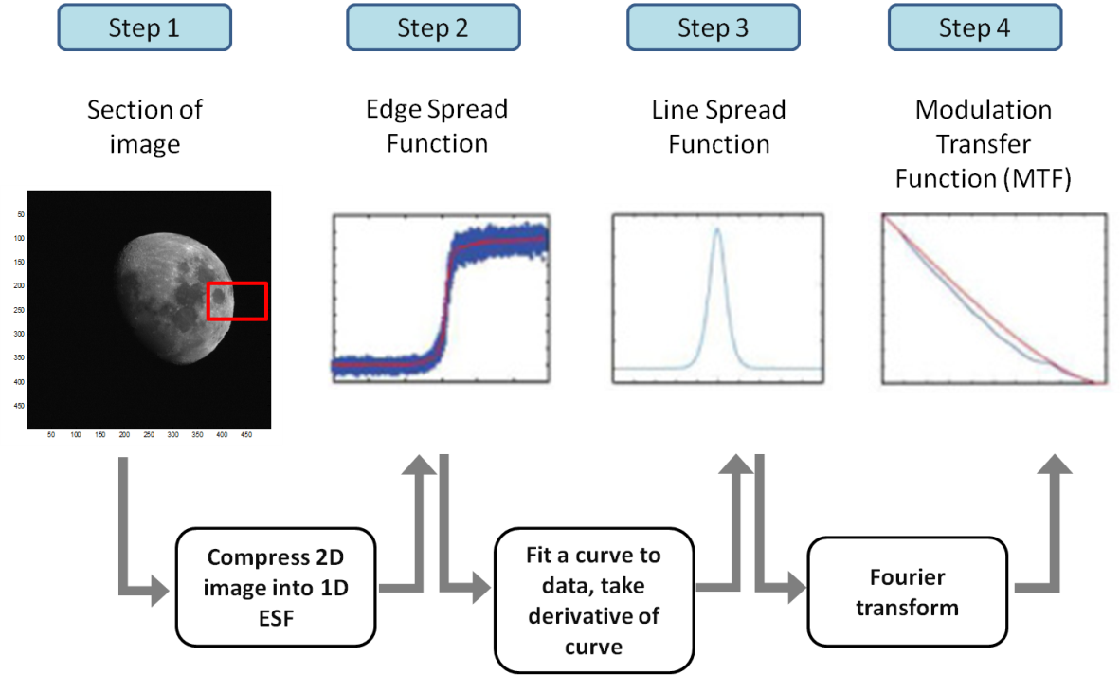
On-orbit MTF characterization
Assessment on MSG-1 over 3½ years (46 HRV images and 176 LRES images)
Good agreement, in particular N-Sc
In-orbit MTF measurement limited to channels with no saturation over the Moon (warm channels for SEVIRI).
For FCI: possibility to change the gains during commissioning ➔ MTF characterization also for IR channels

Slide 35
Conclusions

Slide 36
Conclusions
ACHIEVEMENTS
  Flexible and robust extraction tool in place for the GEOs imagers
  Unique archive of lunar observations from GEOs available
  Applications: instrument monitoring + characterization
  To secure operations, implemented independent version of the ROLO model
  Extremely accurate drift estimate (uncertainty: ~0.02% yr⁻¹ for LRES, ~0.05% yr⁻¹ for HRVIS)
  All SEVIRI well within specification for long-term drift
  Lunar calibration can be used to monitor the vicarious calibration
HOWEVER:
  Phase-angle dependence of the ROLO model
  Original ROLO spectral sampling
FUTURE: keep consolidating in-house expertise and provide support to present and future programs and to climate activities.
Presentations + Discussion Wednesday PM

