Slide 1
GSICS Data Management Working Group Joint Meeting Report
Manik Bali(Chair), Aleksandar Jelenak,
Rob Robelling, Peter Miu, Masaya Takahashi, Byung-II
NOAA Satellite and Information Service

Slide 2
Outline
Introduction
Welcome Message.
GDWG Milestones Since 2007.
GSICS Communications
GSICS user messaging service.
GSICS Dev server.
Review of activities since the last meeting.
NOAA. JMA, EUMETSAT
CMA, KMA
Where do we go from here
Highlights of the breakout session agenda..
Conclusions.
Progress
Past 1 Yr
Future

Slide 3
Warm welcome to all GDWG members
Min Min
Yuan Li
Peter Miu
Simon Elliott
R. K Giri
Masaya Takahashi
Younghooi Hwang
Sergey Uspensky
Kazuo Umezawa
Jerome Lafeuille
KMA ( Byung-II) and CMA (Scott)

Slide 4
Introduction
GSICS EP
GRWG
GPRC
GCC Dir.
GDWG
Product Quality Manager
GSICS Quarterly Editor
GCC
Product Baseline Manager
Web Master
US/European/
Asian Correspondent
GCC Deputy
IR
UV
VIS
MW
Advise the Executive Panel in the planning and implementation of data management activities.

Slide 5
Introduction
Concept
Implementation
2007
Archiving requirements.
Access methods.
Data sets.
Meta Data v Documentation v Security Requirements.
2010
The essential requirements of the server as a data exchange platform were satisfied. The server was ready for operations.
2011
Bias Monitoring.
NetCDF file naming conventions
2008
Concept of Catalogue.
Data format.
Event log.
Data Management Services
2012
GSICS User Messaging Service
NetCDF file naming conventions
THREDDS Config. finalization
2009
GPPA (Product Acceptance )
Docs on WIKI
NetCDF file definitions
2013
Product Catalogue.
Web-based bias monitoring tool
2014

Slide 6
Communication
GSICS User Messaging Service
256 Subscribers.
Since last annual meeting 38 new subscribers added.
Recent issues with mail chimp resolved, winter NL published successfully
GUMS CAMPAIGNS

Slide 7
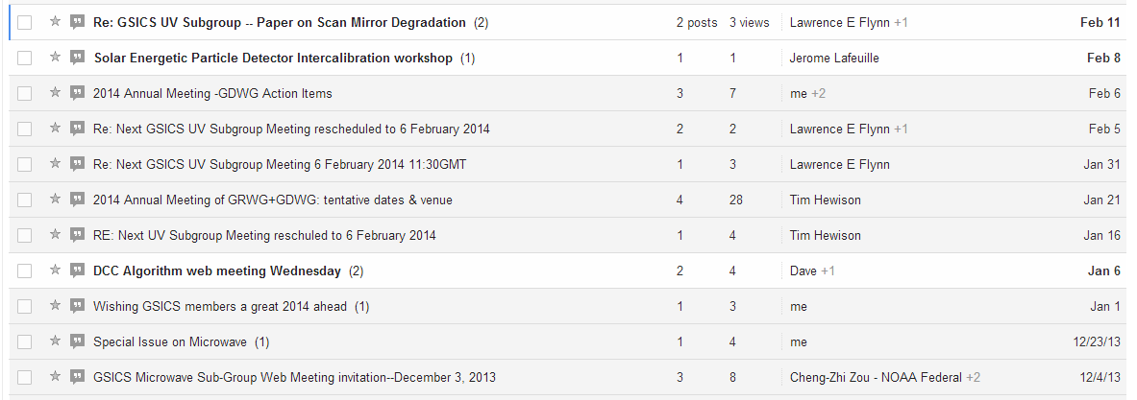
Communication
GSICS Dev Server

Slide 8
Review of activities since the last meeting
Action Items Progress
26 action items from the last Joint Meeting
17+ completed
9 overdue (some reflect change of circumstances; some will likely be reformulated at this meeting)

Slide 9
Review of activities since the last meeting
IMD GDWG progress
GEO and LEO Data receiving stations have been setup.
Real time visualization and quality monitoring for NPP, METOP-A/B , MODI NOAA available
Infrastructure for cross calibration being setup.

Slide 10
NOAA GDWG progress
Review of activities since the last meeting
Support to GCC for the transition of MW FCDR product demo and then to pre-operational phase.
SRF of GEO instruments in NetCDF format [support to DCC]
Developed Product Taxonomy
This is supposed to be the basis for redoing the THREDDS configuration to group GSICS correction products differently. Also the taxonomy would come handy in planning how to utilize the file naming convention and any other data management task.
Developed a data model for satellite instrument event logs and translated it into an extension to the ISO 19115-2 metadata standard's XML Schema.

Slide 11
NOAA GDWG progress
Review of activities since the last meeting
Initiated process to get DOI number for all GSICS products
Phil Jones (NCDC)
“The two MW FCDRs meet all of our criteria, so I just need to revise the landing page content and register the datasets. I will share the landing pages with you and the PI for a review once ready. I think once these are ready it will give you a good idea on how the DOI works for NOAA.
Other GSICS products need review.(clarity on archival & status )
New website for GDWG ( content requested from members).
New GPPA ( proposed by Peter Miu).
24-28March 2014 GSICS Joint Working Groups Meeting, Darmstadt, Germany

Slide 12
JMA GDWG progress
Review of activities since the last meeting
Satellite event log
Provided the information on the JMA website in Mar/June 2013
Change of the GEO-LEO IR RAC NetCDF contents
Met the requirements of EUMETSAT bias plotting tool in July 2013
Provision of official SRF data to GRWG VIS/NIR sub-group
Provided data to GDWG in Apr 2013
Collaboration with WIS
Reported feasibility to the GDWG chair in May 2013
Calibration change alerts
Reported feasibility to gsics-dev in June 2013
24-28March 2014 GSICS Joint Working Groups Meeting, Darmstadt, Germany

Slide 13
EUMETSAT GDWG progress
Review of activities since the last meeting
Improvements in Event logging data model.
Proposed New GPPA.
Support to all GDWG activities.
Visualization tool.

Slide 14
Review of activities since the last meeting
CMA progress
IASI acquirement transferred from CLASS to EUMETSAT pushing (March, 2013)
Update GSICS data collection system for FY new sensors (FY-3C) and new reference instrument (NPP-CrIS, NPP-VIIRS)
Automatically PICS data extraction for FY-3/MERSI/VIRR
Provide the instrument telemetry/Engineering data (OBC files) from FY operational processing system
CMA GPRC new website is developing and will finish shortly

Slide 15
Review of activities since the last meeting
KMA progress
Developing KMA’s GSICS website
General Introduction of COMS inter-calibration
Methods and Bias Monitoring for IR and VIS
Links to Other GSICS Website
Corrected Data filename and format

Slide 16
FROM RESEARCH TO PRODUCTION BASIC PATHWAYS/TOOLS HAVE BEEN MET
24-28March 2014 GSICS Joint Working Groups Meeting, Darmstadt, Germany

Slide 17
Where Do We Go From Here
Future needs.
Maintenance of current services
THREDDS Server
Product Catalog
Wiki Page/ Web Page
GPPA Support/Event Logging/Meta Data
Capacity Building.
Event Log Analysis.
Centralized Bias monitoring system.
24-28March 2014 GSICS Joint Working Groups Meeting, Darmstadt, Germany

Slide 18
Where Do We Go From Here
More subgroups -> More Data releases.
Scalable data processing system
High speed connectivity
Easy Visualization

Slide 19
Where Do We Go From Here
Perform analytics when instruments are compared with stable references
Detect instrument degradation trends
Detect impacts of diurnal/seasonal instrument temp variations.
Correlate measurements with event logs.

Slide 20
Breakout Session Highlights
Future Chairing of GDWG.
Maintenance of current GDWG infrastructure.
File naming and DOI number for products.
GDWG status of members.
Adoption of the proposed product taxonomy
New organizing of the products on the THREDDS catalog based on proposed taxonomy
NetCDF file content organization of new products
Formats and procedure for storing and exchanging satellite instrument event logs.
Revisit GSICS Product Acceptance.
Is Big Data an answer to our questions.

Slide 21
Breakout Session Highlights
Archiving of GSICS intermediate data sets and products.
CF conventions submission; what this involves, and how GSICS can improve and support this process.

Slide 22
THANK YOU

